Slide 1

Microbiology – Lecture 7
Introduction to viruses
In this link, you will find any corrections or notes unmentioned in the team's work. Please check the link below frequently.
https://docs.google.com/presentation/d/1yIQt3G8UDFG6xYMRhXkTk-dS54NeTfhJaPe_y0M-kjk/edit?usp=sharing

Slide 2
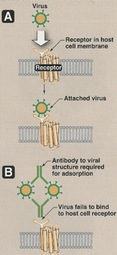
Objectives
Distinguish the viruses from other microorganisms
General characteristics of viruses.
Structure & symmetry of viruses.
Classification of viruses.
Steps of virus replication .
Laboratory diagnosis of viral infections.

Slide 3
Properties of Microorganisms
Characteristics | Parasites | Fungi | Bacteria | Viruses
Is it a cell? | Yes | Yes | Yes | No
Type of nucleus | Eukaryotic | Eukaryotic | Prokaryotic
Type of nucleic acid | Both DNA & RNA | Both DNA & RNA | Both DNA & RNA | DNA OR RNA (not both!)
Ribosomes | Present | Present | Present | Absent
Mitochondria | Present | Present | Absent | Absent
Replication | Mitosis | Budding or Mitosis | Binary fission | Special

Slide 4
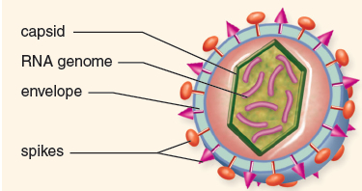
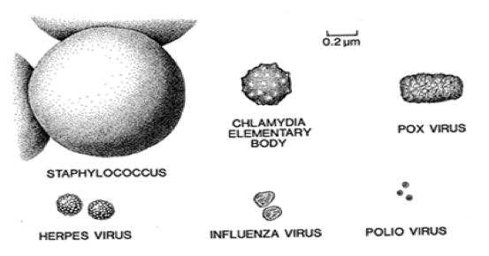
Characteristics of Viruses & Virus proteins
They are Acellular organisms (Acellular = not having cells)
They are tiny particles consisting of :
An internal core (Containing DNA or RNA)
Protein coat (capsid)
some viruses also have lipoprotein membranes (envelope) the envelop is taken from the host .
They are obligate intracellular organisms. (which means that they are unable to reproduce outside of their host cell) Why? They don’t have ribosomes or mitochondria
Replicate in a manner different from cells (e.g. one virus replicate to Produce many viruses)
Size: 20-300 nm
They can only be seen by electron because of their tiny size
They are 1000 times smaller than bacteriamicroscope
The Outer Viral Proteins | The Internal Viral Proteins
Mediate attachment to specific receptors on the host cell Induce neutralizing antibodies. (neutralizing antibody: is an antibody that defends a cell from an antigen or infectious body by neutralizing any effect it has biologically). They are the target of antibodies | Structural proteins ( capsid proteins of enveloped viruses ) Nonstructural proteins ( enzymes) All single stranded RNA viruses with (-) polarity have transcriptase (an RNA dependent RNA polymerase) inside virions. (Virions: the complete, infective form of a virus outside a host cell) Retroviruses & HBV contain reverse transcriptase

Slide 5
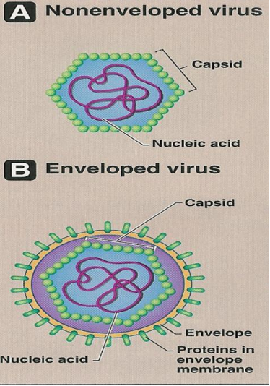
Viral Structure
All viruses are haploid, except Retroviruses which are diploid
1-Viral Genome Can be either | 2-Envelope | 3-Capsid
1-RNA (Ribonucleic acid) All RNA viruses have single stranded RNA except Reoviruses(multiple) (+) polarity (having same sequence as RNA) (-) polarity (having complementary sequence as RNA) 2-DNA (Deoxyribonucleic acid) All DNA viruses have double stranded DNA except Parvoviruses. Has single stranded Single molecule (It mean they only have 1 molecule of DNA) | It is a Lipoprotein membrane (host lipid + virus specific protein ) contains protein and glycoprotein Budding Envelope is derived from host cell membrane, except herpesviruses from nuclear membranes. Enveloped Viruses are more sensitive to heat ,dry & other factors than non-enveloped Viruses. Glycoprotein attaches to host cell receptor usually in form of spike / finger like projections. | A protein coat made of subunits (capsomeres) Genome (Nucleic acid)+capsid = nucleocapsid Function -Protects Nucleic Acid -Facilitates its entry into cell
For more info click here
Also here

Slide 6

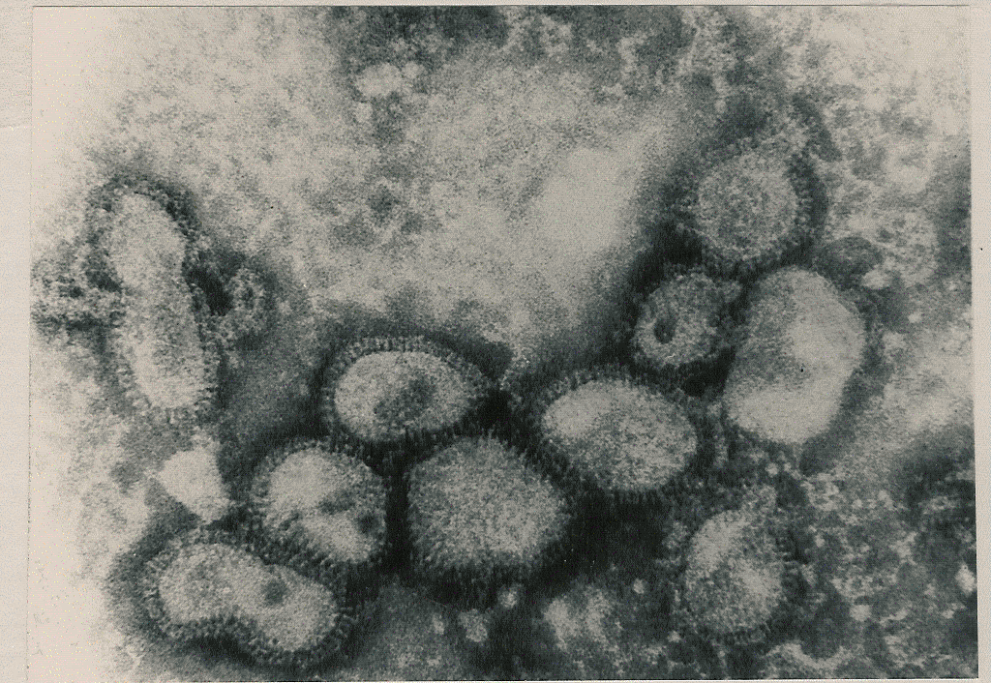
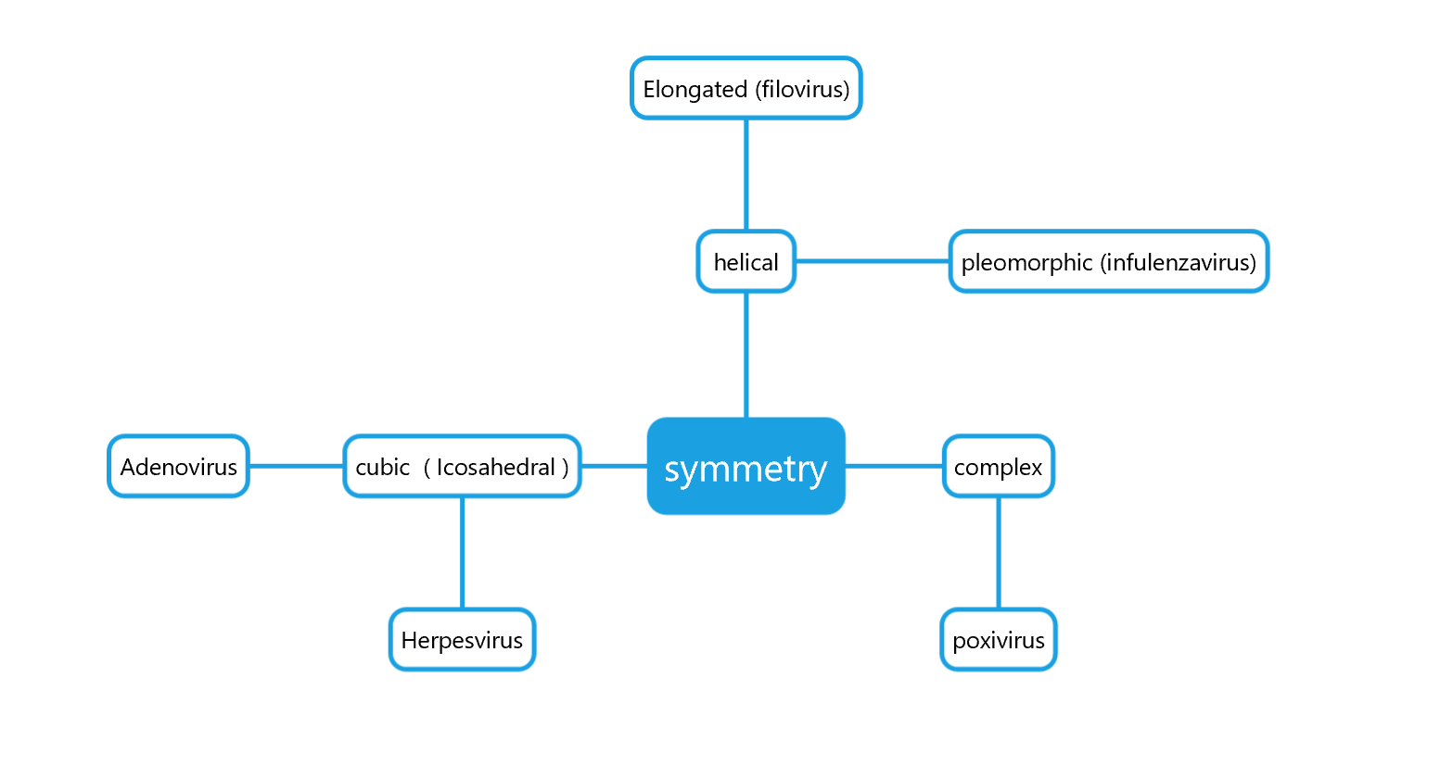
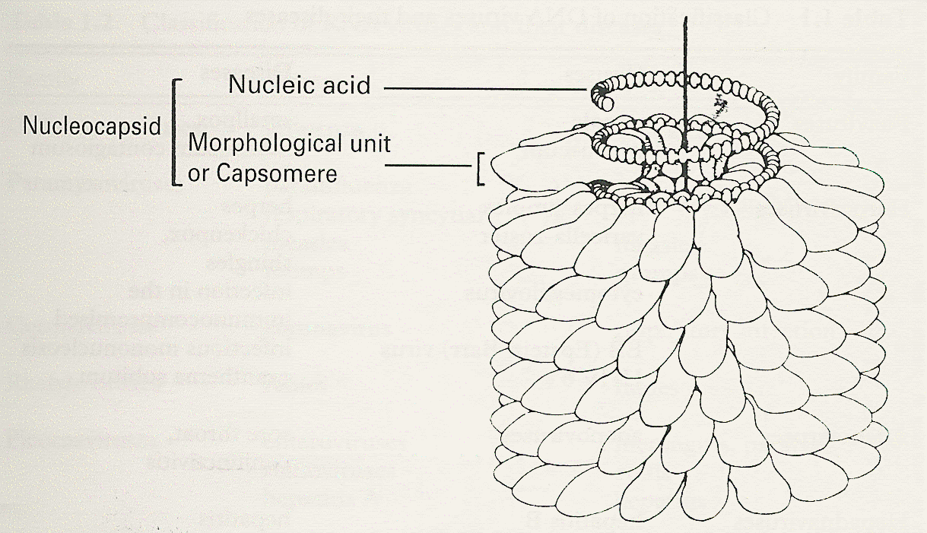
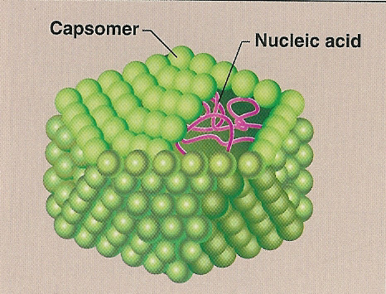
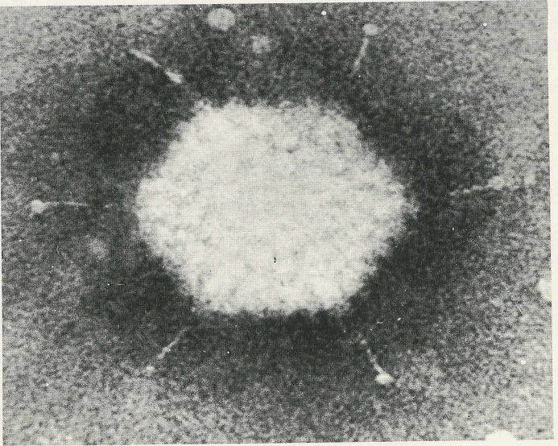
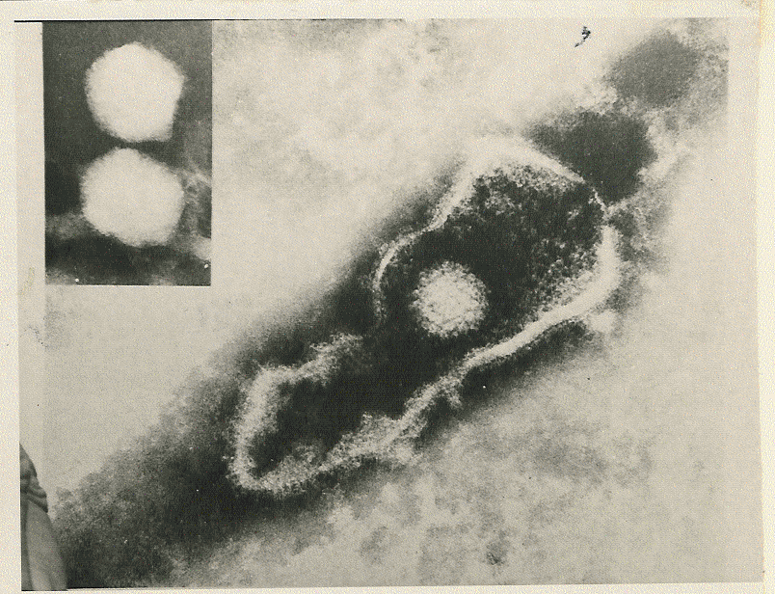
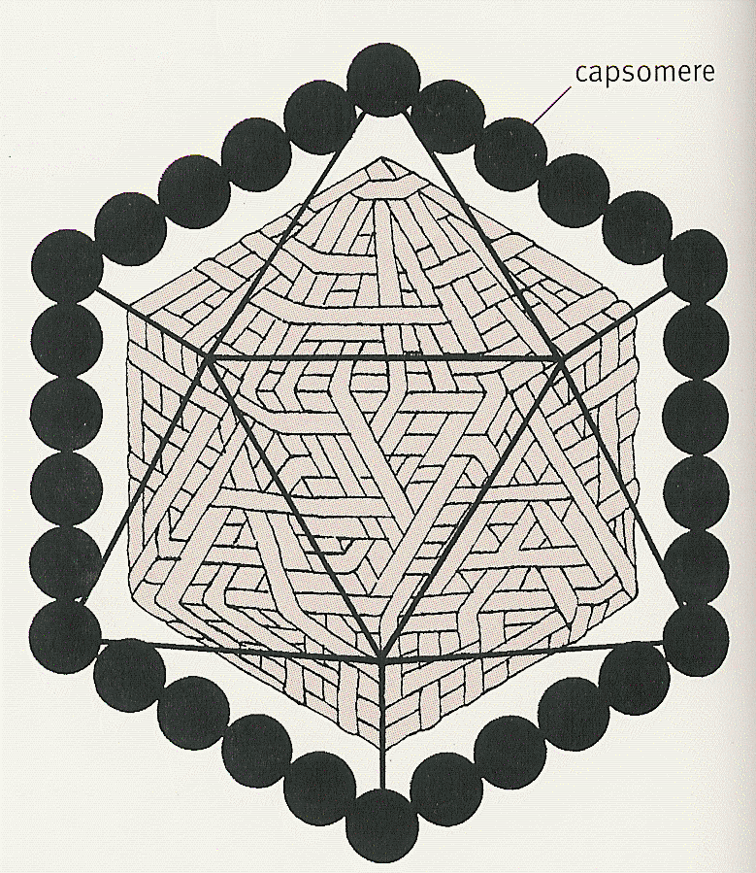
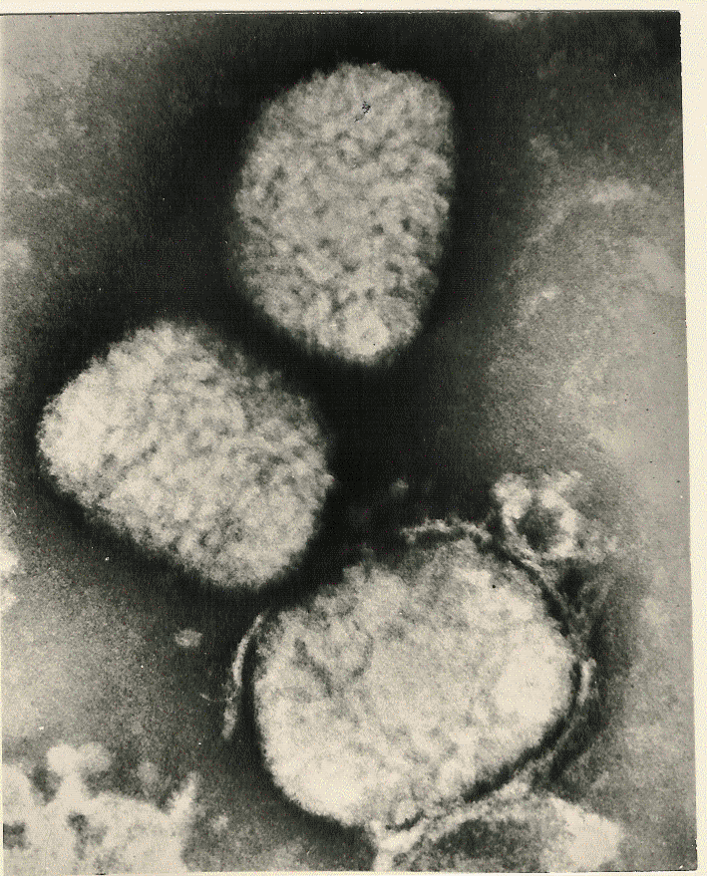
Symmetry
20 Triangles
The arrangement of a virus’ capsomeres gives it a unique symmetry

Slide 7
Classification of Viruses
Classification of Viruses
Type of Nucleic Acid
(DNA/RNA)
The number of strand
(Single/Double)
The polarity
of viral genome
(+/-)
The presence or
absence of envelope
Type of symmetry

Slide 8
Medically Important Viruses
بس اعرفوا التقسيم
No need to memorize names
1- DNA
Single Stranded | Double Stranded
Non- Enveloped | Enveloped |  | Non- Enveloped
Icosahedral | Complex | Icosahedral | Icosahedral
Parvoviridae | Poxviridae | Herpesviridae | Adenoviridae
2- RNA
Single Stranded |  |  | Double Stranded
Neg-Strand | Pos-Strand |  | Non-Enveloped
Enveloped | Enveloped | Non-Enveloped | Icosahedral
Helical Filoviridae | Helical Coronaviridae Icosahedral Retroviridae | Icosahedral Hepeviridae | Reoviridae
Team 436

Slide 9
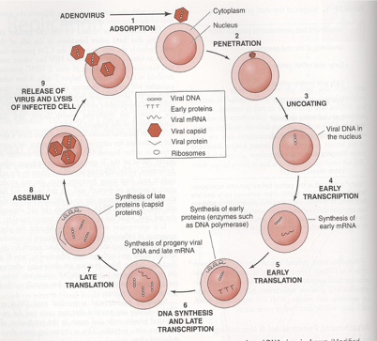
Replication
Viral Growth Cycle
1-Adsorption (Attachment)
6-Release
2-Penetration
5-Assembly
3-Uncoating
4-Synthesis of viral components (mRNA,Viral proteins, Nucleic Acid)

Slide 10
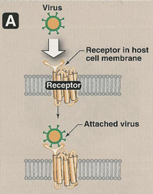
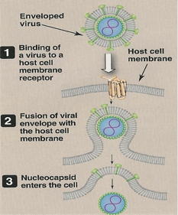
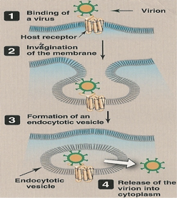
Replication
1-Adsorption
2-Penetration
ex- glycoprotein fiber
1-Fusion
(for enveloped virus only)
2-Endocytosis (cell eating)
Enveloped virus fuses with endosome membrane
Nonenveloped Virus lysis, pore
Note: Why can the enveloped virus membrane infuse with cell membrane?
It is made of lipids unlike bacteria made of polysaccharides

Slide 11
Replication
3-Uncoating
4-Synthesis of viral components
Uncoating:
Release of viral genome
cytoplasm
nucleus (Most DNA viruses replicate here)
mRNA
    Viral genome transcription
    +ssRNA acts directly
Viral proteins
    mRNA translation viral proteins:
    cell ribosome - enzymes
    - structural proteins
    (eg; capsomeres)
replication of viral genome
+ssRNA = single stranded +RNA
mRNA
5-Assembly
The viral Proteins +Nucleic acid= virion
Then the virion is released.
What is a virion? is a complete virus particles, consisting of RNA or DNA surrounded by a protein shell.
Basically it is the infective form of a virus.
The virus will replicate and synthesize it’s nucleic acids using the host cell’s resources مواردها
One virus can produce millions of viruses by continuation of this process ( synthesis of viral proteins )
If –RNA virus : viral genome goes through transcription to make (+mRNA) which is translatable. So it goes through ALL the steps
If +RNA virus : no need for step 1 (already has mRNA) so it automatically goes to step 2.

Slide 12
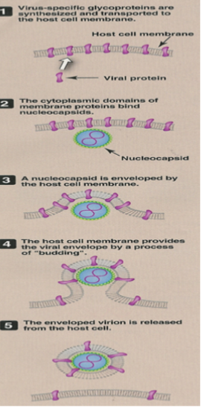
Replication
last step of the replication cycle of the viruses.
6- Release
Enveloped Viruses
Non-Enveloped viruses
The Virion leaves the Cell and creates its Envelope by budding through the host’s cell membrane.
Except Herpes viruses = budding host’s nuclear membrane
Cell lysis or rupture

Slide 13
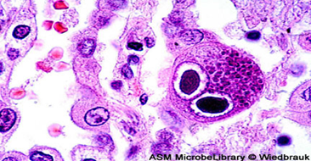
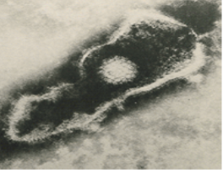
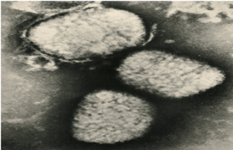
Laboratory Diagnosis of Viral Infections Microscopic examination.
Light microscopy:
Electron microscopy:
See effect of virus on cell Can’t see Virus
see SIZE and Morphology of virus.
Morphology & size of virions . “ to see the virus particle itself”
• Ex. Diagnosis of viral gastroenteritis such as Rota, adenoviruses. Diagnosis of skin lesion caused by herpes, or poxviruses.
• It is replaced by Antigen detection & molecular tests
Histological appearance “to see what the virus has done to the cell, without seeing the virus itself”
Ex. “Inclusion bodies”
Owl’s eye (CMV)
Herpesvirus
Poxvirus

Slide 14
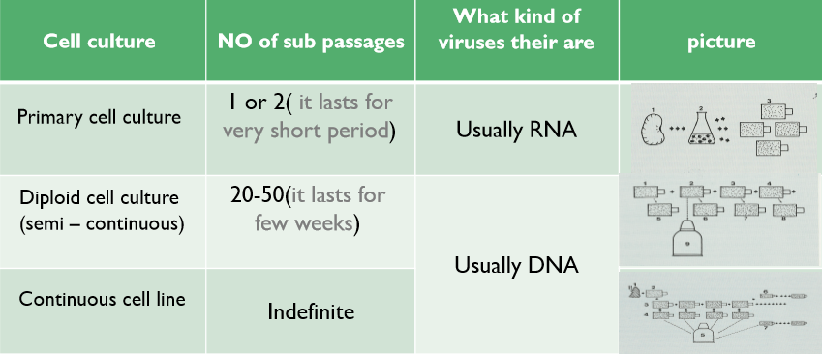
Cell culture
Difficult to handle used only in laboratories
Virus cultivation :
Laboratory animal.
Embryonated egg.
Cell culture.
Cell culture refers to the removal of cells to see their subsequent growth under suitable environment.
After isolating the cells from the tissue, it has 3 types of sub passages :
ھو ﺗﺄﺛﯾر اﻟﻔﯾروس ﻋﻠﻰ اﻟﺧﻼﯾﺎ ﺧﺎرج ﺑﯾﺋﺗﮭﺎ ﻟﺗﺷﺧﯾص اﻟﻌدوى اﻟﻔﯾروﺳﯾﺔ
Note :there are Variation of Sensitivity of cell cultures to infection by viruses.
ﯾﻌﻧﻲاﻟﺧﻼﯾﺎ اﻟﻠﻲ ﻓﻲ اﻟﻌﺑوات ﺗﺧﺗﻠف ﺣﺳﺎﺳﯾﺗﮭﺎ ﺗﺟﺎه اﻟﻔﯾروس وھذا اﻟﺷﻲ اﻟﻠﻲ ﯾﺣددﻛوﻧﮭﺎ
Primary or diploid or continues
Team 436

Slide 15
What is meant by passage in cell culture?
In biology, a subculture is a new cell or microbiological culture made by transferring some or all cells from a previous culture to fresh growth medium. This action is called subculturing or passaging the cells. Subculture is used to prolong the life and/or expand the number of cells or microorganisms in the culture
The term passage number refers to the number of times that a cell population has been removed from the culture vessel and undergone a subculture (passage) process, in order to keep the cells at a sufficiently low density to stimulate further growth.
نفس السلايد الي قبل + شرح

Slide 16
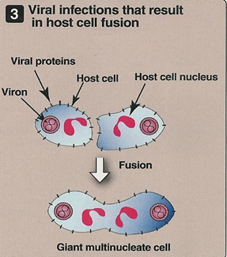
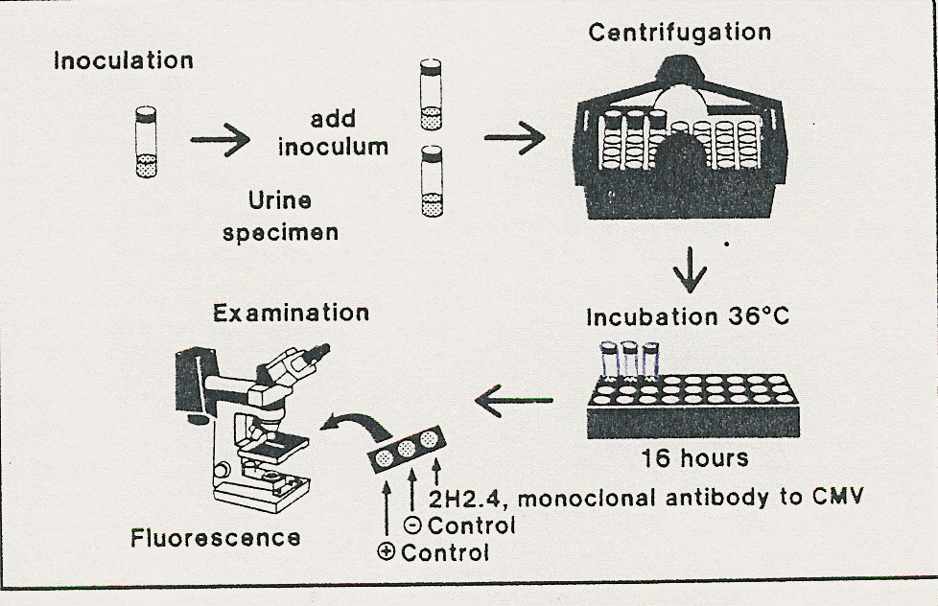
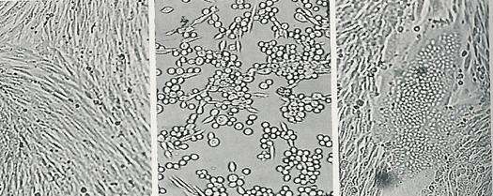
Cell culture
Rapid culture technique : Shell viral assay It detect viral antigens within 1-3 days
Detection of viral growth:
By the cytopathic effects The affected cell will have “Rounding, shrinkage, aggregation, Syncytium( giant multinucleate cell) and lose of adherence.
Other
By Immunofluorescence (IF)
Problems with cell culture :
Long incubation (up to 5 days) can be solved with rapid culture technique
Sensitivity is variable
Susceptible to bacterial contamination (عرضه للتلوث البكتيري)
Some Viruses do not grow in cell culture ex. HCV
Uninfected cc
Cell rounding
Syncytium

Slide 17
Laboratory Diagnosis of Viral Infections -3-SEROLOGICAL TEST:
To locate antibody or antigen:
  Immunofluorescence (IF)
  Enzyme- linked immunosorbent assay (ELISA)
  Molecular test
Uses the same technique
1- ELISA
2- IF
To find either antigen or antibody!
Antigen detection
It is a test that looks for a (antibodies) from a sample to determine the availability of (antigen)
sample | virus | test
Skin scrapings | HSV | IF
Blood | (HBV)hepatitis B virus (HBsAg) | ELISA

Slide 18
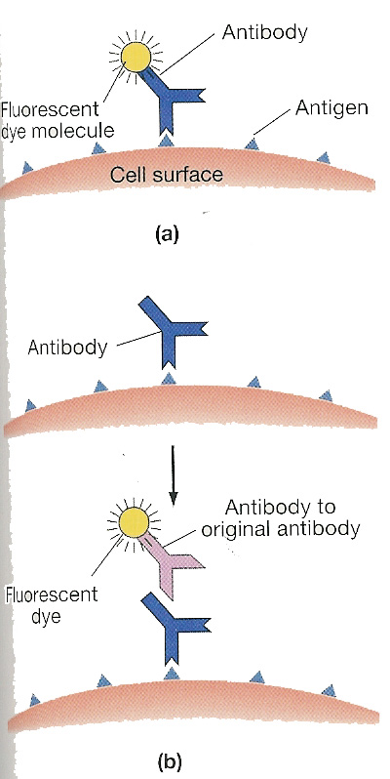
Laboratory Diagnosis of Viral Infections -3-SEROLOGICAL TEST:
Immunofluorescence (IF)
using a fluorescent dye And can be viewed by fluorescence microscope .
- Direct Ag detection; Sample (Antigen)
- Indirect Ab detection; Sample (Antibody)

Slide 19
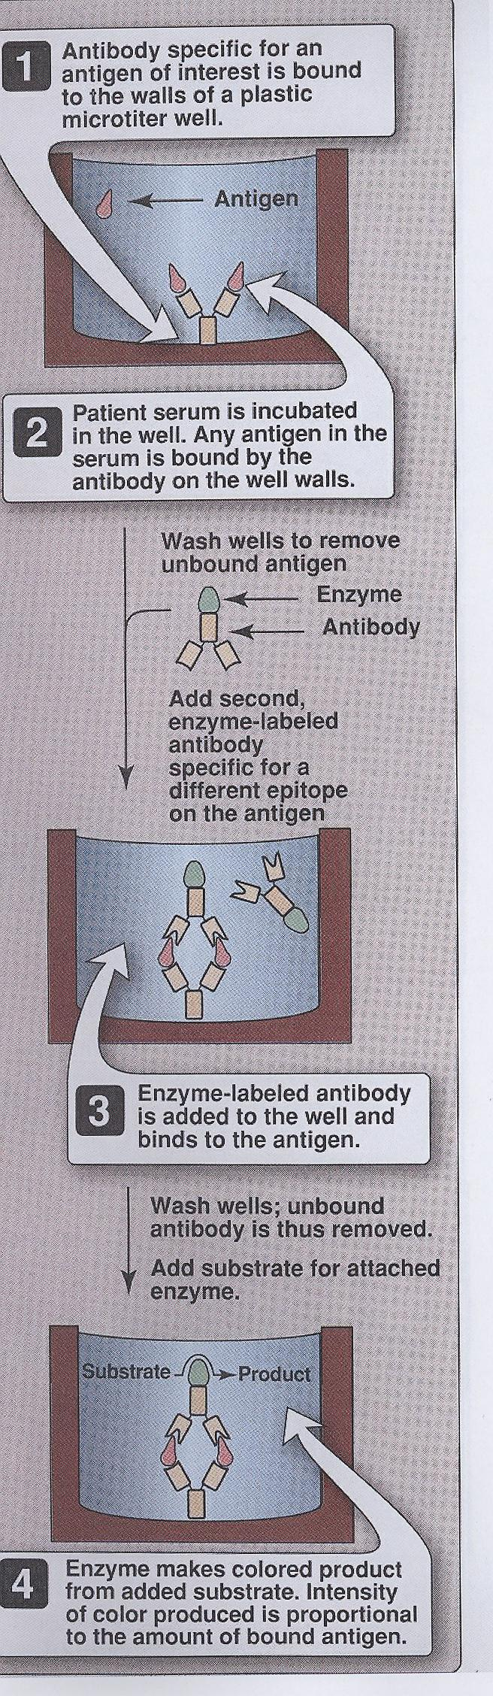
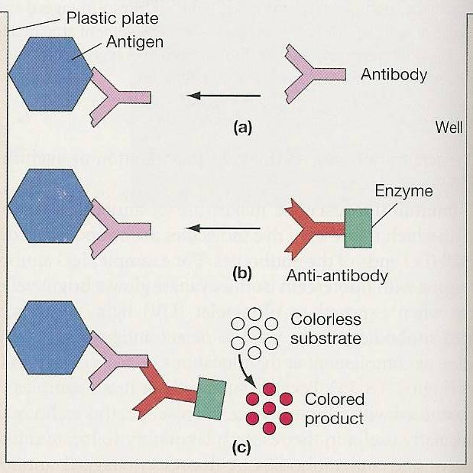
Laboratory Diagnosis of Viral Infections -3-SEROLOGICAL TEST:
-Direct ELISA for Antigens detection or specific IgM, IgG
enzyme-linked immunosorbent assay (ELISA)
ﻣﻼﺣظﺔ : اﻟطرق أﺣﯾﺎﻧﺎ ﺗﻛون ﻣﺑﺎﺷرة وﻏﯾر مباشرة . اذا ﻛﺎﻧت ﻏﯾر ﻣﺑﺎﺷرة ﻓﮭﻲ ﻋن طرﯾق اﻷﻧﺗﻲ ﺑدﯾز واذا ﻣﺑﺎﺷرة ﻋﻠﻰ طول ﺗﻛون ﻋن طرﯾق اﻻﻧﺗﻲ ﺟﯾن
Sample is viewed using spectrometer.
-Indirect ELISA for Antibodies
detection ; colored wells indicate reactivity

Slide 20
Laboratory Diagnosis of Viral Infections
Molecular test
Used for Diagnosis
Only way to measure viral load ﻛﻣﯾﺔ اﻟﻔﯾروﺳﺎت
Uses:
-Diagnosis
-Monitoring response to treatment
Polymerase chain reaction (PCR):
- NA Amplification technique.
-Viral genome
Molecular diagnostics is a collection of techniques used to analyze biological markers in the genome and proteome—the individual's genetic code and how their cells express their genes as proteins—by applying molecular biology to medical testing.

Slide 21
Medically important viruses
RNA
DNA
اسامي الفيروسات غير مطلوبه مننا في الوقت الحالي بس اعرفوا التقسيمات.
DNA\RNA
Complex or icosahedral enveloped or non-enveloped etc…
Complex
poxviridae
lcosahedral
Herpesviridae
Hepadnaviridae
Reoviridae
lcosahedral
Non
enveloped
enveloped
Nonenveloped
Icosahedral
enveloped
Helical
Pos-strand
Icosahedral
Double-stranded
Double-stranded
Picornaviridae
Hepeviridae
Calicviridae
AstroViridae
lcosahedral
Adenoviridae
papillomaviridae
polyomaviridae
Non
enveloped
coronaviridea
Togaviridae
Flaviviridae
Retroviridae
Enveloped
Helical
single-stranded
Neg-strand
Orthomyxoviridae
Paramyxoviridae
Rhabdoviridae
Filoviridae
Bunyaviridae
Arenaviridae
single-stranded
Non-
Enveloped
lcosahedral
Parvoviridae

Slide 22
Quiz and references
1- Viruses contain :
A) RNA b)DNA c)RNA or DNA d) both RNA and DNA
2- Direct ELISA detection for which of the following:
A) RNA b) DNA c) antibody d)antigen
3- All viruses are haploid except :
A)retroviruses b)phage c)herpesviridae d)parvoviruses
4- The viral envelope is composed from :
A) lipoprotein b)polysaccharides c) proteins d)glycoprotein
Sherries Medical Microbiology, an Introduction to Infectious Diseases.
Latest edition, Kenneth Ryan and George Ray. Publisher : McGraw Hill .

Slide 23
1- c
2-d
3-a
4-a
5-a
6-d
7-b
8-c
9-F
Quiz and references
5-herpes virus is derived from:
A)Hosts nuclear membrane b) Hosts plasma membrane C)cell wall
6-How many genes present in the smallest virus :
A)3 B)5 C)6 d)4
7-We can not see viruses in :
Electron microscope B) light microscope C) cell culture d)inclusion body
8- Capsid composed from :
Lipoprotein b)polysacchraides C) proteins d)glycoprotein
9- Enveloped viruses less sensitive to heat than non-enveloped viruses?
T B) F

Slide 24

الهام العلامي
رناد المقرن
هديل عورتاني
اسراء النزاوي
لمياء القويز
شوق القحطاني
نورة القاضي
افنان المصطفى
رهف الشمري
الهنوف الجلعود
لايقوى الإنسان في الحياة على هذه الأرض من دون أن يعاونه النّاس ويقفوا معه.
Team members:
داود إسماعيل
عمر الفوزان
عبدالله الزهراني
معن شكر
عبدالمجيد الوردي
محمد إبراهيم
عمر السحيباني
سيف المشاري
سعد العقيلي
فهد الشغيرثي
حسين علامي
فهد الفايز
سعد الهداب
خالد الدوسري
خالد المطيري
أنس السيف
عبدالجبار اليماني
عبدالله السرجاني
عبدالعزيز الدخيل
عادل العريني
محمد الدويغري
Team leaders:
غادة الحيدري ، علي الشحادة
For any corrections, suggestions or any useful information please contact us at: Micro.437@hotmail.com

