Slide 1
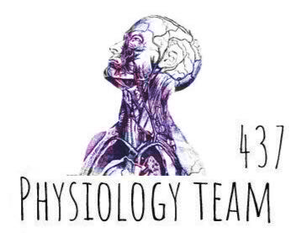
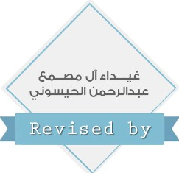
Extra Information
Only Found in Males’ slides
Only Found in Females’ slides
Females & Males Slides
Very Important Notes
Notes
PHYSIOLOGY

Slide 2
AUTONOMIC NERVOUS SYSTEM

Slide 3
Objectives
At the end of this session, the students should be able to:
Organization of the Autonomic Nervous System.
Terminology.
Sympathetic Nervous System (SNS).
Neurotransmitters and Types of Receptors.
Parasympathetic Nervous System.
Autonomic Receptors:
A) Adrenoreceptors.
B) Cholinorecptors.
Prototypes of Agonists and Antagonists to Autonomic Receptors.
Sympathetic and Parasympathetic Tone.
Function of Adrenal Gland.
Examples of The Effects of Sympathetic and Parasympathetic.
Anatomy and physiology of Autonomic Nervous System.
appreciate the anatomy of sympathetic& parasympathetic nervous system.
explain physiological functions of Sympathetic &parasympathetic nerves in head &neck, chest, abdomen and pelvis.

Slide 4
THE NERVOUS SYSTEM
INTRODUCTION:
The nervous system monitors and controls almost every organ / system through a series of positive and negative feedback loops.
The Central Nervous System (CNS): Includes the brain and spinal cord.
The Peripheral Nervous System (PNS): Formed by neurons & their process present in all the regions of the body.
It consists of cranial nerves arising from the brain & spinal nerves arising from the spinal cord.
The peripheral NS is divided into:
A) Somatic Nervous system.
B) Autonomic nervous system.
*سلايد كامل من البنات

Slide 5
SOMATIC AND AUTONOMIC NERVOUS SYSTEM
The motor efferent nervous system has two components:
A) Somatic. B) Autonomic.
Somatic Nervous System:
a voluntary nervous system under conscious control.
consists of a single motoneuron and skeletal muscle fibers.
Cell bodies of motor neurons reside in CNS (brain or spinal cord).
Their axons (sheathed in spinal nerves) extend all the way to their skeletal muscles.

Slide 6
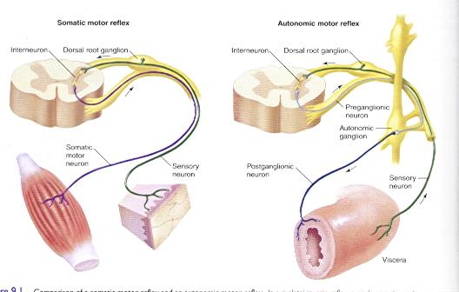
Organization of the Autonomic Nervous System

Slide 7
THE AUTONOMIC NERVOUS
SYSTEM
AUTONOMIC NERVOUS SYSTEM
Visceral sensory
Visceral motor
*سلايد كامل من البنات
General: Stretch, pain temperature, chemical changes, and irritation in viscera; nausea and hunger
General: Motor innervation of smooth muscle, cardiac muscle, and glands; equivalent to autonomic nervous system (ANS)
Sympathetic division
Parasympathetic division

Slide 8
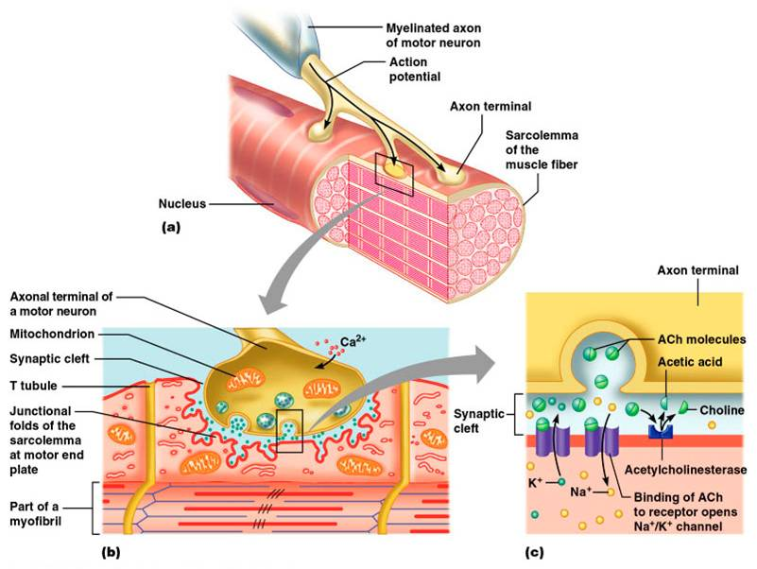
Somatic Nervous System

Slide 9
Organization of the Autonomic Nervous System
An involuntary nervous system that modulates and controls the function of visceral organs.
Autonomic nervous system (ANS) consists of two major divisions:
A) Sympathetic.
B) Parasympathetic.
ANS is activated by centers in spinal cord, brain stem and hypothalamus.
ANS is operated by visceral reflex. (المنعكسات العصبية )

Slide 10
Autonomic Nervous System (ANS)
Organization of autonomic nervous system motor pathway consists of two neurons: A) Preganglionic neuron (cell body in brain or spinal cord) B) Postganglionic neuron (cell body in ganglion outside CNS)
– Slower because lightly myelinated or unmyelinated
All preganglionic neurons release Acetylcholine (Ach).
Ach is a nurotransmiter released by cholinergic.
Postganglionic neurons release either Ach, or norepinephrine.
Norepinephrine is a nurotransmiter released by adrenergic neurons.

Slide 11
Terminology
Sympathetic and parasympathetic are anatomic terms and refer to anatomic origin of preganglionic neurons in the central nervous system (CNS).
Adrenergic and Cholinergic terms are used to describe neurons of either division, according to which neurotransmitter they synthesize and release.
Adrenergic neurons release nor-epinephrine and the receptor is adrenoreceptor.
Cholinergic neurons release Ach and the receptor is cholinergic.

Slide 12
Sympathetic Nervous System (SNS)
Operates continuously to modulate the functions of many organ systems e.g; heart, blood vessels, gastrointestinal tract, bronchi and sweat glands.
Stressful stimulation activates SNS enables the body to be prepared for fear, flight or fight. And leads to a response known as “fight or flight” Which causes :increased arterial pressure, blood flow, blood glucose, metabolic rate , mental activity , heart rate, blood pressure ,cardiac output.
diversion of blood flow from the skin and splanchnic vessels to those supplying skeletal muscle.
Bronchioles dilate, which allows for greater alveolar oxygen exchange.
-The tone increases in case of stress.

Slide 13
Sympathetic Nervous System (SNS)
Sympathetic preganglionic neurons originate from thoracolumbar spinal cord (T1-L3) (lateral horns of the spinal segments).
SNS ganglia are located near the spinal cord either in the paravertebral ganglia (sympathetic chain) (Trunk (chain) ganglia near vertebral bodies ).
or in the prevertebral ganglia near large blood vessel in gut :celiac ,superior mesenteric & inferior mesenteric .
-Ganglia are in 2 regions :1-paravertebral,2- prevertebral
Preganglionic neurons are short and lightly myelinated.
The post ganglionic neurons are long and unmyelinated.
Ganglia close to spinal cord .

Slide 14
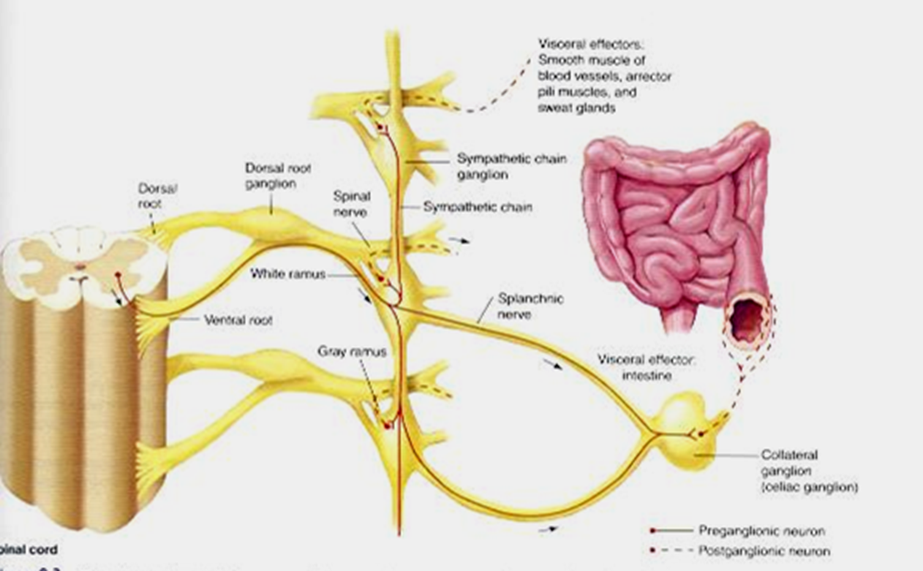
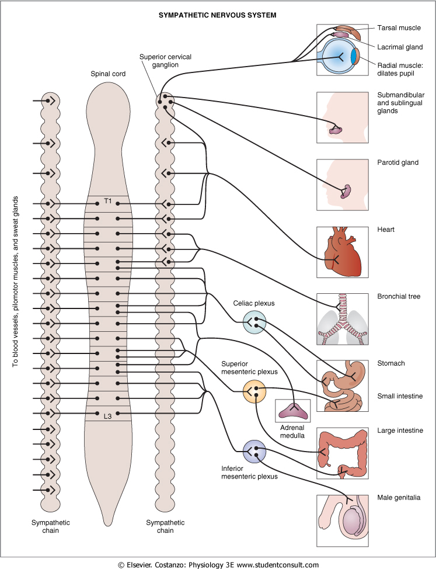
Sympathetic Nervous System (cont.)

Slide 15
Neurotransmitters and Types of Receptors of SNS
Preganglionic neurons are always cholinergic.
Release Ach (acetylcholine), interacts with nicotinic receptors(N) on the cell body of postganglionic neurons.
Postganglionic neurons are adrenergic ( release noradrenalin ) except in thermoregulatory sweat glands (muscarinic(M) cholinergic) and blood vessels to skeletal muscles .
Adrenergic neurons affect adrenoreceptors: alpha₁, alpha₂, beta₁, beta₂

Slide 16
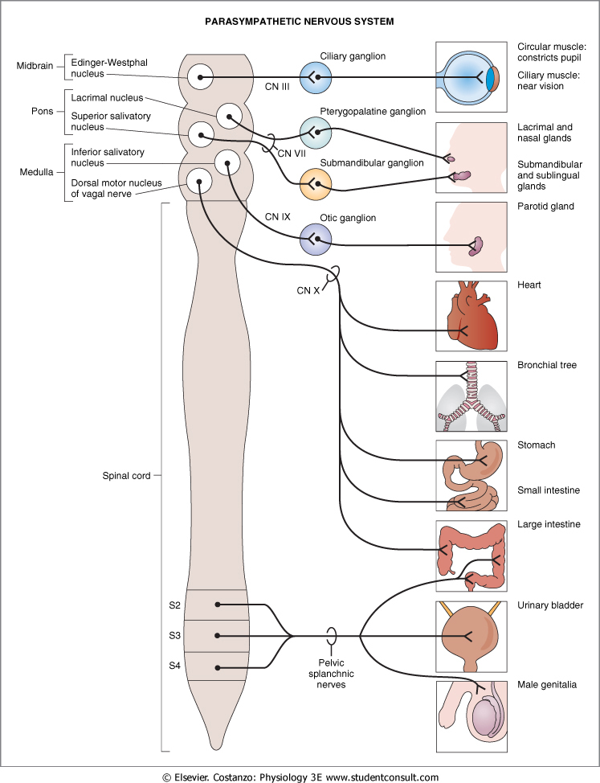
Parasympathetic Nervous System
Preganglionic fibers originate from cranial nuclei ( the motor nuclei of the cranial nerves III, VII, IX and X ) in brain stem (mid brain, pons, medulla) and in sacral segments (S₂-S₄) (Craniosacral)
Parasympathetic ganglia are located on or in the affected organs
Preganglionic neuron has long axon and postganglionic neuron has short axon
-Ganglia of parasympathetic : terminal ganglia, on the affected organ ( عليه بالضبط )

Slide 17
Parasympathetic Nervous System
The cranial nerves III, VII and IX affect the pupil and salivary gland secretion
Vagus nerve (X) carries fibres to the heart, lungs, stomach, upper intestine and ureter
The sacral fibres form pelvic plexuses which innervate the distal colon, rectum, bladder and reproductive organs.

Slide 18
Neurotransmitters and types of receptors
All preganglionic neurons are cholinergic, release Ach which interacts with nicotinic receptors
Cholinergic receptors are : nicotinic (N) and muscarinic(M)
Postganglionic neurons are cholinergic, release Ach which interacts with muscarinic receptors

Slide 19
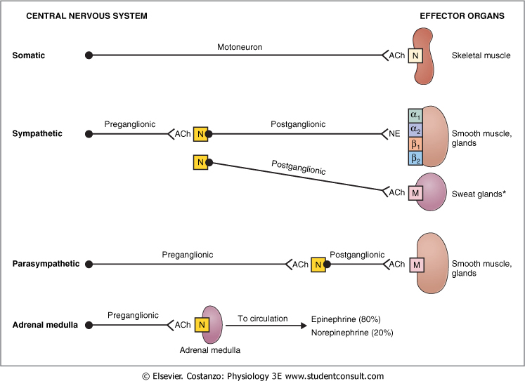
Organization of the Autonomic Nervous System

Slide 20
Autonomic Receptors
Adrenoreceptors (Adrenergic neurons)
Cholinoreceptors (Cholinergic neurons)

Slide 21
Receptors
The parasympathetic nervous system uses only acetylcholine (ACh) as its neurotransmitter.
The ACh acts on two types of receptors, the muscarinic and nicotinic cholinergic receptors.
Most transmitions occur in two stages: When stimulated, the preganglionic nerve release ACh at the ganglion, which acts on nicotinic receptors of the postganglionic nerve.
The post ganglionic nerve then releases ACh to stimulate the muscarinic receptors of the target organ.

Slide 22
ANS Receptors: Classified as either parasympathetic or sympathetic

Slide 23
Adrenoreceptors
The Sympathetic NS acts on two types of receptors: α and β
1) α1 receptor: found in vascular smooth muscle, gastrointestinal (GI) sphincters and bladder, radial muscle of iris:
Activation of α1 contraction (Vasoconstriction).
Activation of α1 Dilatation of pupil.
Activation of α1 Intestinal relaxation.
Activation of α1 Bladder sphincter contraction.
2) β1 receptor: is found in the following tissues:
S.A node heart rate.
AV node conduction velocity.
Ventricular muscle contractility (force of contraction)
Salivary gland salivary secretions, (but enzymes production)
Lipolysis (blocked by atenolol in hypertension).

Slide 24
Adrenoreceptors
3) β2 receptors:
found in vascular smooth muscle wall of bladder, bronchial tract ,uterus and wall (smooth muscles) of GI.
Activation of β2 relaxation (Intestinal and bladder wall relaxation)
Vasodilatation.
Bronchodilatation.
Bladder wall relaxation.
β2 more sensitive to Epinephrine than Nor-epinephrine.
- alpha 2 has the same function as alpha 1 but is rarely found in the human body

Slide 25
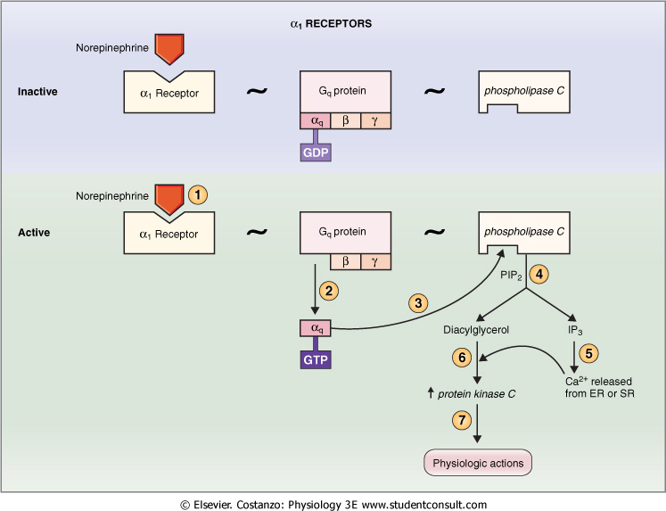
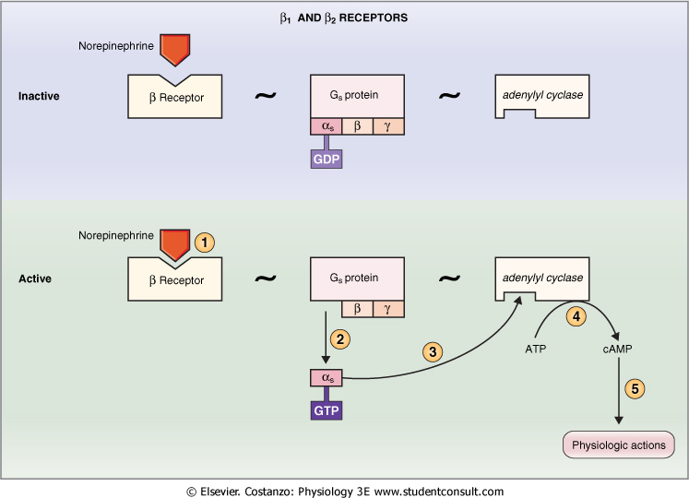
α1 receptor
β1, β2 receptors

Slide 26
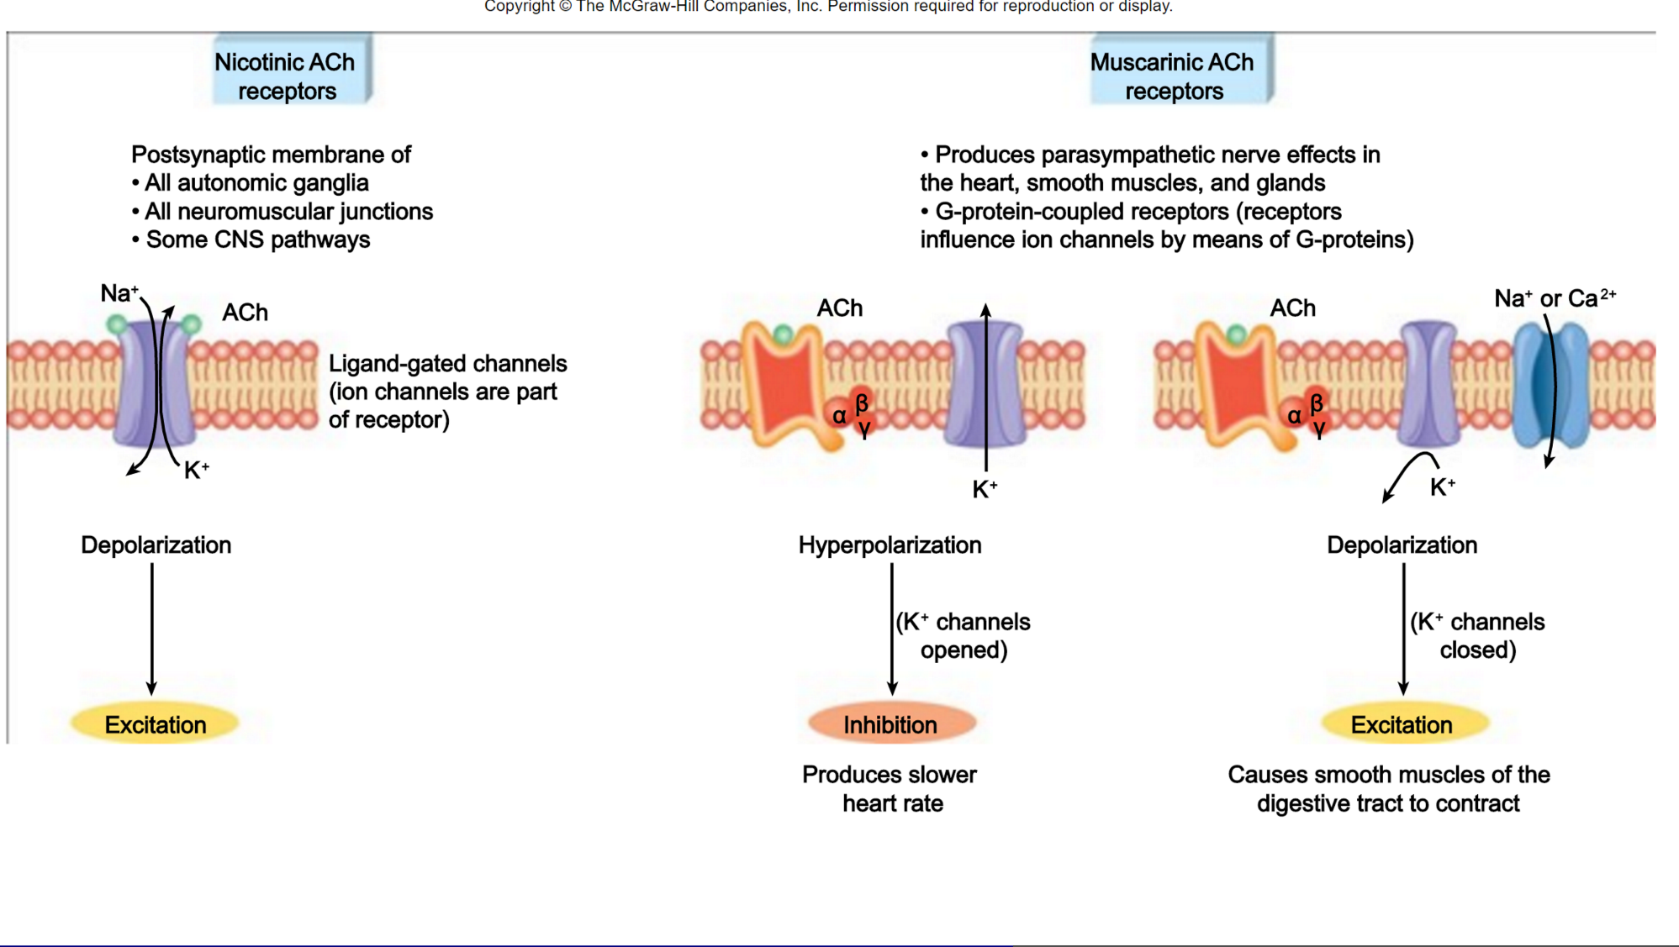
Cholinorecepters
Nicotinic receptor
- an ion channel for Na+ and K+
- in all postganglionic neurons, motor end plate at skeletal muscle and chromaffin cells
Muscurinic Receptor - Works either like α1 adrenoreceptor via PKC, DAC and IP3 or via G protein which has α1 subunit that binds K+ channel and open it
IP3 (Inositol trisphosphate) / DAG ( Diacylglycerol) / PKC (Protein kinase C)

Slide 27
Autonomic Receptors (in summary)
The type of receptor and its mechanism of action determine the physiologic response (inhibition،excitation) e.g. β1 receptor in SA node and in ventricular muscle:
SA node: activation of SA node by the agonist (nor-epinephrine) heart rate
ventricular muscles contractility
What do receptors do?
Activation of α receptors leads to smooth muscles contraction
Activation of β2 receptors leads to smooth muscles relaxation
Activation of β1 receptors leads to smooth muscles contraction (especially in heart)

Slide 28
Prototypes of Agonists and Antagonists to Autonomic Receptors
Antagonists | Agonists | Receptor
Adrenoreceptors
Phenoxybenzamine | Norepinephrine | α₁
Prazosin | Phenylephrine
Yohimbine | Clonidine | α₂
Propranolol | Norepinephrine | β₁
Metoprolol | Isoproterenol
Propranolol | Epinephrine | β₂
Butoxamine | Isoproterenol
 | Albuterol
Cholino receptors
Curare | ACh | Nicotinic
Hexamethonium (blocks ganglionic receptor but not neuromuscular junction) | Nicotine Carbachol
Atropine | ACh | Muscarinic
 | Muscarine
 | Carbachol

Slide 29
Sympathetic and Parasympathetic Tone
The role of them is to keep the stimulated organs in normal stage
Examples:
sympathetic always keeps the blood vessel constricted ½ of its normal diameter.
removal of vagus (Parasympathetic nerve) nerve atony loss of peristalsis (contraction of small intestine) constipation.
Loss of sympathetic tone in blood vessel causes severe vasodilatation but after sometime, intrinsic tone increases by chemical adaptation

Slide 30
Function of Adrenal Gland
Stimulation of sympathetic nerves causes large quantities of Epinephrine and Nor-epinephrine to be secreted in blood.
The effect of Epinephrine & Nor-epinephrine lasts 5-10 times more than the ones which secreted from sympathetic.

Slide 31
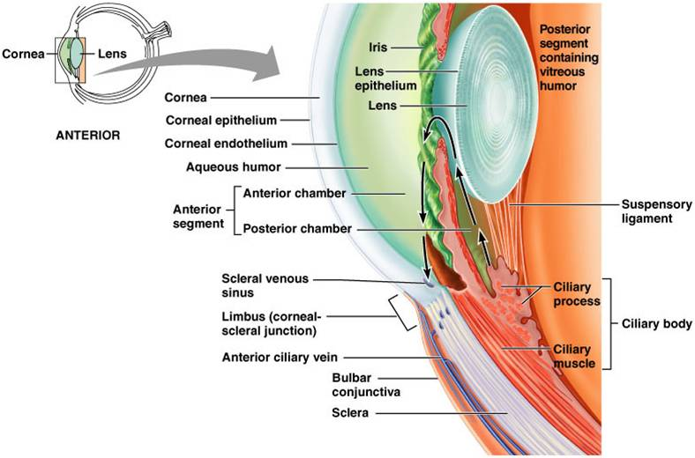
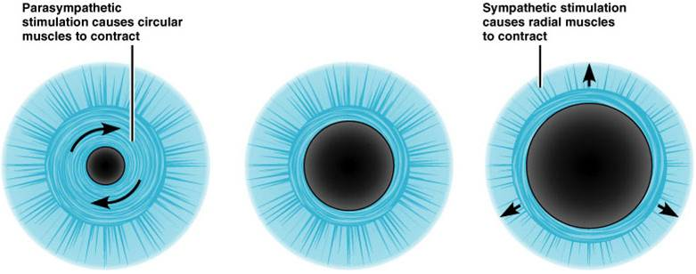
Examples of The Effects of Sympathetic and Parasympathetic
A) The Eyes:
Sympathetic stimulation contracts the meridional fibers of the iris to dilate the pupil.
Parasympathetic stimulation contracts the circular muscle of the iris to constrict the pupil.
Focusing of the lens is controlled by parasympathetic through contraction of ciliary muscle.
Sympathetic nerve dilate the pupil and relax the lens ,allowing more light to enter the eye.
Bronchiolar dialation ,contraction of sphincters and metabolic changes such as the mobilization of fat and glycogen.
Structure of The Eye
Pupil Dilation and Constriction

Slide 32
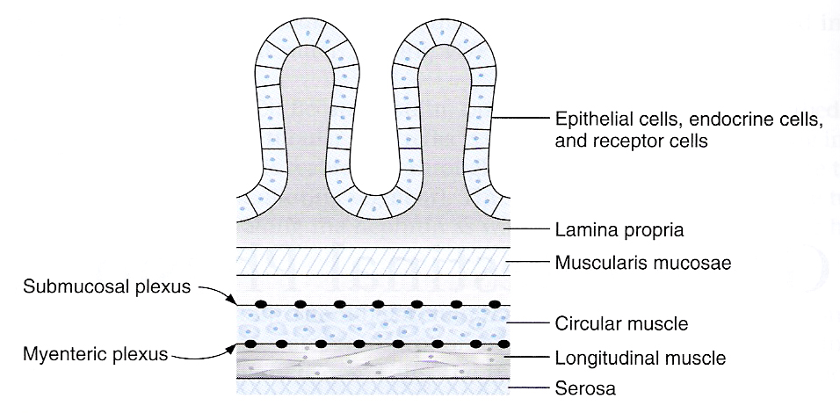
B) The Glands:
Controlled by parasympathetic their secretions
Sympathetic causes vasoconstriction of the blood vessels to the glands which causes reduction in in their secretion
Sweat glands secretion: increased by sympathetic stimulation.
C) The Gastrointestinal tract (GI)
Enteric nervous system
Parasympathetic nervous system increases the activity of GI tract (increases peristaltic contraction, and sphincter relaxation).
Sympathetic decreases the activity of GI.

Slide 33
D) The Heart:
Sympathetic stimulation activity of the heart.
Parasympathetic stimulation doing the opposite.
E) Systemic Blood Vessels:
Constricted by stimulation of sympathetic. - No effect of the parasympathetic except in certain areas, such as blushing of the face.
F) Arterial Pressure:
Sympathetic stimulation the cardiac output and resistance to the blood flow and blood pressure.
Parasympathetic cardiac output and has no effect on blood vessels.

Slide 34
Structure | Sympathetic Stimulation | Parasympathetic Stimulation
Iris (eye muscle) | Pupil dilation | Pupil constriction
Salivary Glands | Saliva production reduced | Saliva production increased
Oral/Na sal Mucosa | Mucus production reduced | Mucus production increased
Heart | Heart rate and force increased | Heart rate and force decreased
Lung | Bronchial muscle relaxed | Bronchial muscle contracted

Slide 35
Structure | Sympathetic Stimulation | Parasympathetic Stimulation
Stomach | Peristalsis reduced | Gastric juice secreted; motility increased
Small Intes | Motility reduced | Digestion increased
Large Intes | Motility reduced | Secretions and motility increased
Liver | Increased conversion of glycogen to glucose
Kidney | Decreased urine secretion | Increased urine secretion
Adrenal medulla | Norepinephrine and epinephrine secreted
Bladder | Wall relaxed Sphincter closed | Wall contracted Sphincter relaxed

Slide 36
Autonomic Reflexes
Most of the visceral functions of the body are regulated by autonomic reflexes
Cardiovascular: - baroreceptor reflex:
It is stretch reflex in the main arteries such as carotid artery to detect the blood pressure.
Gastrointestinal: The receptors in the nose and mouth send a signal to parasympathetic to notify the glands of mouth & stomach to secrete the digestive juices.
Urinary Bladder: - Initiate the micturition (urination) by parasympathetic innervations.
Sexual reflexes: - erection by parasympathetic - ejaculation by sympathetic

Slide 37
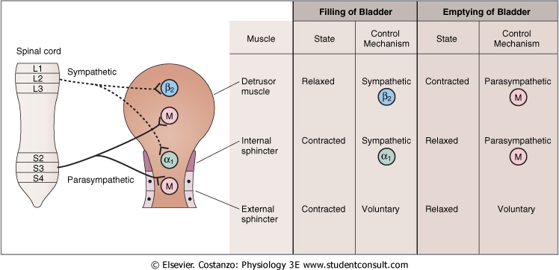
Urinary Bladder

Slide 38
Autonomic Reflexes
Sympathetic activation could occur in isolated portions such as: - heart regulation. - many sympathetic reflexes that regulate G.I. functions.
The parasympathetic usually causes specific localized responses:
The effect of parasympathetic usually specifies to certain organ , but sometimes there is a common effect of parasympathetic activity by affecting the functions of some organs together such as rectal emptying and bladder emptying, salivary secretion and gastric secretion.
Sympathetic can deal with every single organ alone.
Parasympathetic can do that, but sometimes not, should be two processes together.

Slide 39
Quiz
(Fill the boxes)
1)The ---Nervous System : Formed by neurons & their process
present in all the regions of the body.
A)Peripheral B)Central C)Body D)somatic
2)----nervous system axons extend all the way to their skeletal muscles
A) Autonomic B) Somatic C) All D) Viscera
3)ANS is activated by centers in
A)spinal cord B)brain stem C)hypothalamus D)All of the above
4)---is a neurotransmitter released by cholinergic
A)Ash B)Adrenaline C)Noradrenaline D)Acetylcholine

Slide 40
5)---are in 2 regions :1-paravertebral, 2- prevertebral
A)Neurons B)Nerves C)Ganglias D)Neurotransmitters
6)In SNS Postganglionic neurons are adrenergic ( release noradrenalin ) except in---(muscarinic (M) cholinergic)
A)Glands B)heart C)Sweat glands D)All of these
7) Sympathetic stimulation contracts meridional fibers to:
A)No effect on pupil B)Constrict pupil C)Dilate pupilT
D)Increase Aqueous Humor secretion
8) A nicotinic receptor is an ion channel for:
A)K+ B)Na+ C)Ca2+ D)K+ and Na+ T
9) β2 receptors are:
A) More sensitive to Norepinephrine than epinephrine
B) More sensitive to Epinephrine than norepinephrine T
C) Equally sensitive to both
D) Insensitive to both

Slide 41
10) Stimulation of _______ Nerves causes large quantities of
Epinephrine and norepinephrine to be secreted in blood
A) Sympathetic T B)Parasympathetic C)Vagus D)None of the above
11) Secretion of sweat glands is:
A) Increased by Sympathetic nervous system
B) Increased by Parasympathetic nervous system
C) Not affected by Autonomic nervous system
D) Increased by both Parasympathetic and Sympathetic nervous system
12) The parasympathetic nervous system uses ______ as its neuro transmitter/s:
A) Norepinephrine
B) Acetylcholine (ACh)
C) Both Acetylcholine and Norepinephrine
D) Noradrenaline

Slide 42
Answers
Question | answer | Slide number
1 | A | 4
2 | B | 5
3 | D | 9
4 | D | 10
5 | C | 14
6 | C | 17
7 | C | 35
8 | D | 30
9 | B | 28
10 | A | 34
11 | A | 36
12 | B | 25

Slide 43
Thank you & good luck
Boys team members:
هشام الشايع
محمد الحسن
محمد الصويغ
محمد المنجومي
معاذ الحمود
خالد العقيلي
عبدالجبار اليماني
عمر الفوزان
فهد الحسين
سعد الهداب
نواف اللويمي
انس السيف
سيف المشاري
سعود العطوي
نايف المطيري
عبدالرحمن العقيل
Girls team members:
مها العمري
هديل عورتاني
ريما العنزي
روتانا خطيب
لجين عزيز الرحمن
العنود المفرج
ريم القرني
عهد
مها النهدي
بلقيس الراجحي
سارة البليهد
ميعاد النفيعي
نورة البسام
عبير العبدالجبار
وجدان الشامري
الجوهرة الشنيفي
Team Leaders:
-مها بركة - طارق العميم

