Slide 1




Extra Information
Only Found in Males’ slides
Only Found in Females’ slides
Females & Males Slides
Vary Important Notes
Notes
PHYSIOLOGY

Slide 2
Homeostasis I

Slide 3
Objectives
At the end of this session, the students should be able to:
• Differentiate between positive and negative feedback
mechanisms and give examples for each in the body.
• Define a feedback mechanism and describe its components.
Explain how homeostatic mechanisms regulated by negative feedback detect and respond to environmental changes + Define positive and negative feedback
Describe the actions of a positive feedback loop.
• Discuss the physiologic control mechanisms that enable
maintenance of the normal steady state of the body.
• Define and discuss the concept of homeostasis and its
importance to the living organism.
• Define the concept of the “internal environment” and state its
physiologic importance.
• Differentiate between the external and internal environments.
Study source for this lecture:
(Guyton & Hall Textbook of Medical Physiology, 13th ed, Chapter 4)

Slide 4
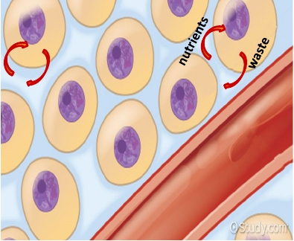
The Internal Environment
• All the cells in the body are continuously bathing in fluid , Because this fluid is outside the cell, it is called extracellular fluid (ECF).
• It is from the ECF that cells get the ions and nutrients needed
to maintain life.
All body cells live in the same environment (i.e. ECF).
The composition of ECF is almost similar between the different species.

Slide 5
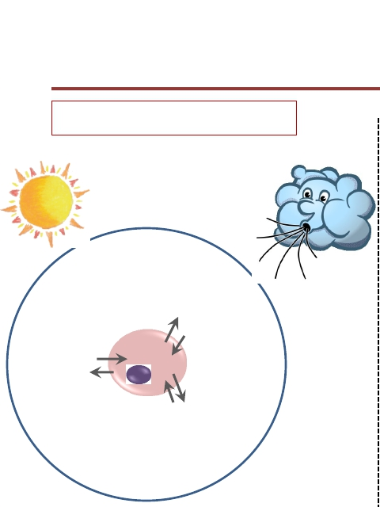

External vs Internal environment
In Multicellular organisms
“External environment”
In Unicellular organisms
Internal environment = External environment
“Internal environment”

Slide 6
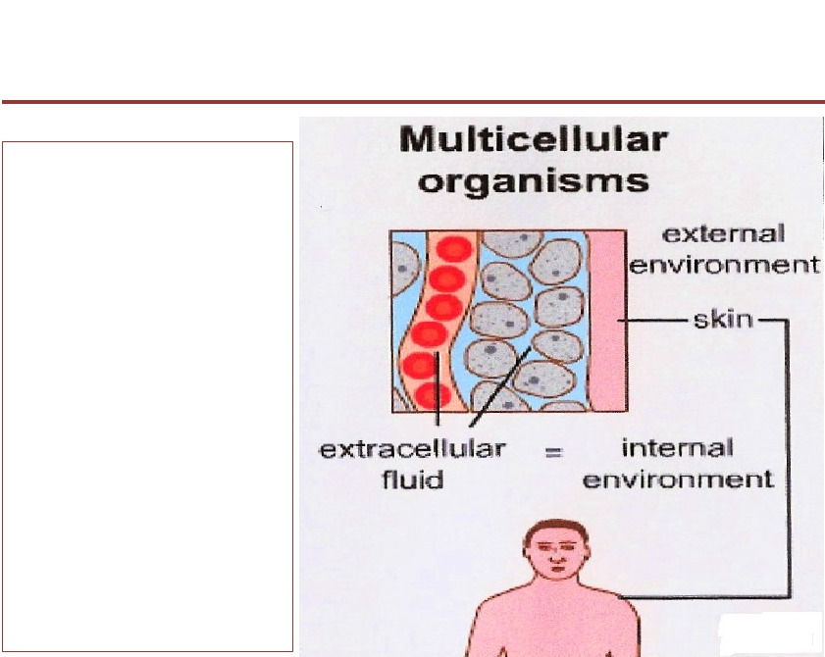
External vs Internal environment
• ECF = the
internal
environment.
• The skin
separates this
environment
from the outside
world which
known as the
external
environment.
5

Slide 7
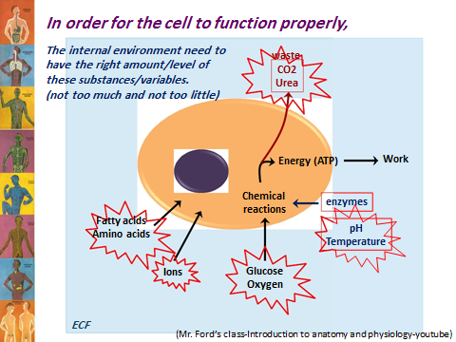
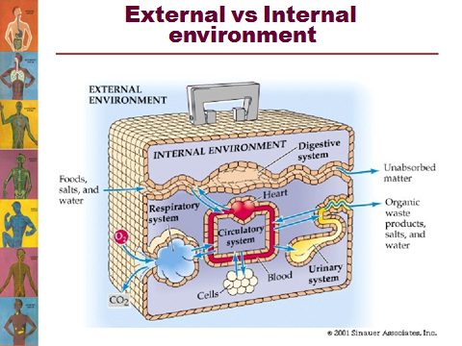
من سلايدات البنات بالكامل

Slide 8
Homeostasis
• The process by which the body keeps the internal environment constant despite changes in the external environment is known as“Homeostasis”.
– Homeo- : sameness, similarity
– stasis: standing
Essentially all the functions of the body organs and tissues aim at keeping the internal
environment at a nearly constant state.
Chemical, thermal, and neural factors interact to maintain homeostasis.
-Hemostasis : Is the tendency to the internal balance or is the maintenance of nearly constant conditions in the internal environment.
من سلايدات الاولاد

Slide 9
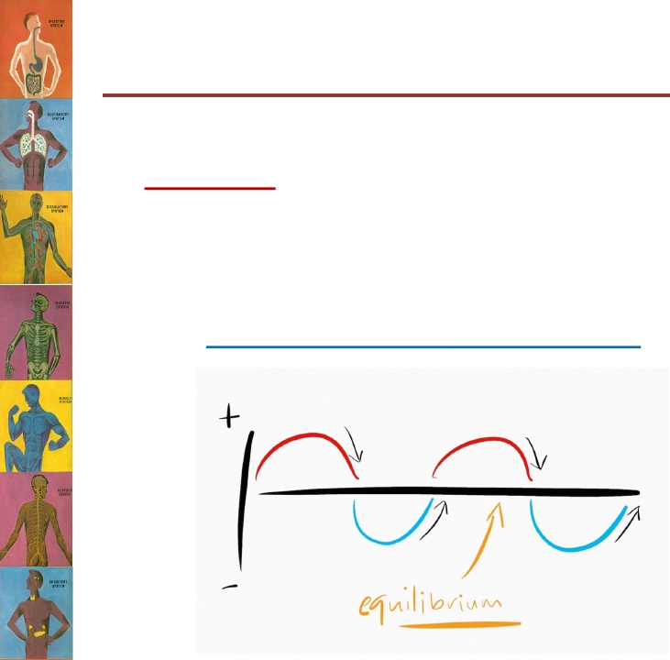
Concept of Homeostasis
من سلايدات البنات
The internal environment of the body (ECF) is in a dynamic state of equilibrium
All different body systems operate in harmony to provide homeostasis
Extreme dysfunction leads to death; moderate dysfunction leads to sickness.
-Internal environment is always in dynamic state to maintain hemostasis
من سلايدات الاولاد

Slide 10
Components of Homeostatic Systems
The body maintains homeostasis by using homeostatic control systems
  Three components associated with each system:
    1-Receptor 2-control center 3-effector
Receptor
  The structure that detects changes in a variable, the stimulus
    e.g., a change in temperature
  Consists of sensory nerves
Control center
  The structure that interprets input from the receptor
  Initiates changes through the effector
  A portion of the nervous system or an endocrine organ
Effector
  The structure that brings about change to alter the stimulus
  Most body structures. e.g., muscles or glands
2
3
1

Slide 11
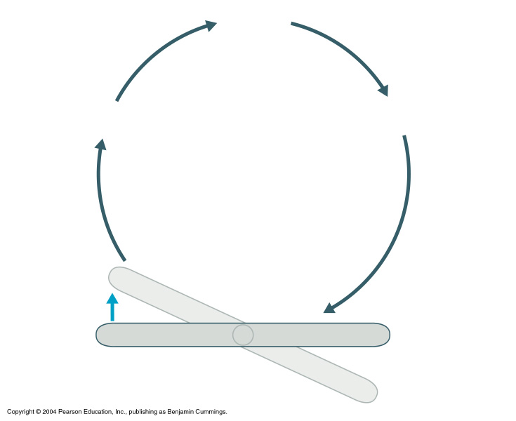
3
Input:
Information
sent along
afferent
pathway to
Control
center
4
Output:
Information sent
along efferent
pathway to
Receptor (sensor)
Effector
2
Change
detected
by receptor
Homeostatic Control Mechanisms
5
Response of
effector feeds
back to influence
magnitude of
stimulus and
returns
variable to
homeostasis
1
Stimulus:
Produces
change
in variable
Imbalance
Variable (in homeostasis)
Imbalance

Slide 12
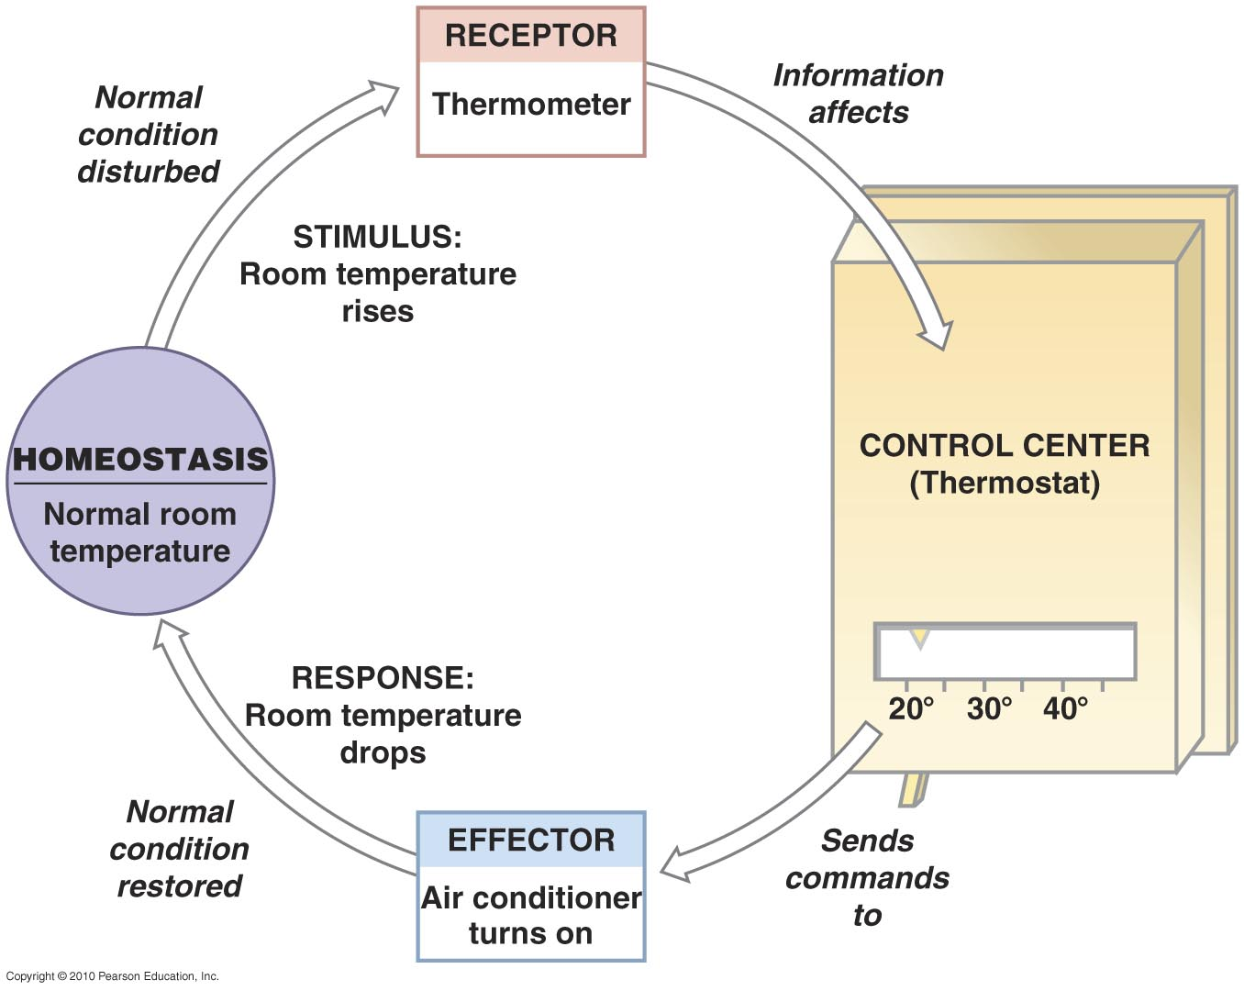
The Control of Room Temperature

Slide 13
Maintenance of Homeostasis
Nervous system:
  Controls and coordinates bodily activities that require rapid responses.
  Detects and initiates reactions to changes in external environment.
  e.g., regulation of blood pressure upon rising.
  - Response faster than endocrine system
Endocrine system:
  Secreting glands of endocrine regulate activities that require duration rather than speed.
  e.g., parathyroid hormone regulating calcium levels.
- Response slower than nervous system

Slide 14
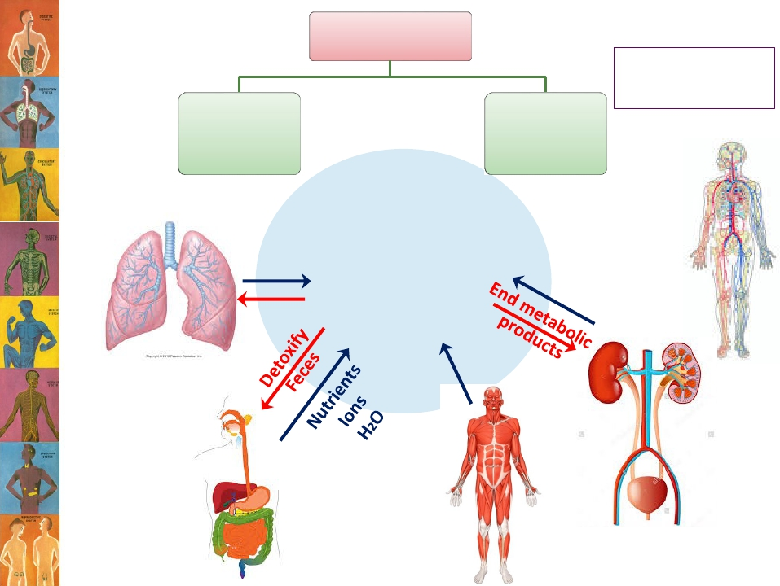
Control systems
Protection
Skin
Immune system
Nervous
system
Endocrine
systems
O2
CO2
Internal
environment

Slide 15
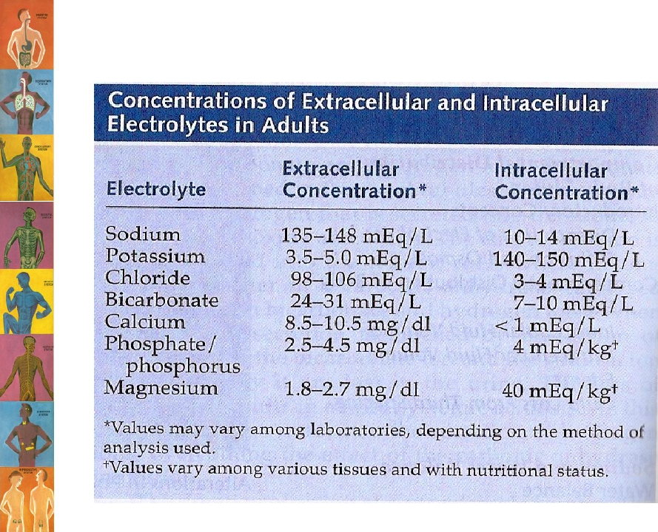
Factors Homeostatically Regulated
Concentration of nutrient molecules. Ex: Glucose
Concentration of water, salt, and other electrolytes
Concentration of waste products
Concentration of O₂ = 100mmHg and CO₂ = 40 mmHg
pH = 7.35
Blood volume 4-6 L and pressure 120/80
Temperature = 37º C
Body constituents are normally regulated within a range rather than a fixed value.

Slide 16
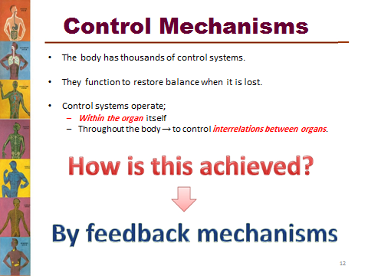
من سلايدات البنات بالكامل

Slide 17
What is meant by feedback?
A loop system in which the system responds to perturbation either in the same direction (positive feedback) or in the opposite direction (negative feedback).
Response of a homeostatic system occurs through a feedback loop:
Stimulus
detection of stimulus by a receptor
information relayed to the control center
integration of the input by control center and initiation of change through effectors
return of homeostasis by the actions of effectors
من سلايدات الاولاد

Slide 18
Feedback Loops: Types
-Negative feedback loop
original stimulus reversed.
used for conditions that need frequent adjustment.
Most feedback systems in the body are negative
-Positive feedback loop
original stimulus intensified.
seen during normal childbirth.
Positive feedback | Negative feedback
The effector response is in the same direction of the stimulus that initiated the response. E.g; • In nerve signaling, entry of a small amount of Na+ into the cell will open more Na+ channels causing more Na+ to enter the cell. • Only few systems display positive feedback mechanisms.. WHY? | The effector response of the system is in the opposite direction to the stimulus that initiated the response. E.g; • A high level of in CO2 in the ECF will increase pulmonary ventilation, increasing the amount of CO2 expired which will bring the level of CO2 in ECF down. • Most of the control systems of the body act by negative feedback.

Slide 19
Homeostatic Systems Regulated by Negative Feedback
Negative feedback
  A type of homeostatic control system that maintains the variable within a normal range
  Variable maintained within a normal level, its set point
    fluctuates around the set point
  If stimulus increases, homeostatic control system activated to cause a decrease in the stimulus
  If stimulus decreases, homeostatic control system activated to cause an increase in the stimulus

Slide 20
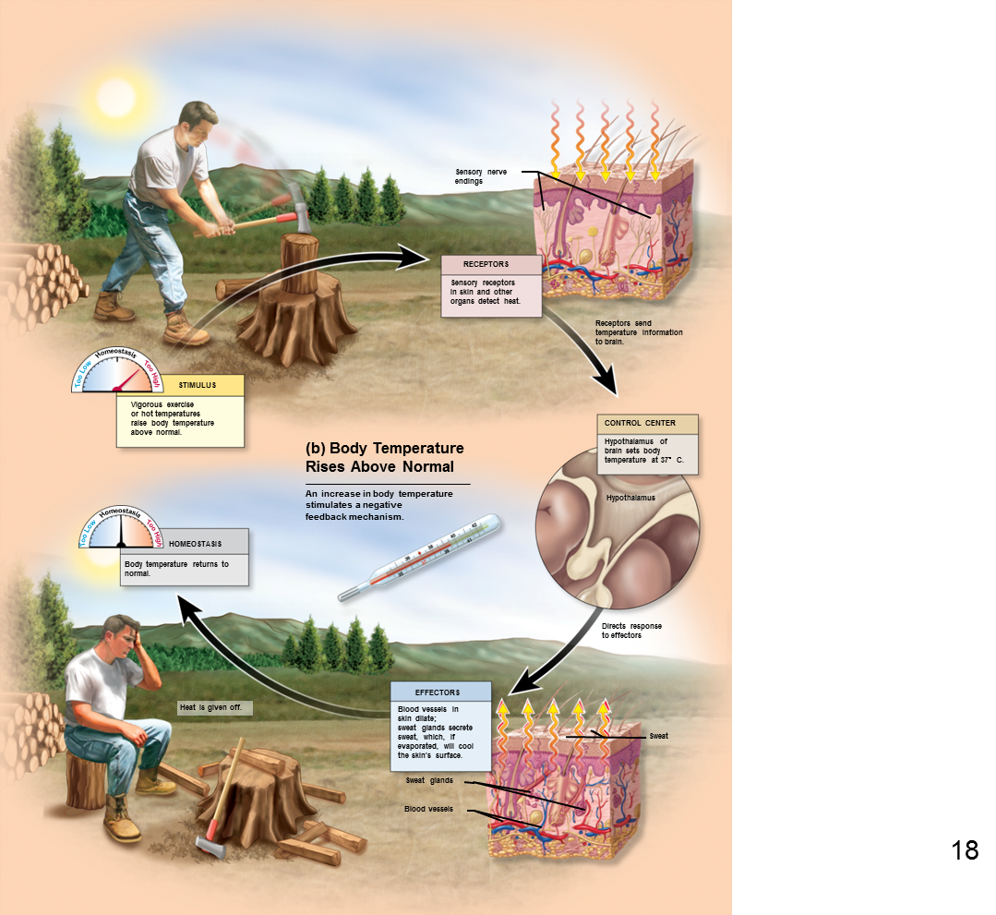
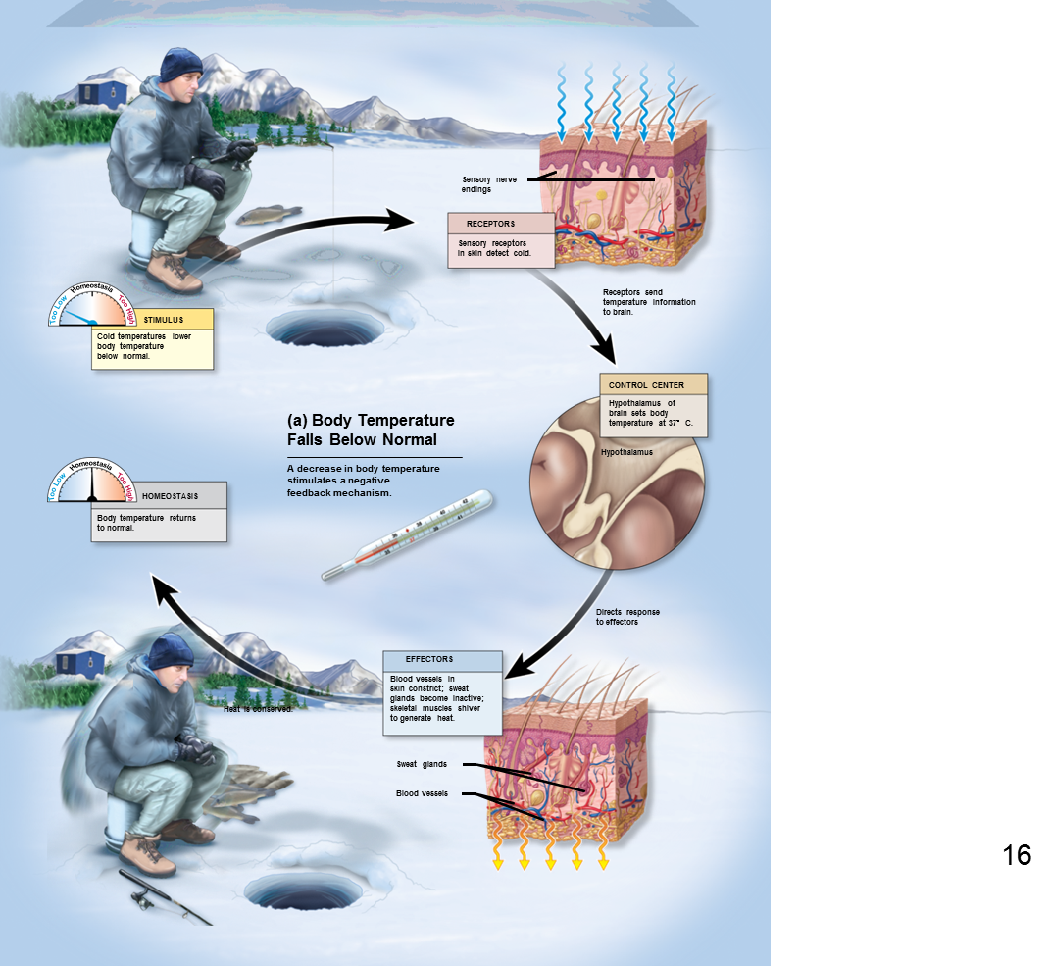
من سلايدات الاولاد بالكامل

Slide 21
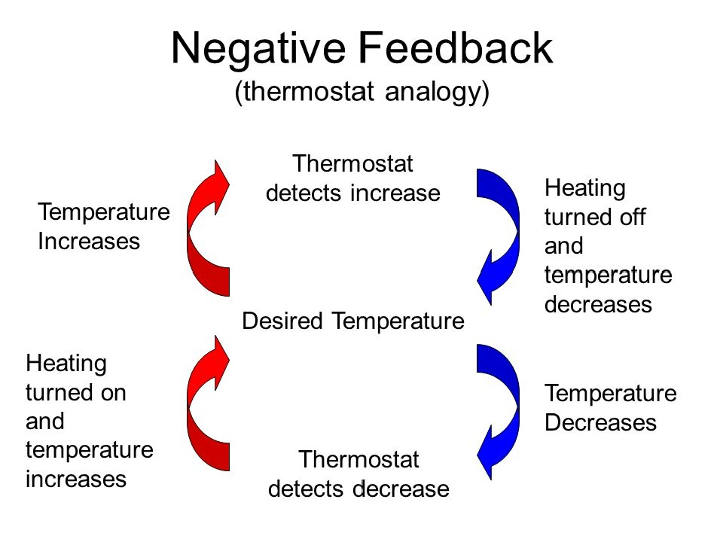
من سلايدات البنات

Slide 22
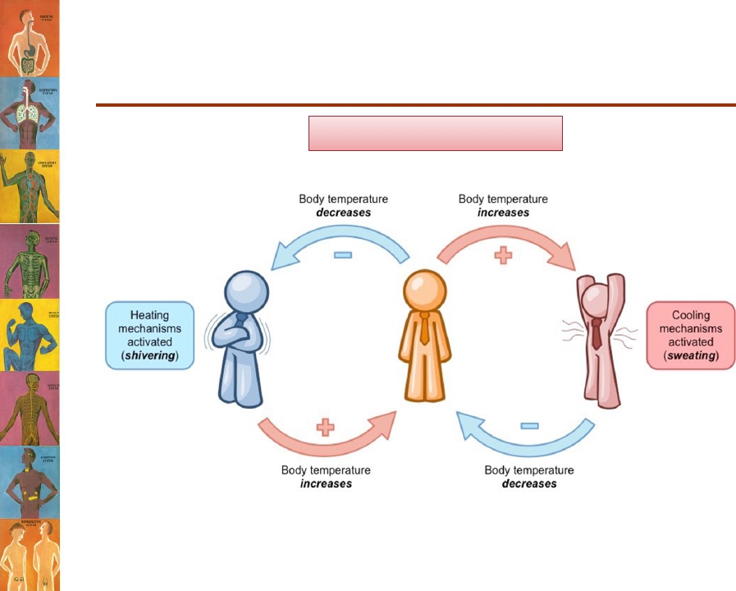
Examples of Negative Feedback
Mechanisms
Body temperature control
من سلايدات البنات

Slide 23

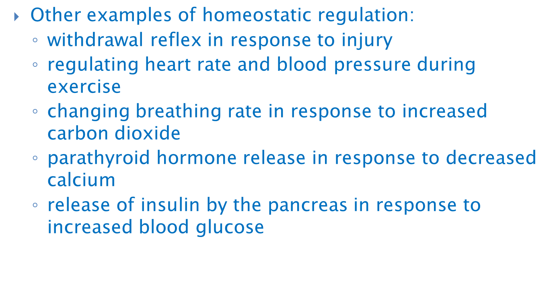
Homeostatic Systems Regulated by Positive Feedback
Positive feedback during breastfeeding
  Sensory detectors detect baby suckling
  Message is transmitted to the hypothalamus
  Hypothalamus signals posterior pituitary to release the hormone oxytocin
  Oxytocin stimulates the mammary gland to eject breast milk
  Cycle repeats as long as the baby suckles
Other examples of positive feedback:
  blood clotting cascade
  uterine contractions of labor

Slide 24
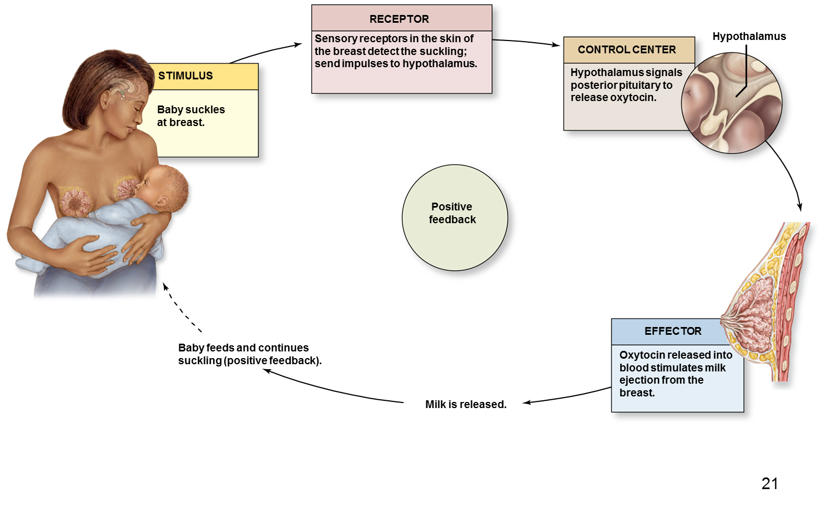
Positive Feedback during Childbirth
Stretch receptors in walls of uterus send signals to the brain
Brain induces release of hormone (oxytocin) into bloodstream
Uterine smooth muscle contracts more forcefully
More stretch, more hormone, more contraction etc.
Cycle ends with birth of the baby & decrease in stretch

Slide 25
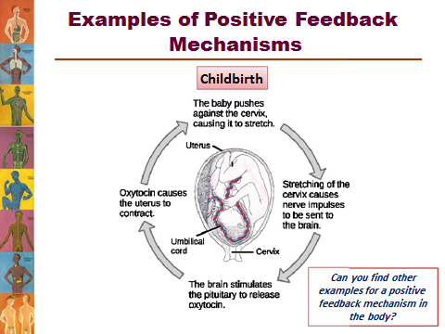
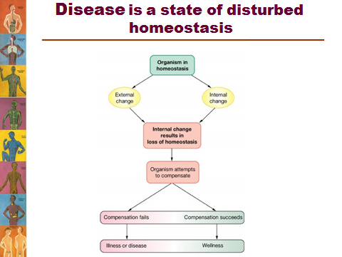
من سلايدات البنات بالكامل

Slide 26
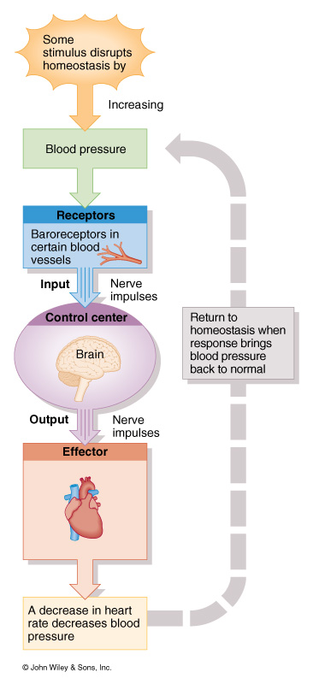
Homeostasis of Blood Pressure
Baroreceptors in walls of blood vessels detect an increase in BP.
Brain receives input and signals from blood vessels and heart.
Blood vessels dilate, HR decreases.
BP decreases

Slide 27
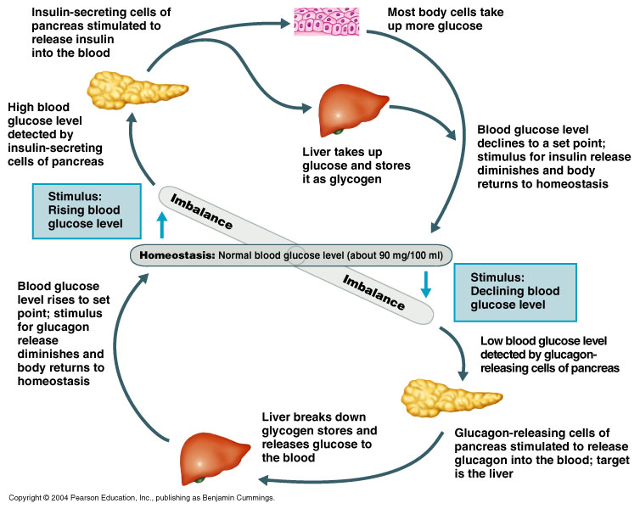
من سلايدات الاولاد

Slide 28
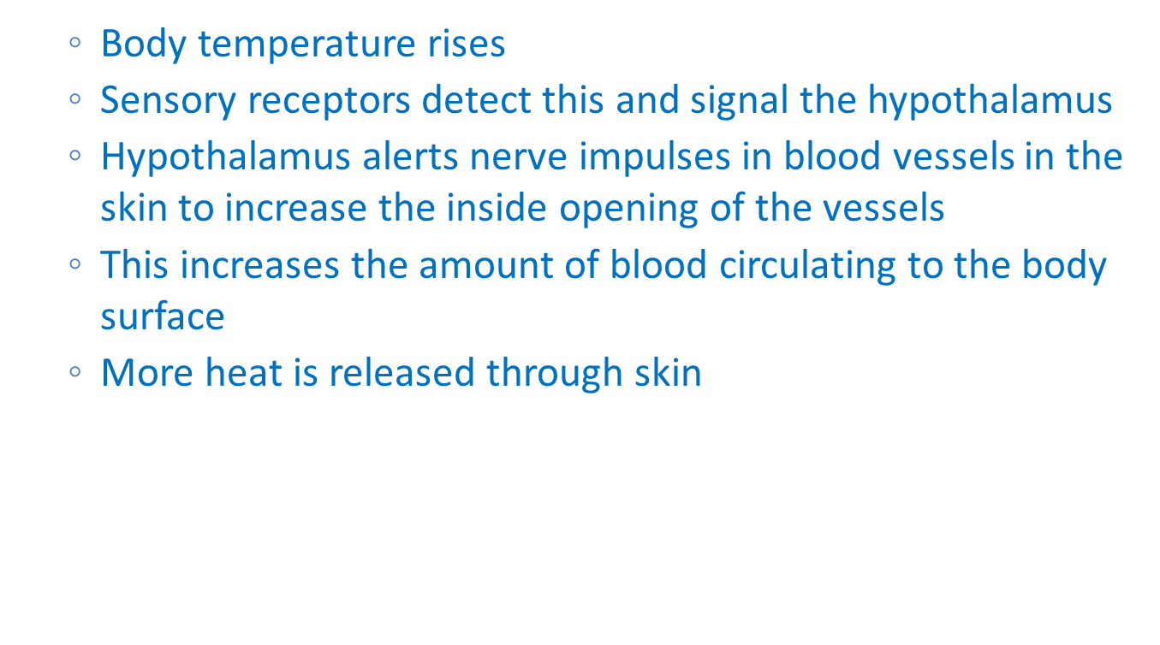
Homeostatic Systems Regulated by Negative Feedback
Temperature regulation
  Body temperature drops
  Sensory receptors detect this and signal the hypothalamus (component of the brain)
  Hypothalamus alerts nerve impulses in blood vessels in the skin to decrease the inside opening of the vessels
  This decreases amount of amount of blood circulating to the surface of the body
  Less heat is released through skin
  Nerve impulses are sent to skeletal muscles, causing shivering
  Nerve impulses are sent to smooth muscles of hair follicles, causing “goosebumps”

Slide 29

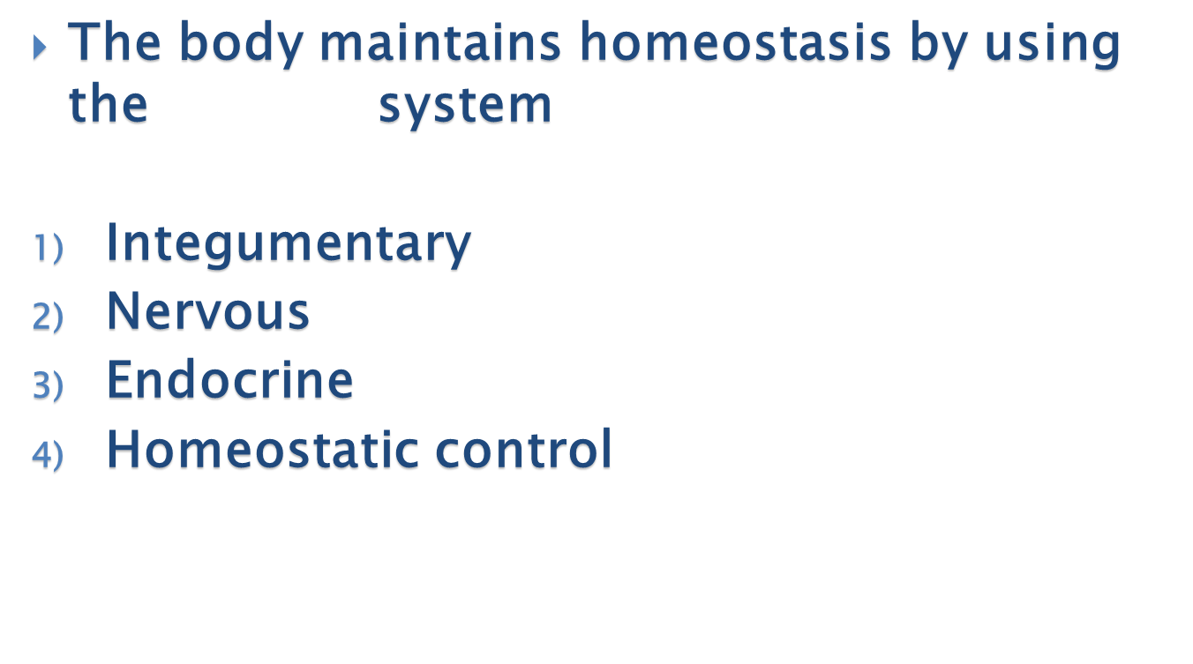

Quiz (Fill the boxes)
1
body cells live in the same environment
Somatic
Nerve
Stimulus
All
2

Slide 30

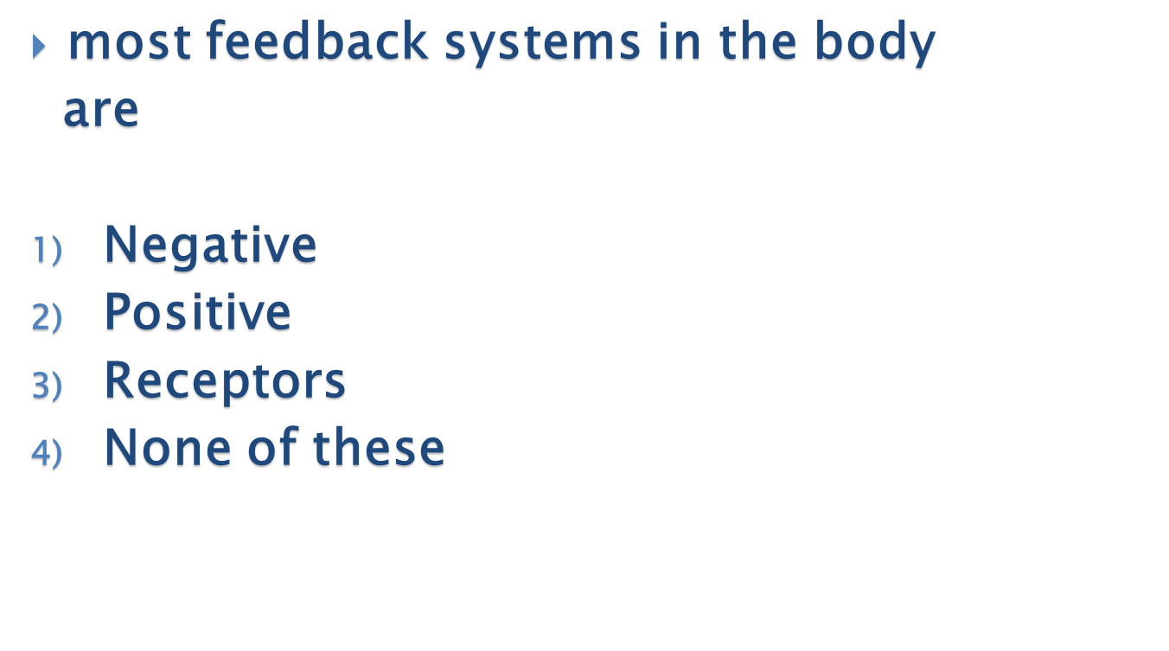
3
A structure that detects changes in a variable is called
Stimulus
Skin
receptor
None of these
4

Slide 31

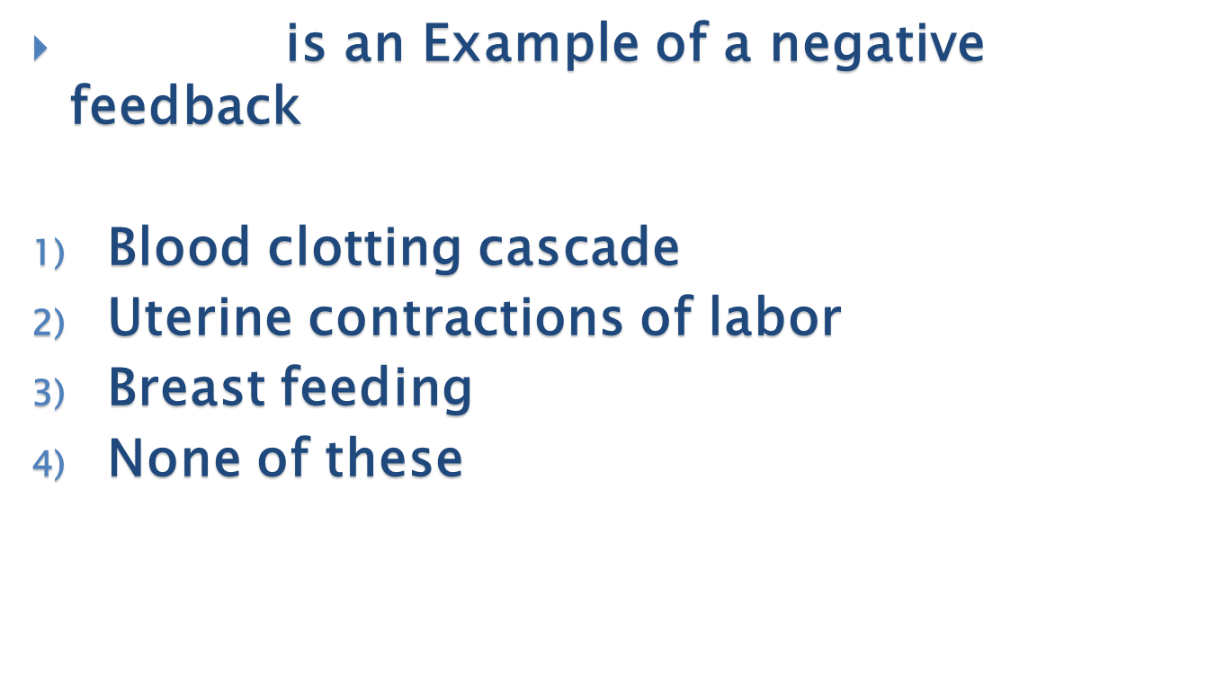
5
?
Essentially all the functions of the
organs and tissues aim at keeping the
internal environment at a nearly constant state
Internal
Body
External
Cardiovascular
6

Slide 32
answers
Question | answer | Slide number
1 | 4 | 4
2 | 4 | 7
3 | 3 | 7
4 | 1 | 14
5 | 2 | 5
6 | 4 | 20

Slide 33

Thank you & good luck
Boys team members:
هشام الشايع
سعود الاحمري
عبدالرحمن آل الشيخ
فايز الدرسوني
محمد الحسن
محمد الصويغ
محمد المنجومي
معاذ الحمود
منصور العبرة
احمد الصبي
خالد العقيلي
عبدالجبار اليماني
عمر الفوزان
Girls team members:
مها العمري
هديل عورتاني
ريما العنزي
روتانا خطيب
لجين عزيز الرحمن
العنود المفرج
ريم القرني
عهد القرين
العنود المنصور
مها النهدي
بلقيس الراجحي
سارة البليهد
ميعاد النفيعي
نورة البسام
عبير العبدالجبار
وجدان الشامري
الجوهرة الشنيفي
Team Leaders:
-مها بركة - طارق العميم

