Slide 1




Extra Information
Only Found in Males’ slides
Only Found in Females’ slides
Females & Males Slides
Vary Important Notes
Notes
PHYSIOLOGY

Slide 2
Body fluids
محاضرة body fluids
من عند البنات والأولاد +
بداية محاضرة Homeostasis 2
من عند الأولاد

Slide 3
Objectives
List and describe of body fluid compartments as intra‐cellular fluid (ICF), Extra‐cellular fluid (ECF), interstitial fluid, trans‐cellular fluid, and total body water (TBW) and state their normal value.
Describe the physiological and pathological factors influencing the body fluid.
Identify and describe daily intake and output of water and maintenance of water balance
Describe the composition of each fluid compartment, in terms of volume and ions and represent them in graphic forms.
State the water content of the body.
Discuss water balance in the body with regards to intake and output.
Enumerate the different body fluid compartments and state their normal volume.
Describe the physiologic mechanisms involved in water balance (the role of ADH hormone and thirst mechanism).
Define osmolarity and state the normal osmolarity of body fluids.
Explain the effects of placing a cell in solutions with varying tonicity on the cell volume.
Enumerate fluids used in clinical practice and state their tonicity compare to that on normal body fluids.
• Describe the effects of infusing IV fluids with different tonicities on the
volume and osmolarity of the different body compartments.

Slide 4
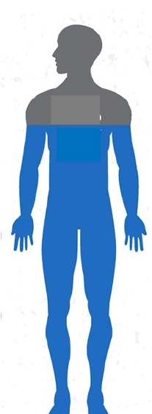
Body Fluid Content
• Total body fluids ≈ 60% (50-70%)
of total body weight (TBW).
هذي السلايد من البنات
• Body fluids = water + dissolved
solutes.
60%
Water
Electrolytes
(Na+, K+, Cl-, HCO3-
, Mg+2, Ca+2)
Solutes
Non-electrolytes
(glucose, urea, creatinine)
• Total body water ≈ 60% of TBW.
(Guyton and Hall Textbook of Medical Physiology. 13th ed. Ch-25)

Slide 5
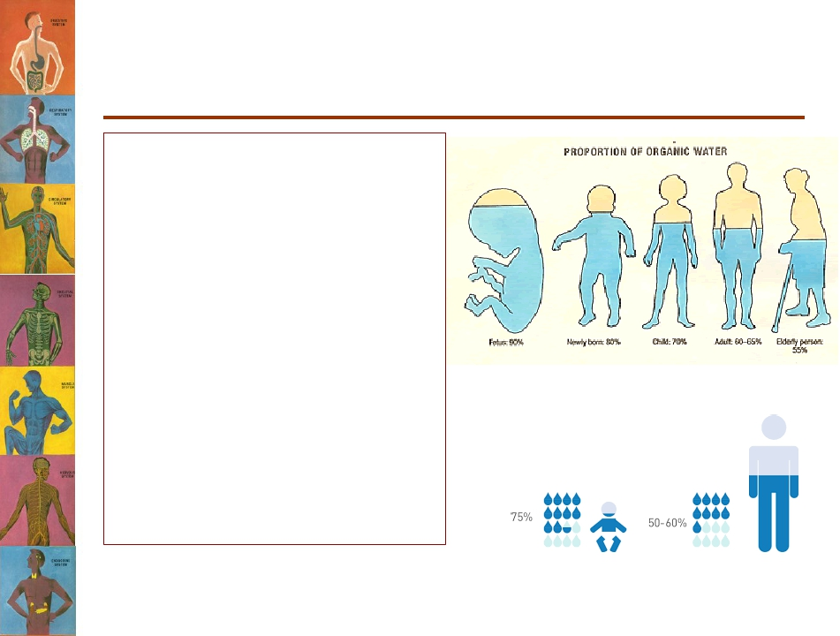
Body Water
The human body made mainly of water, which constitutes about 60% of body weight in the adult, however the amount of water varies with age.
“Increase in age lead to decrease in the percentage of water”

Slide 6
Total Body Fluid
Total body water (TBW):
consititutes 55-60% of the body weight in young men and 45-50% in young women.
Why the percentage is lower in women?
“The percentage of water is lower in women because they have higher fat content than men”
The TBW Is distributed as follows:
Muscle (50%)
Skin (20%)
Other organs (20%)
Blood (10%)
Infants have low body fat, low bone mass, and are 73% or more water.

Slide 7
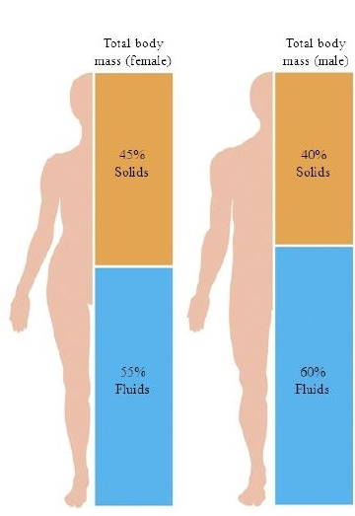
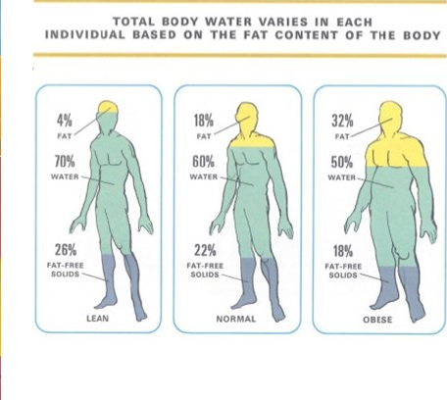

Slide 8
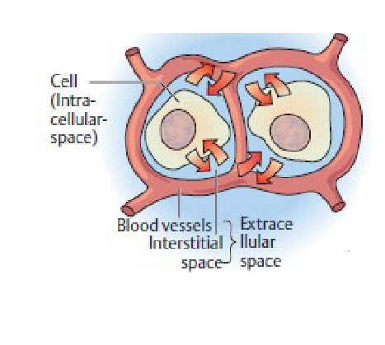
Water Balance
• Cells are largely made of water and are surrounded
by a “sea” of water.
• Water is constantly being exchanged between the
cells and surrounding environment.
• Keeping a constant volume of water is essential
for homeostasis.

Slide 9
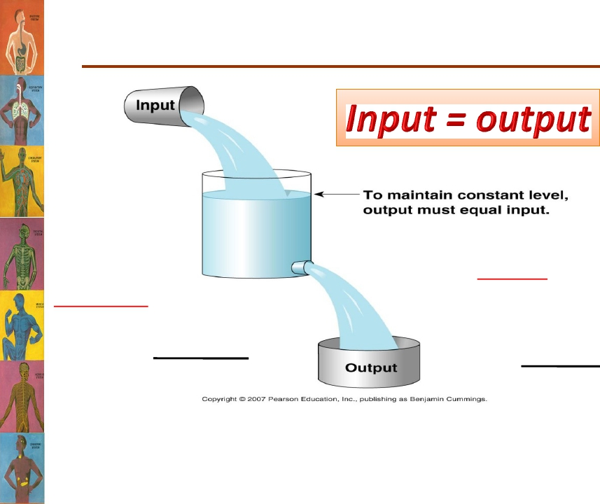
Maintenance of Fluid Balance
Daily loss:
• Insensible loss (700 ml).
• Sweat (100 ml).
• Feces (100 ml).
• Urine (1400 ml).
Total loss = 2300 ml
Water intake:
• Fluids ingested (2100 ml).
• From metabolism (200ml)
Total intake = 2300 ml
Insensible loss:
يعني الماء اللي نخسره من أجسامنا بدون إدراك أو وعي مننا. وهو يحصل خلال:
1. Evaporation through the respiratory tract. (breathing)
(تبخر الماء من الجهاز التنفسي أثناء عملية التنفس)
2.Diffusion through the skin يختلف عن التعرق))

Slide 10
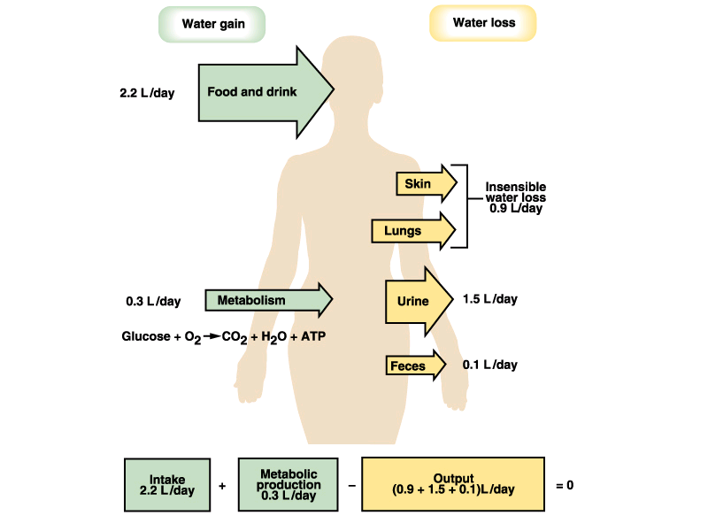
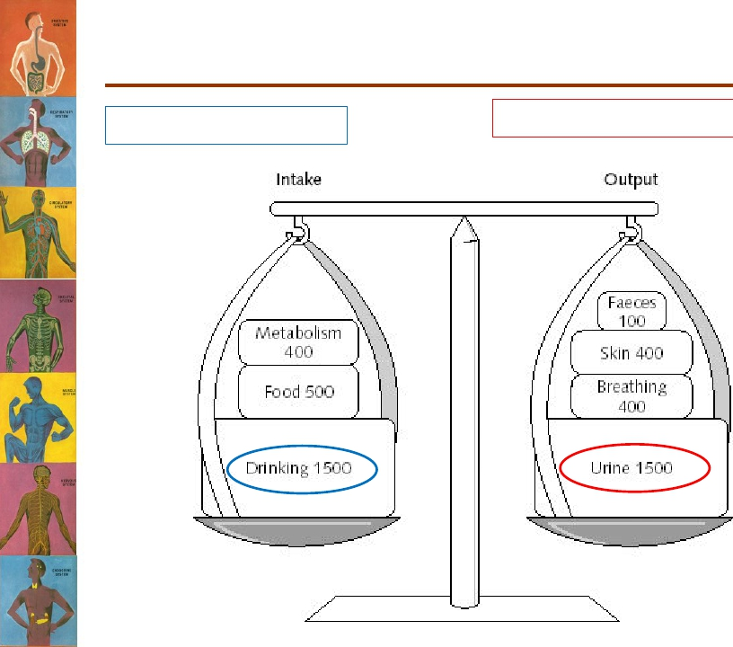
Regulation of Fluid Balance
Amount ingested = amount eliminated.
Modify intake → thirst
Modify output→ Kidney excretion
Major input
Major ouput

Slide 11
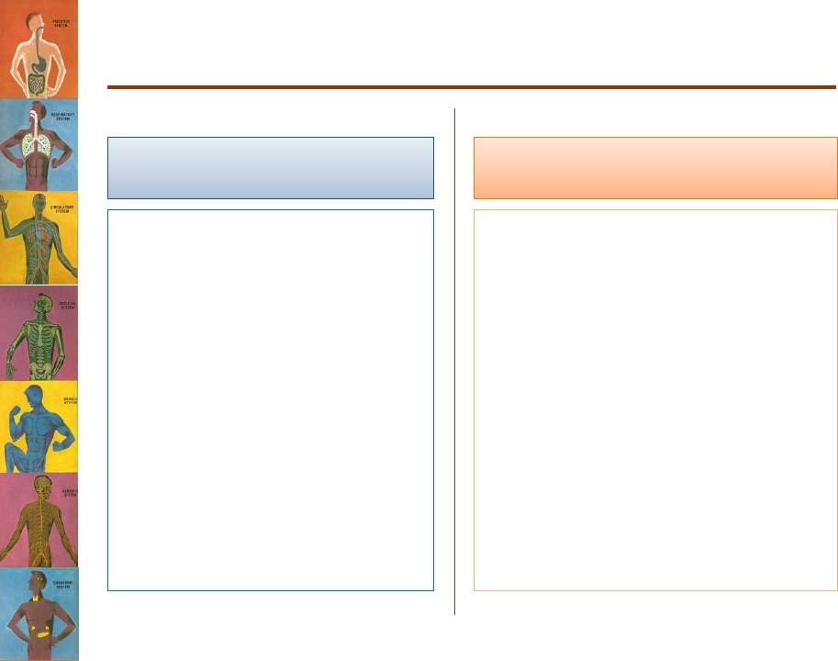
Disturbances in Fluid Balance
Water/fluid intake
Water/fluid output
• Intake is variable
Depends on:
– Climate.
– Habits.
– Physical activity.
-Burns
- Exercise
-Hot weather.
-Diarrhea
-Vomiting
-Blood loss
-Diabetes

Slide 12
Regulation of Fluid Balance
Water deficit
Water excess
• Input < output.
• Leads to:
– Hypovolemia
– Dehydration
• Input > output
• Leads to:
– Hypervolemia
– Edema.
•
Physiologic regulation:
• Physiologic regulation:
1. ↓ ADH secretion →
↓water reabsorption→
↑water excretion by
kidney.
2. Decrease thirst
1. Activates Hypothalamic
Thirst centre → ↑fluid intake
• The hypothalamic thirst centre
is activated by:
– ↓ ECF volume (10-15%)
– ↑ ECF osmolarity (1-2%)
2. ↑ ADH secretion by posterior
pituitary → ↑ water reabsorption by the kidney.

Slide 13
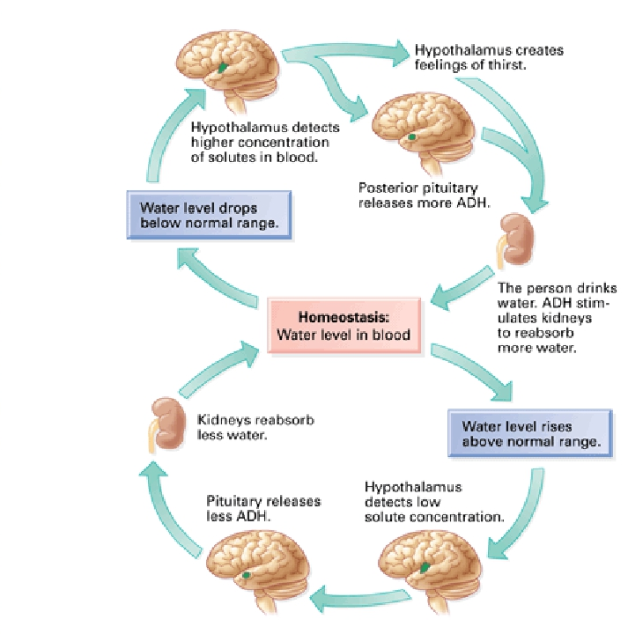
“ADH hormone : هو هرمون يعيد امتصاص الماء في الكلية”

Slide 14
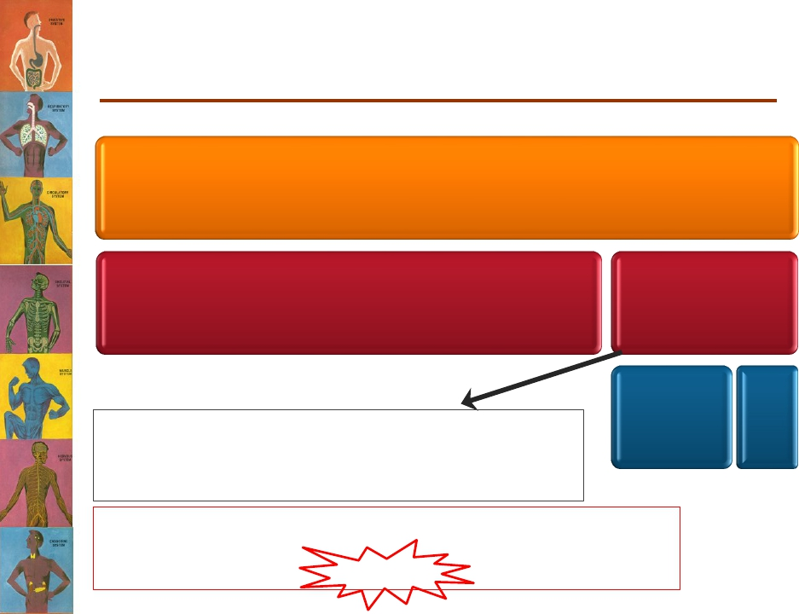
Body Fluid Compartments
Total body water = 60% TBW
*2/3 (40% of TBW)
Intracellular
1/3 (20% of TBW)
Extracellular
¾ (15%)
Interstitial Fluid
¼ (5%)
Plasma
Transcellular fluid (specialised type of ECF e.g.
synovial, CSF, ocular, pericardial, pleural, peritoneal
fluids)= 1-2L
N. B. the fractions refer to its relation with the preceding
compartment. While the percentage refers to its relation
to Total
Body Weight)
(Guyton and Hall Textbook of Medical Physiology. 13th ed. Ch-25)
هذي من سلايدات البنات

Slide 15
Body Fluid Compartment
هذي من سلايدات الأولاد
The water content of the body is divided into two compartments.
1) Intracellular compartment (ICF)
Contained within the cell, represent approximately 67% of the total body water, 40% of total body weight.
2) Extracellular Compartment:(ECF)
Contained within the vessels of the cardiovascular system, is the remaining 33% of the total body water, about 20 % of total body weight.
the fluid portion of the blood, represents approximately 25% of the ECF. Blood volume, approximately 80 ml/kg of body weight (8%).
Plasma
sourrounds all cells except blood cells and includes Lymph (2-3%) of total body weight.
The ISF represent approximately 15% of the total body weight and 75% of the ECF.
Interstitial fluid (ISF)
is about 1 L, occupies approximately 15 ml/kg of body weight (1.5%).* Represents fluid in the lumen of structures lined by epithelium and includes digestive secretions… etc.
Transcellular fluid volume

Slide 16
”intercellular space basically means the
space between cells which is in essence
The interstitial space (interstitium). While
Extracellular comprises both the interstitium
And the plasma” Dr.Maha
Don’t mix up between Intracelular Fluid
( inside the cell )
and Intercellular fluid
(space between cells)

Slide 17
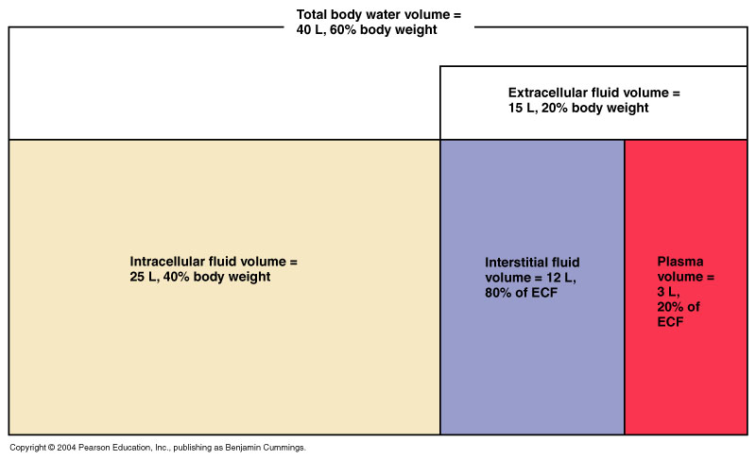
Fluid Compartments

Slide 18
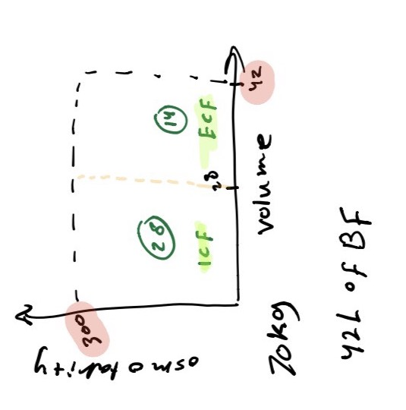
Let’s go back to our 30-year-old man
Calculate the total body water content
of a 40-year-old 70kg man?
• TBW = 42 litres
• How many litres lie intracellularly?
42 X ⅔ = 28L OR 70 X 40/100 = 28L.
• How many litres lie extracellularly?
42 X ⅓ = 14L OR 70 X 20/100 = 14L.
• How many litres constitute the interstitial fluid?
• How many litres are plasma?

Slide 19
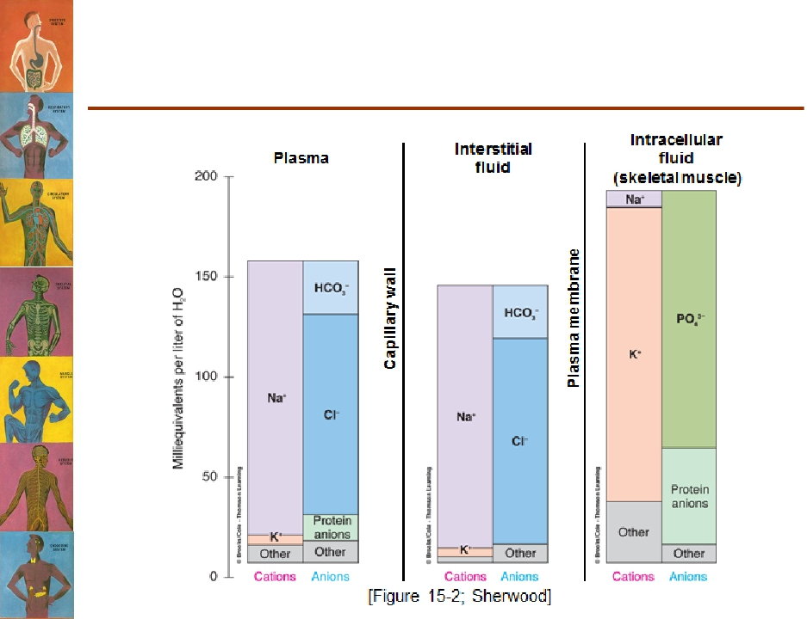
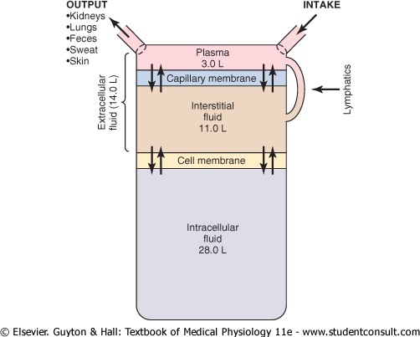
COMPOSITION OF BODY FLUIDS
Does the composition of the different body fluid compartments differ?
The major body fluid compartment and membranes separate them

Slide 20
Constitutes of extracellular and intracellular fluids:
The plasma and interstitial fluid are separated only by highly permeable capillary membranes, their ionic composition is similar but protein is higher in the plasma.
the intracellular fluid is separated from extracellular fluid by a cell membrane that is highly permeable to water but not to most of the electrolytes in the body.

Slide 21
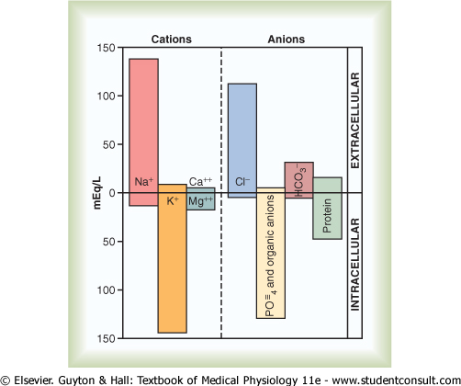
Solute Overview:
Intracellular vs. Extracellular
Ionic composition very different
Total ionic concentration very similar
Total osmotic concentrations virtually identical

Slide 22
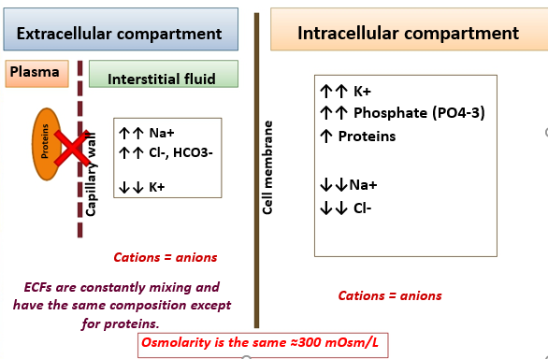
Constituents of the Different Body Fluid Compartments

Slide 23
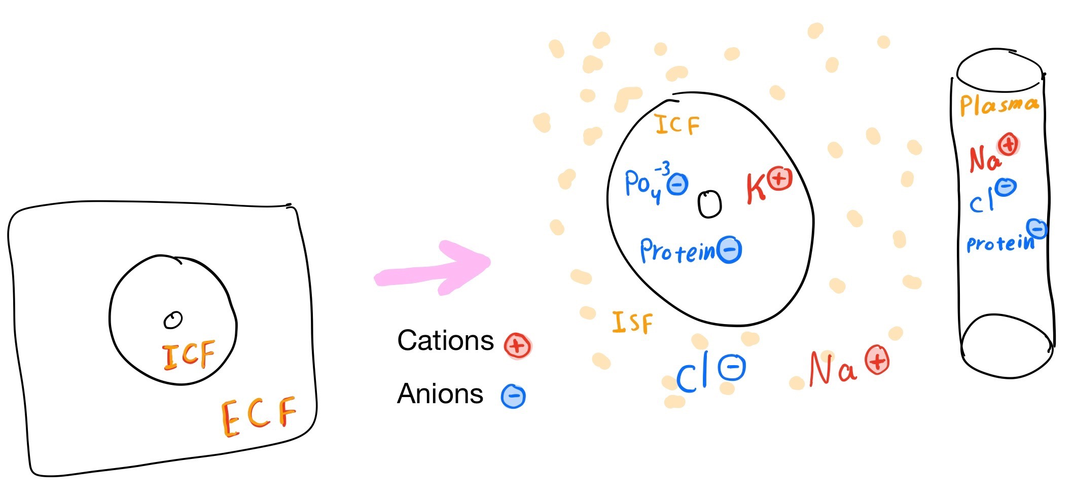

Slide 24
Extracellular and Intracellular Fluids
•Ion fluxes are restricted and move selectively by
active transport.
• Nutrients, respiratory gases, and wastes move
Unidirectionally.
• Plasma is the only fluid that circulates throughout
the body and links external and internal
Environments.
• Osmolarities of all body fluids are equal; changes
in solute concentrations are quickly followed by
osmotic changes.

Slide 25
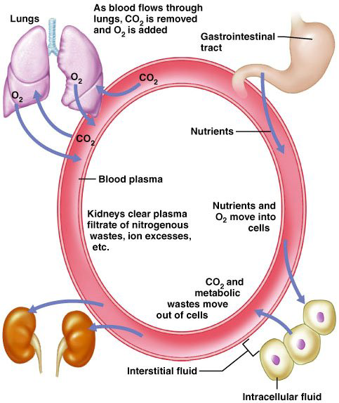
Continuous exchange of Body Fluids

Slide 26
Factors That Affect TBW:
Physiological factor:
Age
Sex
Body fat
Climate
Physical activity
Pathological factors:
Vomiting
Diarrhea
Diseases with excessive loss of water (DM, excessive sweating,etc)
Blood loss

Slide 27
Osmolarity vs Tonicity?
Osmolarity:
  A unit of concentration.
  It measures how concentrated or diluted a solution is.
  Defined as, the number of osmoles of a solute per litre of solution.
  The normal osmolarity of body fluids is ≈ 300 mOsm/L
  describes the concentration of one solution
  It is the movement of water across a semi-permeable membrane from a region of low solute concentration to a region of high solute concentration.
Tonicity:
  Ability of a solution to change the volume or pressure of the cell by osmosis
  is used to compare between the osmolarities of two or more solutions separated by a semi-permeable membrane.

Slide 28
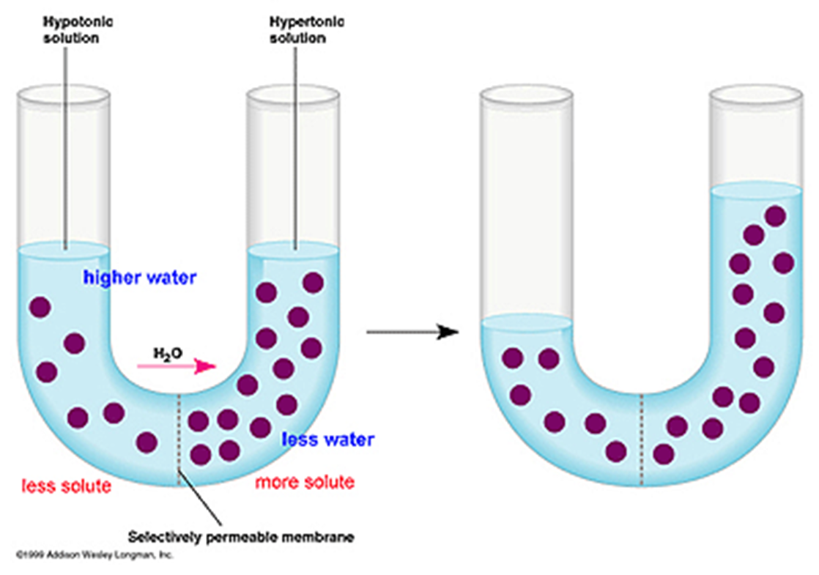
Why Is tonicity important?
The difference in tonicity between two different solutions separated by a semi-permeable membrane determines the movement of water.
“Water move from low Concentration to high concentration”

Slide 29
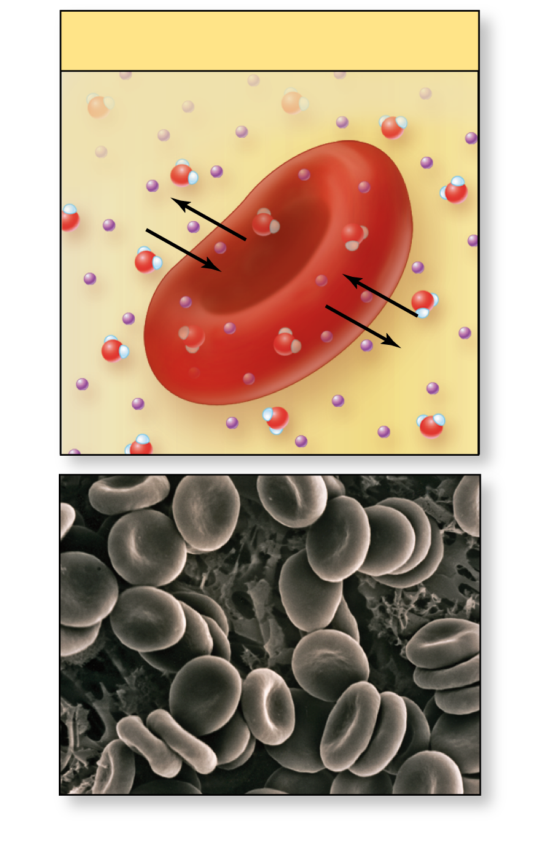
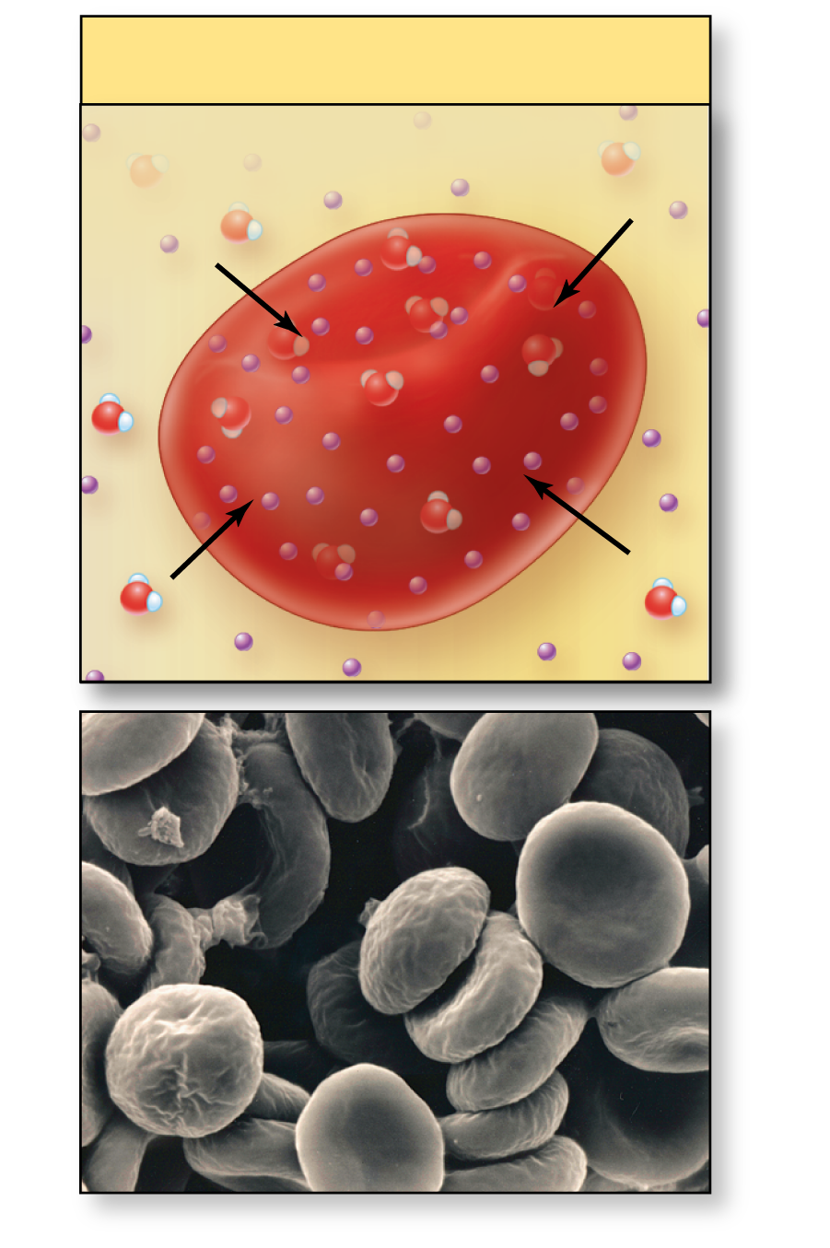
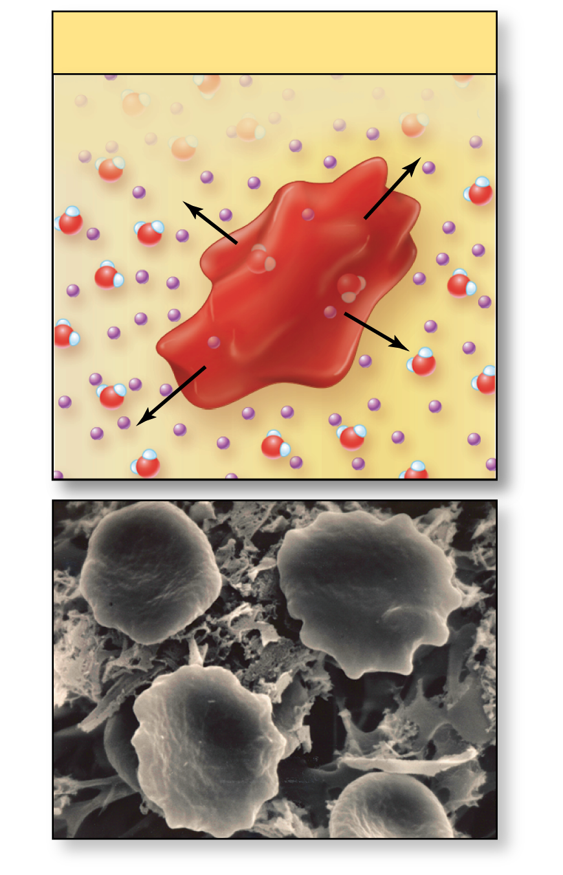
Tonicity
Isotonic:
Equal tension to plasma.
RBCs will not gain or lose H₂0.
Hypotonic:
Osmotically active solutes in a lower osmolality and osmotic pressure than plasma. RBC will hemolyse.
Hypertonic:
Osmotically active solutes in a higher osmolality and osmotic pressure than plasma. RBC will crenate.
Isotonic solution
Hypotonic solution
Hypertonic solution
Interstitial fluid is less
concentrated than cytosol.
Interstitial fluid is more
concentrated than cytosol.
Interstitial fluid is the same
concentration as cytosol.
No net
movement
of water.
Water
enters
cell.
Water
leaves
cell.
Erythrocyte
Erythrocyte
Erythrocyte
SEM 6900x
SEM 9030x
SEM 11,550x
Normal erythrocytes
Erythrocytes nearing hemolysis
Erythrocytes undergoing crenation
(a)
(b)
(c)
29

Slide 30
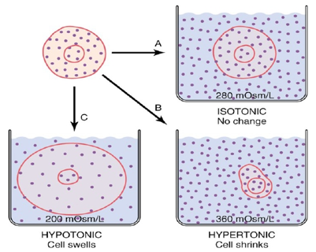
How does it apply to physiology?
How is it related to patient care?
The cell membrane is a semi-permeable membrane (Allows only water to move freely across it)
1. Physicians administer fluids to patients for various reasons that may change the osmolarity of ECF.
2. Abnormalities in electrolytes can change the osmolarity of ECF and can affect the cells
a. Hypernatremia
(↑ Na conc. In ECF)
Hyponatremia
(↓ Na conc. In ECF)
• There are many types of IV fluids with different tonicities.
Some factors can cause the change:
- dehydration
- intravenous infusion (IV)
- abnormal sweating.
- etc..

Slide 31


Clinical Manifestations of Hypo- &
Hypernatremia
Hyponatremia
• ↓↓ Plasma [Na+] →
↓↓ECF osmolarity
causing cells to swell.
• Brain cell edema leads to
neurologic symptoms;
– Headache.
– Nausea.
– Lethargy & disorientation.
• [Na+] < 115-120mmol/L
→ seizures, coma,
permanent brain damage
& death.
Hypernatremia
• ↑↑ Plasma [Na+] → ↑↑
ECF osmolarity causing
cells to shrink.

Slide 32
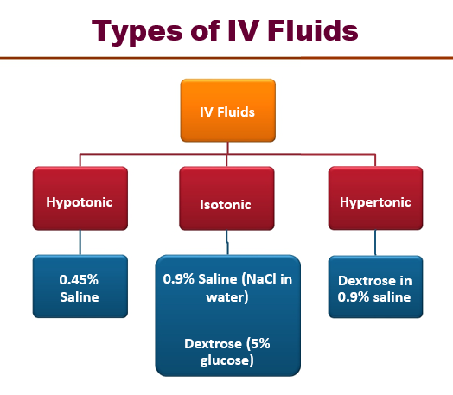

Slide 33
Changes in volume
سلايد كاملة من الأولاد محاضرة homeostasis 2
        Volume contraction
        (Removing):
1- isotonic solution.
e.g. Diarrhea
osmolarity of fluid lost ≈ osmolarity of ECF
(loss of isosmotic fluid)
        volume in ECF.
        arterial pressure
2- hypertonic solution.
e.g. Water deprivation
Osmolarity and volume will change .
Osmolarity in both ECF and ICF.
Volume in both ECF and ICF.
3- hypotonic solution.
e.g. Adrenal insufficiency
i.e. Aldosterone deficiency.
        Volume expansion
        (Adding):
1- isotonic solution.
e.g. Infusion of isotonic NaCl.
in ECF volume.
No change in osmolarity.
(Isomotic expansion)
2- hypertonic solution.
e.g. High NaCl intake
eating salt.
osmolarity in both.
volume of ICF .
volume of ECF .
(hyperosmotic volume expansion).
3- hypotonic solution.
e.g. Syndrome of inappropriate antidiurtic hormone (SIADH)
volume
osmolarity
Na⁺ in the ECF.
osmolarity in both .
in ECF volume.
in ICF volume.

Slide 34
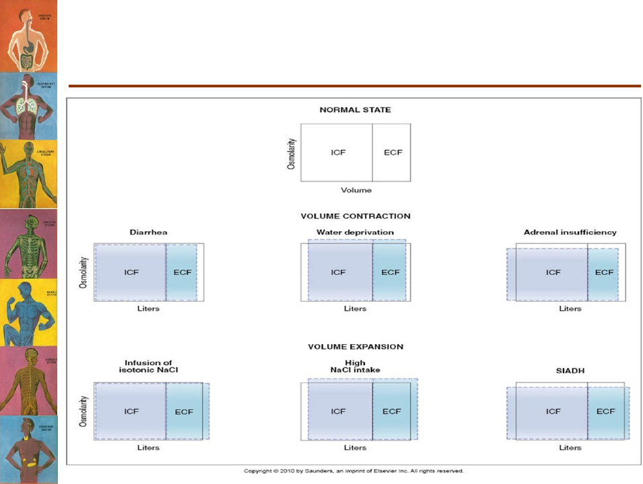
What happens to body fluid compartments in
different clinical situations?

Slide 35
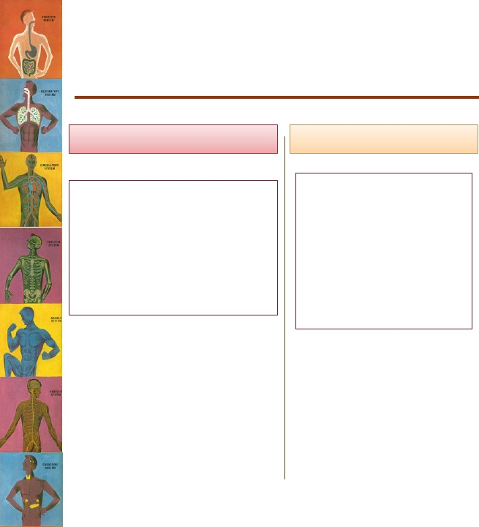

What happens to the different
compartments with the administration
of IV fluids?
Adding hypertonic solution
Adding isotonic solution
Adding hypotonic solution
• ↑ ECF osmolarity
• Water moves out of
cells into ECF.
• ICF volume decreases.
• ECF volume increases.
•↑ ICF osmolarity
• ↓ ECF osmolarity
• Water moves from ECF
into ICF.
• ICF volume increases.
• ECF volume increase.
•↓ ICF osmolarity
cc
cc
• No change in ECF
osmolarity.
• No osmosis occurs
through cell membrane.
• ECF volume increases.

Slide 36
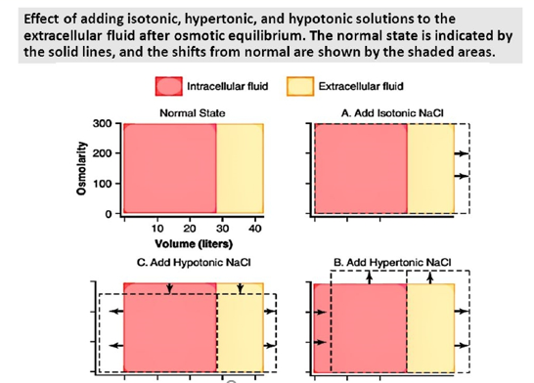
What happens to the different compartments with the administration of IV fluids?
1- the concentration of salt decreases so the vertical axis (osmolarity) will decrease
2- The ECF will move to the ICF and that’s why the cell swelled
1-The concentration of salt will increase , that’s why vertical axis (osmolarity) will increase
2- the ICF will move outside to ECF that’s why the cell shrinks

Slide 37
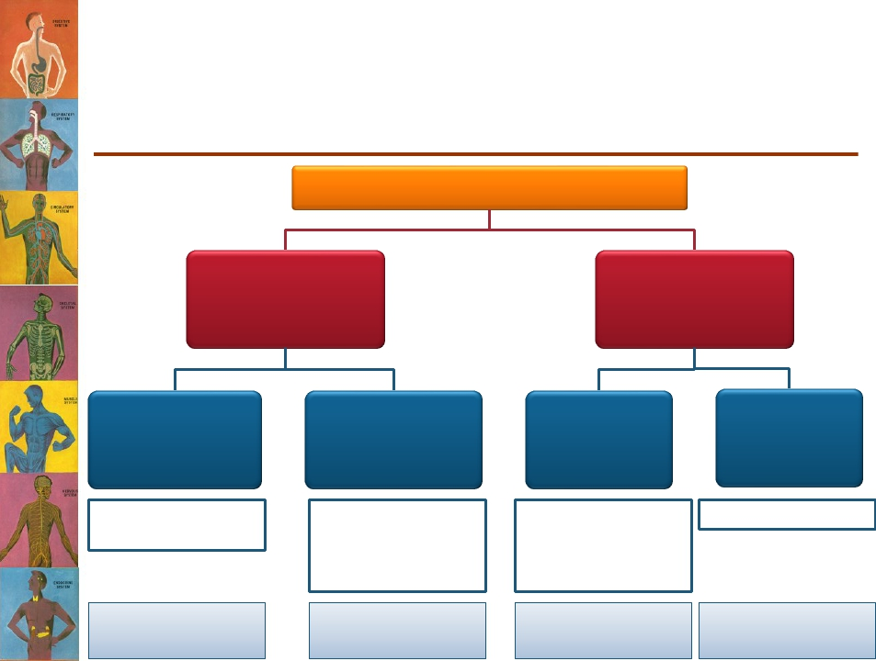
Clinical abnormalities of fluid volume
regulation hypo- & hypernatremia
Plasma Na+ concentration
↑ [Na+]
“Hypernatremia”
↓ [Na+]
“Hyponatremia”
Excess Na+ in
ECF
Excess aldosterone
hormone
Hypernatremia +
overhydration
Loss of water
from ECF
ADH deficiency
Water intake less than
water loss (excessive
sweating)
Hypernatremia +
dehydration
Loss of Na+
from ECF
Decreasealdosterone
secretion
Overuse of diuretics
Vomiting & diarrhea
Hyponatremia +
dehydration
Excess
water in ECF
Excess ADH (SIADH)
Hyponatremia +
overhydration

Slide 38
Regulation of fluids and electrolytes:
Homeostatic mechanisms respond to changes in ECF
No receptors directly monitor fluid or electrolyte balance
  Respond to changes in plasma volume or osmotic concentrations.
  All water moves passively in response to osmotic gradients.
  Body content of water or electrolytes rises if intake exceeds outflow.
Primary regulatory hormones:
Antidiuretic hormone (ADH):
  Stimulates water conservation and the thirst center.
  Regulates the concentration of body fluid.
Aldosterone:
  Controls Na⁺ absorption and K⁺ loss by kidney.
  Regulates the volume of body fluid compartment .
Natriuretic peptides:
  Reduce thirst and block the release of ADH and aldosterone .
38

Slide 39
Sodium balance:
Potassium balance:
Rate of sodium uptake across digestive tract directly proportional to dietary intake
Sodium losses occur through urine and perspiration
Shifts in sodium balance result in expansion or contraction of ECF
Large variations corrected by homeostatic mechanisms
    Too low, ADH / aldosterone secreted
    Too high, ANP secreted
Potassium ion concentrations in ECF are low
Not as closely regulated as sodium
Potassium ion excretion increases as
    ECF concentrations rise
    Aldosterone secreted
    pH rises
    Potassium retention occurs when pH falls

Slide 40
Calcium balance
Magnesium balance
Bone reserves, absorption in the digestive tract, and loss at kidneys
Absorbed by the PCT to keep pace with urinary losses
Phosphate balance
Chloride balance
Absorbed by the PCT in response to calcitriol
Absorbed at digestive tract to balance losses in urine and sweat

Slide 41
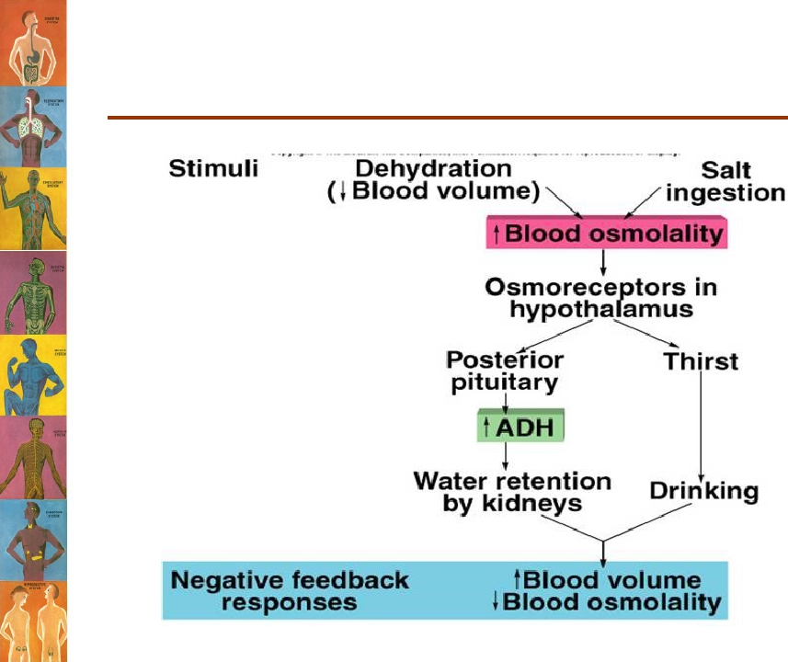
What are the feedback mechanisms
operating in fluid balance control?

Slide 42
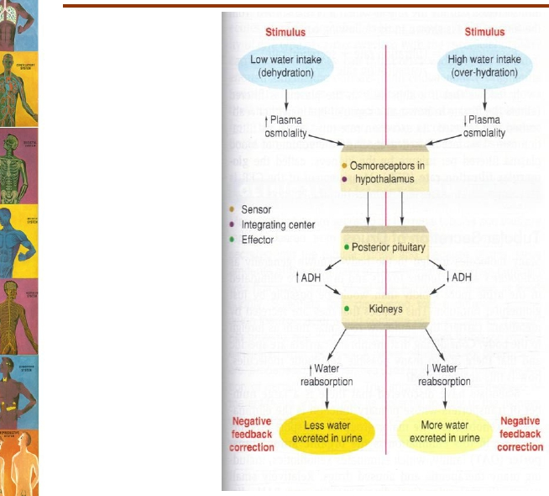
Feedback Mechanisms
Controlling Fluid Balance

Slide 43
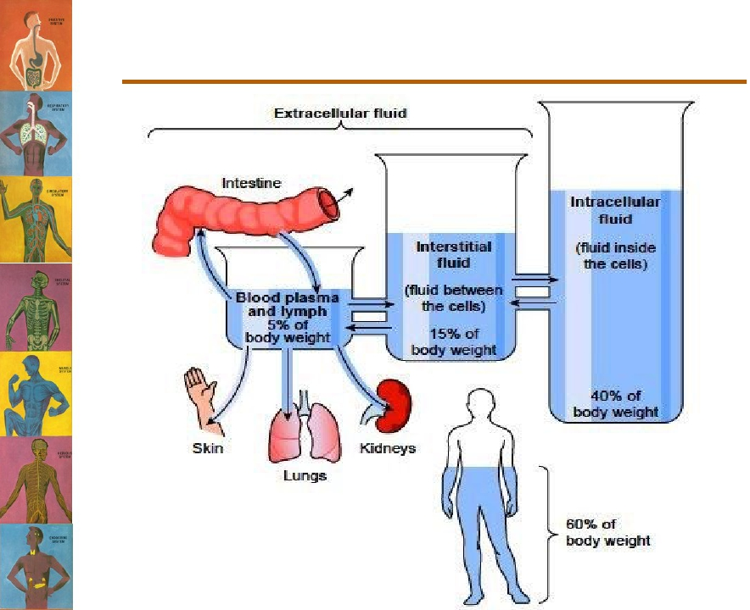
In summary

Slide 44
Water distribution in the body
An exercise
• After learning about water content of the human body
, a 60kg medical student was curious to calculate her
own body water content. What would you expect the
Total volume of her body water to be?
• And what is the volume of the following compartments?
36 L
26 L
-ICF
-ECF
-IF
-Plasma
12 L
9 L
3 L

Slide 45
Chick your understanding !
1- Calculate the total body water content of a 30 year old 60kg man ?
a/ 40 L b/ 25 L c/36 L d/ 33 L
2- ECFs are constantly mixing and have the same composition except for proteins T/F
3- Which of the following isn’t physiological factors?
a/ blood lose b/age c/sex d/body fat

Slide 46
4-Which of the following is incorrect:
(by adding isotonic solution)
a/ No change in ECF Osmolarity.
b/ECF volume increases.
c/ Osmolarity of ECF increase.
5-The Osmolarity describe the concentration of two solution
T/F
6- Intracellular compartment represent 33% of the total
body water, about 20 % of total body weight
T/F

Slide 47
Answers / 1-c , 2-T , 3-a , 4-c , 5-F , 6- F

Slide 48

Thank you & good luck
Boys team members:
هشام الشايع
سعود الاحمري
عبدالرحمن آل الشيخ
فايز الدرسوني
محمد الحسن
محمد الصويغ
محمد المنجومي
معاذ الحمود
منصور العبرة
احمد الصبي
خالد العقيلي
عبدالجبار اليماني
عمر الفوزان
Girls team members:
مها العمري
هديل عورتاني
ريما العنزي
روتانا خطيب
لجين عزيز الرحمن
العنود المفرج
ريم القرني
عهد القرين
العنود المنصور
مها النهدي
بلقيس الراجحي
سارة البليهد
ميعاد النفيعي
نورة البسام
عبير العبدالجبار
وجدان الشامري
الجوهرة الشنيفي
Team Leaders:
-مها بركة - طارق العميم

