Slide 1



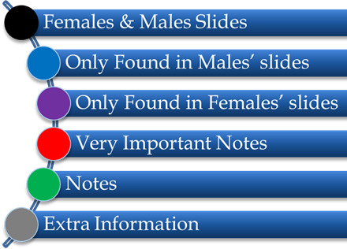

PHYSIOLOGY

Slide 2
Edema
وهي الجزء الثاني من محاضرة الأولاد homeostasis 2
Objectives:
Define Edema and describe its different types.
Discuss and describe the Starling forces governing fluid exchange across capillary walls.
Link changes of hydrostatic and osmotic pressure to the pathogenesis of edema.

Slide 3
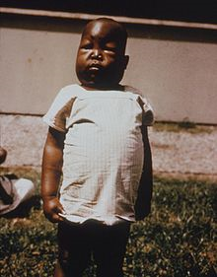
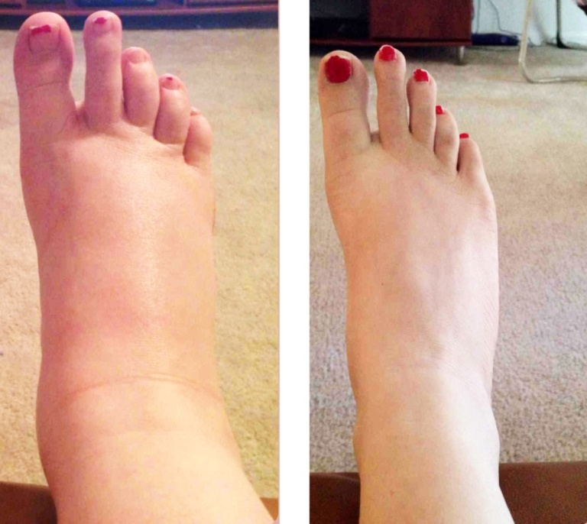
Edema
Edema = Swelling
It is the presence of abnormally large amounts of fluid in the intercellular tissue spaces of the body.
It is excessive accumulation of fluid in the tissues.

Slide 4
Types of Edema
Edema occurs mainly in ECF compartment, but it can involve the ICF compartment as well.
Edema
Intracellular
Extracellular
Due to intracellular swelling.
Caused by:
Hyponatremia.
Depressed metabolism
Lack of nutrition to the cells.
Inflammation.
More common clinically
Due to abnormal accumulation of fluid in the extracellular space.
(I.e. interstitial space )
Can be caused by many conditions.
A common clinical cause is excessive capillary fluid filtration

Slide 5
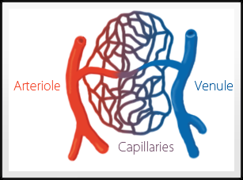
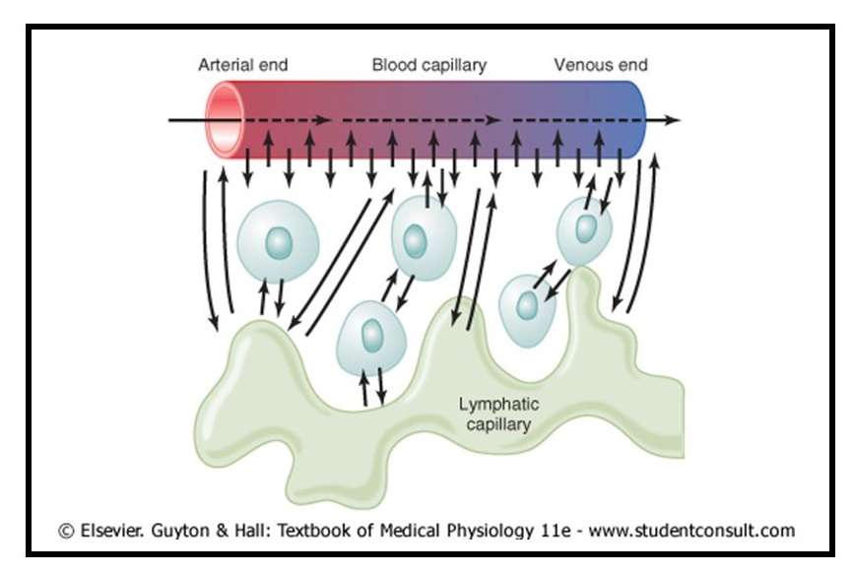
Fluid Exchange Between Blood & Interstitial Fluid
. Normally, fluid is constantly moving in & out of the interstitial space to allow ECF to distribute between plasma and IF.
. This process happens without fluid accumulating between the cells.
. Fluid exchange between blood and tissue cells occurs at the level of the capillaries.
. The capillaries are the smallest blood vessels in our vascular tree.
. These vessels are very small and have a very thin wall allowing easy exchange of fluid across the walls.

Slide 6
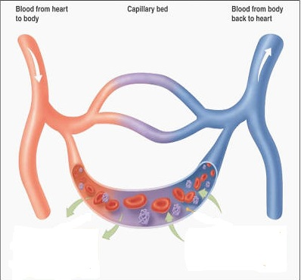
Fluid Filtration Across Capillaries
Excessive capillary fluid filtration is a common cause for Extracellular Edema.
The rate of diffusion through the capillary membrane is proportional to the concentration difference of the substance between two sides of the membrane, for example: Oxygen in the capillary is greater than in the ISF, but CO2 is greater in the ISF than in the capillary-so the excess CO2 will move into blood and the O2 will move into ISF
As blood passes through capillaries…
Substances are primarily transferred between the plasma and the interstitial fluid by diffusion
Water-soluble substances and some proteins pass through capillary membrane through capillary pores
Fluid filters from plasma to interstitium
Fluid is reabsorbed from interstitium into plasma

Slide 7
Factors controlling fluid filtration across capillary walls
Movement of fluids across capillary walls depends on the balance of starling forces acting across the capillary walls.
Starling forces
Forces that control the movement of fluid in/out of the capillary
Hydrostatic pressure P
Colloid osmotic(oncotic) pressureπ
The pressure exerted by blood (water) on the walls of the blood vessel.
The osmotic pressure created by the non-diffusible plasma proteins
inside the blood vessel.
(especially albumin)
Pushes fluid OUTSIDE
Pulls fluid INSIDE

Slide 8
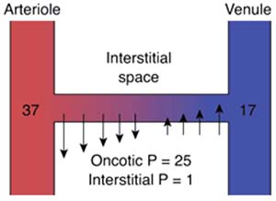
Starling forces acting across capillary membrane
Starling's equation: states that the rate of leakage of fluid is determined by the difference between two forces and also by
the permeability of the vessel wall to water, which determines the rate of flow for a given force imbalance.
Net Filteration Pressure= Pc-Pif-ㅠp-ㅠif

Slide 9
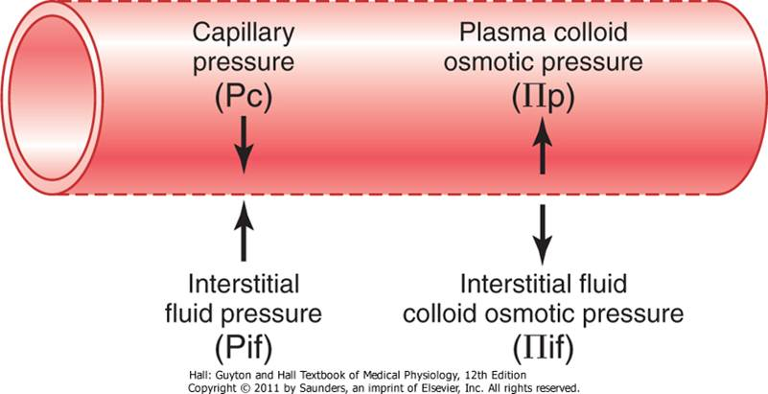
Starling forces acting across capillary membrane
Pif=lower than atm (so is negative) causing a light suction in tissues that helps hold tissues together
Four primary forces determine whether fluid moves in or out of blood “Starling forces”:
capillary “hydrostatic “ pressure out of blood.
IF “hydrostatic” pressure into blood.
. Plasma “colloid osmotic “ pressure into blood
IF “colloid osmotic “ pressure out of blood.
Arteriolar end: Hydrostatic pressure > Oncotic pressure⇒ Fluid passes into interstitium
Venule end: Oncotic pressure > Hydrostatic pressure⇒ Fluid returns capillary bed

Slide 10
Colloid osmotic pressure (oncotic)(πp) Formed by plasma proteins (especially albumin) It tries to keep the fluid in the capillary | Hydrostatic pressure (Pc) It forces the blood fluid pass into the tissues through the capillary wall.
25mmHg | Arterial end =37 mmHg
28mmHg | Venous end =17 mmHg
Colloid osmotic pressure (oncotic)(πIf) | Arterial end = 30 mmHg
8 mmHg | Venous end = 10 mmHg (usually 15-25 mmHg less than arterial end)
*IF hydrostatic pressure (PIf) is usually subatmospheric in loose connective tissue (~ - 3 mmHg)
The increase of pressure at the venule end ⇒Fluid cannot return capillary and stay at the interstitium.
*Negative charge means sucking or absorption
Pc+πif-Pif-πc=
قد تكون قيمة Pif موجبة حسب المعطى

Slide 11
Edema
هذي السلايد من عند البنات
Increase capillary filtration
Decrease lymph uptake
Increased capillary pressure
  Kidney failure
  Heart failure.
  Venous obstruction
Decreased plasma oncotic pressure
  Loss of proteins (nephrotic syndrome, burns).
  Inability to synthesize proteins (liver failure, malnutrition).
Increased capillary permeability
  Inflammation
  Infection.
  Immune reactions.
Lymphatic obstruction
  Infection (filaria).
  Surgery.
  Congenital absence.
  Cancer.

Slide 12
Oncotic pressure:
هذي السلايد من عند الأولاد
Plasma protin content > İnterstitial protein content →
Plasma oncotic pressure > ınterstitial oncotic pressre
Effective oncotic pressure = Plasma oncotic pressure – Interstitium oncotic pressure
Effective oncotic pressure DECREASES:
- As the decreasing of plasma oncotic pressure ( cirrhosis, malnutrition, nephrotic syndrome)
- As the increasing of interstitium oncotic pressure (Increasing of permeability – inflamatory / allergy)

Slide 13
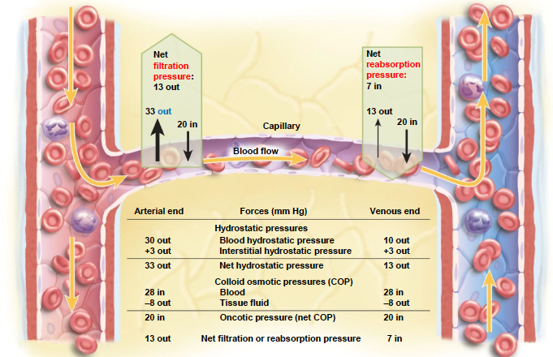
Forces that determine fluid movement through capillary membrane

Slide 14
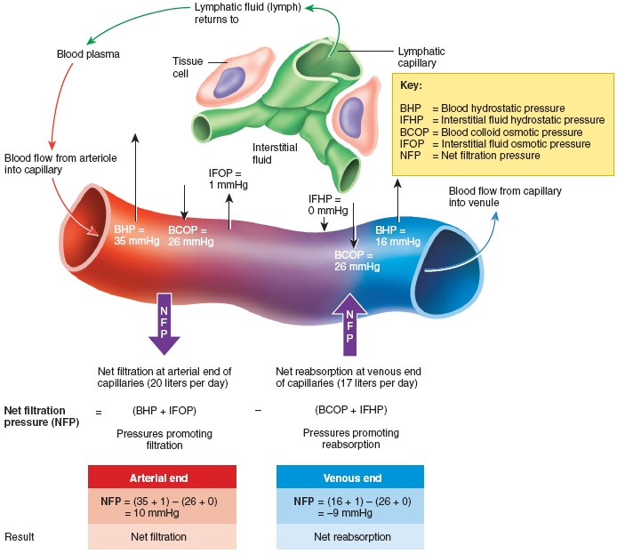
The lymphatic system
The reabsorption pressure causes 9/10 of the filtered fluid to be reabsorbed while 1/10th remains in the interstitial fluid.
The lymphatic cells return the 1/10th of the remaining fluid to the blood vessel.
The total quantity of lymph ≈ 2-3L/day
Lymphatic System plays key role in:
Controlling concentration of proteins in interstitial fluids
the volume of interstitial fluid
the interstitial fluid pressure

Slide 15
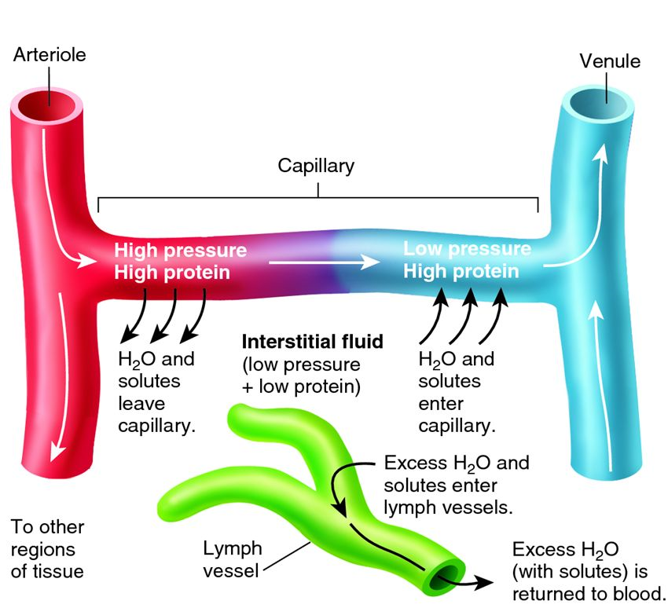
summary

Slide 16
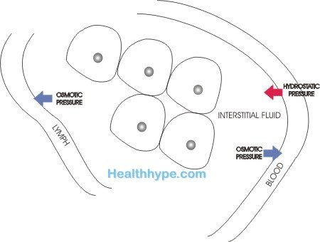
Edama
excessive accumulation of fluid in the EC fluid
Two main reasons
  Failure of lymphatic uptake.
  Abnormal leakage of fluid from plasma to interstitial space.
Capillary filtration= Kf(coefficient of capillary filtration) x NFP (net filtration pressure slide 7) so:
increased Kf
Increased Pc
Decreased ㅠp
can cause ↑ capillary filtration rate which is the most common clinical cause of IF accumulation
↓↓ uptake
Edema
↑↑ filtration

Slide 17
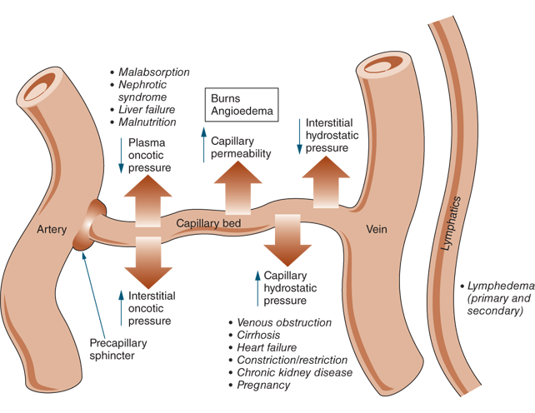

Slide 18
Intracellular Edema:
inflammation of tissues.
membrane permeability.
Na inside cells.
water
edema

Slide 21
Quiz :
True or False
The lack of nutrition to the cells can cause Extracellular Edema. ( True / False )
Fluid is reabsorbed from plasma to interstitium
( True / False )
(3) Increased capillary pressure can lead to Kidney failure and heart failure. ( True / False )

Slide 22
MCQ:
Starling forces : are forces that control movement of fluid in / out of a :
Capillary (B) Vessels (C) Cell membrane
(2) Capillary with a “hydrostatic “ pressure moves fluid :
Out of blood (B) Into blood (C) Both A&B
(3) Edema occurs mainly in the……..Compartments but it can involve the……..Compartments as well.
EFC , IEF (B) ECF , ICF (C) ECF, IFC

Slide 23
Answers :
True and False
False (2) False (3) True
MCQ
A (2) A (3) B

Slide 24

Thank you & good luck
Boys team members:
هشام الشايع
محمد الحسن
محمد الصويغ
محمد المنجومي
معاذ الحمود
خالد العقيلي
عبدالجبار اليماني
عمر الفوزان
فهد الحسين
سعد الهداب
نواف اللويمي
انس السيف
سيف المشاري
سعود العطوي
نايف المطيري
عبدالرحمن العقيلي
Girls team members:
مها العمري
هديل عورتاني
ريما العنزي
روتانا خطيب
لجين عزيز الرحمن
العنود المفرج
ريم القرني
عهد القرين
العنود المنصور
مها النهدي
بلقيس الراجحي
سارة البليهد
ميعاد النفيعي
نورة البسام
عبير العبدالجبار
وجدان الشامري
الجوهرة الشنيفي
Team Leaders:
-مها بركة - طـارق الـعـميم

