Slide 1
Extra Information
Only Found in Males’ slides
Only Found in Females’ slides
Females & Males Slides
Vary Important Notes
Notes
PHYSIOLOGY

Slide 2
Blood physiology (1,2) –female- Erythropoiesis Composition and Functions of the Blood control of Erythropoiesis Iron Metabolism and Haemoglobin -male-

Slide 3
Objectives”female”:
Blood physiology (1)
-Describe Cellular and non-cellular components of blood.
-Recognize functions of blood.
-Define Erythropoiesis; leucopoiesis, thrombopoiesis.
-Recognize sites of RBC formation at different developmental age.
-Describe different stages of RBC differenation.
-Describe features of RBC maturation.
-Describe regulation of RBC production and erythropoietin hormone secretion in response to hypoxia.
-Recognize clinical conditions associated with high level of erythropoitein in the blood.

Slide 4
Objectives”male”:
Erythropoiesis
-Define erythropoiesis, leucopoiesis, and thrombopoiesis
-List the sites (areas) of the body that produce red blood cells
-Describe the steps involved in erythropoiesis from differentiation of stem cell to progenitor cell to final RBC
-Outline the features of RBC maturation
-Summarize the synthesis of Hemoglobin
-Recognize hemoglobin structure and its functions
-Describe the life cycle of normal RBCs

Slide 5
Objectives”female”:
Blood physiology (2)
Describe essential elements needed for RBC formation.
Describe the process of Vit B12 absorption and its malabsorption.
Recognize haemaglobin structure and its functions.
Discuss iron metabolism ( absorption , storage , transport ).
Describe the fate of old RBC.
Describe anemia and its causes.
Recognize causes of polycythemia.

Slide 6
Objectives”male”:
Composition and Functions of the Blood
- List the functions of the blood
- Describe the physical characteristics of blood
- Discuss the composition of the blood
- Differentiate between the terms formed elements, Packed Cell Volume, plasma and serum
- Outline the functions of the plasma proteins
- Describe the shape of mature red blood cells and explain the advantages of this shape
- Explain what maintains the shape of the normal red blood cell and outline the pathogenesis of
hereditary spherocytosis
- Summarize the functions of red blood cells
- Describe the different hematological indices and indicate their physiological significance

Slide 7
Objectives”male”:
control of Erythropoiesis Iron Metabolism and Haemoglobin
-Discuss regulation of erythropoiesis
-Describe the factors required for normal erythropoiesis and the role of erythropoietin in erythropoiesis
-Recognize clinical conditions associated with high level of erythropoietin in the blood
-Summarize the synthesis of Hemoglobin
-Recognize hemoglobin structure and its functions
-Describe metabolism of iron and vitamin B12
-Define anemia
-Classify anemia and explain its assessment
-Describe the physiological consequences and clinical picture of anemia
-Define polycythemia
-Classify polycythemia
-Describe the physiological consequences of polycythemia

Slide 8
Physical Characteristics of Blood
volume | - Blood makes up 7-9% of body weight Blood volume is 5 to 6 liters in adult males , 4 to 5 liters in adult females 45% is packed cells volume (PCV). 55% is plasma volume.
Viscosity (thickness and stickiness of blood) | - Blood is thicker (more viscous) than water and flows more slowly than water - Plasma at 37°C is about 1.8-times more viscous than water; therefore, the relative viscosity of plasma (compared to water) is about 1.8 - Whole blood viscosity (relative to water) = 4.5-5.5
PH | - Slightly alkaline: 7.4 - Ranges from 7.35 to 7.45
color | - Bright red = O₂ rich - Dull red = O₂ poor
Osmolarity | - Plasma osmolarity is about 300 mOsmol/L - Plasma osmolarity is equal to the osmolarity of Normal Saline = 0.9% NaCl Solution. Hence, Normal Saline is an Isotonic solution
Male slide

Slide 9
Physical Characteristics of Blood
Osmotic Pressure: is the pressure necessary to prevent net movement of water (in osmosis)
In other words, osmotic pressure is the pressure developed by solutes dissolved in water working across a selectively permeable membrane.
At normal plasma osmolarity of about 300 mOsmol/L,
plasma osmotic pressure is about 5540 mmHg.
Plasma Osmotic Pressure :
Crystalloid osmotic pressure:
is the pressure generated by all crystal substances, particularly electrolytes (mainly NaCl).
This pressure modulates water distribution between inside and outside of cells
it is important in maintaining fluid balance across cell membranes.
Colloid osmotic pressure:
is the pressure generated by plasma proteins, particularly albumin.
This pressure modulates water distribution between inside and outside of blood capillaries.
it is important in fluid transfer across capillaries. It is normally about 25 mmHg, which represents about 0.5% of the total plasma osmotic pressure.
Male slide

Slide 10
Functions of Blood
Blood transports:
Blood maintains:
Blood prevents blood loss by:
Oxygen from the lungs and nutrients from the digestive tract
Hormones from endocrine glands to target organs
Metabolic wastes from cells to the lungs and kidneys for elimination
Blood prevents infection by:
adequate fluid volume in the circulatory system
Appropriate body temperature by absorbing and distributing heat
Normal pH in body tissues using buffer systems
Initiating clot formation when a vessel is broken
Activating plasma proteins and platelets
Activating WBCs to defend the body against foreign invaders
Synthesizing and utilizing antibodies
Activating complement proteins

Slide 11
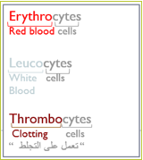
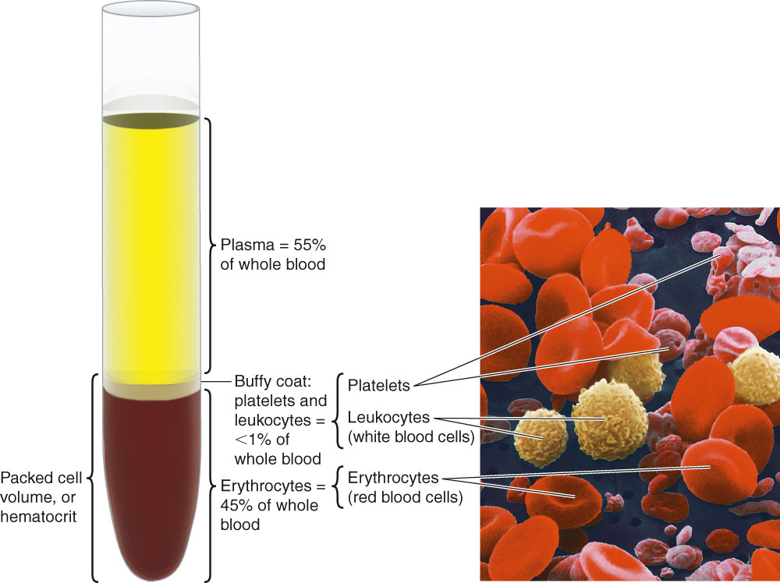
Blood Composition
Cellular components 45% :
Red Blood Cells 99% (Erythrocytes)
White Blood Cells < 1% (Leucocytes)
Platelets (Thrombocytes)
Plasma makes up 55% of blood volume :
98% water + ions + plasma proteins e.g.
(Albumin, globulin, Fibrinogen)
Same ionic composition as interstitial fluid.
NOTE: red blood cells are in millions
• Platelets are hundred thousands
• white blood cells are in thousands.
WBC (leucocytes)
Granular
Agranular
Neutrophls
Eosinophils
basophils
Lymphocytes
T cells
B cells
Will be in detail in WBC lecture

Slide 12
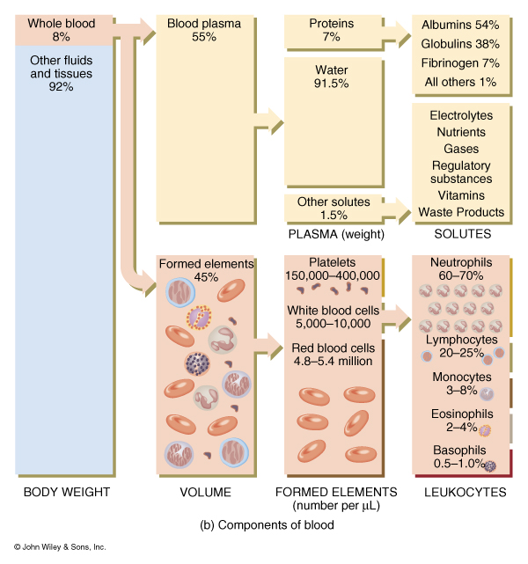
صورة من سلايدات الأولاد أحس للاطلاع
=) بس كيفكم إذا بتحفظونها

Slide 13
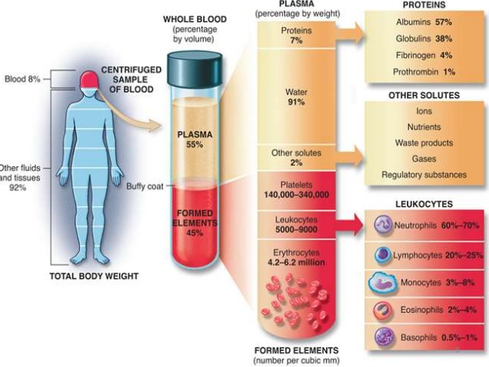
Composition of Blood
صورة من سلايدات الأولاد أحس للاطلاع
=) بس كيفكم إذا بتحفظونها

Slide 14
Blood Cells Formation
Erythropoiesis: Formation of RBC (erythrocytes)
granular leukocytes
A granular leukocytes
Thrombopoiesis: Formation of platelets (thrombocytes)
Leucopoiesis: Formation of WBC (leucocytes)
basophils
neutrophils
eosinophils
monocytes
lymphocytes = T cells, B cells

Slide 15
Formation of Blood Cells
Erythropoiesis
Formation of erythrocytes (RBC)
Leucopoiesis
Formation of leucocytes (WBC)
Thrombopiesis
Haematopoiesis
Formation of thrombocytes (platelets)
Formation of blood

Slide 16
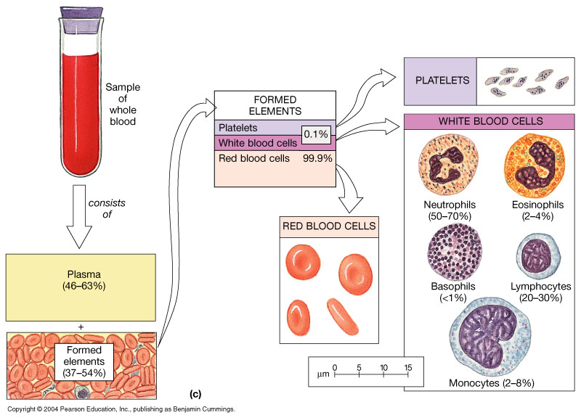

Slide 17
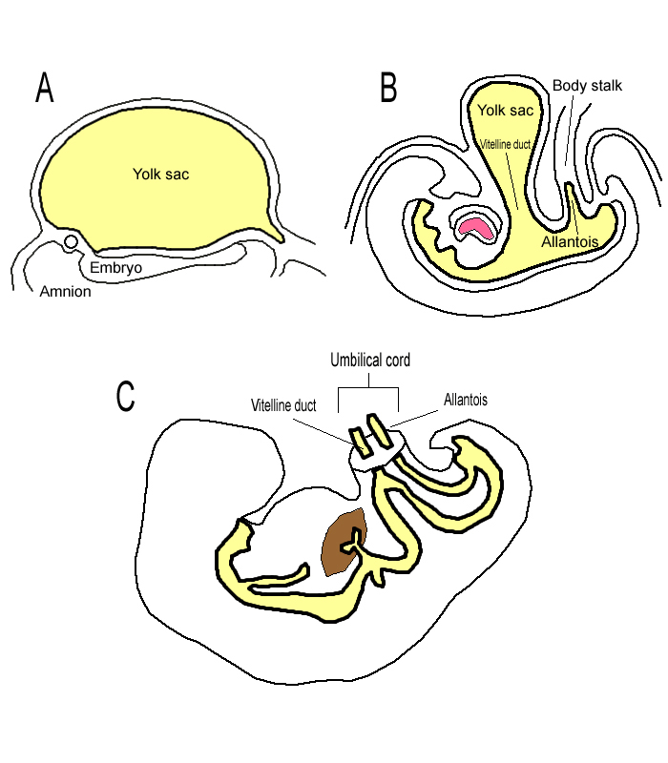
1st 8 weeks
2nd to 5th months
5th month and on
Female slide
هذي السلايد نفسها موجوده عند الأولاد بس بصيغه ثانيه وتحت مسمى
”location of erythropoiesis”

Slide 18
Location of Erythropoiesis
Male slide
embryonic development:
During the 1st 8 weeks of, RBCs are formed in yolk sac
During the 2nd to 5th months, RBCs are formed in liver (main supplier) and spleen
From the 5th month on, RBCs formed in bone marrow
After birth
and in adults, RBCs are formed in red bone marrow
Bone marrow of all bones produces red blood cells until a person is 5 years old.
Bone marrow of long bones, except for the proximal portions of the humeri and tibiae, becomes quite fatty and produces no more red blood cells after about age 20 years.
Beyond this age, most red cells continue to be produced in the marrow of the vertebrae, sternum and ribs.
Portions of: vertebrae, ribs, scapulae, skull, pelvis, proximal heads of femur and humerus
Yellow marrow of medullary cavities can be converted back into red marrow, if needed

Slide 19
Locations of Erythropoiesis
100
%
Yolk sac
Liver
Spleen
Bone Marrow
50
3
6
Birth
3
6
Month

Slide 20
Locations of Erythropoiesis

Slide 21
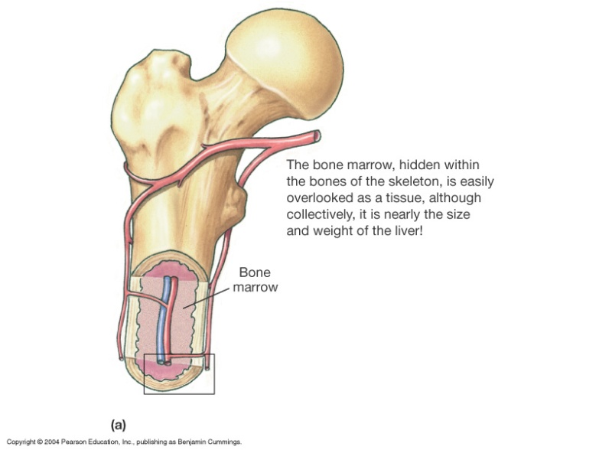
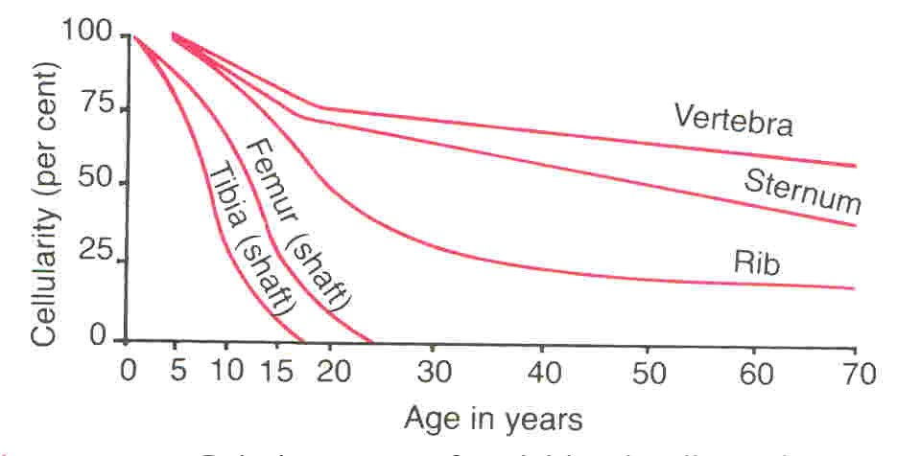
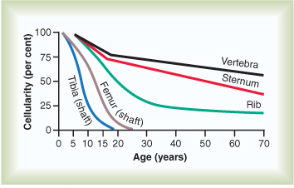
Production of RBC
“Children need RBC more than adults for their growth”

Slide 22
Red Blood Cells Shape & size
Flat biconcave disc
Non-nucleated
Flexible
Number = 4.7 – 5 x10⁶
Dimensions are about (7.5X2X1 µm)
Average volume is about 90-95 µm³
Hb - 14-16 g/dl in the blood
it doesn’t have nucleus, mitochondria, ribosomes, endoplasmic reticulum or golgi apparatus.
What does the cytoplasm contains?
Hemoglobin (protein that functions in gas transport)
Carbonic Anhydrase (enzyme)
Other enzymes responsible for glucose metabolism and 2,3 DPG synthesis
Glucose enters RBC by facilitated (carrier-mediated) diffusion.
Glycolysis accounts for 90% and HMP Shunt for 10% of glucose metabolism.
RBC : able of storage

Slide 23
Genesis (Production) of RBC
The Pluripotent hematopoietic stem cells (PHSC); hemocytoblast from which all the cells of the circulating blood are eventually derived.
(Committed Cells) is where all blood cells are formed from.
These PHSC are least differentiated and can develop into any blood cell.
They give rise to uncommitted stem cells that in turn give rise to committed stem cells; committed progenitor cells; progenitor cells (colony-forming units).
A committed stem cell that produces erythrocytes is called a colony-forming unit-erythrocyte (CFU-E).
CFUs form differentiation lines leading to RBCs, megakaryocytes and most WBCs.
Thus, the CFUs are specialized to form specific cell types.
For example: CFU-E develops eventually into only red blood cells
There are two separate committed cells for both RBC and WBC.
Growth factors are what controls the growth of the different stem cells.
* الكلام اللي بالأزرق موموجود بسلايدز البنات بس موجود بصوره حاطتها د. نيرفانا )السلايد الجاية (.

Slide 24
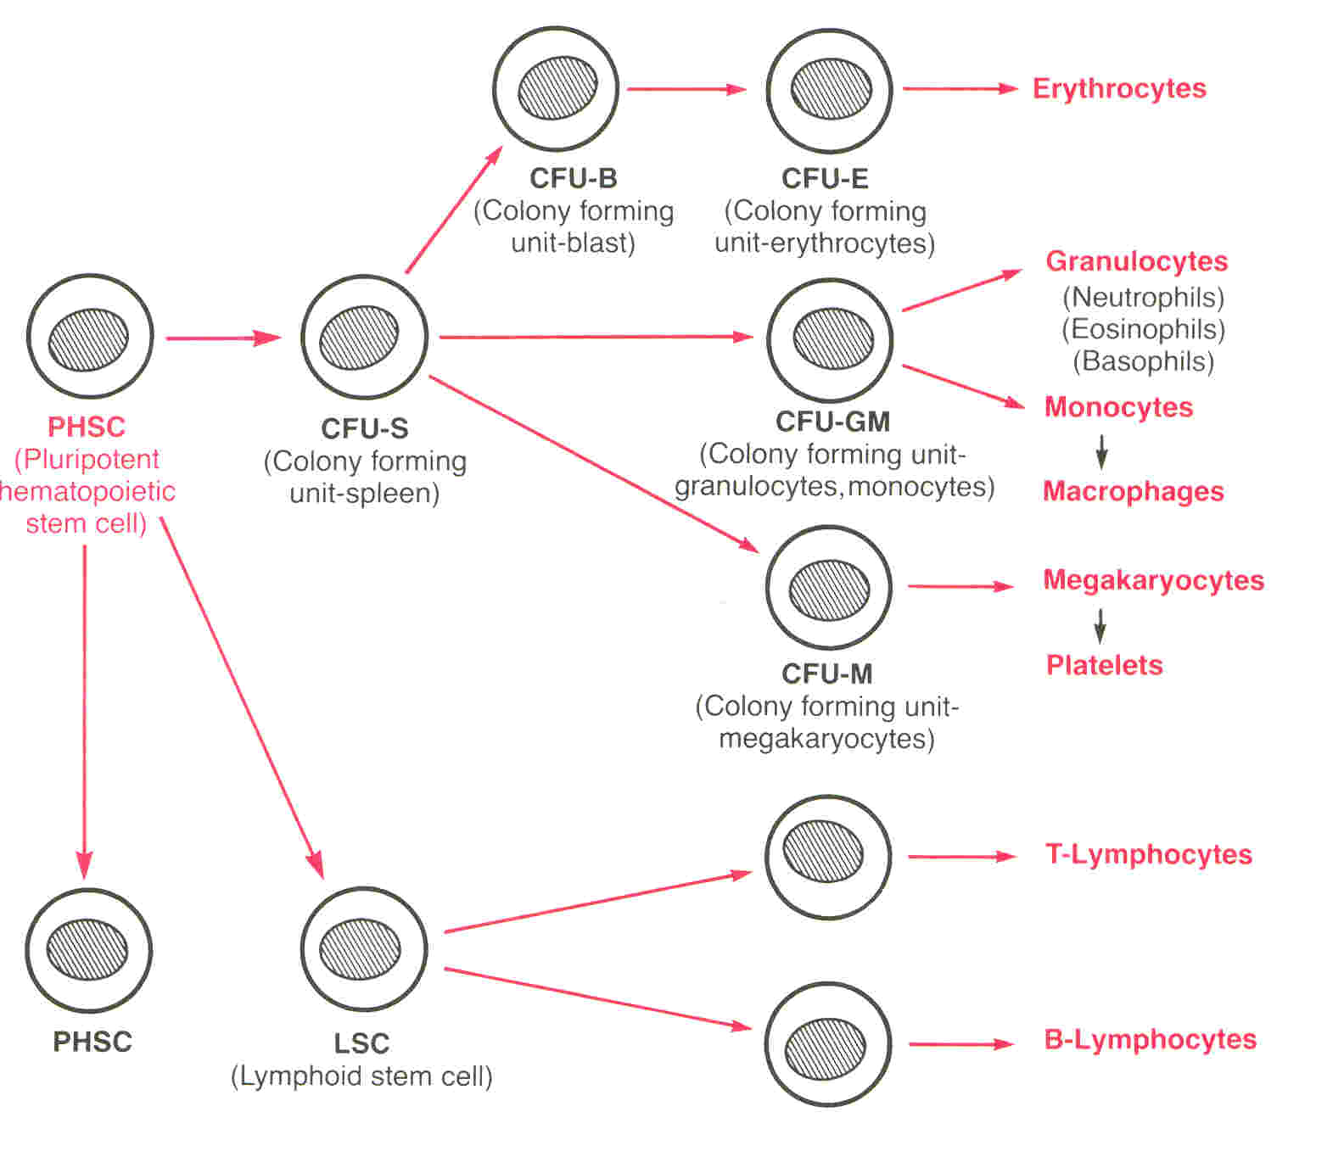
Genesis (production) of RBC
Female slide

Slide 25
Growth and reproduction of stem cells
Growth and reproduction of the different stem cells are controlled by multiple proteins called growth inducers. One of these, interleukin-3, promotes growth and reproduction of virtually all the different types of committed stem cells, whereas the others induce growth of only specific types of cells.
Differentiation of the cells is the function of another set of proteins called differentiation inducers. Each of these causes one type of committed stem cell to differentiate one or more steps toward a final adult blood cell.
Formation of the growth inducers and differentiation inducers is itself controlled by factors outside the bone marrow. For instance, in the case of erythrocytes (red blood cells), exposure of the blood to low oxygen for a long time results in growth induction, differentiation, and production of greatly increased numbers of erythrocytes.

Slide 26
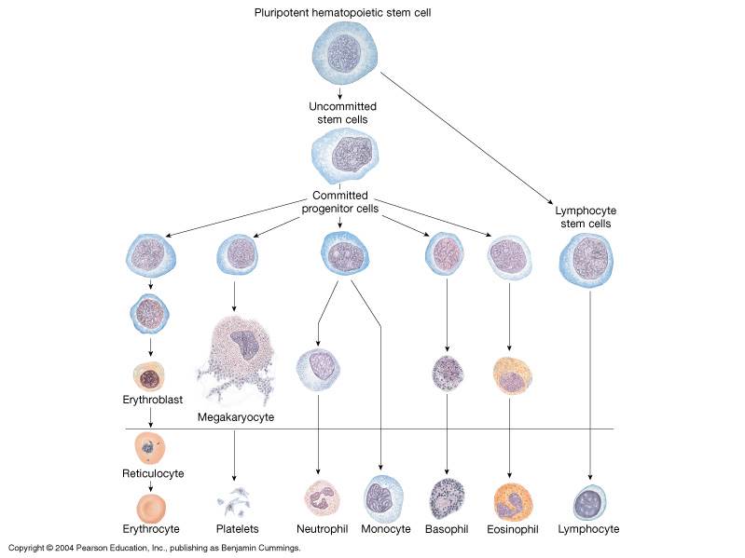
Required Growth factors:(growth inducers)
Erythropoietin
Colony stimulating factors
Interleukins
Thrombopoietin

Slide 27
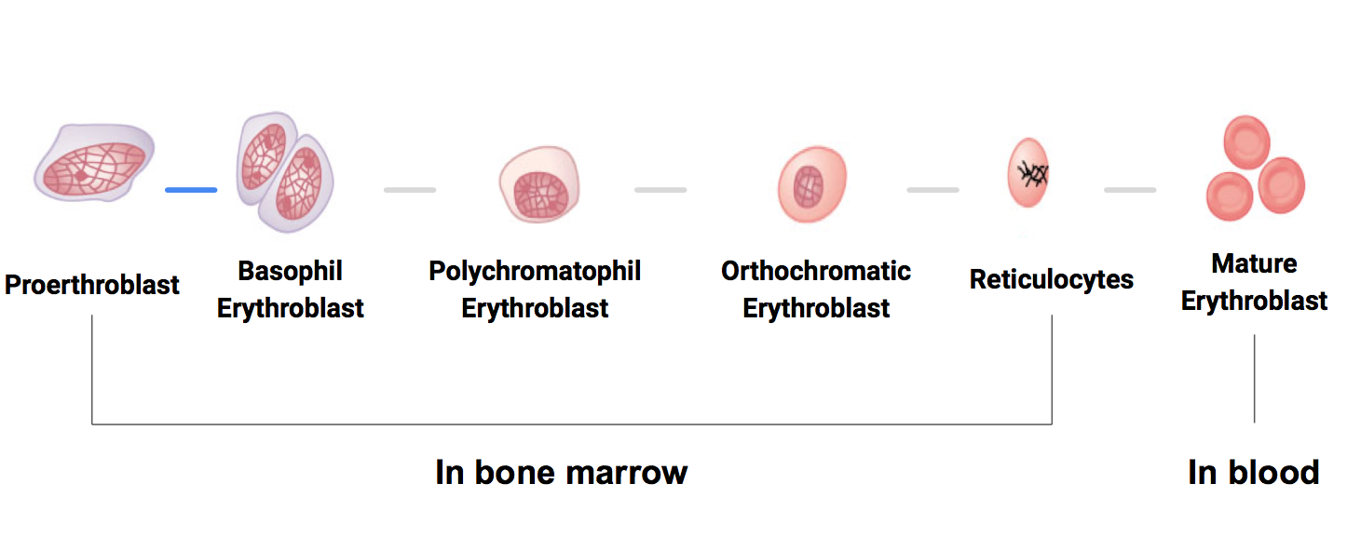
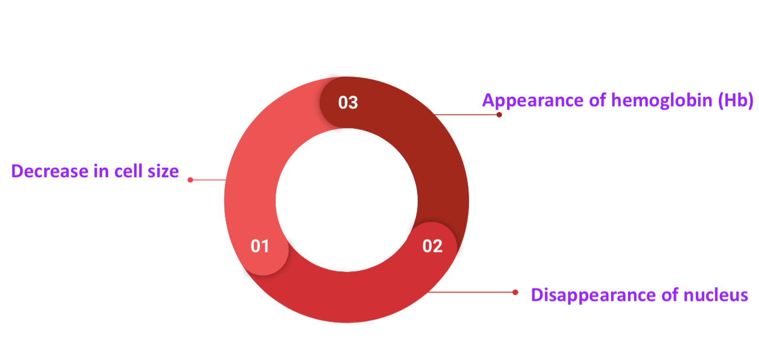
Stages of differentiation od RBC:
You have to know the stages
.د نيرفانا أكدت عليها
First Identifiable cell
First cell to appear in the circulation. It matures in 1 – 2 days
In cases of rapid RBC production → ↑ reticulocytes in the circulation.
RBC development is characterized by:

Slide 28
Stages of differentiation of RBC:
RBCs are formed from PHSC (hemocytoblasts).
These give rise to uncommitted stem cells, which in turn give rise to committed stem (progenitor) cells (CFU-E), which give rise to proerythroblasts.
The proerythroblasts are considered as differentiated RBC precursors.
They are the first cells that can be identified as belonging to the red blood cell series.
The proerythroblasts give rise to basophil erythroblasts
erythroblasts: synthesize Hb
normoblasts: lose nucleus , some mitochondria
Reticulocytes contain ribosomes and mitochondria (but no nucleus)
reticulocyte count: normally 0.8-2.0% of RBC population
In 1-2 days, reticulocytes eject the remaining organelles to become a mature RBC

Slide 29
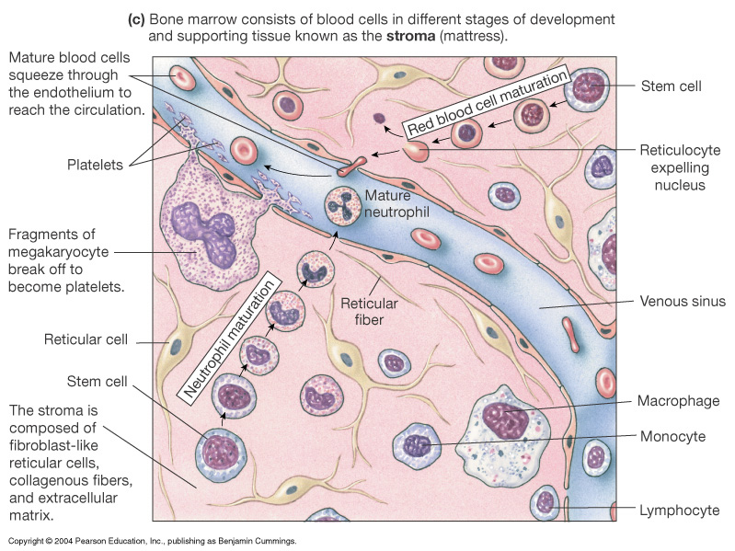
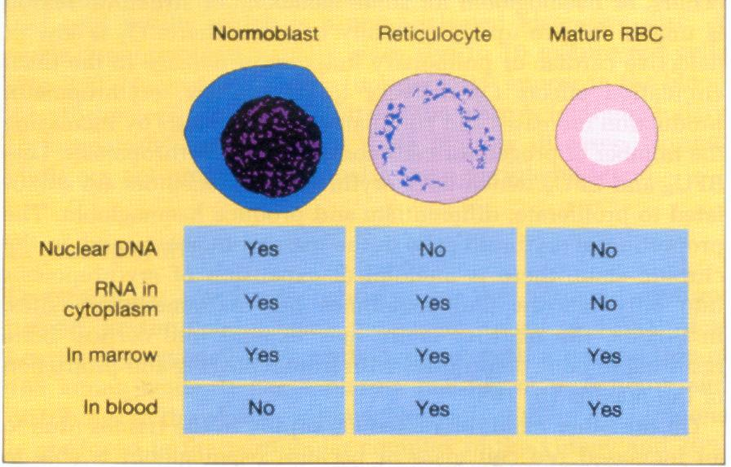
Stages of Erythropoiesis

Slide 30
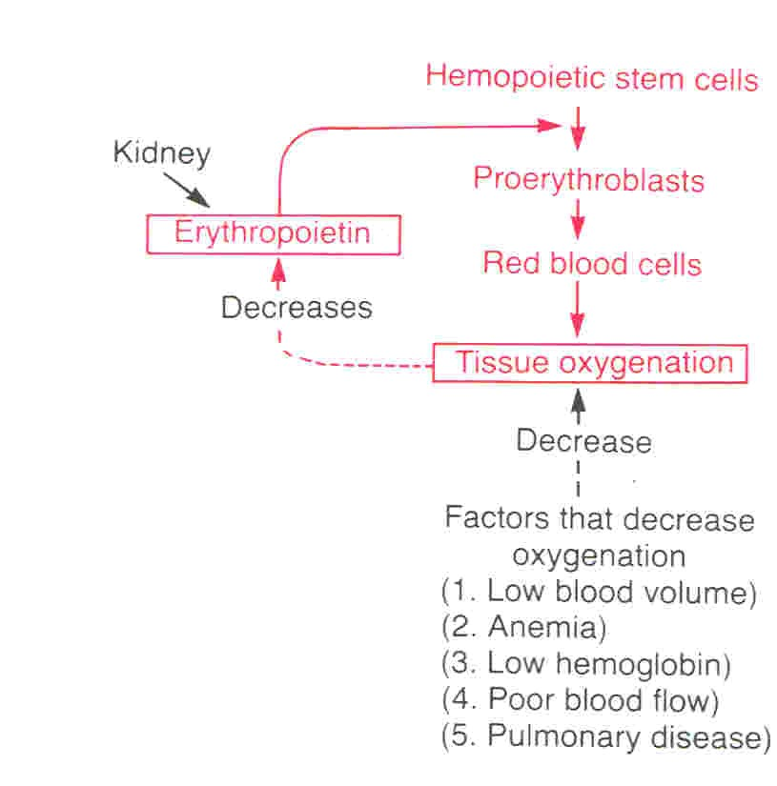
Erythropoietin
Feedback Control of Erythropoiesis
When hypoxia ( low oxygen in blood) occurs the kidney response by producing a hormone called Erythropoietin which stimulate Erythropoiesis
Erythropoiesis is stimulated by erythropoietin
Erythropoietin is a glycoprotein, which is synthesized from renal cortex (kidney) (90%) and the liver (10%)
Stimulate the growth og early stem cells
Doce not affect maturation process
Erythropoietin stimulate the production of proerythroblasts from hematopoietic stem cells in the bone marrow. Once the proerythroblasts are formed, erythropoietin causes these cells to pass more rapidly through the different erythroblastic stages and can increase it to perhaps 10 or more times normal
Erythropoietin can be measured in plasma & urine
High level of erythropoietin are produced in response to hypoxia (↓ O₂), which can be caused by:
Low RBC count (Anemia)
Prolong heart failure
Lung disease
Hemorrhage
High altitude

Slide 31
Regulation of Erythropoiesis
Erythropoiesis is under the influence of erythropoietin
Other Factors Influencing Rate of Erythropoiesis
Hormones: androgens (testosterone), thyroxin, growth hormone and cortisol stimulate erythropoiesis. Deficiency of any of these hormones results in anemia
Adequate diet
Amino acids: are important for the formation of globin in Hb. Severe protein deficiency → anemia
Vitamins:
-Vitamins B₁₂ and folic acid are important for the synthesis of nucleoproteins (DNA) and final maturation of RBCs. Deficiency of Vitamins B₁₂, folic acid → megaloblastic anemia. Pernicious anemia is due to deficiency of Vit. B₁₂ due to lack of intrinsic factor produced by gastric mucosa, which is needed for Vit B₁₂ absorption. Pernicious anemia is an autoimmune condition in which the body's immune system attacks the actual intrinsic factor protein or the parietal cells in the lining of the stomach that make it.
-Other vitamins :Vit B₆, Riboflavin, nicotinic acid, biotin (B₇), Vit C, Vit E
Iron (Fe): 60-70% of iron in the body is in the Hb inside the RBCs. Fe is important for the formation of heme in Hb. Iron deficiency → iron-deficiency anemia (microcytic hypochromic anemia)

Slide 32
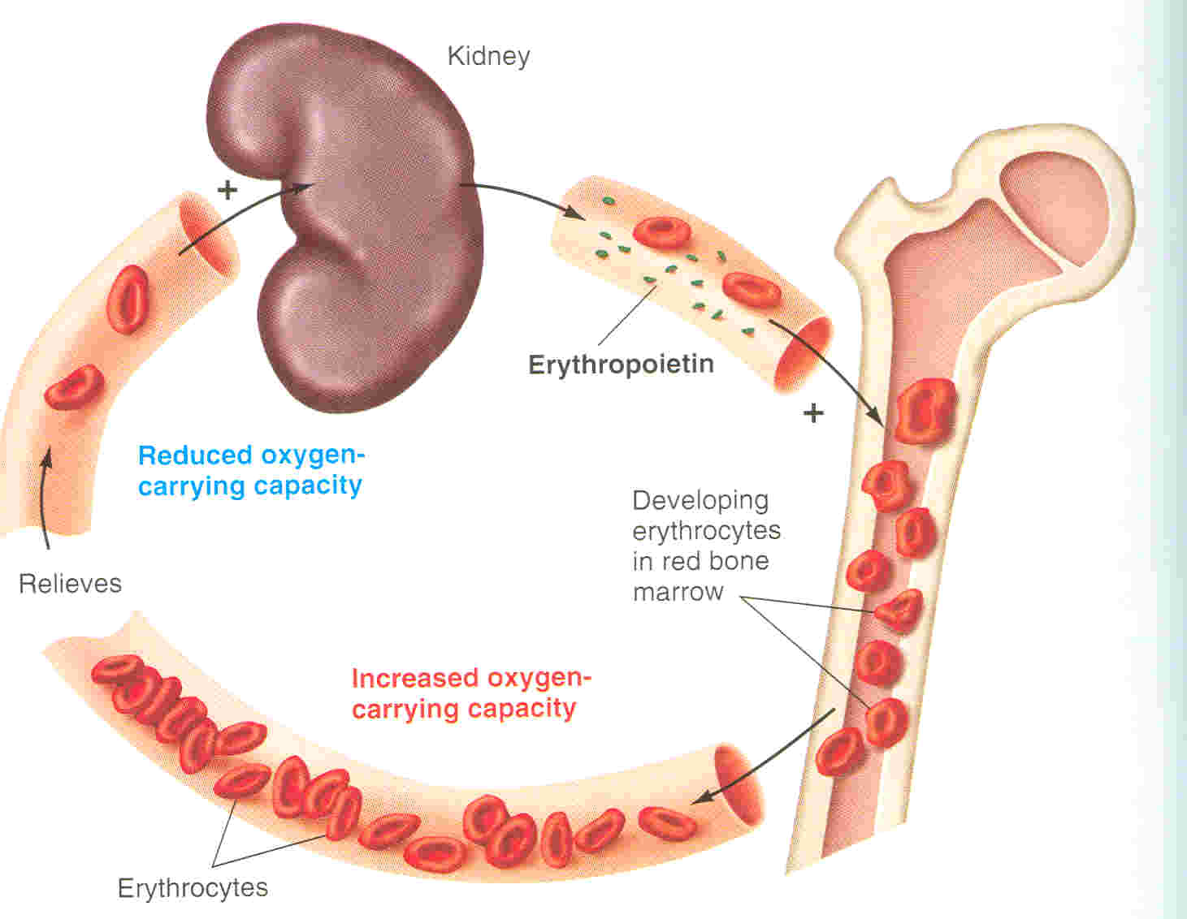
Role of the kidneys in RBC formation
“Healthy kidneys produce a hormone called erythropoietin and prompts the bone marrow to make red blood cells, which then carry oxygen throughout the body”

Slide 33
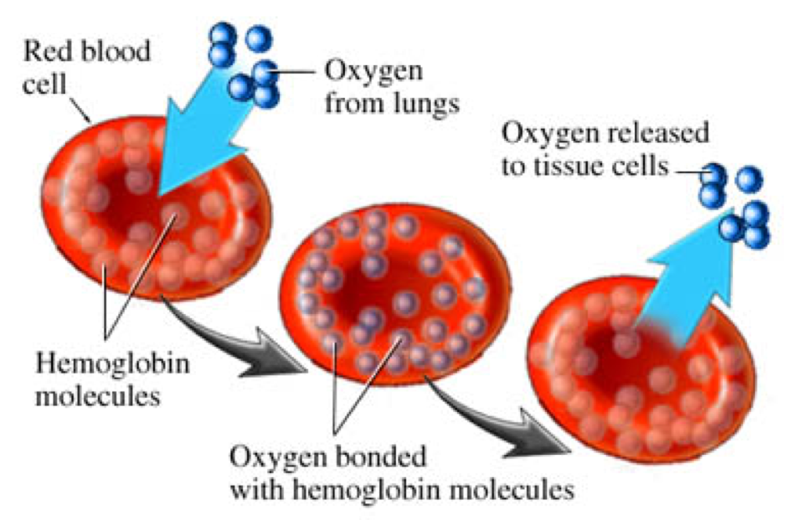
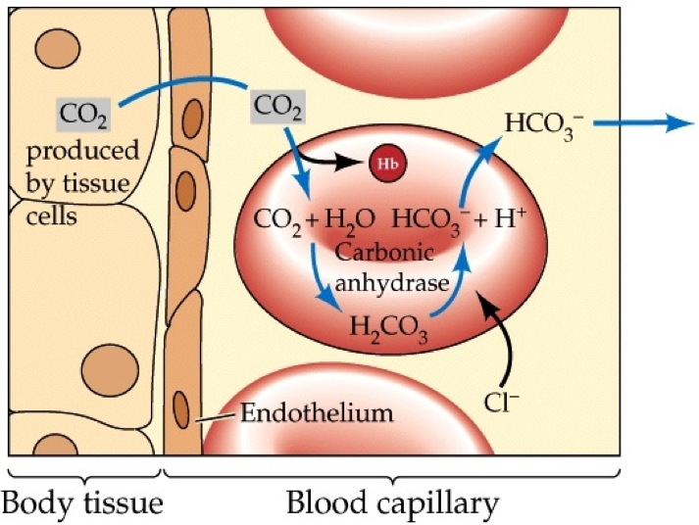
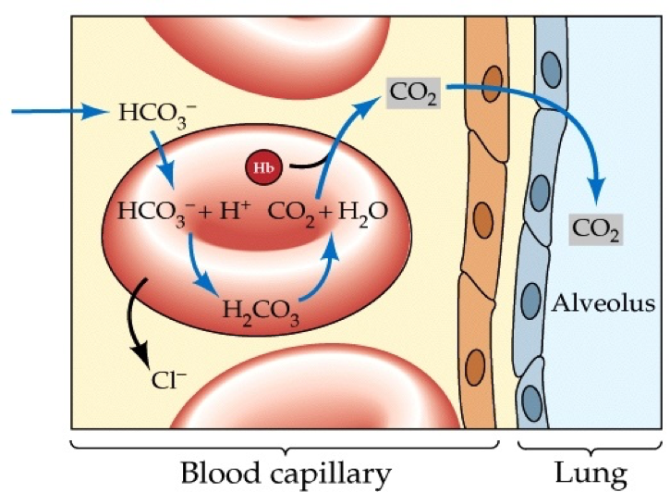
Functions of Red Blood Cells:
Transportation of O_{2*} and CO₂ from the lungs to the tissues:
-Hemoglobin combines reversibly with oxygen as blood passes through
pulmonary capillaries in the lungs where oxygen is high.
-Hemoglobin releases oxygen as blood passes through systemic capillaries in
the tissues where oxygen is low.
RBCs contain the enzyme carbonic anhydrase. This enzyme that catalyzes the reversible reaction between carbon dioxide (CO₂) and H₂O to form carbonic acid (H₂CO₃), increasing the rate of this reaction several thousand fold.
The rapidity of this reaction makes it possible for the water of the blood to transport enormous quantities of CO₂ in the form of bicarbonate ion (HCO3⁻) from the tissues to the lungs, where it is reconverted to CO₂ and expelled into the atmosphere as a body waste product.
Buffer

Slide 34
Essential elements for RBCs formation and maturation
Vitamins:
B12 , Folic acid
(synthesis of nucleoprotein)
Other Vitamins:
B6 , C , E , biotin , Riboflavin , nicotinic acid
-deficiency
Essential elements:
Copper , cobalt , zinc , manganese
Iron:
Formation of haemoglobin
-deficiency
Hormones
Androgens , thyroid , cortisol , growth hormones
-deficiency
Amino Acids:
Formation of globin in haemogloin
-sever protein deficiency
Anaemia

Slide 35
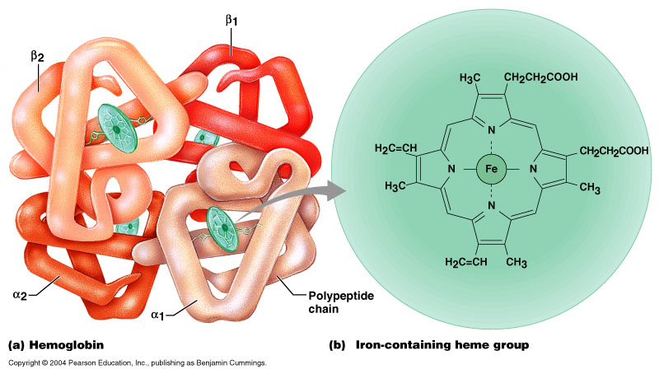
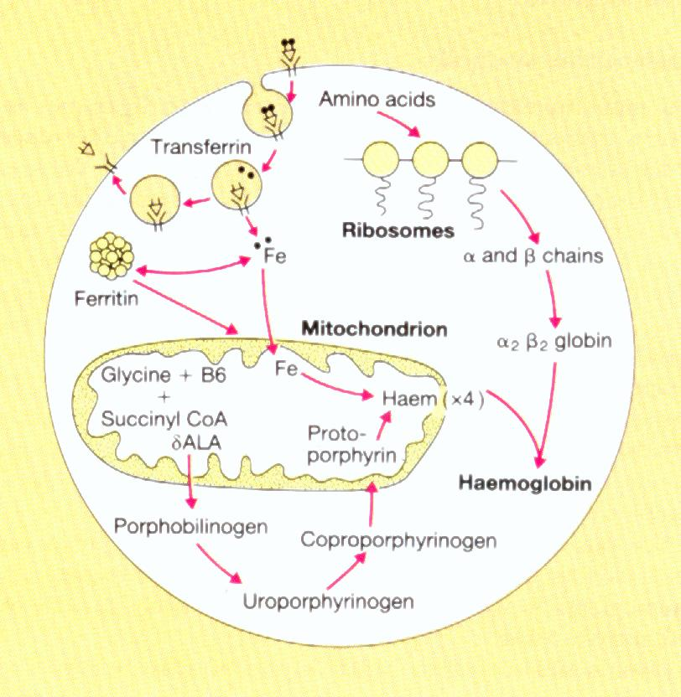
Hemoglobin
Hemoglobin (Hb) Synthesis
Hemoglobin is a Globular protein
Accounts for more than 95% of protein in RBC.
Concentration of Hb in the Blood Measured as g/dl (grams per deciliter, or per 100 ml)
Main function:
Carriage of O2 It carries ~ 98.5% of all O2
HP reversibly bind O2 (oxyhemoglobin) ,
affected by PH , temperature , h+
Carriage of CO2
HP bind CO2 (carboxyhemoglobin)
Buffer
Main component of blood
Hemoglobin synthesis occurs in the mitochondria of the developing RBC in bone marrow
Transferrin attaches to surface receptor
Iron(F²⁺) is released and transported to mitochondria where it combines with protoporphyrin ring to form heme
Heme combines with α and β protein chains formed on the ribosomes to make haemoglobin
Hemoglobin molecules consist of 4 chains each formed of (Heme) and polypeptide chain (Globin).
Because Protein
Carbon Monoxide CO
Attaches IRREVERSIBLY
(يمسك و ما بيسيبهوش)
يسبب اختناق ويشب نار
زي الدفاية وقت الشتاء

Slide 36
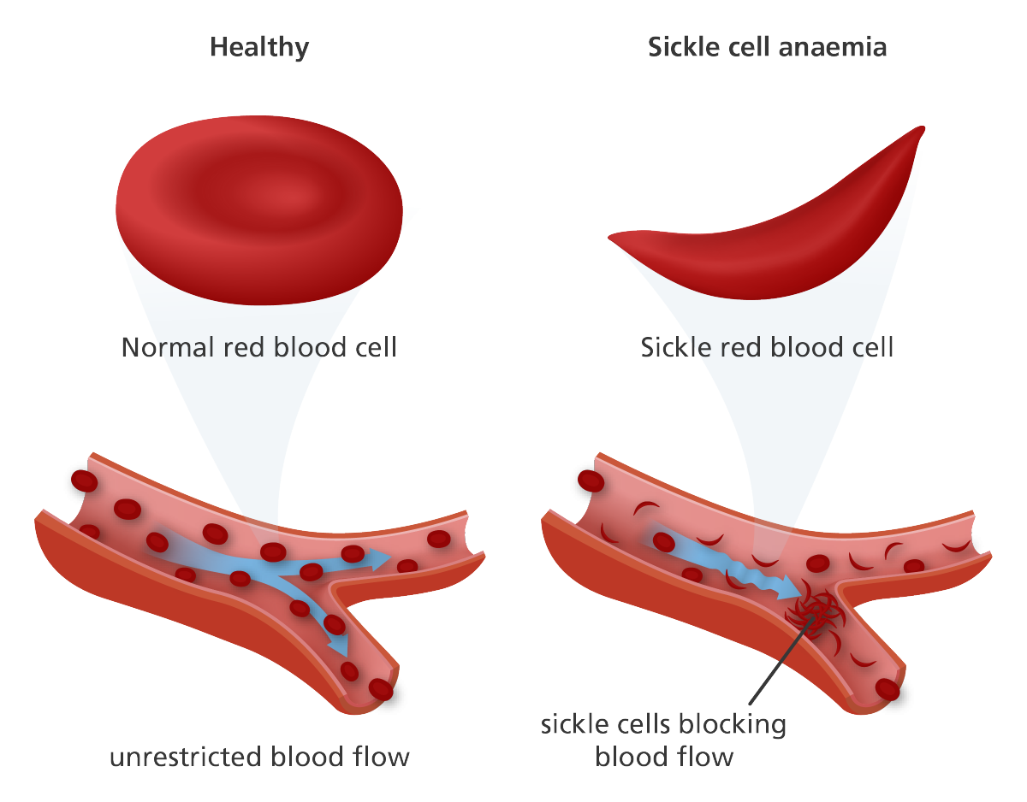
Types of Hemoglobin (Hb)
HB F = Fetal Life
-higher affinity to oxygen
(يسحب الاكسجين بكمية اكبر)
-Baby اناني
GROWS THEN TO HB A
HB A :
(Adult HP)
2$α$ and 2$β$ chains
98%
HB F :
(Fetal Hemoglobin) intrauterine life
2$α$ and 2$γ$ chains
80-90% of fetal Hb at birth
HB A2 :
(Minor Adult Form)
2$α$ and 2 $delta$ (α₂δ₂)
chains
2%-2.5%
tetrameric protein
alpha 141 aa residues
beta 146 aa residues
Gamma
-Abnormality in the polypeptide chain will lead
to an abnormal HP (hemoglobinopathies)
e.g thalassemias ,sickle cell anemia (HbS).

Slide 37
Fate of Components of Heme

Slide 42
Hematocrit; Hct (PCV)
- Hct is the ratio of formed elements to whole blood
- It is the proportion of blood made up of cells (mainly RBCs)
-It is expressed as percentage
-Percentage of blood made up of cells
-Males: average 47% (range: 42-52%)
-Females: average 42% (range 37-47%)
-Minimum hematocrit to donate blood = 38%
-Hct is measured by centrifuging a tiny sample of blood
- Centrifugation separates formed elements from plasma
- After centrifugation the heavier red blood cells settle to the bottom of the tube. The plasma remains at the top.
-The two layers are separated by a ‘buffy coat’ of white cells and platelets.
Male slide

Slide 43
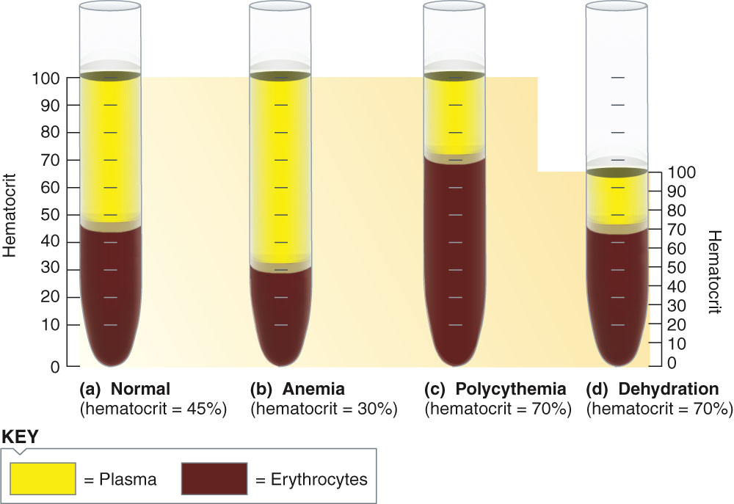
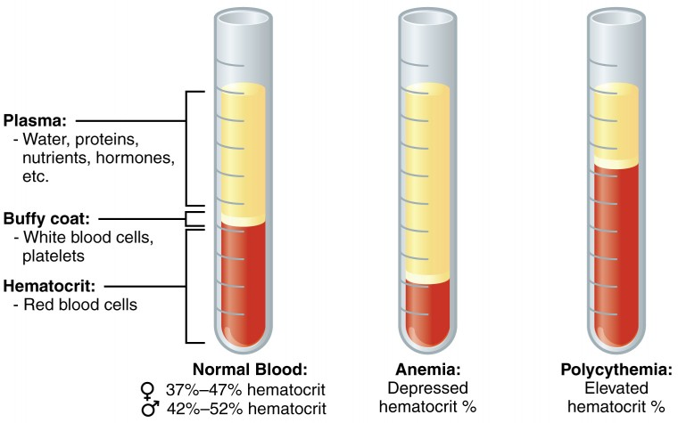
Hct under various conditions

Slide 44
Anaemia
Anemia is decrease in RBC mass as determined by Hct or Hb values below reference level for age and gender. Symptoms: tired , fatigue , short of breath , heart failure
VERY IMP.
You compare for the same AGE and the same SEX
(women Hb count to normal women Hb count. NOT MEN)
Macrocytic anemia:
-The RBC are almost as large as the lymphocyte.
-Fewer RBCs.
Microcytic anemia:
-The RBCs are smaller than normal and have an increased zone of central pallor.
-This is indicative of a microcytic (smaller size)and hypochromic (less hemoglobin) anemia. (باهتة)
-There is also increased anisocytosis (variation in size) and poikilocytosis (variation in shape).

Slide 45
Causes of anemia:
again; the Causes and the shape of Anemia it gives
Blood loss:
-acute accident (RBC return to normal 3-6 weeks).
-chronic microcytic hypochromic anaemia (ulcer , worms ).
Decrease RBC production:
-Nutritional causes:
Iron microcytic hypochromic anaemia.
Vit B12 and Folic Acid megaloblastic anaemia.
-Non-nutritional causes:
Bone marrow failure, destruction by cancer , radiation , drugs , Aplastic anaemia.
Haemolytic excessive destruction:
-Abnormal cells or HB (Sepherocytosis , sickle cells)
-Incompatible blood transfusion.
-Erythroblastosis fetalis.
Chronic: كمية بسيطة يدوم لفترة طويلة (Menstruation)
Acute: حاد (نقل دم , حوادث)
تصنيع مع عيوب

Slide 46
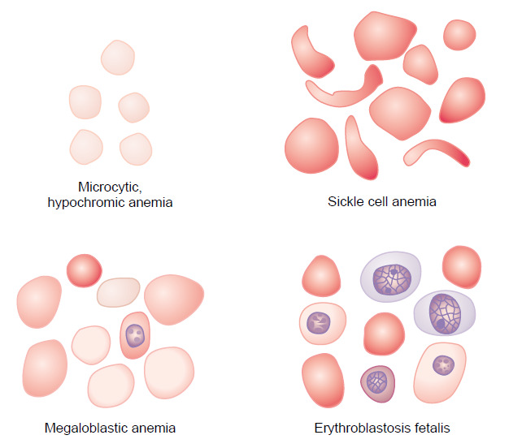
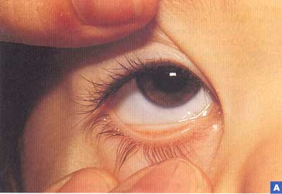
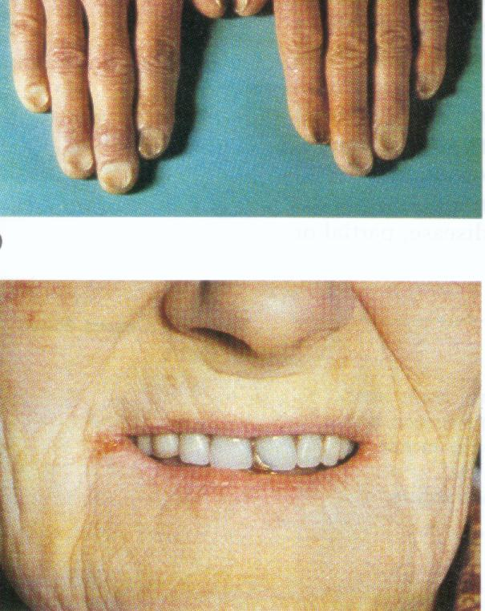
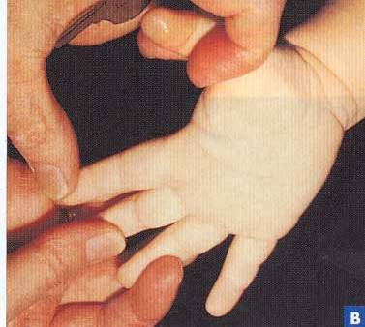
Anemia
RBC loss without RBC Destruction | Decreased RBC Production | Increased RBC Destruction over Production (Hemolytic Anemias)
Hemorrhage Due to trauma Due to disorders: e.g.cancer, ulcers Menstrual flow Gynecological disorders - Parasitism Hookworms | Neoplasia Leukemia Myelofibrosis Pernicious anemia Iron Deficiency anemia Aplastic anemia Chloramphenicol administration Renal disease (lack of erythropoietin production) | Intrinsic Abnormalities Hereditary Spherocytosis Thalassemia Sickle Cell Anemia G6PD deficiency Hexokinase deficiency Extrinsic Abnormalities Infections Malaria Mycoplasma
Clinical Picture of Anemia

Slide 47
Basic Evaluation of Anemia
Clinical Picture of Anemia
Effects of Anemia on Body Functions
Symptoms
-fatigue, cold intolerance and paleness
-oxygen-carrying capacity of blood is reduced
- lack of O₂ for ATP and heat production
Signs
-Pallor: an abnormal loss of skin or mucous membrane color.
-Koilonychia: is when the nail curves upwards (becomes spoon-shaped)
-Angular stomatitis: deep cracks and splits form at the corners of the mouth
-Glossitis: is inflammation or infection of the tongue
Review of blood count, blood smear and RBC indices (MCV, MCH, MCHC)
MCV is the most accurate method of measuring red blood cells and most useful in classification of anaemia as:
Reticulocyte index
= reticulocyte count (%) x [observed haematocrit / normal haematocrit] ie normalized for hematocrit
Reticulocyte index > 2% indicates excessive RBC destruction or loss
Reticulocyte index < 2% indicates decreased production
Increased cardiac output, as well as increased pumping workload on the heart, because of decreased viscosity and vasodilation.
Reduced oxygen-carrying capacity of blood and lack of O₂ for ATP and heat production, manifested mostly during exertion.
If severe, can lead to heart failure

Slide 48
Polycythemia Polycythaemia is increase in RBC mass as determined by Hct or Hb values above reference level for age and gender types are:
Normal: 5 million
Polycythemia: 15 million
CAUSE
Primary (polycythemia rubra vera – PRV ):
Uncontrolled RBC production.
Secondary to hypoxia:
High altitude (physiological) , chronic respiratory or cardiac disease.
سبب غير معلوم.
Type of autoimmune disease
يعوض الجسم عن نقص
Oxygen
(Type of Adaption)
Relative
Hemoconcentration:
» loss of body fluid in vomiting, diarrhea, sweating
Complications of polycythemia: hyperviscosity of the blood

Slide 49
Malabsorption of Vitamin B12
مافي intrinsic
يصير pernicious Anemia
Megaloblastic
(macrocytic)
Causes of deficiencies
Inadequate intake (low intake)
Poor absorption due to Intestinal disease
Pernicious Anemia: lack of vitamin B12
Vit. B12 needs an intrinsic factor to get absorbed, therefore it gets released by parietal cells of stomach.
Then the Vit. B12 binds to the intrinsic factor which get absorbed in the terminal ileum
(رخيص و بكل مكان فيكون في تحت)VB12
المشكلة هنا
V B12 + Intrinsic = absorbed in the terminal ileum
released in the
stomach

Slide 50
Vitamin B₁₂ and Folic Acid
Important for DNA synthesis and final maturation of RBCs.
Dietary sources include: meat, milk, liver, fat, green vegetables.
Deficiency leads to:
Failure of nuclear maturation & division
Abnormally large & oval shaped RBCs
Short life span of RBCs
Reduced RBC count & Hb concentration
Macrocytic (megaloblastic) anemia
Note the hypersegmented neurotrophil and also that the RBC are almost as large as the lymphocyte.
Finally, note that there are fewer RBCs.

Slide 51
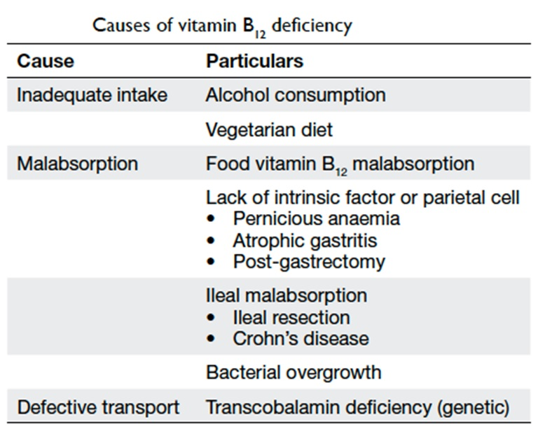
Causes of Vitamin B₁₂ Deficiency

Slide 52
Iron Metabolism
Iron is needed for the synthesis of hemoglobin, myoglobin, cytochrome oxidase, peroxidase & catalase
The total quantity of iron in the body averages 4-5 g
Hemoglobin: 65-75% (3 g)
Stored iron: 15-30%, particularly in the form of ferritin in the liver, spleen and bone marrow.
Myoglobin: 4%
Heme compounds that promote intracellular oxidation (cytochrome): 1%
Plasma iron: (transferrin): 0.1%
A man excretes about 0.6 mg of iron each day, mainly into the feces. Additional quantities of iron are lost when bleeding occurs. For a woman, additional menstrual loss of blood brings long-term iron loss to an average of about 1.3 mg/day.
Diet provides 10-20 mg iron per day.
Only 10% of dietary iron is absorbed (1 – 2 mg ).
Iron in food mostly in oxidized form (Ferric, F⁺³). It is better absorbed in reduced form (Ferrous, F⁺²). Iron in stomach is reduced by gastric acid, and Vitamin C.

Slide 53
Iron absorption
Iron in food mostly in oxidized form
Iron in stomach is reduced by
gastric acid + vit. C
Ferrous F⁺²
Ferric F⁺³
Better absorbed in reduced form
* Rate of absorption depends on the amount of iron stored.

Slide 54
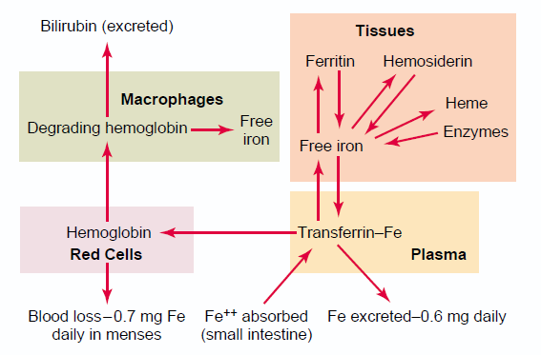
Iron Absorption, Transport and Metabolism
Iron is absorbed from all parts of the small intestine,
The liver secretes apotransferrin into the bile.
In the duodenum, the apotransferrin binds with iron forming transferrin.
The formed transferrin is absorbed into in the intestinal epithelial cells by receptor-mediated pinocytosis. This is later released into the blood capillaries in the form of plasma transferrin.
Only a few milligrams of iron can be absorbed per day. Thus, even when tremendous quantities of iron are present in the food, only small proportions can be absorbed.

Slide 55
Iron Absorption, Transport and Metabolism
In the cell cytoplasm, iron combines mainly with a protein, apoferritin, to form ferritin. This iron stored as ferritin is called storage iron.
Smaller quantities of the iron in the storage pool are in an extremely insoluble form called hemosiderin. This is especially true when the total quantity of iron in the body is more than the apoferritin storage pool can accommodate.
When iron is absorbed from the small intestine, it immediately combines in the blood plasma with apotransferrin, to form transferrin, which is then transported in the plasma.
The iron is loosely bound in the transferrin and, consequently, can be released to any tissue cell at any point in the body.
Excess iron in the blood is deposited and stored especially in the liver hepatocytes and less in the Reticuloendothelial cells of the bone marrow.
When the body has become saturated with iron so that all apoferritin is already combined with iron, the rate of additional iron absorption from the intestinal tract becomes greatly decreased.
Conversely, when the iron stores have become depleted, the rate of absorption can accelerate probably five or more times normal.
Thus, total body iron is regulated mainly by altering the rate of absorption.

Slide 56
Storage and transport of iron
Forms of storage
Ferritin (apoferritin + iron)
Hemosiderin (insoluble complex molecule) in liver, spleen, and bone marrow
Form of transportation
(in plasma)
Transferrin (apotransferrin + iron)
* Daily loss of iron is 0.6 mg in male & 1.3mg/day in females.

Slide 57
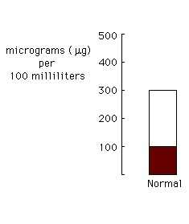
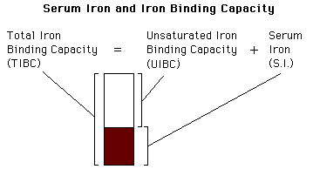
Serum Iron and Total Iron Binding Capacity (TIBC)
Normally transferrin in the plasma is 30-40% saturated with iron, giving a plasma iron level of 100-130 µg/100ml)
When transferrin is 100% saturated with iron → plasma iron level reaches 300 µg/100ml. This is referred to as Total Iron Binding Capacity (TIBC)

Slide 58
Fate of Components of Heme
Male slide
Biliverdin (green)
bilirubin (yellow)
secreted by liver into bile
Urobilinogen
stercobilin (brown pigment in feces)
by bacteria of large intestine
- if urobilinogen is reabsorbed from intestines into blood, it will be converted to a yellow pigment, urobilin and excreted in urine.

Slide 59
Destruction of RBC
RBC life span in circulation = 120 days.
Metabolic active cells.
Old cell has a fragile cell membrane, cell will rupture as it passes in narrow capillaries of the spleen.
Released Hemoglobin is taken up by macrophages in liver, spleen & bone marrow:
Hemoglobin is broken into its component:
Globin:
Polypeptide amino acids (protein pool = storage)
Heme:
Iron (get away from the heme) ferritin (iron without heme)
Porphyrin biliverdin (bilirubin) secreted by the liver into bile. (excess destruction of RBC causes Jaundice)

Slide 60
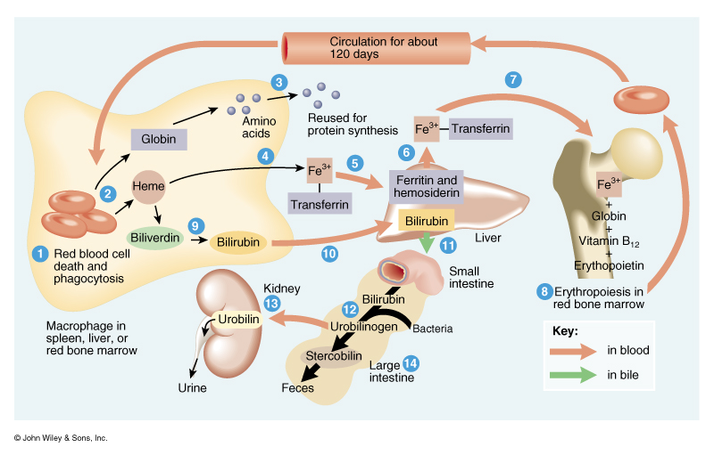
RBC life cycle
Cells wear out from bending to fit through capillaries
Repair is not possible due to lack of organelles
Breakdown products are recycled

Slide 61
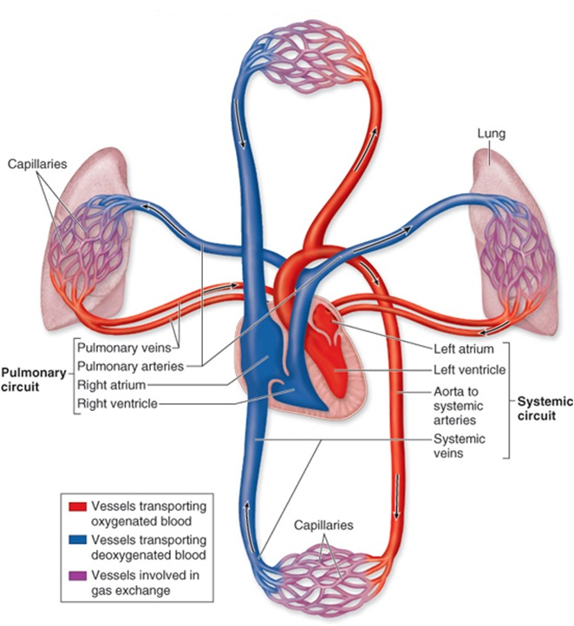
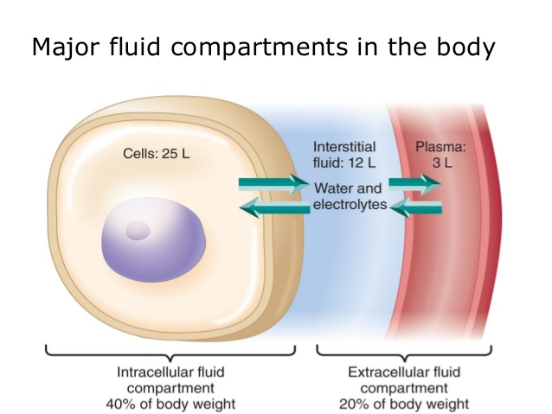
Major Components of the Circulatory System
Heart
Blood vessels
Blood

Slide 62
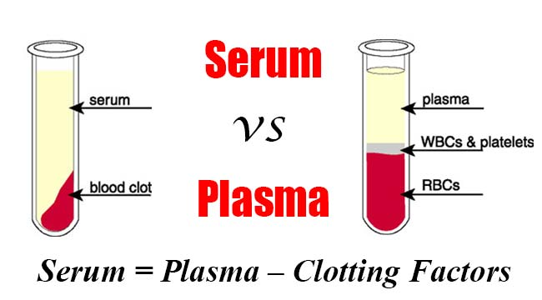
Plasma: Definition and Composition
Plasma = whole blood minus cells
Serum = plasma minus clotting proteins
- If whole blood is allowed to clot
- Then, clot is removed, the remaining fluid is SERUM
- Thus, serum doesn't contain coagulation factors
- Constituents of plasma
- 91.5% water
- 7% plasma proteins
- 1.5% other solutes including:
-Electrolytes
-Organic nutrients and wastes
-Respiratory gases
-Vitamins
In female 98%
so its 90~99
Male slide

Slide 63
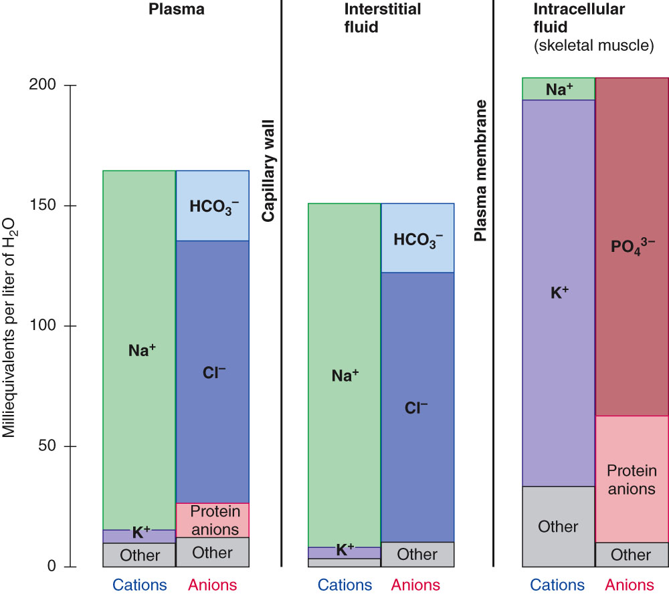
Ionic Composition of the Plasma
Ionic composition of the plasma is very similar to that of the interstitial fluid

Slide 64
Functions of Plasma Proteins
Generation of plasma colloid osmotic pressure (oncotic pressure): most capillary walls are relatively impermeable to the proteins in plasma, and the proteins therefore exert an osmotic force of about 25 mm Hg across the capillary wall (oncotic pressure that pulls water into the blood.) Albumin is the most abundant protein in plasma: about half of all plasma protein. It provides about 80% of plasma oncotic pressure.
Buffering function of plasma proteins: the plasma proteins are also responsible for 15% of the buffering capacity of the blood.
Plasma proteins function as nonspecific carriers : for various hormones (e.g., cortisol, thyroxin), other solutes (e.g., iron, cupper), and drugs.
Defense: Gamma globulins are antibodies
Plasma proteins include proteins concerned with blood clotting.
Male slide

Slide 65
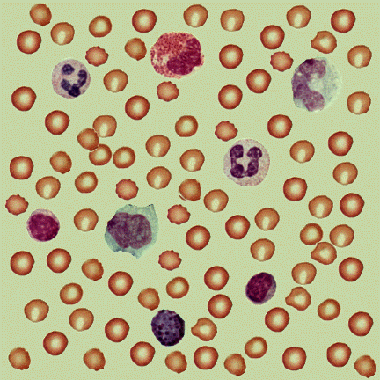
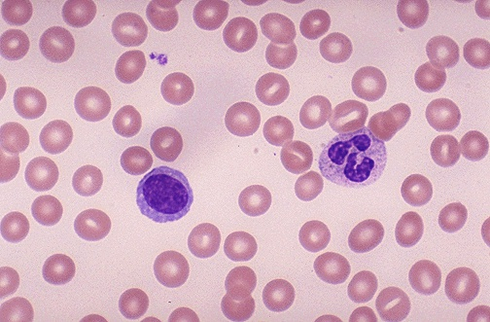
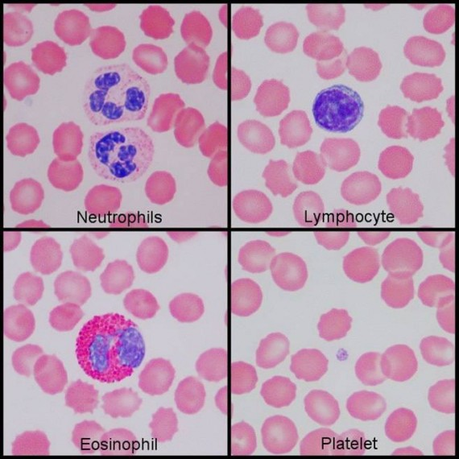
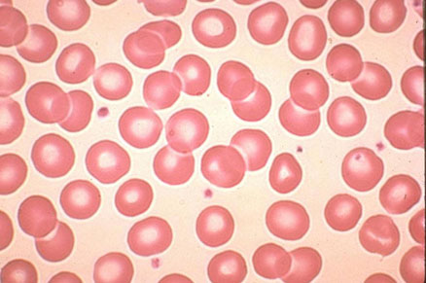
Blood Film (Blood Smear) Technique

Slide 66
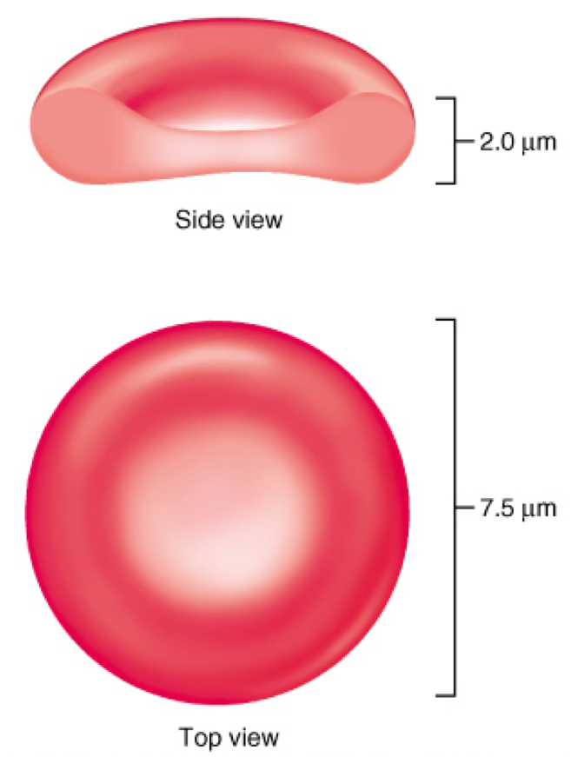
Characteristics of a Mature Erythrocytes (RBC)
Male slide
What does the plasma membrane contains?
Protein spectrin which responsible for:
Giving RBCs their flexibility.
Change shapes as necessary with significantly smaller forces.
An example of the complementarities of structure and function are Erythrocytes
What are the structural characteristics that contribute to gas transport function?
Biconcave shape that has a huge surface area to volume ratio which is is essential for gas exchange.
Discounting water content, erythrocytes are 97% hemoglobin
ATP is generated anaerobically so RBCs don’t consume the oxygen they transport.

Slide 67
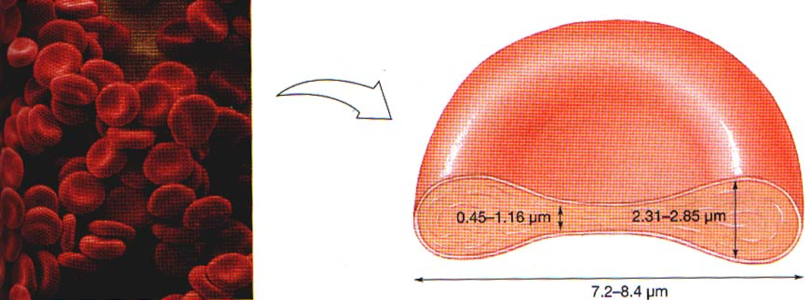
Normally, RBCs account for >99% of all formed elements
Red blood cell count:
Persons living at high altitudes have greater numbers of red blood cells.
(polycythemiaوممكن يسوي ) RBCsلأنه الأوكسجين أقل وبالتالي رح تزيد
 | Males | Females
Average number of RBCs per cubic millimeter | 5,200,000 (±300,000) | 4,700,000 (±300,000)

Slide 68
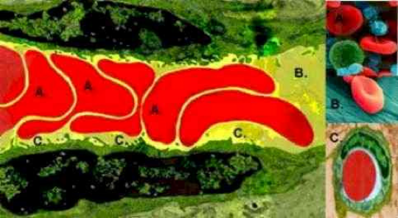
Red Blood Cells in Blood Capillaries
Male slide
Blood capillaries are very narrow blood vessels.
The shapes of RBCs can change as the cells pass through blood capillaries since they squeeze through capillaries.
RBC is a bag of hemoglobin that can be deformed into almost any shape.
This keeps them in very close contact with the capillary walls, which reduce the diffusion distance for gas exchange with the surrounding tissues.
Because RBC has a great excess of cell membrane for the quantity of material inside, deformation does not stretch the membrane greatly and it consequently does rupture the cell just like any other cell.

Slide 69
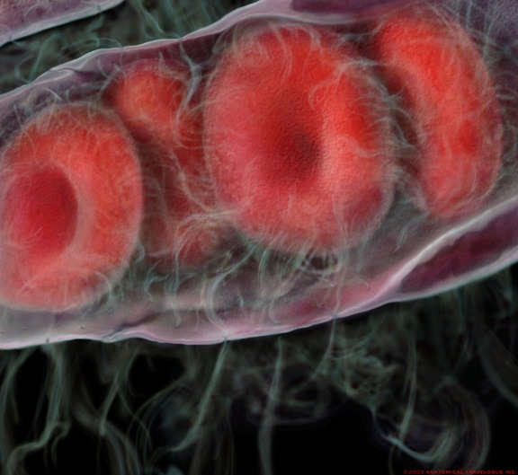
Male slide
Characteristics of RBCs in Blood Capillaries:
RBCs in single file
RBCs are flexible and elastic
They are subject to high amounts of shear stress as they traverse the narrow capillaries of the microvasculature since they squeeze through the narrow capillaries.

Slide 70
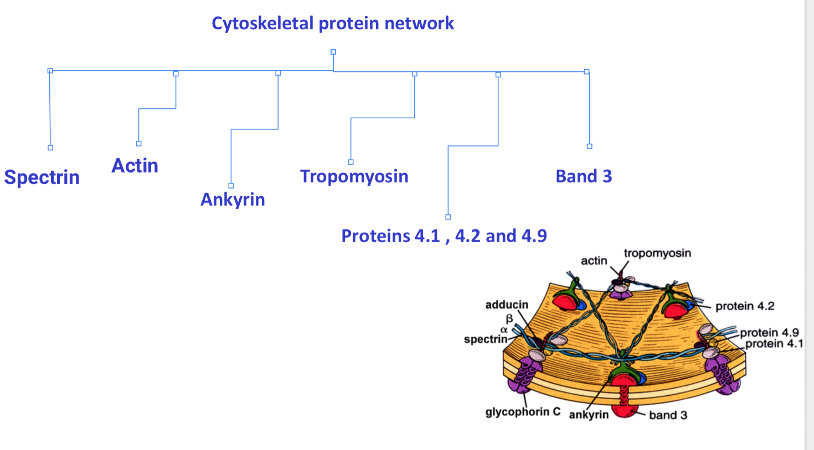
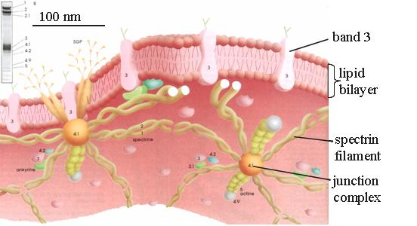
Red Blood Cell Cytoskeleton
Male slide
The RBC, as it continuously circulates the narrow capillaries of the microvasculature, must be able to undergo extensive passive deformation and to resist fragmentation.
This requires a highly deformable yet remarkably stable membrane.
The cytoskeletal proteins are responsible for these important characteristics of the plasma membrane and give the red blood cell the unique biconcave shape.

Slide 72
Quiz:
1-Have an increase zone of central pallor?
A- microcytic hypochromic anemia B-macrocytic anemia C-aplastic anemia D-pernicious anemia
2-Heme (in hemoglobin) consist of?
A-folic acid and Vit B12 B-iron and Vit B6 C-protoporphyrin ring and iron D-apotransferrin and iron
3-Intrinsic factors are secreted by?
A-metabolic active cell B-parietal cell in stomach C-sickle cell D-terminal Ileum
4-Irone in stomach is reduced by?
A-gastric acid and Vit C B-folic acid and Vit B12 C-iron and Vit B6 D-riboflavin
5-Haemoglobin (Hb) of intrauterine life is?
A-Hb A B-Hb A2 C-Hb F
1-A
2-C
3-B
4-A
5-C
6- b
6- The RBCs are flat biconcave disc and nucleated
a – T b – F

Slide 73
Thank you & good luck
Boys team members:
هشام الشايع
سعود الاحمري
عبدالرحمن آل الشيخ
فايز الدرسوني
محمد الحسن
محمد الصويغ
محمد المنجومي
معاذ الحمود
منصور العبرة
احمد الصبي
خالد العقيلي
عبدالجبار اليماني
عمر الفوزان
Girls team members:
مها العمري
هديل عورتاني
ريما العنزي
روتانا خطيب
لجين عزيز الرحمن
العنود المفرج
ريم القرني
عهد القرين
العنود المنصور
مها النهدي
بلقيس الراجحي
ميعاد النفيعي
نورة البسام
عبير العبدالجبار
وجدان الشامري
الجوهرة الشنيفي
Team Leaders:
-مها بركة - طارق العميم

