Slide 1
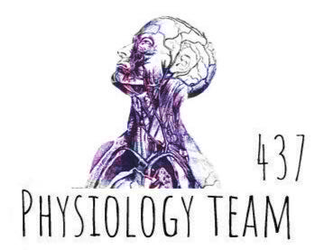
Females & Males Slides
Only Found in Males’ slides
PHYSIOLOGY
Only Found in Females’ slides
Vary Important Notes
Notes
Extra Information

Slide 2
BLOOD PHYSIOLOGY
White Blood Cells
(WBC)
محاضرتين مع بعض من البنات
و محاضرة الأولاد

Slide 3
Objectives
At the end of this lecture student should be able to:
1- Describe different Types of WBC
2- Recognize the general functions of WBC
3- Describe genesis and site of formation of WBC.
4- Describe stages of neutrophil formation
5- Describe the role of neutrophils in defending the body against infection
6- Describe the process of phagocytosis
7- Describe Esinophils formation and functions
8- Describe Basophils formation and functions
9- Describe Monocytes and macrophage formation and functions.
10- Describe Reticuloendothelial componants and functions
11- Describe lymphocytes formation and maturation
12- Describe the functions of the different types of lymphocytes.
13- Recognise leucocytosis and leucopenia.
14- Recognize type of leukaemia
15- Outline components of the immune system
16-Describe the structure of the different types of WBCs.
17-Outline differential WBCs count.
18-Describe the role of the WBCs in immune responses and defending against infection.
3

Slide 4
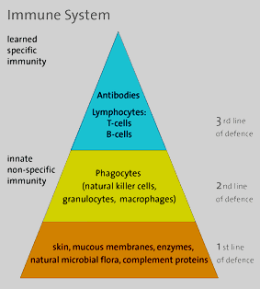
Immune System
The immune system is a system of barriers, cells, tissues and organs that work to fight invaders.
Another important component of the immune
system is the complement system.
The major functions of the immune system are:
Differentiate self from non-self.
Eliminate foreign substances, cells and pathogens.
Organization of the immune system
Cells
Primary (or central) lymphoid organs
Secondary (or peripheral) lymphoid organs
Blood vasculature and lymph systems
connect the different organs

Slide 5
Major organs
Primary Lymphoid Organs
Secondary (or peripheral) Lymph organs
Bone marrow
Thymus
tonsils
adenoids
spleen
Lymph nodes
Lymphatic vessels
Immune cells mature to become immunocompetent in these organs.
Most cells mature to immune cells within the bone marrow and, after release, begin a life of patrol in the blood. The exception is the pre-T cell, which first undergoes maturation in the thymus before circulating in blood.
appendix
peyer's patches
These are the organs where mature immune cells participate in specific immune defense reactions.

Slide 6
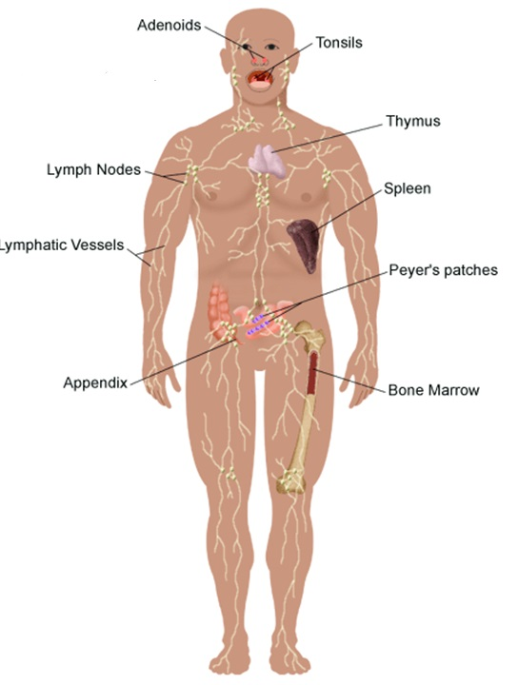
Major organs
2º
2º
2º
1º
2º
2º
2º
2º
1º

Slide 7
Types of Immunity
Immune system
Innate (non-specific; natural) immunity
Adaptive (specific; acquired) immunity
Second line of defense
Is present at birth
Persists throughout life
Can be mobilized rapidly and act quickly
Attacks all antigens fairly equally
Third line of defense.
Antigen specificity. It is activated by thousands of diverse antigens.
Responds with the proliferation of cells and the generation of antibodies.
Responds slowly, being fully activated about 4 days after the immunologic threat.
Exhibits immunologic memory, so that repeated exposure to the same infectious agent results in improved resistance against it.

Slide 8
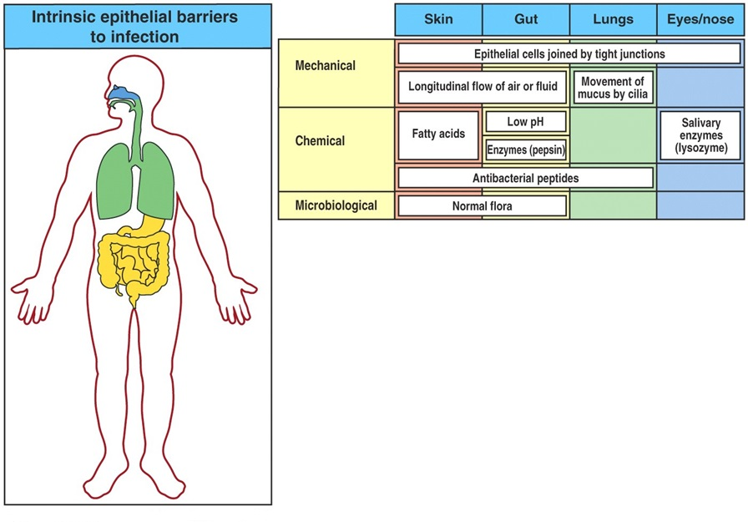
First line or defence – Epithelial Barriers

Slide 9
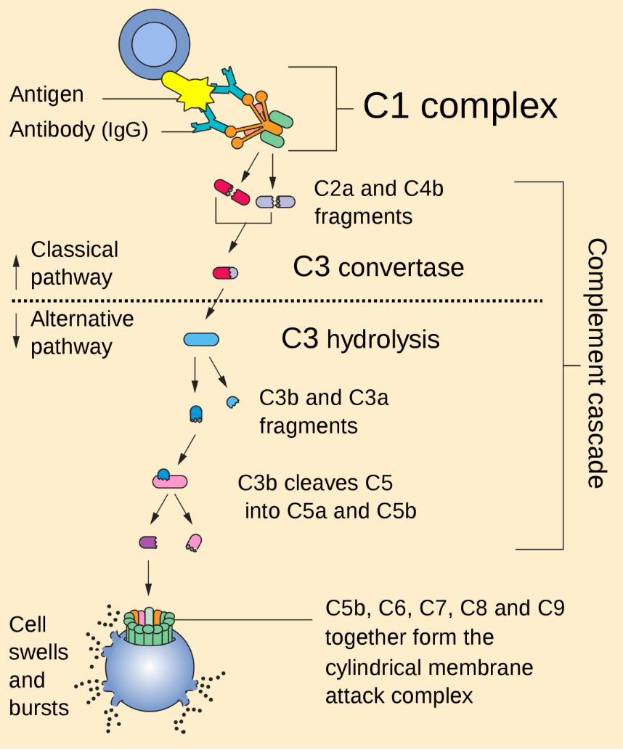
The Complement System is Part of the 1st Line of Defense
complement system:
1- The first part of the immune system that meets invaders such as bacteria
2-it is a group of proteins.
3- These proteins flow freely in the blood and can quickly reach the site of an invasion where they can react directly with antigens ( molecules that the body recognizes as foreign substances).
functions of complement proteins (When activated ):
Trigger inflammation.
Attract eater cells such as macrophages to the area.
Coat intruders so that eater cells are more likely to devour (swallow and eat) them (a process called as opsonization).
Kill intruders.

Slide 10
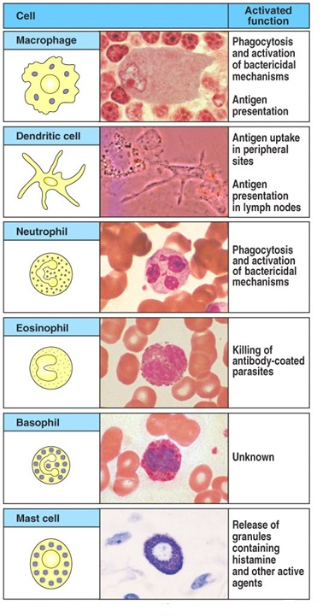
Cellular Elements of the Innate Immune System
(2nd line of defense)

Slide 11
Cells of the Immune System
The cells of the immune system work together with different proteins to seek out and destroy anything foreign or dangerous that enters our body.
Cells of the Immune System
Phagocytes
Inflammatory cells
Antigen Specific cells
Monocytes and macrophages
Neutrophils
Dendritic cells
Basophils and Eosinophils
B cells or B lymphocytes
T cells or T lymphocytes
Mast cells

Slide 12
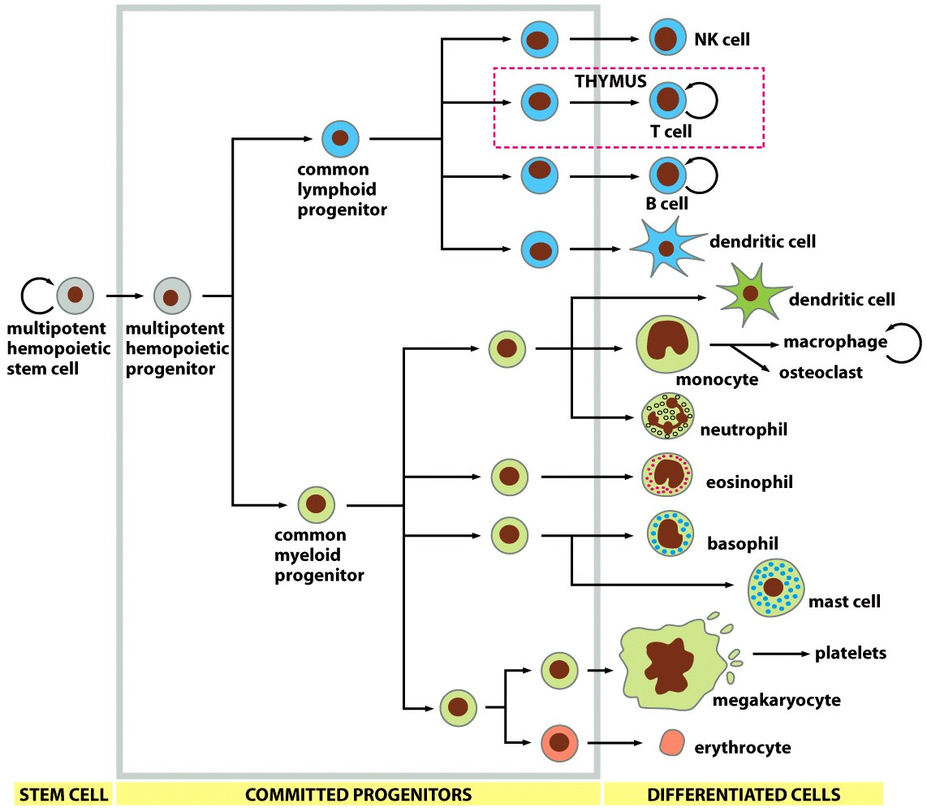
Cells of the Immune System

Slide 13
White Blood Cells (Leucocytes)
Formation
Function Protection against infection by:
bone marrow
lymph tissue
Phagocytosis
Secretion of antibodies

Slide 14
Remember
أقل
red blood cells
(5-6-million/ml)
white blood cells
4000-11000/ml
3

Slide 15
المخطط يختصرالسلايدات القادمة
Types of WBC
Granular
(polymorphnuclear PMN)
PMNs; because of multiple(lobes) nuclei
A granular
ما فيها granules
Neutrophil
- 62%
- lobulated nucleus
basic stain
2-5
^{- Purple} cytoplasmic granules
Eosinophil
- 2.3%
- 2 lobe
nucleus
eosin stain
- coarse ^{red}
granules
Basophil
- 0.4%
- rarely segmented nucleus
- nucleus hidden by large round bluish granules
سميناها كذا على حسب اسم الصبغة
Monocytes
5.3%
kidney shape nucleus
(make macrophage system)
Lymphocyte
30%
round nucleus
Small large
1-T lymphocyte
2-B lymphocyte
3-Natural killer
cells (NKCs)
Genesis of WBC:
Myelocytic
(granular+monocytes)
Genesis of WBC:
Lymphocytic
sites of formation:
bone marrow
sites of formation:
- Bone marrow
- Thymus
- Lymphoid tiss
مو مهم تحفظوا الحجم عشان كذا ما حطيتها
ركزوا على النسب والأشكال والألوان
)كلام د.نيرفانا (
الألوان لتسهيل الحفظ )ما له دخل سلايدات الأولاد والبنات(

Slide 16
Types of WBC
مو مهم تحفظوا الحجم عشان كذا ما حطيتها بالمخطط
ركزوا على النسب والأشكال والألوان
)كلام د.نيرفانا (
1- Granular (polymorphnuclear PMN):
Neutrophil | Eosinophil | Basophil
62%. | 2.3% | 0.4%.
10-16um | 12-18um | 10-14um
lobulated nucleus 2-5. | 2 lobe nucleus. | rarely segmented nucleus.
^{Purple} cytoplasmic granules | coarse ^{red} granules | nucleus hidden by large round bluish granules.

Slide 17
Types of WBC cont.
مو مهم تحفظوا الحجم عشان كذا ما حطيتها
ركزوا على النسب والأشكال والألوان
)كلام د.نيرفانا (
2. A granular
Monocytes | Lymphocyte
5.3% | 30%
15-20um | small (5-8um) large (9-15um)
kidney shape nucleus | round nucleus

Slide 18
Physiological Variations in WBCs Count
Age:
Infants: about 20,000 /mm³
Children:10,000 to 15,000/mm³
Adults: 4,000 and 11,000/mm³
Sex: males have more WBCs than females.
Diurnal variation: Minimum in early morning and maximum in the afternoon.
Exercise: Increases slightly.
Sleep: Decreases.
Emotional conditions like anxiety: Increases.
Pregnancy: Increases.
Menstruation: Increases.
Parturition: Increases.
Male Slide

Slide 19
WBCs Concentrations (Normal Counts)
and Life Span
Percentage of Total WBCs | Approximate Normal Range (/µL) | Cells
 | 4000 - 11000 | Total WBCs
60 –70% (62%) | 3000 - 6000 | Neutrophils
1 – 4% (2.3%) | 150 - 300 | Eosinophils
0.4% (0.4%) | 0 - 100 | Basophils
20 – 40% (30%) | 1500 - 4000 | Lymphocytes
2 – 8% (5.3%) | 300 - 600 | Monocytes (Macrophages)
الألوان ما لها دخل بسلايدات الأولاد والبنات ,د.نيرفنا ما ركزت على أعدادهم بالتفصيل

Slide 20
Granulocytes
Neutrophil, Eosinophil, Basophil
in tissues
4-5 days
During Infection: only few hours (they die after ingesting bacteria)
Monocytes
In blood: 10-20 hours
Leave to the tissue: - transform into macrophage – stay up to months
Lymphocytes
weeks to months according to its type
B > few weeks T > year (100-300day)
Life span of WBCs

Slide 21
Genesis of WBC (Leucopoiesis)
Two major lineage of WBC are formed :
Myelocytic: beginning with myelobast and giving rise to granular leucocytes and monocytes
Lymphocytic: beginning with lymphoblast and giving rise to lymphocytes
the WBC need to leave the blood to work unlike RBC.
Sites of WBC Formation
Granulocytes
(neutrophil, basophil, eosinophil)
Monocytes
Lymphocytes
in bone marrow
bone marrow
bone marrow and lymphoid tissues especially the lymph glands, spleen, thymus, tonsils, and Peyer’s patches

Slide 22
Genesis of WBC
WBCs formed in the bone marrow are stored within the marrow until they are needed in the circulatory system. Various factors cause them to be released.
Normally, about three times as many white blood cells are stored in the marrow as circulate in the entire blood.
The lymphocytes are mostly stored in the various lymphoid tissues, except for a small number that are temporarily being transported in the blood.

Slide 23
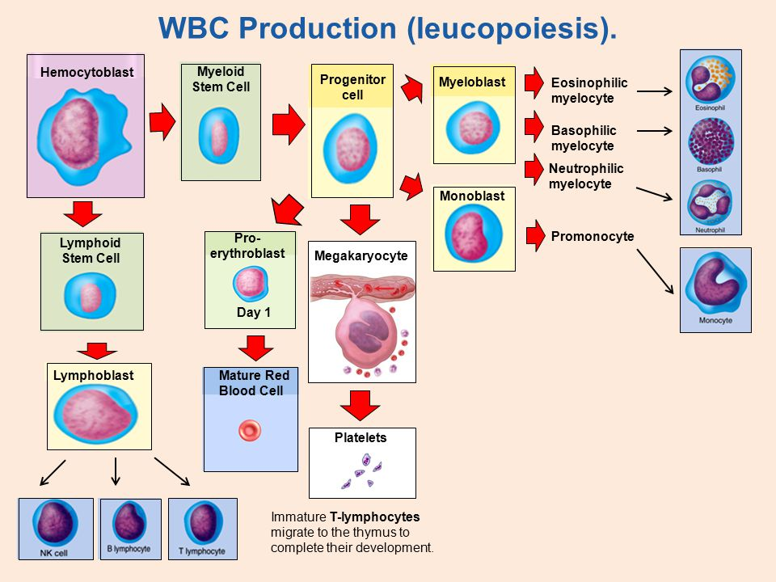
Genesis of WBC

Slide 24
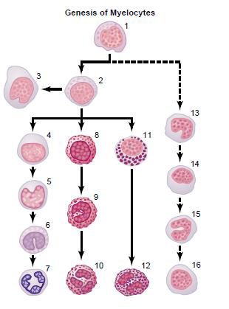
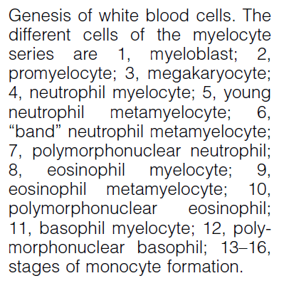
Genesis of WBC
Leucopoiesis

Slide 25
White Blood Cells
NEUTROPHILLS
Formation and Maturation of Neutrohils: in Bone Marrow
Stem cells
مو مهم تحفظوا المراحل كلها )أهم شي أول وآخر وحدة(
وركزوا على Maturation of red blood cells
بالمحاضرة السابقة )كلام د.نيرفانا (
Myeloblast
Promyelocytes
Neutrophil myelocytes
Just read it
Young neutrophil metamyelocytes
Band neutrophil
Polymorphnuclear neutrophil (MatureNeutrphils released to blood)

Slide 26
White Blood Cells
NEUTROPHILLS
Polymorphonuclear.
They contain small granules of both acidic and basic.
They constitute the first line of defence against bacterial infection.
Very important at “clearing” bacterial infections.
Cells infected by bacteria usually get dealt with by Neutrophils

Slide 28
Neutrophil Function
Defense against infection:
Neutrophil has the ability of engulfing bacteria or organism by a process of phyagocytosis
Steps of Phygocytosis
Neutrophil Phagocytosis
1-neutrophil attaches itself to the particle and projects pseudopodia in all directions around the particle.
2-pseudopodia meet one another on the opposite side and fuse, creating an enclosed chamber that contains the phagocytized particle.
3-the chamber moves to the inside of the cytoplasmic cavity and breaks away from the outer cell membrane to form a free-floating phagocytic vesicle (also called a phagosome) inside the cytoplasm.
4-The phagocytized particle is then digested by intracellular enzymes
Chemotaxis
Margination
Diapedesis
Ameoboid movement
Engulfing and killing of a microbe
Like alarms
تتحرك نفس الاميبا
Females slide

Slide 29
Chemotaxis
The attraction of the neutrophils and monocytes to move to inflamed area following chemotactic substances release from infected site.
The chemotactic agents include a component of the complement system (C5a); leukotrienes; and polypeptides from lymphocytes, mast cells, and basophils.
Chemotactic substances:
- Bacterial toxin
- Degenerative products of inflamed tissue
- Complement system
- Reaction product of plasma clotting
Chemotaxis is effective up to 100 micrometers away from an inflamed tissue. Therefore, because almost no tissue area is more than 50 micrometers away from a capillary, the chemo- tactic signal can easily move hordes of WBCs from the capillaries into the inflamed area.

Slide 30
Margination & Diapedesis
There are gabs inbetween the endothelial capillaries where the neutrophils squeeze through
تحريك وصف ال neutrophils
1- WBCs marginate (aggregate and stick) along the wall of blood capillaries.
2- WBC squeezes itself through endothelial holes leaving blood capillaries (diapedesis)
3- WBCs move by amoeboid motion towards inflammation area following chemotactic substance released from site of infection
4- Upon reaching the site of infection neutrophils start to engulf infecting organism

Slide 31
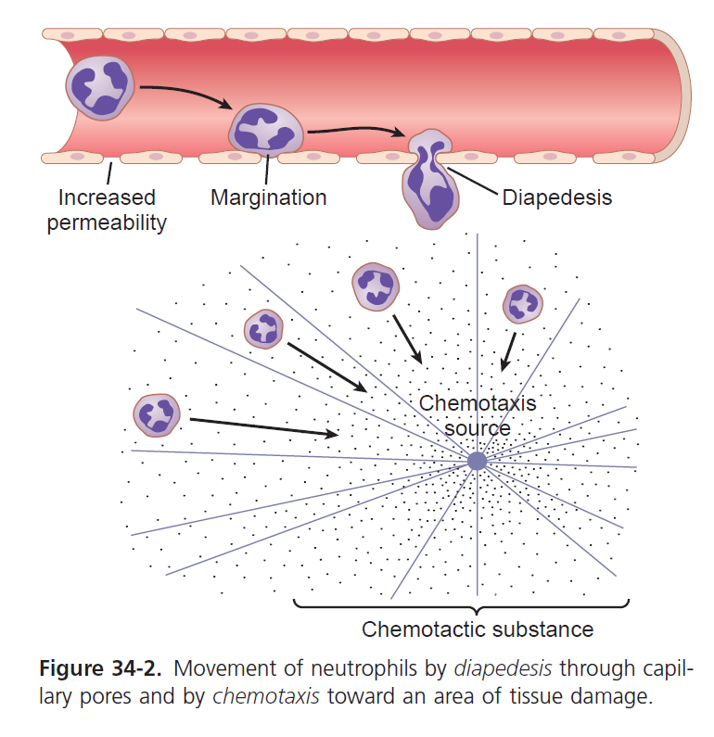
Chemotaxis, margination & diapedesis

Slide 32
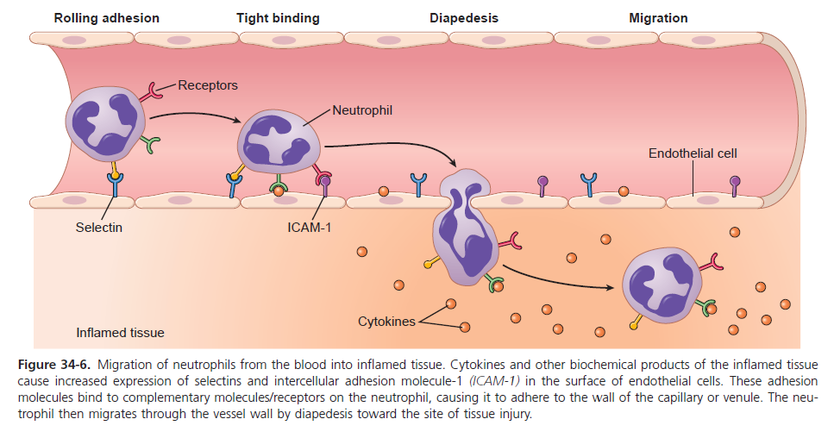

Slide 33
Phagocytosis and Opsonization
Phagocytosis: means cellular ingestion of the offending agent.
opsonization is the coating of the invader
Selective process: foreign substance recognize by:
-Rough surface
-No protective protein coat, which prevents phagocytosis.
-Marked by certain substance (opsonization)
e.g Complement 3 or antibodies making them ready for killing.
مثل name tagللتعرف عليها
Neutrophils encircled the bacteria with pseudopodia and engulf it inside into a vacuole (phagosome), takes 3-20 bacteria
Opsonization: Complement 3b or antibodies like IgG making them ready for killing a process known as opsonization.
Some plasma factors act on the bacteria to make them “tasty” to the phagocytes (opsonization). The principal opsonins that coat the bacteria are immunoglobulins of a particular class (IgG) and complement proteins.

Slide 34
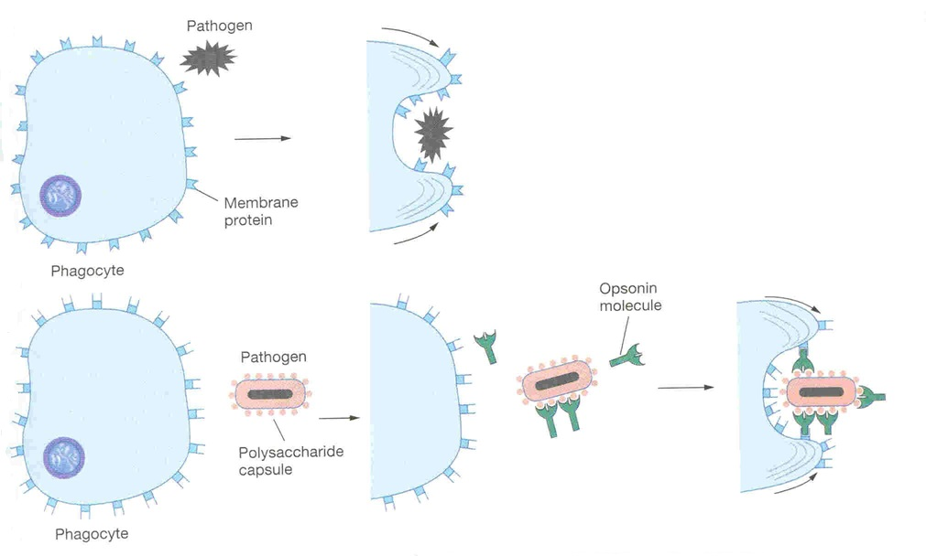
Opsonization and Phagocytosis

Slide 35
Microbial killing
killing effect results from several powerful oxidizing agents formed by enzymes in the membrane of the phagosome or by a special organelle called the peroxisome. ese oxidizing agents include large quantities of superoxide− (O2−), hydrogen peroxide (H2O2), and hydroxyl ions (OH ), which are lethal to most bacteria, even in small quantities.
Digestion of organism inside the phagosome:
1- Fusion of intracellular lysosomes with phagosome vacuole
2- Lysosomes discharge its proteolytic enzymes such as myeloperoxidase, catalase into the vacuole, killing and digesting the engulfed bacteria.
And\or Release of bactericidal such as superoxide, hydrogen peroxide to kill the bacteria
Some bacteria, notably the tuberculosis bacillus, have coats that are resistant to lysosomal digestion and also secrete substances that partially resist the killing effects of the neutrophils and macrophages.These bacteria are responsible for many of the chronic diseases, an example of which is tuberculosis.

Slide 36
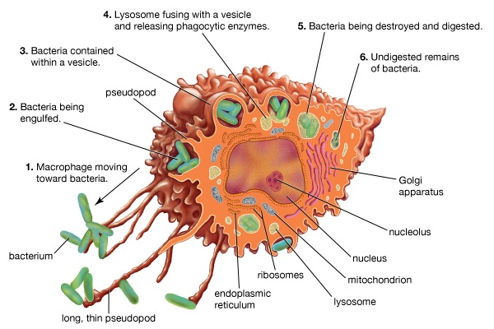
Microbial killing

Slide 37
Formation and Maturation of Eosinophils: in Bone Marrow
Stem cells
مو مهم تحفظوا المراحل كلها )أهم شي أول وآخر وحدة(
وركزوا على Maturation of red blood cells
بالمحاضرة السابقة )كلام د.نيرفانا (
Myeloblast
Promyelocytes
Eosinophil myelocytes
Just read it
Eosinophil metamyelocytes
polymorphnuclear eosinophil (Mature Eosinophil released to blood)

Slide 38
Eosinophil Function
1- they are weak phagocytes.
1- they are weak phagocytes.
2- they are often produced in large numbers in people with parasitic infections, and they migrate in large numbers into tissues diseased by parasites., e.g., ascaris, hook worm, bilharzia. Eosinophils attach themselves to the parasites by way of special surface molecules and release substances that kill many of the parasites ex:(hydrolytic anzymes,superoxide)
3- They are increased in allergic conditions by the release of eosinophil chemotactic factor released from the mast cells and basophiles.
4- Eosinophils phagocytose the antigen-antibody complexes and release substances to neutralize the histamine. ex: (asthma, rhinitis, drug reaction)
4-They may produce profibrinolysin → fibrinolysin which digest fibrin clot.

Slide 39
Formation and Maturation of Basophils: in Bone Marrow
Stem cells
مو مهم تحفظوا المراحل كلها )أهم شي أول وآخر وحدة(
وركزوا على Maturation of red blood cells
بالمحاضرة السابقة )كلام د.نيرفانا (
Myeloblast
Promyelocytes
Basophil myelocytes
Just read it
Basophil metamyelocyt
Polymorphnuclear Basophil (Mature Basophils released to blood)
large round cytoplasmic polysaccharide granules which take base dye (methylene blue) and stain blue in color.

Slide 40
Basophils Functions:
1-Both mast cells and basophils secrete:
histamine (to prevent clotting), heparin, bradykinin, Serotonin (5HT) (contribute to inflammation response), slow-reacting substance of anaphylaxis (a mixture of three leukotrienes) and a number of lysosomal enzymes.
The release of those substances cause local and vascular reactions characteristic of allergic manifestation
2-They are increased in allergic reaction: immediate-type hypersensitivity (allergic) reactions.

Slide 41
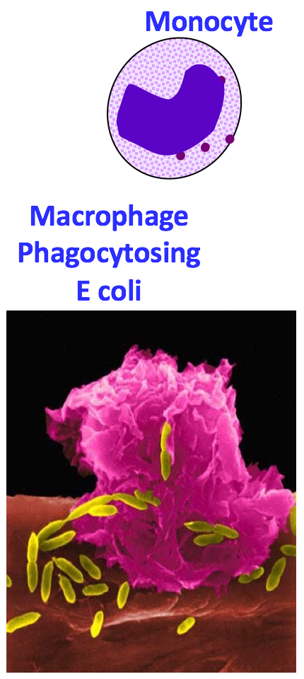
Monocytes\ Macrophages
Monocytes leave the blood stream to tissues and turn into macrophages.
Monocytes are young macrophages.
Monocytes are big eaters.
15-20 µm - Active cells 60-80 µm
Monocytes contain agranular cytoplasm, but when they convert into macrophages and enter tissue, they swell and their cytoplasm become filled with a large number of lysosomes.
Monocytes are slower to respond to invaders than neutrophils, but they are larger, have greater capacities, and live longer.

Slide 42
Monocytes\ Macrophages
Anti-Inflammatory:
Directly: phagocytosis of bacteria, dead cells.
Indirectly: cooperating with lymphocytes by recognizing foreign body (take in foreign body process it and present it to lymphocytes).
Functions of monocytes/macrophages:
First line of defense.
Phagocytosis and killing of microorganisms. They are more Efficient than Neutrophils (100 bacteria vs 3-20 by Neutrphil, larger particles like old RBCs & malarial parasites).
Activation of T cells and initiation of the immune response by presenting the antigen to these cells.
gets rid of waste and survives.
Monocytes secrete:
Interleukin-1 (IL-1).
Colony stimulating factor (M-CSF).
Platelet-activating factor (PAF).

Slide 43
Direct anti Inflammatory
Indirect anti-inflammatory

Slide 44
Formation and Maturation of Monocytes and Macrophages: in Bone Marrow
Stem cells
مو مهم تحفظوا المراحل كلها )أهم شي أول وآخر وحدة(
وركزوا على Maturation of red blood cells
بالمحاضرة السابقة )كلام د.نيرفانا (
Monoblast
ووmonoblast
Promonocyte
promonocyte
Just read it
mature monocytes released into blood
Stay for 10-20 hours in circulation
Then leave blood to tissues transforming into larger cells macrophage
. Macrophage life span is longer upto few months

Slide 45
Monocytes\ Macrophages
There are two types of macrophages; motile and fixed.
There are tissue-specific macrophages; fixed macrophages (monocyte-macrophage system; reticulo-endothelial system)
Alveolar macrophage
Peritoneal macrophage
Kuppfer cells in liver sinuses
Osteoclasts in bone
Microglial cells in brain
Histiocytes in skin and subcutaneous tissue
Mesengial cells in the kidneys
Few specialized endothelial cells in bone marrow, spleen and lymph nodes

Slide 46
Reticuloendothelial System
Consist of:
Monocytes
Macrophage
Endothelial cells
(bone marrow,spleen, lymph node)
Located in:
all tissues especially: skin
(histocytes), liver (kupffer), spleen, bone marrow, lymph nodes, lung
رح ناخذه بالتفصيل بسنة ثاني بس ركزوا عالنقاط الرئيسية )كلام د.نيرفانا (

Slide 47
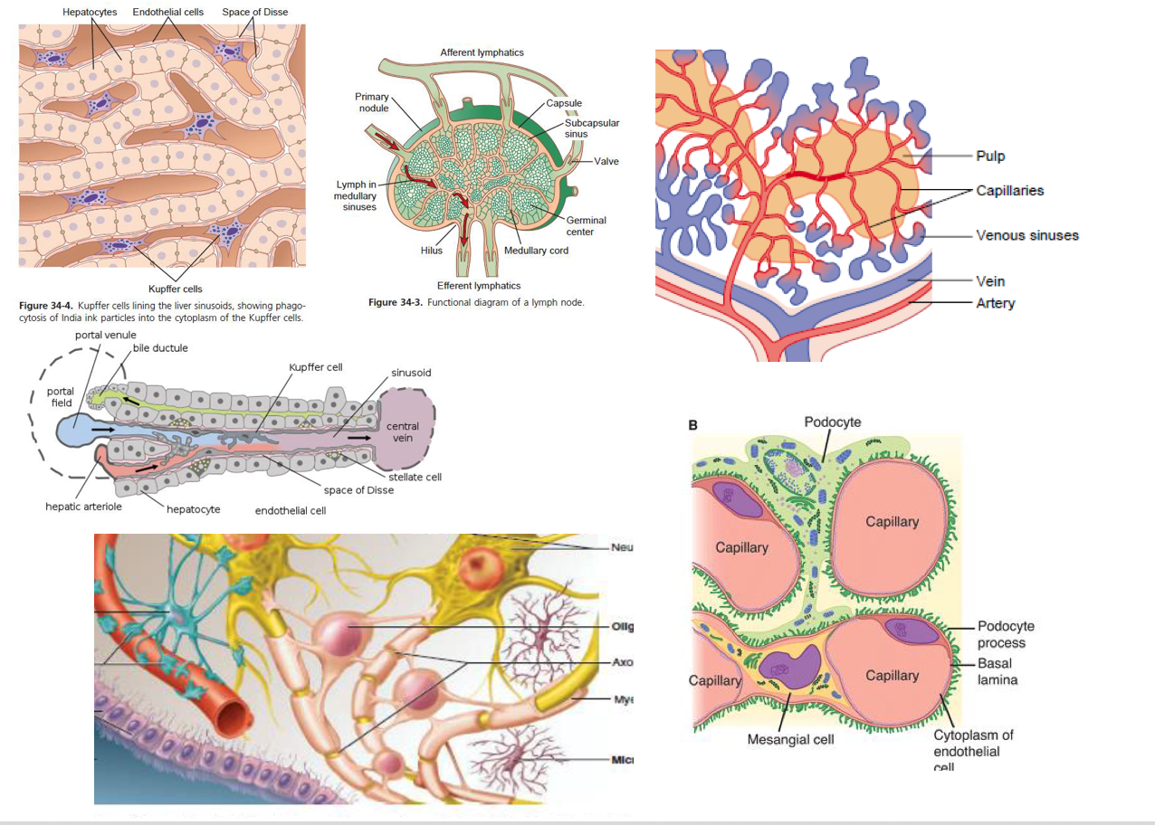
Functions of Reticuloendothelial system
-Phagocytosis: Bacterial, dead cells, foreign particles.
-Breakdown of Hb
-Immune function: processing antigen and antibodies production (indirect)
-Storage of iron
in the liver and
bone marrow in
the form of fe3
(mostly),fe2

Slide 48
Macrophage and Neutrophil Responses
During Inflammation
Neutrophils =
microphages
1st line of defense –Tissue macrophages, barriers and complement system.
2nd line of defense –Neutrophil invasion of the inflamed area.
3rd line of defense –Monocytes–macrophage invasion of inflamed area.
4th line of defense –Increased production of granulocytes and monocytes by the bone marrow.

Slide 49
LYMPHOCYTES Function and types
Types:
1-Thymus dependent (T-lymphocytes)
_{2 -Thymus independent} (B-lymphocytes)
LYMPHOCYTES ARE RESPONSIBLE FOR ADAPTED/ACQUIRED IMMUNITY
Function:

Slide 50
Lymphocytes Formation and Maturation:
Formed in bone marrow, thymus, lymphoid tissues
T lymphocyte and B lymphocyte
produced by the bone marrow
however, T get maturated in the
thymus and the B cells in the bone
marrow then they go to the lymphoid
organs like spleen Lymph nodes…etc
Stem cells (thymus, lymphoid tissue & bone marrow)
مو مهم تحفظوا المراحل كلها )أهم شي أول وآخر وحدة(
وركزوا على Maturation of red blood cells
بالمحاضرة السابقة )كلام د.نيرفانا (
lymphoblast
intermediate pyronophilic blast cell
Just read it
lymphocytes
Life Span Of Lymphocytes range from weeks to months according to its type.
Both types of lymphocytes are derived in the embryo from (pluripotent hematopoietic stem cells) that form common (lymphoid progenitor cells).

Slide 51
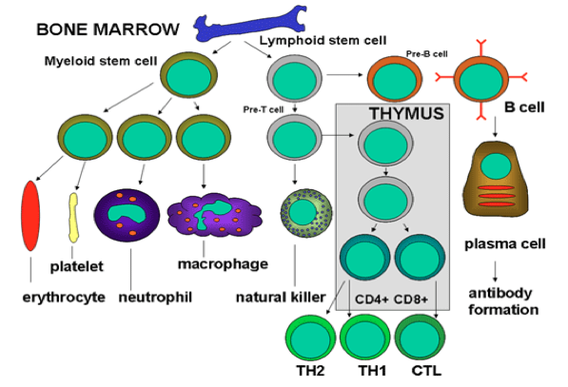
Lymphocytes – T and B cells
•Lymphocytes migrate to the lymphoid organs.
•On the surface of each lymphocyte are receptors that enable them to recognize foreign substances. These receptors are very specialized - each can match only one specific antigen.
•It might seem limiting that the receptors of each lymphocyte cell can only match one specific type of antigen, but the body makes up for this by producing so many different lymphocyte cells that the immune system can recognize nearly all invaders.
from the males slides

Slide 52
Preprocessed of lymphocytes
The T lymphocyte :
preprocessed in the thymus gland, and thus they are called “T” lymphocytes.
They are responsible for cellular or cell-mediated immunity
The B lymphocyte :
preprocessed in the liver during mid–fetal life and in the bone marrow in late fetal life and after birth.
They are changed to plasma cells and are responsible for humeral immunity or antibody- immunity.

Slide 53
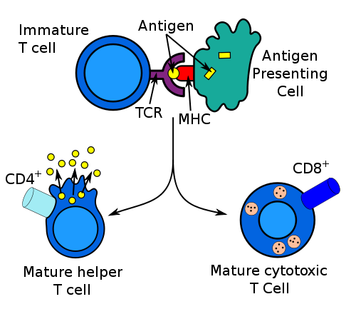
T-Lymphocytes
(Thymus dependent)
Formed in: bone marrow or lymphoid tissue migrate to thymus for maturation hence these lymphocytes are called T cells.
Life spans: 100-130 days.
Circulate between: blood, tissues, lymph.
Types of T-lymphocytes:
T-helper
T-cytotoxic
Natural killer
Activates B cells.
مثل عند رفض الزراعة للاعضاء والدم
Functions:
Kills virally infected cells.
Cellular immunity (graft rejection , delyed hypersensitivity.)
Role in antibody secretion.

Slide 54
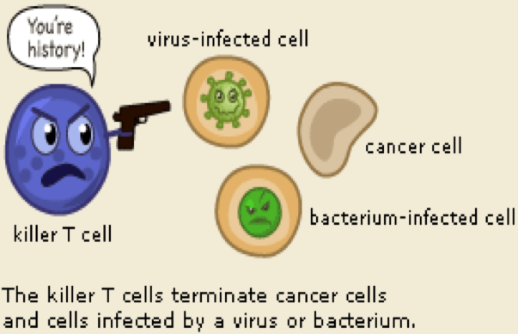
A cytotoxic T cell (also known as T_{C}, cytotoxic T Lymphocyte, CTL, T-killer cell, cytolytic T cell, CD8+T-cell or killer T cell)
Attacking cells that are infected by viruses and sometimes also by bacteria. It can also attack cancer cells.
Infected cells are recognized because tiny traces of the intruder, antigen, can be found on their surface.
Killer T cells
Has receptors that are used to search each cell that it meets. If a cell is infected, it is swiftly killed.
T cells
major driving force and the main regulators of the immune defense.
Helper T cells
Their primary task is to activate B cells and killer T cells but the helper T cells must be activated first.

Slide 55
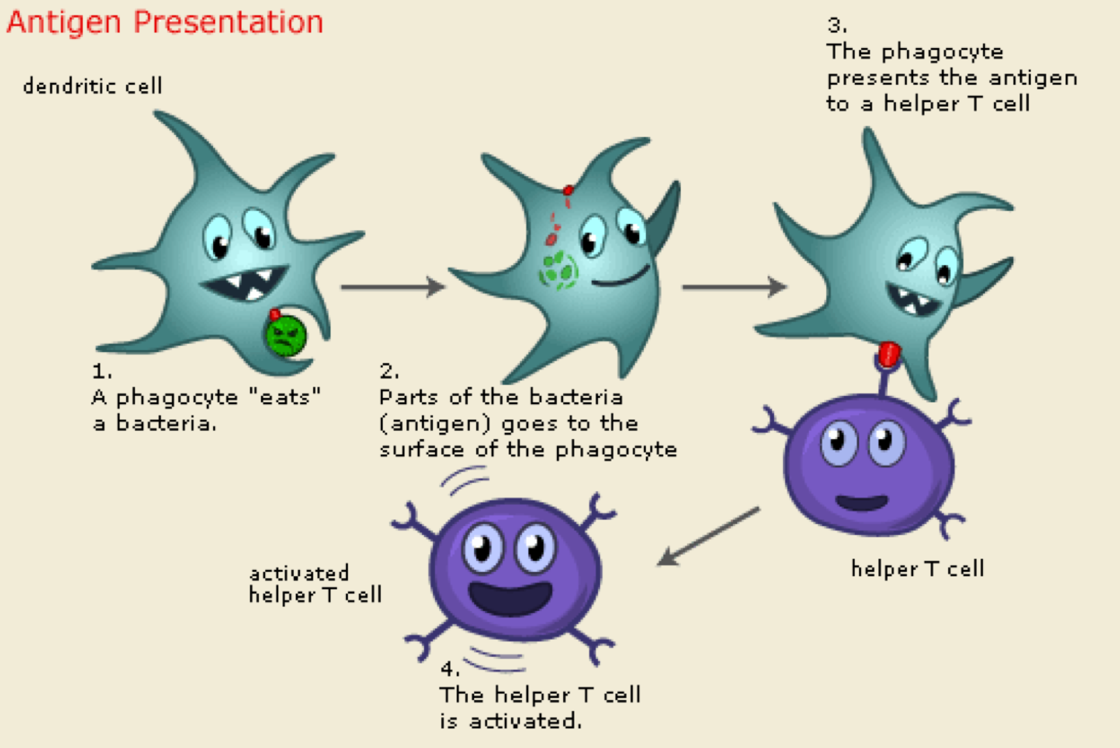
HOW CAN HELPER T CELL GET ACTIVATED?
when a macrophage or dendritic cell which has eaten an invader, travels to the nearest lymph node to present information about the captured pathogen.
The phagocyte displays an antigen fragment from the invader on its own surface, a process called antigen presentation.
When the receptor of a helper T cell recognizes the antigen, the T cell is activated.
Once activated, helper T cells start to divide and to produce proteins that activate B and T cells as well as other immune cells.
from the males slides

Slide 56
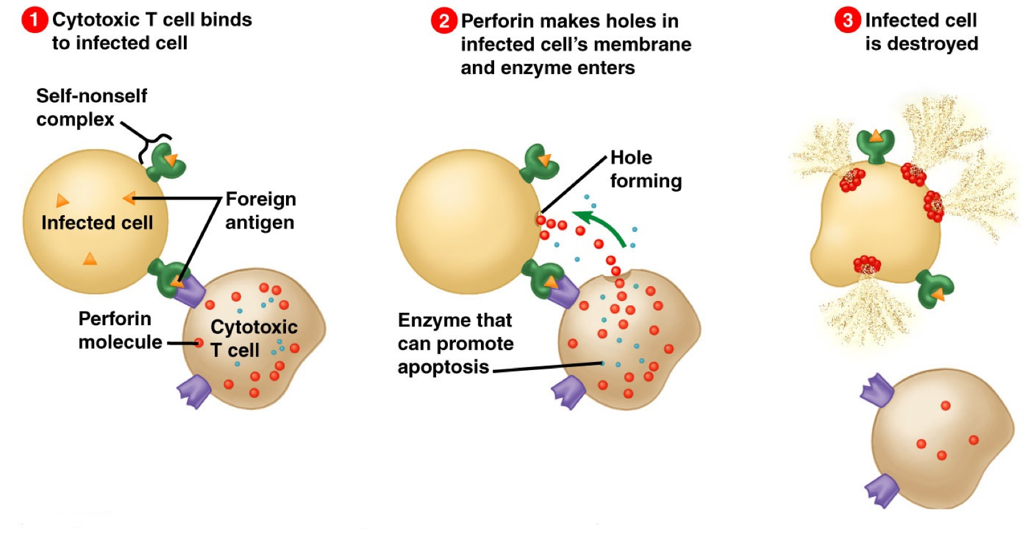
Killer T cells

Slide 57
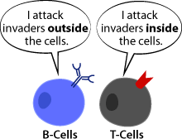
B- Lymphocytes
(thymus-independents)
First discovered in Bird Bursa
Formed in: Bone marrow, germinal layer of lymph node, red pulp of spleen
Life span 2-7 days
It transforms into large plasma cell (produce antibody)
Function: Humoral immunity.
Stimulated by antigen transforming
B-lymphocyte تتعرض ل antigeneفتتحول إلى
plasma cell which produces the antibodies
ثم يحدث تفاعل بين antigenes , antibodiesونتخلص منهم اثنينهم

Slide 58
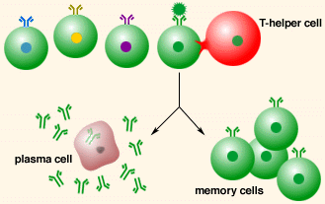
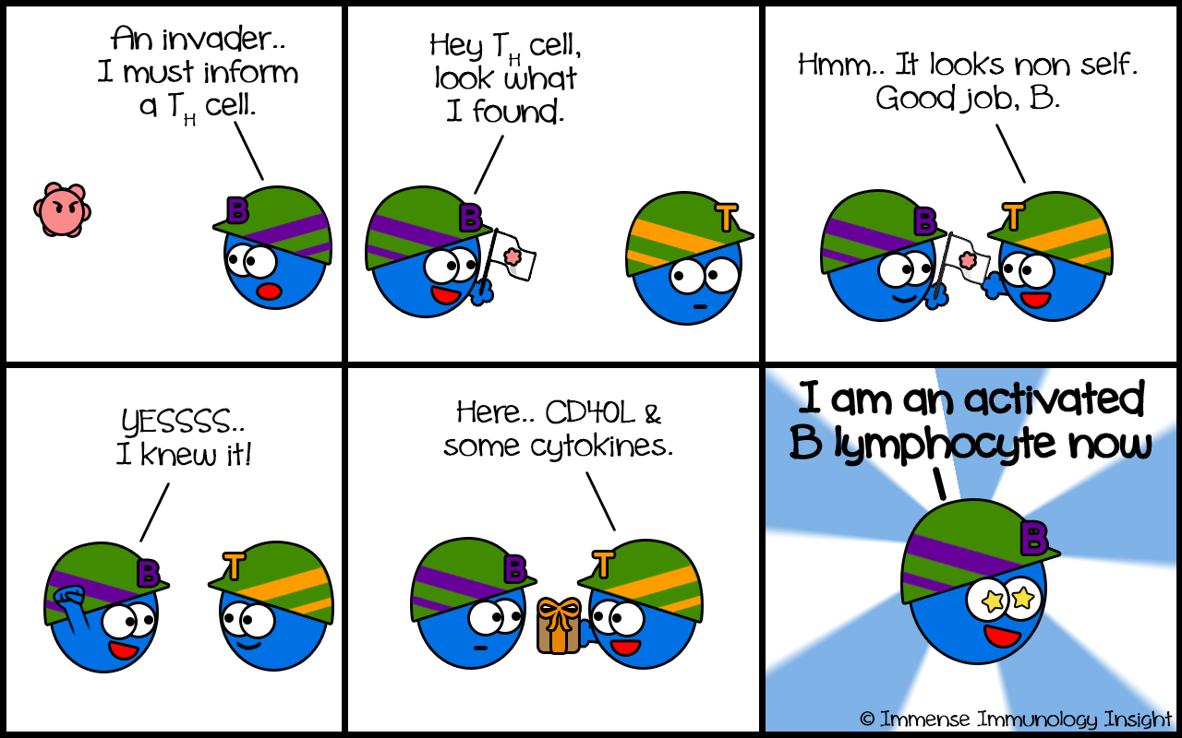
B-Cells
B-lymphocytes search for an antigen that matches their receptors, when it finds a suitable antigen it connects to it and sets off a signal then goes to a T-helper cell. The T-helper cell gives the B-cell a protein that enables it to clone itself into 2 types of B-cells:
plasma cell
B memory cells
produces specific proteins called antibodies
have a prolonged lifespan and can “remember” specific intruders
T-cells are also able to produce memory cells with an even longer span than B memory cells, so when the same intruder tries to act the body for a second time-both B and T cells will help activate the immune system faster and wipe out the invaders before the infected human feels any symptoms
body achieves immunity against this type of invader
From male slides

Slide 59
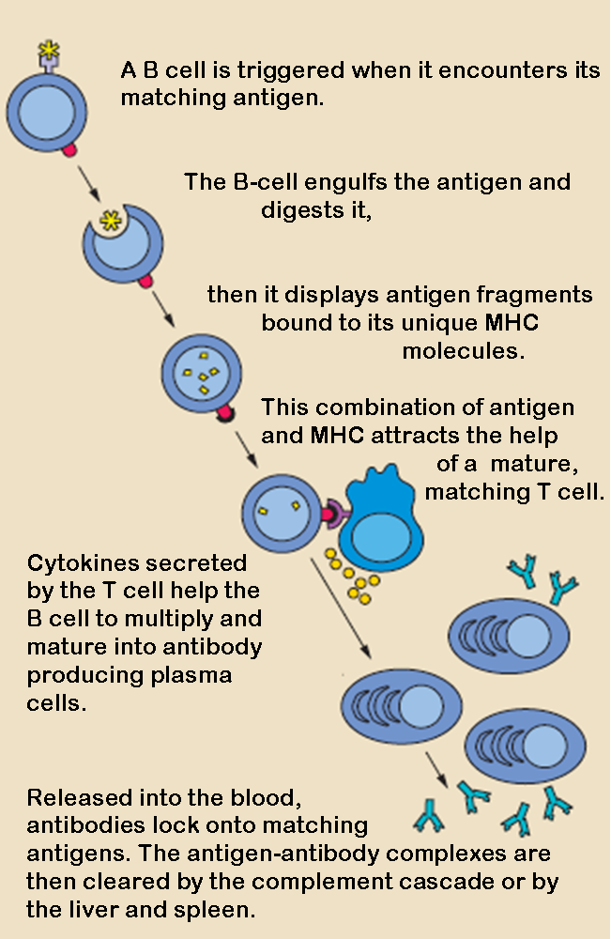
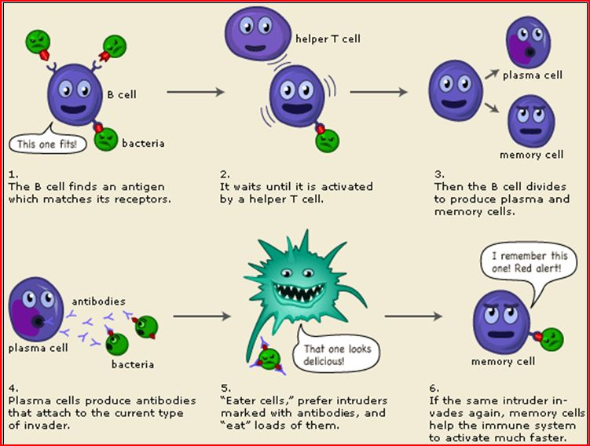

Slide 60
Leucocytosis
Muscular exercise
Anesthesia
Cold or hot weather
Bacterial and warm infection
Pregnancy
Diurnal ↓morning ↑ evening
Labor
After meals
Pain
Emotions
Emotions
Cold bath
Increased number of WBCs
occurs in the following conditions:

Slide 61
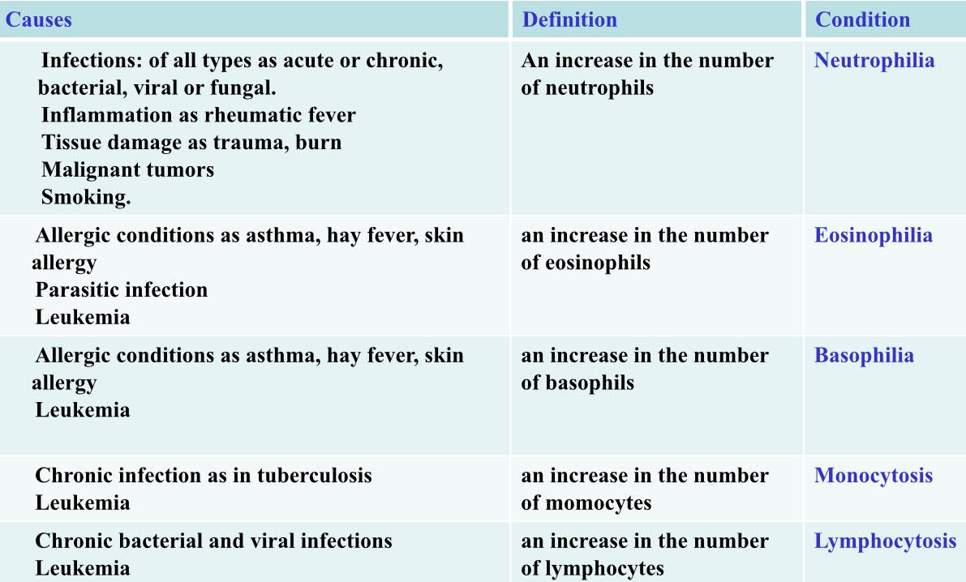
Pathological Leukocytosis
from the males slides

Slide 62
Leucopenia (Leukopenia )
decrease in the total leucocyte count below 4.000/mm³.
In this condition the body is not protected against infections and death may occur.
It is caused by:
Bone marrow depression by radiation, drugs, and cancer chemotherapy.
Some bacterial infections as typhoid fever, brucellosis.
Some viral infections as AIDS, influenza, hepatitis.
Malnutrition (decrease B12, folic acid)
بالعادة لما يكون فيه Feverتزيد ال WBCإلا هذا النوع لو كان الشخص عنده Fever وقلت WBC رح يشكوا بال typhoid fever

Slide 63
Leukaemia
Cancer of white cells due to chromosomal abnormality caused by chemicals, radiation, and viruses
It is a malignant disease of bone marrow causing marked increase in WBCs , WBC more than 50x10³
Types of leukaemia:
Myeloblast leukaemia → myeloid cells
Lymphoblast leukaemia →lymphocytic cells Acute or chronic onset
Leukemia is associated with anemia and bleeding tendency (due to decrease in bone marrow area responsible for RBCs and platelet synthesis respectively).
from the female slides

Slide 64
Choose the correct answer
Quiz
All of the following are granular
WBC EXEPT
neutrophil
basophil
lymphocyte
Eosinophil
1
4
Monocytes stey in the blood
weeks
months
10-20 days
10-20 hours
3
1
2
4
2
2
2
The monocyte formation site is:
bone marrow
thymus
lymphoid tissues
Humoral immunity is the
function of:
T-lymphocye
B-lymphocye
monocytes
Basophil
5
3
The attraction of the neutrophils
to inflamed area is:
Margination
chemotaxis
Diapedesis
6
Leukaemia is considered as:
Cancer of white cells due to uncontrolled growth of cells
Cancer of white cells due to chromosomal abnormality
Increase in WBC
Decrease in WBC

Slide 65
Thank you & good luck
Boys team members:
أنس السويداء
محمد الحسن
محمد الجمعة
محمد القحطاني
محمد المحيميد
محمد الصويغ
خالد العقيلي
خالد الدوسري
خالد شويل
عبدالجبار اليماني
عمر الفوزان
فهد الحسين
سعد الهداب
سعد الفوزان
نواف اللويمي
انس السيف
سعود العطوي
نايف المطيري
نواف اللويمي
نواف هلال
عبدالرحمن العقيل
عبدالله الربيعة
عبدالله الزيد
عبدالله العمر
عبدالله المعيذر
Girls team members:
مها العمري
هديل عورتاني
ريما العنزي
روتانا خطيب
لجين عزيز الرحمن
العنود المفرج
ريم القرني
عهد القرين
العنود المنصور
مها النهدي
بلقيس الراجحي
سارة البليهد
ميعاد النفيعي
نورة البسام
عبير العبدالجبار
وجدان الشامري
الجوهرة الشنيفي
العنود المنصور
Team Leaders:
-مها بركة - طارق العميم

