Slide 1
Hip, Knee & Ankle Joints
Dr Jamila EL Medany

Slide 2
OBJECTIVES
At the end of the lecture, students should be able to:
List the type & articular surfaces of the hip, knee and ankle joints.
Describe the capsule and ligaments of the hip, knee and ankle joints.
Describe movements of hip, knee and ankle joints and list the muscles involved in these movements.
List important bursae in relation to knee joint.
Apply Hilton’s law about nerve supply of joints.

Slide 3
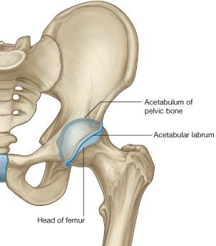
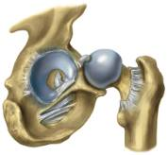
HIP JOINT
TYPE:
Synovial, Ball & Socket joint.
ARTICULAR SURFACES:
Acetabulum of hip (pelvic) bone
Head of femur
Acetabular labrum:
C-shaped fibro-cartilaginous collar attached to margins of acetabulum, increases its depth for better retaining of head of femur.
Acetabular labrum

Slide 4
CAPSULE
Attached Medially to hip bone :
1. Labrum acetabulare.
2. Transverse acetabular ligament.
Posteriorly :
Halfway along the posterior aspect of the neck. (Part of the neck lies inside the capsule and the other part is outside it).
Anteriorly :the neck of the femur is completely inside the capsule

Slide 5
Ligaments: (3) Extracapsular
Iliofemoral ligament:
Y-shaped
Located anterior to joint
limits extension
Intertrochanteric line
Pubofemoral ligament:
Located antero-inferior to joint
limits abduction & lateral rotation
Ischiofemoral ligament:
Located posterior to joint
limits medial rotation

Slide 6
(3) Intracapsular
Transverse acetabular ligament: converts acetabular notch into foramen through which pass acetabular vessels
Ligament of femoral head:
carries vessels to head of femur
Acetabular labrum

Slide 7
Movements
Flexion: Iliopsoas (mainly), sartorius, pectineus, rectus femoris.
Extension: Hamstrings (mainly), gluteus maximus (powerful extensor).
Abduction: Gluteus medius & minimus, sartorius.
Adduction: Adductors, gracilis.
Medial rotation: Gluteus medius & minimus.
Lateral rotation: Gluteus maximus, quadratus femoris, piriformis, obturator externus & internus.

Slide 8
BLOOD SUPPLY
The main arterial supply is from branches of the circumflex femoral arteries especially the medial).
The blood passes to the joint through :
(1) Retinacular fibers of the neck.
(2) Ligament of the head of the femur.

Slide 9
Damage of the retinacular fibers as in fracture neck of the femur can results in
A vascular necrosis of the head of the femur.
Fracture neck of the femur is common after age of (60) years especially in women because of Osteoporosis.

Slide 10
STABILITY OF THE JOINT
The hip joint is one of the most stable joints of the body because of :
(1) The Head of the femur fits very accurately in the acetabulum due to the following
A. The acetabulum is very deep and its depth is increased by the labrum acetabulare.
B. The labrum acetabulare forms a firm grip on the head of the femur.
C. The atmospheric pressure resists separation between the head of the femur and the acetabulum.
(2) The three strong Extrinsic ligaments.
(3) The surrounding strong Muscles.

Slide 11
DISLOCATION OF HIP JOINT
CONGENITAL
More common in girls and associated with inability to adduct the thigh.
The upper lip of the acetabulum fails to develop adequately.
The head of the femur rides up out of the acetabulum onto the gluteal surface of the ileum.

Slide 12
TRAUMATIC:
It is common in motor vehicle accidents when the thigh is flexed and adducted.
The dislocated head is displaced posteriorly to lie on the posterior surface of the ileum.
In posterior dislocation the sciatic nerve is liable to be injured.

Slide 13
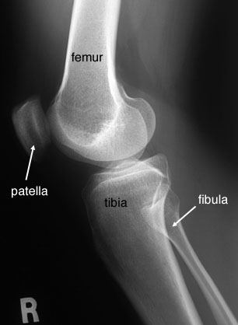
KNEE JOINT
FUNCTIONS:
1. Weight bearing.
2.Essential for daily activities: standing walking & climbing stairs.
3.The main joint responsible for sports: running, jumping , kicking etc.

Slide 14
Type & Articular Surfaces
Knee joint is formed of:
Three bones.
Three articulations.
Femoro-Tibial articulation: between the 2 femoral condyles & upper surfaces of the 2 tibial condyles
Type: synovial, modified hinge
Femoro-Patellar articulation: between posterior surface of patella & patellar surface of femur
Type: synovial, plane.

Slide 15
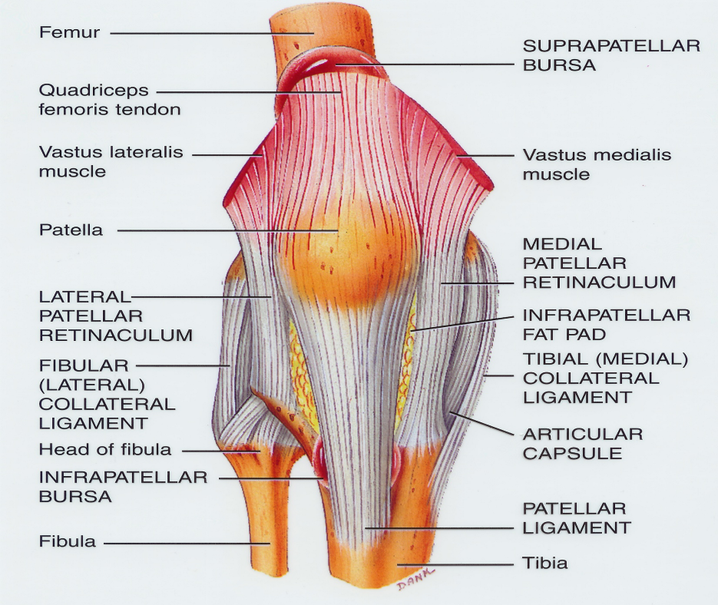
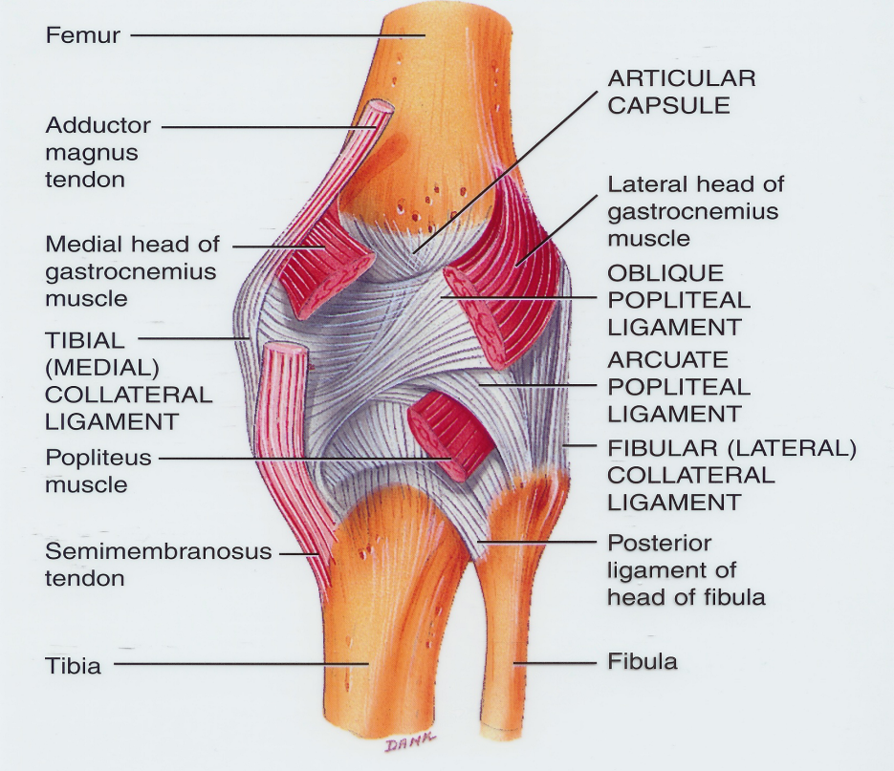
Capsule
Is Deficient Anteriorly & replaced by: quadriceps femoris tendon, patella & ligamentum patellae.
Possesses 2 openings: one for popliteus tendon & one for communication with suprapatellar bursa.

Slide 16
Ligaments: (4) Extracapsular
Ligamentum patellae (patellar ligament): from patella to tibial tuberosity.
Medial (tibial) collateral ligament: from medial epicondyle of femur to upper part of medial surface of tibia (firmly attached to medial meniscus).
Lateral (fibular) collateral ligament: from lateral epicondyle of femur to head of fibula
Oblique popliteal ligament: extension of semimembranosus tendon.

Slide 17
INTRA Capsular Structures : Menisci
They are 2 C-shaped plates of fibro-cartilage attached by anterior & posterior horns, to the articular surface of tibia.
FUNCTION:
They deepen articular surfaces of tibial condyles.
They serve as cushions between tibia & femur.
Lateral Meniscus:
Small & Circular.
Its outer border is separated from lateral collateral ligament by popliteal tendon.
Medial Meniscus:
Large & Oval.
Its outer border is (firmly attached to the capsule & medial collateral ligament.
medial meniscus is less mobile & more liable to be injured.

Slide 18
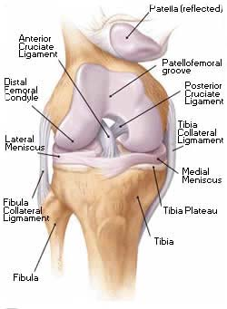
CRUCIATE Ligaments
Two in number, situated in the middle of the joint.
They are called Cruciate because they cross each other
Have received the names Anterior and Posterior, from the position of their attachments to the tibia.
Anterior cruciate ligament:
Extends from anterior part of intercondylar area of tibia to posterior part of lateral condyle of femur.
Posterior cruciate ligament:
Extends from posterior part of intercondylar area of tibia to anterior part of medial condyle of femur.

Slide 19
Functions of Cruciate Ligaments
Anterior ligament:
Prevents posterior displacement of the femur on the tibia and the tibia from being pulled anteriorly when the knee joint is extended.
It is taught in Hyper extension.
Posterior ligament:
prevents anterior displacement of the femur on the tibia and the tibia from being pulled posteriorly when the knee joint is flexed.
It is taught in Hyper flexion.

Slide 20
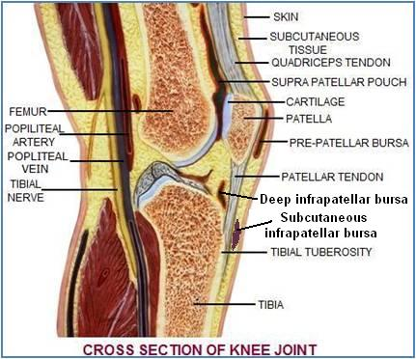
Bursae Related to Knee joint
Suprapatellar bursa: between femur & quadriceps tendon, communicates with synovial cavity of knee joint (Clinical importance?)
Prepatellar bursa: between patella & skin.
Deep infrapatellar bursa: between tibia & ligamentum patella.
Subcutaneous infrapatellar bursa: between tibial tuberosity & skin.
Popliteal bursa between popliteus tendon & capsule, communicates with synovial cavity of knee joint.

Slide 21
MOVEMENTS
FLEXION:
Mainly by hamstring muscles: biceps femoris , semitendinosus & semimembranosus.
Assisted by sartorius , gracilis & popliteus.
EXTENSION:
Quadriceps femoris.
ACTIVE ROTATION (PERFORMED WHEN KNEE IS FLEXED):
A) MEDIAL ROTATION:
Mainly by semitendinosus & semimembranosus.
Assisted by sartorius & gracilis.
B) LATERAL ROTATION:
Biceps femoris.

Slide 22
INACTIVE (DEPENDANT) ROTATION
A) LOCKING OF KNEE:
The joint assumes the position of full extension.
It becomes a rigid structure.
The menisci are compressed between the tibial and femoral condyles.
Results mainly by tension of anterior cruciate ligament.
Tightening of all the major ligaments.
The femur is medially rotated on the tibia (Lateral rotation of tibia).

Slide 23
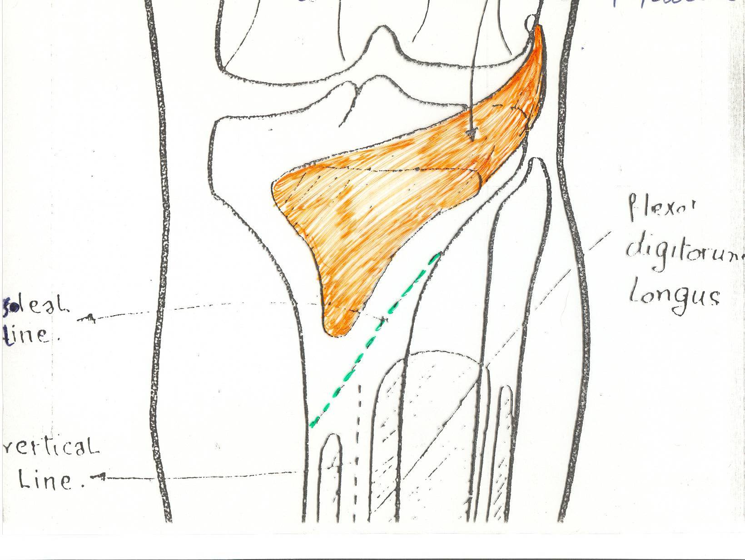
B) UNLOCKING OF KNEE:
Medial rotation of tibia (Lateral rotation of femur), at the beginning of flexion
Performed by Popliteus to relax ligaments & allow easy flexion.
popliteus

Slide 24
STABILITY OF THE JOINT
1. Muscles :
QUADRICEPS particularly the inferior fibers of the Vasti lateralis and medialis.
Many sport injuries can be preventable through appropriate training and conditioning of the muscle.
2. Ligaments :
The knee joint can function well following a ligamentous strain if the quadriceps is intact.

Slide 25
Skeleton of Foot

Slide 26
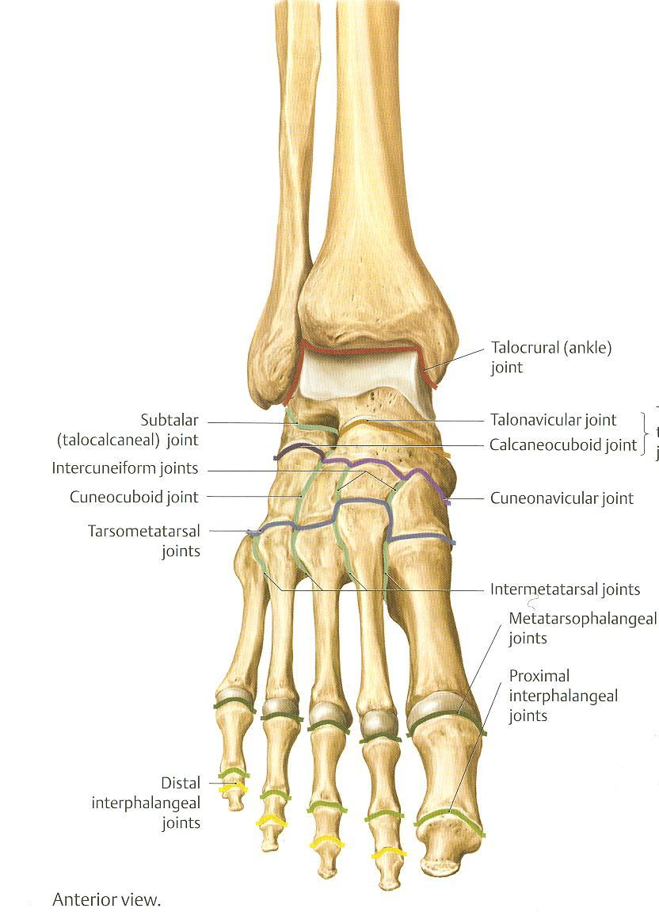
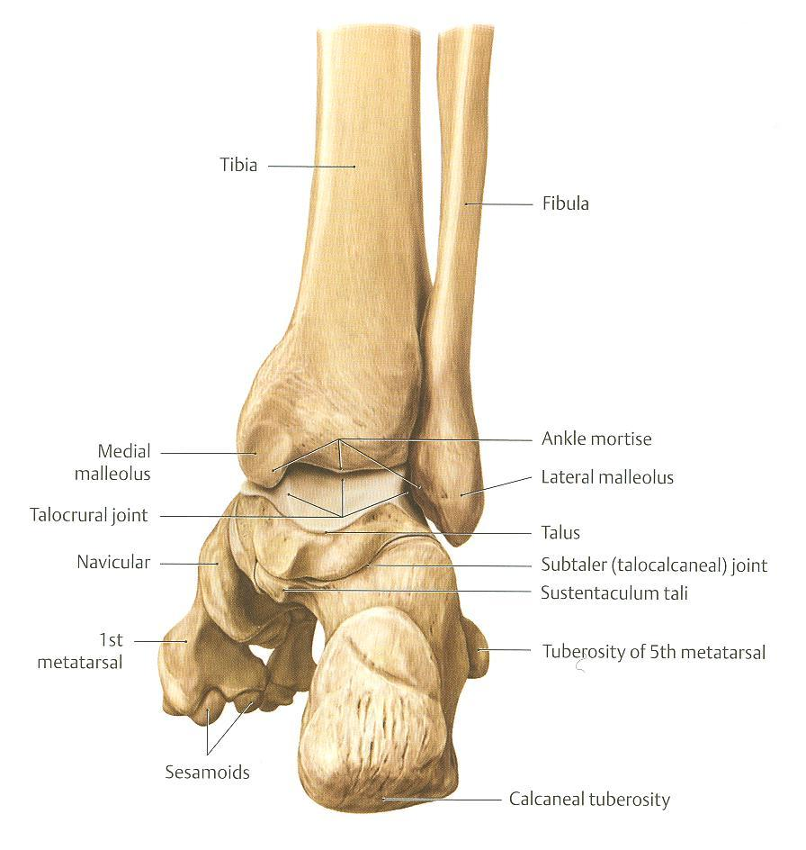
ANKLE JOINT
TYPE: synovial, hinge joint.
ARTICULAR SURFACES:
UPPER:
A socket formed by: Lateral malleolus, the lower end of tibia & medial malleolus.
LOWER:
Body of talus.

Slide 27
Ligaments
MEDIAL (DELTOID) LIGAMENT:
A strong triangular ligament.
Apex: attached to medial malleolus.
Base: subdivided into 4 parts:
Anterior tibiotalar part.
Tibionavicular part.
Tibiocalcaneal part.
Posterior tibiotalar part.
LATERAL LIGAMENT:
Composed of 3 separate ligaments
Anterior talofibular ligament.
Calcaneofibular ligament.
Posterior talofibular ligament.

Slide 28
Movements
DORSIFLEXION:
Performed by muscles of anterior compartment of leg (tibialis anterior, extensor hallucis longus, extensor digitorum longus & peroneus tertius).
PLANTERFLEXION:
Initiated by soleus.
Maintained by gastrocnemius.
Assisted by other muscles in posterior compartment of leg (tibialis posterior, flexor digitorum longus & flexor hallucis longus) + muscles of lateral compartment of leg (peroneus longus & peroneus brevis).
INVERSION & EVERSION MOVEMENTS occur on the talo-calcaneo-navicular (subtalar ) joint (Not on ankle joint).

Slide 29
Nerve Supply of all JOINTS
HILTON’S LAW:
“The joint is supplied by branches from nerves supplying muscles acting on it”.

Slide 30
BEST LUCK

