Slide 1
BONES OF LOWER LIMB
ANATOMY DEPARTMENT
Dr. Sanaa Alshaarawi

Slide 2
OBJECTIVES
At the end of the lecture the students should be able to:
Classify the bones of the three regions of the lower limb (thigh, leg and foot).
Memorize the main features of the
Bones of the thigh (femur & patella)
Bones of the leg (tibia & Fibula).
Bones of the foot (tarsals, metatarsals and phalanges)
Recognize the side of the bone

Slide 3
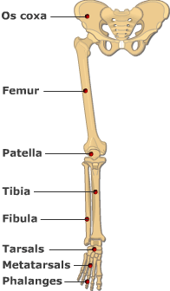
BONES OF THIGH (Femur and Patella)
Femur:
Articulates above with acetabulum of hip bone to form the hip joint.
Articulates below with tibia and patella to form the knee joint.

Slide 4
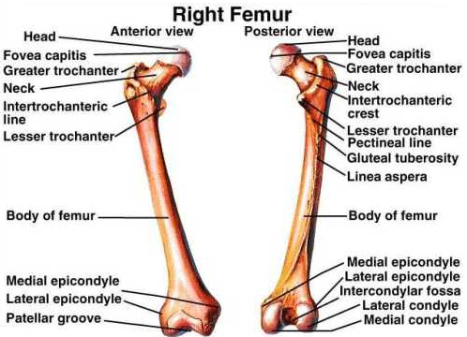
BONES OF THIGH (Femur and Patella)
Femur :
Consists of :
Upper end
Shaft
Lower end
Anterior View
Posterior view

Slide 5
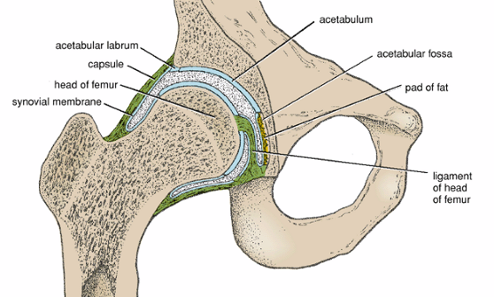
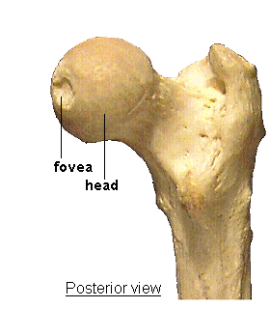
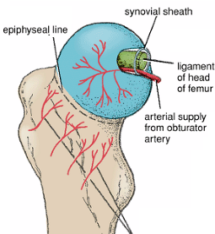
UPPER END OF FEMUR
Head :
It articulates with acetabulum of hip bone to form hip joint.
Has a depression in the center (fovea capitis), for the attachment of ligament of the head of femur.
Obturator artery passes along this ligament to supply head of femur.
Neck :
It connects head to the shaft.
NECK

Slide 6
UPPER END OF FEMUR
Greater & lesser trochanters :
Anteriorly, connecting the 2 trochanters,
the inter-trochanteric line, where the iliofemoral ligament is attached.
Posteriorly, the inter-trochanteric crest, on which is the quadrate tubercle (Qudratus femoris muscle).

Slide 7
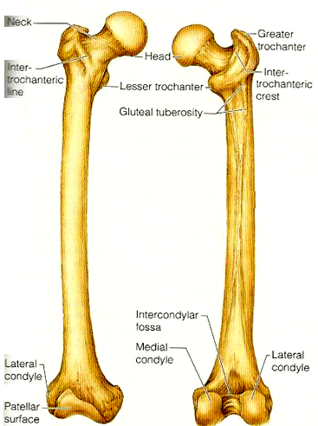
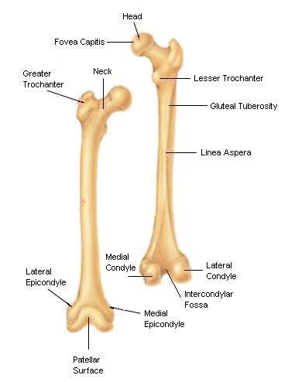
SHAFT OF FEMUR
It has 3 surfaces
Anterior
Medial
Lateral
It has 3 borders
Two rounded medial and lateral
One thick posterior border or ridge called linea aspera
Anterior view
Posterior view

Slide 8
SHAFT OF FEMUR
Anteriorly : is smooth and rounded.
Posteriorly : has a ridge, the linea aspera.
Posteriorly : below the greater trochanter is the gluteal tuberosity for attachment of gluteus maximus muscle.
The medial margin of linea aspera M continues below as medial supracondylar ridge.
The lateral margin L continues below with the lateral supracondylar ridge.
A Triangular area, the popliteal surface lies at the lower end of shaft.
M
L

Slide 9
LOWER END OF FEMUR
Has lateral and medial condyles, separated anteriorly by articular patellar surface, and posteriorly by intercondylar notch or fossa.
The 2 condyles take part in the knee joint.
Above the condyles are the medial & lateral epicondyles.
Anterior
Posterior

Slide 10
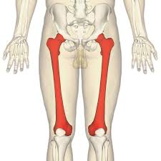
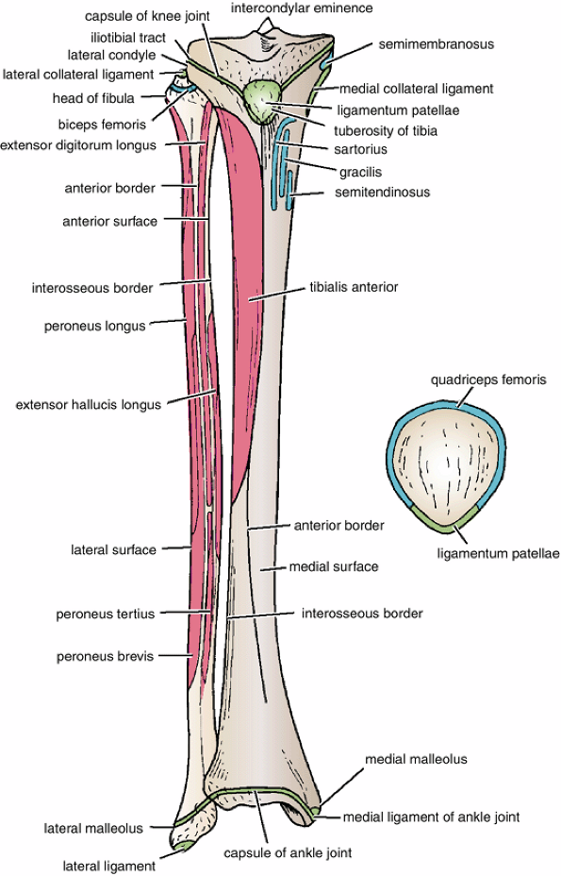
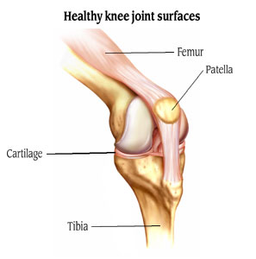
PATELLA
It is a largest sesamoid bone (lying inside the Quadriceps tendon in front of knee joint).
Its anterior surface is rough and subcutaneous.
Its posterior surface articulates with the condyles of the femur to form knee joint.
Its apex lies inferiorly and is connected to tuberosity of tibia by ligamentum patellae.
Its upper, lateral, and medial margins give attachment to Quadriceps femoris muscles.

Slide 11
POSITION OF FEMUR (RIGHT OR LEFT)
Head is directed upward & Medially.
Shaft is smooth and convex anteriorly.
Shaft is rough and concave posteriorly.

Slide 12
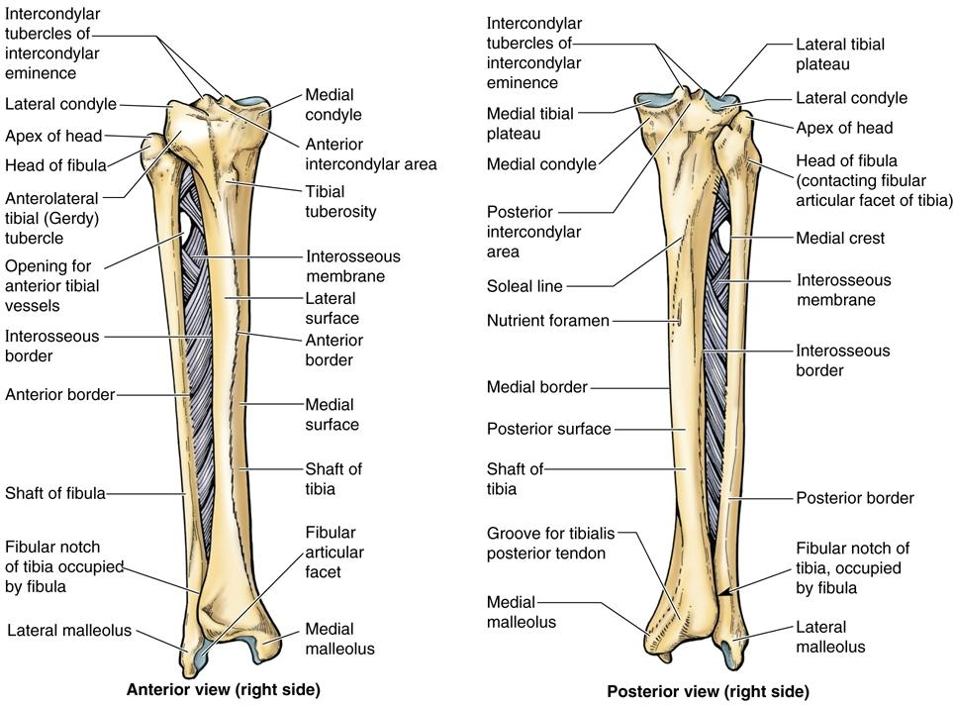
BONES OF LEG (TIBIA AND FIBULA)
Tibia :
It is the medial bone of leg.
Fibula :
It is the lateral bone of leg.
Each of them has upper end, shaft, and lower end.

Slide 13
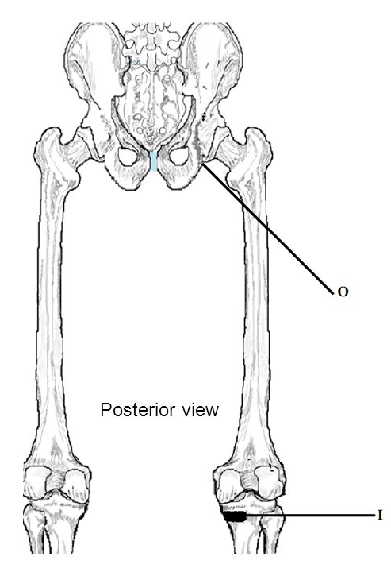
TIBIA
Upper end has:
2 tibial condyles:
Medial condyle : is larger and articulate with medial condyle of femur. It has a groove on its posterior surface for semimembranosus ms.
Lateral condyle : is smaller and articulates with lateral condyle of femur. It has facet on its lateral side for articulation with head of fibula to form proximal tibio-fibular joint.
Intercondylar area : is rough and has intercondylar eminence.

Slide 14
TIBIA
Shaft has:
Tibial tuberosity :
Its upper smooth part gives attachment to ligamentum patellae.
Its lower rough part is subcutaneous.
3 borders :
Anterior boder : sharp and subcutaneous.
Medial border.
Lateral border interosseous border.
3 surfaces :
Medial : subcutaneous.
Lateral
Posterior has oblique line, soleal line for attachment of soleus muscle

Slide 15
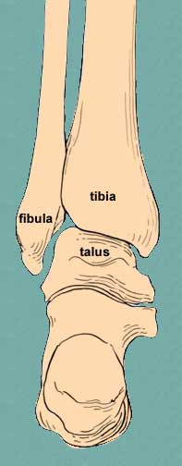
TIBIA
Lowe end:
Articulates with talus for formation of ankle joint.
Medial malleolus:
Its medial surface is subcutaneous.
Its lateral surface articulate with talus.
Fibular notch: lies on its lateral surface of lower end to form distal tibiofibular joint.

Slide 16
POSITION OF TIBIA (RIGHT OR LEFT)
Upper end is larger than lower end.
Medial malleolus is directed downward and medially.
Shaft has sharp anterior border.

Slide 17
FIBULA
It is the selender lateral bone of the leg.
It takes no part in articulation of knee joint.
Its upper end has :
Head : articulates with lateral condyle of tibia.
Styloid process.
Neck.

Slide 18
FIBULA
Shaft has :
4 borders : its medial ‘interoseous border gives attachment to interosseous membrane.
4 surfaces.
Lower end forms :
Lateral malleolus :
is subcutaneous.
Its medial surface is smooth for articulation with talus to form ankle joint.

Slide 19
BONES OF FOOT
7 Tarsal bones: start to ossify before birth and end ossification by 5th year in all tarsal bones. They are :
Calcaneum.
Talus .
Navicular.
Cuboid.
3 cuneiform bones.
Only Talus articulates with tibia & fibula at ankle joint.
Calcaneum: the largest bone of foot, forming the heel.

Slide 20
BONES OF FOOT
5 Metatarsal bones:
They are numbered from medial (big toe) to lateral.
1st metatarsal bone is large and lies medially.
Each metatarsal bone has a base (proximal). a shaft and a head (distal).
14 phalanges:
2 phalanges for big toe (proximal & distal)
3 phalanges for each of the lateral 4 toes (proximal, middle & distal)
Each phalanx has base, shaft and a head.
1
2
3
4
5

Slide 21
THANK YOU

Slide 22
SUMMARY
Skeleton of lower limb consists of:
Femur: is the bone of thigh.
Tibia: is the medial bone of the leg.
Fibula: is the lateral bone of leg.
Skeleton of foot :
Tarsal bones (7 in number), calcaneum is the largest bone forming the heel.
Metatarsal bones (5 in number).
Phalanges (14 in number).
The subcutaneous parts of bones in the lower limb are:
Patella.
Anterior border of the tibia
Tibial tuberosity.
Medial surface of shaft of tibia.
Medial malleolus of tibia.
Lateral malleolus of fibula.
The foot is a complex structure. There are 26 bones in each foot alone. The foot is also well muscled and is supported by ligaments and tissue known as fascia.
Support is of prime importance in the foot, as it bears the weight of the body and must adopt different configurations to permit locomotion.

Slide 23
The patella :
Lies on the back of the knee joint.
Has apex lying superiorly.
Has smooth articulating anterior surface.
Gives attachment to quadriceps femoris tendon.
Which one of the foot bones contributes in the ankle joint ?
Calcaneum.
Talus.
Cuboid.
Navicular.
The tarsal bones of foot consists of :
5 bones.
7bones.
9 bones.
10 bones.

Slide 24
Which one of the following bones is the largest bone in the foot ?
Cuboid.
Cuneiform.
Navicular.
Calcaneum.
Which one of the following bones forms the heel of foot?
a. Talus.
b. Calcaneum.
c. Cuboid.
d. Navicular.
The medial bone of the leg is :
Femur.
Humerus.
Tibia.
Fibula.

