Slide 1
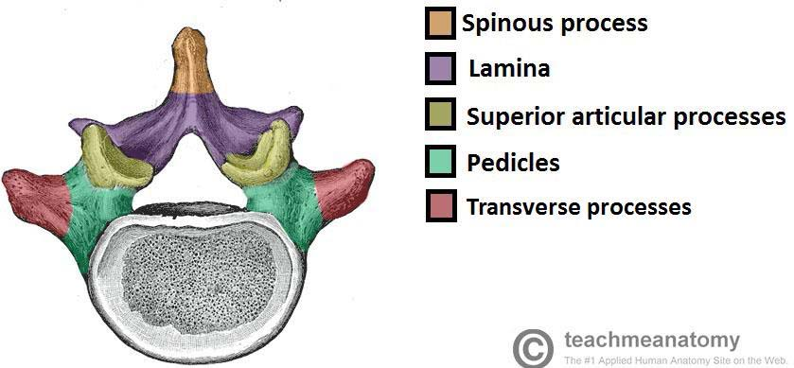
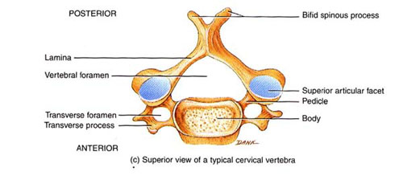
CERVICAL SPINE
DEPARTMENT OF ANATOMY.
DR.SANAA AL-SHAARAWY.

Slide 2
CERVICAL SPINES
By the end of this lecture the student should be able to:
Describe the 7 cervical vertebrae, (typical & atypical).
Describe the joints between the cervical vertebrae.
Describe the movements which occur in the region of the cervical vertebrae.
List the structures which connect 2 adjacent vertebrae together.

Slide 3
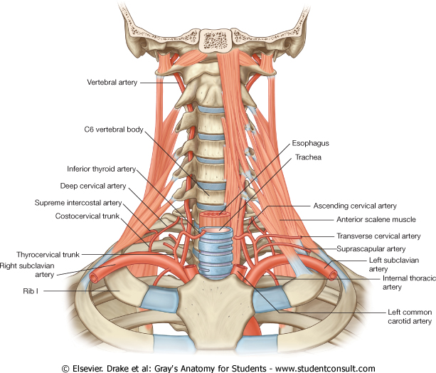
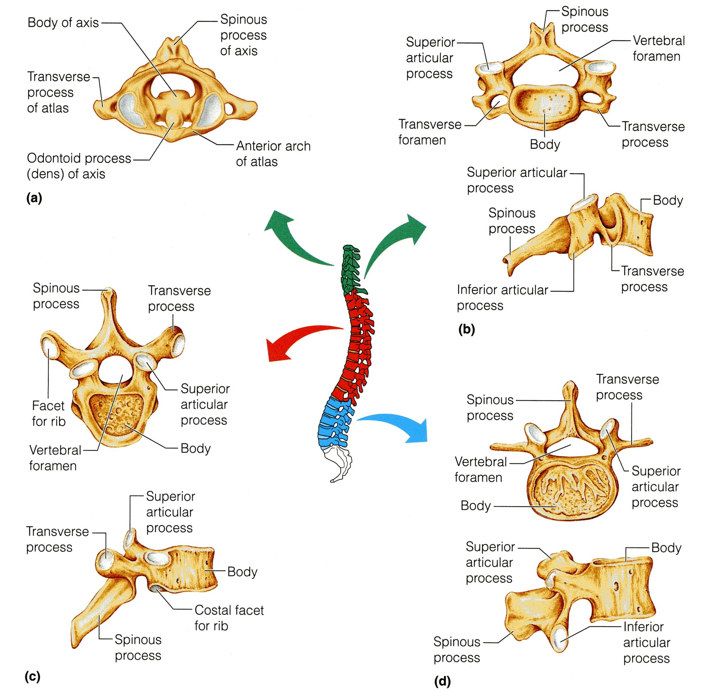
CERVICAL
VERTEBRAE
They are 7 in number.
All characterized by presence of foramen transversarium in the transverse process.
They are classified into:
1- Typical: 3rd , 4th ,5th & 6th.
2- Atypical: 1st, 2nd and 7th.

Slide 4
The body is small and longer horizontally than antero-posterior
Its spinous processes is short bifid.
The transverse processes has the foramen transversarium through which allows passage of the vertebral arteries & veins.
TYPICAL
CERVICAL VERTEBRAE C3, C4, C5 &C 6
The vertebral foramen is large and triangular.

Slide 5
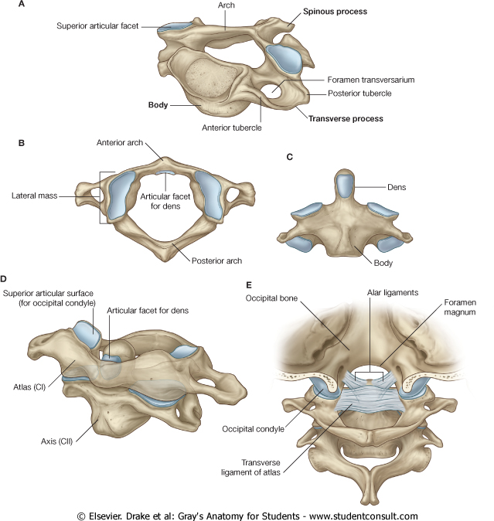
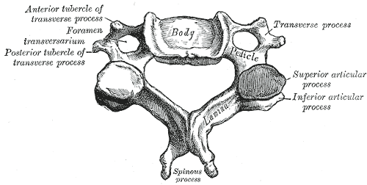
TYPICAL
CERVICAL VERTABRAE
The superior articular processes:
Which have small facets that face upward and backward.
The inferior articular processes:
Which have facets that, face downward and forward.
The transverse process has 2 tubercles one infront and one behind the transverse foramen.

Slide 6
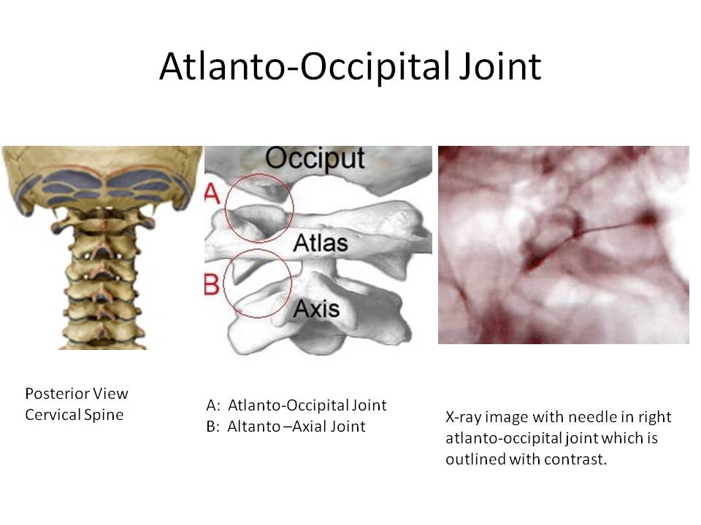
ATLAS- C1
It has No body, No spine.
It has 2 lateral masses connected together by small anterior arch & long posterior arch.
Each lateral mass has articular surface on its upper and lower aspects.
The superior articular surface :
Articulates with the occipital condyles of the skull.
It forms the Atlanto-Occipital joints.
This joint allows you to nod “say Yes” (Flexion of the head).

Slide 7
The inferior articular surface of the atlas is circular and articulates with the axis. It forms the 2 lateral Atlanto-Axial joints.
This joint together with the joint between the dens of axis and anterior small arch of atlas, they allow you to “Say No “ lateral rotation of the face.
AXIS
Atlanto-axial joint

Slide 8
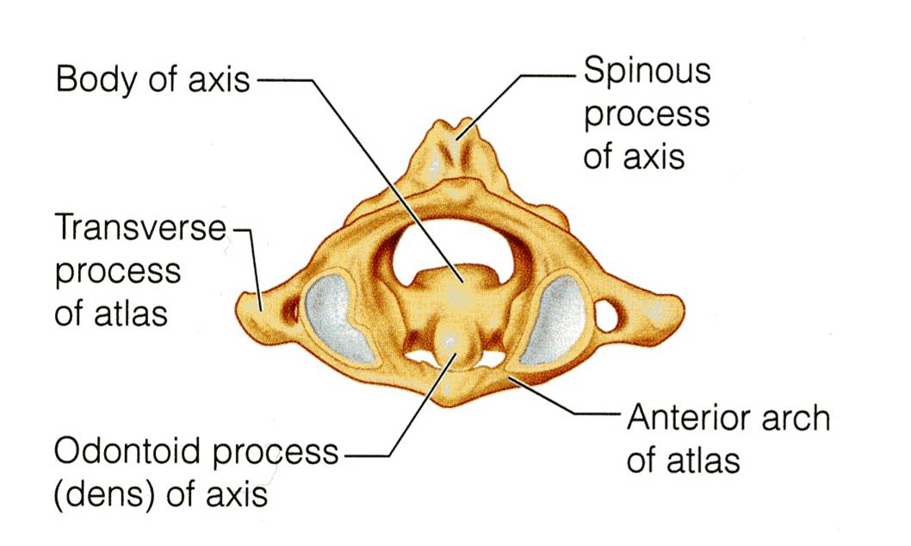
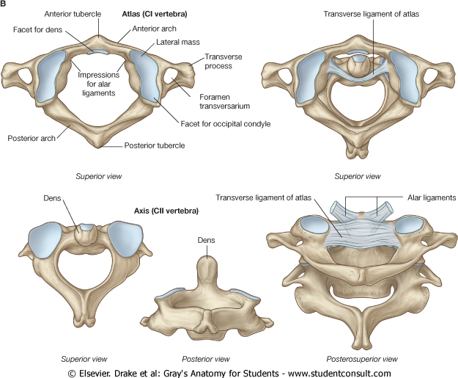
AXIS- C 2
It acts as a pivot for the rotation of the atlas (and the skull) above.
It has a large upright peg-like odontoid process, or dens, which projects upward from the superior surface of the body.
Actually it represents the body of the atlas that has fused with the axis.

Slide 9
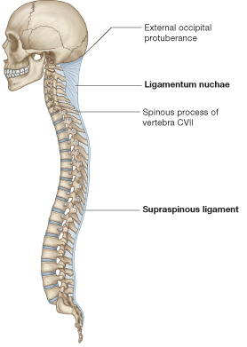
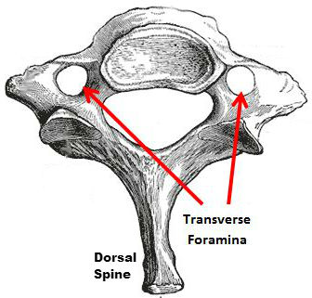
7th
CERVICAL VERTEBRA
OR
Cervica Prominens
It has the longest spinous process which is not bifid.
It is the first spine to be felt subcutaneously in the root of back of neck.
The transverse process is large while its foramen transversaium is small and may be absent, and does not transmit the vertebral artery.

Slide 10
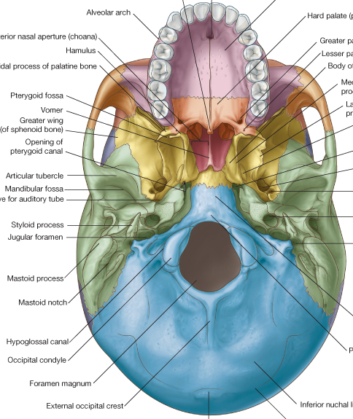
Joints of Cervical Vertebrae
Atlanto-Occipital Joints
Synovial joints between the occipital condyles of skull and upper facets on the lateral mass of the atlas.
1
2

Slide 11
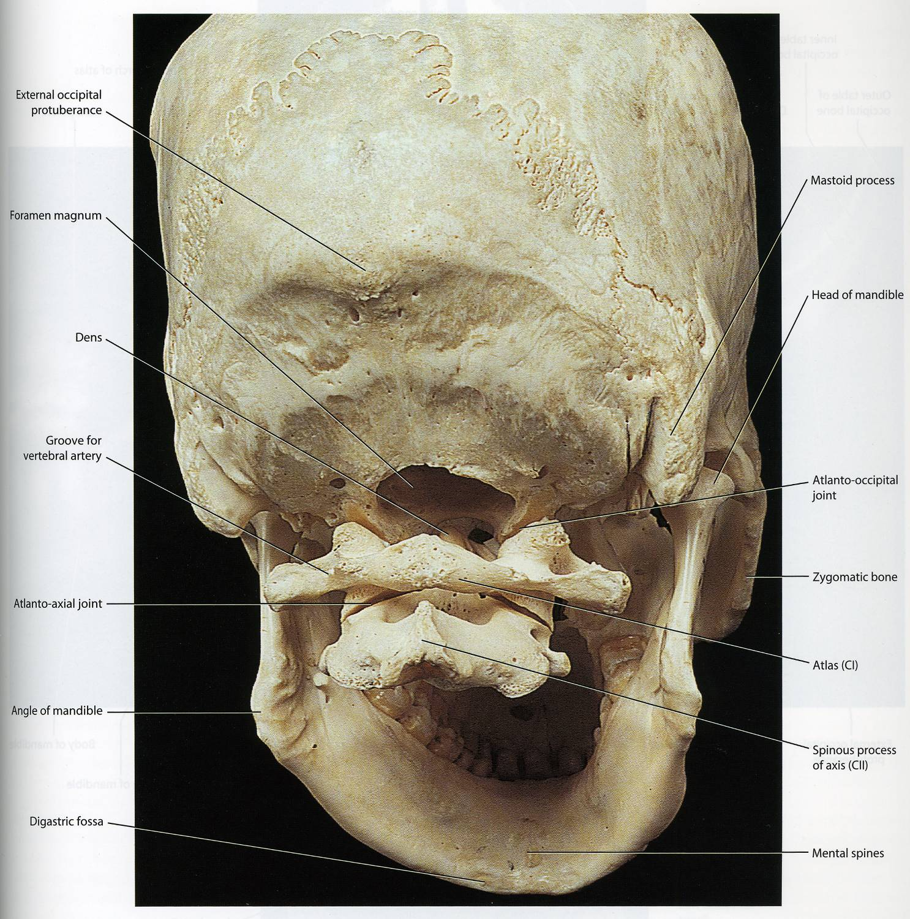
The Atlanto-occipital joints are synovial joints between the occipital condyles, and the superior facets of the lateral masses of the atlas below.
atlas
axis
L
P
A
M

Slide 12
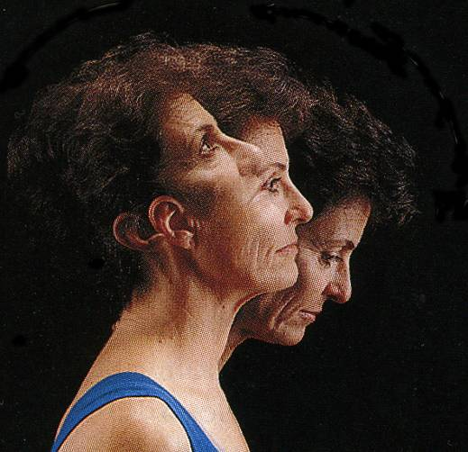
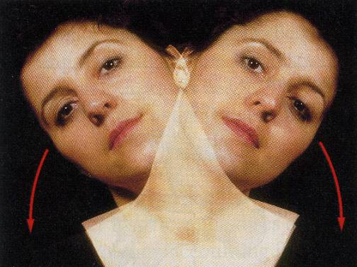
MOVEMENTS IN THE ATLANTO-OCCIPITAL JOINT
The joints are capable of:
Flexion,
Extension, and
Lateral flexion;
They do not rotate.

Slide 13
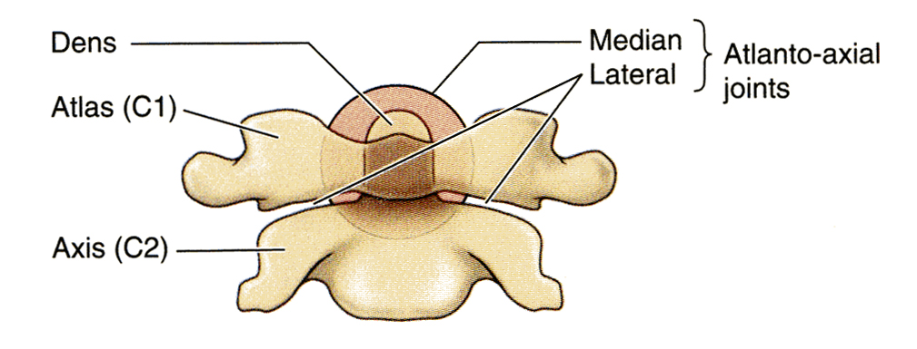
ATLANTO-AXIAL JOINTS
The Atlanto-axial joints are Three Synovial Joints:
One median, between the odontoid process and the anterior arch of the atlas.
the other two are between the inferior facet of lateral masses of the atlas and superior facets of the axis.

Slide 14
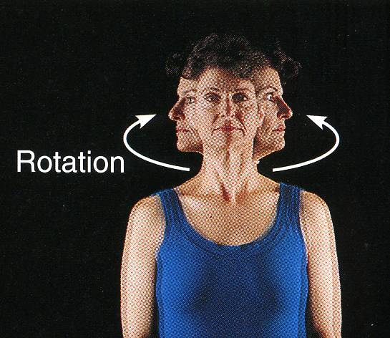
MOVEMENTS IN THE ATLANTO-AXIAL
JOINT
There can be extensive rotation of the atlas and the skull (and thus of the head on the axis).
N.B Atlanto-axial joint allows you to “Say No “ lateral rotation of the face.

Slide 15
JOINTS OF THE VERTEBRAL COLUMN BELOW THE AXIS
JOINTS BETWEEN
TWO VERTEBRAL BODIES

Slide 16
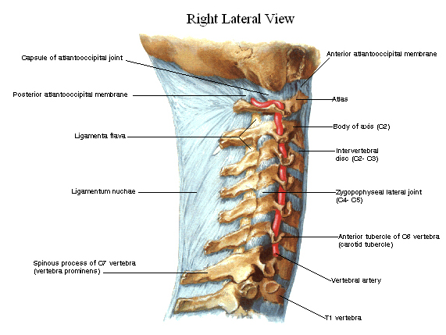
II- Synovial joints between their articular processes
I- Cartilaginous joints between their bodies .
With exception of the first two cervical vertebrae, the other cervical vertebrae articulate with each other by means of :

Slide 17
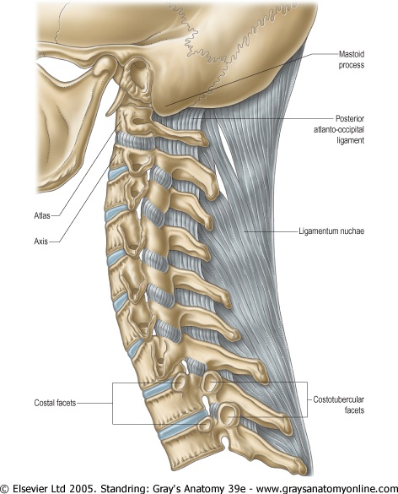
I- Intervertebral disc
The upper and lower surfaces of the bodies of 2 adjacent vertebrae are covered by thin plates of hyaline cartilage.
Between the plates of hyaline cartilage is an intervertebral disc of fibrocartilage.
The collagen fibers of the disc strongly connect the bodies of the two vertebrae.

Slide 18
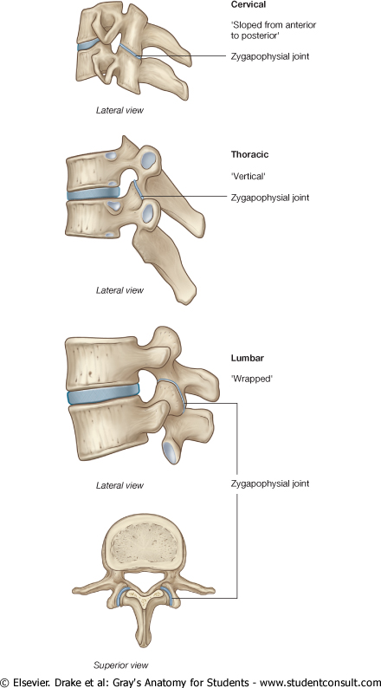
JOINTS BETWEEN TWO VERTEBRAL ARCHES
Joint between the articular processes of two adjacent vertebrae.

Slide 19
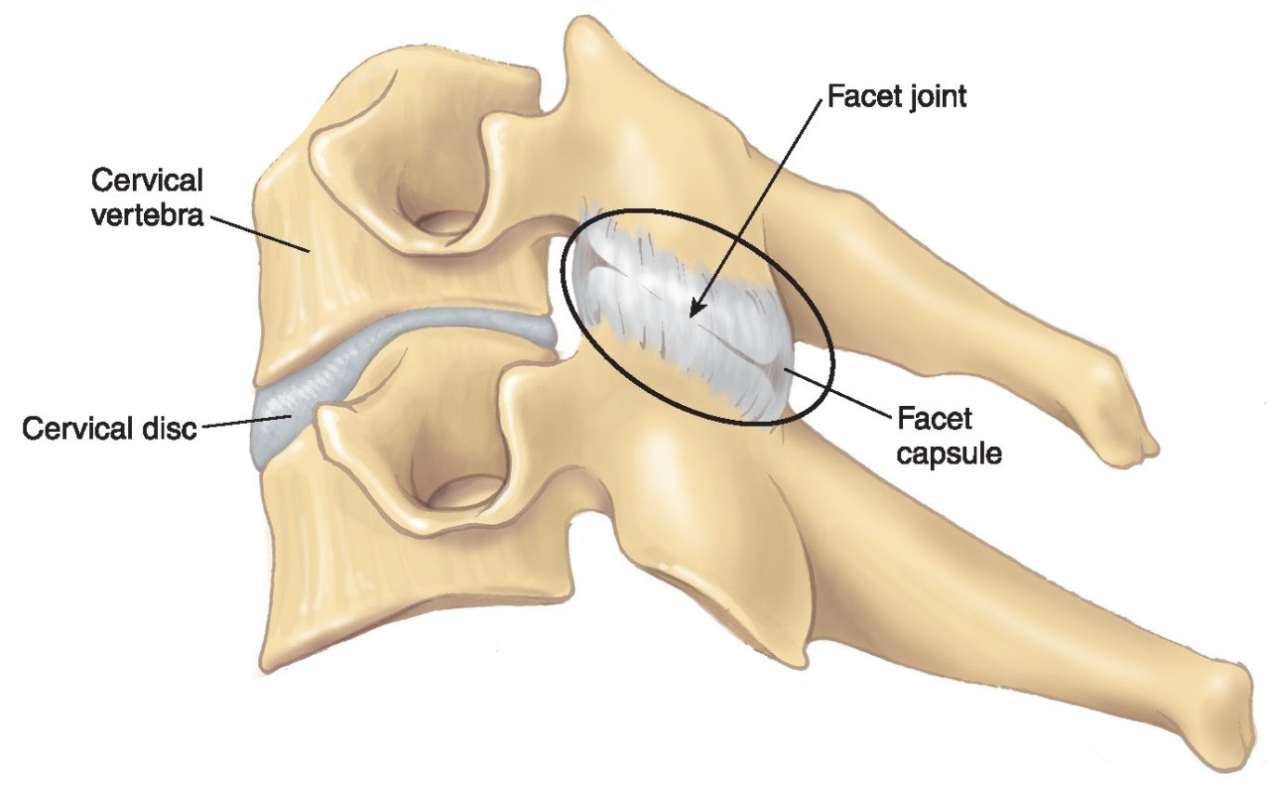
The joints between two vertebral arches consist of synovial joints between the superior and inferior articular processes of adjacent vertebrae.
The articular facets are covered with hyaline cartilage, and the joints are surrounded by a capsule.

Slide 20
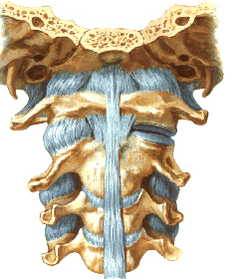
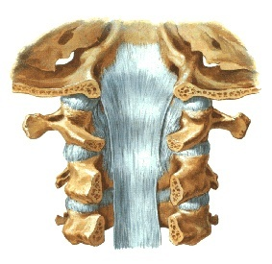
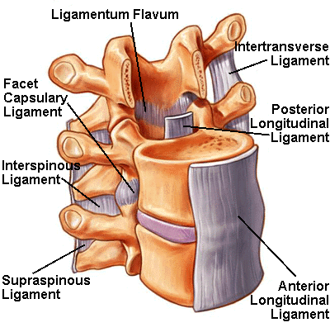
L
I
G
A
ME
N
T
S
The anterior and posterior longitudinal ligaments run as continuous bands along the anterior & posterior surfaces of the vertebral bodies.
These ligaments hold the vertebrae firmly together but at the same time permit a small amount of movement to take place.

Slide 21
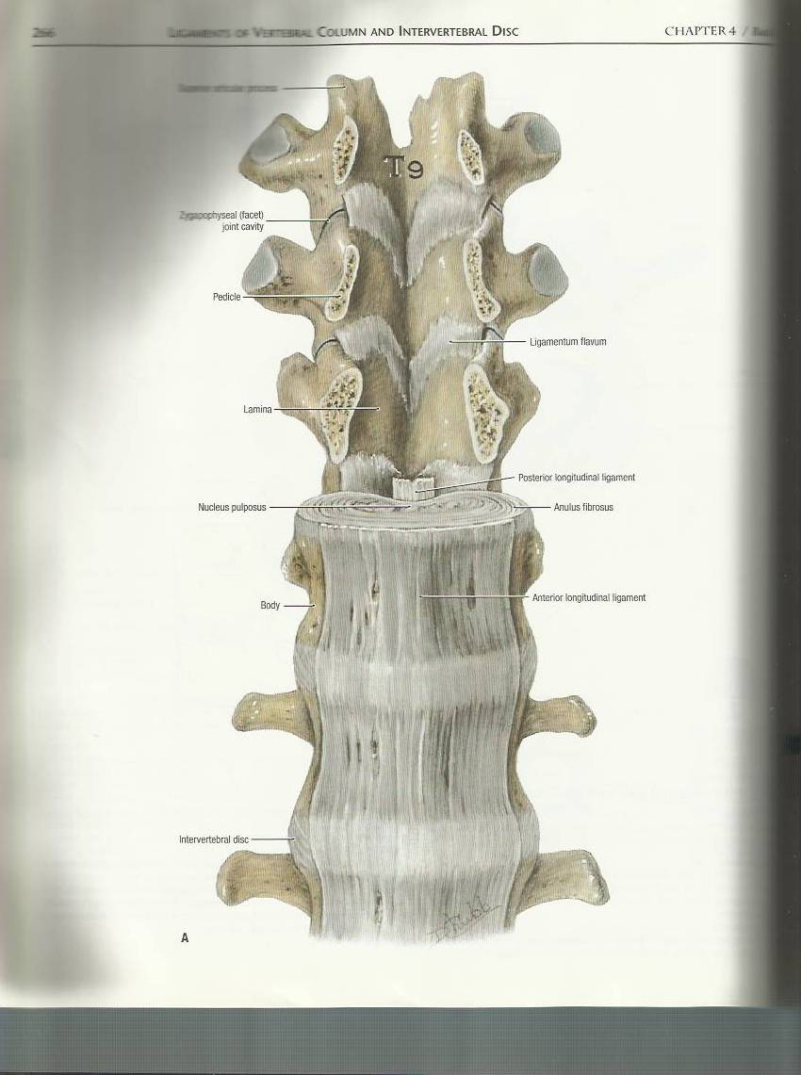
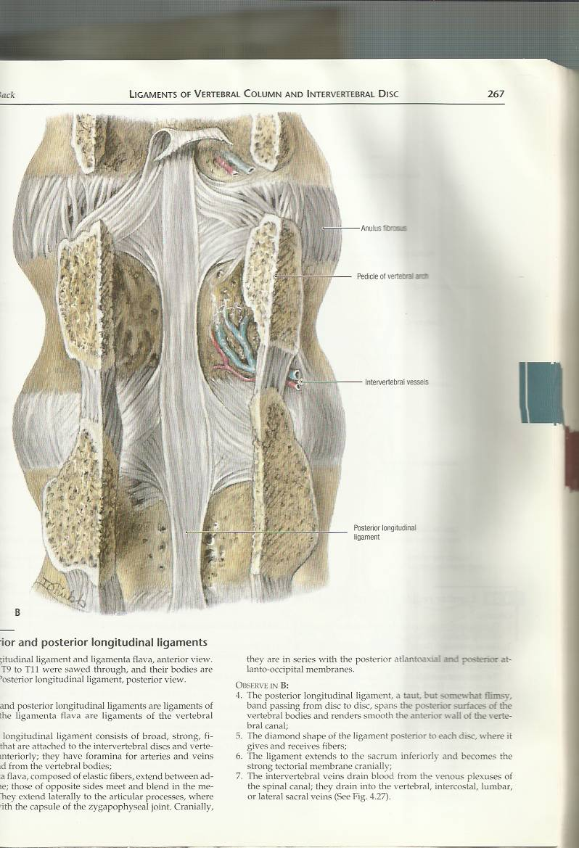
Anterior Longitudinal Ligament
Posterior Longitudinal Ligament

Slide 22
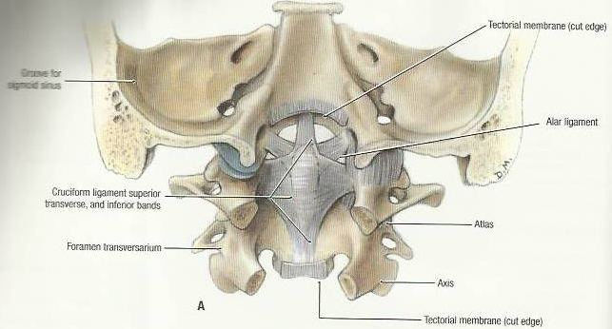
2
1
1
3
2
Apical ligament : median ligament connects apex of odontoid process to foramen magnum (it is undercover of cruciate ligament).
Alar ligaments : these lie on each side of apical ligament and connect odontoid process to medial side of occipital condyles.
Cruciate ligament : consists of a transverse part & a vertical part/vertical (between body of axis and foramen magnum)/ transverse (binds odontoid process to anterior arch of atlas).

Slide 23
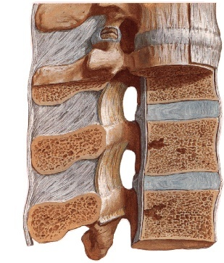
OTHER LIGAMENTS
Supraspinous ligament:
It runs between the tips of adjacent spines.
Interspinous ligament:
It connects adjacent spines.
Lamina
Ligamentum flavum:
It connects the laminae of adjacent vertebrae.
Lamina

Slide 24
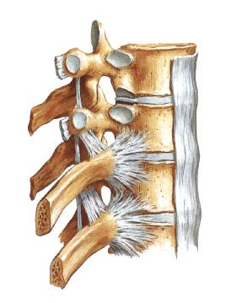
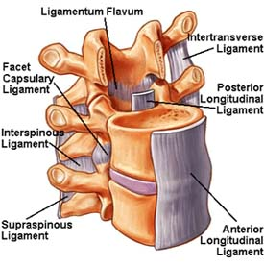
Intertransverse ligaments:
They run between adjacent transverse processes.

Slide 25
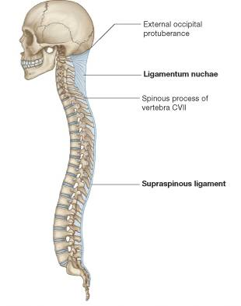
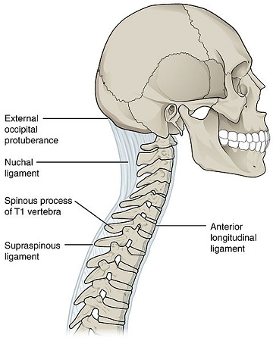
LIGAMENTUM NUCHAE
In the cervical region, the Supraspinous and Interspinous ligaments are greatly thickened to form the strong ligamentum nuchae.
It extends from the spine of the seventh cervical vertebra to the external occipital protuberance of the skull, with its anterior border being strongly attached to the cervical spines.

Slide 26
THANK YOU

