Slide 1
Microbiology of Bone and Joint Infections (Osteomyelitis & Septic Arthritis)
Prof. hanan habib
Department of pathology
college of medicine
ksu

Slide 2
Objectives
Define osteomyelitis and arthritis
Know that the two conditions can happen together or separately.
Differentiate between acute and chronic osteomyelitis and arthritis
Know the pathogenesis and risk factors of both osteomyelitis and arthritis
Realize that bone and joint infections can be acquired through blood or directly from adjacent affected organs and tissues.

Slide 3
Know the commonest causative agents of arthritis and osteomyelitis.
Know the laboratory diagnosis and investigation of both conditions.
know the management and treatment of both osteomyelitis and arthritis.

Slide 4
Introduction
Bone & joint infections may exist separately or together.
Both are more common in infants and children.
Usually caused by blood borne spread ,but can result from local trauma or spread from contiguous soft tissue infection.
Often associated with foreign body at the primary wound site.
If not treated lead to devastating effect.

Slide 5
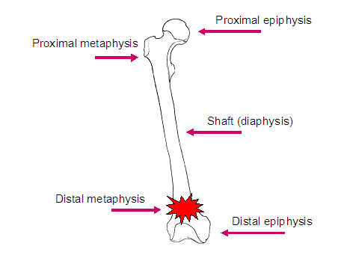
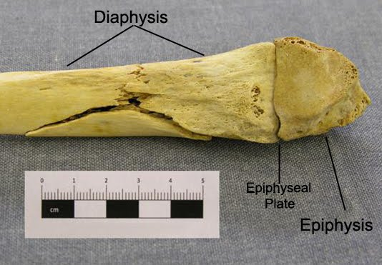

Slide 6
Acute Osteomyelitis
Acute osteomyelitis is an acute infectious process of the bone and bone marrow .
How the pathogen reach the bone ?
1- Hematogenous route
2- Contiguous soft tissue focus ( post operative infection, contaminated open fracture, soft tissue infection , puncture wounds)
3- In association with peripheral vascular disease (diabetes mellitus ,severe atherosclerosis, vasculitis)
May have a short duration ( few days for hematogenously acquired infection) or may last several weeks to months ( if secondary to contiguous focus of infection).

Slide 7
Etiology, Epidemiology & Risk Factors
Primary hematogenous is most common in infants & children.
Infants: S.aureus, group B streptococci, E.coli.
Children: S.aureus, group A streptococci, H.influenzae.
Site : Metaphysis of long bones (femur,tibia& humerus )
Adults: Hematogenous cases less common, but may occur due to reactivation of a quiescent focus of infection from infancy or childhood. Most cases are due to S.aureus.
Septic arthritis is common as the infection begins in the Diaphysis.

Slide 8
Other causes -special clinical situations
Streptococci and anaerobes in fist injuries, diabetic foot and decubitus ulcers.
Salmonella or Streptococcus pneumoniae in sickle cell patients.
Mycobacterium tuberculosis ( MTB) or Mycobacterium avium in AIDS patients.

Slide 9
Common causes of acute osteomyelitis
Age /special conditions
Common causative organisms
Infants
Children
Adults
Sickle cell disease
Infection after trauma ,injury or surgery
Infection after puncture wound of foot.
AIDS patients
S.aureus, group B Streptococcus,Gram negative rods (eg. E.coli, Klebsiella ).
S. aureus, group A Streptococcus & H. influenzae
S.aureus
S.aureus, S. pneumoniae, Salmonella species
S.aureus, group A Streptococcus,Gram negative rods, anaerobes.
Pseudomonas aeruginosa, S.aureus
MTB or M.avium.

Slide 10
Clinical presentation & investigation findings
Acute osteomyelitis usually of abrupt onset
Clinically : fever, localized pain , heat , swelling,
tenderness of affected site ( one or more bones or joints affected in hematogenous spread).May be local tissue infection ( abscess or wound) .
Blood findings: leukocytosis, high ESR and C-reactive protein.
X-ray findings: normal at early stages. Swelling of soft tissues followed by elevation of periosteum ,demineralization and calcification of bone later on.

Slide 11
Diagnosis of acute osteomyelitis
Blood culture: bacteremia common.
biopsy of periosteum or bone or needle aspiration of overlying abscess if blood culture is negative.
Blood test: complete blood and differential counts .
Erythrocyte sedimentation rate ( ESR) .
C-reactive protein
Imaging studies:
X-RAY, MRI, CT-SCAN

Slide 12
Management & Treatment
MSSA ( methicillin sensitive S.aureus) : Cloxacillin, or Clindamycin .
MRSA( methicillin resistant S.aureus): Vancomycin , Clindamycin, Linezolid, or TMP-SMX.
Polymicrobial infection: Piperacillin-Tazobactam or Quinolone with Metronidazole.
Duration for several weeks to ensure cure and prevent progression to chronic osteomyelitis.
Surgical drainage (as needed) if there is local purulent process

Slide 13
Chronic Osteomyelitis
A chronic infection of the bone and bone marrow usually secondary to inadequately treated or relapse of acute osteomyelitis.
Management difficult , prognosis poor.
Infection may not completely cured.
May recur many years or decades after initial episode.
Most infections are secondary to a contiguous focus or peripheral vascular disease.
Chronic infection due to hematological spread is rare.

Slide 14
Chronic Osteomyelitis
S.aureus is the most common pathogen
Other microorganisms: S.epidermidis, Enterococci, streptococci, Enterobactericae, Pseudomonas and anaerobes.
Polymicrobial infection common with decubitus ulcers and diabetic foot infections.
TB and fungal osteomyelitis clinically have indolent “chronic” course

Slide 15
Chronic Osteomyelitis
Mycobacteria and fungi may be the cause in immunosuppressed patients.
- MTB osteomyelitis primarily results from haemtogenous spread from lung foci or as an extension from a caseating lymph bone ( 50% in spine). It resembles Brucella osteomyelitis .
- TB & Brucella are common in KSA.
Haematogenous osteomyelitis due to fungi eg. Candida species, Aspergillus species and other fungi may occur.

Slide 16
Diagnosis of chronic osteomyelitis
Blood culture is not very helpful because bacteremia is rare.
WBC usually normal, ESR elevated but not specific.
Radiological changes are complicated by the presence of bony abnormalities.
MRI helpful for diagnosis and evaluation of the extent of disease.

Slide 17
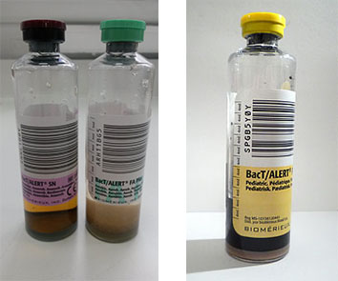
Blood Culture bottles

Slide 18
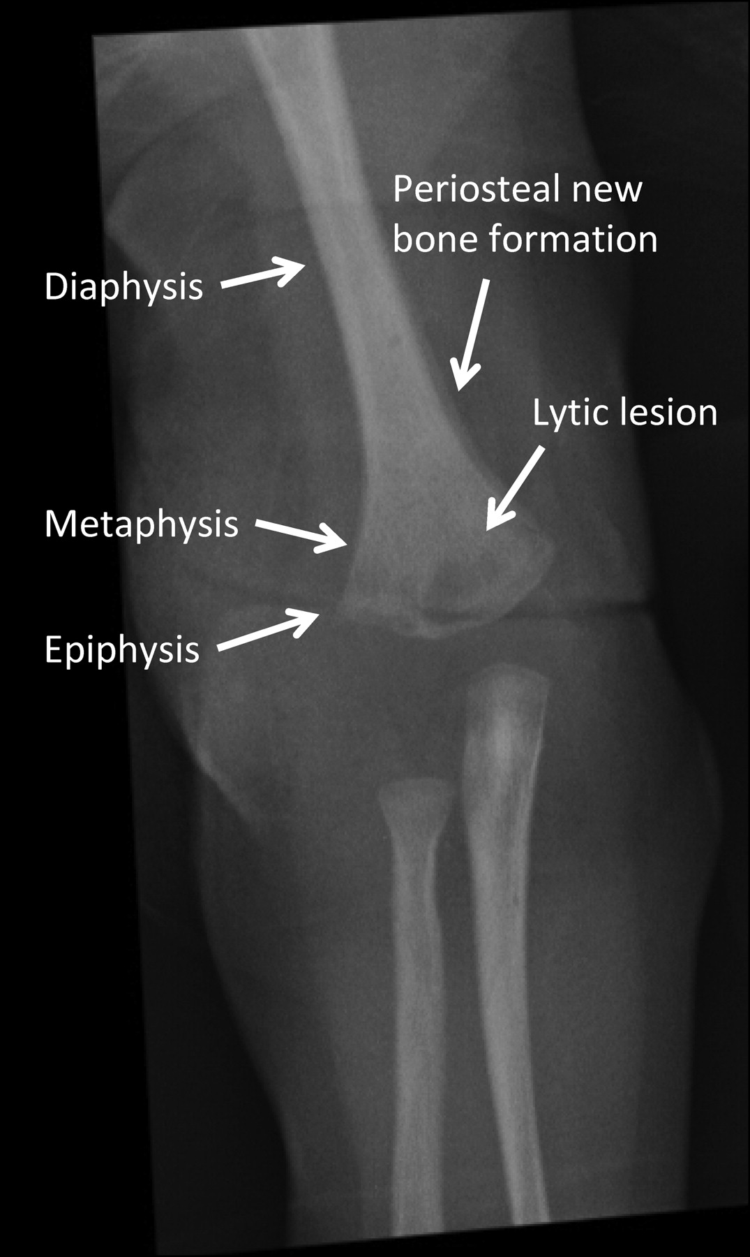
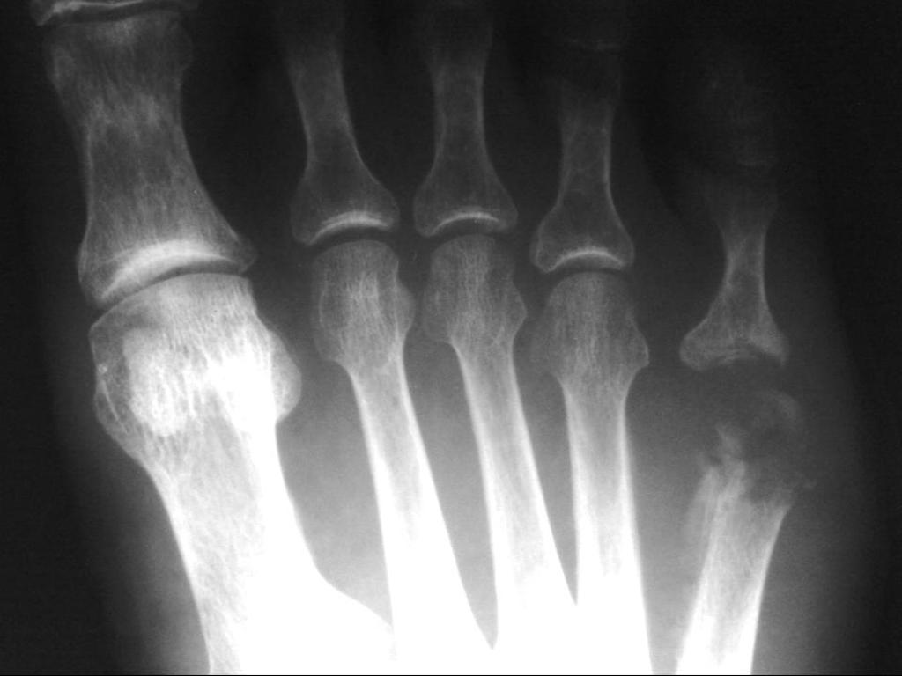
Radiography of acute osteomyelitis

Slide 19
Management & Treatment
Extensive surgical debridement with antibiotic therapy. Parenteral antibiotics for 3-6 weeks followed by long term oral suppressive therapy.
Some patients may require life long antibiotic ,others for acute exacerbations.
MSSA: Cloxacillin
MRSA & S.epidermidis: Vancomycin then oral Clindamycin or TMP-SMX.
Other bacteria: treat as acute osteomyelitis.
MTB: 4 drugs : INH,RIF ,Pyrazinamide & Ethambutol for 2 months followed by RIF + INH for additional 4 months. Brucella is treated with Tetracycline and Rifampicin for 2 to 3 months.

Slide 20
Septic Arthritis
Septic (Infectious) Arthritis is inflammation of the joint space secondary to infection.
Generally affects a single joint and result in suppurative inflammation. May caused by bacteria or viruses.
Haematogenous seeding of joint is most common.
Common symptoms :pain, swelling, limitation of movement.
Diagnosis by Arthrocentesis to obtain synovial fluid for analysis; Gram stain, culture & sensitivity
Drainage & antimicrobial therapy important management.

Slide 21
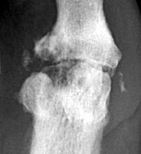
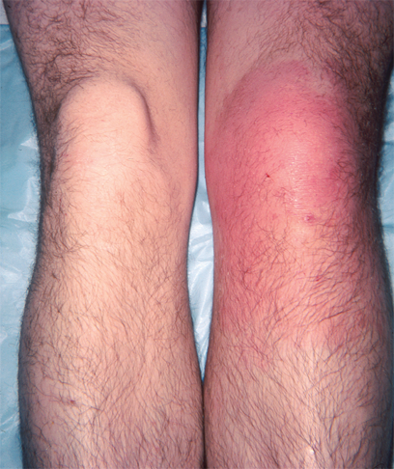
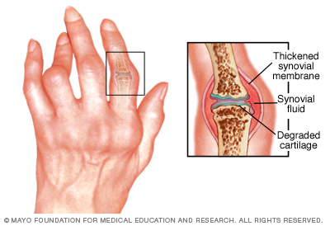
Septic Arthritis

Slide 22
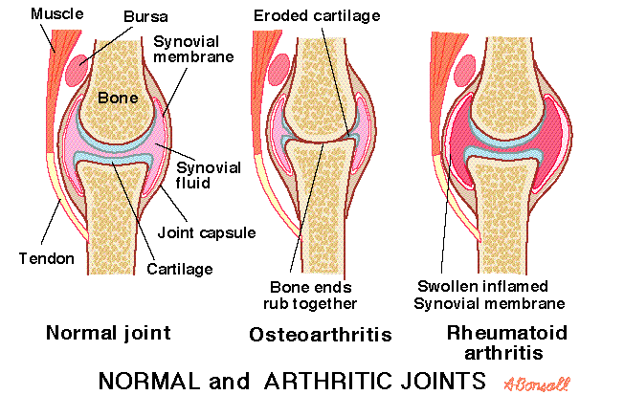

Slide 23
Common causes of septic arthritis
Age/special conditions
Common organism
Neonates
Infants /children
Adults
Sickle cell disease
Trauma /surgical procedure
Chronic arthritis
Prosthetic arthritis
S.aureus, group B Streptococcus, Gram negative rods ( eg. E.coli, Klebsiella, Proteus,Pseudomonas) .
S.aureus, group A Streptococcus, S.pneumoniae, H. influenzae type b
S.aureus, Neisseria gonorrheae
Salmonella species, S.aureus
S.aureus
MTB, Fungi
Skin flora

Slide 24
Other causes of Arthritis
Viruses:
Include: Rubella, Hepatitis B, mumps, Parvovirus B19,Varicella,EBV,Adenoviruse,..etc. These are self-limiting
Reactive arthritis due to:
Campylobacter jejuni
Yersinia enterocolitica
Some Salmonella species
Non –infectious causes of arthritis:
Rheumatoid arthritis
Gout
Traumatic arthritis
Degenerative arthritis

Slide 25
Risk factors & Pathogenesis
Gonococcal infection most common cause in young, sexually active adults caused by Neisseria gonorrheae . Leads to disseminated infection secondary to urethritis/cervicitis. Initially present with polyarthralgia, tenosynovitis, fever, skin lesions. If untreated leads to suppurative monoarthritis.
Nongonococcal arthritis occurs in older adults. Results from introduction of organisms into joint space as a results of bacteremia or fungaemia from infection at other body sites.

Slide 26
Risk factors
Occasionally results from direct trauma, procedures (arthroscopy) or from contiguous soft tissue infection.
S.aureus is most common cause. Other organisms : streptococci and aerobic Gram negative bacilli.
Lyme disease due to tick bite in endemic areas. Uncommon in KSA.
In sickle cell disease patients , arthritis may be caused by Salmonella species.
Chronic arthritis may be due to MTB or fungi.

Slide 27
Diagnosis of Septic Arthritis
History/examination to exclude systemic illness. Note history of tick exposure in endemic areas
Arthrocentesis should be done as soon as possible;
1-Synovial fluid is cloudy and purulent
2- Leukocyte count generally > 25,000/mm3,with predominant neutrophils.
3- Gram stain and culture are positive in >90% of cases.
4-Exclude crystal deposition arthritis or noninfectious inflammatory arthritis.

Slide 28
Blood cultures indicated
If Gonococcal infection suspected, take specimen from cervix, urethra, rectum & pharynx for culture or DNA testing for N.gonorrheae. Investigate for other sexually transmitted diseases.
Culture of joint fluid and skin lesions .

Slide 29
Treatment & Management
Arthrocentesis with drainage of infected synovial fluid.
Repeated therapeutic Arthrocentesis often needed
Occasionally, arthroscopic or surgical drainage/debridement
Antimicrobial therapy should be directed at the suspected organism and susceptibility results:
Gonococcal arthritis: IV Ceftriaxone (or Ciprofloxacin or Ofloxacin) then switch to oral Quinolone or Cefixime for 7-10 days.

Slide 30
Nongonococcal infectiuos arthritis:
MSSA: Cloxacillin or Cefazolin
MRSA: Vancomycin
Streptococci: Penicillin or Ceftriaxone or Cefazolin
Enterobacetriacae: Ceftriaxone or Fluroquinolone
Pseudomonas: Piperacillin and Aminoglycoside
Animal bite : Ampicillin-Sulbactam
Lyme disease arthritis: Doxycycline for one month.

Slide 31
Prognosis & Complications
Gonococcal arthritis has an excellent outcome .
Non-Gonococcal arthritis: can result in scarring with limitation of movement, ambulation is affected in 50% of cases.
Risk factors for long term adverse sequelae include:
Age, prior rheumatoid arthritis, polyarticular joint involvement, hip or shoulder involvement, virulent pathogens and delayed initiation or response to therapy.

Slide 32
Infections of Joint Prosthesis
Occur in 1 - 5 % of total joint replacement.
Most infections occur within 5 years of joint replacement.
Often caused by skin flora.
Diagnostic aspiration of joint fluid necessary .
Result in significant morbidity and health care costs.
Successful outcomes results from multidisciplinary approach.

Slide 33
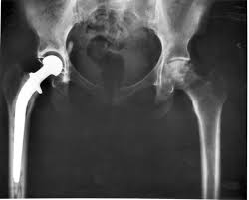
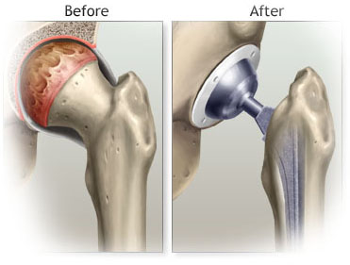
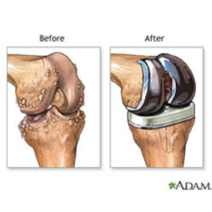
Joint Prosthesis

Slide 34
Diagnosis of Prosthetic Arthritis
Aspiration & surgical exploration to obtain specimen for culture , sensitivity testing & histopathology.
Skin flora regarded as pathogens if isolated from multiple deep tissue cultures.
Plain X-ray may not be helpful.
Arthrography may help define sinus tracts.
Bone scan-not specific for infection.
ESR and C-reactive protein( CRP ) may be high.

Slide 35
Management & Treatment
Surgical debridement and prolonged antimicrobial therapy
Surgery: removal of prosthesis
Antibiotic –impregnated cement during re-implantation
Antimicrobial for 6 weeks:
Begin empiric IV antibiotic to cover MRSA and Gram negative rods ( Vancomycin+ Cefepime, Ciprofloxacin, or Aminoglycoside)
Chronic therapy with oral drug if removal of prosthesis not possible.

