Slide 1
MUSCULOSKELETAL BLOCK
Pathology
Non-infectious arthritis
Dr.Amany Fathaddin

Slide 2
Objectives
Know the pathogenesis and clinicopathological features of osteoarthritis (degenerative joint disease),
Know the pathogenesis and clinicopathological features of rheumatoid arthritis
Know the pathogenesis and clinicopathological features of gout and calcium pyrophosphate arthropathy [pseudogout]

Slide 3
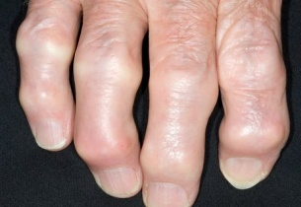
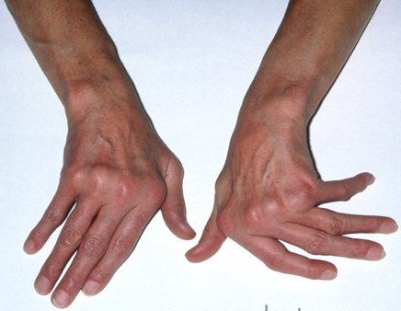
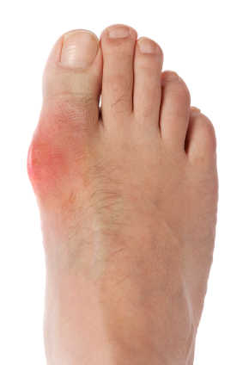
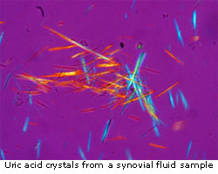
Inflammatory disease of joints
(arthritis and synovitis)
has four main causes
  Degeneration, e.g. osteoarthritis.
  Autoimmity, e.g. rheumatoid arthritis, SLE
  Crystal deposition, e.g. gout and other crystalline arthropathies.
  Infection, e.g. septic arthritis, tuberculous arthritis.

Slide 4
Osteoarthritis
Definition and Incidence
Osteoarthritis ( degenerative joint disease)is the most common joint disease and is characterized by the progressive degeneration of articular cartilage in weight-bearing joints.
Osteoarthritis can be: primary or secondary

Slide 5
Osteoarthritis
Types
Primary osteoarthritis:
  appears insidiously with age and without apparent initiating cause
  usually affecting only a few jonts.

Slide 6
Osteoarthritis
Types
Secondary osteoarthritis:
  some predisposing condition, such as previous traumatic injury, developmental deformity, or underlying systemic disease such as diabetes, hemochromatosis, or marked obesity
  Secondary osteoarthritis affects young
  often involves one or several predisposed joints
  less than 5% of cases

Slide 7
Osteoarthritis
Pathogenesis
Articular cartilage bears the brunt of the degenerative changes in osteoarthritis.
Normal articular cartilage performs two functions:
(1) Along with the synovial fluid, it provides virtually friction-free movement within the joint
(2) In weight-bearing joints, it spreads the load across the joint surface
These functions require the cartilage to be elastic (i.e., to regain normal architecture after compression) and to have high tensile strength. These attributes are provided by proteoglycans and type II collagen, both produced by chondrocytes

Slide 8
Pathogenesis
Chondrocyte function is affected by a variety of influences: mechanical stresses , aging and Genetic factors.
Regardless of the inciting stimulus, there is an imbalance in the expression, activity, and signaling of cytokines and growth factors that results in degradation and loss of matrix.
Early osteoarthritis is marked by degenerating cartilage containing more water and less proteoglycan
The type II collagen network also is diminished, presumably as a result of decreased local synthesis and increased breakdown

Slide 9
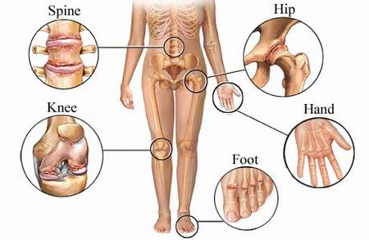
Osteoarthritis
Common sites
Gender has some influence:
Women : knees and hands
Men : hips

Slide 10
Small cysts develop in the bone
constant friction of bone surfaces, leading to a polished ivory bony articular surface (eburnation)
osteophytes

Slide 11
Morphology
fibrillation and cracking of the matrix occur as the superficial layers of the cartilage are degraded
Eventually, full-thickness portions of the cartilage are lost, and the subchondral bone plate is exposed and is smoothened by friction, giving it the appearance of polished ivory (bone eburnation)
Small fractures can dislodge pieces of cartilage and subchondral bone into the joint, forming loose bodies (joint mice).
The fracture gaps allow synovial fluid to be forced into the subchondral regions to form fibrous walled cysts.
Mushroom-shaped osteophytes (bony outgrowths) develop at the margins of the articular surface

Slide 12
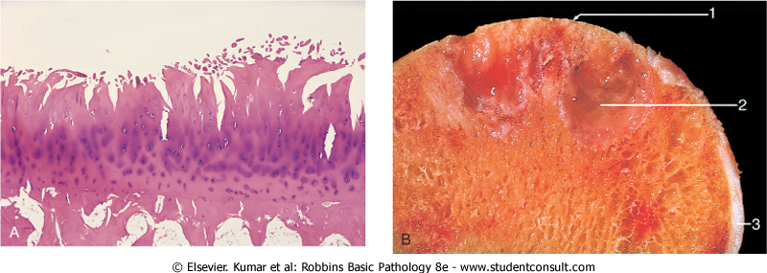
Osteoarthritis. : Histologic demonstration of the characteristic fibrillation of the articular cartilage.

Slide 13
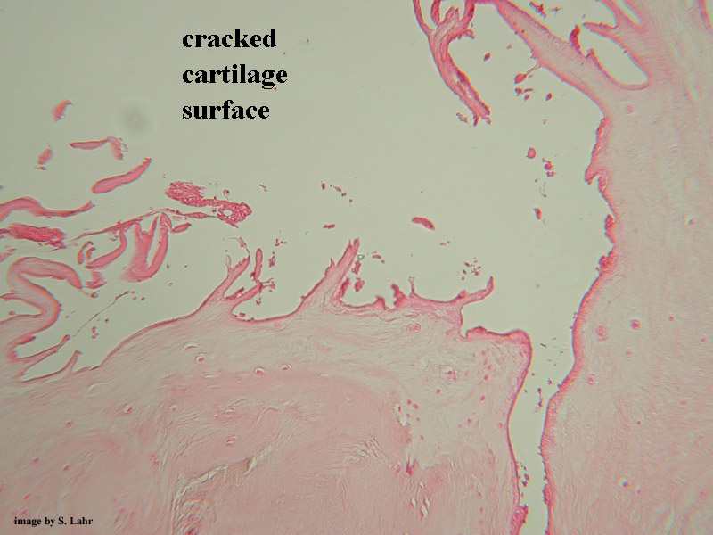
Cracking and fibrillation of cartilage

Slide 14
Severe Osteoarthritis
Eburnated articular surface exposing subchondral bone
Subchondral cyst
Residual articular cartilage

Slide 15
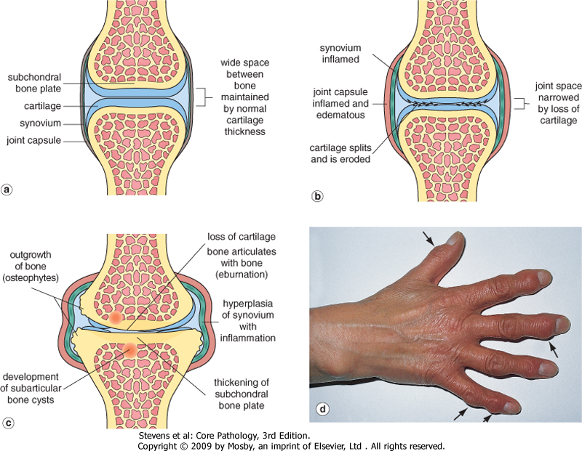
Pathological changes in osteoarthritis
normal synovial joint
early change in osteoarthritis
'Heberden's nodes (osteophytes on the interphalangeal joints of the fingers)

Slide 17
Clinical course
Characteristic symptoms and signs include deep, aching pain exacerbated by use, morning stiffness, crepitus (grating or popping sensation in the joint), and limitation in range of movement.
Osteophyte impingement on spinal foramina can cause nerve root compression with radicular pain and neurologic deficits.
Hips, knees, lower lumbar and cervical vertebrae, proximal and distal interphalangeal joints of the fingers, first carpometacarpal joints, and first tarsometatarsal joints of the feet are commonly involved. Heberden nodes in the fingers, representing prominent osteophytes at the distal interphalangeal joints, are characteristic in women.

Slide 18
Course & Prognosis
slowly progressive.
With time, significant joint deformity can occur, Treatment usually is based on symptoms, with joint replacement in severe cases.

Slide 19
Rheumatoid arthritis

Slide 20
Rheumatoid arthritis
Rheumatoid arthritis (RA) is a systemic, chronic inflammatory autoimmune disease affecting many tissues but principally attacking the joints.
It causes a nonsuppurative proliferative synovitis that frequently progresses to destroy articular cartilage and underlying bone with resulting disabling arthritis.
RA is a relatively common condition, with a prevalence of approximately 1%; it is three to five times more common in women than in men.
The peak incidence is in the second to fourth decades of life, but no age is immune.

Slide 21
Pathogenesis (RA)
RA is an autoimmune disease involving complex, and still poorly understood, interactions of genetic risk factors, environment, and the immune system. The pathologic changes are caused mainly by cytokine-mediated inflammation, with CD4+ T cells being the principal source of the cytokines
Many patients also produce antibodies against cyclic citrullinated peptides (CCPs), which may contribute to the joint lesions In RA, antibodies to citrullinated fibrinogen, type II collagen, α-enolase, and vimentin are the most important and may form immune complexes that deposit in the joints. These antibodies are a diagnostic marker for the disease and may be involved in tissue injury.

Slide 22
Pathogenesis (RA)
Genetic factors: It is estimated that 50% of the risk of developing RA is related to genetic factors. Susceptibility to rheumatoid arthritis is linked to the HLA-DRB1 locus.
Environmental factors: Many candidate infectious agents whose antigens may activate T or B cells have been considered, but none has been conclusively implicated.

Slide 23
Pathogenesis (RA)
About 80% of patients have serum immunoglobulin M (IgM) (and, autoantibodies that bind to the Fc portions of their own (self) IgG.
These autoantibodies are called rheumatoid factor. They may form immune complexes with self-IgG that deposit in joints and other tissues, leading to inflammation and tissue damage. However, the role of rheumatoid factor in the pathogenesis of the joint or extraarticular lesions has not been established.

Slide 24
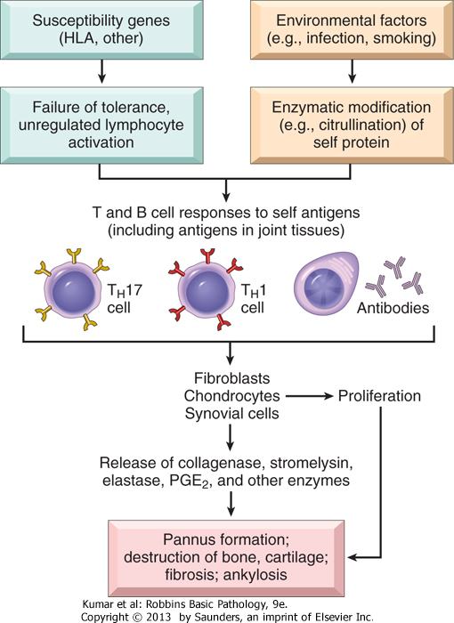
HLA-DR4, DR1 (65%)
Antibodies against cyclic citrullinated peptides (CCP protein antibodies) is the most specific for a diagnosis of rheumatoid arthritis

Slide 25
Rheumatoid arthritis
Laboratory Findings:
Rheumatoid factor: 80% have IgM autoantibodies to Fc portion of IgG
  not sensitive or specific
Anti-CCP (cyclic citrullinated peptides)protein antibodies most specific for a diagnosis of rheumatoid arthritis
ESR and C-reactive proteien

Slide 26
Rheumatoid arthritis
Pathologic Features
synovial cell hyperplasia and proliferation
dense perivascular inflammatory cell infiltrates (Chronic synovitis ) (frequently forming lymphoid follicles) in the synovium composed of CD4+ T cells, plasma cells, and macrophages
increased vascularity due to angiogenesis
neutrophils and aggregates of organizing fibrin on the synovial surface
increased osteoclast activity in the underlying bone ➔ bone erosion.

Slide 27
Rheumatoid arthritis
Pathologic Features
Pannus
formed by proliferating synovial-lining cells admixed with inflammatory cells, granulation tissue, and fibrous connective tissue
Eventually the pannus fills the joint space, and subsequent fibrosis and calcification may cause permanent ankylosis.

Slide 28
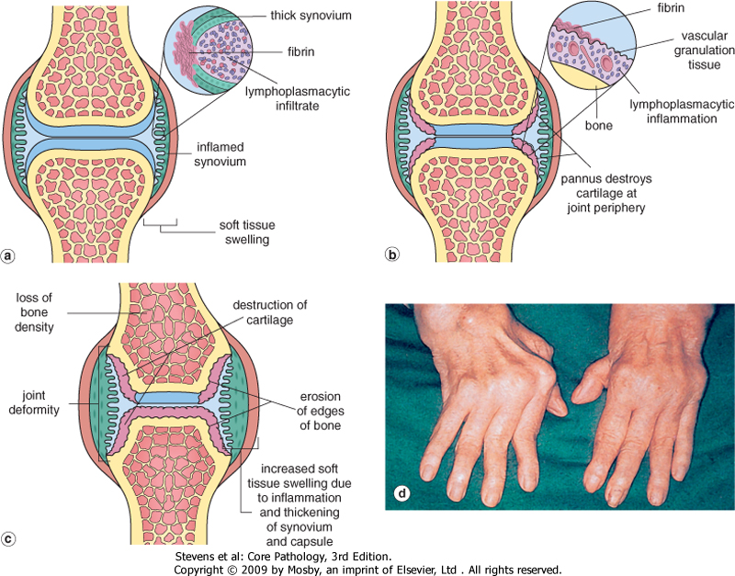
dense perivascular inflammatory cell infiltrates
increased vascularity
neutrophils and aggregates of organizing fibrin on the synovial surface
synovial cell hyperplasia and proliferation
Pannus formation
increased osteoclast activity in the underlying bone ➔ bone erosion
swan neck finger

Slide 29
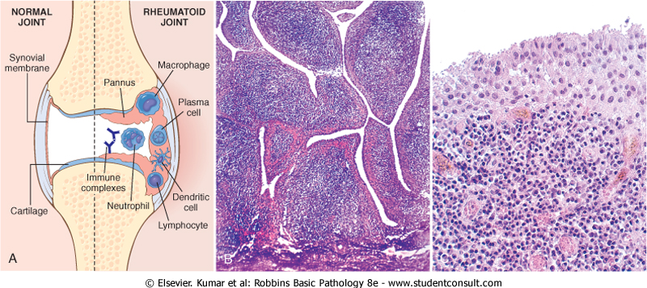
Rheumatoid arthritis
Pathologic Features

Slide 30
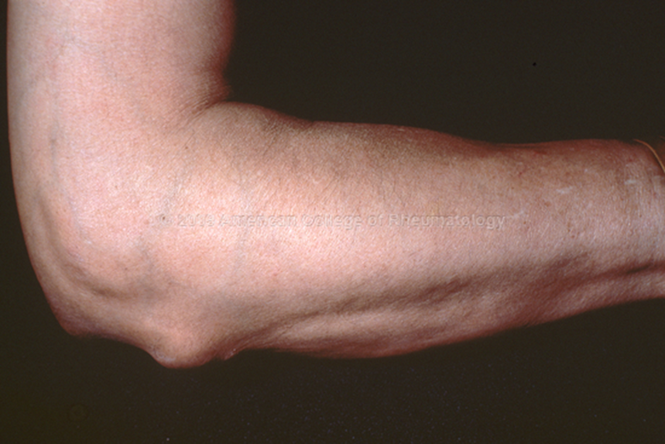
Rheumatoid subcutaneous nodules
develop in about one fourth of patients
occurring along the extensor surface of the forearm
Rheumatoid nodules are firm, nontender, oval or rounded masses as large as 2 cm in diameter.
They are characterized microscopically by a central focus of fibrinoid necrosis surrounded by a palisade of macrophages, which in turn is rimmed by granulation tissue and lymphocytes

Slide 31
Rheumatoid subcutaneous nodules

Slide 32
RA
Clinical features
symmetric arthritis, principally affecting the small joints of the hands and feet, ankles, knees, wrists, elbows, and shoulders.
Most often, the proximal interphalangeal and metacarpophalangeal joints are affected, but distal interphalangeal joints are spared.
Axial involvement, when it occurs, is limited to the upper cervical spine; similarly, hip joint involvement is extremely uncommon.

Slide 33
RA
Clinical features
Weakness , low grade fever
aching and stiffness of the joints, particularly in the morning
As the disease advances, the joints become enlarged, motion is limited
characteristic derformities develop. These include:
Radial deviation at the wrists.
Ulnar deviation at the fingers.
Flexion and hyperextension deformities of the fingers (swan neck and boutonniere deformities).

Slide 34

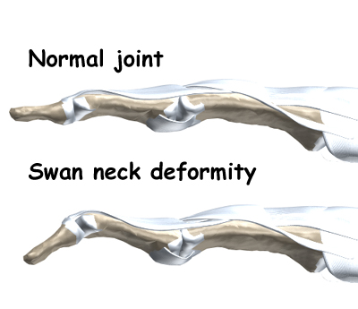

Slide 35
Rheumatoid arthritis
X-ray:
Loss of articular cartilage leading to narrowing of the joint space.
Joint effusions.
Erosions.

Slide 36
Rheumatoid arthritis
Prognosis
The clinical course of RA is highly variable.
In a minority of patients, the disease may stabilize or even regress
in most patients it pursues a chronic, remitting-relapsing course.
progressive joint destruction leading to disability after 10 to 15 years. The outcome has been dramatically improved by recent advances in therapy.
RA is an important cause of reactive amyloidosis, which develops in 5% to 10% of these patients, particularly those with long-standing severe disease

Slide 37
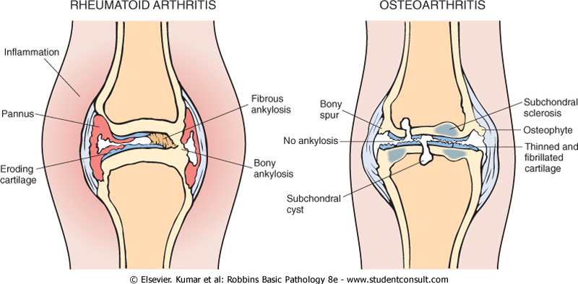
Comparison of the morphologic features of RA and osteoarthritis

Slide 38
Comparison of
Osteoarthrosis & Rheumatoid Arthritis

Slide 39
GOUT

Slide 40
Gout
Gout affects about 1% of the population, and shows a predeliction for males.
It is caused by excessive amounts of uric acid,
Monosodium urate crystals precipitate from supersaturated body fluids and induce an acute inflammatory reaction.
Gout is marked by recurrent episodes of acute arthritis, sometimes accompanied by the formation of large crystalline aggregates called tophi, and eventual permanent joint deformity.
Risk factors for the disease include obesity, excess alcohol intake, consumption of purine-rich foods, diabetes, the metabolic syndrome, and renal failure.

Slide 41
Gout is divided into :
Primary 90%
Secondary 10 %forms

Slide 43
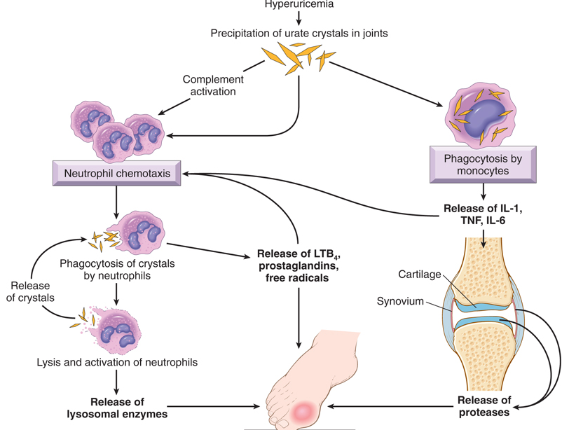

Slide 44
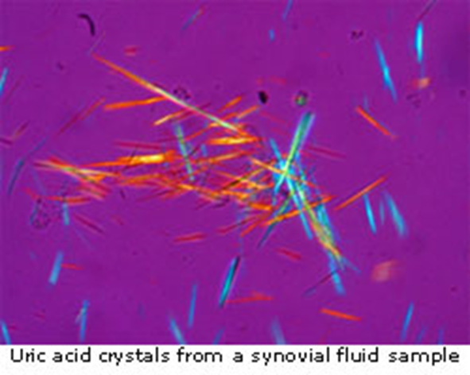
Gout Morphology
Acute arthritis is characterized by a dense neutrophilic infiltrate permeating the synovium and synovial fluid. Long, slender, needle-shaped monosodium urate crystals frequently are
Chronic tophaceous arthritis evolves from repetitive precipitation of urate crystals during acute attacks. The synovium becomes hyperplastic, fibrotic, and thickened by inflammatory cells
.

Slide 45
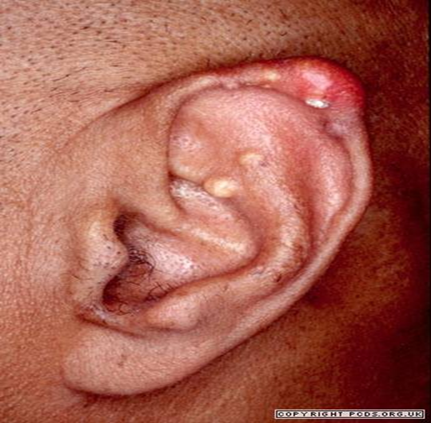
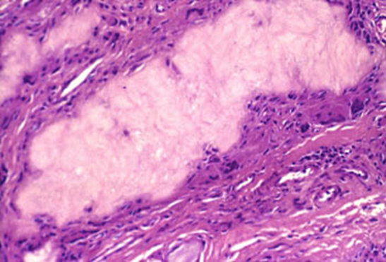
Gout Morphology
Tophi are pathognomonic for gout. They are formed by large aggregations of urate crystals surrounded by an intense inflammatory reaction of lymphocytes, macrophages, and foreign-body giant cells
Tophi can appear in the articular cartilage of joints and in the soft tissues, including the ear lobes & nasal cartilages

Slide 46
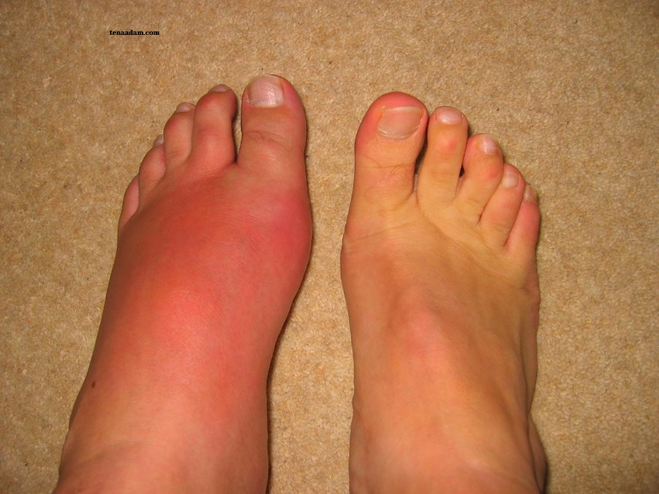
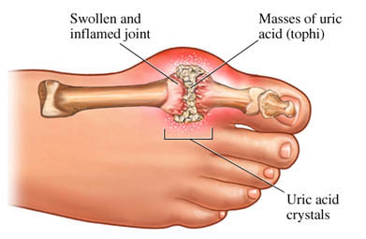
Gout, clinical features
The most commonly affected site is: first metatarsophalangeal joint.
It is swollen, red, and very painful.
Renal manifestations of gout can appear as renal colic associated with the passage of gravel and stones

Slide 47
Pseudogout
Calcium pyrophosphate crystals
This condition is due to the deposition of calcium pyrophosphate crystals in the synovium (pseudogout) and articular cartilage (chondrocalcinosis). It can occur in three main settings:
Sporadic (more common in the elderly).
Hereditary.
Secondary to other conditions, such as previous joint damage, hyperparathyroidism, hypothyroidism, haemochromatosis and diabetes.
The crystals first develop in the articular cartilage (chondrocalcinosis), which is usually asymptomatic. From here, the crystals may shed into the joint cavity resulting in an acute arthritis, which mimics gout and is therefore called pseudogout.

Slide 48
Pseudogout can be differentiated from gout in three ways:
The knee is most commonly involved.
X-rays show the characteristic line of calcification of the articular cartilage.
The crystals look different under polarizing microscopy, they are rhomboid in shape .

