Slide 1
MUSCULOSKELETAL BLOCK Pathology OSTEOMYELITIS And SEPTIC ARTHRITIS
Dr.Amany Fathaddin

Slide 2
Objectives
Understand the etiology, pathogenesis and clinical features of osteomyelitis.
Be familiar with some of the terminology used in bone infections like: sequestrum, involucrum, Brodie abscess and Pott’s disease.
Understand the clinicopathological features of tuberculous osteomyelitis
Identify he bacteria commonly involved in septic arthritis, the clinicopathological features and the characteristics of the joint fluid

Slide 3
OSTEOMYELITIS Definition
Osteomyelitis refers to inflammation of the bone and marrow and is usually the result of infection

Slide 4
OSTEOMYELITIS Etiology
All types of organisms, including viruses, parasites, fungi and bacteria can produce osteomyelitis.
The most common are infections caused by certain pyogenic bacteria and mycobacteria

Slide 5
PYOGENIC OSTEOMYELITIS
Staphylococcus aureus is the most frequent causative organism
Neonates: Escherichia coli and group B streptococci.
Persons with sickle cell disease: Salmonella

Slide 6
PYOGENIC OSTEOMYELITIS
Patients with genitourinary tract infections or with intravenous drug abusers: E.coli, Klebsiella and Pseudomonas
Direct spread during surgery or open fractures (secondary to bone trauma): Mixed bacterial infections, including anaerobes

Slide 7
PYOGENIC OSTEOMYELITIS
Routes of infection
hematogenous dissemination (most common)
extension from an infection in adjacent joint or soft tissue
traumatic implantation after compound fractures or orthopedic procedures.

Slide 8
PYOGENIC OSTEOMYELITIS
Bacteria proliferate, inducing an acute inflammatory reaction, with consequent cell death.
Entrapped bone rapidly becomes necrotic; this non-viable bone is called a sequestrum.
Bacteria and inflammation can percolate throughout the haversian systems to reach the periosteum.
In children, the periosteum is loosely attached to the cortex; therefore, sizable sub periosteal abscesses can form and extend for long distances along the bone surface.
Brodie abscess is a small intraosseous abscess that frequently involves the cortex

Slide 10
Rupture of the periosteum can lead to abscess formation in the surrounding soft tissue that may lead to a draining sinus Sometimes the sequestrum crumbles, releasing fragments that pass through the sinus tract.

Slide 11
PYOGENIC OSTEOMYELITIS
In infants (and uncommonly in adults), epiphyseal infection can spread into the adjoining joint to produce suppurative arthritis, sometimes with extensive destruction of the articular cartilage and permanent disability.
An analogous process can involve vertebrae, with an infection destroying intervertebral discs and spreading into adjacent vertebrae.

Slide 12
PYOGENIC OSTEOMYELITIS
After the first week of infection, chronic inflammatory cells become more numerous.
Leukocyte cytokine release stimulates osteoclastic bone resorption, fibrous tissue ingrowth, and bone formation in the periphery.
Reactive woven or lamellar bone can be deposited; when it forms a shell of living tissue around a sequestrum, it is called an involucrum
Viable organisms can persist in the sequestrum for years after the original infection

Slide 13
PYOGENIC OSTEOMYELITIS Clinical features
Osteomyelitis classically manifests as an acute systemic illness, with malaise, fever, leukocytosis, and throbbing pain over the affected region.
Symptoms also can be subtle, with only unexplained fever, particularly in infants, or only localized pain in the adult.

Slide 14
PYOGENIC OSTEOMYELITIS
Diagnosis;
Sign/symptoms.
X-ray:a lytic focus of bone surrounded by a zone of sclerosis
Blood cultures
biopsy

Slide 15
In many untreated cases, blood cultures are positive, but biopsy and bone cultures are usually required to identify the pathogen.

Slide 16
Treatment
Treatment requires aggressive antibiotic therapy. Inadequate treatment of acute osteomyelitis may lead to chronic osteomyelitis which is notoriously difficult to manage. Surgical removal of bony tissue may be required.

Slide 17
PYOGENIC OSTEOMYELITIS
Chronicity may develop with:
delay in diagnosis
extensive bone necrosis
abbreviated antibiotic therapy
inadequate surgical debridement,
weakened host defenses.

Slide 18
PYOGENIC OSTEOMYELITIS
Complications:
Pathologic fracture.
Secondary amyloidosis
Endocarditis
Sepsis
Squamous cell carcinoma if the infection creates a sinus tract.
Rarely sarcoma in the affected bone

Slide 19
Tuberculous osteomyelitis
Routes of entry;
Usually blood borne and originate from a focus of active visceral disease.
Direct extension (e.g. from a pulmonary focus into a rib or from tracheobronchial nodes into adjacent vertebrae) or spread via draining lymphatics.

Slide 20
Tuberculous osteomyelitis
The most common sites of skeletal involvement are:
thoracic and lumber vertebrae followed by the knees and hips
Pott’s disease is the involvement of spine
In patients with AIDS frequently multifocal

Slide 21
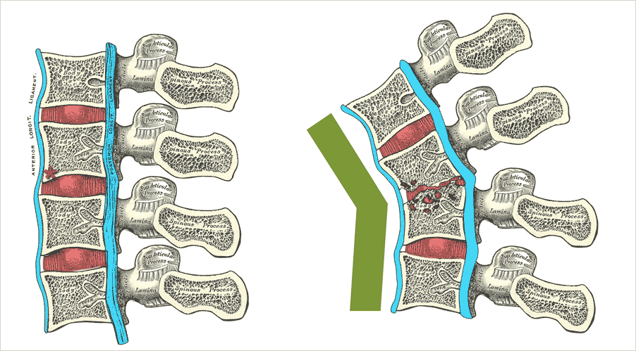
The infection breaks through the intervertebral discs and extends into the soft tissues forming abscesses.
Pott’s disease

Slide 22
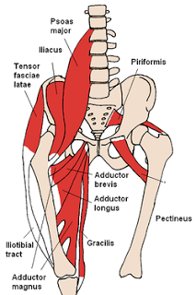
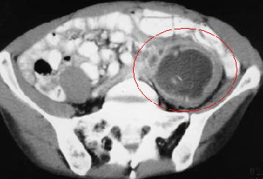
In Pott’s disease, the infection may breaks through the intervertebral discs and extends into the muscle forming Psoas abscesses

Slide 23
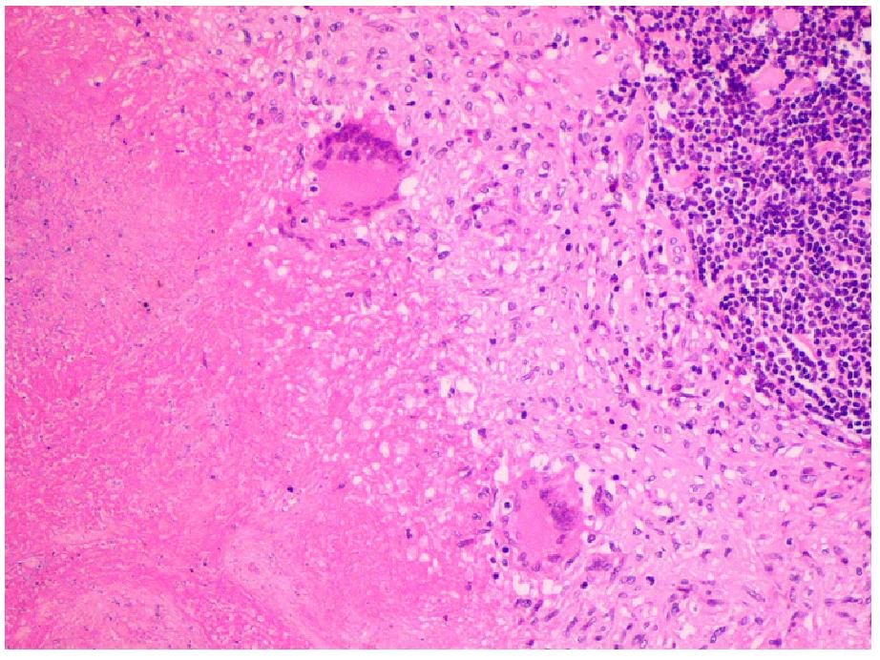
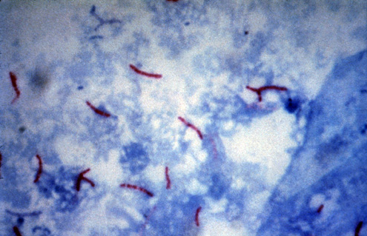
Tuberculous osteomyelitis
Histopathology: collections of epithelioid histiocytes and lymphocytes with caseation necrosis
Ziehl Neelsen stain

Slide 24
Tuberculous osteomyelitis
Clinical features :
Pain
Fever
Weight loss
May form an inguinal mass “ psoas abscess”.

Slide 25
Tuberculous osteomyelitis
Complications
Bone destruction
Tuberculous arthritis
Sinus tract formation
Amyloidosis

Slide 27
Infectious Arthritis
Microorganisms of all types can seed joints during hematogenous dissemination.
Articular structures can also become infected by direct inoculation or from contiguous spread from a soft-tissue abscess or focus of osteomyelitis.
Infectious arthritis is potentially serious, because it can cause rapid destruction of the joint and produce permanent deformities

Slide 28
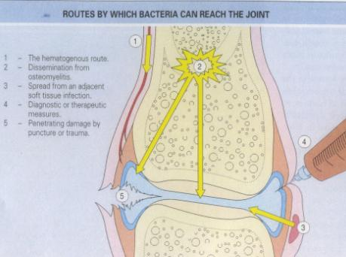
Routes of infection:
Hematogenous
Contiguous spread from osteomyelitis
Contiguous spread from a soft tissue abscess
Iatrogenic
Traumatic

Slide 29
Infectious Arthritis-bacterial
Bacterial infections almost always cause an acute suppurative arthritis
Any bacteria can be causal:
Haemophilus influenzae predominates in children under age 2 years
S. aureus is the main causative agent in older children and adults
gonococcus is prevalent during late adolescence and young adulthood.
Individuals with sickle cell disease are prone to infection with Salmonella at any age.

Slide 30
Risk factors
Immune deficiencies (congenital and acquired)
Debilitating illness
Joint trauma
Intravenous drug abuse

Slide 31
Infectious Arthritis
The infection involves only a single joint
usually the knee-followed in order by hip, shoulder, elbow, wrist, and sternoclavicular joints.
Joint aspiration is typically purulent
Culture allows identification of the causal agent.

Slide 32
Infectious Arthritis
Clinical features:
sudden onset of pain
redness, and swelling of the joint with restricted range of motion.
Fever, leukocytosis, and elevated erythrocyte sedimentation rate

Slide 33
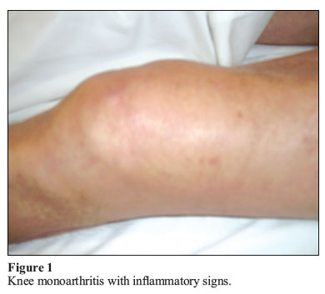
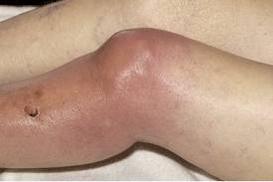
Infectious arthritis must be rapidly diagnosed and treated promptly to prevent irreversible and permanent joint damage.

Slide 34
Complication
Septic arthritis can lead to ankylosis and even fatal septicemia.
However, prompt antibiotic therapy and joint aspiration or drainage cures most patients.

