Slide 1
Dr.Aida Korish akorish@ksu.edu.sa
1
Physiology of Bone
Dr. Aida Korish, PhD Physiology Department, KSU

Slide 2
Objectives
2
By the end of the lecture you will be able to:
Define bone and differentiate cortical & trabecular bone (sites
and function of each).
State the normal levels and forms of ca++ in the ECF and its
relation to PO4.
Identify the bone cells and the function of each.
Define bone remodelling and explain the mechanism of bone formation.
Define osteoporosis.
Discuss the effect of different hormones on bone physiology.

Slide 3
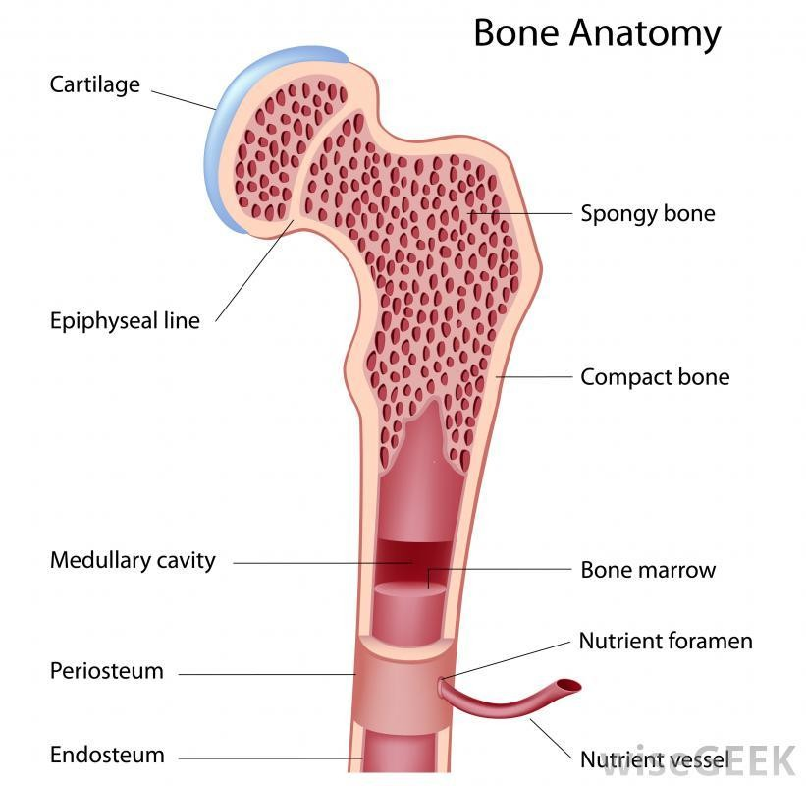
Physiology of Bone
3
Bone is a special form of connective tissue.
It is well vascularized with total blood flow of 200–400 mL/min in adult humans.
The ends of each long bone (epiphyses) are separated from the shaft of the bone by a plate of actively proliferating cartilage, the epiphyseal plate.
Linear bone growth can occur as long as the epiphyses are separated from the shaft of the bone, but such growth ceases after the epiphyses unite with the shaft (epiphyseal closure).

Slide 4
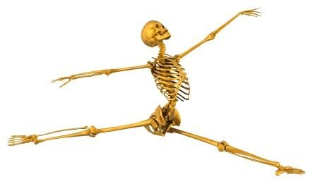
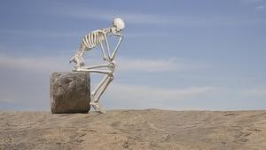
Functions of bone
4
Is involved in the overall Ca++ and PO4– homeostasis.
Protects the vital organs,
Permits locomotion and support against gravity.
Contains the bone marrow
(blood cells formation).

Slide 5
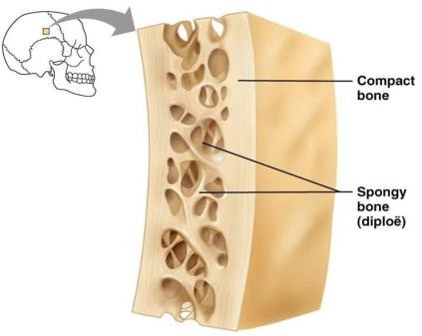
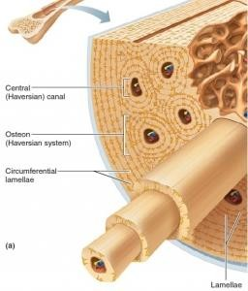
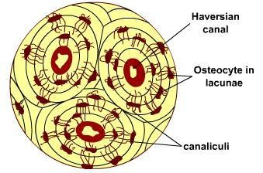
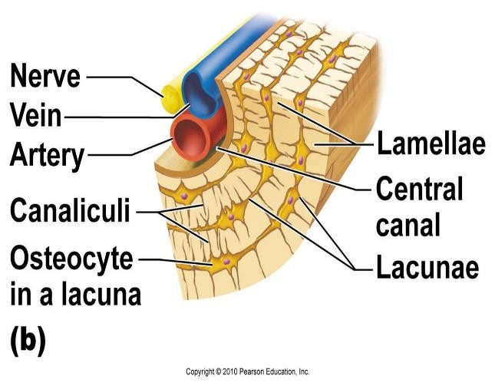
Types and structure of bone
5
Compact or cortical bone: in the outer layer of most bones is (80%) of the bones in the body.
Trabecular or spongy bone inside the cortical
bone, is 20% of the body bone.
◻In compact bone, the bone cells lie in lacunae. They receive nutrients by way of canaliculi from haversian canals vessels.
◻Collagen is arranged in concentric layers, around the haversian canals forming cylinders called osteons or haversian systems.
◻Trabecular bone is made up of spicules or plates. Nutrients diffuse from bone extracellular fluid (ECF) into the trabeculae.
Dr.Aida Korish
akorish@ksu.edu.sa

Slide 6
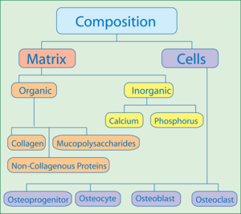
Composition of Compact Bone
6
A- Matrix
(30%) is organic Matrix : composed of
Collagen fibers 90-95%: extend primarily along the lines of tensional force and give bone its powerful tensile strength.
Ground substance 5-10% of
ECF and Proteoglycans, hayluronic acid
(70%) is bone Salts :
Crystalline salts of Ca++ & PO4 (Hydroxyapatite) the ratio of Ca/P ratio is 1.5- 2).
Mg+, Na+, K+, Carbonate ions are also present.
NB: newly formed bone have_{D}a_{r.A}c_{i}o_{da}ns_{K}i_{o}d_{ri}e_{s}r_{h}ab_{ak}l_{o}y_{ri}h_{sh}i@gh_{k}e_{su}r_{.edu.sa} percentage of matrix in relation to salts.

Slide 7
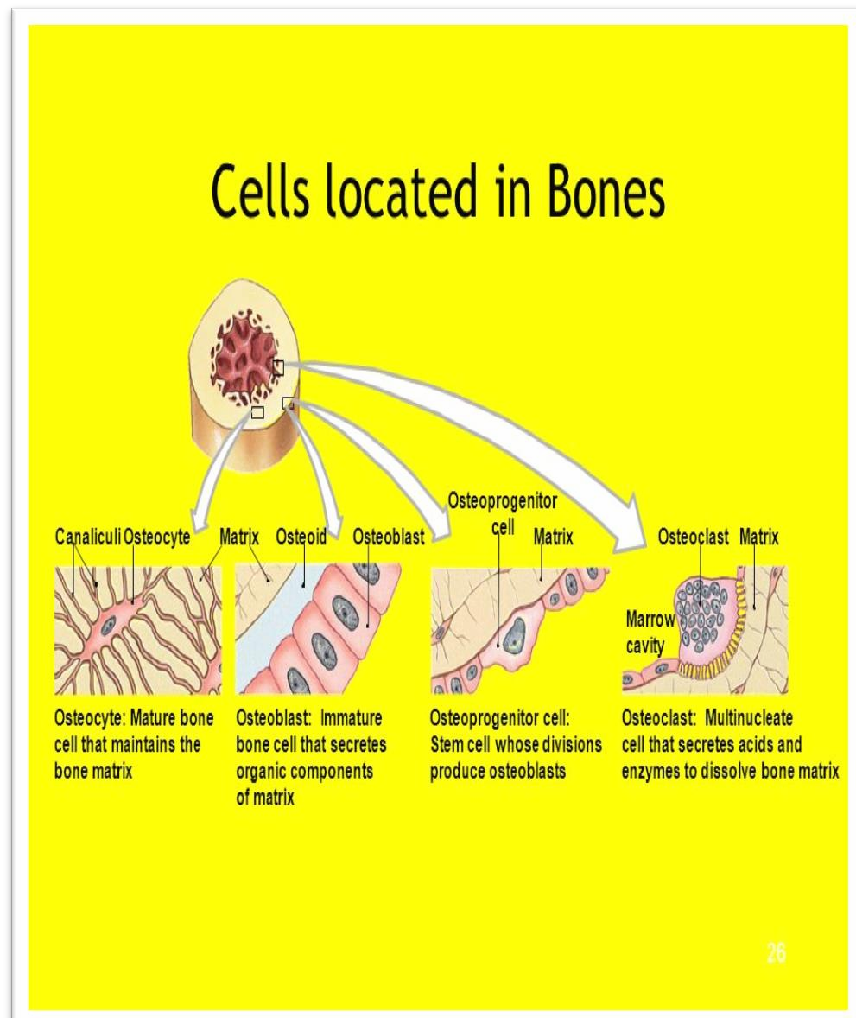
B- Bone cells
7
Osteoblasts are
the bone secrete
forming cells that
collagen forming a matrix around themselves which then calcifies and when surrounded by calcified matrix, they are called Osteocytes and send processes into the canaliculi that ramify throughout the bone.
Osteoblasts regulate Ca and Phosphate concentration in bone fluid.
Osteoclasts are multinuclear cells that erode and resorb previously formed bone. They phagocytos bone, digesting it in their
cytoplasm.
Dr.Aida Korish akorish@ksu.edu.sa

Slide 8
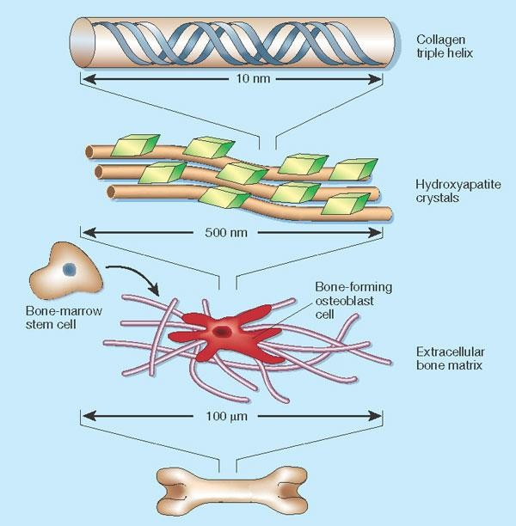
Mechanism of Bone Calcification.
8
Osteoblasts secrete collagen (monomers) and ground substance (proteoglycans).
The collagen monomers polymerize to collagen fibers.
The resultant tissue becomes osteoid, a cartilage-like material differing from cartilage in that calcium salts readily precipitate in it.
Osteoblasts become entrapped in the osteoid and are now called osteocytes.
After the osteoid is formed, calcium salts
begin to precipitate on the collagen fibers
Dr.Aida Korish akorish@ksu.edu.sa

Slide 9
Tensile and Compressional Strength of Bone
9
The collagen fibers of bone, like those of tendons, have great tensile strength, whereas the calcium salts have great compressional strength.
These combined properties plus the degree of bondage between the collagen fibers and the crystals provide a bony structure that has both extreme tensile strength and extreme compressional strength.
N.B: hydroxyapatite crystals fail to be formed in normal
tissues except in bone despite the high levels of Ca & P ions due to the presence of an inhibitor of precipitation called pyrophosphate.
Dr.Aida Korish akorish@ksu.edu.sa

Slide 10
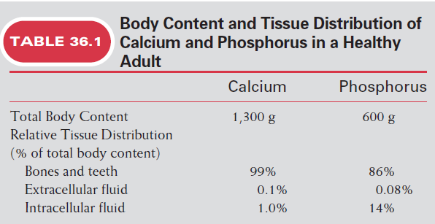
Body Calcium levels
10
1.5% of body weight is Calcium,
about 1100 - 1300 gm.
99% is in the skeleton.
Dr.Aida Korish
akorish@ksu.edu.sa

Slide 11

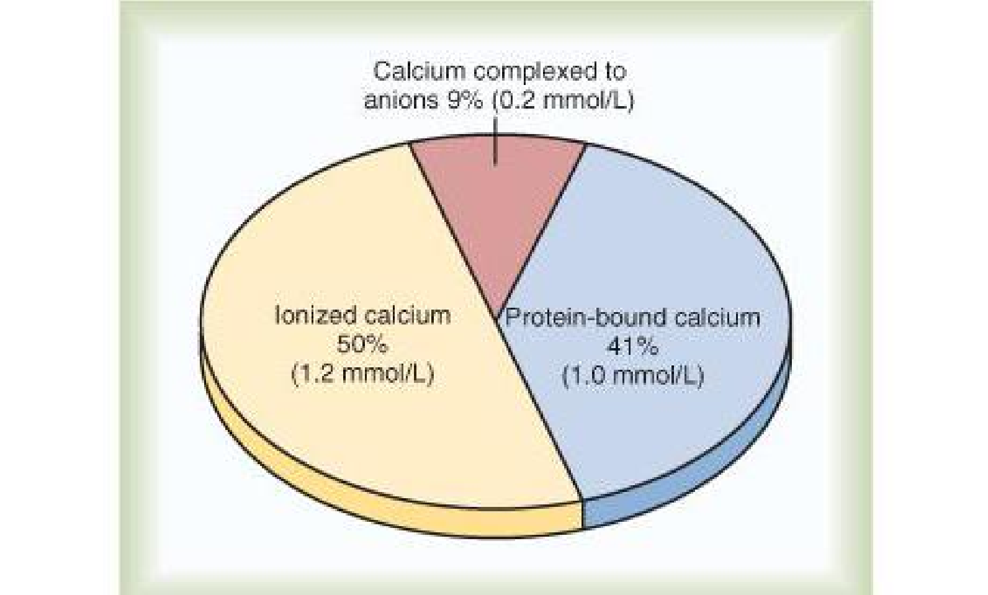
Plasma calcium
Plasma calcium level: (9 -11 mg/dl) average :9.4 mg/dl 59% (diffusible)= ionized + Complexed
41% (non diffusible)= protein bound

Slide 12
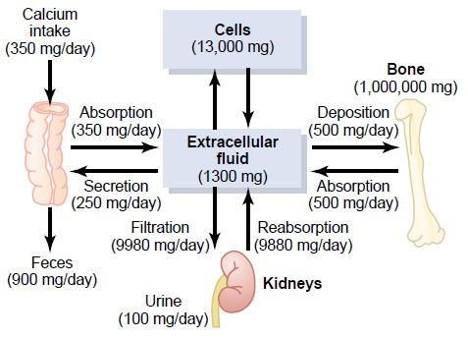
Calcium homeostasis in human body
12

Slide 13
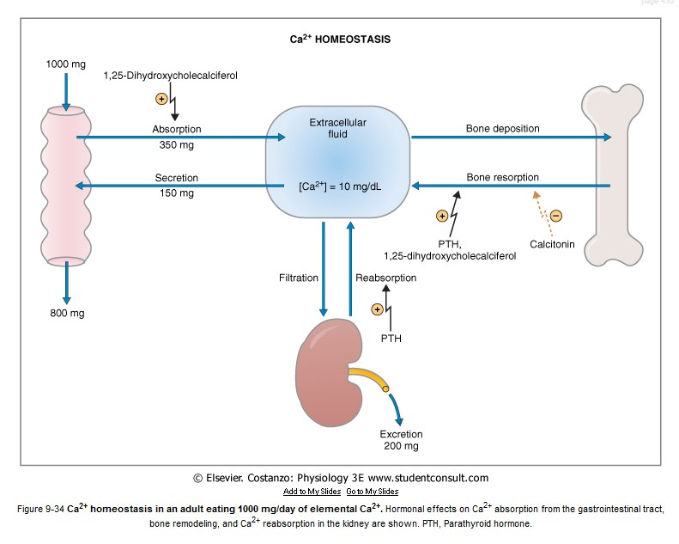
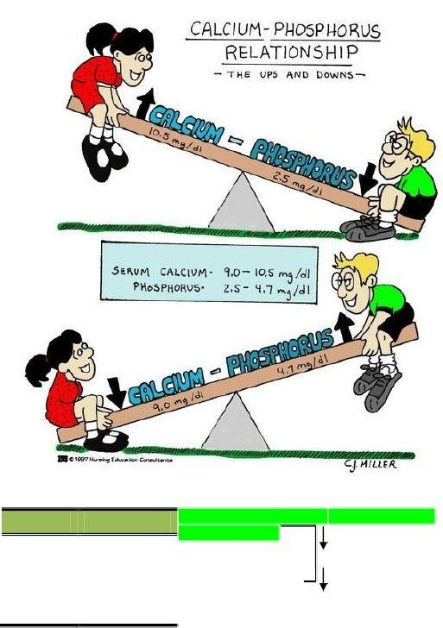
Serum calcium and Phosphate
13

Slide 14
Calcium Exchange Between Bone and ECF
14
The bone contains a type of exchangeable calcium that is always in equilibrium with the Ca++ ions in the ECF
It normally amounts to about ( 0.4-1%) of the total bone
calcium.
This calcium is a form of readily mobilizable salt such as CaHPO4 and other amorphous calcium salts.
The importance of exchangeable calcium is that it provides a rapid buffering mechanism to keep the Ca++ ions concentration in ECF from rising to excessive levels or falling to very low levels under transient conditions of excess or decreased availability of calcium.

Slide 15
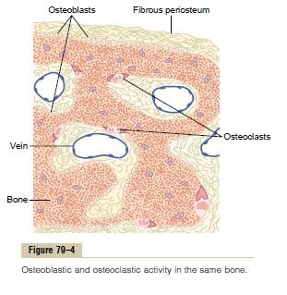
Deposition and Absorption of Bone
Remodeling of Bone
15
Bone is continually deposited by osteoblasts, and absorbed where osteoclasts are active.
Osteoblasts are found on the outer surfaces of the bones and in the bone cavities.
A small amount of osteoblastic activity occurs on about 4% of all bone surfaces at any given time in an adult), so that at least some new bone is being formed constantly.
The renewal rate is about 4% per year
^{for compact bone an}D^{d}r.Ai²da⁰K%orish^{pe}ak^{r}or^{y}ish^{e}@ªk^{r}su^{f}.eºd^{r}u.sa trabecular bone.

Slide 16
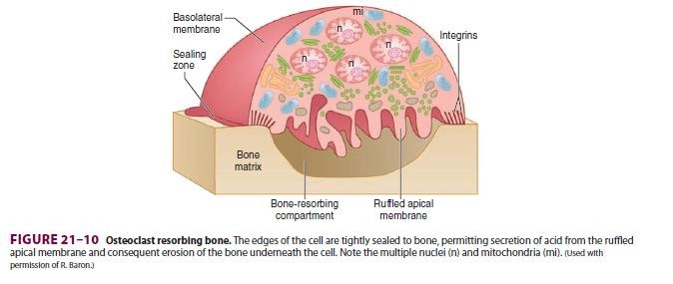
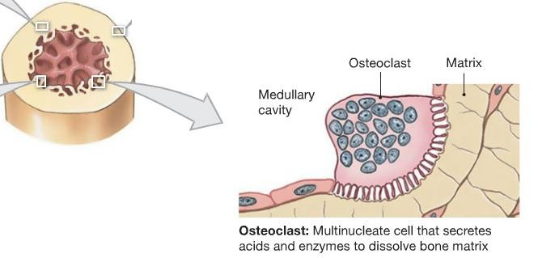
Cont..…Bone resorption
16
Osteoclasts are large phagocytic multinucleated cells
They are normally active on less than 1% of the bone surfaces of an adult.
The osteoclasts secrete two types of substances:
proteolytic enzymes from the lysosomes
several acids from the mitochondria and secretory vesicles.
The enzymes dissolve the organic matrix, and the acids cause solution of the bone salts.
The osteoclastic cells also phagocytose minute particles of bone matrix and crystals,
dissoluting them and relea^{D}s^{r.}i^{A}n^{id}gª t^{K}hºe^{ris}p^{h} rªo^{k}d^{or}u^{is}c^{h@}ts^{ksu.edu.sa}
into the blood.

Slide 17
Value of Continual Bone Remodeling
17
Bone adjusts its strength in proportion to the degree of bone stress and it thicken when subjected to heavy loads.
The shape of the bone can be rearranged for proper support of mechanical forces by deposition and absorption of bone in accordance with stress patterns.
Because old bone becomes relatively brittle and weak, new organic matrix is needed as the old organic matrix degenerates. In this manner, the normal toughness of bone is maintained.
Therefore, the bones of children are less brittle in comparison with the bones of the elderly, due to more remodeling in the children.

Slide 18
Control of the Rate of Bone Deposition by Bone “Stress”
18
Bone is deposited in proportion to the load that it must
carry.
Continual physical stress stimulates osteoblastic
deposition and calcification of bone.
The bones of athletes become considerably heavier than those of no athletes. Also, the bone of the leg in the cast becomes thin and up to 30 % decalcified within a few weeks.
Bone stress also determines the shape of bones under certain circumstances. (e.g. Healing of fractures may start angulated in children then become straight).

Slide 19
Repair of a Fracture Activates Osteoblasts
19
Fracture of a bone activates all the periosteal and intraosseous osteoblasts involved in the break.
Large numbers of new osteoblasts are formed from
osteoprogenitor cells, which are bone
stem cells in the surface tissue lining bone, called the "bone membrane.
Shortly a large bulge of osteoblastic tissue and new organic bone matrix, develops between the two broken ends of the bone followed shortly by the deposition of calcium salts. This is called a callus.

Slide 20
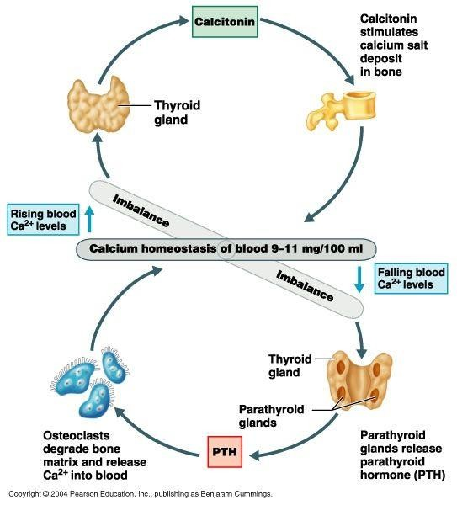
Hormonal Control of Calcium Metabolism & Physiology
of Bone
20
Three major hormones are concerned :
◻1, 25 dihydroxycholecalciferol: a steroid hormone formed from Vitamin D.
◻Parathyroid hormone (PTH):
secreted by parathyroid gland
◻Calcitonin: secreted by c-cells in the thyroid gland.
◻To a lesser extent ; Glucocorticoids, GH, estrogens & various growth factors also affect
Calcium Metabolism.
Dr.Aida Korish akorish@ksu.edu.sa

Slide 21
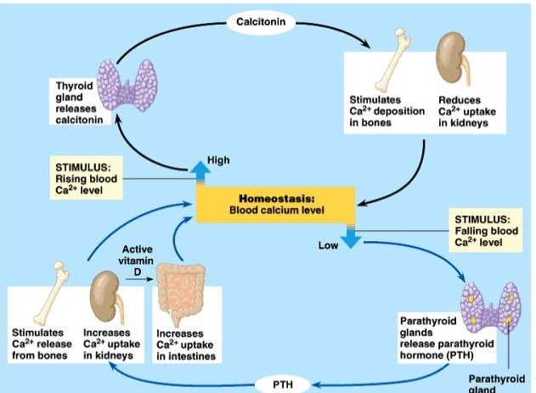
21

Slide 22
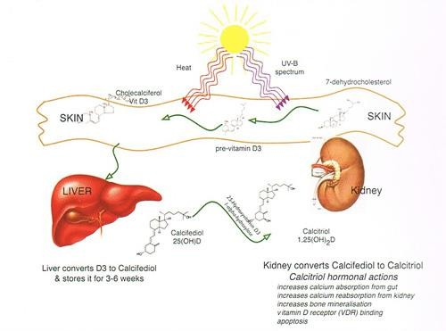
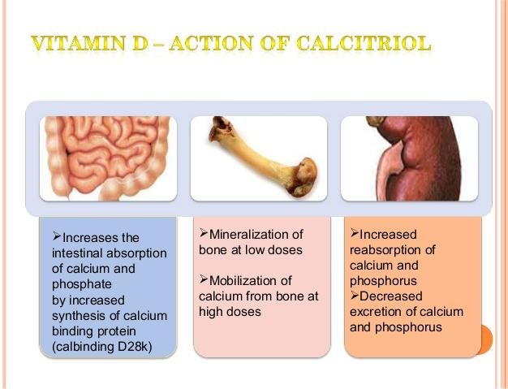
Vitamin D
22

Slide 23
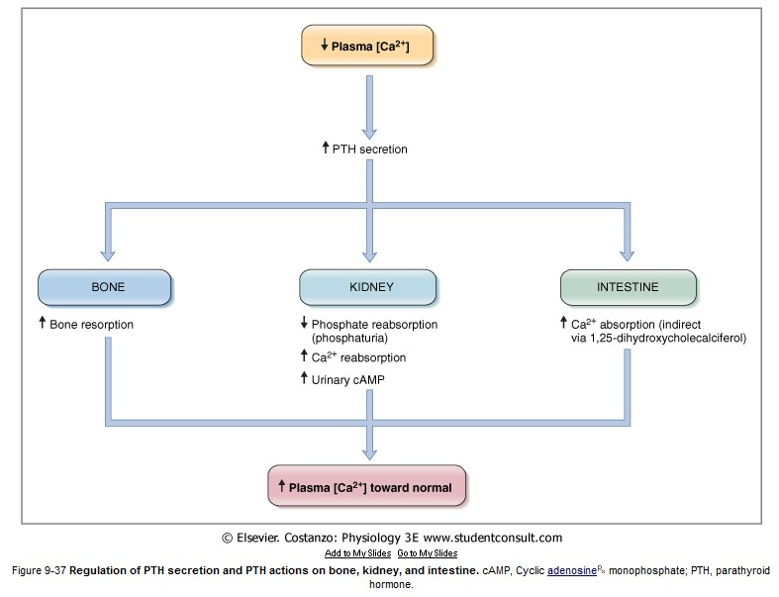
Parathyroid Hormone (PTH)
23

Slide 24
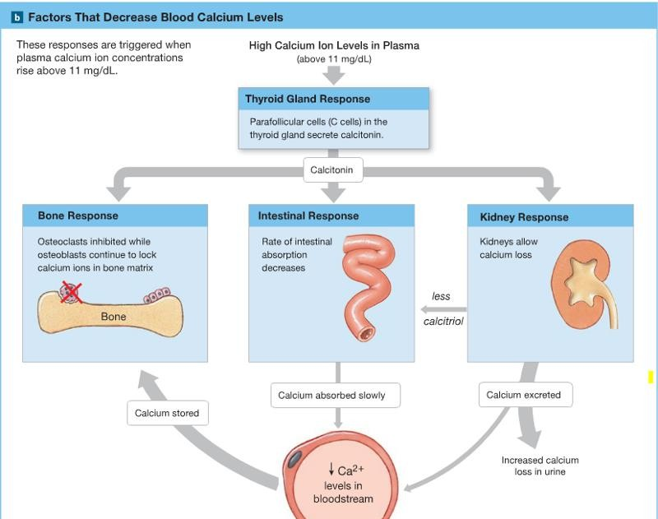
Calcitonin Hormone
24

Slide 25
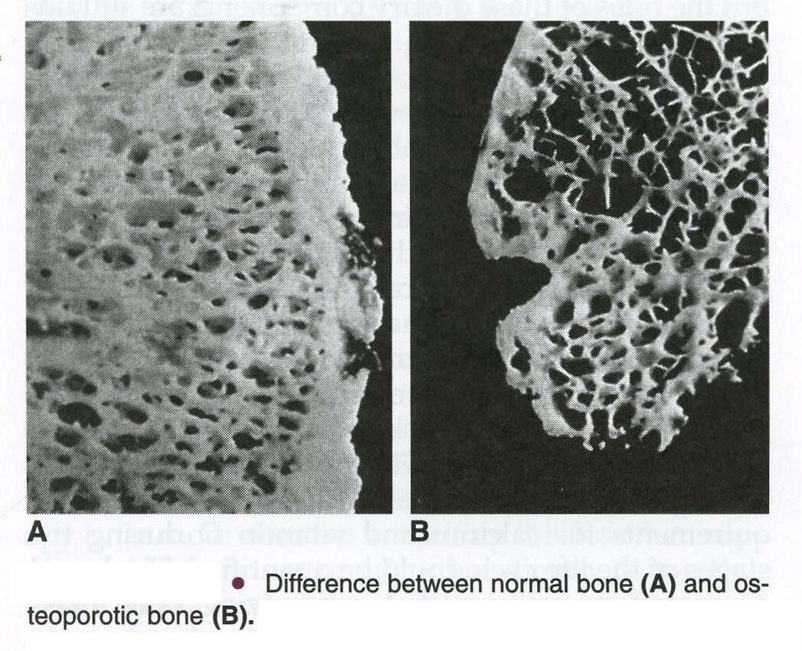
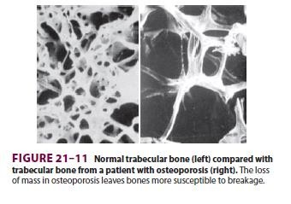
Osteoporesis
25

Slide 26
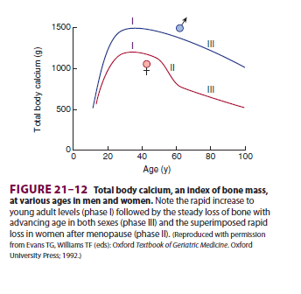
Osteoporosis
26
Osteoporosis: Is caused by a relative excess of osteoclastic function. Loss of bone matrix is marked. Matrix and mineral are both lost and there is a loss of bone mass. Due to :
Lack of physical stress
Malnutrition, lack of vitamin C
Old age, Postmenopausal lack of estrogen
Cushing’s syndrome.

Slide 27
Complications of Osteoporesis
27
The incidence of fractures is increased particularly in the distal forearm (Colles fracture), vertebral body, and hip. These areas have a high content of trabecular bone, which is more active metabolically, it is lost more rapidly.
Fractures of the vertebrae with kyphosis produces “widow’s hump” in elderly women with osteoporosis.
Fractures of the hip in elderly are associated with a mortality rate of 12–20%, and half of those who survive require prolonged expensive care.
Increased intake of calcium and moderate exercise may help prevent or slow the progress of osteoporosis,

Slide 28



28

