Slide 1

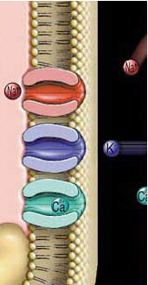
The excitable tissues
(Nerve+ Muscle)
TEXTBOOK OF MEDICAL PHYSIOLOGY
GUYTON & HALL 13TH EDITION
UNIT II CHAPTER 5

Slide 2
Objectives
At the end of this lecture the student should be able to:
Discuss the resting membrane potential and its genesis.
Know the ionic channels involved in resting membrane potential.
Describe the function Na+-K+ pump and the stages of action potential.
Explain the threshold Potential, local Response and action Potentials.
Describe the electrical changes in membrane potential during the action potential, their chemical bases and excitability changes.
Describe conduction along nerve fibers, role of myelination and how nerve fibers are classified.

Slide 3
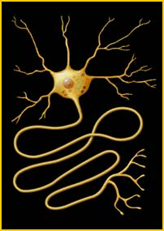
The nerve

Slide 4
Neuron:-
DIF: unit of function of the central nervous
system
Parts of motor neuron & function of each part:
1- Soma (cell body)
2-Dendrites carry nerve impulses from surroundings to the soma
3 Axon hillock at which nerve impulses begin
4-Axon & axon terminal

Slide 5
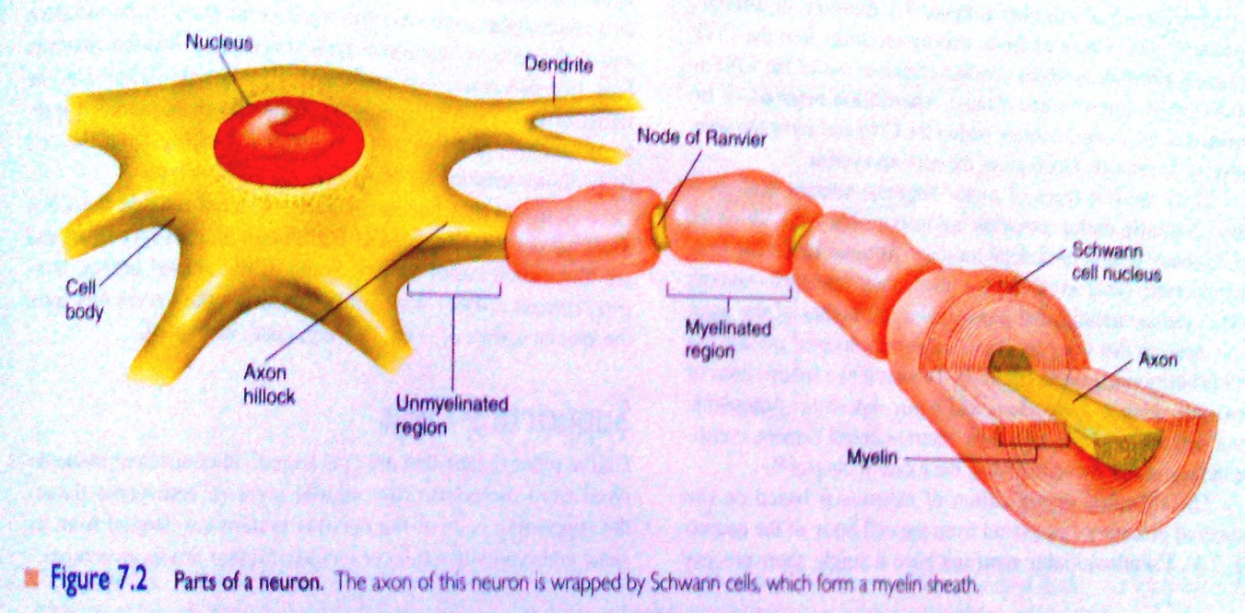

Slide 6
-Histological classification of axons:-
1- myelinated : have myelin sheath (diameter more than 1um)
2- unmyelinated (diameter less than1um )
-type C :postganglionic autonomic &pain fibers

Slide 7
-Myelin sheath is formed by schwann cell which deposit sphingomyelin
Functions of myelin sheath
1-insulator
3- increase conduction velocity

Slide 8
The resting membrane potential of nerves

Slide 9
RESTING MEMBRANE POTENTIAL
DIF: it is potential difference across membrane during rest (without stimulation)
Value:- -70 to-90 mv in large nerve fibers ( -ve inside)
-The membrane is polarized

Slide 10
Causes of RMP:
1. RMP is 100 times more permeable to K+ than Na+. K+ tends to leak out of the cell down its conc gradient, carrying +ve charge with it. (through K leak channels).
2. non-diffusible anions (proteins, sulphate and phosphate ions) cannot leave the cell.
3. very small amount of Na+ diffuses into the cell down its conc gradient. The mb only slightly permeable to Na+. (through Na+ leak channels).
4. Na+-K+ pump maintain conc gradients of K+, and Na+ between the two sides of the mb.

Slide 11
Origin of RMP:
1- Contribution of K diffusion potential:-
N.B/ K diffusion contributes far more to membrane potential .
-K leak channels:- K OUTFLUX TO OUTSIDE causing –ve inside (from high conc inside to outside carrying +ve charge with
it→ electropositivity outside& electronegativity inside

Slide 12
2- Contribution of Na diffusion potential:-
Na leak channels :- Slight membrane permeability to Na ions in leak channels from outside to inside.(why slight?)
3. Na+-K+ pump maintain conc gradients of K+, and Na+ between the two sides of the mb.

Slide 13
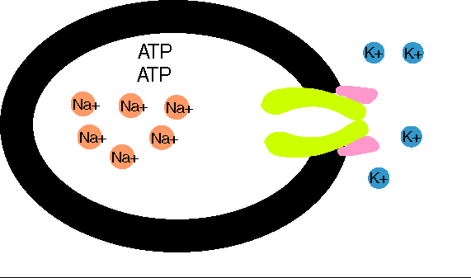

Slide 14
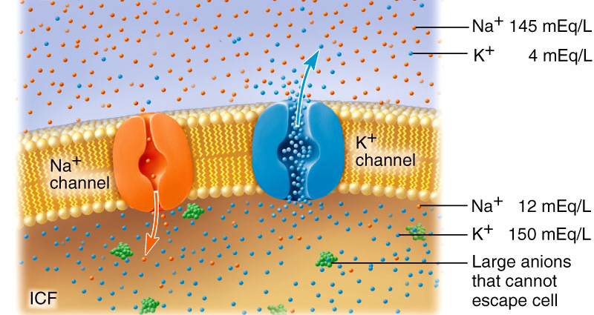
What does it mean when a neuron “fires”?
Firing = excitability = action potential = nerve impulse
Recall resting potential of all cells
  High K+ in; high Na+ out
  Cell is polarized
  Cell overall neg. charge inside due to molecules like proteins, RNA, DNA
    Charge measured in millivolts
    Potential = difference in charge across PM
    Current = flow of charge (ions) from one point to another

Slide 15
Changes that occure through the nerve after stimulation by threshold (effective) stimulus:-
1- Electrical changes (nerve action potential)
2- Excitability changes
3-Thermal changes
4-Chemical changes

Slide 16
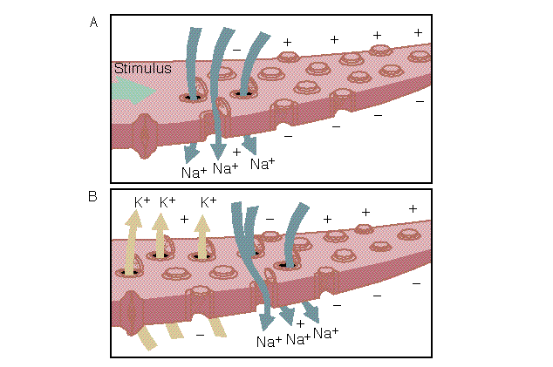
Nerve physiology:
Action potentials

Slide 17
The action potential
It is sudden reversal of membrane polarity produced by a stimulus to produce a physiological effect such as:
Transmission of impulse along nerve fibres
Release of neurotransmitters
Muscle contraction
Activation or inhibition of glandular secretion

Slide 18
1- Electrical changes
The nerve action potential
-It is potential difference along nerve membrane after stimulation
by threshold (effective)stimulus
- oscilloscope to measure rapid changes in membrane potential
-Nerve signals (impulses) are transmitted as nerve action potentials conducted along the nerve fiber as a wave of depolarization to its end
-The factors necessary for nerve action potential are voltage gated Na &
Voltage gated k channels
Threshold stimulus
-

Slide 19
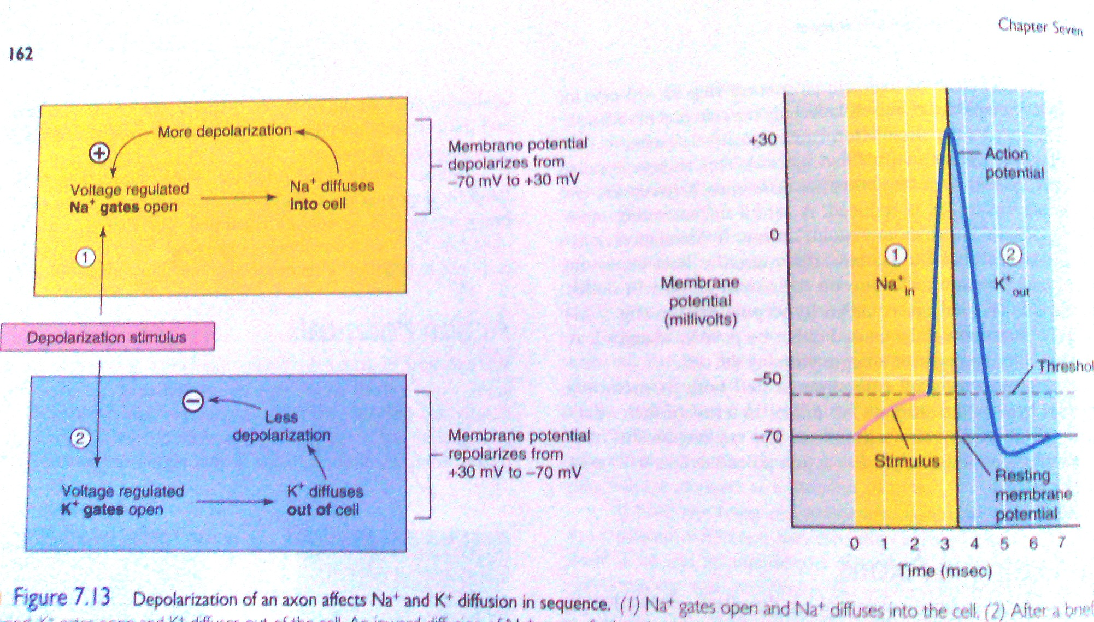

Slide 20
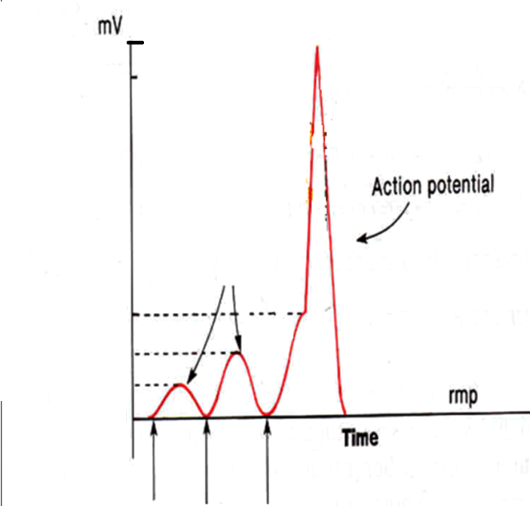
Reversal Potential
= + 35 mV
Local Responses
Threhold
Potential ( Firing Level )
= -50 to -65 mV
RMP= -90 mV
Q : What opens the voltage-gated channels ? Opened by a stimulus strong enough to depolarize them to threshold
Increasing Stimulation

Slide 21
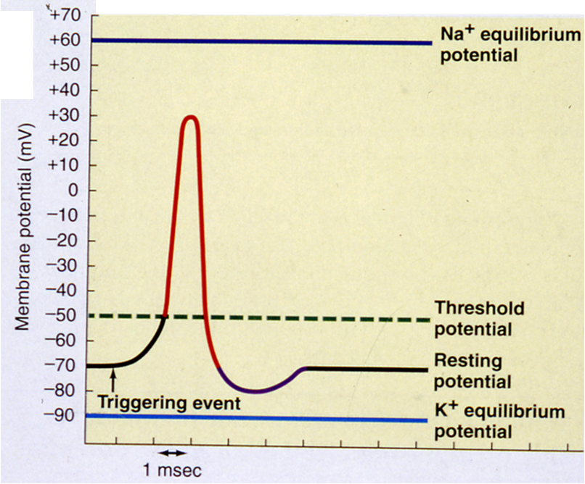
We need to start from the
baseline i.e., Resting State of
the cell i.e, at the RMP
A threshold Stimulus will
lead to →
(1) Depolarization
(2) Repolarization phase .
(3) In some neurons there is a 3rd phase called Hyperpolarization
Na Pump brings MP back to its resting value
-65
-90
Hyperpolarization ( positive after-potential )

Slide 22
Summary of events that causes AP:-
1-Initiation of Action Potential (AP)
- -70 to-90 mv is the resting potential
- Threshold stimulus open voltage gated Na channels & Na influx rises resting potential from -90 towards zero (gradual depolarization)
-as membrane potential raises ---------- open more Na channels & more Na influx (+ve feedback ) until all voltage gated Na channels open.

Slide 23
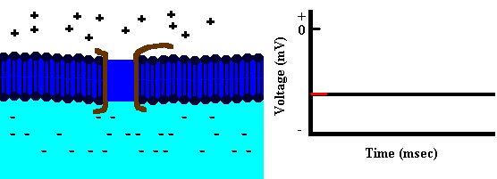
Depolarization

Slide 24
2-Depolarization occurs & membrane potential reach zero value to reach + 35 mv,
-at + 35 mv all Na channels begin to close suddenly( Depolarization ends)

Slide 25
c-Repolarization :- due to high K conductance( flow) to outside (K outflux) by openning of all voltage gated K channels (causes negativity inside )

Slide 26
Repolarization

Slide 27
Hyperpolarization: Why?
Na-K pump now start to move Na out & K in against their concentration gradient, so the RMP is resumed and the membrane is ready for another stimulus

Slide 28
The action potential (cont.)***
Threshold stimulus:
If a stimulus is strong enough to move RMP from its resting value (-70mV) to the level of (-55mV) which leads to production of an AP

Slide 29
Subthreshold stimulus:
    Stimulus that result only in local depolarisation

Slide 30
All or nothing principle:-
- Once threshold value for excitation is reached a full AP produced ,its intensity can not increased by increasing stimulus intensity ( suprathreshold)

Slide 31
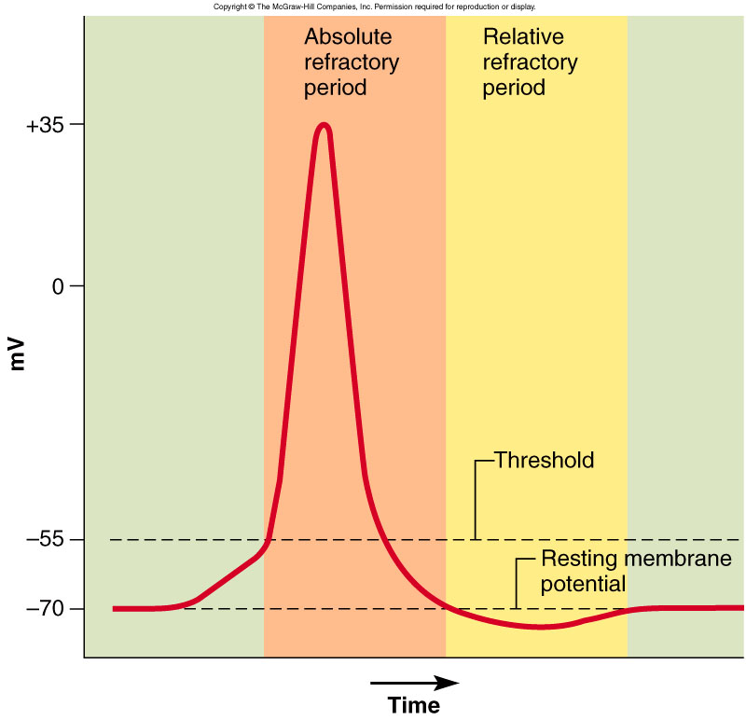
What happens after an action potential?
Refractory period: few millisecs
  Time during which can’t stimulate neuron a second time
  Happens until recovery of resting potential
Two stages
  Absolute refractory period
    No new action potential possible
  Relative refractory period
    Can trigger new action potential if stimulus is very strong

Slide 32
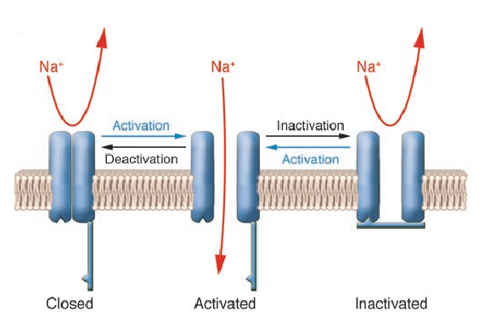
Activation-Inactivation-Deactivation

Slide 33
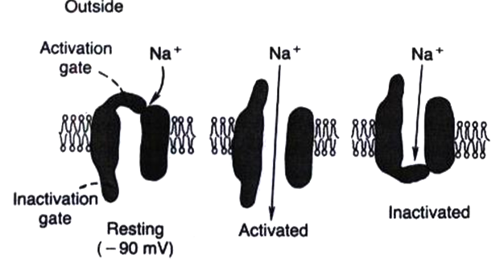
The Na+ Voltage-Gated Channel (1)
Has 2 gates : one on the outer side of the membrane and is called the activation gate ,
and another one on the inner side of membrane called the inactivation gate .
And this channel has 3 states :
(1) Resting state : in the resting cell , when the MP = RMP = -70 to -90 mV , →
the activation gate is closed
this prevents entry of Na+ to the interior of the cell through this gate.

Slide 34
Activated State of Sodium Channel
(2) Activated state : when a Threshold Depolarizing Stimulus moves the MP from its resting value (-90 mV ) to its Threshold value (-65 to -55mV)
→ this opens the activation gate , and now the Na+ channel is said to be in the Activated State
( NB in this case BOTH the activation gate & inactivation gate are open ) →
permeability to Na+ becomes increased 500 to 5000 times → Na+ influx
Na+ flows into the cell in large amounts ,

Slide 35
Inactivated State of Sodium Channel
(3) Inactivated state : A few milliseconds after the activation gate opens , the channel becomes inactivated :
At the peak of AP the inactivation gate will close
the inactivation gate will
not open by a second stimulus → & the cell
becomes Refractory ممانعة ) to another
stimulation .
This goes on until the MP has gone back to its resting ( RMP) level ( -70 to -90mV).
→ in this case , while the activation gate is still open ,
the inactivation gate is closed .

Slide 36
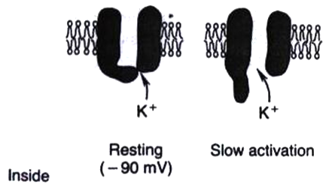
The Potassium Voltage-Gated Channel
Has one gate only .
During the resting state , the gate of the potassium channel is closed , and K+ can not enter through it .
Shortly after depolarization , when the sodium channel begins to be inactivated , the potassium channel opens .
→ K+ exits ( called K+ Efflux) خروج البوتاسيوم
→ Repolarization

Slide 37
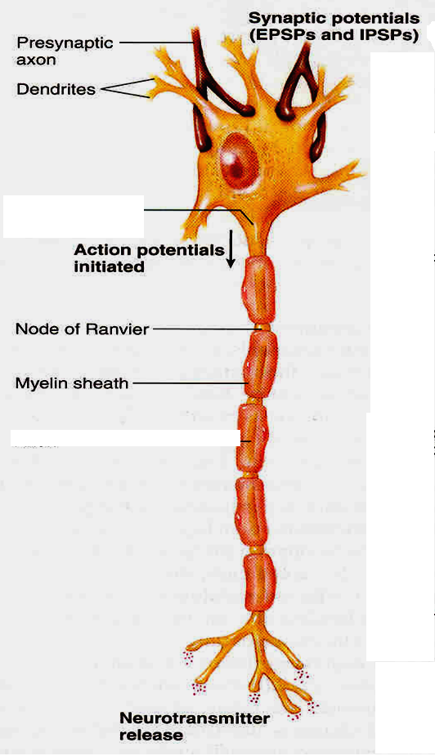
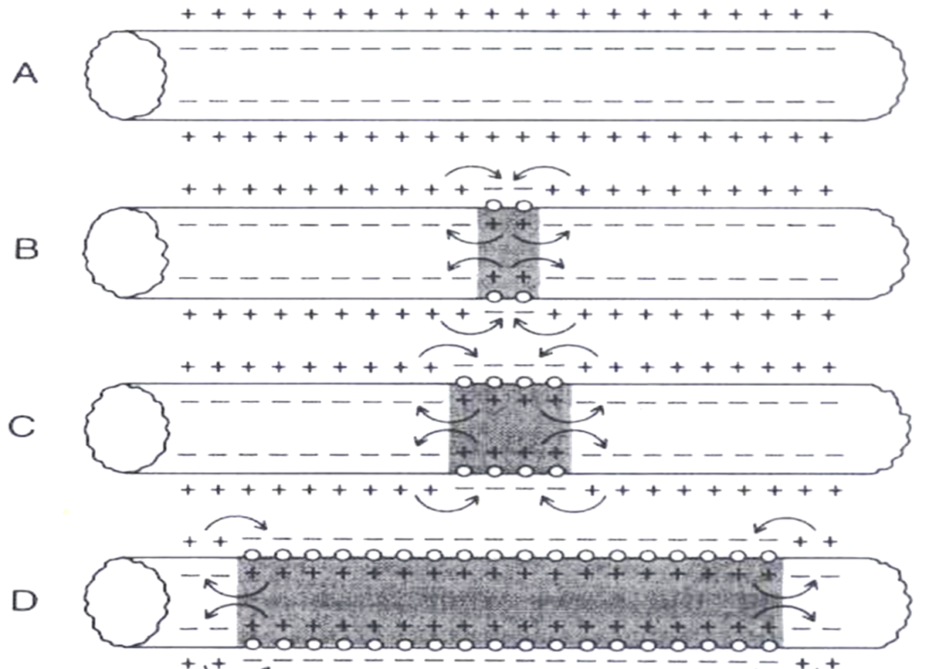
Direction of AP Propagation (Conduction)
Artificial Electrical Stimulation
Axon Hillock
Under Artificial condition of electrical stimulation in the laboratory , the AP propagates in both directiions .
But normally AP starts in axon hillock & propagates distally in one directions

Slide 38
Nerve physiology:
Action potentials

Slide 39
Propagation of action potential
1- in myelinated nerve fibers:-
Saltatory conduction ( jumping)
Value:-
1-↑ velocity of conduction of nerve impulses
2-Conserve energy for axon because only nodes depolarize

Slide 40
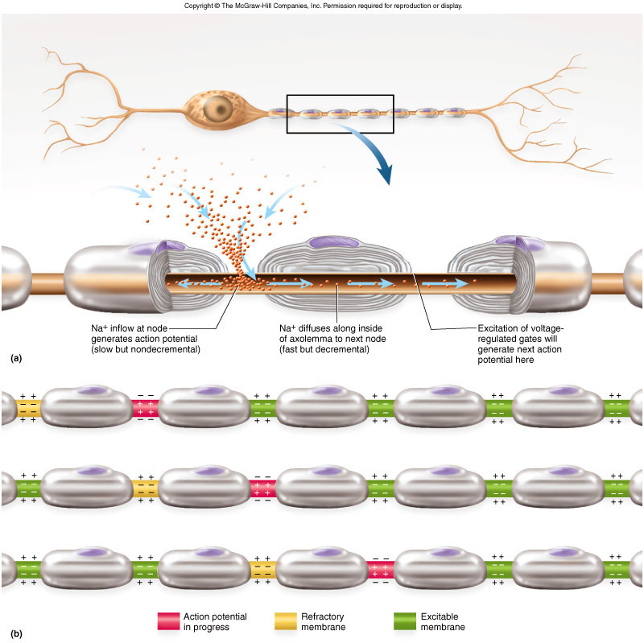
How do action potentials travel down the axon?
Myelinated sheaths
  Many times faster transmission
  Action potential skips from one node of Ranvier to the next
    Called saltatory conduction
    http://www.blackwellpublishing.com/matthews/actionp.html

Slide 41

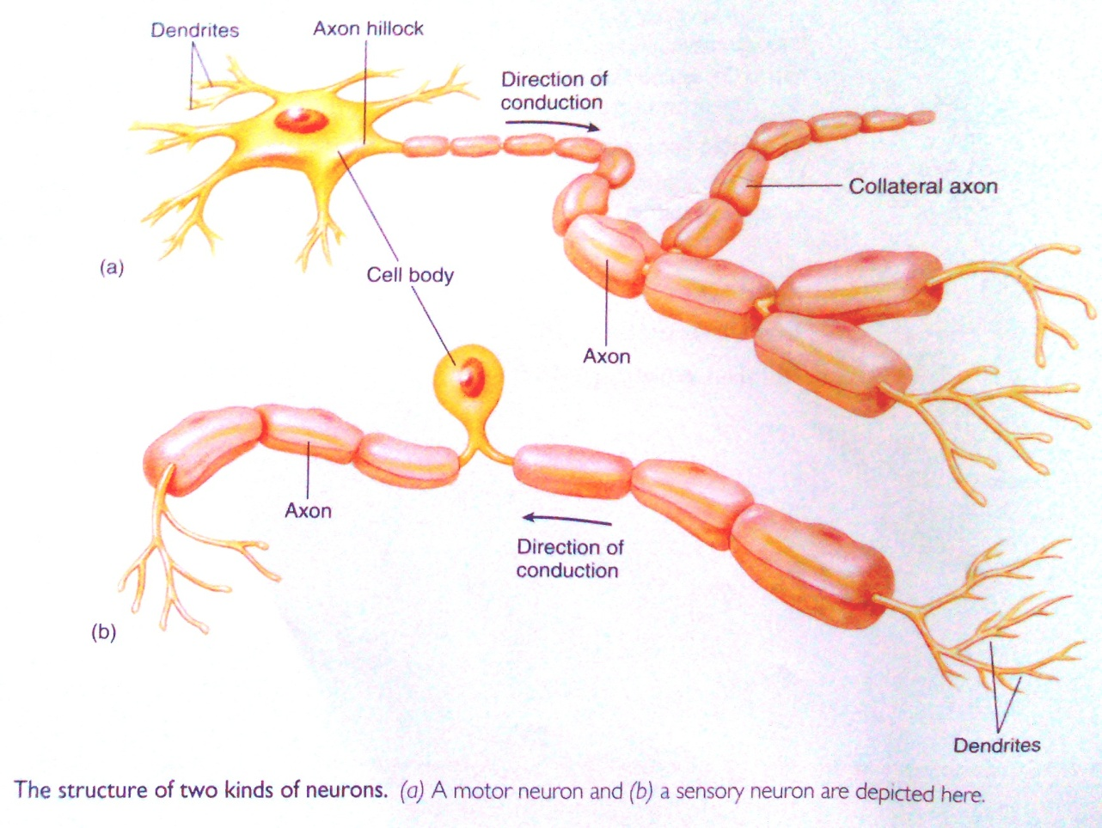

Slide 42
2- Non- myelinated nerves:-
(local circuits)=point to point
-depolarization pass by local circuits. -

Slide 43
What else influences speed of action potential?
.Axon diameter
  -The larger the diameter, the faster the speed of transmission
  -Less resistance to current flow with larger diameter
Slower transduction
Faster transduction

Slide 44
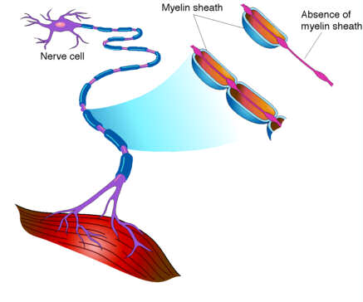
What happens if myelination is lost?
Multiple sclerosis
  Autoimmune disease
  Usually young adults
  Blindness, problems controlling muscles
    Ultimately paralysis
  Immune system attacks myelin sheaths and nerve fibers
    Scar tissue (scleroses) replaces some damaged cells

Slide 45
Thank You

