Slide 1
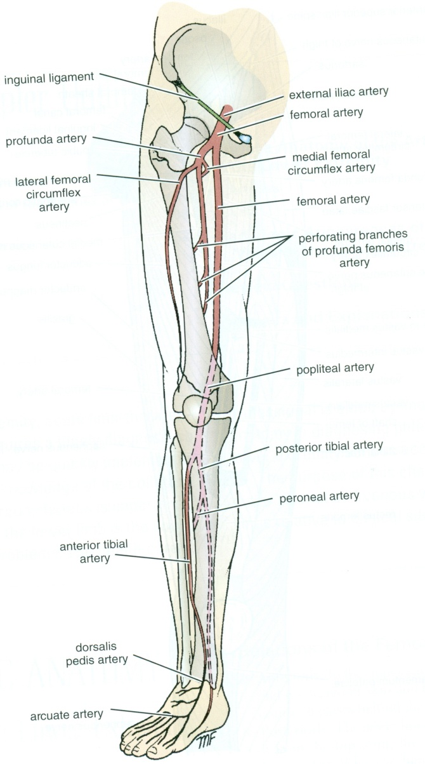
VASCULATURE OF LL
Dr JAMILA ELMEDANY
Dr ESSAM ELDIN SALAMA

Slide 2
OBJECTIVES
At the end of the lecture, students should:
List the main arteries of the lower limb.
Describe their anatomy regarding: origin, course distribution & branches.
List the main arterial anastomosis.
List the sites to feel the peripheral arterial pulse.
Describe the anatomy of the veins of the lower limb regarding: differentiation into superficial& deep, origin, course & termination

Slide 3
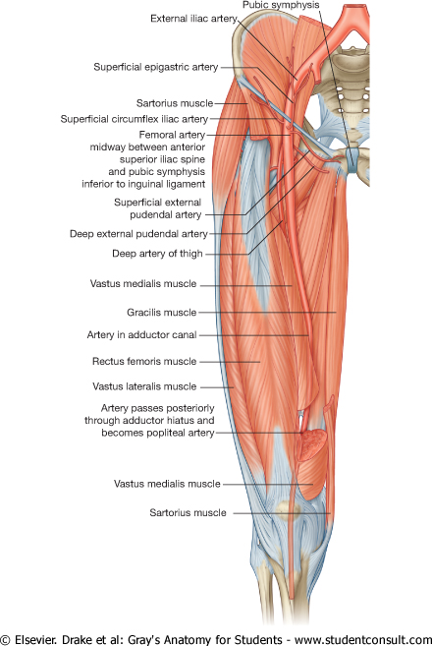
FEMORAL ARTERY
It is the main arterial supply to the lower limb.
Origin:
It is the continuation of the External iliac artery.
How it enters the thigh?
Behind the inguinal ligament; midway between the anterior superior iliac spine and the symphysis pubis.

Slide 4
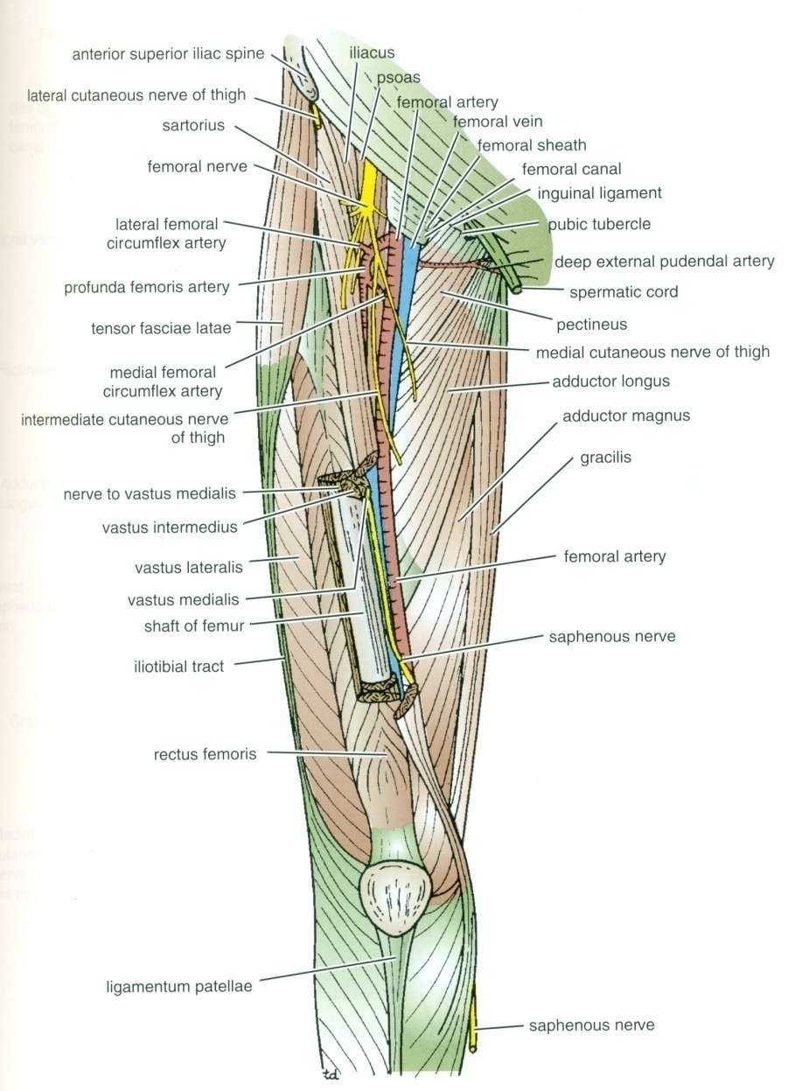
RELATIONS
Anterior:
Upper part: Skin &fascia.
Lower part: passes behind the Sartorius.
Posterior:
Psoas (separates it from the hip J),Pectineus & Adductor longus.
Medial:
Femoral vein.
Lateral :
Femoral nerve and its branches.

Slide 5
Femoral A. & Femoral V.
At the inguinal ligament:
The vein lies medial to the artery.
At the apex of the femoral triangle:
The vein lies posterior to the artery.
At the opening in the adductor magnus:
The vein lies lateral to the artery.
V
A

Slide 6
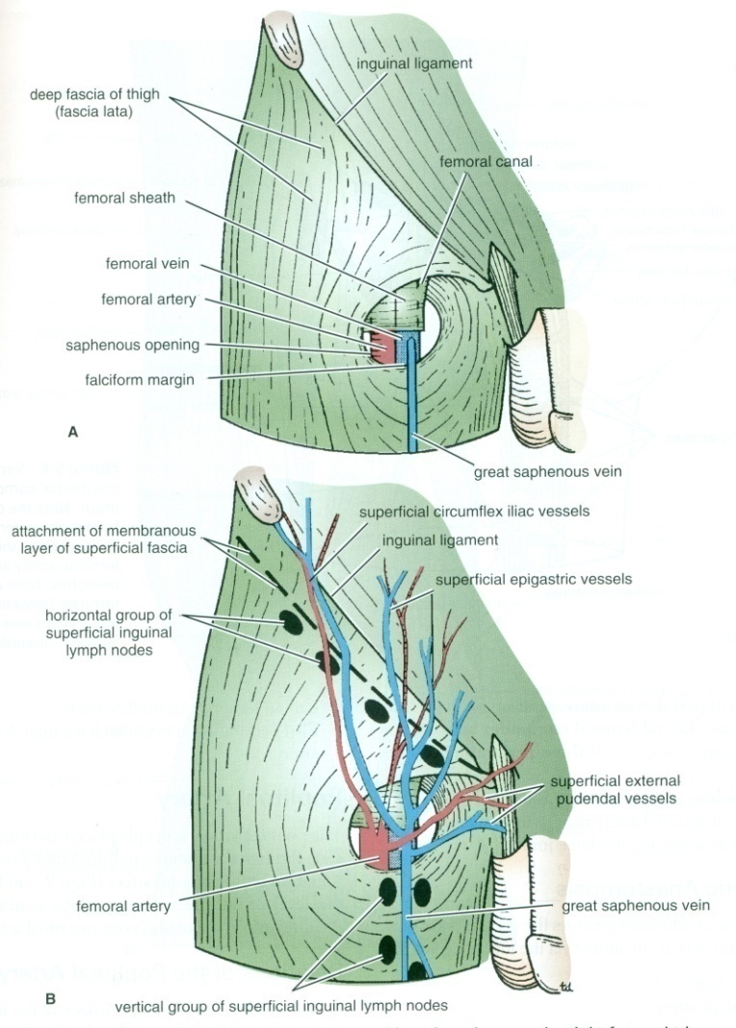
BRANCHES OF FEMORAL A.
1. Superficial Epigastric.
2. Superficial Circumflex iliac.
3. Superficial External Pudendal.
4. Deep External Pudendal.
5. Profunda femoris.

Slide 7
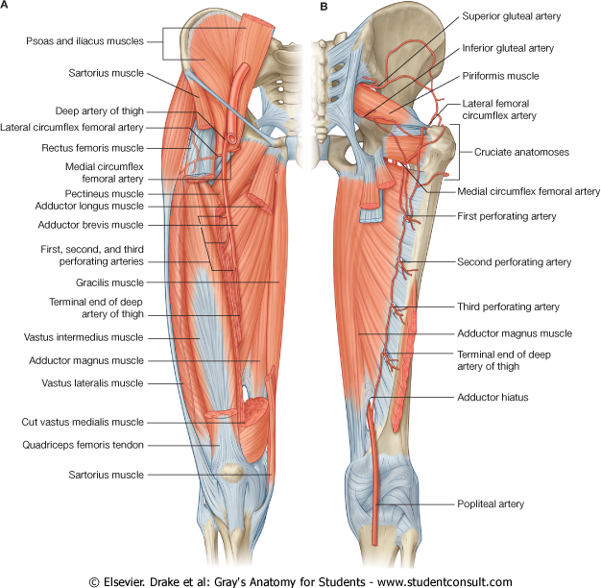
PROFUNDA FEMORIS A.
It is an important, large artery.
Arises from the lateral side of the femoral artery(4cm below the inguinal ligament).
It Passes medially behind the femoral vessels.
Branches:
Medial & Lateral circumflex femoral arteries.
Three Perforating arteries.
It ends by becoming the 4th perforating artery.
.
P

Slide 8
POPLITEAL ARTERY
It is the continuation of Femoral artery.
It enters the Popliteal fossa through an opening in the Adductor magnus.

Slide 9
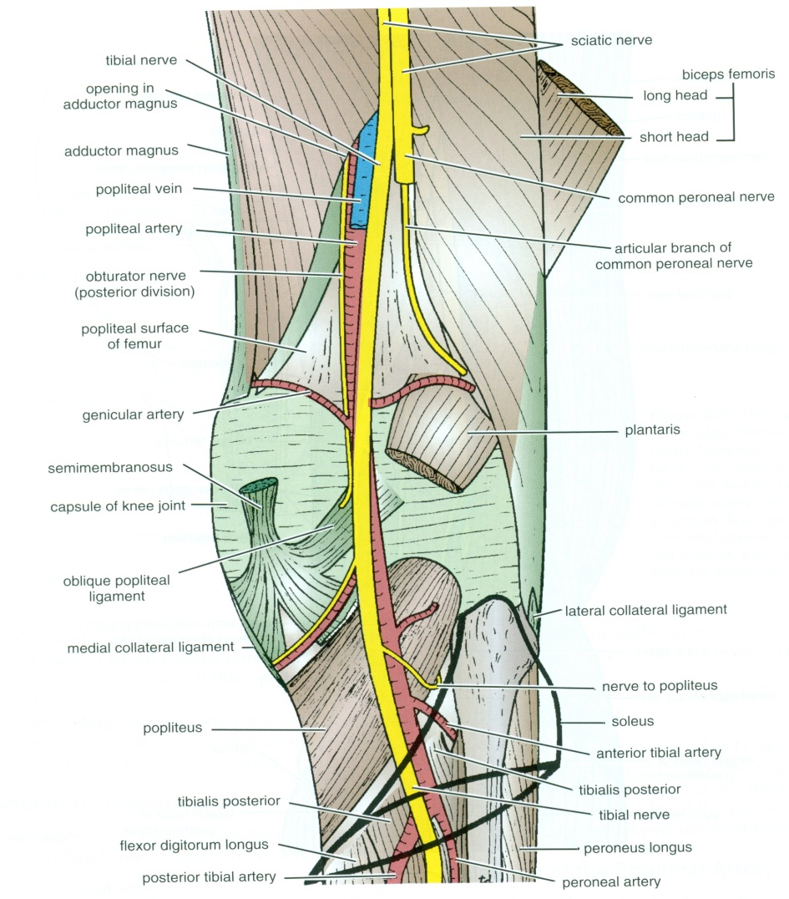
RELATIONS & BRANCHES
Anterior:
Popliteal surface of the femur.
Knee joint.
Popliteus muscle.
Posterior:
Popliteal vein, Tibial nerve, skin and fascia.
Branches:
Muscular & Articular to the knee.
Termination:
At the lower border of Popliteus muscle by dividing into
Anterior and Posterior Tibial Arteries.

Slide 10
ANTERIOR TIBIAL ARTERY
It is the smaller of the two terminal branches of the popliteal artery.
It enters the anterior compartment of the leg through an opening in the upper part of the interosseous membrane.
It descends with the Deep Peroneal nerve.
In the upper part of its course, it lies Deep.
In the lower part, it lies Superficial in front of the lower end of the tibia.
Branches:
Muscular& Anastomotic.

Slide 11
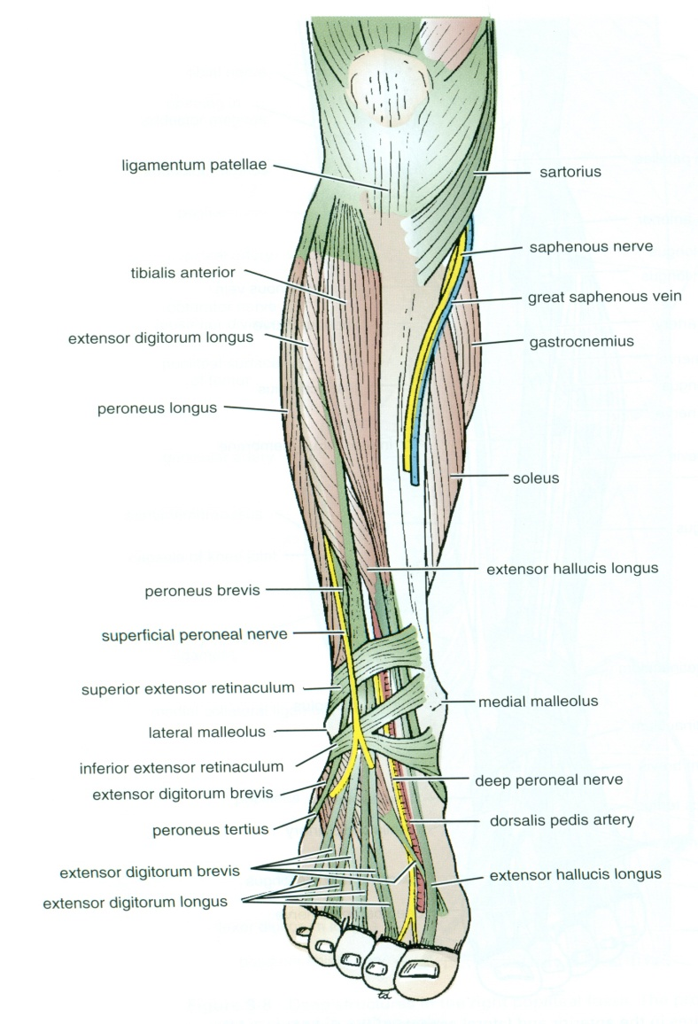
DORSALIS PEDIS ARTERY
Begins in front of ankle joint as a continuation of the Anterior Tibial artery.
It is superficial in position.
Crossed by the inferior extensor retinaculum and the first tendon of extensor digitorum brevis.
Medially:
Tendon of extensor hallucis longus.
Laterally:
Deep peroneal nerve& extensor digitorum longus.

Slide 12
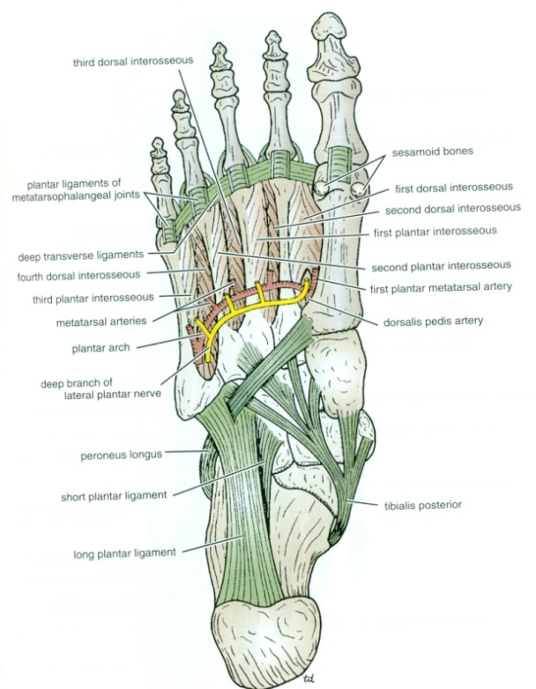
DORSALIS PEDIS ARTERY
It Terminates by passing between the two heads of the 1st dorsal interosseous muscle.
It joins the Lateral plantar artery to complete the Plantar Arch.
Branches:
Lateral tarsal artery.
Arcuate artery.
1st dorsal metatarsal artery.

Slide 13
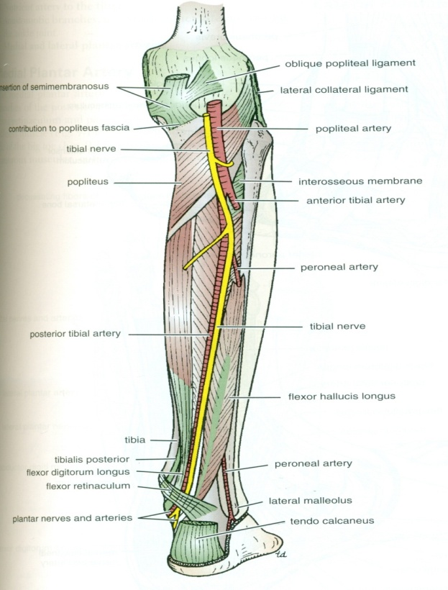
POSTERIOR TIBIAL ARTERY
Descends Deep to Soleus & Gastrocnemius.
Lies on the posterior surface of Tibialis Posterior muscle above
and on the posterior surface of Tibia below.
Its lower part is covered by Skin & Fascia only.
Passes Behind Medial Malleolus , Deep to Flexor Retinaculm

Slide 14
POSTERIOR TIBIAL ARTERY -PTA
Terminates by dividing into: Medial & Lateral plantar arteries.
Branches:
1. Peroneal artery:
A large artery, descends behind the fibula (the artery of the lateral compartment of the leg).
Gives :
A. Nutrient artery to the fibula.
B. Muscular branches.
C. Perforating branch to lower part of front of leg.
D. Shares in the Anastomosis around the ankle joint.

Slide 15
BRANCHES OF PTA
2.Nutrient artery to the tibia.
3. Anastomotic branches to anastomosis around ankle joint.
4. Medial & Lateral plantar arteries.

Slide 16
MEDIAL PLANTAR ARTERY
The smaller of the two terminal branches of the posterior tibial artery.
Arises beneath the Flexor Retinaculum.
Gives: Muscular, Articular and Cutaneous branches.
Ends by supplying the medial side of the big toe.

Slide 17
LATERAL PLANTAR ARTERY
The larger of the two terminal branches of the posterior tibial artery.
At the base of the 5th metatarsal bone, it curves medially to form the Deep Plantar Arch.
Joins the Dorsalis pedis artery at the proximal end of the 1st intermetatarsal space.
Gives:
Muscular, Articular & Cutaneous branches.
The Plantar Arch gives Plantar Digital Arteries.

Slide 18
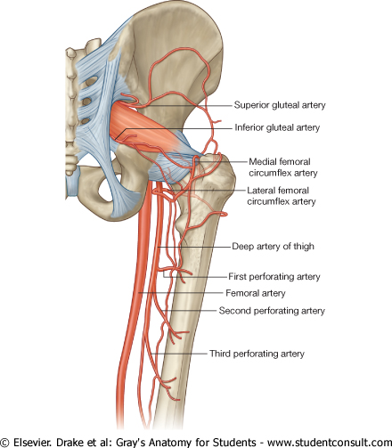
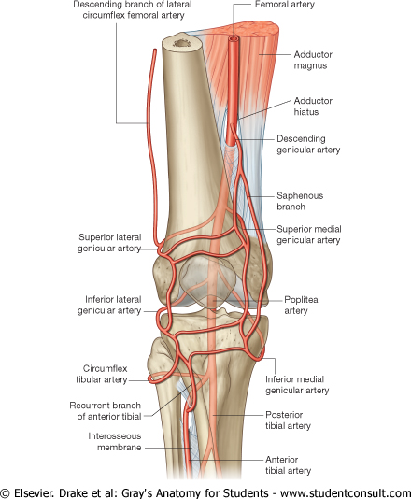
ARTERIAL ANASTOMOSISES
TROCHANTERIC (supplies the head of femur)
CRUCIATE
AROUND THE KNEE

Slide 19
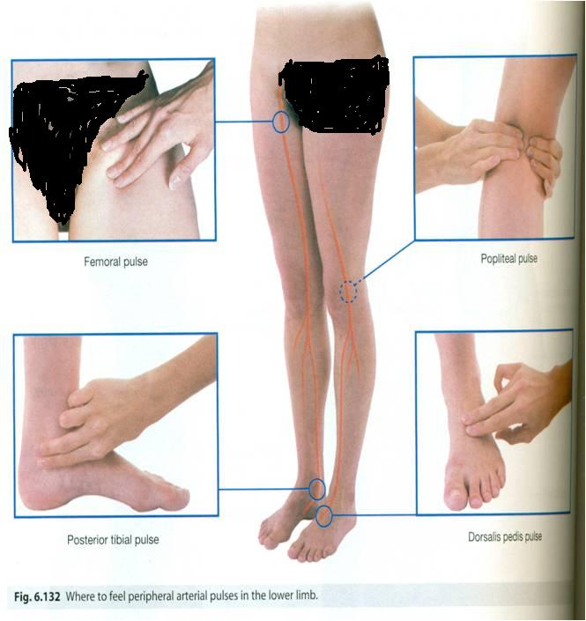
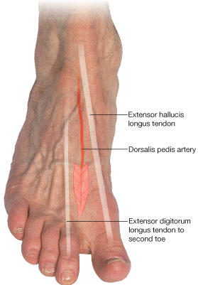
WHERE TO FEEL PERIPHERAL ARTERIAL PULSE ?
Femoral pulse:
Inferior to the lingual ligament and midway between the anterior superior iliac spine and symphysis pubis.
Popliteal pulse:
Deep in the popliteal fossa medial to the midline.
Posterior tibial pulse:
Posteroinferior to the medial malleolus in the groove between the malleolus and the heel.
Dorsalis pedispulse:
Over the dorsum of the tarsal bones between the tendons of extensor hallucis longus and extensor digitorum.

Slide 20
VEINS OF THE L.L
The veins of the lower limb are:
(1) Superficial.
(2) Deep.

Slide 21
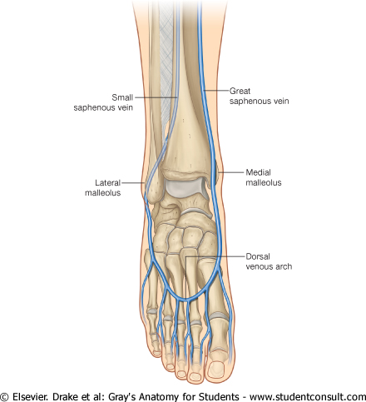
SUPERFICIAL VEINS
They are immediately under the skin in the subcutaneous tissue.
Dorsal Venous arch (network):
Drains most of the blood of the foot through Digital and Communicating veins.
It is Drained on:
Medial side by the Great Saphenous vein.
Lateral side by the Small saphenous vein

Slide 22
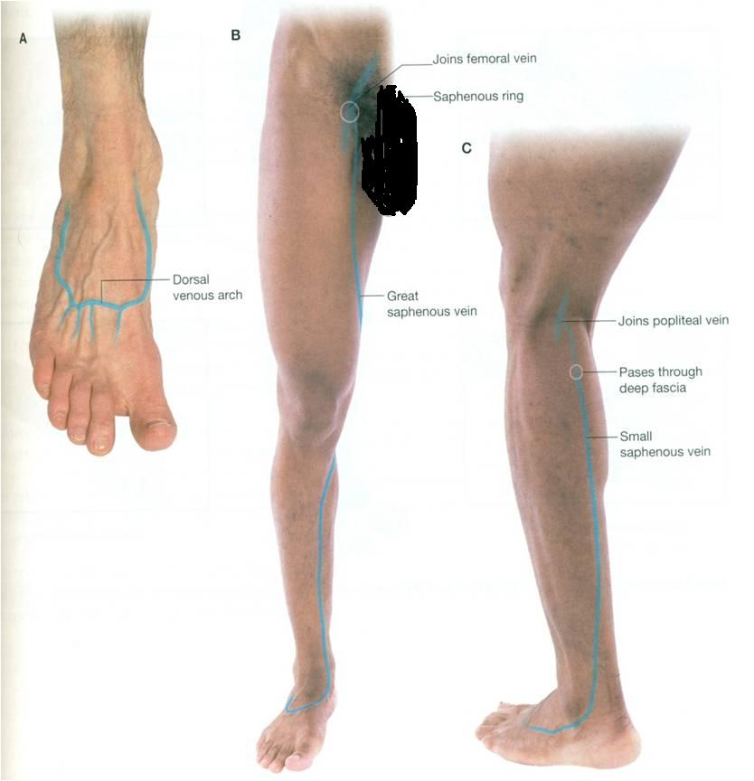
GREAT SAPHENOUS VEIN
The Longest Superficial vein of the body.
Begins from the medial end of the dorsal venous arch (as the medial marginal vein).
Ascends: In front of the Medial Malleolus accompanied by the (Saphenous nerve).
Posterior to the Medial Condyle of the femur.
Passes through the Saphenous Opening (2.5-3.25) cm below and lateral to the pubic tubercle.
Terminates in: Femoral Vein.

Slide 23
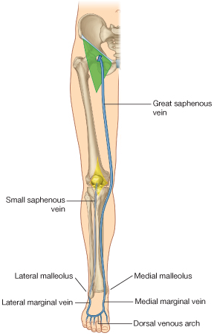
SMALL SAPHENOUS VEIN
Originates from the lateral end of the dorsal venous arch.
Ascends: Behind the lateral Malleolus in company with the Sural nerve.
Along the middle of the back leg.
Termination :
1. It may join the Great Saphenous vein.
2. Or Bifurcates:
One branch joins the Great saphenous and the other joins the Popliteal vein.

Slide 24
DEEP VEINS
Popliteal vein
Formed by the union of venae comitantes around the anterior & posterior tibial arteries.
lies posterior to popliteal artery.
Femoral vein
It enters the thigh by passing through the opening in the adductor magnus .
It leaves the thigh in the intermediate compartment of the femoral sheath.
Passes behind the inguinal ligament to become the External iliac vein

Slide 25
DEEP VEINS (VENAE COMITANTES)
Accompany all the major arteries and their branches.
Usually paired.
They are contained within the vascular sheath of the artery, whose pulsations help to compress and move blood in the veins.

Slide 26
PERFORATING VEINS
Connect the Great Saphenous vein with the deep veins along the medial side of the calf.
Their valves only allow blood to flow from the superficial to the deep veins.

Slide 27
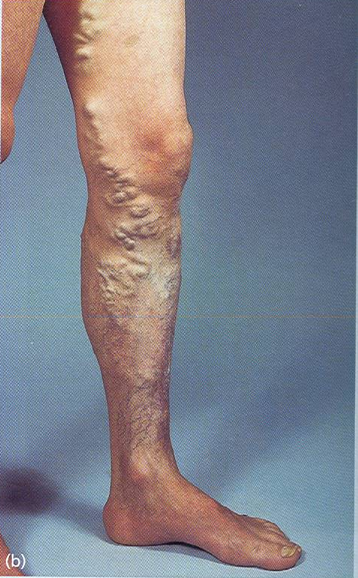
VARICOSE VEINS
Dilatation and Degeneration of the superficial veins that may be complicated by ulcers.
More common in the postero medial part of the lower limb.
Results from incompetence of the valves in the perforating veins, or within the great saphenous itself.
This allows the passage of high pressure blood from the deep to the superficial veins.

Slide 28
Thank you

