Slide 1
Popliteal fossa back of leg & Sole of foot
DR.SAEED VOHRA
DR.SANAA AL- SHAARAWY

Slide 2
Objectives
At the end of the you should know:
The popliteal fossa with its contents.
The contents of posterior fascial. compartment of the leg.
The structures hold by Flexor retinaculum at the ankle joint.
Layers forming in the sole of foot.

Slide 3
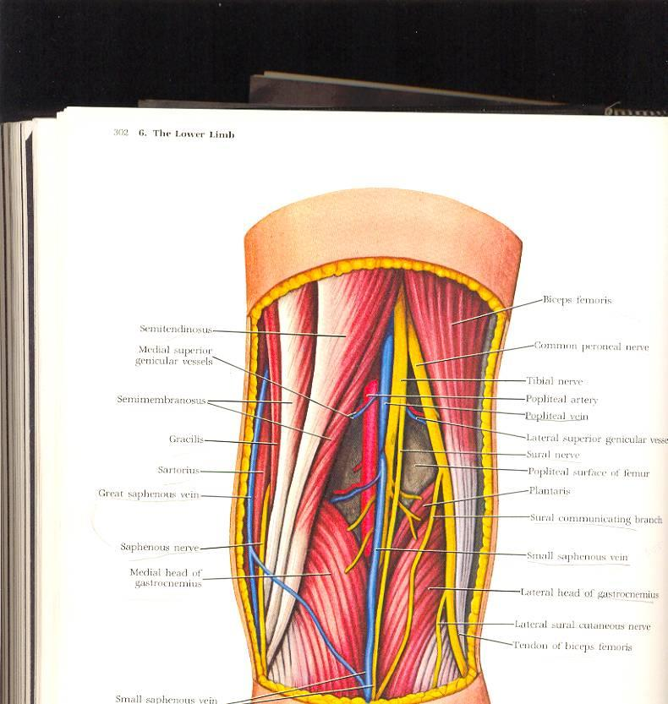
Popliteal Fossa
Is a diamond-shaped intermuscular space at the back of knee
Boundaries
Laterally:
Above: biceps femoris.
Below: lateral head of gastrocnemius & plantaris
Medially:
Above: semitendinosus & semimembranosus Below: medial head of gastrocnemius
Roof: Skin, superficial fascia and deep fascia of the thigh
Floor: Popliteal surface of femur, posterior ligament of knee joint and popliteus muscle

Slide 4
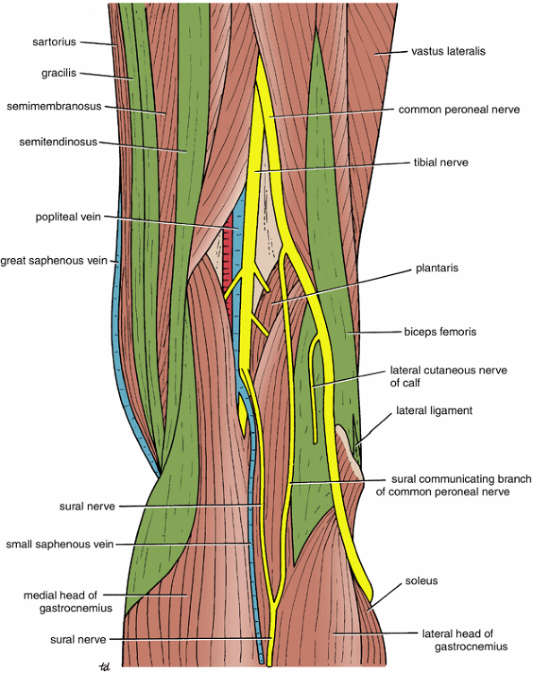
Popliteal Fossa
Contents:
1. Popliteal vessels
2. Small saphenous vein
3. Common peroneal nerve
4. Tibial nerve
5. Posterior cut. nerve of thigh
6. Connective tissue & popliteal lymph nodes

Slide 5
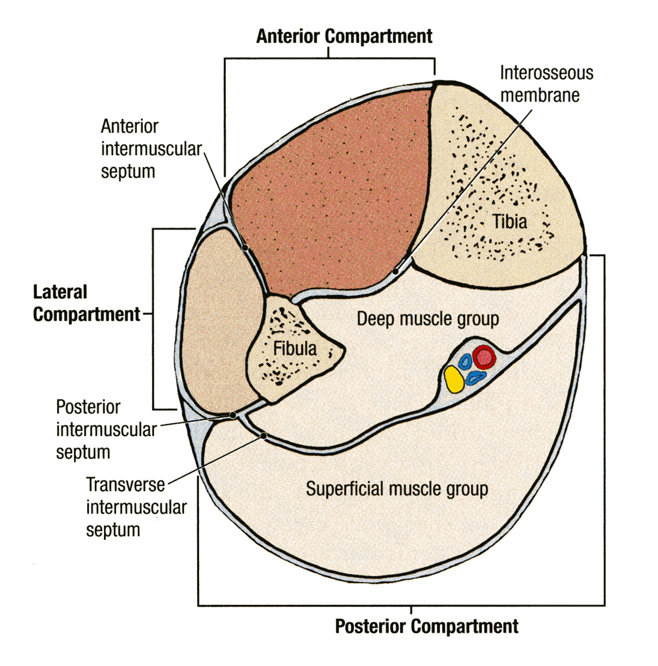
CONTENTS OF THE POSTERIOR FASCIAL COMPARTMENT OF THE LEG
The deep transverse fascia of the leg is a septum that divides the muscles of the posterior compartment into superficial and deep groups.
Contents:
Superficial group of muscles
Deep group of muscles
Posterior tibial artery
Tibial nerve

Slide 6
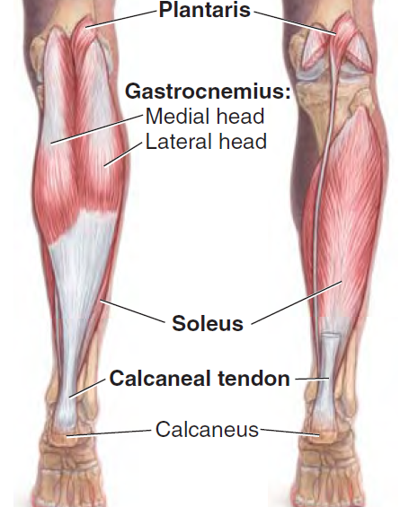
SUPERFICIAL GROUP
Muscle | Origin | Insertion | Action
Gastrocnemius | 1-lateral head lateral condyle of femur. 2-medial head popliteal surface of femur above medial condyle | Via tendo-calcaneus into posterior surface of calcaneum | 1-plantar flexes ankle joint 2-flexes knee joint
plantaris | Lateral supracondylar ridge. | Posterior surface of calcaneum
soleus | Shaft of tibia & fibula. | Via tendo-calcaneus into posterior surface of calcaneum | Together with gastrocnemius & plantaris is the powerfull plantar flexor at ankle j. It is the main force in walking & running.

Slide 7
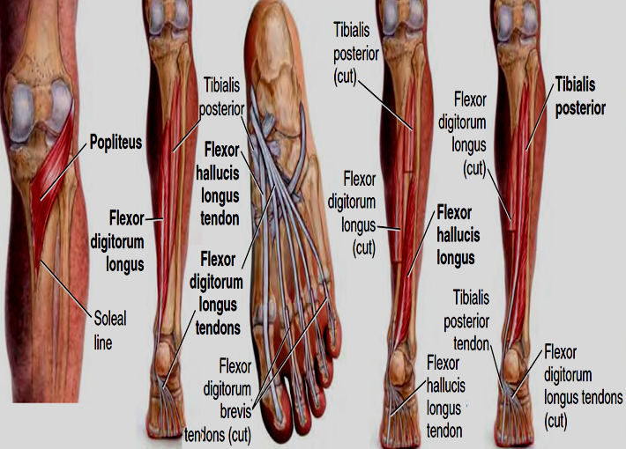
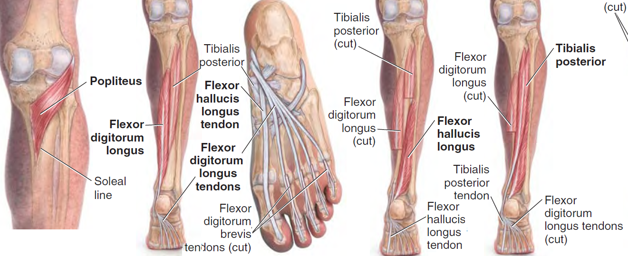
DEEP GROUP
Muscle | Origin | Insertion | Action
Popliteus | lateral condyle of femur (Intra-capsular). | Posterior surface of tibia above soleal line. | 1-Flexes knee 2-Unlocks knee joint by lateral rotation of femur on tibia
Flexor digitorum longus | Posterior surface of shaft of tibia. | Bases of distal phalanges of lateral 4 toes. | 1-Flexes phalanges of lateral 4 toes. 2-Plantar Flexes foot at ankle joint
Flexor hallucis longus | Posterior surface of shaft of fibula. | Base of distal phalanx of big toe. | 1-Flexex phalanx of big toe. 2-Plantar flexes
Tibialis posterior | Posterior surface of tibia & fibula +I.M. | All tarsal bones except talus. | Plantar Flexes inversion

Slide 8
POSTERIOR TIBIAL ARTERY
The posterior tibial artery is one of the terminal branches of the popliteal artery

Slide 9
TIBIAL NERVE
The tibial nerve is the larger terminal branch of the sciatic nerve in the lower third of the back of the thigh

Slide 10
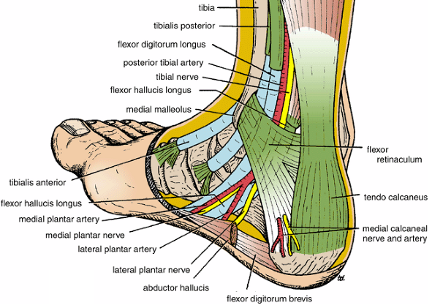
Flexor Retinaculum
Extends from back of
medial malleolus to
medial side of
calcaneum

Slide 11
Structures passing posterior to medial malleolus, deep to flexor retinaculum
Medial to lateral
Tibialis posterior tendon
Flexor digitorum longus tendon
Posterior tibial artery with venae comitantes
Tibial nerve
Flexor hallucis longus tendon
All the tendons are surrounded by a synovial sheath

Slide 12
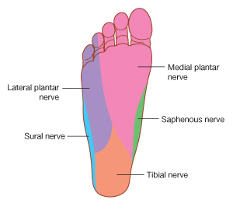
Sensory Nerve Supply
Lateral plantar nerve innervate the lateral third of the sole
The sensory nerve supply to the skin of
the sole of the foot is derived from
Medial plantar nerve innervate the medial two thirds of the sole
Tibial nerve innervates the medial side of the heel

Slide 13
DEEP FASCIA
The plantar aponeurosis is a triangular thickening of the deep fascia that protects the underlying nerves, blood vessels, and muscles.
Its apex is attached to the medial and lateral tubercles of the calcaneum.
The base of the aponeurosis divides into five slips that pass into the toes.

Slide 14
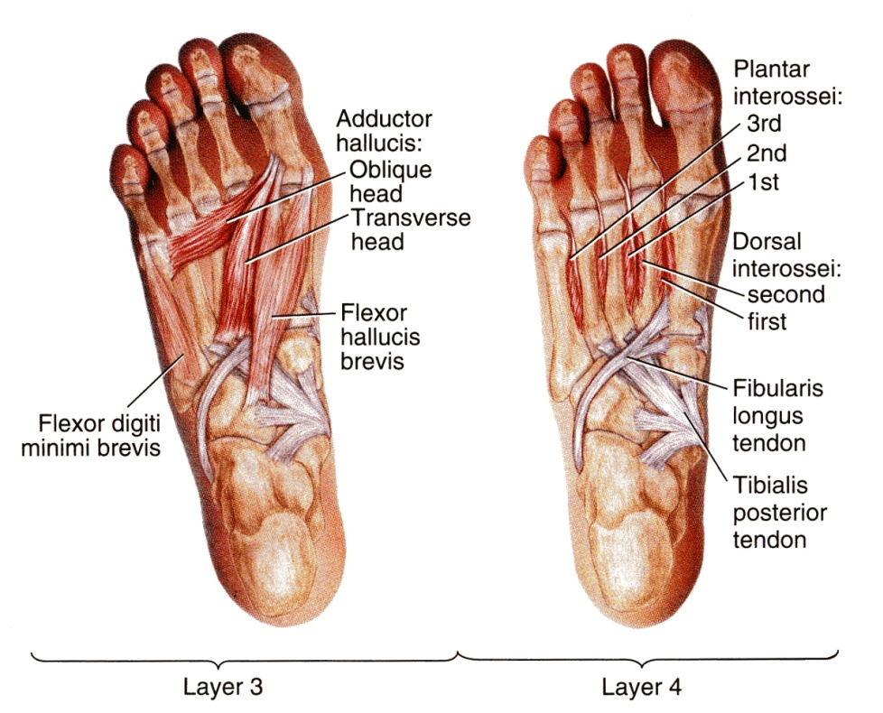
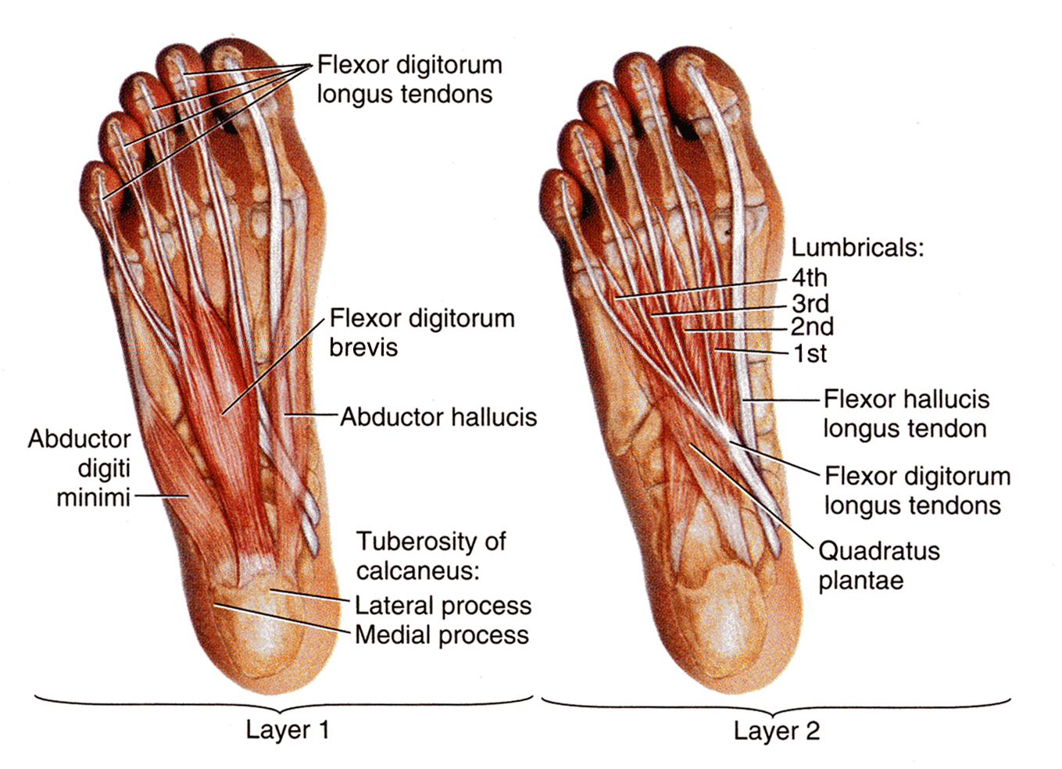
MUSCLES OF THE SOLE OF THE FOOT
The muscles of the sole are conveniently described in four layers from superficial to deep.

Slide 15
First Layer
Abductor hallucis,
Flexor digitorum brevis,
Abductor digiti minimi

Slide 16
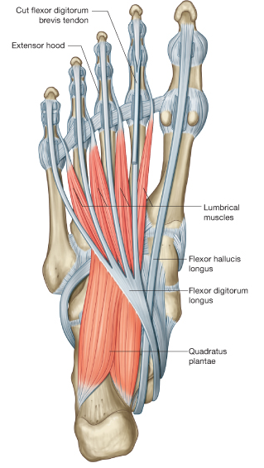
Second Layer
Quadratus plantae,
Lumbricals,
Flexor digitorum longus tendon,
Flexor hallucis longus tendon

Slide 17
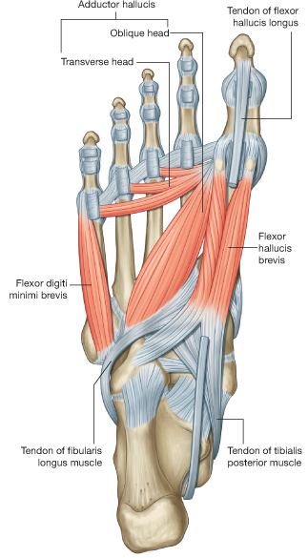
Third Layer
Flexor hallucis brevis
Adductor hallucis
Flexor digiti minimi brevis

Slide 18
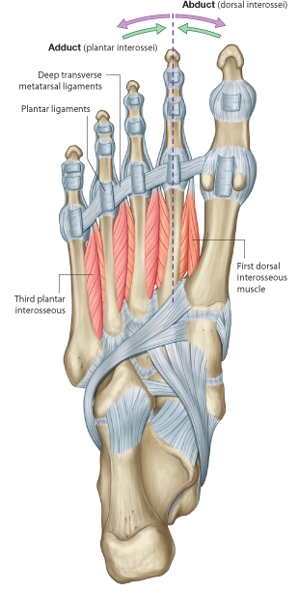
Fourth Layer
Interossei,
Peroneus longus tendon,
Tibialis posterior tendon

Slide 19
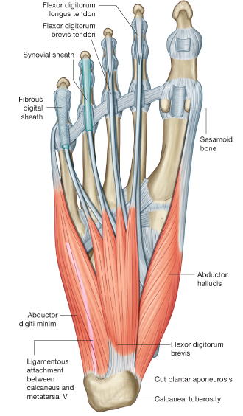
Fibrous Flexor Sheaths
The inferior surface of each toe, from the head of the metatarsal bone to the base of the distal phalanx, is provided with a strong fibrous sheath, which is attached to the sides of the phalanges.
The fibrous sheath, together with the inferior surfaces of the phalanges and the interphalangeal joints, forms a blind tunnel in which lie the flexor tendons of the toe

Slide 20
Synovial Flexor Sheaths
The tendons of the flexor hallucis longus and the flexor digitorum longus are surrounded by synovial sheaths

Slide 21
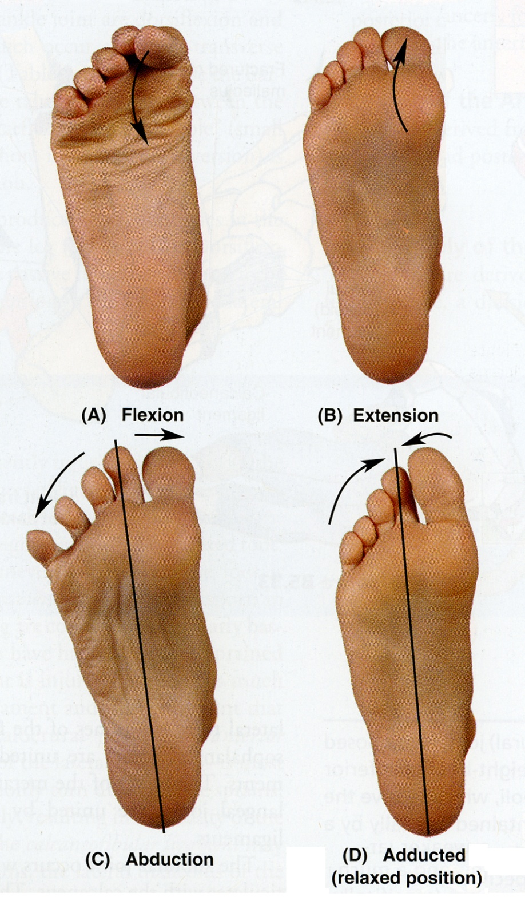
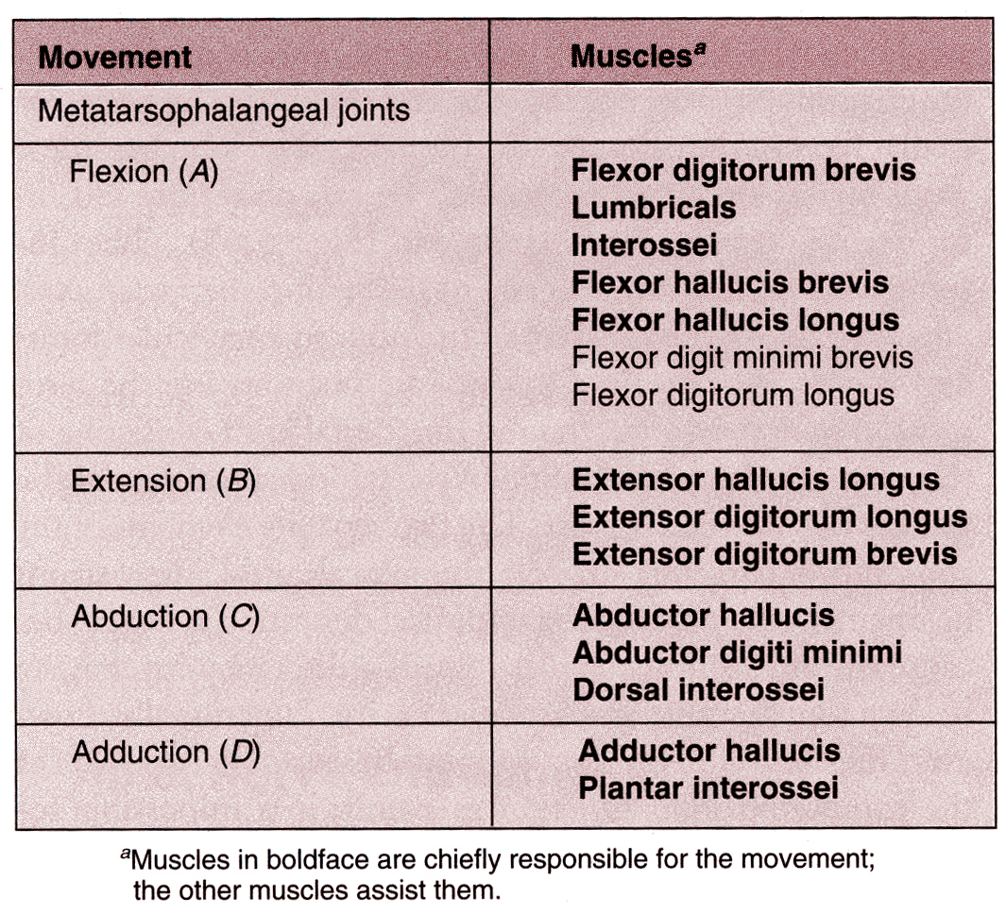

Slide 22
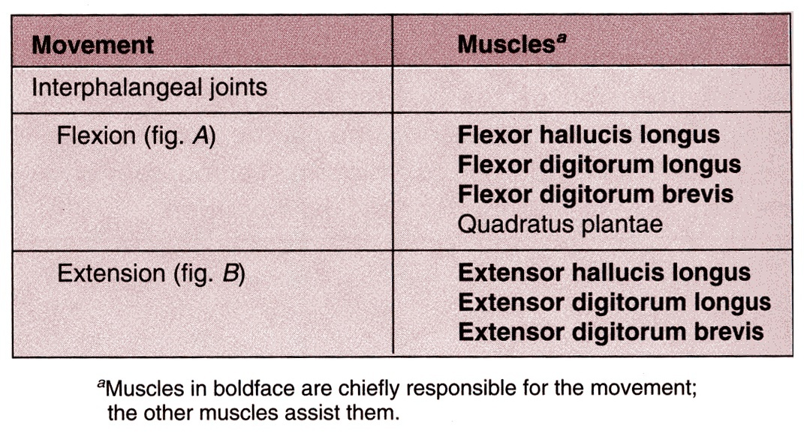

Slide 23
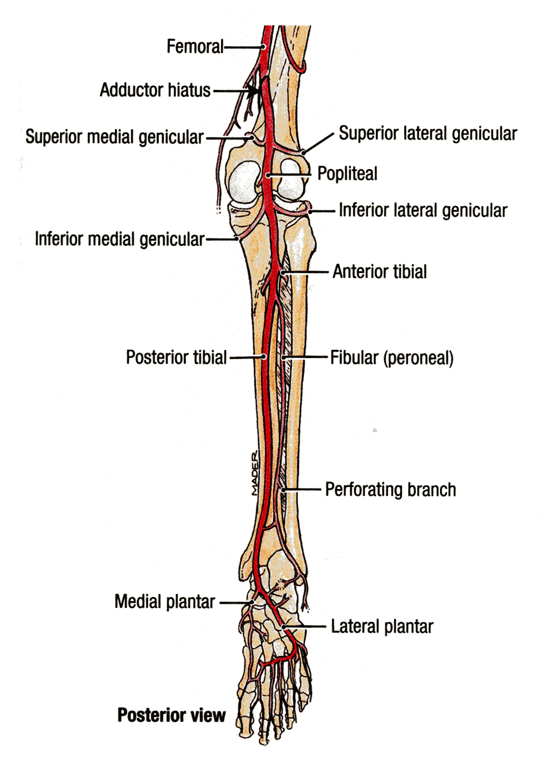
Medial & Lateral Plantar Arteries
The medial plantar artery is the smaller & lateral plantar artery is the larger of the terminal branches of the posterior tibial artery

Slide 24
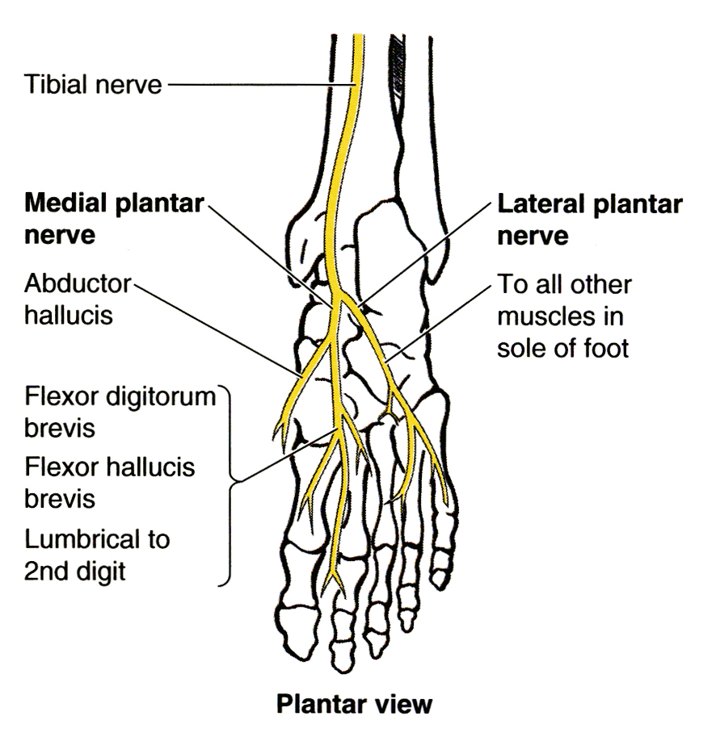
Medial & Lateral Plantar Nerve
The medial plantar nerve is a terminal branch of the tibial nerve.
The lateral plantar nerve is a terminal branch of the tibial nerve.
(1st lumbrical )

Slide 25
Thank you

