Slide 1
NSAIDs Epidemiology
NSAIDs amounts for 3.8 of all prescriptions
A significant quantity is sold over the counter(OTC)
Use increases with age
90% of all NSAIDs prescriptions are issued to patients at ages over 65 years
NSAIDs is the most prominent risk for gastric ulceration, hemorrhage and perforation
The prevalence of NSAID-induced ulcers is 10% to 30%

Slide 2
ILos
To focus on the general mechanism of action of NSAIDs
To classify NSAIDs on basis of their specifity to COX isoenzymes
To outline the common pharmacodynamic effects and ADRs of NSAIDs
To detail on the phramacokinetic properties and pharmacodynamic effects of selected NSAIDs

Slide 3
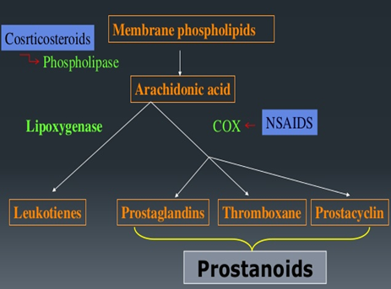
MECHANISM OF ACTION OF NSAIDS
NSAIDs inhibit cyclo oxygenase enzyme

Slide 4
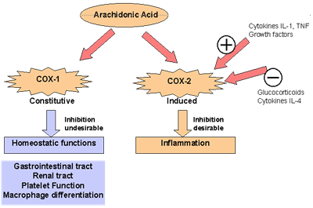
COX isoforms
COX3 is found in the brain

Slide 5
Classification of NSAIDs
Nonselective COX-1/COX-2
Inhibitors
Aspirin, Diclofenac
Selective COX-2
Inhibitors
Coxibs
Preferential COX-2 inhibitors
Meloxicam
COX-3 inhibitors
Paracetamol

Slide 6
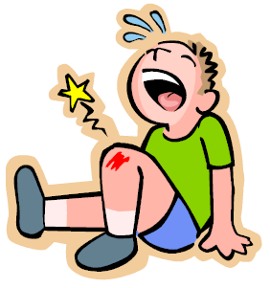
PGS
Nociceptors at nerve endings
PAIN
Inflammatory factors
-
NSAIDs
+
Bradykinin
Histamine
Pharmacodynamic effects
1-analgesic

Slide 7
2-Antipyretic
Pyrogens
PGs
NSAIDs
Thermoregulatory centre
-
Set point↑
Heat production↑
Heat dissipation↓
Fever

Slide 8
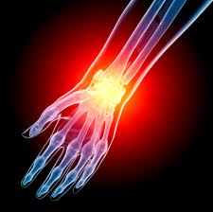
3-Anti-inflammatory
-
NSAIDs
PGs
Inflammatory factors
+
Symptoms of inflammation
Bradykinin
Histamine
Serotonin
Red , Heat , Swelling, Pain

Slide 9
Clinical uses
Fever
Headache, Migraine,
Dental pain, Dysmenorrhea
Common cold
Rheumatoid arthritis / myositis

Slide 10
adrs
GIT upsets (nausea, vomiting)
GIT bleeding & ulceration
Hypersensitivity reaction
Inhibition of uterine contraction
Salt & water retention

Slide 11
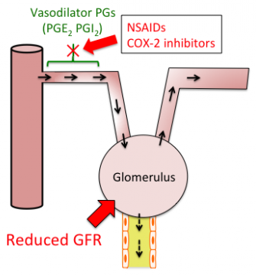
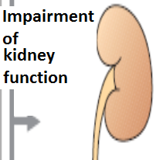
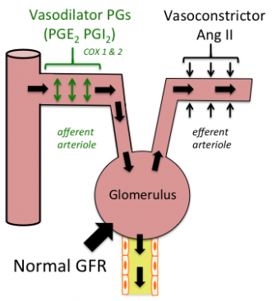
adrs
NSAIDs cause hemodynamically- mediated acute renal failure

Slide 12
Non selective cox inhibitors
Aspirin
Diclofenac
Ibuprofen
Ketoprofen
Naproxen
Piroxicam
Indomethacin

Slide 13
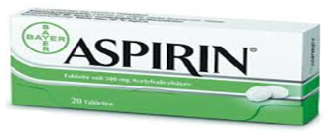
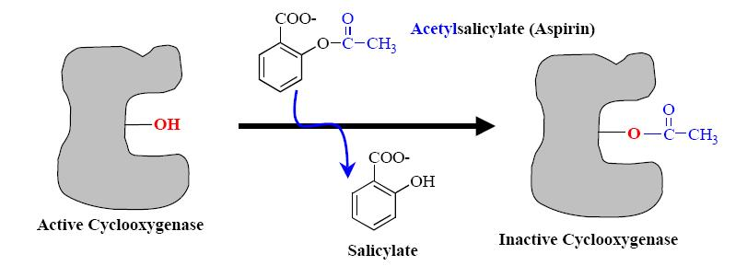
Non selective cox inhibitors
Mechanism of action
Aspirin inhibits COX irreversibly

Slide 14
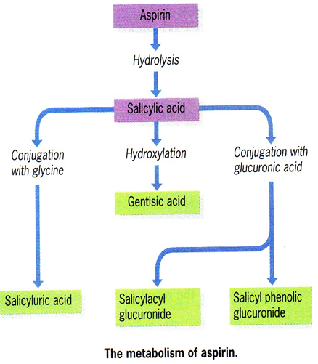
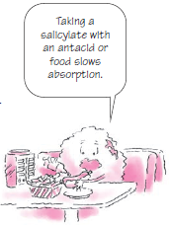
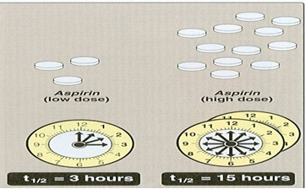
Pharmacokinetics
Metabolized by hydrolysis and then conjugation
Why a high dose has a long plasma half- life?

Slide 15
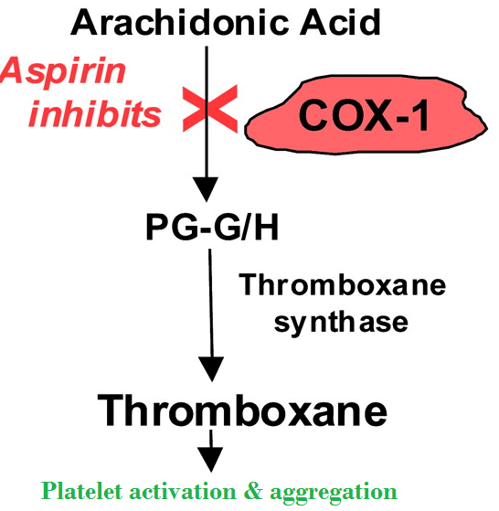
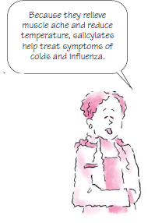
Clinical uses
Acute rheumatic fever
Reducing the risk of myocardial infarction (cardioprotective)
Prevention of pre-eclampsia
Chronic use of small doses ,
reduce the incidence of
colon cancer

Slide 16
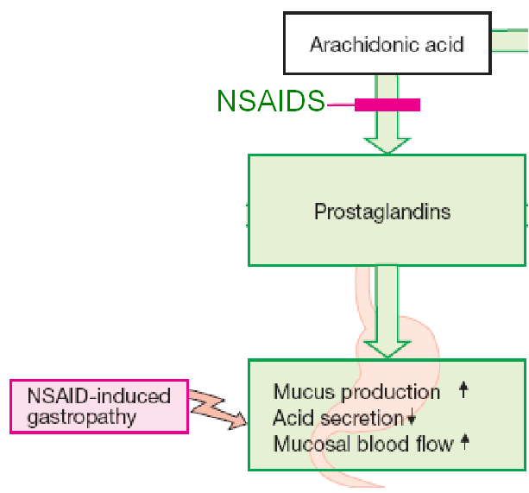
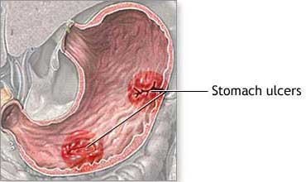
Adrs at clinical doses
Hypersensitivity
Acute Gouty arthritis
Reye's syndrome
Impaired haemostasis
GIT side effects, dyspepsia, nausea, vomiting
Mucosal damage→ hemorrhage

Slide 17
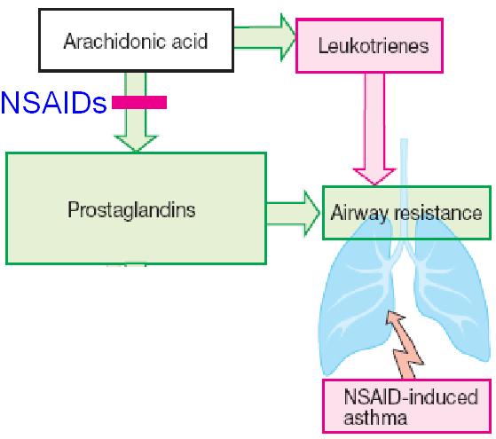
Adrs at clinical doses
Bronchospasm in aspirin- sensitive asthmatics

Slide 18
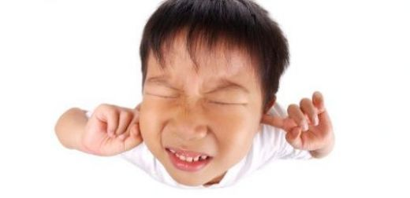
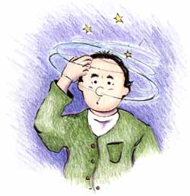
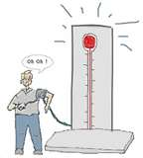
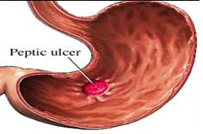
ADRS at overdose
Salicylism ( ringing of ear , vertigo)
Hyperthermia
Gastric ulceration & bleeding

Slide 19
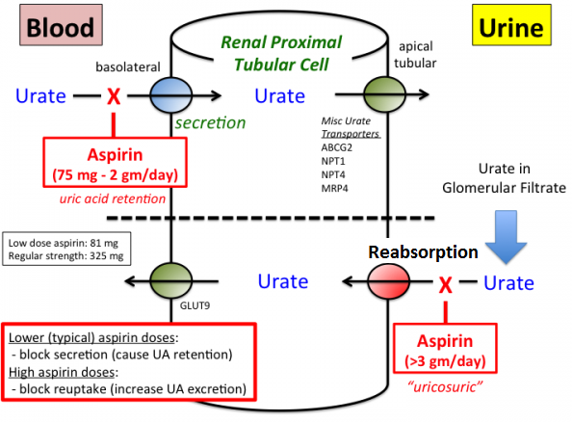
contraindications
Peptic ulcer
Pregnancy
Hemophilic
patients
Patients taking
anticoagulants
Children with
viral infections
Gout (small doses)

Slide 20
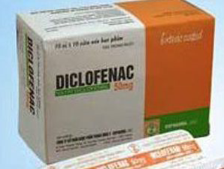
Non selective cox inhibitors
Clinical uses
Analgesic
Antipyretic
Anti inflammatory
Acute gouty arthritis
Locally to prevent post- operative ophthalmic inflammation (solution)

Slide 21
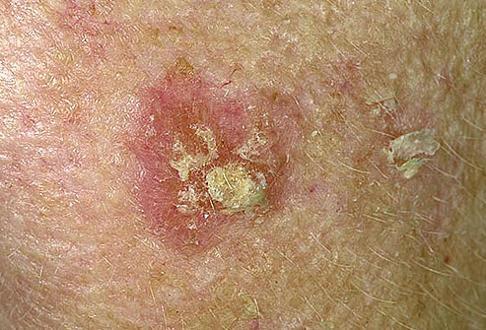
preparations
Diclofenac with misoprostol decreases upper gastrointestinal ulceration ,but result in diarrhea.
Diclofenac with omeprazole to prevent recurrent bleeding
0.1% ophthalmic preparation for postoperative ophthalmic inflammation.
A topical gel 3% for solar keratoses.
Rectal suppository as analgesic
Oral mouth wash.
Intramuscular preparations

Slide 22
Selective COX-2 inhibitors
Celecoxib
Etoricoxib
Paracoxib
Lumiracoxib
Withdrawn because of risk of myocardial infarction & stroke
Rofecoxib
Valdecoxib

Slide 23
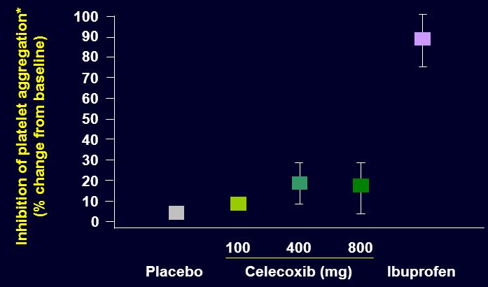
Selective COX-2 inhibitors
Potent anti-inflammatory
Antipyretic & analgesic
Lower incidence of gastric upset
No effect on platelet aggregation ( COX-1)

Slide 24
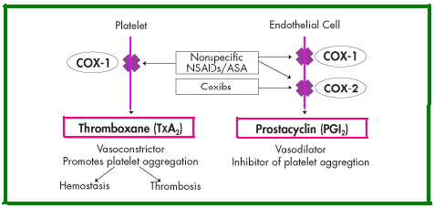
General ADRs
Renal toxicity
Dyspepsia & heartburn
Allergy
Cardiovascular (do not offer the cardioprotective effects of non-selective group).
Should not be given to a patient with CV disease

Slide 25
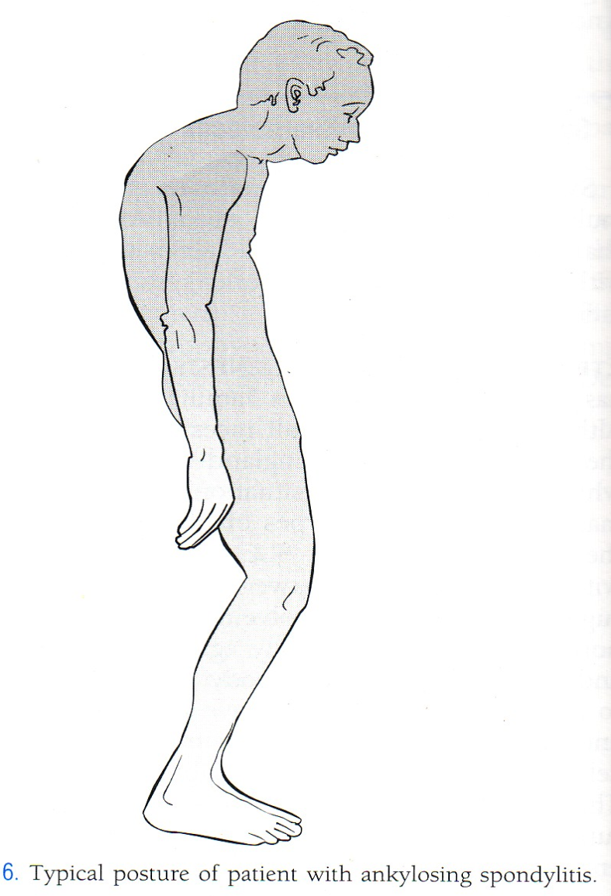
GENERAL CLINICAL USES
Short-term use in postoperative patients
Acute gouty arthritis
Acute musculoskeletal pain
Ankylosing spondylitis

Slide 26
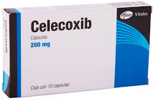
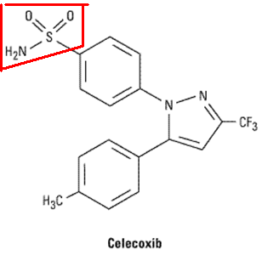
Selective COX-2 inhibitors
Half-life 11 hours
Food decrease its absorption
Highly bound to plasma proteins
Contra indicated in patients allergic to sulphonamides

Slide 27
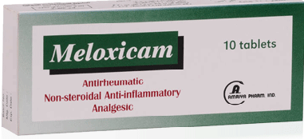
preferential COX-2 inhibitors
Meloxicam, nimesulide, nambumetone
Preferentially inhibits COX-2 over COX-1 ,particularly at low dose
Associated with lower GIT symptoms & complains, compared to non –selective COX inhibitors
t½=20 hours
Used for osteoarthritis & rheumatoid arthritis

Slide 28
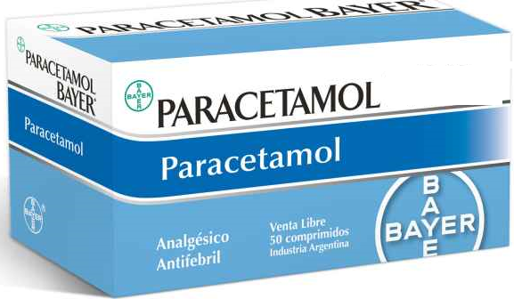
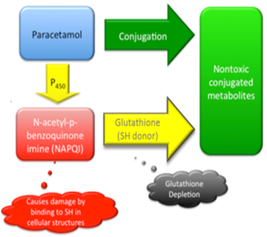
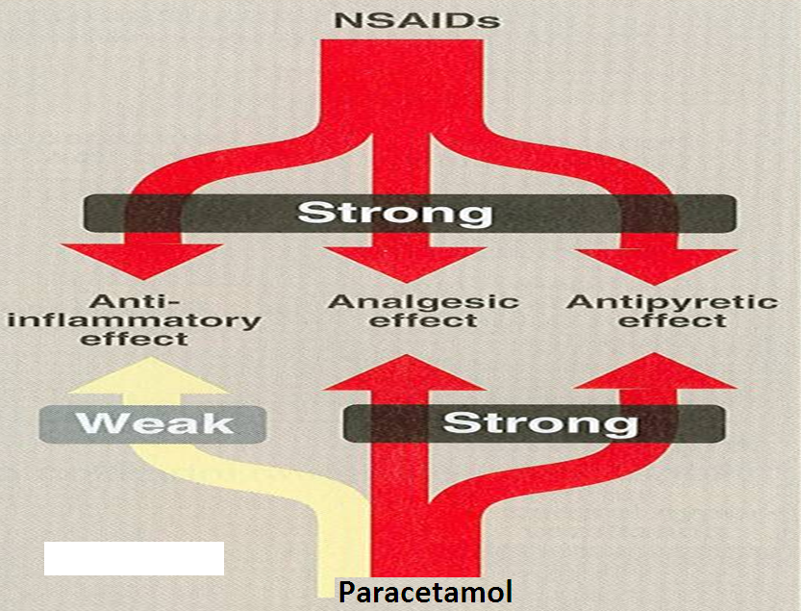
cox-3 inhibitors
Weak anti inflammatory effect
Given orally , well absorbed.
t½=2-4h
Metabolized by conjugation at therapeutic doses

Slide 29
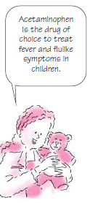
Clinical uses
Commonly used analgesic antipyretic
instead of aspirin in cases of:-
Peptic or gastric ulcers
Bleeding tendency
Allergy to aspirin
Viral infections in children
Pregnancy

Slide 30
ADRS
Mainly on liver due to
its active metabolite
Binding of paracetamol to COX is inhibited by peroxides produced in inflammatory sites.
There is no evidence that COX3 exists in humans.
Therapeutic doses
elevate liver enzymes
In large doses it is metabolized into N- acetyl-p-benzoquinone imine, which causes liver damage.
Treatment of toxicity of paracetamol is by N- acetylcysteine to neutralize the toxic metabolite

