Slide 1
Indirect acting cholinrtgic drugs
Ali Alhoshani
ahoshani@ksu.edu.sa
http://fac.ksu.edu.sa/ahoshani Office: 2B 84

Slide 2
Objectives
By the end of this lecture the student should able to :
Classification of indirect acting cholinomimetics
Mechanism of action, kinetics, dynamics and uses of anticholinesterases
Adverse effects & contraindications of anticholinesterases
Symptoms and treatment of organophosphates toxicity.

Slide 3
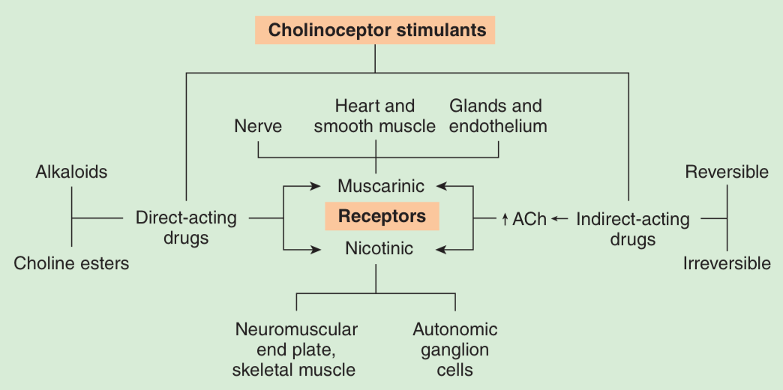
Parasympathomimetic/ cholinomimetics (Cholinergic Drugs )

Slide 4
Indirect-acting on Ach receptors
(also called anticholinesterases)
Mechanism of action:
Anticholinesterases prevent hydrolysis of Ach by inhibiting acetyl cholinesterase thus increase Ach concentrations and actions at the cholinergic receptors (both nicotinic and muscarinic).

Slide 5
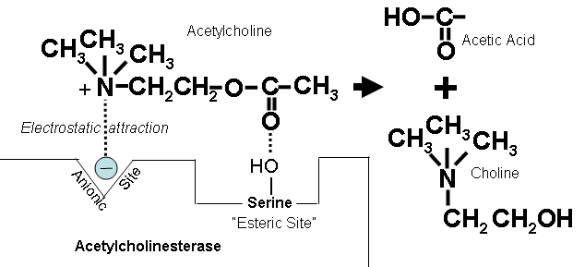
Indirect-acting on Ach receptors
Mechanism of action :
Normally

Slide 6
Indirect-acting on Ach receptors
Reversible anticholinesterases
Short acting (Alcohols) edrophonium
Intermediate acting (Carbamates esters)
Physostigmine, Neostigmine, Pyridostigmine
Irreversible anticholinesterases
Long acting
Phosphates esters e.g. insecticides, gas war
e.g. Ecothiophate & Isoflurophate

Slide 7
Indirect-acting on Ach receptors
Structure: (Reversible anticholinesterases)
1- Simple alcohols ( Short Acting )
Forms weak hydrogen bond with acetylcholinesterase enzyme

Slide 8
Indirect-acting on Ach receptors
Structure (Reversible anticholinesterases)
2- Carbamic acid esters (Intermediate acting)
binds to two sites of cholinesterase enzyme
All polar and synthetic except physostigmine
Physostigmine
Pyridostigmine
Neostigmine
pyridostigmine

Slide 9
Indirect-acting on Ach receptors
Structure: Irreversible anticholinesterases
3- Organic derivatives of phosphoric acid ( Long Acting)
used as insecticides(malathion) or nerve gases (sarin)
Form very stable covalent bond with cholinesterase
All phosphates are lipid soluble except ecothiophate which is polar.
e.g. Ecothiophate – Isoflurophate

Slide 10
Pharmacological effects of anticholinesterases
ALL Anticholinesterases
Action on | Yes/No
muscarinic | YES
nicotinic | YES
CNS effects | only lipid soluble drugs

Slide 11
Pharmacological effects of anticholinesterases
Nicotinic actions
Neuromuscular junction
Therapeutic dose: muscle contraction
Toxic dose: relaxation or paralysis of skeletal muscles.
Ganglia: stimulation of sympathetic and parasympathetic ganglia
Adrenal medulla release of catecholamines (A & NA).

Slide 12
Pharmacological effects of anticholinesterases
Muscarnic actions
Cholinergic actions | Organs
Contraction of circular muscle of iris (miosis)(M3) Contraction of ciliary muscles for near vision (M3) Decrease in intraocular pressure | Eye
bradycardia ( heart rate ) (M2) Release of NO (EDRF) | Heart endothelium
Constriction of bronchial smooth muscles Increase bronchial secretion M3 | Lung
Increased motility (peristalsis) Increased secretion Relaxation of sphincter M3 | GIT
Contraction of muscles Relaxation of sphincter M3 | Urinary bladder
Increase of sweat, saliva, lacrimal, bronchial, intestinal secretions M3 | Exocrine glands

Slide 13
Drugs indirect-acting on Ach receptors (CHOLINOCEPTORS)
Edrophonium
Reversible anticholinesterase
alcohol
Polar
NOT absorbed orally (given by injection)
attach mainly to acetyl cholinesterase by weak hydrogen bond.
Has short duration of action (5-15 min.)
Used for diagnosis of myasthenia gravis.

Slide 14
Drugs indirect-acting on Ach receptors (CHOLINOCEPTORS)
Physostigmine
Reversible anticholinesterase
Tertiary ammonium compound
Non polar (lipid soluble)
Good lipid solubility
Good oral absorption
Has muscarinic & nicotinic actions
cross BBB (has CNS effects)
Uses
Glaucoma
atropine toxicity (atropine is anticholinergic drug)

Slide 15
Drugs indirect-acting on Ach receptors (CHOLINOCEPTORS)
Neostigmine
Reversible anticholinesterase
Quaternary ammonium comp.
Polar compound
Can be used orally
No CNS effect
Has muscarinic & nicotinic actions (prominent on GIT & urinary tract).
Uses
Treatment of myasthenia gravis
Paralytic ileus & Urinary retention
Competitive neuromuscular blockers intoxication

Slide 16
Drugs indirect-acting on Ach receptors (CHOLINOCEPTORS)
Uses | Kinetics | Actions | Drug
Myasthenia gravis treatment Paralytic ileus Urinary retention Curare toxicity | 0.5-2hr polar | Nicotinic & muscarinic M, N | Neostigmine
Glaucoma atropine toxicity | 0.5-2hr Lipid soluble | Nicotinic muscarinic M, N, CNS | Physostigmine
Myasthenia gravis treatment | 3-6 polar | Nicotinic & muscarinic M, N | Pyridostigmine
Myasthenia gravis treatment | 4-8 polar | Nicotinic & muscarinic M, N | Ambenonium

Slide 17
Drugs indirect-acting on Ach receptors (CHOLINOCEPTORS)
Ecothiophate (Organophosphorous compounds)
Irreversible anticholinesterase
Binds to cholinesterase by strong covalent bond.
Have very long duration of action
Aging make bond extremely stable
Not lipid soluble
Used
for glaucoma.

Slide 18
Drugs indirect-acting on Ach receptors (CHOLINOCEPTORS)
Organophosphates toxicity
Heart:
Lung:
GIT:
CNS:
Skeletal muscles :

Slide 19
Drugs indirect-acting on Ach receptors (CHOLINOCEPTORS)
OXIMES
Pralidoxime (PAM)
cholinesterase reactivator
Acts by regeneration of cholinesterase enzyme.
reactivates recently inhibited enzymes before aging.
Uses
I.V. → over 15-30 min for organophosphate intoxication.

Slide 20
Drugs indirect-acting on Ach receptors (CHOLINOCEPTORS)
Donepezil
Anticholinesterase drugs.
Given orally.
used for treatment of dementia of
Alzheimer’s disease

Slide 21
Drugs indirect-acting on Ach receptors (CHOLINOCEPTORS)
Diagnosis of Myasthenia gravis | Very Short 5-15 min, Polar | Edrophonium M, N
Myasthenia gravis treatment Paralytic ileus Urinary retention curare toxicity | Short 0.5-2hr polar | Neostigmine M, N
Glaucoma atropine toxicity | Short 0.5-2hr Lipid soluble | Physostigmine M,N, CNS
Myasthenia gravis treatment | Short 3-6, polar | Ambenonium Pyridostigmine M, N
Glaucoma. | Long 100hr, polar | Ecothiophate M, N
dementia of Alzheimer’s disease |  | Donepezil M, N

Slide 22
Summary for cholinomimetics & their uses
Eye : treatment of glaucoma
Pilocarpine (direct muscarinic agonist)
Physostigmine
Ecothiophate (indirect cholinomimetics)
Urinary retention and paralytic ileus
Bethanechol (direct)
Neostigmine (indirect)
Myasthenia gravis (only indirect cholinomimetics)
Pyridostigmine, Neostigmine, Ambenonium
Xerostomia
Pilocarpine – Cevimeline (Sjogren’s syndrome)
Alzheimer’s disease:
Donepezil

Slide 23
Drugs indirect-acting on Ach receptors (CHOLINOCEPTORS
Adverse effects of cholinergic drugs:
Bradycardia
Sweating & Salivation
Bronchoconstriction
Diarrhea
Contraindications of cholinergic drugs
Bronchial asthma
Peptic ulcer
Angina pectoris
Incontinence
Intestinal obstruction

Slide 24
Drugs in/direct-acting on Ach receptors
Adverse effects:
In mid-afternoon, a coworker brings 43-year-old JM to the emergency department because he is unable to continue picking vegetables. His gait is unsteady and he walks with support from his colleague. JM has difficulty speaking and swallowing, his vision is blurred, and his eyes are filled with tears. His coworker notes that JM was working in a field that had been sprayed early in the morning with a material that had the odor of sulfur. Within 3 hours after starting his work, JM complained of tightness in his chest that made breathing difficult, and he called for help before becoming disoriented.

