Slide 1
Direct acting cholinrtgic drugs
Ali Alhoshani
ahoshani@ksu.edu.sa
http://fac.ksu.edu.sa/ahoshani Office: 2B 84

Slide 2
Objectives
By the end of this lecture , you should able to :
Mention the different types, locations and actions of cholinergic receptors.
Identify the mechanism of action of direct acting cholinomimetics.
Describe the pharmacokinetics of cholinergic drugs.
Identify pharmacological actions and uses of cholinomimetics.

Slide 3
Organization of The Nervous System
Peripheral Nerve System (PNS)
Afferent Division (SENSORY)
Efferent Division (MOTOR)
Autonomic
Somatic
Skeletal Muscles
Smooth muscles
Parasympathetic
Sympathetic
Nervous System
Central; Nerve System (CNS)
Enteric

Slide 4
ANS , Efferent division of the PNS
Peripheral Nerve System (PNS)
Efferent Division (MOTOR)
Somatic
Autonomic
ANS
Parasympathetic
ANS
Sympathetic
M,D
Spinal Cord
Somatic

Slide 5
ANS , Parasympathetic
ANS
Parasympathetic
Preganglionic neurons
Long
Synapses with postganglionic at or near organ
ACh is neurotransmitter
Nicotinic receptor on postganglionic
Postganglionic
Short
Synapses on the organ
ACh is neurotransmitter
Muscarinic receptor on the organ
Cholinergic fibers: act by releasing acetylcholine

Slide 6
Autonomic Nervous System

Slide 7
Warm up Q?
What is the Primary neurotransmitter (s) in parasympathetic ?
A- Ach
B- NE/Epi
C- Dopamine
D- A&B

Slide 8
Cholinergic Transmission
Choline Transportation
AcCoA Synthesis
Acetylcholine Transportation
Acetylcholine Release
Acetylcholine metabolism
Half-life of is very short
Q? why do we need to know
Targets for pharmacologic therapy (interventions)
Synthesis, storage, release, and termination of action of the transmitter, and receptor effects
Inhibitors

Slide 9
Autonomic Receptors
Cholinergic Receptors
A) Nicotinic Receptor
B) Muscarinic Receptor

Slide 10
Autonomic Receptors (Cholinergic)
Cholinergic Receptors
A) Nicotinic Receptor
Nicotinic Receptor (nAChRs)
Similar to those induce by nicotine
Locations:
At neuromuscular junctions of skeletal muscle (N_{M})
On Adrenal medulla (N_{N})
In CNS (N_{N})

Slide 11
Autonomic Receptors (Cholinergic)
Cholinergic Receptors
A) Nicotinic Receptor
Locations:
Ganglionic neurons in the autonomic ganglia (N_{N})

Slide 12
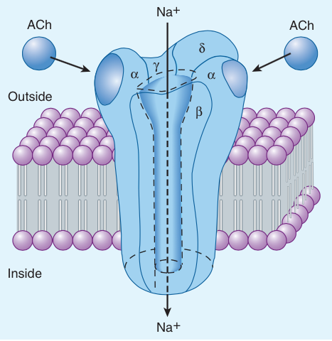
Autonomic Receptors (Cholinergic)
Type:
Ligand-gated ion (Na+) channel
ACh binds to the α subunits
2 acetylcholine molecules
Structurally and functionally similar to the Na⁺
Channel
Cholinergic Receptors
A) Nicotinic Receptor

Slide 13
Autonomic Receptors (Cholinergic)
Primary location of nicotinic receptors and their actions
Pharmacological actions | Locations | Receptor
sympathetic & parasympathetic stimulation | Autonomic ganglia | N_{N}
release of catecholamines (adrenaline & noradrenaline) | Adrenal medulla | N_{N}
Low concentration → muscle contraction High concentration → persistent depolarization & relaxation (depolarization block). | Skeletal muscles | N_{M}

Slide 14
Autonomic Receptors (Cholinergic)
Cholinergic Receptors
B) Muscarinic Receptor
Muscarinic Reciptors (mAChRs)
Similar to those induce by muscarine
Locations:
all target organs
e.g, heart, CVS, eye, bladder, GIT
Sweat glands

Slide 15
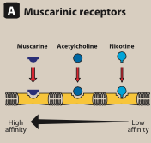
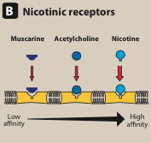
Autonomic Receptors (Cholinergic)
Type
Muscarinic receptors are GPCRs
Five Subtypes: M₁, M₂, M₃, M₄, M₅
Odd-numbered members M₁, M₃ : Excitatory
Even-number M₂, M₄ : Inhibitory
Affinity to ACh
B) Muscarinic Receptor

Slide 16
Autonomic Receptors (Cholinergic)
Muscarinic receptors are GPCRs
M₁, M_{3,} and M₅ M₂ and M₄

Slide 17
Autonomic Receptors (Cholinergic)
Primary location of muscarinic receptors and their actions
Pharmacological actions | Locations | Receptor
CNS excitation Gastric acid secretion | CNS gastric parietal cells | M₁ Excitatory
Cardiac inhibition (Bradycardia) | Heart | M₂ Inhibitory
Secretion of glands Relaxation of sphincter ?? Smooth muscle contraction Circular& ciliary muscle Contraction Vasodilatation (via nitric oxide) | Exocrine glands Smooth muscles (GIT, urinary tract, bronchial muscles) Eye Vascular endothelium | M₃ Excitatory
memory, arousal, attention and analgesia | CNS | M₄ & M₅

Slide 18
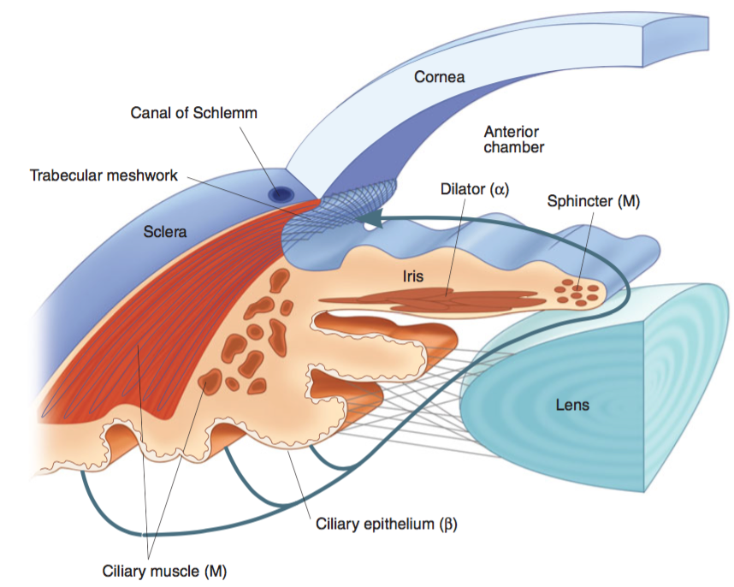
Drugs In/direct-acting on Ach receptors
Organ System Effects (EYE)
The parasympathetic innervates the constrictor pupillae (circular muscles of iris) which is important for adjusting the pupil in response to change in light intensity & regulating the intraocular pressure.

Slide 19
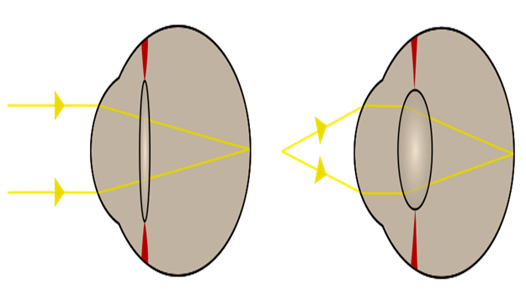
Ach receptors
Organ System Effects (EYE)
When the ciliary muscle contracts, the lens bulge more → this parasympathetic reflex is essential to accommodate for near vision

Slide 20
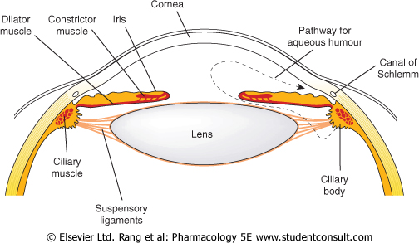
Ach receptors
Organ System Effects (EYE)
Aqueous humour secreted by ciliary body, is removed continuously by drainage into the Canal of Schlemm.
Normal intraocular pressure is 10-15mmHg above atmospheric pressure . Abnormally raised pressure (glaucoma)→retinal detachment.
Miosis →↓ intraocular pressure in patient with glaucoma

Slide 21
Pharmacological actions of cholinergic drugs
Actions that are similar to the effects of parasympathetic system activation.
nicotinic actions
muscarinic actions
Cholinergic drugs acts upon two types of receptors
nicotinic receptors
muscarinic receptors

Slide 23
Parasympathomimetic (Cholinergic Drugs )

Slide 24
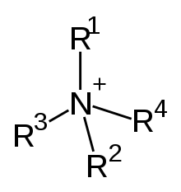
Drugs direct-acting on Ach receptors (CHOLINOCEPTORS)
Choline esters
Charged quaternary ammonium group-Activity (polar)
Poor distribution
can not cross BBB (No CNS effects)
Not metabolized by cholinesterase.( except Ach)
Have longer duration of action than Ach.
β-methyl group : Selectivity to M receptor
Never given I.V. or I.M But S.C Why??
Cevimeline

Slide 25
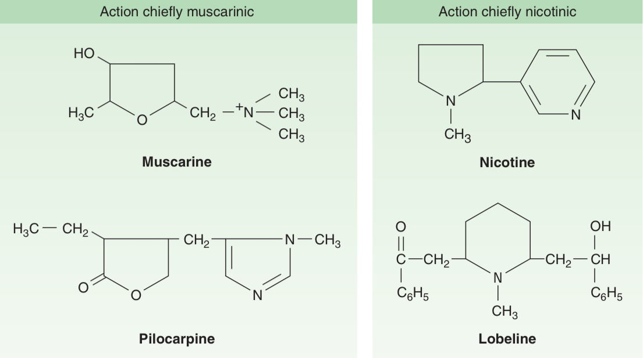
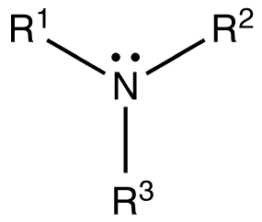
Drugs direct-acting on Ach receptors (CHOLINOCEPTORS)
Tertiary natural alkaloids – Muscarine quaternary
Well absorbed except Muscarine , Excreted by the kidneys

Slide 26
Drugs direct-acting on Ach receptors (CHOLINOCEPTORS)
Acetylcholine (Ach)
Muscarinic and nicotinic
agonist
Not used clinically because Ach
Is not selective as it acts on both nicotinic and muscarinic receptors
Has short duration of action. Why?
Due to rapid metabolism by acetycholinesterase

Slide 27
Drugs direct-acting on Ach receptors (CHOLINOCEPTORS)
Carbachol
Muscarinic actions on Eye, GIT, UT.
Has nicotinic actions (side effects).
Resistant to hydrolysis by acetyl cholinesterase
Longer duration than Ach.
Used for treatment of glaucoma

Slide 28
Drugs direct-acting on Ach receptors (CHOLINOCEPTORS)
Bethanechol
Prominent muscarinic actions on GIT, UT.
No nicotinic action
Resistant to hydrolysis by acetyl cholinesterase
Longer duration than Ach
Used for
Paralytic ileus
Urinary retention in cases of post-operative atony & neurogenic bladder

Slide 29
Drugs direct-acting on Ach receptors (CHOLINOCEPTORS)
Cevimeline
Direct acting muscarinic agonist (M3)
Used for treatment of dry mouth symptom
associated with Sjogren's syndrome
(autoimmune disease characterized by Formation of antibodies leading to dryness of mouth and eye).

Slide 30
Drugs direct-acting on Ach receptors (CHOLINOCEPTORS)
Pilocarpine
well absorbed, good distribution
Cross BBB (has central effects).
Not metabolized by cholinesterase
Long duration of action
Excretion is enhanced by acidification of urine
Direct muscarinic agonist(mainly on eye & secretion).

Slide 31
Drugs direct-acting on Ach receptors (CHOLINOCEPTORS)
Pilocarpine
Uses:
Xerostomia (dry mouth).
Drug of choice in emergency glaucoma
applied as eye drops.
Adverse effects:
Profuse sweating
Salivation
Bronchoconstriction
Diarrhea
CNS effects

Slide 32
Drugs direct-acting on Ach receptors (CHOLINOCEPTORS)
Pilocarpine | Bethanechol | Carbachol | ACh
Tertiary non polar | Quaternary Polar | Quaternary Polar | Quaternary Polar | Chemistry
Complete | better absorbed than Ach | better absorbed than Ach | NOT | Absorption
NOT metabolized by cholinesterase |  |  | metabolized by cholinesterase | Metabolism by cholinesterase
Longer (++) | Longer (++) | Longer (++) | Very short | Duration
oral, eye drops | Oral S.C. | Oral, eye drops S.C. | I.V. eye drops | administration

Slide 33
Drugs direct-acting on Ach receptors (CHOLINOCEPTORS)
Cevimeline M | Pilocarpine M | Bethanechol M | Carbachol M,N | ACh M, N
Muscarinic | Muscarinic | Muscarinic | Muscarinic Nicotinic | Muscarinic Nicotinic | Receptors
+++ | +++ | +++ | +++ | +++ | Muscarinic
Exocrine glands | More on eye, exocrine glands | GIT, Urinary bladder | Eye, GIT Urinary bladder | NOT | Selectivity
NO | NO | NO | +++ | +++ | Nicotinic
Sjogren's syndrome | Glaucoma Xerostomia | Paralytic ileus Urinary retention | Glaucoma | NO | Uses

Slide 34
Drugs direct-acting on Ach receptors (CHOLINOCEPTORS)
Contraindications
Bronchial asthma.
Peptic ulcer.
Angina pectoris
Urinary incontinence
Intestinal obstruction

