Slide 1
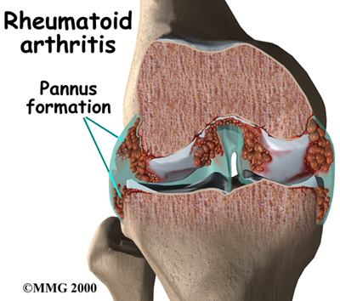
DMARDS
Epidemiology of rheumatoid arthritis
Affects 1-2% of the adult population
Is more common among women than in men(2-3 times)
Usually appears between ages 25 and 40 years
The incidence also increases with age, peaking between the 4th and 6th decades
Causes pain, disability and loss of function

Slide 2

dmards
ilos
Emphasize the rationale for early treatment of RA
Classify drugs used for treatment of RA
Compare and contrast the advantages and disadvantages of NAISDs, Steroids and DMARDS in treatment of RA
Explore the pharmacokinetic aspects and pharmacodynamic effects of selected DMARDs

Slide 3
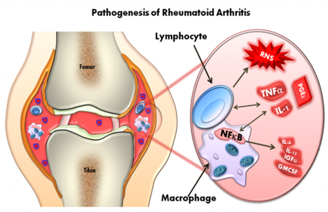
Rheumatoid arthritis
RA is a chronic autoimmune disorder in which the normal immune response is directed against an individual's own tissue leading to:-
Decline in functional status
Work disability
Co-morbidity
Increased mortality

Slide 4
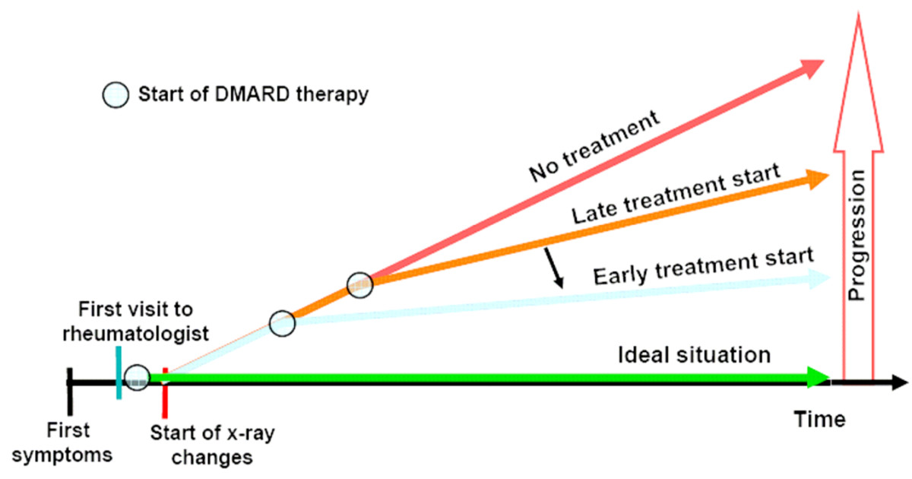
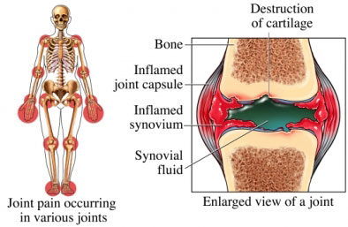
Rationale for early treatment
Joint damage is an early phenomenon
of rheumatoid arthritis
  Joint erosions occur in up to 93% of patients within less than 2 years of disease activity
  Disability occurs early – 50% of patients with RA will be work disabled at 10 years
  Severe disease is associated with increased mortality
  Early and aggressive treatment may have long-term benefits

Slide 5
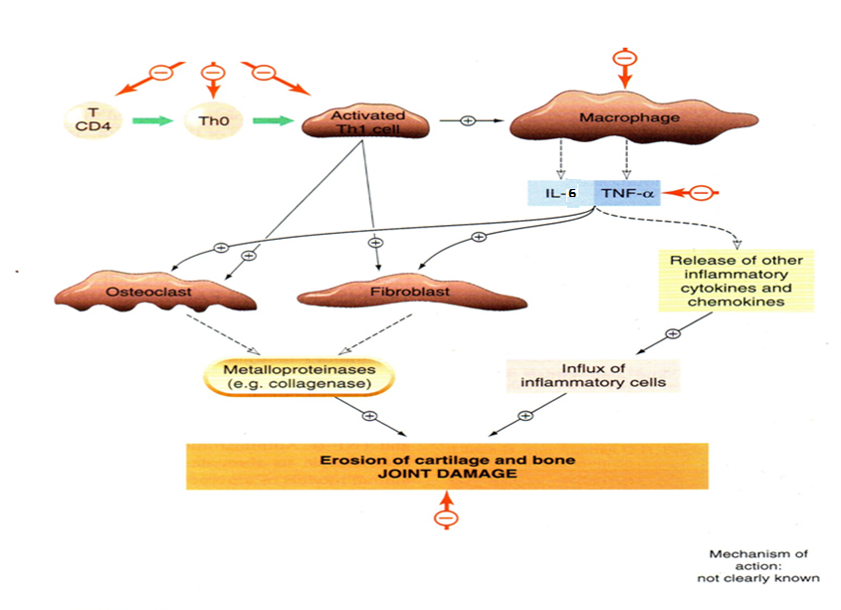
Glucocorticoids
Tocilizumab
Hydroxychloroquine
pathogenesis
Infliximab
Methotrexate

Slide 6
classification
Drugs for Rheumatoid Arthritis
DMARDs
Classical
Biologic
NSAIDs
Glucocorticoids

Slide 7
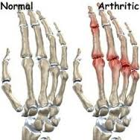
nsaids
Do not slow the progression of the disease
Provide partial relief of pain and stiffness
Rapid onset of action
Used in acute cases to relief inflammation & pain
Chronic use should be minimized due to the possibility of side effects, including gastritis and peptic ulcer disease as well as impairment of renal function.

Slide 8
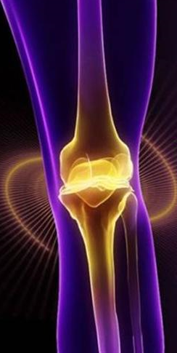
Glucocorticoids
Anti-inflammatory drugs with an intermediate rate of action (slower than NSAIDs but faster than other DMARDs)
Therapeutic action involves their anti- inflammatory & immunosuppressant effect
May be administered in low to moderate doses to achieve rapid disease control before the onset of fully effective DMARD therapy
Reserved for temporary control of severe exacerbations and long-term use in patients with severe disease not controlled by other agents
Corticosteroids are too toxic for routine chronic use

Slide 9
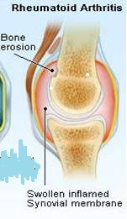
Classification of dmards
DMARDs
Biologic
Classical
Infliximab
Tocilizumab
Methotrexate
Hydroxychloroquine

Slide 10
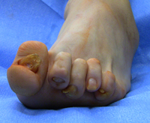
General features
Used when the disease is progressing & causing deformities
Can not repair the existing damage, but prevent further deformity
Have no analgesic effects
Their effects take from 6 weeks up to 6 months to be evident

Slide 11
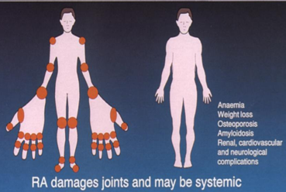
methotrexate
“Gold standard” for DMARD therapy & is the first-line DMARD for treating RA and is used in 50–70% of patients
Active in RA at much lower doses than those needed in cancer chemotherapy

Slide 12
methotrexate
mechanism
Inhibits dihydrofolate reductase
Reduces thymidine & purine synthesis
But at the dosages used for the treatment of RA, methotrexate has been shown to stimulate adenosine release from cells, producing an anti-inflammatory effect.
Inhibition of polymorphonuclear chemotaxis
Inhibition of T-Cells
( cell-mediated immune reactions)

Slide 13
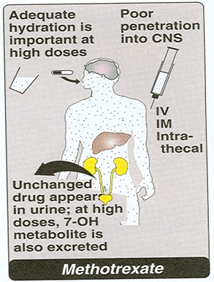
methotrexate
pharmacokinetics
Approximately 70% absorbed after oral administration
Metabolized to a less active hydroxylated product
Half-life is usually only 6–9 hours
Excreted principally in the urine, but up to 30% may be excreted in bile.
Given 7.5 – 30 mg weekly

Slide 14
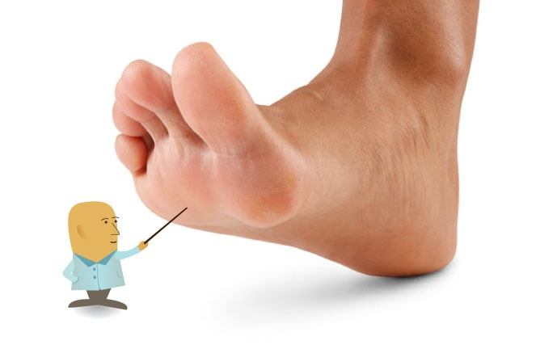
adrs
Bone marrow suppression
Dyspepsia, Mucosal ulcers
Hepatotoxicity
Pneumonitis
Teratogenicity
Leukopenia, anemia, stomatitis, GI ulcerations, and alopecia are probably the result of inhibiting cellular proliferation
Folic acid reduces GI & bone marrow effects
Monitoring:-Full blood count, ALT, Creatinine

Slide 15
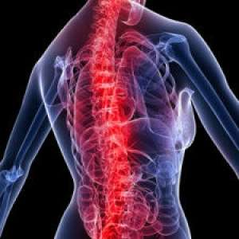
hydroxychloroquine
mechanism
Stabilization of lysosomal enzyme activity
Trapping free radicals
Suppression of T lymphocyte cells response to mitogens
Inhibition of leukocyte chemotaxis
Dampens antigen–antibody reactions at sites of inflammation

Slide 16

hydroxychloroquine
pharmacokinetics
Rapidly absorbed and 50% protein-bound
Extensively tissue-bound, particularly in melanin-containing tissues such as the eyes
Elimination half-life of up to 45 days
Highly concentrated within cells→
increases intracellular pH

Slide 17
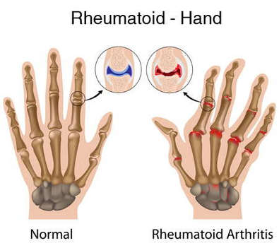
hydroxychloroquine
Clinical uses
Has not been shown to delay radiographic progression of disease
Generally used for treatment of early, mild disease or as adjunctive therapy in combination with other DMARDs.
Used in increasing methotrxate efficacy
6 month response, mild antirheumatic effect

Slide 18
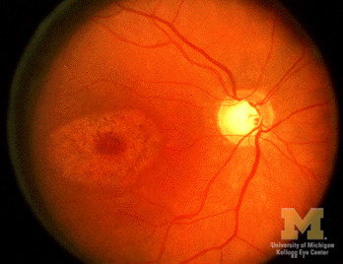
adrs
Least toxic, no blood tests is required
Nausea & vomiting
Corneal deposits
Irreversible retinal damage, rare
Ophthalmologic evaluation every 6 months

Slide 19
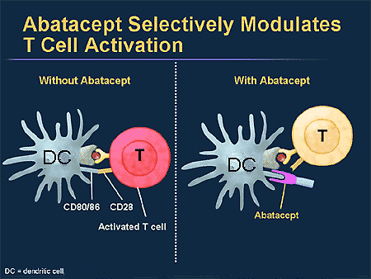
Biologic disease modifier
Genetically engineered drugs that are used to modify imbalances of the immune system in autoimmune diseases.
Some of these agents block, or modify the activity of selected cells in the immune system
Others work by blocking cytokines, that send signals between those cells
They are expensive

Slide 20
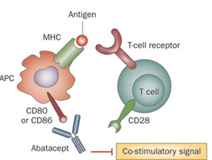
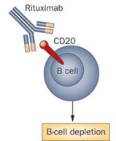
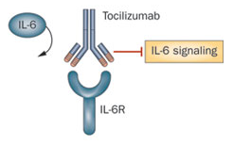
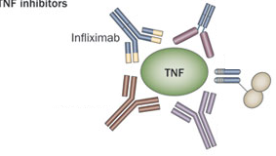
Biologic disease modifier
classification
T-cell modulating drug (abatacept)
B-cell cytotoxic agent (rituximab)
Anti-IL-6 receptor antibody (tocilizumab)
TNF- blocking agents (infliximab)

Slide 21
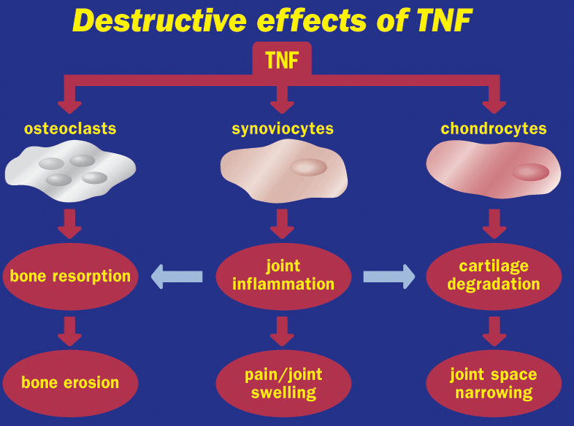
Tnfα blocking agents
Role of Tnf on joint destruction

Slide 22
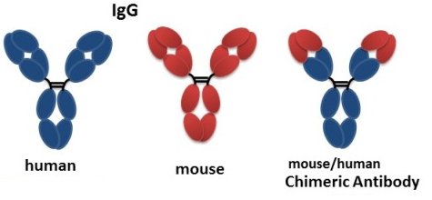
Tnfα blocking agents
infliximab
A chimeric IgG₁ monoclonal antibody (25% mouse, 75% human)
mechanism
It complexes with soluble TNF-α (and possibly membrane- bound TNF-α)and prevents its interaction with the cell surface receptors
This results in down-regulation of macrophage and T-cell function.

Slide 23
Monoclonal Antibody directed against TNF-alpha: Infliximab (Remicade ®), Adalimumab (Humira®)
Soluble TNF-Receptors serve as a balance to TNF
Engineered Soluble TNF Receptor Etanercept (Enbrel®)
TNF
SIGNAL

Slide 24
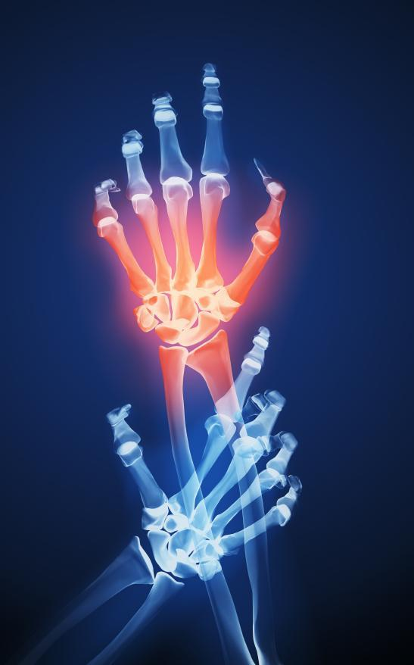
infliximab
pharmacokinetics
Given as an intravenous infusion with “induction” at 0, 2, and 6 weeks and maintenance every 8 weeks thereafter.
Terminal half-life is 9–12 days
After intermittent administration elicits human antichimeric antibodies in up to 62% of patients
Concurrent therapy with methotrexate decreases the prevalence of human antichimeric antibodies

Slide 25
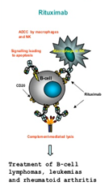
infliximab
Clinical uses
Infliximab is approved for use in RA, Ankylosing spnodilytis, Crohn’s disease, ulcerative colitis,
It could be cobmined with methotrexate, hydroxychloroquine and other non biological DMARDs

Slide 26
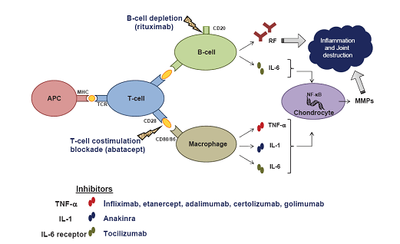
infliximab
adrs
Upper respiratory tract infections
Activation of latent tuberculosis
Infusion site reaction
Headache
Cough
Increase the risk of skin cancers—including melanoma

Slide 27
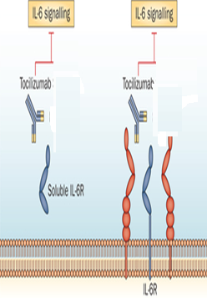
tocilizumab
IL-6 is a proinflammatory cytokine implicated in the pathogenesis of RA,
With detrimental effects on both joint inflammation and cartilage damage
Tocilizumab binds to membrane IL-6 receptors, blocking the activity of IL-6 in mediating signals that affect cytokine production, osteoclast activation
Half-life is dose- dependent
Given as monthly IV

Slide 28
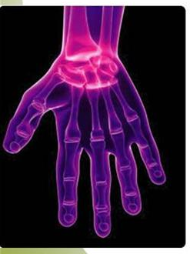

tocilizumab
Clinical uses
Used as monotherapy in adult with rheumatoid arthritis or in children over 2 years with systemic juvenile arthritis
In combination with methotrexate or other non biologic anti-rheumatic drugs in patients with active rheumatoid arthritis not responding to TNF blockers or other biologic drugs

Slide 29

tocilizumab
adrs
Serious infections ( bacterial, tuberculosis ,fungal )
Infusion reactions
Increase in cholesterol level
Neutropenia, and thrombocytopenia (reversible upon stopping the drug)
Decrease in WBCs
Increase in liver enzymes
Blood tests will be used monthly for increase in cholesterol, liver enzymes & decrease in WBCs

Slide 30
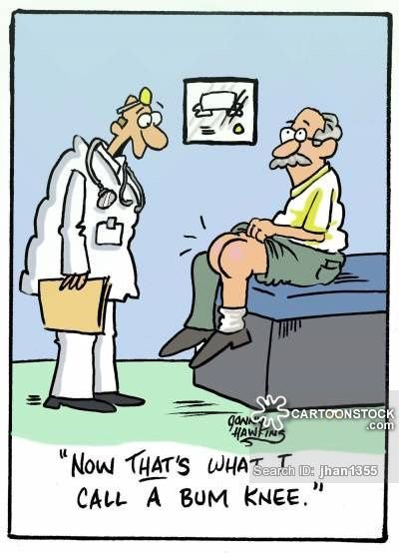
tocilizumab
Drug interactions
IL-6 inhibits CYP450
Tocilizumab restores the activity of the enzyme (essential for the metabolism of some drugs such as cyclosporine, warfarin).

