Slide 1
RADIOLOGICAL ANATOMY OF THE VERTEBRAE
Practical (1)
Radiology

Slide 2
Which of following radiological modalities can be used in imaging the vertebra?
X ray
CT scan
Nuclear scan
MRI
US

Slide 3
ALL can be used

Slide 4
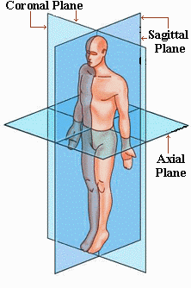

Slide 5
X-ray

Slide 6
Cervical spine

Slide 7
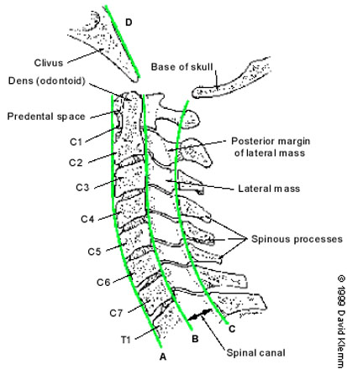

Slide 8
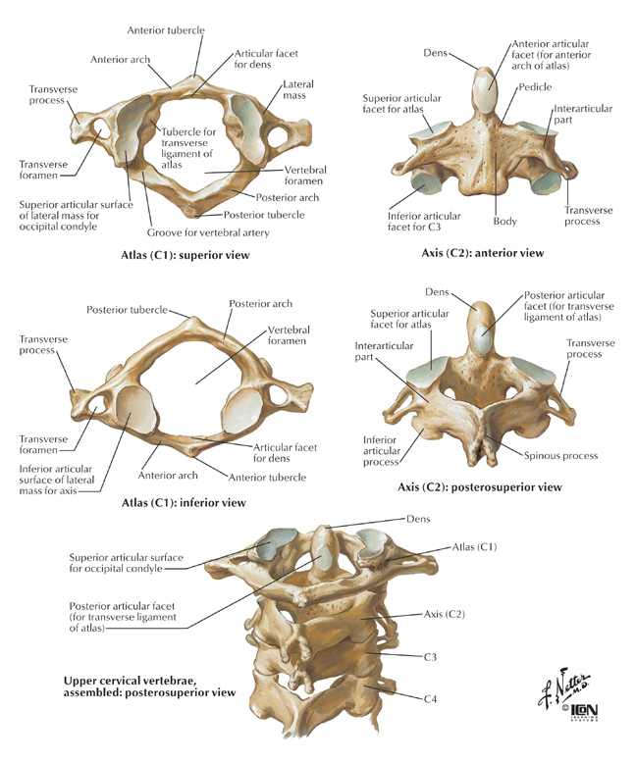

Slide 9
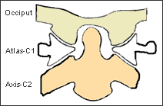

Slide 10
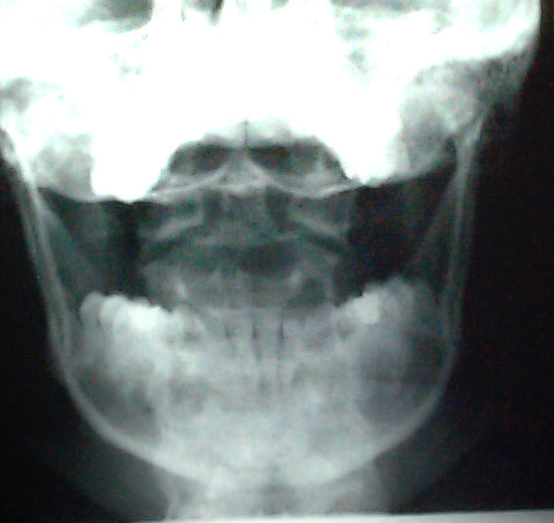
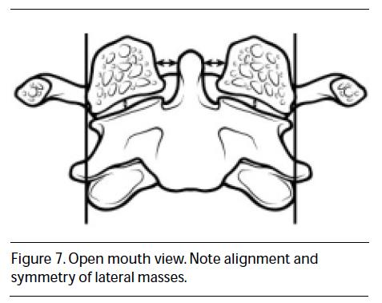
1
2

Slide 11
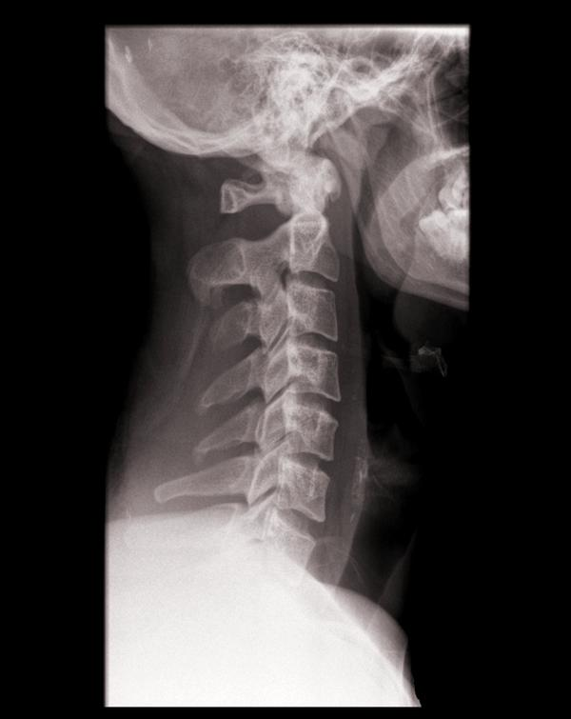
1
2
6
3
5
4

Slide 12
1
2
C1
C2
C3
Intervertebral disc
Spinous process of C4
Facet joint
6
3
5
4

Slide 13
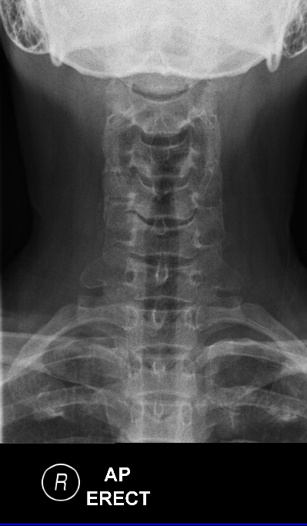
1
3
2
4

Slide 14
Vertebral body C5
Spinous process
Transverse process
First rib
1
3
2
4

Slide 15
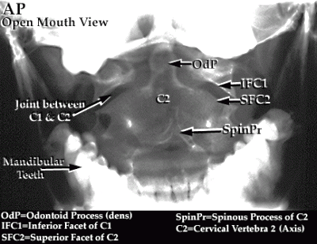

Slide 16
Thoracic spine

Slide 17
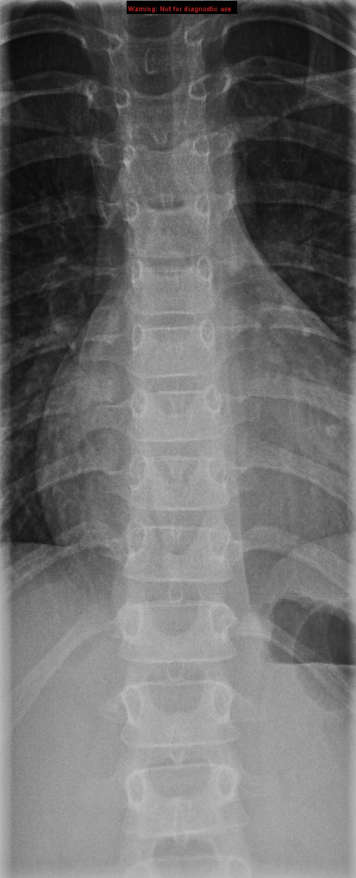
2
1
3
4
5

Slide 18
2
Vertebral body
Spinous process
Transverse process
Pedicle
Rib
1
3
4
5

Slide 19
1
2
3
4

Slide 20
Vertebral body
Intrvertebral disc
Pedicle
Rib
1
2
3
4

Slide 21
Lumbar spine

Slide 22
2
1
Vertebral body
Transverse process
Pedicle
Spinous process
Sacrum
4
3
5

Slide 23
3
1
4
2
5

Slide 24
3
Vertebral body L3
Intrvertebral disc
Spinous process
Neural foramen
Sacrum
1
4
2
5

Slide 25
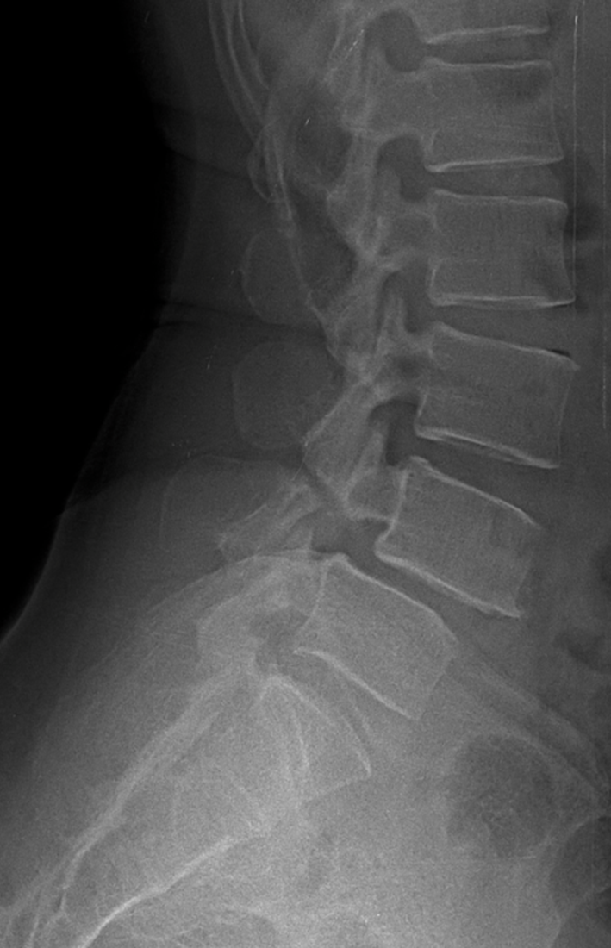
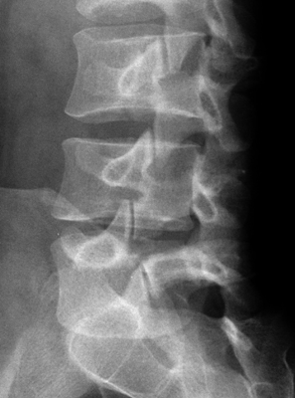

Slide 26
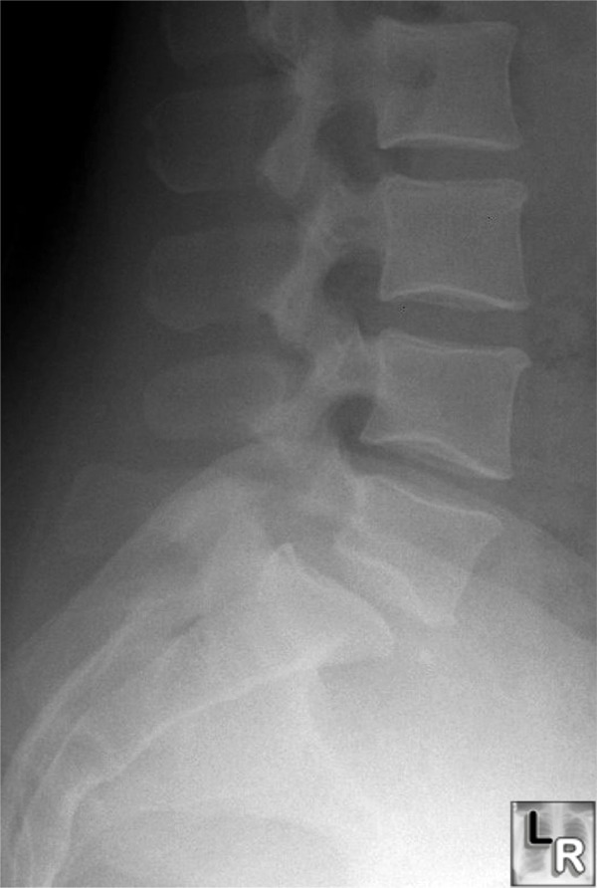

Slide 27
CT scan

Slide 28
Cervical spine

Slide 29
Cervical spine
Vertebral body
Spinous process
Pedicle
Lamina
Transverse foramen
1
5
3
2
4

Slide 30
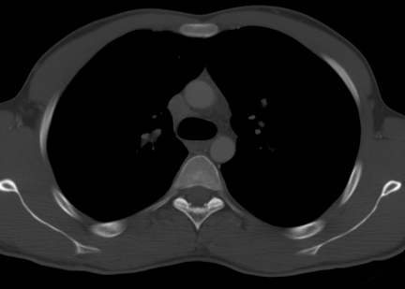
Thoracic spine
4
7
5
6
Vertebral body
Neural foramen
Lamina
Pedicle
Transverse process
Spinous process
Rib
1
2
3

Slide 31
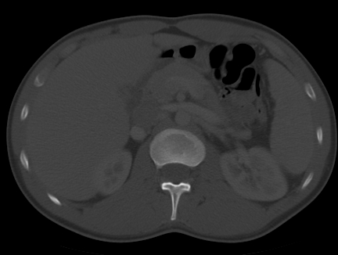
Lumbar spine
1
2
3
Vertebral body
Neural foramen
Spinous process
Pedicle
Transverse process
4
5

Slide 32
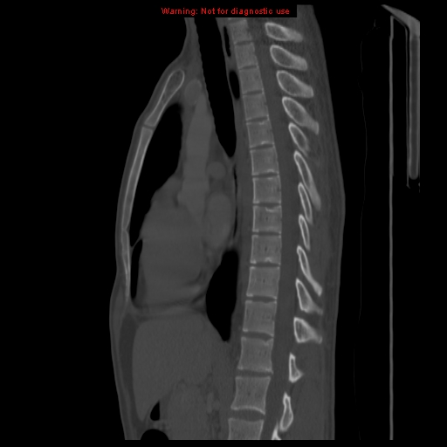
Dorsal spine
3
1
2
4
Vertebral body
Intrvertebral disc
Spinous process
Pedicle
Neural foramen
5

Slide 33
Lumbosacral spine
1
3
2
5
6
4
Vertebral body
Intrvertebral disc
Spinous process
Sacrum
Pedicle
Neural foramen

Slide 34
MRI

Slide 35
1
Lumbar spine
2
3
Vertebral body
Neural foramen
Spinous process
Thecal sac
Para-spinal muscles
4
5

Slide 36
Cervical spine
1
C2
Disc
Spinal cord
Spinous process
2
4
3

Slide 37
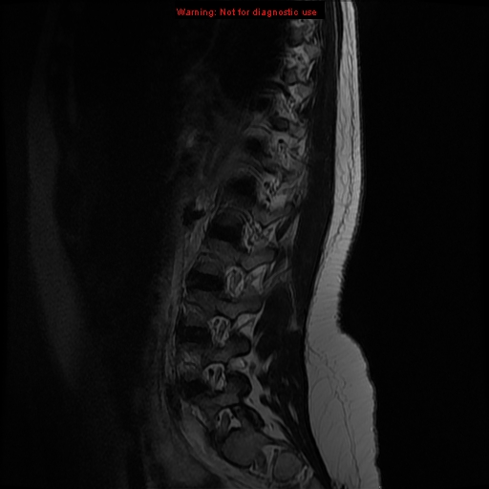
Lumbosacral spine
1
2
3
4
5
Spinal cord
Disc
Vertebral body
Sacrum
Neural foramen
Pedicle
6

Slide 38
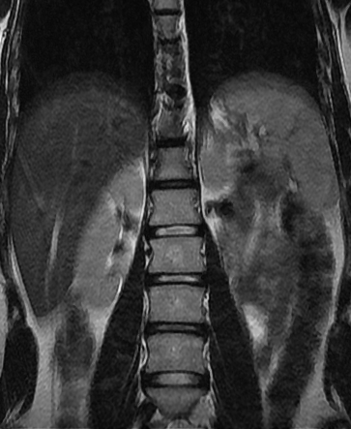
Lumbar spine
Vertebral body
disc
1
2

Slide 39
Nuclear scan

Slide 40
1
2
Ribs
Vertebral body
Disc
sacrum
3
4

Slide 41
ULTRASOUND

Slide 42
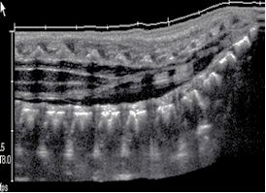
3
4
2
1
Vertebral body
Disc
Spinous process
Spinal cord

Slide 43
THE END

