Slide 1
Ospe Anatomy
Musculoskeletal Block

Slide 2
Case Studies

Slide 3
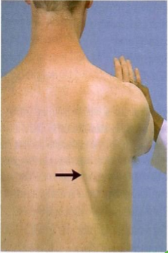
Q1: A 23-year-old soldier presents with a shrapnel wound in the lateral wall of his chest. A few months later, his physical therapist observed his scapula moves away from the chest.
-Which nerve is likely damaged?
Long thoracic nerve or nerve to Serratus Anterior or nerve of bell
-What is the root value of this nerve?
C5, C6, and C7
-Which muscle is most likely affected?
Serratus Anterior
-Action of Serratus Anterior:
(Boxer muscle): causes protraction of the scapula
Also rotates the scapula upwards and forwards when raising the arm above 90 degrees
-Origin: upper eight ribs
-Insertion: Medial border of scapula
Extra info

Slide 4
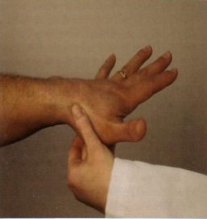
Q2: A 17-year-old student examined by his family physician as he has sever pain in the root of his left thumb, after a basketball game. The physician exacerbates his pain as he applied pressure in the anatomical snuff box as shown in the photo
-Which bones does the physician suspect injury?
Styloid process of the radius (proximal)
Scaphoid bone (distal)
-Which artery runs in the floor of this area?
Radial artery
-There are two tendons in the snuff box:
Medial: extensor pollicis longus
Lateral: extensor pollicis brevis & abductor polices longus

Slide 5
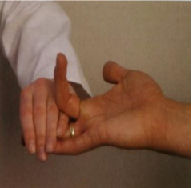
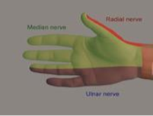
Q3: On evaluation of the hand function, the physician 3 fingers in extended position and asked the patient to flex the proximal interphalangeal joint of the middle finger.
-Which muscle is the doctor testing?
Flexor digitorum superficialis
-Which nerve is supplying this muscle?
Median nerve (C5,C6, C7, C8, T1)
All flexor muscles in the forearm are supplied by:
-Median nerve
EXCEPT: Flexor carpi ulnaris and medial ½ of Flexor digitorum profundus which is supplied by ulnar nerve
Only if they asked for root value

Slide 6
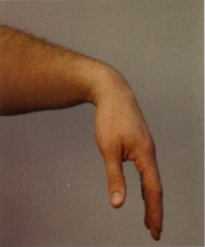
Q4: A 33-year-old male had a fracture on his left humerus at the level of the spiral groove. Two months later, he cannot extend his wrist or the left fingers
-Which nerve is most likely injured?
Radial nerve
(C5. C6, C7, C8, T1)
( arising from posterior cord of brachial plexuses)
-Describe the are of cutaneous loss:
Lateral 2/3 of the dorsal surface of the hand
Lateral 3 ½ fingers up to the middle phalanx
For understanding

Slide 7
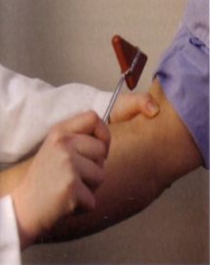
Q5: A physician performs a tendon reflex
-Which tendon is he testing for?
Biceps reflex
-What is the nerve supply of the tested muscle?
Musculocutaneous nerve
-Which cord gives this nerve?
Lateral cord with a root value of (C5, C6, C7)
What muscles are also supplied by this nerve?
Coracobrachialis
Brachialis (Medial Fibers)

Slide 8
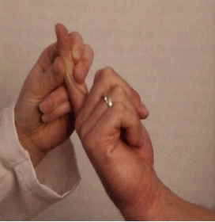
Q6: On evaluation of the hand function, the physician asked the patient to flex the terminal phalanax of the right index finger.
-Which muscle is the physician testing?
Flexor digitorum profundus
-What is the nerve that supplies this muscle?
Median nerve (anterior interosseus branch)
Flexor digitorum profundus
is inserted into the base of the distal phalanages of the 4 medial fingers

Slide 9
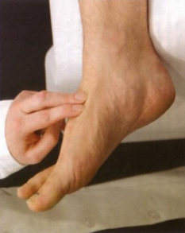
Q7: On evaluation of the peripheral circulation of a diabetic patient, the physician put his fingers as shown in the photo:
-Which artery is the physician trying to feel?
Dorsalis pedis artery
(main supply of blood for the toes)
-Which tendons descend on both sides of the artery in this area?
Medially: Extensor hallucis longus
Laterally: Extensor digitorum longus

Slide 10
Q8: On evaluation of the foot function, the physician asked the patient to raise his heel from the ground as shown in the photo:
-Enumerate two muscles that perform his action
Soleus (initiates it)
Gastrocnimus (maintains it)
Plantaris
Tibialis posterior
Flexor digitorum longus
-What is the nerve supply of each?
Tibial nerve (Gastrocnimus & Soleus)

Slide 11
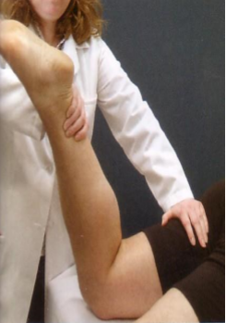
Q9: On evaluation of the knee function, the physician asked the patient to flex the knee against resistance as shown in the photo:
-Which group of muscles perform this action?
Hamstrings group along with the Sartorius and Gracialis muscle
-What is the nerve that supplies this group?
Sciatic nerve (L4+L5+S1+S2+S3)

Slide 12
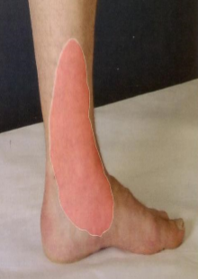
Surgery for restoring blood flow to a blocked artery
Q10: A 67-year-old man recently went a coronary bypass operation. After he recovered, he experienced a burning sensation in the marked are in the photo:
-Which nerve supplies this area?
Saphenous nerve
-Which nerve does it originate from?
Femoral nerve
-Which vein is used in the bypass operation?
Great saphenous vein (superficial)

Slide 13
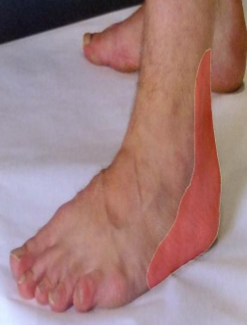
Q11: A 75-year-old man recently has coronary a bypass. After recovery, he noticed numbness and paresthesia in the marked area:
-Which vein was used in this coronary bypass operation?
Small saphenous vein
-Which nerve supplies the skin in this area?
Sural nerve (branch of tibial nerve)

Slide 14
Labeling

Slide 15
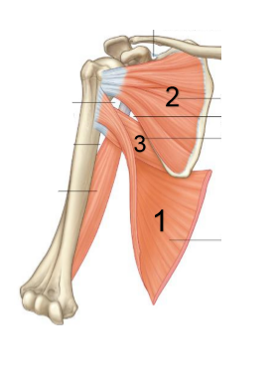
2. Subscapularis
3.Teres Major
Nerve supply:
Upper & lower subscapular nerves
Nerve supply:
lower subscapular nerve
C5, C6
C5, C6
1. Latissmus Dorsi
C6, C7. C8
Nerve supply:
Thoracodorsal nerve
OR
Nerve to latismuss dorsi

Slide 16
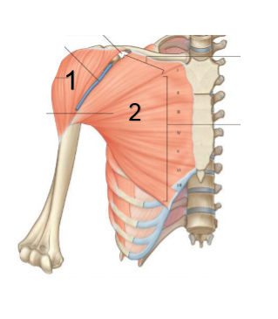
1. Deltoid
Nerve supply:
Axillary nerve
Posterior chord of Brachial Plexuses
Root value: (C5, C6)
Action:
1-Anterior fibers:
Flexion & medial rotation of shoulder (or arm) .
2-Middle fibers:
Abduction of humerus
(15º-90º)
3-Posterior fibers:
Extension & lateral rotation of shoulder (or arm).
2. Pectoralis major
Nerve supply:
Medial pectoral nerve
(Medial chord of Bracial Plexuses)
(Root value: C8,T1
Lateral pectoral nerve
(Lateral chord of Brachial Plexuses)
(Root value: C5,C6,C7)
Action:
Adduction & medial rotation of shoulder (or arm)

Slide 17
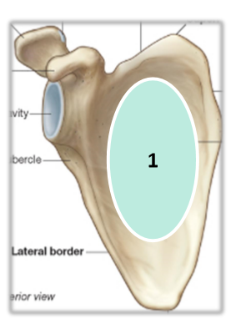
-Identify the muscle attached to the marked area:
Subscapularis
-What nerve enervates this muscle?
Upper & lower subscapular nerve
-Where is it inserted?
Lesser tubercle of the humerus
-What is its function?
Medial rotation of shoulder (or arm).

Slide 18
-Identify the muscles attached in the marked areas and their nerve supplies:
Biceps brachii
2. Pronator quadratus
-Nerve supply:
Musculocutaneous
Lateral Cord of Brachial plexuses
Root value: (C5,C6,C7)
-Nerve supply:
Anterior interosseus nerve from Median nerve

Slide 19
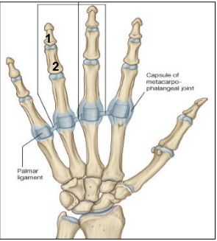
-Identify the muscles attached to the marked areas and their nerve supplies:
Flexor digitorum profundis
2. Flexor digitorum superficialis
-Nerve supply:
Ulnar nerve → Medial two fingers (little and ring finger)
Median nerve(anterior interosseus branch)→ Lateral two fingers (index and middle finger)
-Nerve supply:
Median nerve→ All four medial fingers (index/middle/ring/little)

Slide 20
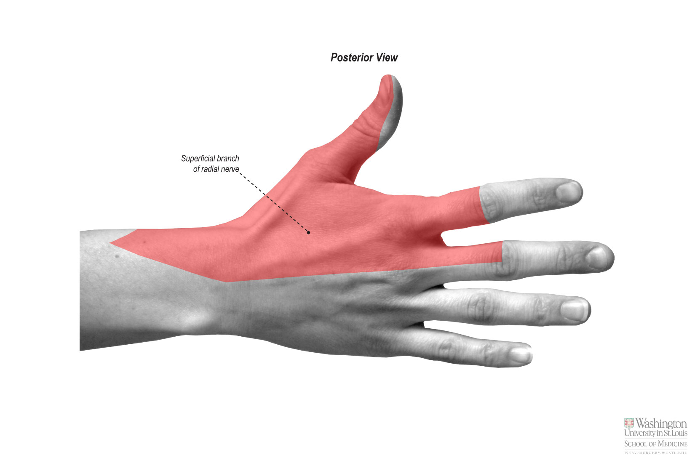
-What is the nerve that is supplies the skin this shaded area?
Radial nerve
Posterior cord of Brachial Plexuses
Root value: (C5,C6,C7,C8,T1)

Slide 21
-Identify the muscle attached to the marked area
Medial head of triceps
-Where is it inserted?
Olecranon process of ulna
-What is its nerve supply?
Radial nerve
-Main action?
Extension of the elbow
Extra info:
Lateral head of triceps attached above spiral groove
Long head of triceps attached to infraglenoidal tubercle
Brachialis: corresponding to the media head from the anterior aspect, it’s inserted in the coronoid process of the ulna.

Slide 22
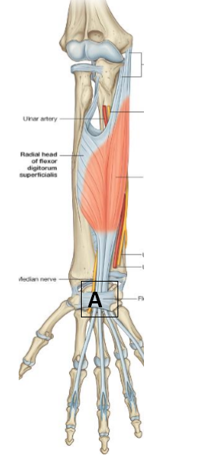
Q1- Identify the structure “A”
Flexor retinaculum .
Q2-Enumerate 2 nerves passing superficial & 2 tendons deep to it.
Superficial nerve:
1- Ulnar nerve. (also the ulnar artery)
2- Palmar cutaneous branch of ulnar and median nerves.
(also the tendon of palmaris longus)
Deep tendons:
1- Flexor digitorum superficialis and profundus.
2- Flexor pollicis longus.
Medial to flexor retinaculum:
Pisiform & Hook of Hamate
Lateral to flexor retinaculum:
Scaphoid & Trapezium

Slide 23
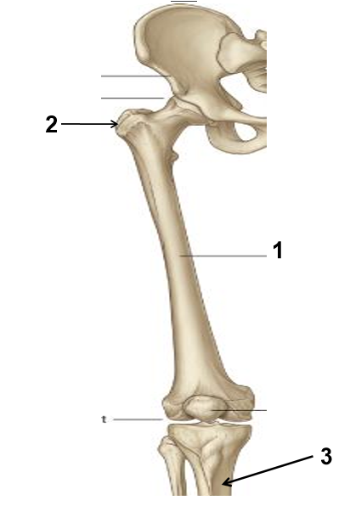
Q1- Identify the marked areas
Q2- Identify one structure attached to each area.
1- Shaft of femur:
Muscle attached: vastus intermedius
2- Greater trochanter :
Muscles attached:
-Anterior surface → gluteus minimus.
-Lateral surface → gluteus medius.
- Medial surface → Obturator internus.
3-upper part of medial surface of Tibia:
(SGS )
Sartorius femoral nerve (L2+L3+L4)
Gracillis obturator nerve (L2+L3+L4)
Semitendinosus tibial portion of sciatic nerve. (L4+L5+S1+S2+S3)
Nerve supply: femoral nerve
Nerve supply: superior gluteal nerve
Nerve supply: obturator internus.

Slide 24
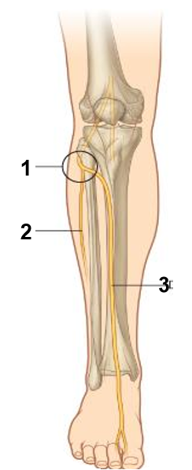
- What is the nerve that supplies the lateral side of the foot?
Sural nerve
1. Common peroneal nerve
2.Musculocutaneous nerve
Or
Superficial peroneal nerve
3. Deep peroneal
OR
Anterior tibial

Slide 25
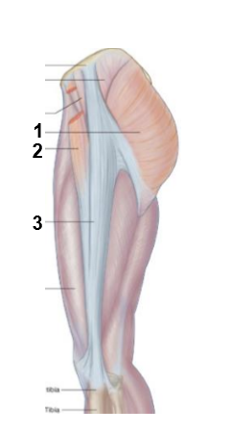
Q1-Identify these structures:
1-Glutes maximus.
2-Tensor fascia lata.
3-Iliotibial tract.
Q2-What is the nerve supply for 1 &2.
Inferior gluteal nerve.
2. Superior gluteal nerve

Slide 26
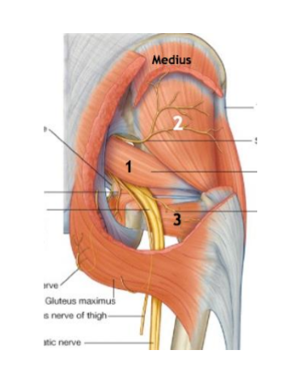
-Identify the muscles and their nerve supply
1- Piriformis muscle.
Nerve: S1 &2.
2- Gluteus minims.
Nerve: superior Gluteal nerve.
3- Quadratus femoris.
Nerve: Nerve to quadratus femoris

Slide 27
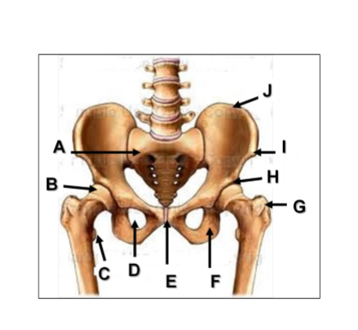
- Identify
A: Sacrum
B: Head of femur
C: Lesser trochanter
D: Obturator foramen
E: Pubic symphysis
F: Ischial tuberosity
G: Greater trochanter
H: Acetabulum
I: Anterior superior iliac spine
J: Iliac crest

Slide 28
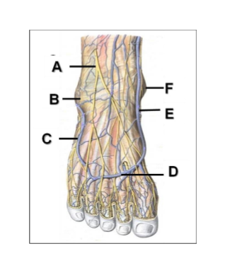
- Identify
A: Superficial peroneal nerve
B: Lateral malleolus
C: Small saphenous vein
D: Dorsal venous arch
E: Great saphenous vein
F: Medial malleolus

Slide 29
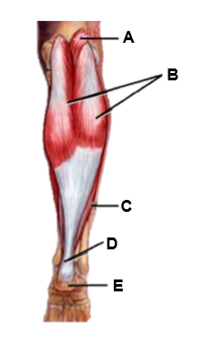
- Identify
A: Plantaris
B: Gastrocnemius
C: Soleus
D: Achilles tendon
E: Calcaneum

Slide 30
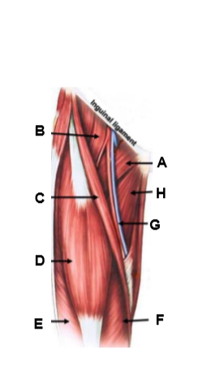
-Identify
Iliacus
A: Pectineus
B: Psoas major
C: Sartorius
D: Rectus femoris
E: Vastus lateralis
F: Vastus Medialis
G: Femoral vessels
H: Adductor longus

Slide 31
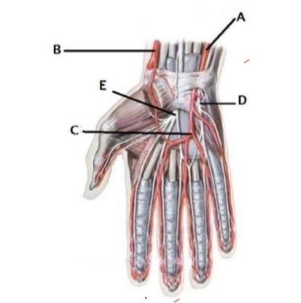
-Identify
A: Ulnar artery
B: Radial artery
C: Superficial palmer arch
D: Ulnar nerve
E: Median nerve
-NOTE:
The picture is incorrect because A (ULNAR ARTERY) & D (ULNAR NERVE) go above the flexor retinuculum
HOWEVER THE LABELING IS CORRECT

Slide 32
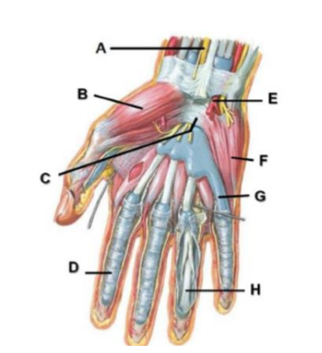
-Identify
-NOTE:
E (ULNAR ARTERY) should go above the flexor retinuculum
A: Median nerve
B: Thenar muscles
C: Flexor retinaculum
D: Fibrous flexor sheath
E: Ulnar artery
F: Hypothenar eminence
G: Flexor synovial sheath
H: Tendon of flexor digitorum profundus

Slide 33
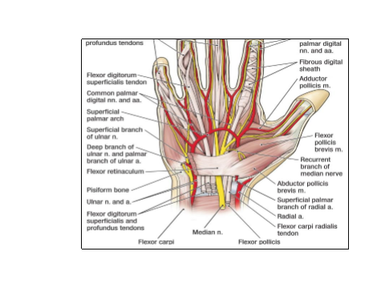
-Structures that run superficially above the Flexor Retinuculum from medial to lateral:
1- Tendon of Flexor carpi ulnaris.
2- Ulnar nerve.
3- Ulnar artery.
4- Palmar cutaneous branch of ulnar nerve.
5- Palmaris longus tendon.
6- Palmar cutaneous branch of median nerve

Slide 34
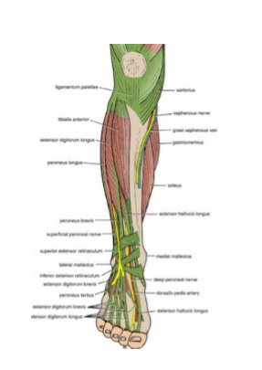
-Structures of Extensor Retinaculum from medial to lateral
Tibialis anterior
Extensor hallucis longus
Anterior tibial vessels
Deep peroneal nerve
Extensor digitorum longus
Peroneus tertius
Mnemonic:
Tom Has Very Nice Dog and Pig

Slide 35
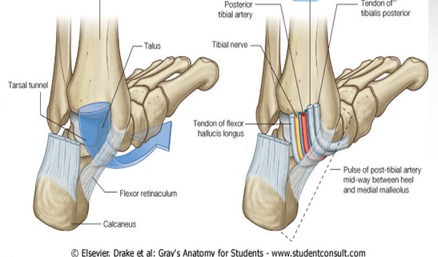
From medial to lateral
1.Tibialis posterior
2.Flexor Digitorum longus
3. Posterior tibial artery & vena comitantes
4.Posterior tibial nerve
5.Flexor hallocis longus
Mnemonic:
Tom, Dick and Nervous Harry

Slide 36
X-Ray

Slide 37
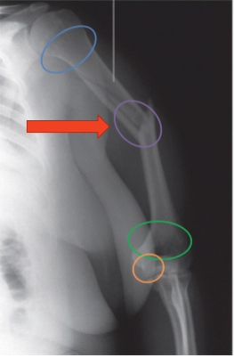
-What nerve is in danger in the case of this fracture?
Radial nerve
(profunda artery) if asked for vessel
-Common fractures of the humerus:
• Surgical neck: axillary nerve.
• Medial epicondyle: ulnar nerve.
• Spiral groove: radial nerve.
• Distal end (supracondylerfracture) : median nerve.

Slide 38
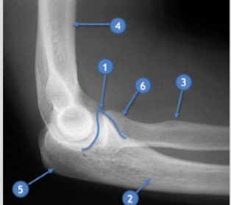
Lateral elbow X-Ray
1-Coronoid process.
2-Ulna.
3-Radial tuberosity.
4-Humerus.
5-Olecranon process
6-Radial head

Slide 39
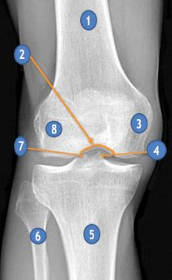
Frontal knee X-Ray
1-Femur.
2-Interchondylarnotch.
3-Medial femoral condyle
4-Medial tibialspine ( medial tibialeminence)
5-Tibia (or tibial tuberosity)
6-Fibula
7-Lateral tibialspine ( lateral tibialeminence )
8-Lateral femoral condyle.

Slide 40
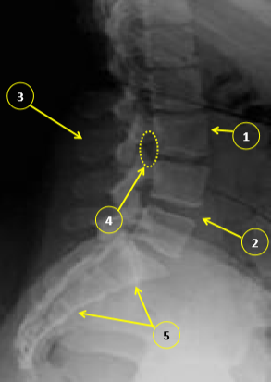
Identify:
1.Vertebral body (L3)
2-Intervertebral disk
3-Spinous process
4-Neural foramen
5-Sacrum

Slide 41
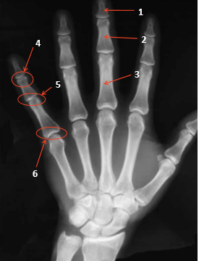
Identify:
1- Distal phalanx
2- Middle phalanx
3- Proximal phalanx
4- Distal interphalangeal joint
5- Proximal interphalangeal joint
6- Metacarpophalangeal joint

Slide 42
GOOD LUCK!
Lamia Alkuwaiz
Alanoud Almuffarej
Faisal Alsaif
Mohammed Binmayouf
Special thanks for team 436.

