Slide 3
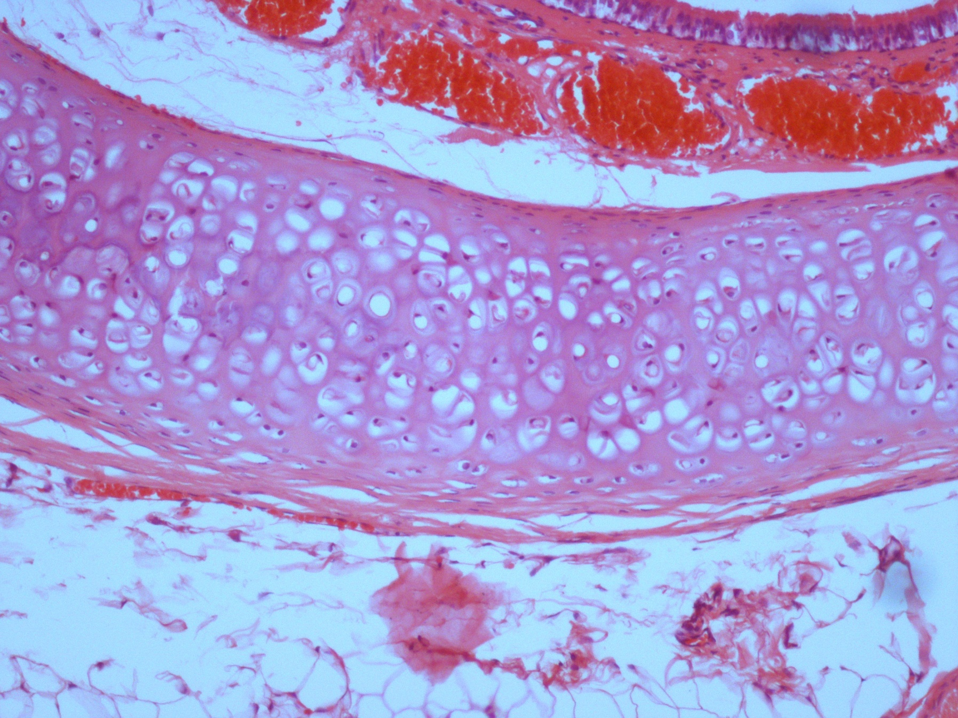
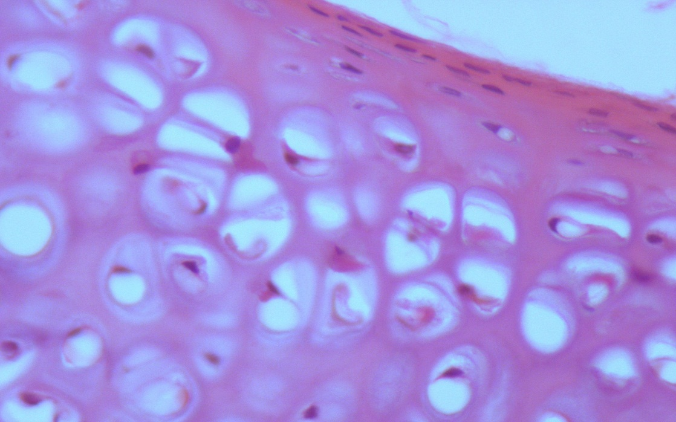
Hyaline Cartilage
Q1- Identify the structure?
Hyaline Cartilage
Features :
Perichondrium.
chondroblasts
chondrocytes (found in lacunae ).
Matrix :
Homogeneous and Basophilic .
collagen fibers type II.
Q- mention the organs (distribution, site & example)?
Articular surfaces of bones.
Foetal (fetal) skeleton.
Costal cartilage.
Nose , Trachea & Bronchi.
Perichondrium
( the outer fiber layer )
chondroblasts
Chondrocytes

Slide 4
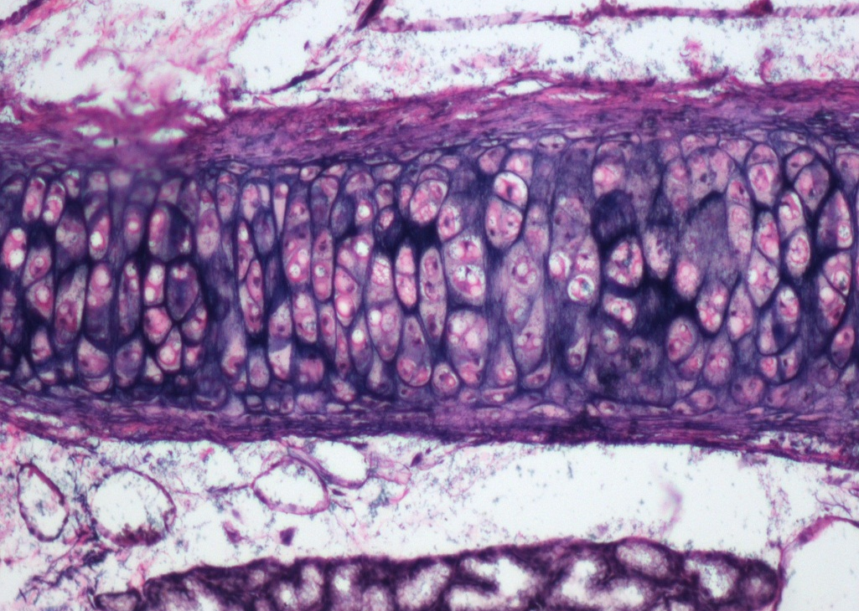
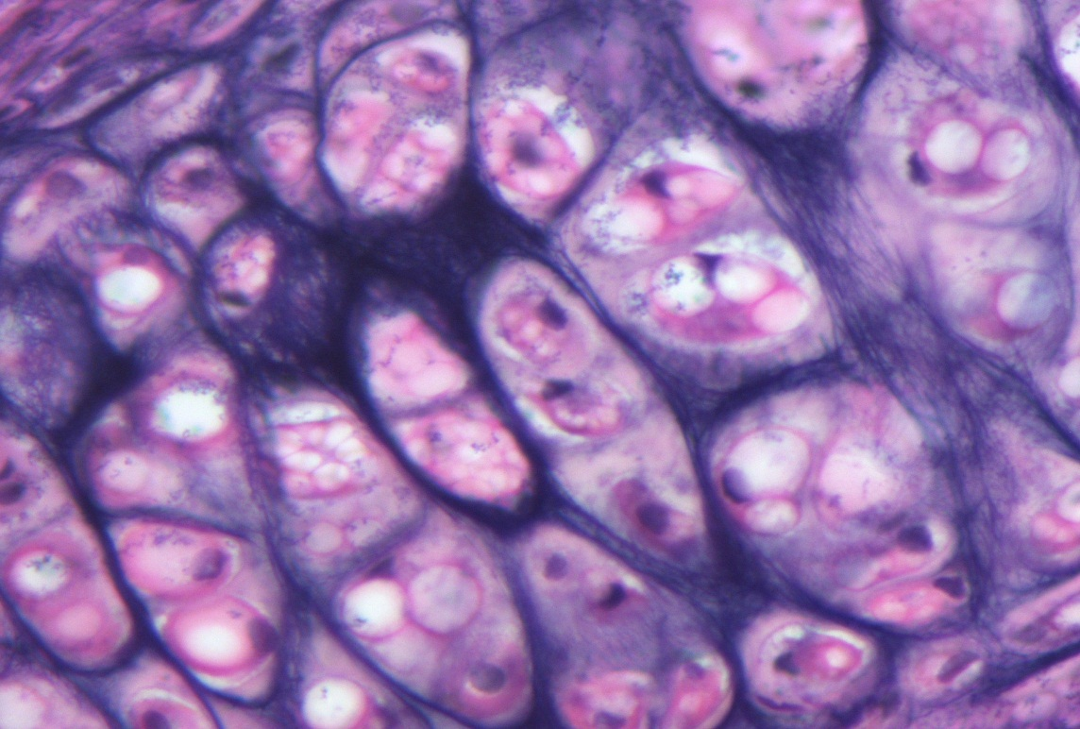
Elastic Cartilage
Q1- Identify the structure?
Elastic Cartilage
Features :
Perichondrium
Chondrocytes
Matrix :
Contains elastic fibers
Q2- mention the organs (distribution, site & example)?
External ear
Epiglottis
Perichondrium
( the outer fiber layer )
Elastic fibers
Chondrocytes

Slide 5
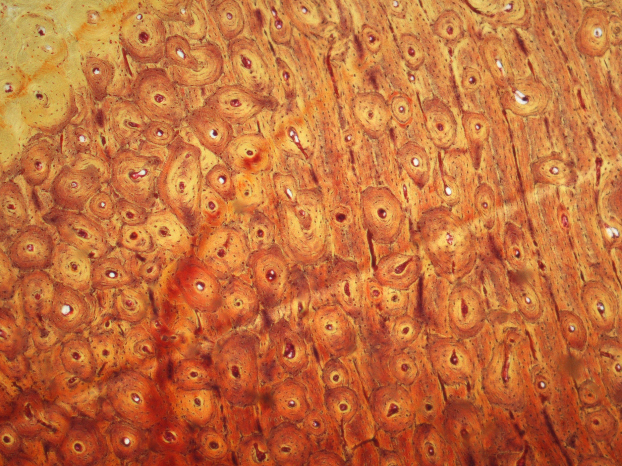
Compact bone (cortical)
Q1- Identify the structure?
Compact bone (cortical)
Features:
Bone Lamellae.
Haversian systems.
Osteocyte inside lacunae that have canaliculi.
Q2- mention the organs (distribution, site & example)?
Diaphysis of long bones.
Volkmann’s canal
Haversian system

Slide 6
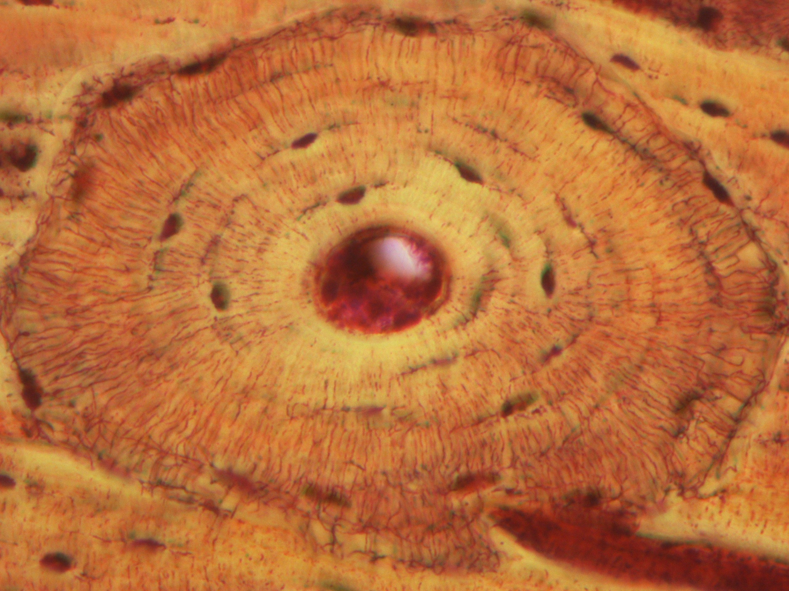
Haversian Systems (Osteons)
Q1- Identify the structure?
Haversian Systems (Osteons)
Features:
Concentric bone lamellae.
Haversian canal.
Osteocyte inside lacunae.
Canaliculi (fine lines)
Q2- mention the organs (distribution, site & example)?
Inside the compact bone in diyaphysis of long bone.
Haversian canal
Canaliculi
(fine lines)

Slide 7
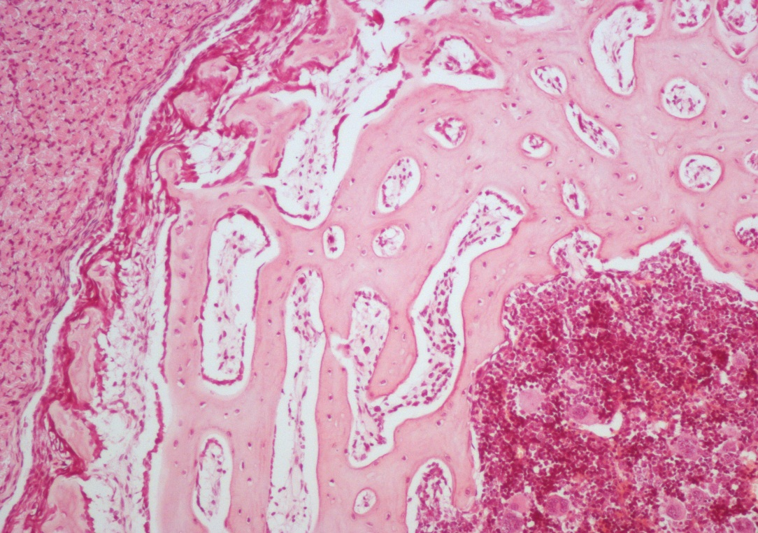
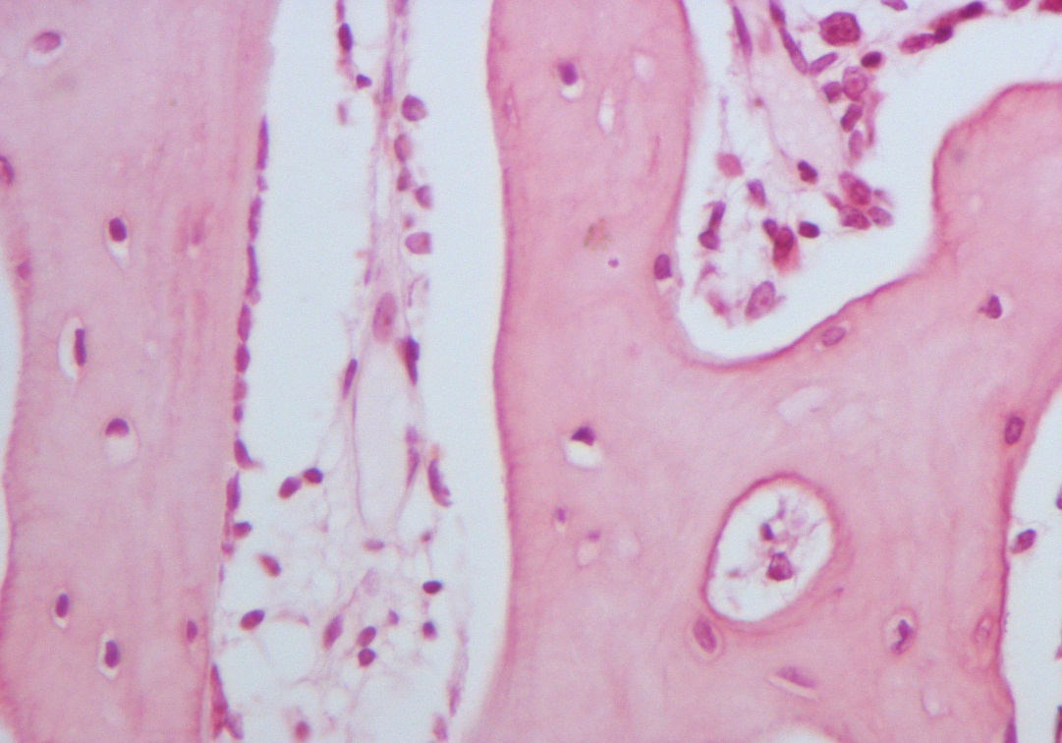
Spongy (Cancellous) Bone
Osteoclasts
Q1- Identify the structure?
Spongy (Cancellous) Bone
Features :
Irregular bone trabeculae ( matrix ).
Irregular bone marrow spaces contains bone marrow .
NO Haversian systems .
Osteoclasts ( multinucleated )
Q2- mention the organs (distribution, site & example)?
Flat bones.
Epiphysis of long bone.

Slide 8
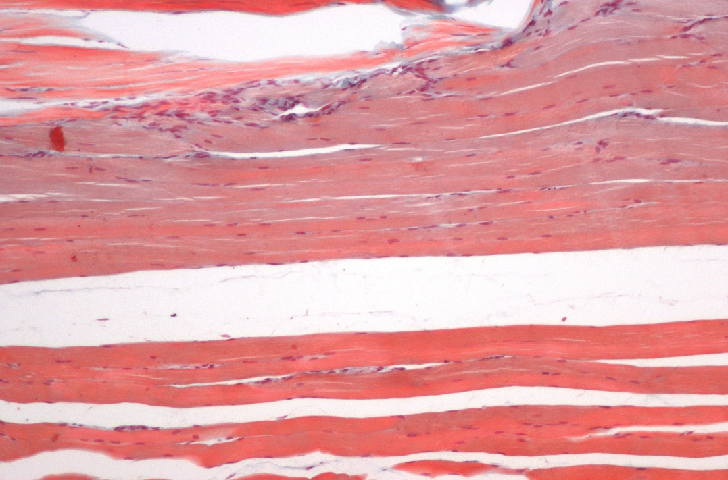
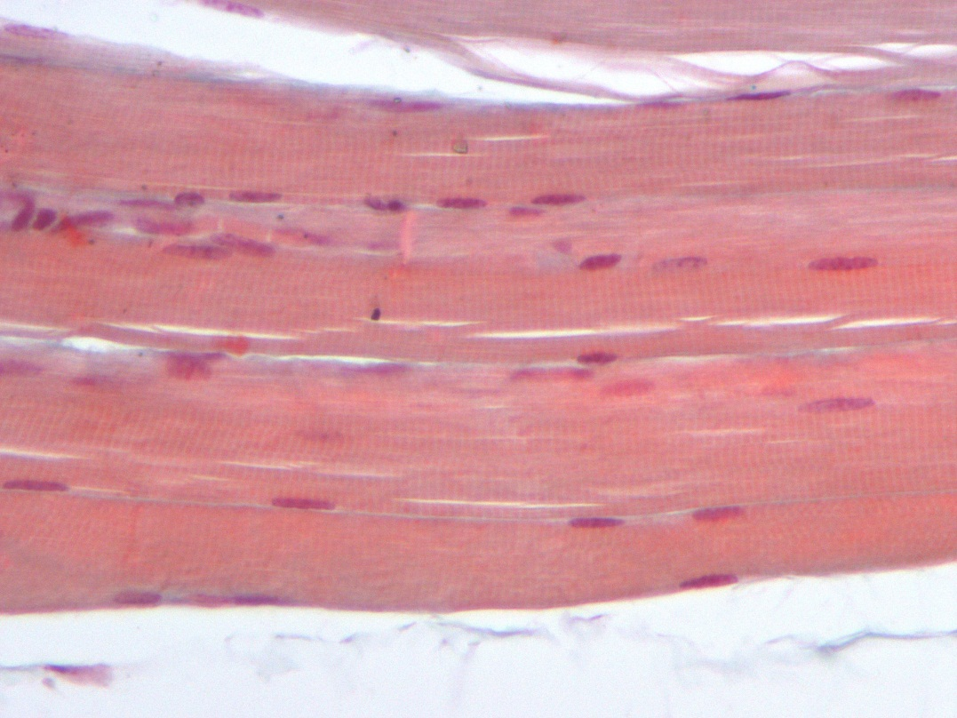
Skeletal muscle ( L.S.)
Q1- Identify the structure?
Skeletal muscle ( L.S.)
Features :
Multinucleated, nuclei on periphery.
Cylindrical in shape.
Non-branched .
Cytoplasm (sarcoplasm) is acidophilic and
shows clear transverse striations.
Q2- mention the organs (distribution, site & example)?
Skeletal system ( all voluntary muscles ).

Slide 9
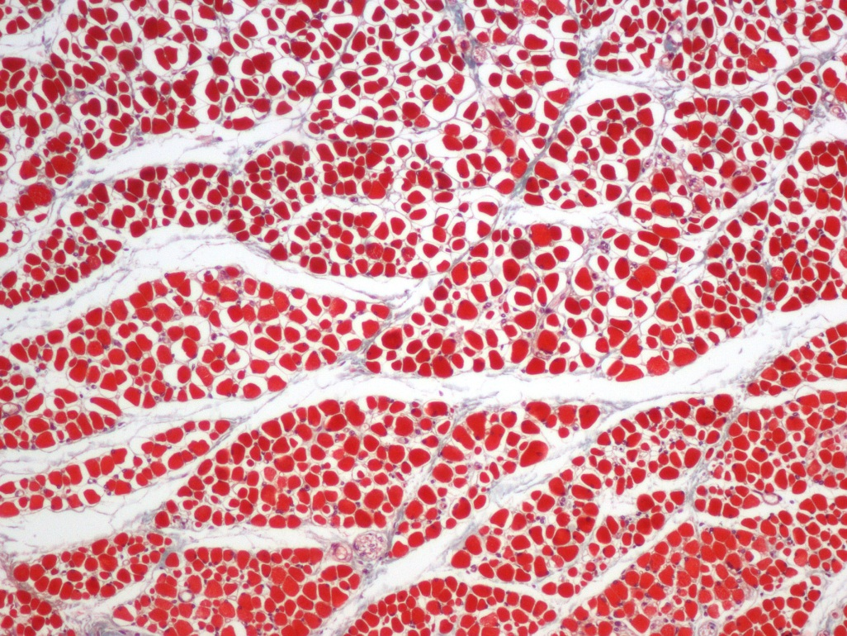
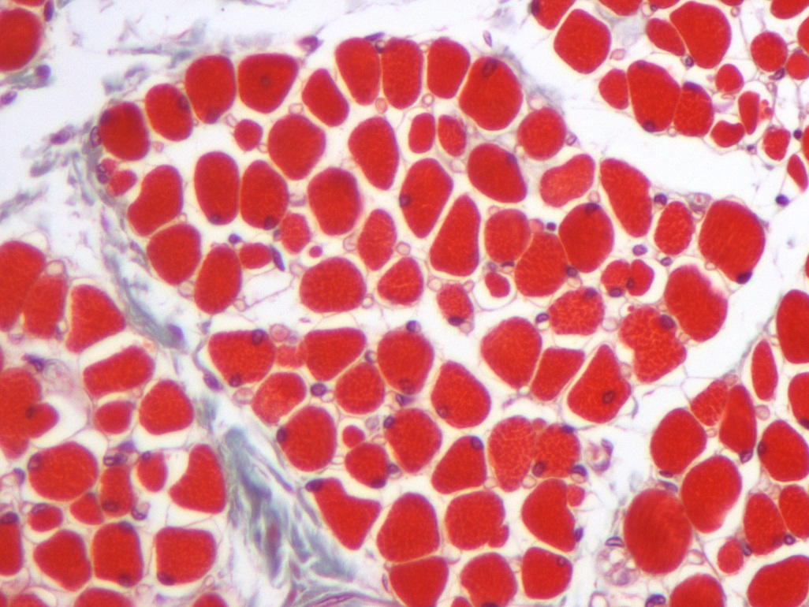
Skeletal muscle (T.S.)
Q1- Identify the structure?
Skeletal muscle (T.S.)
Features:
Endomysium: Loose C.T. separates the individual fibres.
Perimysium: Separates the parallel bundles of muscle fibres.
Epimysium: Thick CT covering the whole muscle.
Perimysium
T.S of muscle fibre
Nucleus of muscle
Endomysium

Slide 10
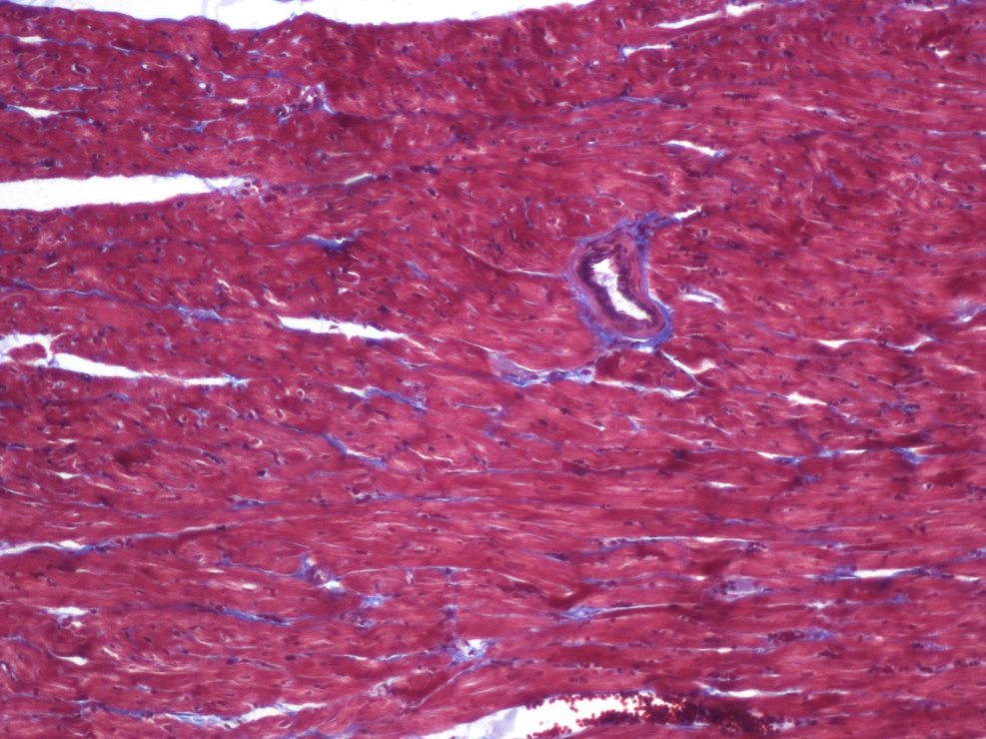
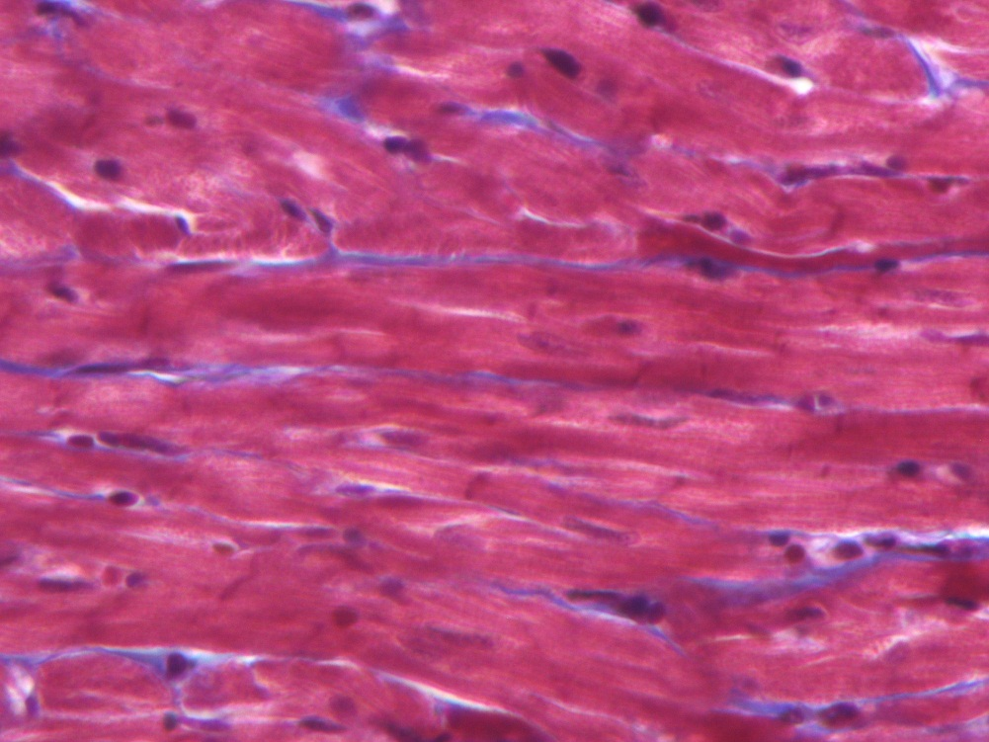
Cardiac muscle
Q1- Identify the structure?
Cardiac muscle
Features:
Mononucleated.
Oval and central nuclei.
Branched and anastomose.
Striated (not clear)
Cylindrical in shape.
Intermediate in diameter (in comparison to other muscles)
Gap junctions are present .
Intercalated discs.
Q2- mention the organs (distribution, site & example)?
Myocardium.
Intercalated discs

Slide 11
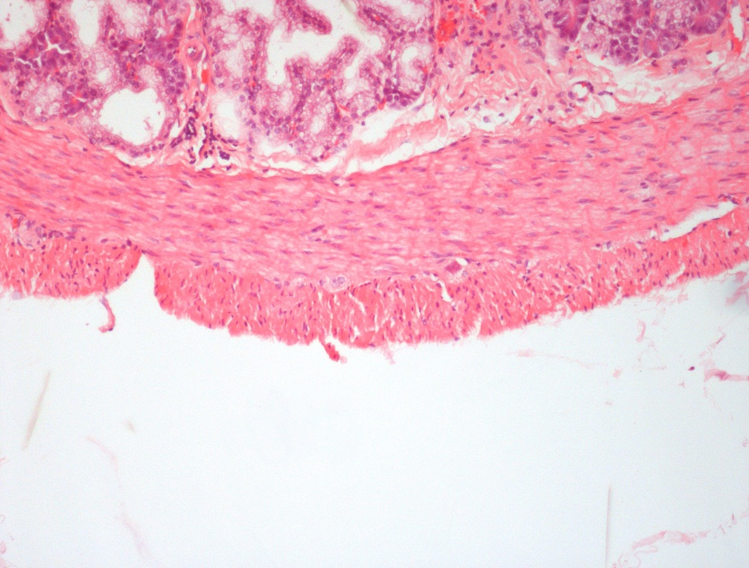
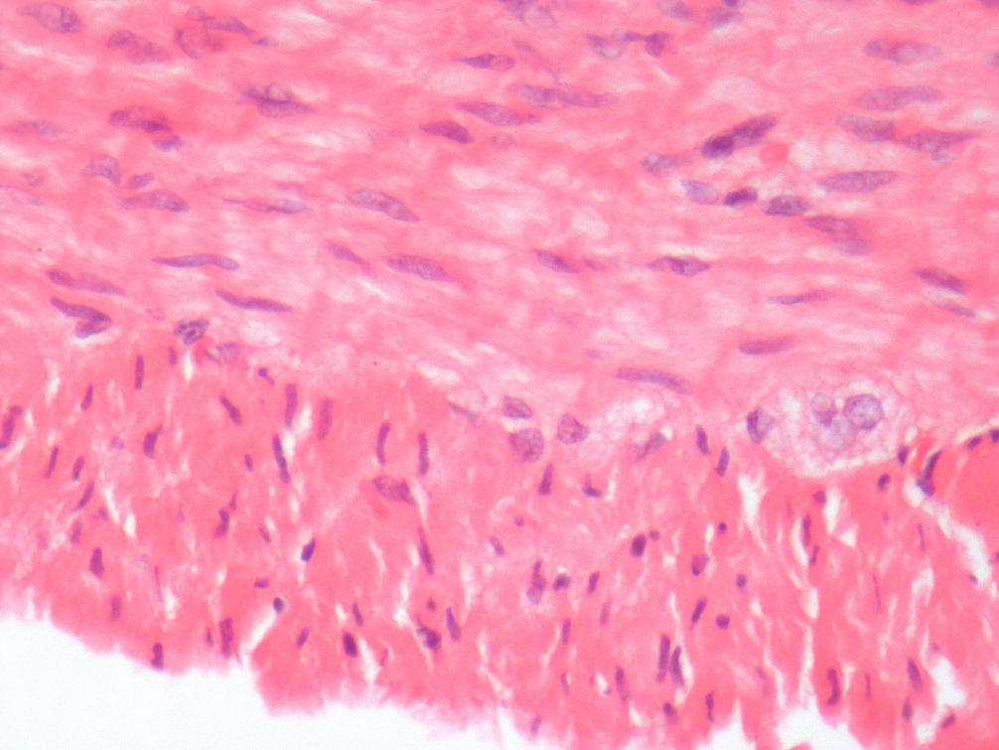
Smooth muscle ( T.S & L.S )
Q1- Identify the structure?
Smooth muscle ( T.S & L.S )
Features:
Mononucleated; oval and central nuclei.
Non striated.
Non branched.
Fusiform (spindle shaped).
Small in diameter.
Gap junctions are present.
Q2- mention the organs (distribution, site & example)?
Walls of blood vessels.
Viscera.

