Slide 1
Arm & Elbow
Lecture 10
Please check our Editing File.

Slide 2
Objectives
Describe the attachments, actions and innervations of: Biceps brachii, Coracobrachialis, Brachialis, Triceps brachii.
Demonstrate the following features of the elbow joint: Articulating bones, Capsule, Lateral & medial collateral ligaments, Synovial membrane.
Demonstrate the movements : flexion and extension of the elbow.
List the main muscles producing the above movements.
Define the boundaries of the cubital fossa and enumerate its contents.
Text in BLUE was found only in the boys’ slides
Text in PINK was found only in the girls’ slides
Text in RED is considered important
Text in GREY is considered extra notes

Slide 3
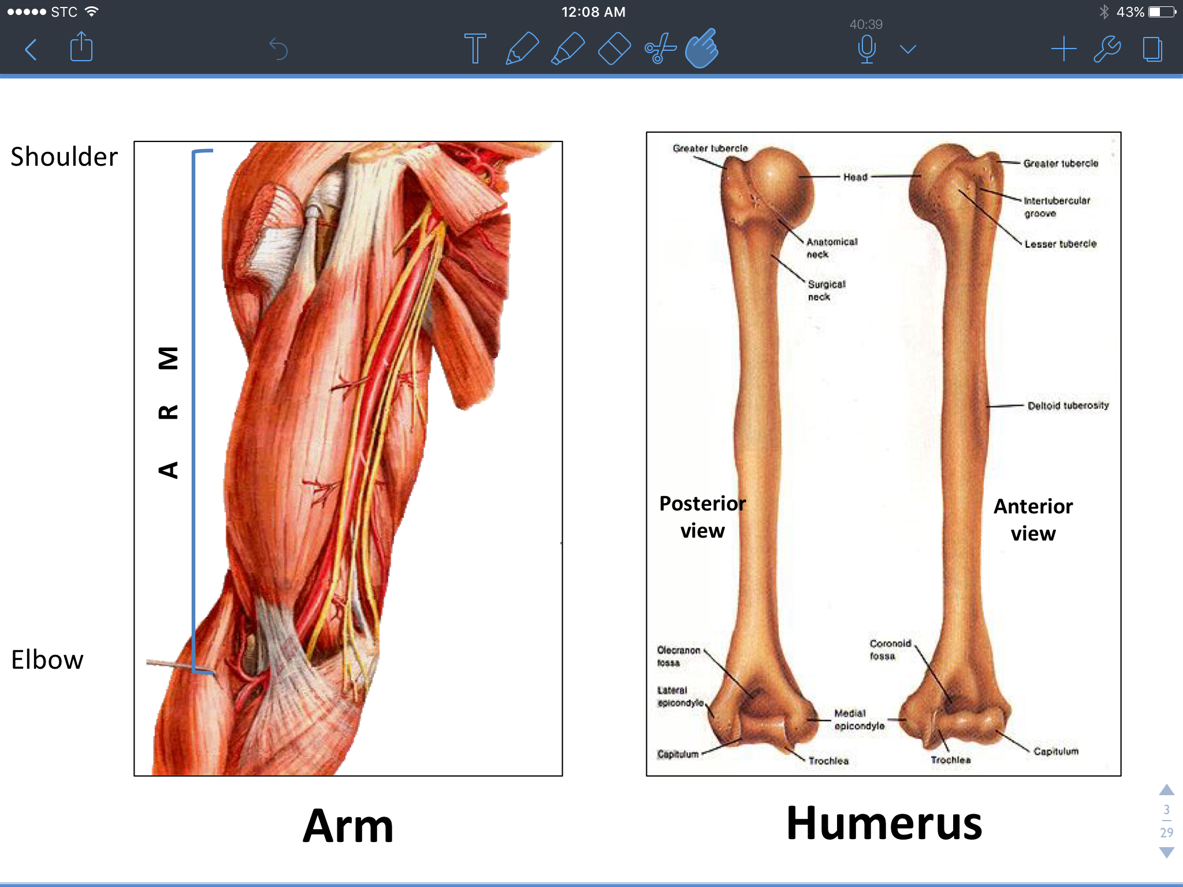
The ARM
*Arm: is the region between the axilla and the elbow.
Deep fascia form the lateral and medial intermuscular septa which divide the distal part of the arm into two compartments:
Anterior (Flexor) compartment.
Posterior (Extensor) compartment.
Clinical importance:
this process of compartmentalizing is important because an infection in one part cannot spread to the next.
Skin is only supplied by sensory nerves (no motor nerves).
The skin does not attach to the muscle directly except in the face.
The general arrangement of the body is:
skin => fascia => muscle => bone.
Deep Fascia (does not contain fat)
*The function of the deep fascia is: protection, compartmenting, and allowing neurovascular bundles to pass.
Superficial Fascia (contains fat)

Slide 4
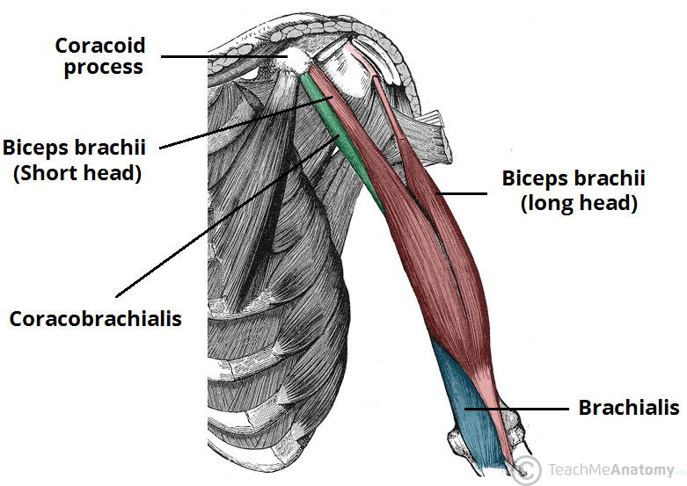
Anterior Fascial Compartment Content
Muscles: Biceps brachii, Coracobrachialis and Brachialis.
Blood vessels: Brachial artery and Basilic vein.(the brachial artery is a continuation of the axillary artery)
Nerves: Musculocutaneous, Median, Radial and Ulnar*.
Team436
*the radial and ulnar nerves begin in the anterior compartment then pierce the intermuscular septum and enter the posterior compartment.
Bi = Two, Ceps = Head (Biceps = Two Headed)
Brachii = Arm
Coraco = under the Coracoid process

Slide 5
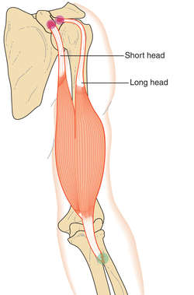
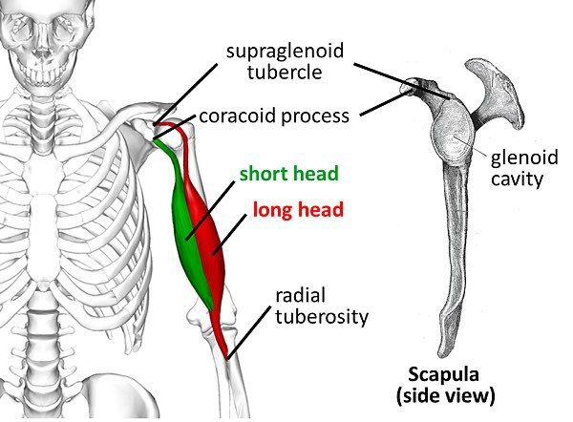
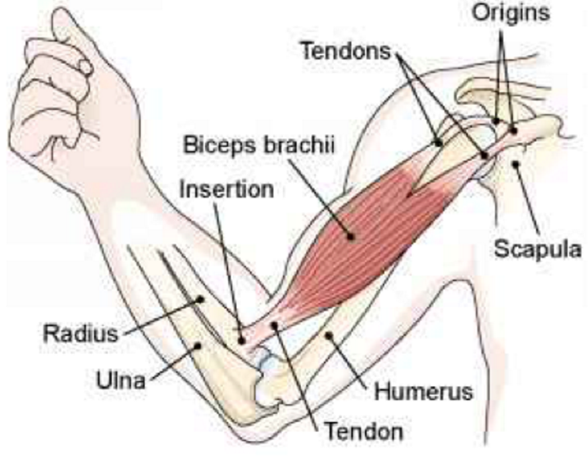
Biceps Brachii
Question: what are the primary and secondary actions of the biceps brachii?
Strong supinator (primary action)
Powerful flexor (secondary action)
Origin: Two heads:
Long Head (Lateral head): from supraglenoid tubercle of scapula (intracapsular*).
Short head (medial head): from the tip of coracoid process of scapula.
The two heads join in the middle of the arm.
Insertion:
Into the posterior part of radial tuberosity.
Into the deep fascia of the medial aspect of forearm through bicipital aponeurosis.
Clinical importance: the median cubital vein passes above the bicipital aponeurosis, which makes it a safe and easy access point to draw blood.
Nerve supply: Musculocutaneous.
Action:
Strong supinator of the forearm (used in screwing).
Powerful flexor of elbow.
Weak flexor of shoulder.
*Intracapsular = inside shoulder joint.

Slide 6
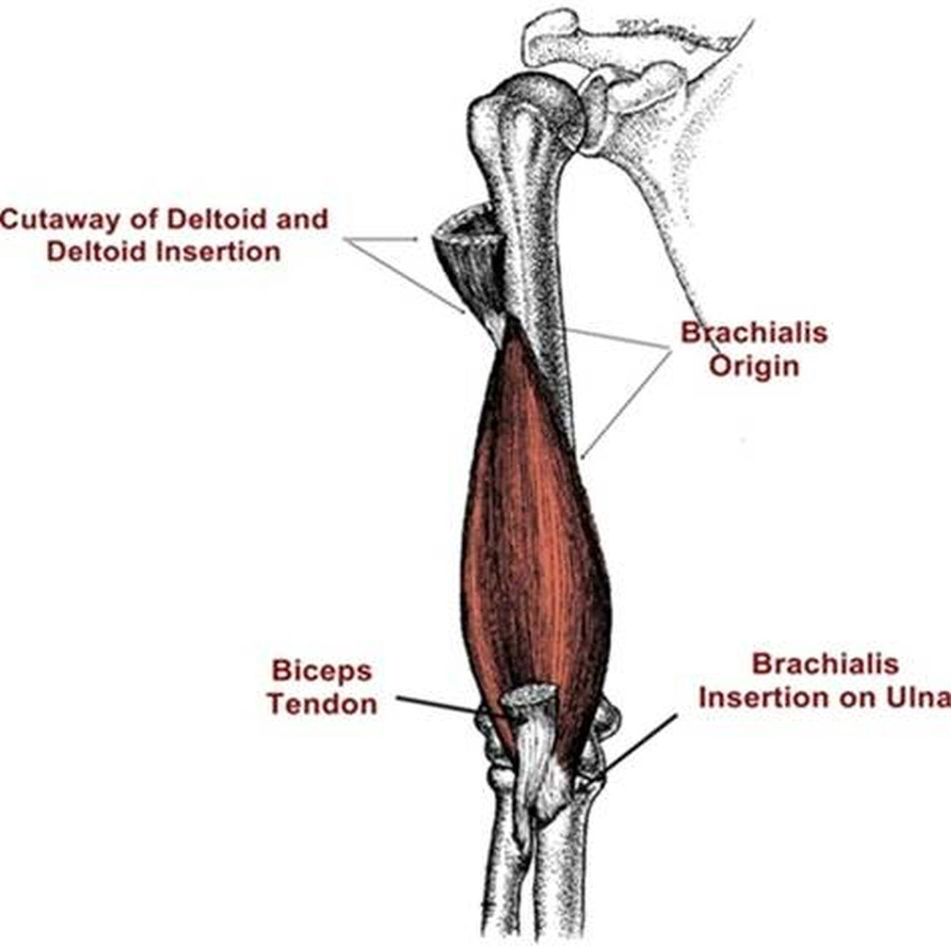
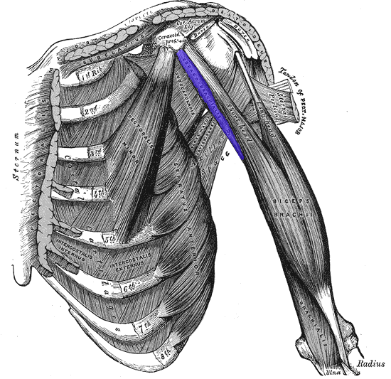
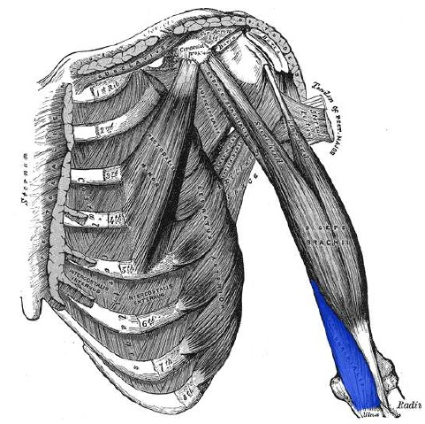
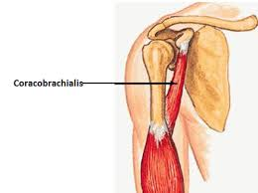
Coracobrachialis
Brachialis
Origin: Tip of the coracoid process of scapula. (with short head of biceps brachii).
Insertion: Middle of the medial side of the shaft of the humerus.
Nerve supply: Musculocutaneous
Action: Flexor and a weak adductor of the arm.
Origin: Front of the lower half of humerus.
Insertion: Anterior surface of coronoid process of ulna.
Nerve supply: Double nerve supply by: the Musculocutaneous (medial part) and. Radial (lateral part).
Action: Strong flexor of the forearm.

Slide 7
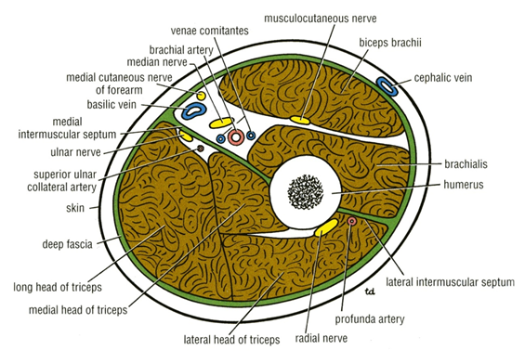
Posterior fascial compartment contents
Muscles: Triceps brachii
(tri- = three / -ceps = heads)
Vessels: Profunda (deep) brachii artery and superior ulnar collateral arteries (which enters the forearm behind the medial epicondyle)
Nerves: Radial & Ulnar (from the medial cord). The posterior compartment is only supplied by the radial nerve, the ulnar nerve only passes through it.

Slide 8
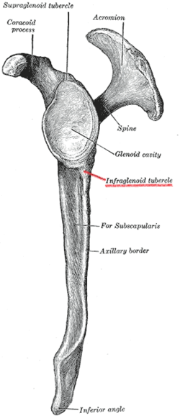
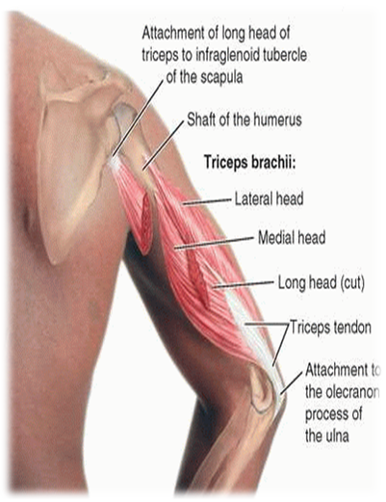
Triceps brachii
Origin: Three heads (tri):
1- Long Head from infraglenoid tubercle of the scapula.
2- Lateral Head from the upper half of the posterior surface of the shaft of humerus above the spiral groove.
3- Medial Head from the lower half of the posterior surface of the shaft of humerus below the spiral groove.
Insertion:
Common tendon inserted into the upper surface of the olecranon process of ulna.
Nerve supply:
Radial nerve (the main nerve of the posterior compartment of the arm).
Action:
Strong extensor of the elbow joint

Slide 9
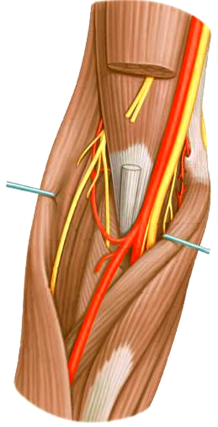
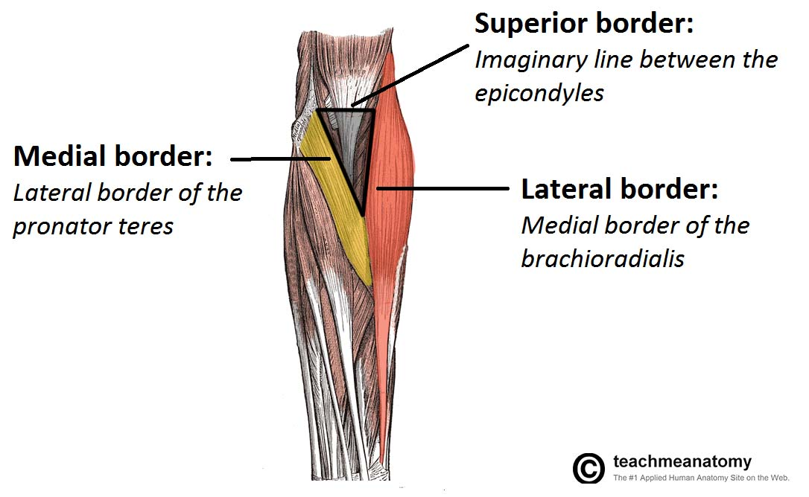
Cubital Fossa
Contents of Cubital Fossa (Very important)
Is a triangular depression that lies in front of the elbow:
Base: Line drawn through the two epicondyles of humerus
Laterally: Brachioradialis
Medially: Pronator teres
Roof: Skin, superficial & deep fascia and bicipital aponeurosis
Floor: Brachialis medially and supinator laterally.
From medial to lateral:
1- Median nerve. (Most medial)
2- Brachial artery.
3- Biceps brachii tendon.
4- Deep branch of radial nerve. (Most lateral)
Radial Artery
Possible Question: Which of the following is from the contents of the cubital fossa?
Ulnar Artery
1. Median nerve
3. Biceps brachii tendon
4. Deep branch of radial nerve
2. Brachial artery
Ulnar artery
Radial artery

Slide 10
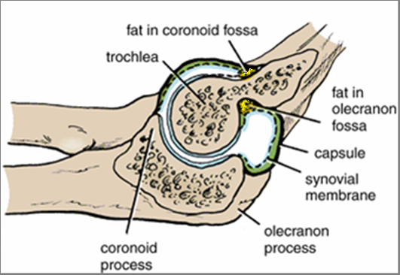
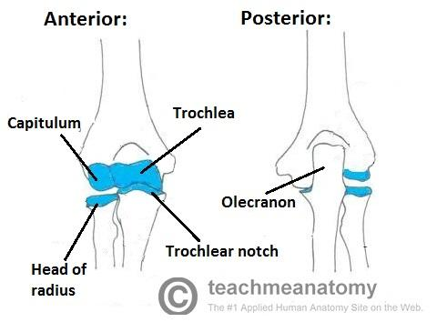
Elbow Joint
Synovial Membrane (inner side of capsule)
Joint Type: Uniaxial, Synovial Hinge joint
This lines the inner surface of the capsule and covers fatty pads in the floors of the coronoid, radial, and olecranon fossa.
Is continuous below with synovial membrane of the superior radioulnar joint.
The articular surfaces are covered with articular (hyaline) cartilage.
Articulation:
Above: Trochlea and capitulum of the humerus
Below: Trochlear notch of ulna and the head of radius
Synovial membrane produces fluid called Synovial fluid

Slide 11
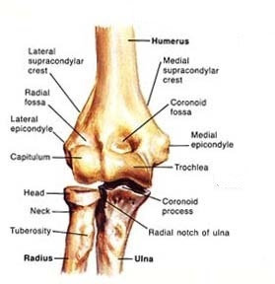
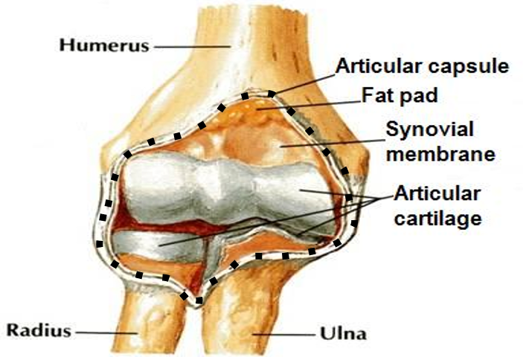
Capsule (covers articular surface) | Anteriorly: attached | Posteriorly: attached
Above | To the humerus along the upper margins of the coronoid and radial fossa and to the front of the medial and lateral epicondyles. | To the margins of the olecranon fossa of the humerus.
Below | To the margin of the coronoid process of the ulna and to the annular ligament, which surrounds the head of the radius. | To the upper margin and sides of the olecranon process of the ulna and to the annular ligament.

Slide 12
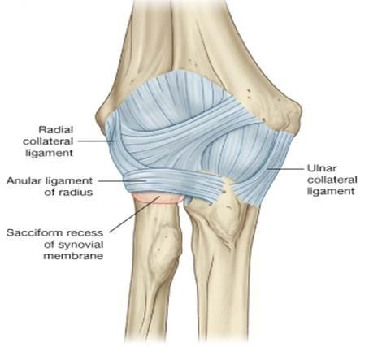
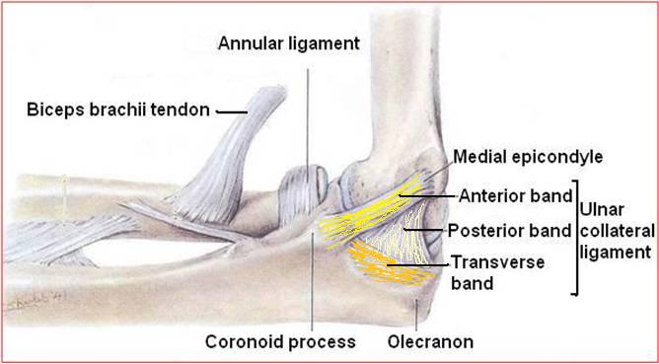
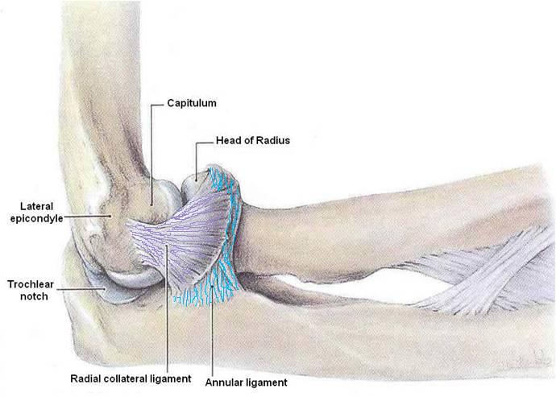
Ligaments
Lateral (radial collateral) ligament: | Medial (ulnar collateral) ligament:
Shape: Triangular Apex: Attached to the lateral epicondyle of humerus Base: Attached to the upper margin of annular ligament*. | - Anterior strong cord-like band: Between medial epicondyle and the coronoid process of ulna - Posterior weaker fan-like band: Between medial epicondyle and the olecranon process of ulna. - Transverse band: Passes between the anterior and posterior bands.
*Annular ligament: Circular ligament around the radius

Slide 13
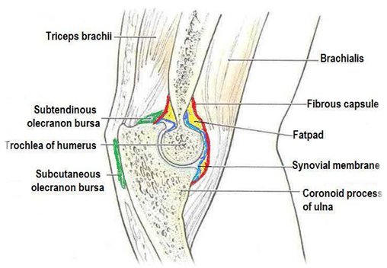
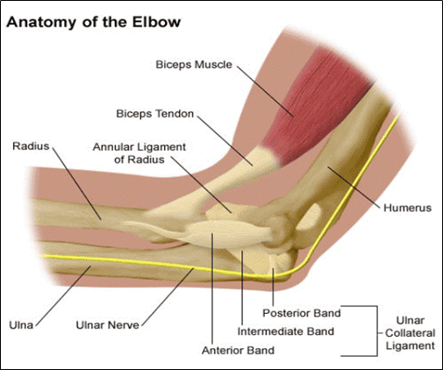
Relations of Elbow Joint
Anterior | 1-Brachialis. 2-tendons of biceps. 3-Median nerve. 4-Brachial artery.
Posterior | 1-Triceps muscle. 2-small bursa intervening.
Lateral | 1- Common extensor tendon (attached to lateral epicondyles of the humerus). 2- Supinator.
Medial | Ulnar nerve : (between the medial epicondyle and the skin) -Considered the largest unprotected nerve by muscle or bone. هذا هو سبب شعورنا بألم (كهرباء) عند ضرب الكوع
Bursae around the elbow joint:
(a sac containing synovial fluid which protects the joint)
1- Subcutaneous (under the skin) olecranon bursa.
2- Subtendinous (under the tendon) olecranon bursa.

Slide 14
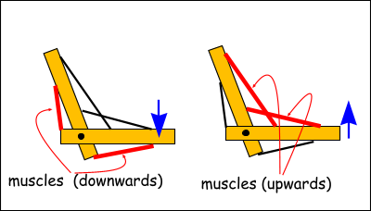
Movements of Elbow Joint (Very Important)
Flexion:
Is limited by the anterior surfaces of the forearm and arm coming into contact.
Extension:
Is limited by the tension of anterior ligament and the brachialis muscle.
The joint is supplied by branches from the nerves:
Median Nerve.
Ulnar Nerve.
Musculocutaneous Nerve.
Radial Nerve.
All the nerves in the arm supply the elbow joint.

Slide 15
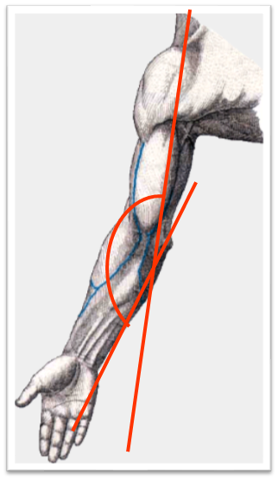
Carrying Angle
Angle
Opens
The Degree (About)
Disappears
Permits
Between the long axis of the extended forearm and the long axis of the arm.
Laterally.
170 in male
167 in females.
When the elbow joint is flexed.
The forearms to clear the hips in swinging movements during walking, and is important when carrying objects.
165°-170°

Slide 16
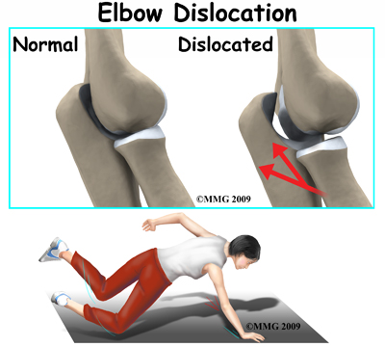
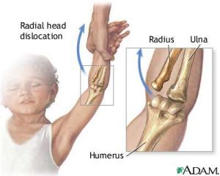
Articulations and Applied Anatomy
Wrench-shaped articular surface of the olecranon and the pulley-shaped trochlea of humerus
The elbow joint is stable because of
Strong medial and lateral ligaments.
Elbow dislocations are common and most are posterior dislocations:
Posterior dislocation usually follows falling on the outstretched hand.
Posterior dislocations of the joint are common in children because the parts of the bones that stabilize the joint are incompletely developed.

Slide 17
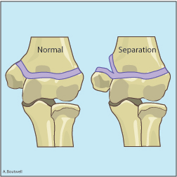
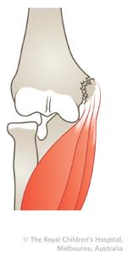
Elbow Joint
—Avulsion (نزع/تمزيق) of the epiphysis of the medial epicondyle,
is also common in childhood because the medial ligament is much stronger than the bond of union between the epiphysis and the diaphysis.
(بمعنى انه منطقة الepiphysis of the medial epicondyle عند الأطفال أكثر عرضة للخلع لان الاربطة الي في ال medial اقوى من التي بينepiphysis and the diaphysis)
They are usually a result from an avulsion (pull off) injury caused by a valgus stress at the elbow and contraction of the flexor muscles as in:
Fall on an outstretched hand with the elbow in full extension.
Posterior elbow dislocation (common in children).
Direct blow.
3- Avulsion
1- Dislocation
2- More Contraction

Slide 18
MCQ:
Answers:
Q1 : The brachialis muscle lies in which fascial compartment?
A) Posterior B) Anterior
Q2: What is the origin of the long head of the biceps brachii?
A) Coracoid process B) Supraglenoid tubercle. C) Infraglenoid tubercle D) Medial border of scapula
Q3: In males what is the degree of the carrying angle?
A) 170 B) 180 C) 167 D) 200
Q4: Which of the following is in the medial boundary of the cubital fossa?
A) Pronator teres B) Brachioradialis C) Brachialis D) Supinator
Q5: What type of nerve supplies the biceps brachii?
A) Radial B) Median
C) Ulnar D) Musculocutaneous
Q6: What nerve supplies the lateral part of brachialis?
A) Median B) Ulnar C) Axillary D) Radial
Q7: What is the shape of the lateral ligaments of the elbow?
A) Squared B) Triangular
Q8: The lateral epicondyle of the humerus is attached to which part of the elbow ligaments?
A) Apex B) Base
1)B
2)B
3)A
4)A
5)D
6)D
7)B
8)A

Slide 19
Team Members
Lamia Abdullah Alkuwaiz (Team Leader)
Rawan Mohammad Alharbi
Alanoud Almufarrej
Abeer Alabduljabbar
Afnan Abdulaziz Almustafa
Ahad Algrain
Alanoud Almansour
Albandari Alshaye
AlFhadah abdullah alsaleem
Arwa Alzahrani
Dana Abdulaziz Alrasheed
Dimah Khalid Alaraifi
Ghada Alhaidari
Ghada Almuhanna
Ghaida Alsanad
Hadeel Khalid Awartani
Haifa Alessa
Khulood Alwehabi
Layan Hassan Alwatban
Lojain Azizalrahman
Lujain Tariq AlZaid
Faisal Fahad Alsaif (Team Leader)
Abdulaziz Al dukhayel
‏Fahad Alfaiz
‏Akram Alfandi
‏Saad Aloqile
‏Saleh Almoaiqel
‏Abdulaziz Alabdulkareem
‏Abdullah Almeaither
‏Yazeed Aldossari
‏Muath Alhumood
Abdulrahman Almotairi
‏
Abdulelah Aldossari
‏Abdulrahman Alduhayyim
‏Hamdan Aldossari
‏Abdullah Alqarni
‏Mohammed Alomar
‏Abdulrahman Aldawood
‏Saud Alghufaily
‏Hassan Aloraini
Khalid Almutairi
‏‏
Maha Barakah
Majd Khalid AlBarrak
Norah Alharbi
Nouf Alotaibi
Noura Mohammed Alothaim
Rahaf Turki Alshammari
Reham Alhalabi
Rinad Musaed Alghoraiby
Sara Alsultan
Shahad Alzahrani
Wafa Alotaibi
Wejdan Fahad Albadrani
Wjdan AlShamry
Abdulmajeed Alwardi
‏Abdulrahman Alageel
‏Rayyan Almousa
‏Sultan Alfuhaid
‏Ali Alammari
‏Fahad Alshughaithry
Fayez Ghiyath Aldarsouni
‏Mohammed Alquwayfili
‏‏Abduljabbar Al-yamani
‏Sultan Al-nasser
‏Majed Aljohani
‏Zeyad Al-khenaizan
‏Mohammed Nouri
‏Abdulaziz Al-drgam
‏Fahad Aldhowaihy
‏Omar alyabis

