Slide 1
Joints
Lecture 11
Please check our Editing File.
{وَمَنْ يَتَوَكَّلْ عَلَى اللَّهِ فَهُوَ حَسْبُهُ}
هذا العمل لا يغني عن المصدر الأساسي للمذاكرة

Slide 2
Objectives
Define the term “Joint”.
Describe the classification of 3 types of joints & give an example of each.
Describe the characteristics of synovial joints.
Describe the classification of synovial joints & give an example of each.
List factors maintaining stability of joints.
Recite “Hilton’s law” for nerve supply of joints.

Slide 3
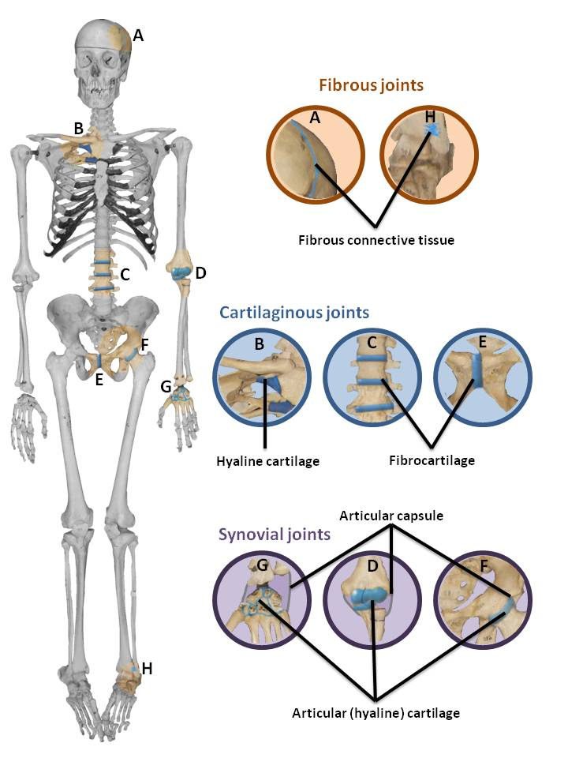
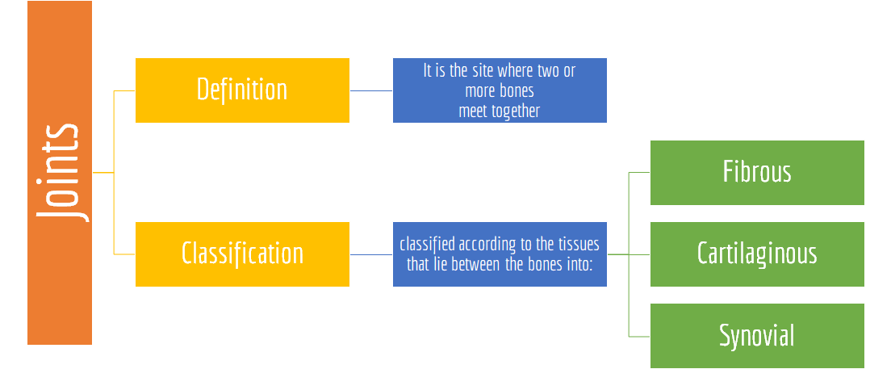
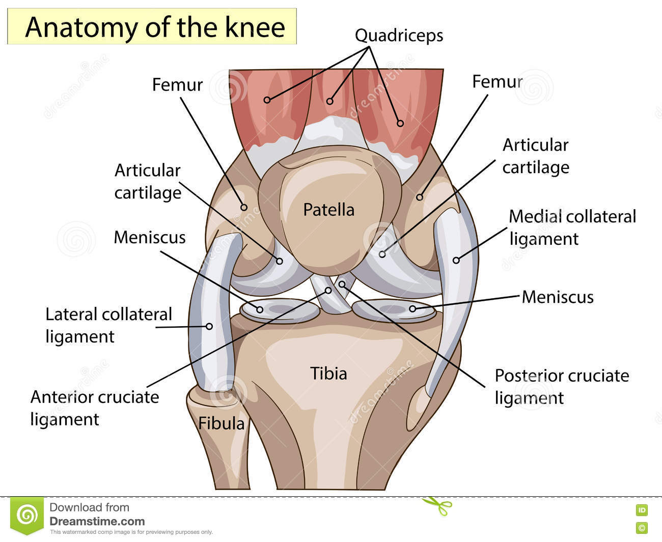
Definition and classification of joints
فيديو توضيحي

Slide 4
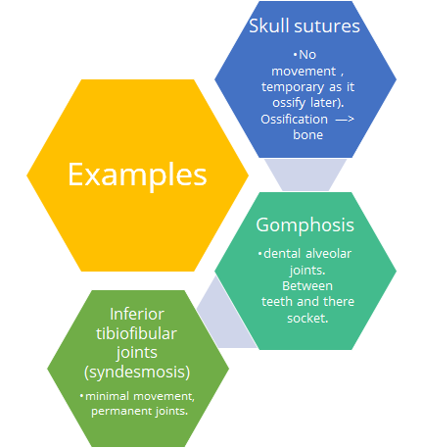
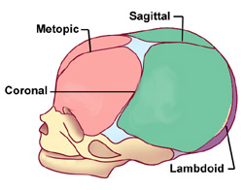
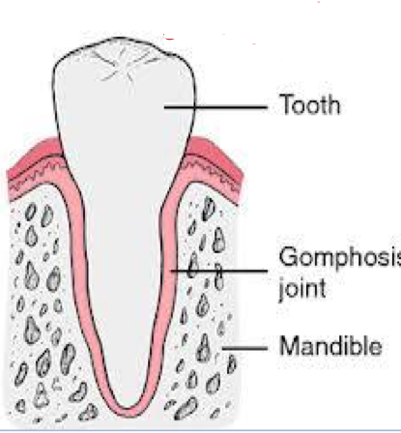
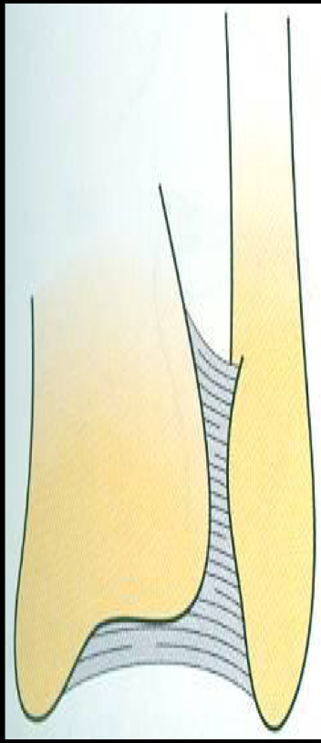
Fibrous Joints
The articulating surfaces are joined by fibrous connective tissue, where no or very mild movement.

Slide 5
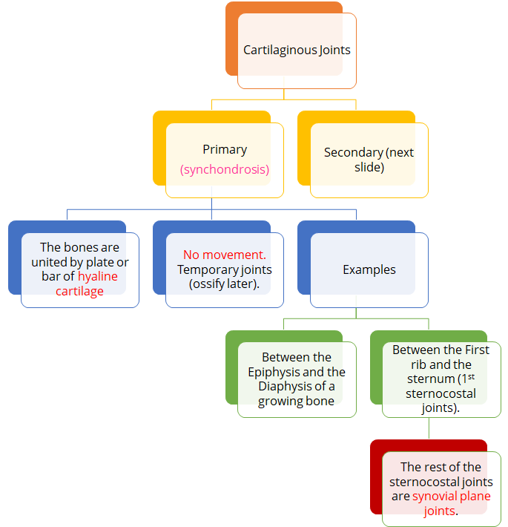
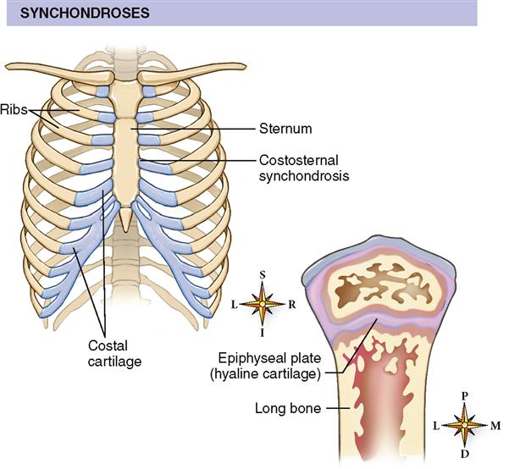
CARTILAGINOUS JOINTS
The two bones are joined by cartilage and is of two types:

Slide 6
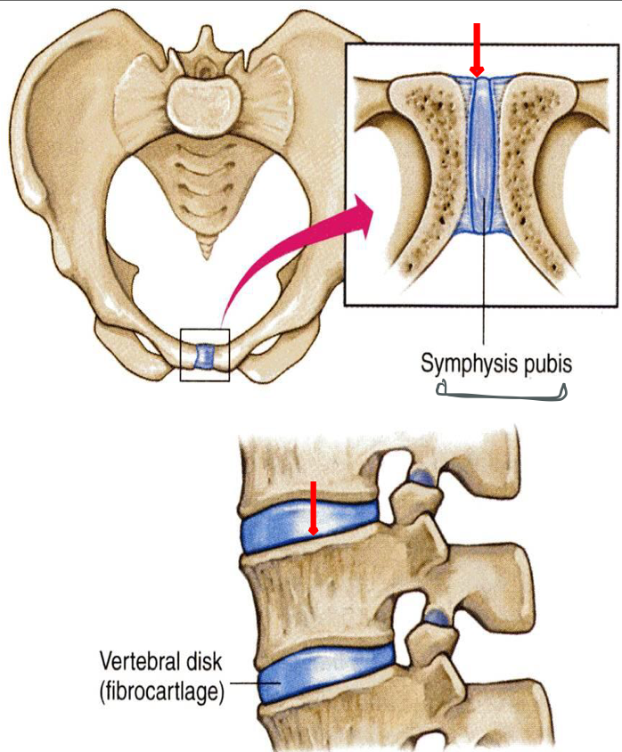
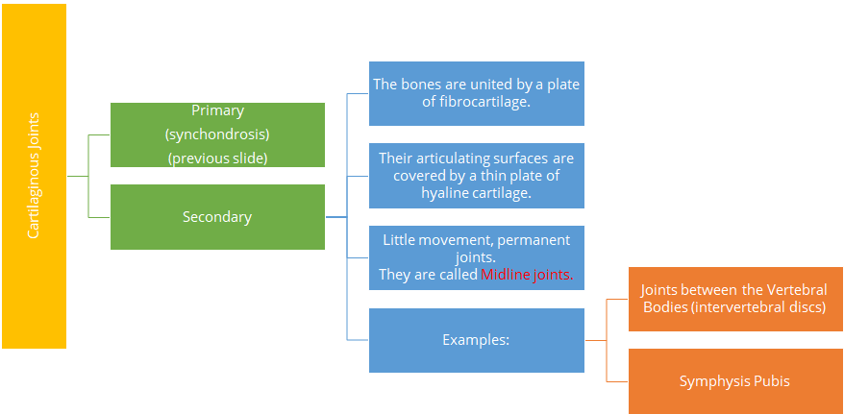
CARTILAGINOUS JOINTS

Slide 7
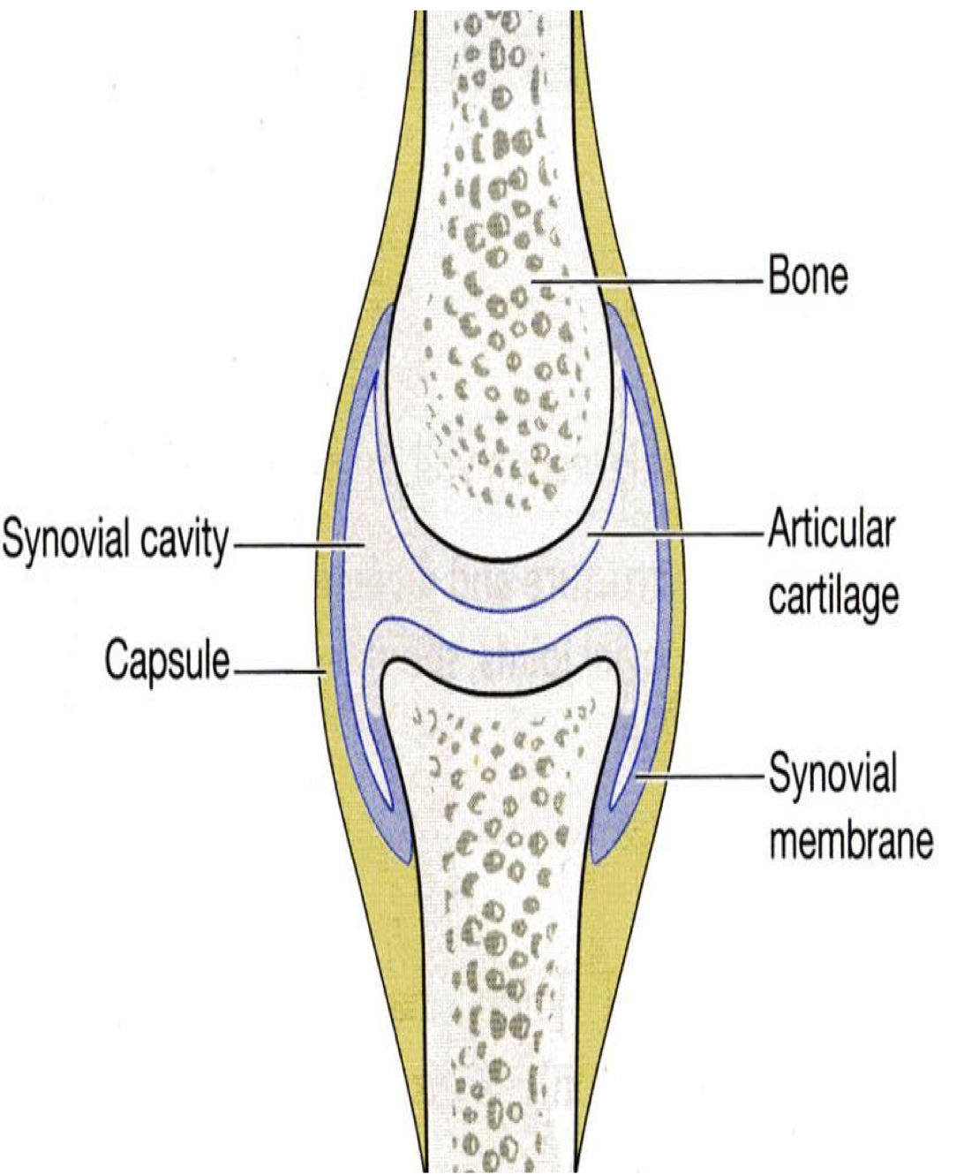
Synovial joints
The articular surfaces are covered by a thin layer of hyaline cartilage (articular cartilage).
Characteristic features
Freely movable joints
A joint cavity enclosed within the capsule.
The bones are joined by a fibrous capsule, which is attached to the margins of articular surfaces and enclosing the joints.

Slide 8
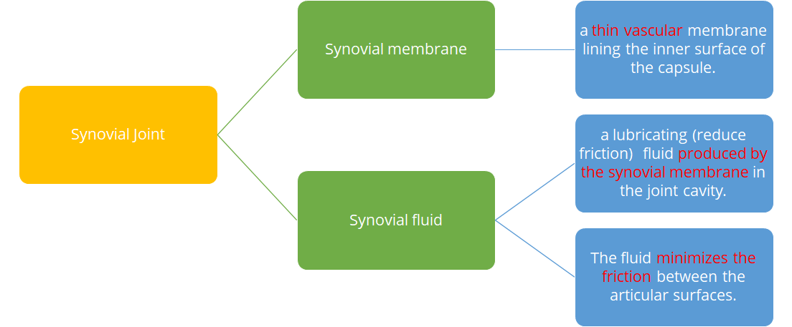
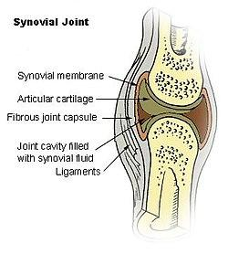
Synovial joints

Slide 9
CLASSIFICATION OF SYNOVIAL JOINTS
The arrangement of the articular surfaces
Classification according to
Plane synovial joints.
The range of movement that are possible
Axial synovial joints.
فيديو توضيحي
Uniaxial
Biaxial
Multi-axial

Slide 10
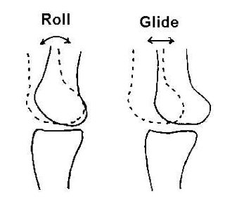
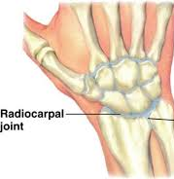
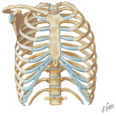
Plane synovial joints (gliding joints)
The articulating surfaces are flat, and the bones slide on one another, producing a gliding movement.
Intercarpal joint
Intercarpal joint
Examples
sternoclavicular joint
acromioclavicular joint
between the 2nd-7th sternocostals

Slide 11
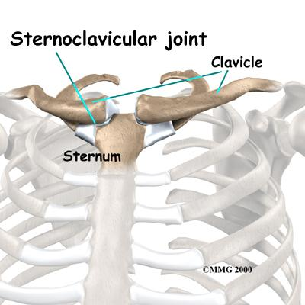
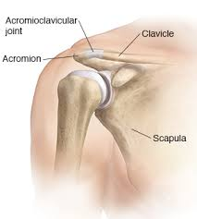

Slide 12
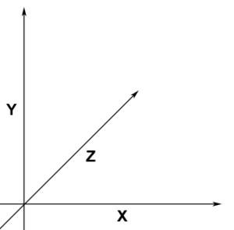
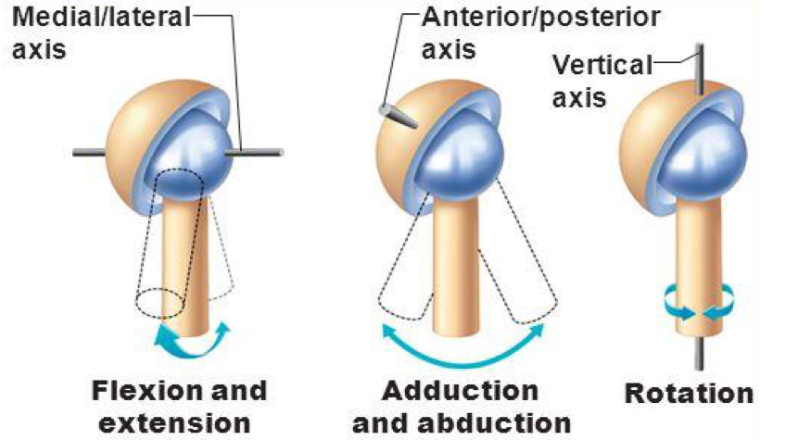
Axial synovial joints
1- Transverse (x-axis): flexion & extension occur. ex: elbow.
Movements occur ALONG an AXIS*
2- Longitudinal(y-axis): rotation occurs. (supination + pronation)
3- Antero-posterior(z-axis): abduction & adduction occur.
*an imaginary line about which a body rotates.
1. Uniaxial
Axial joints are divided into:
2. Biaxial
3. Multi-axial (polyaxial).

Slide 13
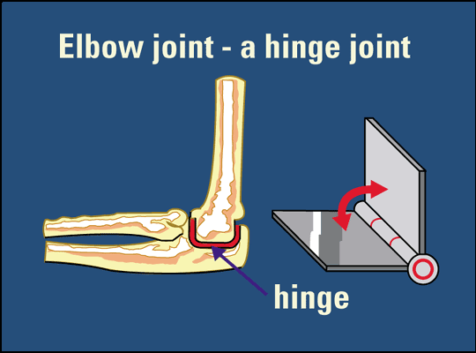
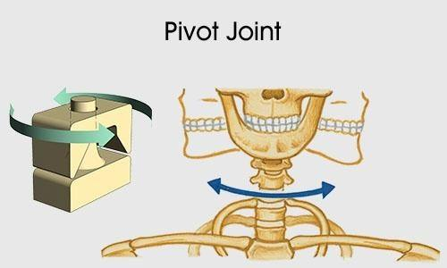
Uniaxial Synovial Joints
Important!!!
Hinge Joint
Axis: Transverse*
Movements: Flexion & Extension
Dorsiflexion & Plantarflexion
Examples: Elbow and ankle joints
Pivot Joint
Axis: Longitudinal*
Movements: Rotation
Examples: Radio-ulnar & atlanto-axial joints
*Transverse: محور بالعرض يعني راح تكون الموفمنت على فوق وتحت
*Longitudinal: محور طولي يعني راح تكون الموفمنت يمين ويسار (دوران)
Remember: The atlanto-axial joints allows you to say NO (Extensive Rotation)

Slide 14
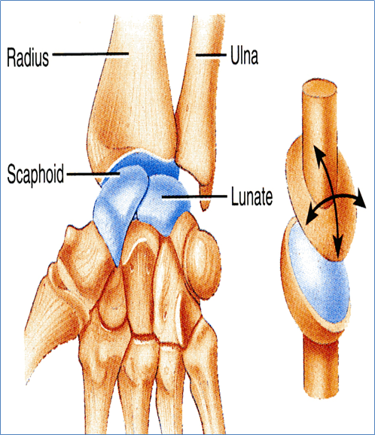
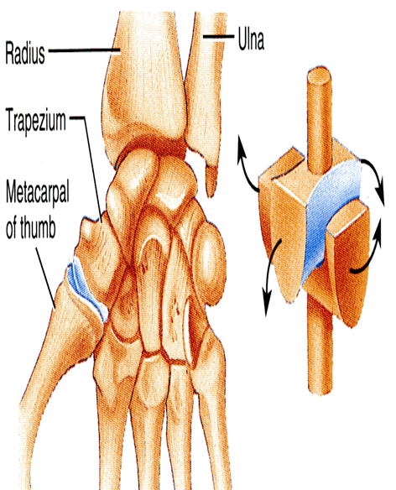
Biaxial Synovial Joints
Ellipsoid Joint
- An elliptical convex fits into an elliptical concave articular surfaces.
Axises: Transverse & Antero-posterior
Movement: Flexion & extension + abduction & adduction but rotation is impossible
Example: Wrist Joint
Saddle Joint
- The articular surfaces are reciprocally concavoconvex (resemble a saddle on a horse’s back.)
Axis: Transverse & antero-posterior + Longitudinal (limited)
Movement: Like Ellipsoid + small range of rotation
Example: Carpometacarpal joint of the thumb

Slide 15
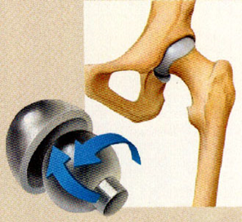
Polyaxial Synovial Joints
Ball and Socket joint
- A ball–shaped head of a bone fits into a socket-like concavity of another
Axis: All axes
Movement: Flexion & extension + abduction & adduction + rotation along a separate axis (all types of movements)
Examples: the only 2 examples
Shoulder joint
Hip joint

Slide 16
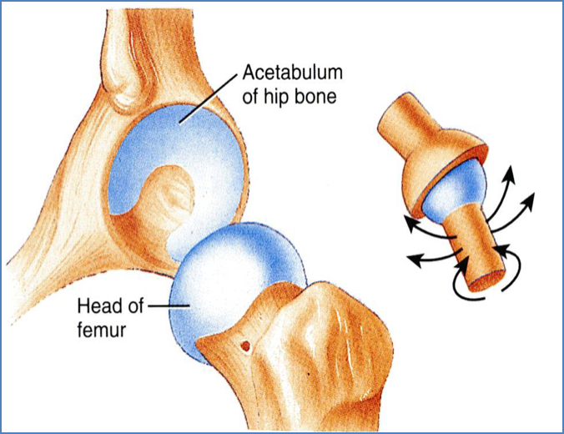
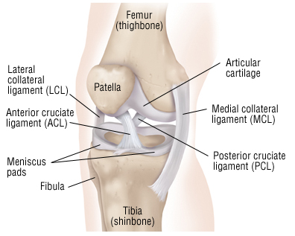
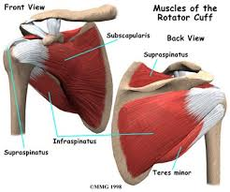
Stability of synovial joint
It depends on :
1-The shape of articular surface
2-Strength of the ligaments
3-Tone of the surroundings muscles
-ex:The ball and socket shape of the hip joint is a good examples of the importance of bone shape to maintain joint stability.
-The hip joint is more stable than the shoulder joint because the hip has deep concavity that
gives more support than the shoulder which is shallowly concave and needs more support into it.-Team436-
-The shape of the bones forming the knee joint has nothing to do for stability.
-ex: cruciate ligaments of the knee joint
-They prevent excessive movement in a joint.
-Iliofemoral ligament prevents hyperextension in hip joint.
-In most joints, it’s the major factor controlling stability.
-ex:The short muscles (rotator cuff muscles) around the shoulder joint
-keeps the head of the humerus in the shallow glenoid cavity.
Note:the muscle does not have to be contracted the tone is enough to stabilize the joint. -team436-

Slide 17
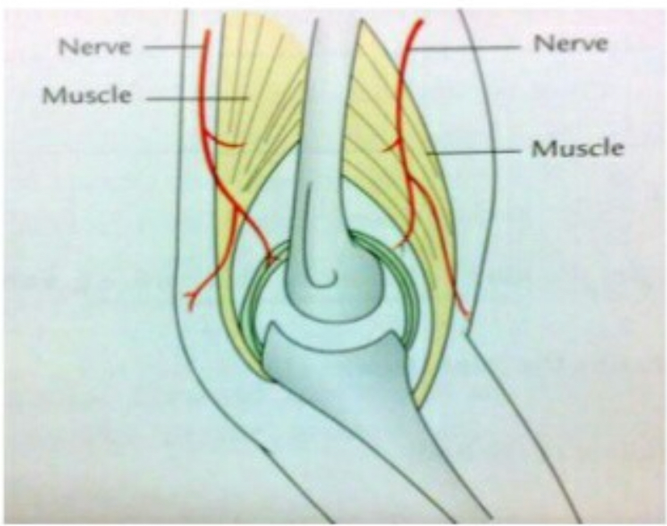
Nerve supply of joints
The capsule and ligaments receive an abundant sensory nerve supply.
HILTON’S LAW: A sensory nerve supplying a joint also supplies the muscles moving that joint and the skin overlying the insertions of these muscles

Slide 18
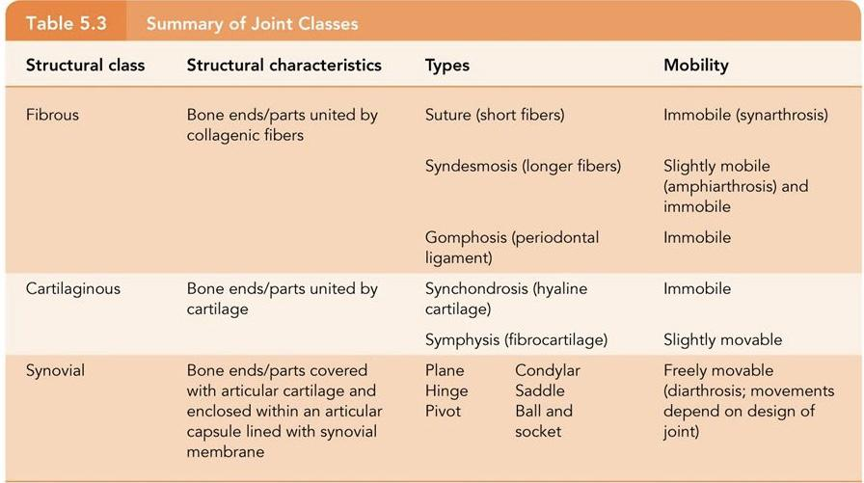
Summary

Slide 19
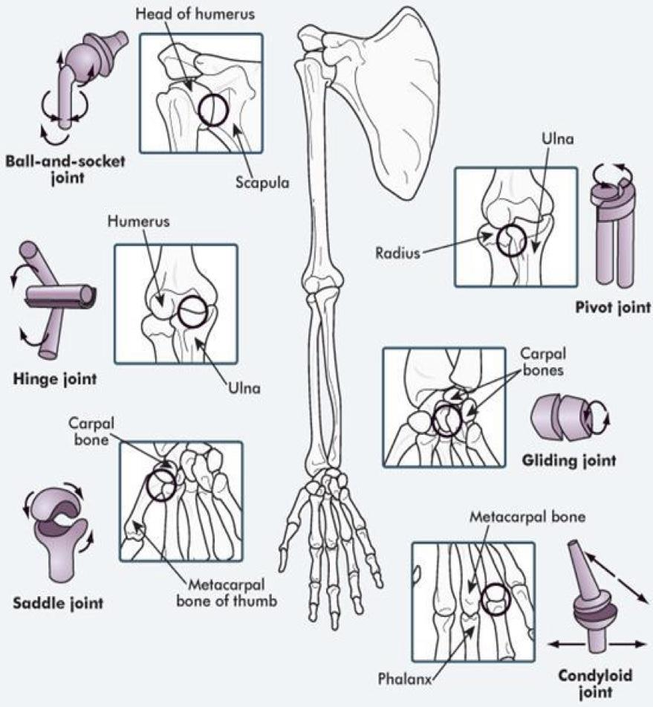
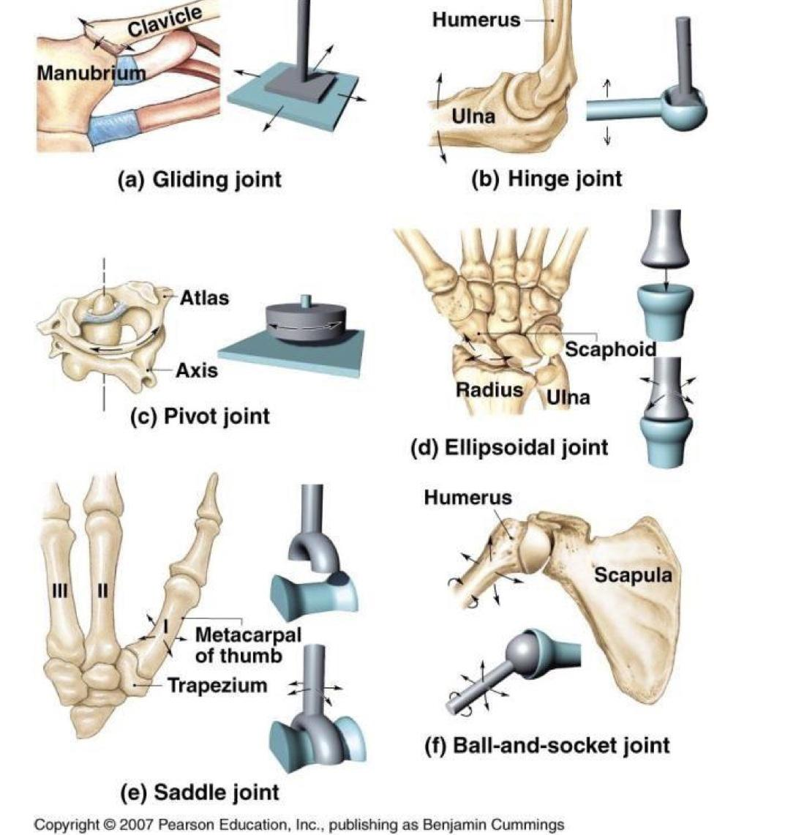
Summary
Team 436

Slide 20
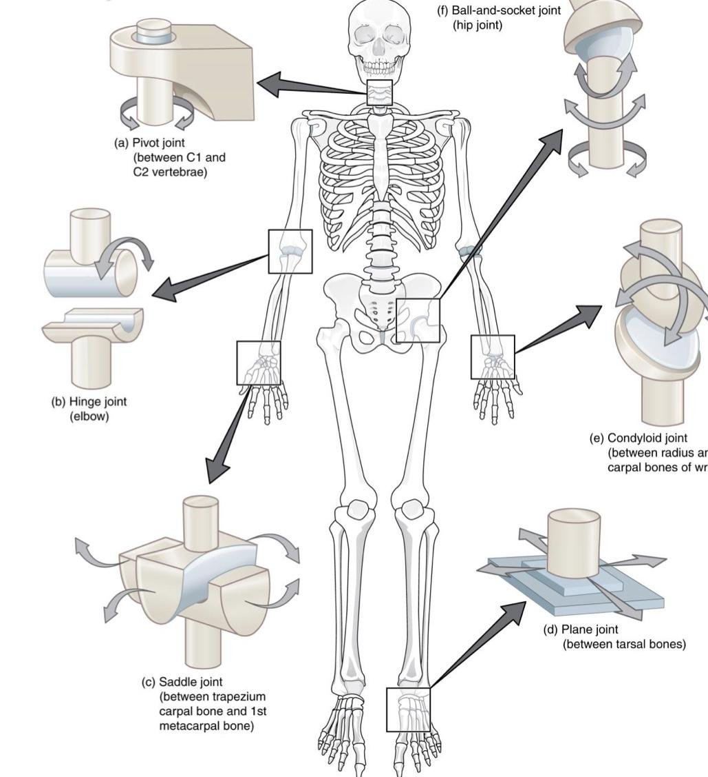
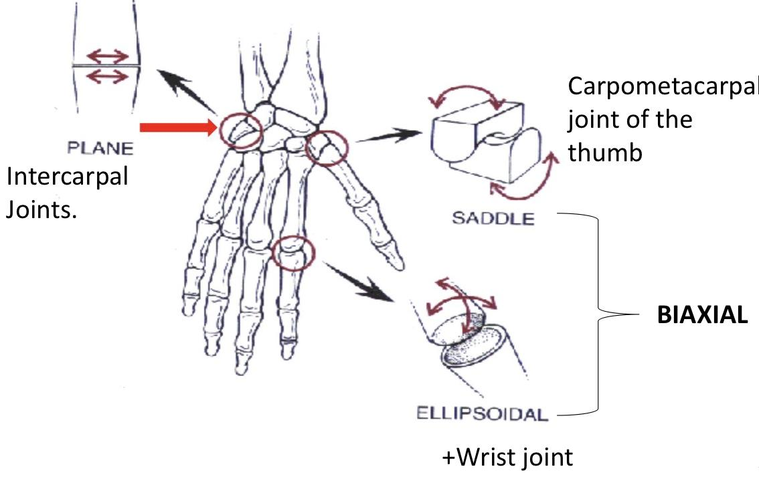
Summary
Team 436

Slide 21
Questions
1- the intercarpal joints is an example for:
A- axial. B-biaxial. C- poly-axis. D- plane synovial
2- Wrist is an example of a synovial joint known as
A- Hinge synovial joint B- Pivot synovial joint C- Ellipsoid synovial joint
3- hilton’s law: a sensory nerve supplying a joint also supplies …… related to that joint
A- the muscles B- the skin. C- the muscles and the skin D- none of these
4. The type of the 1st sternocostal joint is:
A- Synchondrosis B- Secondary Cartilaginous C- Synovial joint D- Fibrous joint
5- which one ot the following is an example of a fibrous joint:
A- syndesmosis B- epiphyseal plate C- symphsis pubis. D- intervertbral discs
6- Antero-posterior axis is responsible for:
A- flexion. B- rotation. C- abduction. D- extension.
Answers: 1)D 2)C 3)C 4)A 5)A 6)C

Slide 22
Team Members
Faisal Fahad Alsaif (Team Leader) Abdulaziz Al dukhayel ‏Fahad Alfaiz ‏Akram Alfandi ‏Saad Aloqile ‏Saleh Almoaiqel ‏Abdulaziz Alabdulkareem ‏Abdullah Almeaither ‏Yazeed Aldossari ‏Muath Alhumood Abdulrahman Almotairi
‏
Abdulelah Aldossari ‏Abdulrahman Alduhayyim ‏Abdullah AlOmar
Hamdan Aldossari ‏Mohammed Alomar ‏Abdulrahman Aldawood ‏Saud Alghufaily ‏Hassan Aloraini Khalid Almutairi‏‏
Lamia Abdullah Alkuwaiz (Team Leader)
Rawan Mohammad Alharbi
Abeer Alabduljabbar Afnan Abdulaziz Almustafa Ahad Algrain Alanoud Almansour Albandari Alshaye AlFhadah abdullah alsaleem Arwa Alzahrani Dana Abdulaziz Alrasheed Dimah Khalid Alaraifi Ghada Alhaidari Ghada Almuhanna Ghaida Alsanad Hadeel Khalid Awartani Haifa Alessa Khulood Alwehabi Layan Hassan Alwatban Lojain Azizalrahman Lujain Tariq AlZaid
Maha Barakah Majd Khalid AlBarrak Norah Alharbi Nouf Alotaibi Noura Mohammed Alothaim Rahaf Turki Alshammari Reham Alhalabi Rinad Musaed Alghoraiby Sara Alsultan Shahad Alzahrani Wafa Alotaibi Wejdan Fahad Albadrani Wjdan AlShamry
Abdulmajeed Alwardi ‏Abdulrahman Alageel ‏Rayyan Almousa ‏Sultan Alfuhaid ‏Ali Alammari ‏Fahad alshughaithry Fayez Ghiyath Aldarsouni ‏Mohammed Alquwayfili ‏‏Abduljabbar Al-yamani ‏Sultan Al-nasser ‏Majed Aljohani ‏Zeyad Al-khenaizan ‏Mohammed Nouri ‏Abdulaziz Al-drgam ‏Fahad Aldhowaihy ‏Omar alyabis

