Slide 1
Vascular Anatomy of the Upper Limbs
Lecture 12
Please check our Editing File.
هذا العمل لا يغني عن المصدر الأساسي للمذاكرة
{وَمَنْ يَتَوَكَّلْ عَلَى اللَّهِ فَهُوَ حَسْبُهُ}

Slide 2
Objectives
Identify the origin of the vascular supply for the upper limb.
Describe the main arteries and their branches of the arm, forearm & hand.
Describe the vascular arches for the hand.
Describe the superficial and deep veins of the upper limb
Text in BLUE was found only in the boys’ slides
Text in PINK was found only in the girls’ slides
Text in RED is considered important
Text in GREY is considered extra notes

Slide 3
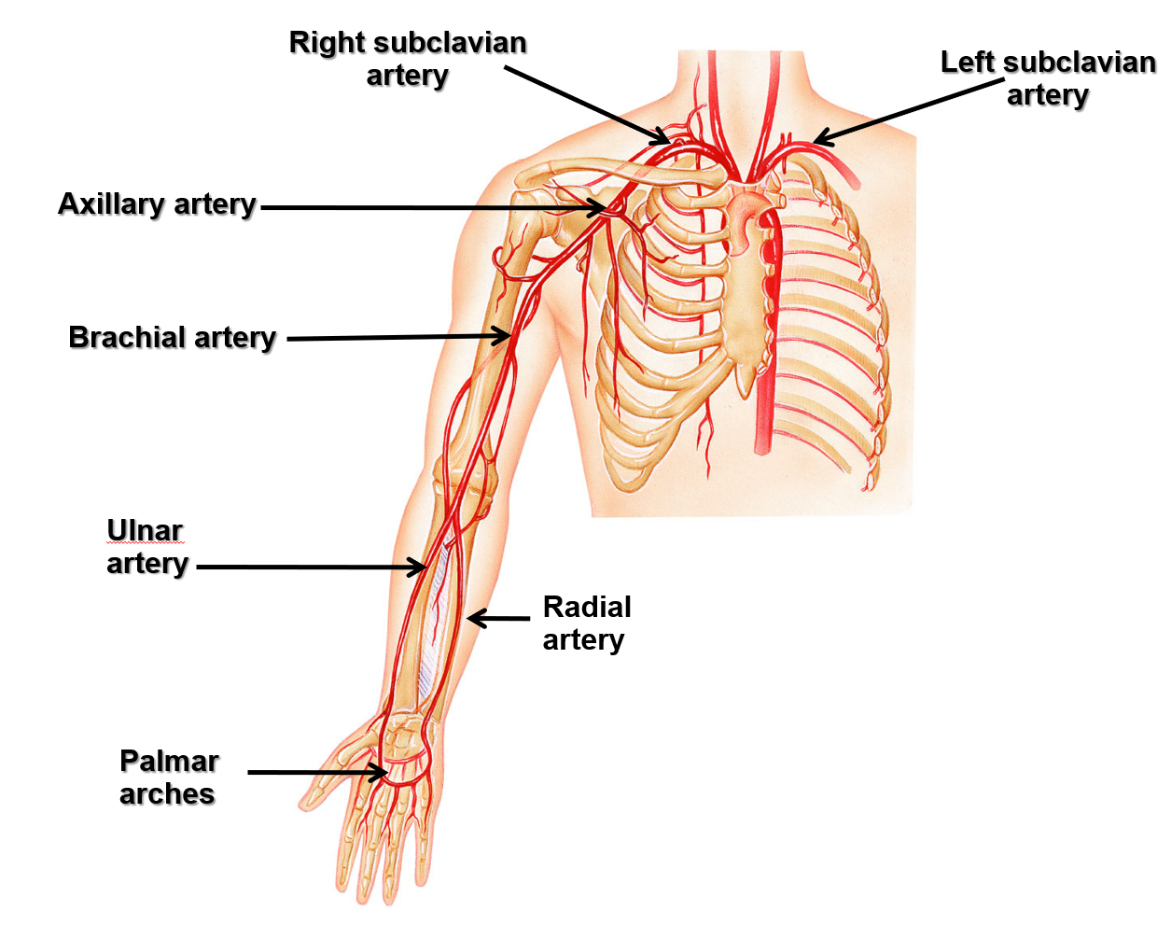
Arteries Of The Upper Limb

Slide 4
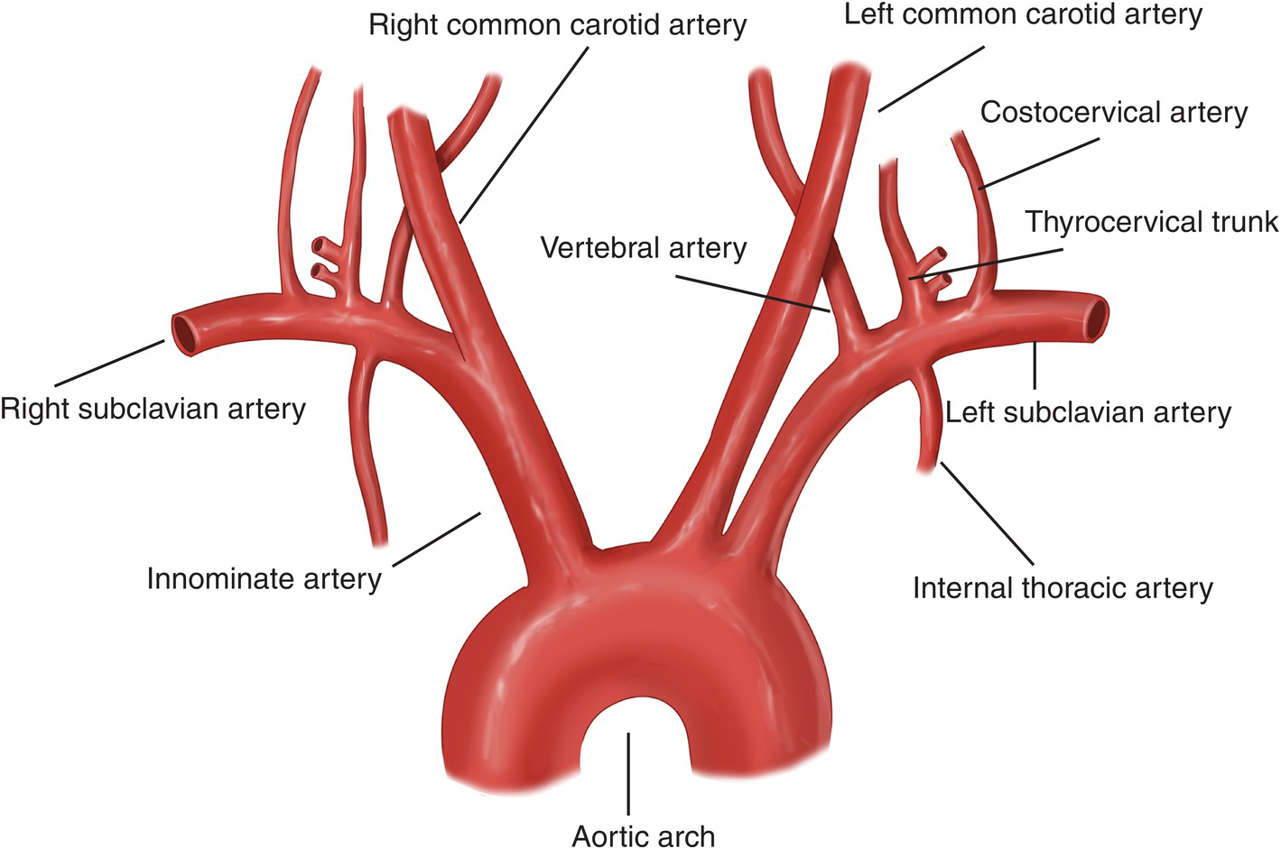
The Subclavian Artery
The right subclavian artery originates from the brachiocephalic artery (AKA Innominate artery). (originates from a branch of the aorta)
The left subclavian artery originates from the arch of the aorta. (originates directly from the aorta)
Continues as the Axillary artery at the lateral border of the 1st rib (بدايته)

Slide 5
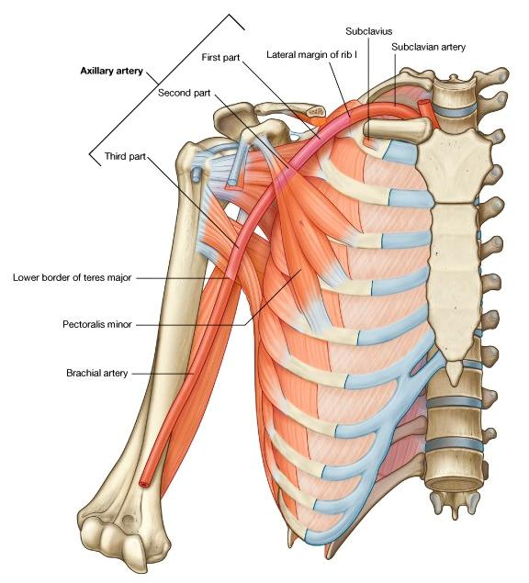
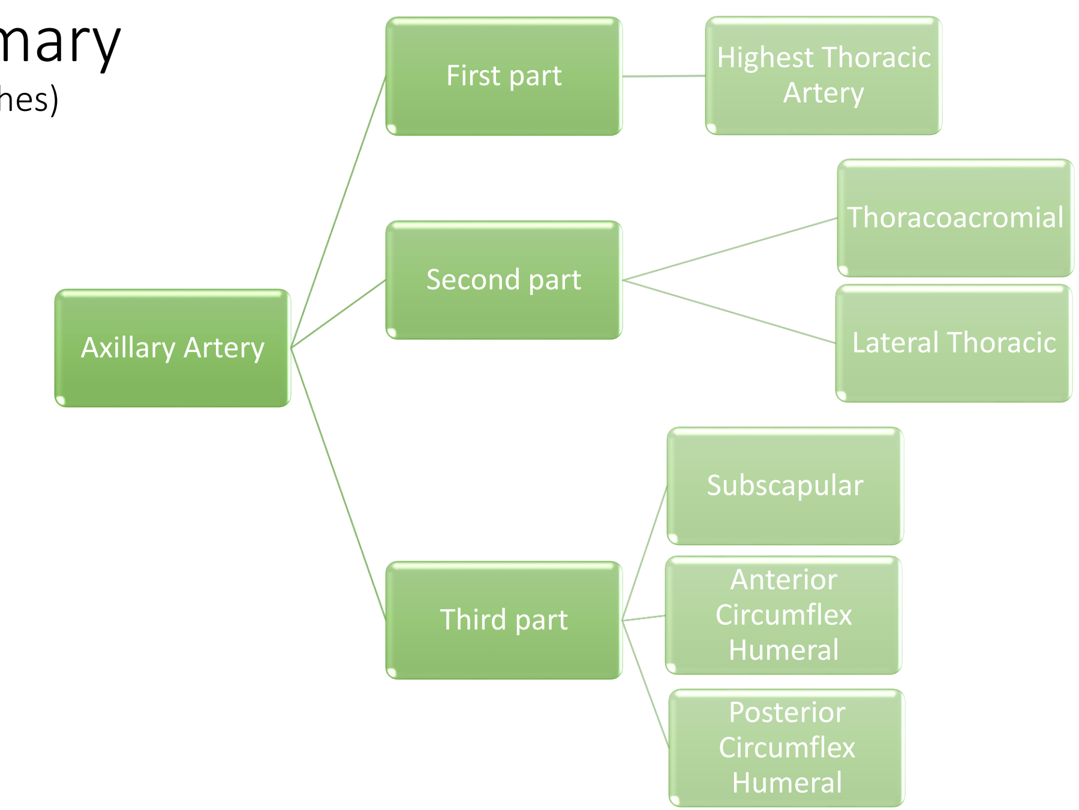
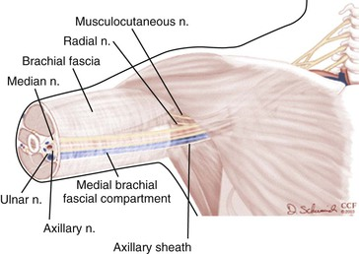
The Axillary Artery
Begins at the lateral border of the 1st rib as continuation of the subclavian artery
Continues as brachial artery at lower border of teres major
It is closely related to the cords of brachial plexus and their branches
Is enclosed within the axillary sheath.
It is crossed anteriorly by the pectoralis minor and is divided into three parts; 1st (above), 2nd (behind) & 3rd (below).
Diagram from team 436:

Slide 6
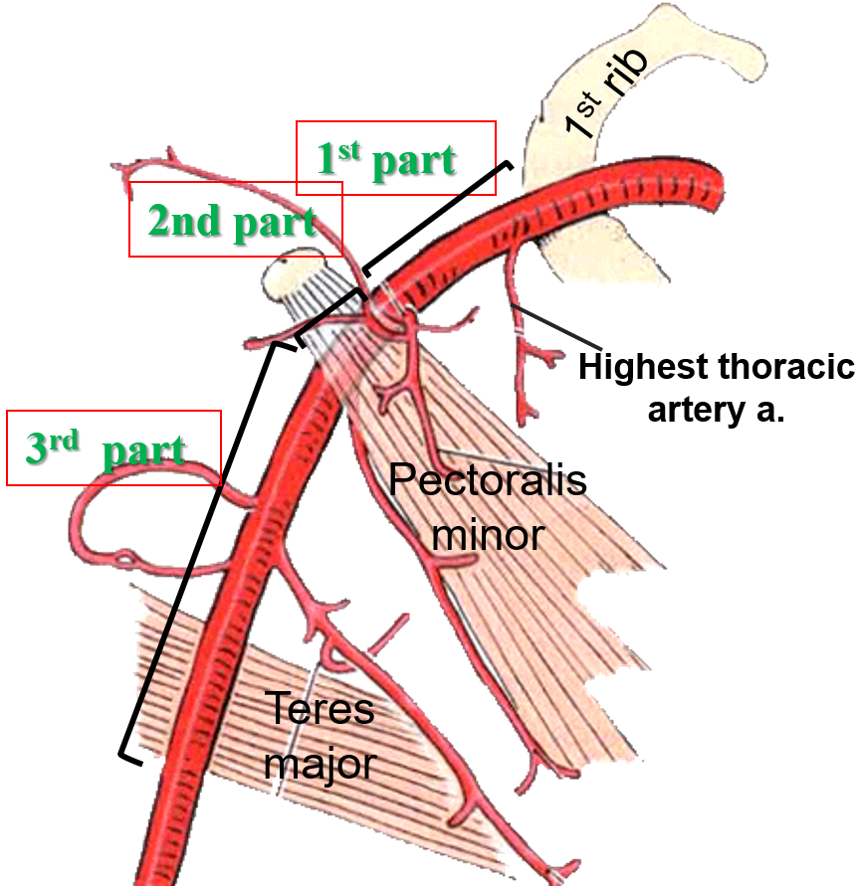
The 1st part of the axillary artery
Extends from the lateral border of 1st rib to the upper border of the pectoralis minor muscle.
Related:
Anteriorly: to the pectoralis major muscle
Laterally: to the cords of the brachial plexus.
It gives ONE branch: Highest thoracic artery
1st part 1 branch
2nd part 2 branches
3rd part 3 branches

Slide 7
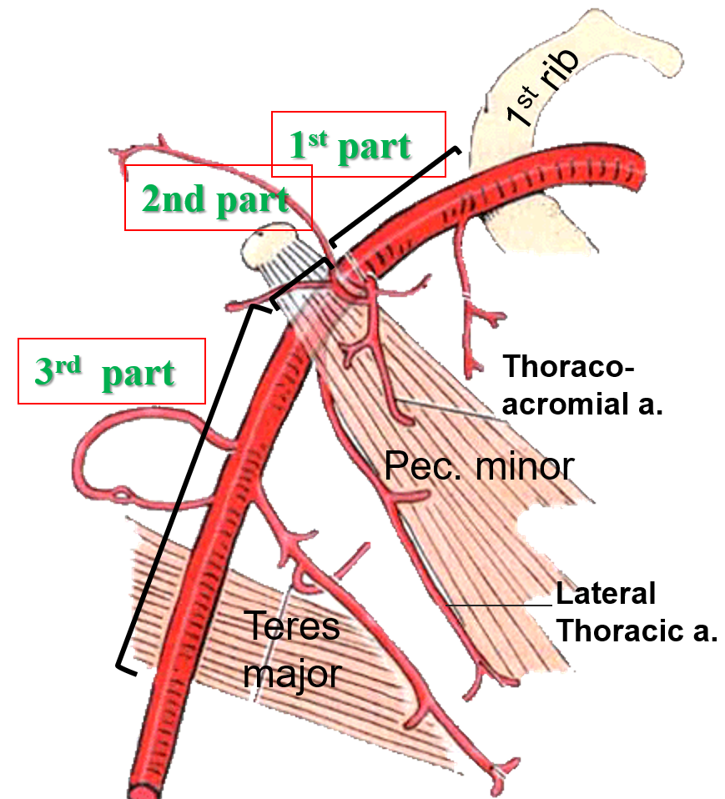
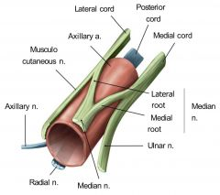
The 2nd part of the axillary artery
Lies behind the pectoralis minor muscle.
It is surrounded medially, laterally, and posteriorly by the corresponding cord of the brachial plexus.
It gives; TWO branches:
Thoracoacromial
Lateral thoracic

Slide 8
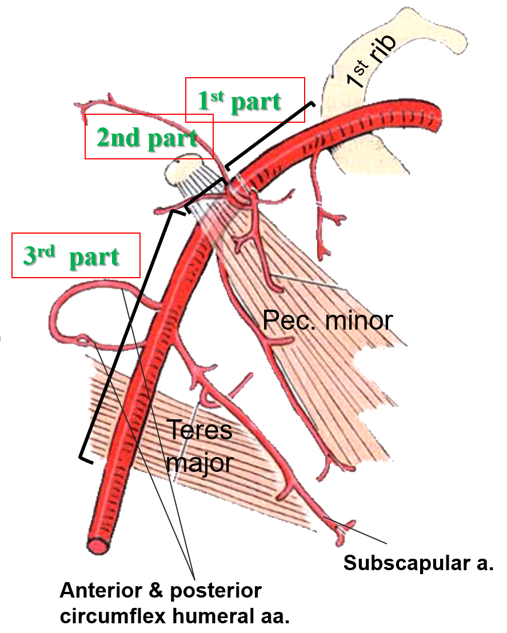
The 3rd part of the axillary artery
Extends from the lower border of pectoralis minor muscle to the lower border of the teres major muscle.
It is surrounded medially, laterally, and posteriorly by the branches (not cords themselves) of the cords of the brachial plexus
It gives; THREE Branches:
Subscapular
Anterior circumflex humeral (الاصغر)
Posterior circumflex humeral. (الاكبر)
Around the surgical neck of humerus

Slide 9
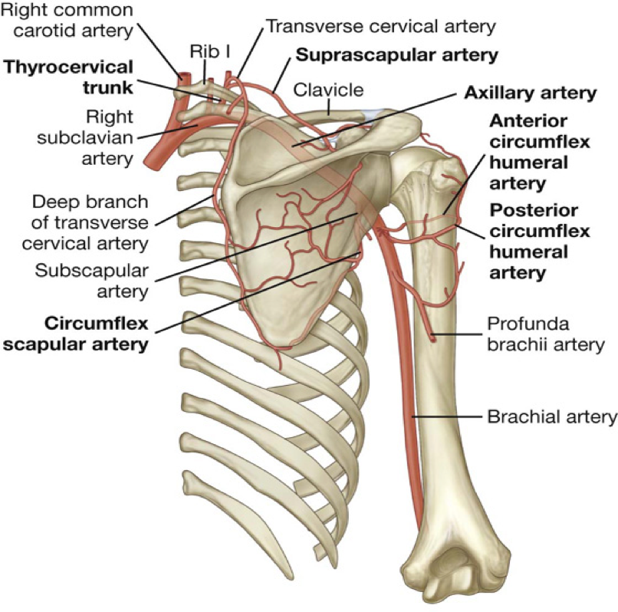
Anastomosis
Anastomosis occurs between branches of Subclavian and Axillary arteries:
From Girls’ lecture only
around Shoulder joint (SCAPULA)
The scapula moves all the time so it needs rich supply
Branches from Subclavian Artery:
1-Suprascapular artery
2-Transverse cervical artery
1-Subscapular artery
2-Posterior circumflex humeral artery
3-Anterior circumflex humeral artery
Branches from Axillary Artery:
Anastomosis around the surgical neck of humerus

Slide 10
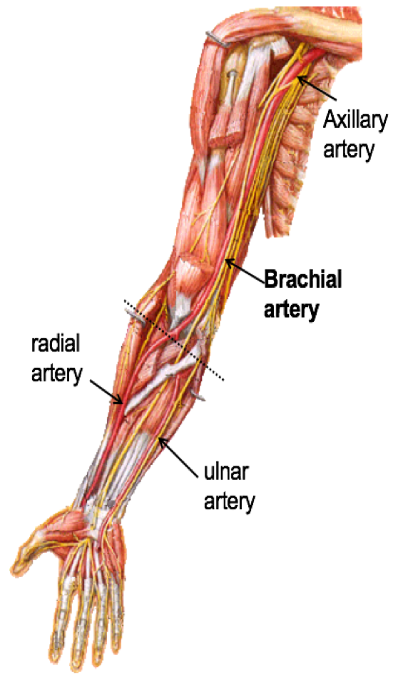
The Brachial Artery:
coracobrachialis
Provides main arterial supply to the arm.
Is a continuation of the axillary artery at the lower border of teres major muscle.
Terminates opposite Neck of Radius by dividing into Radial & Ulnar arteries. (In the cubital fossa)
Biceps
Brachialis
Median N.
Relations of brachial artery:
Anteriorly: crossed from above downward by medial cutaneous nerve of the forearm, median nerve, and bicipital aponeurosis.
Posteriorly: triceps, coracobrachialis and brachialis.
Medially: basilic vein, ulnar and median nerves.
Laterally: coracobrachialis and biceps muscles.
Ulnar N.

Slide 11
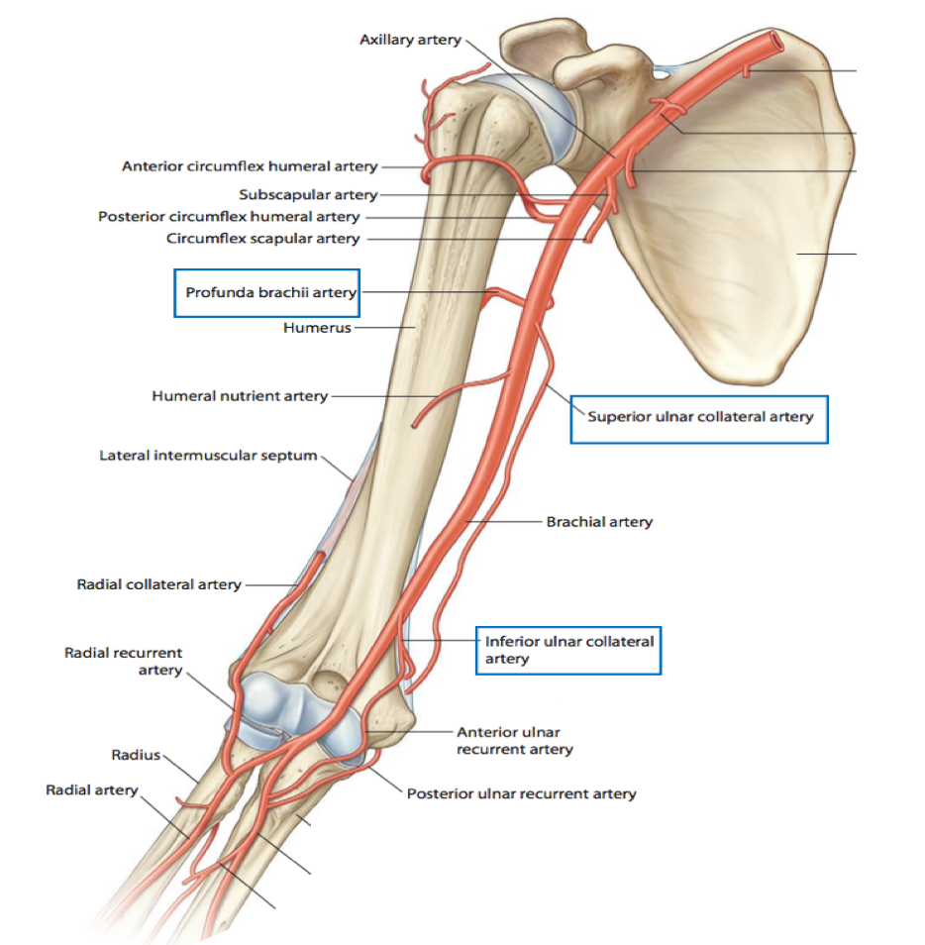
Branches of Brachial Artery
O Muscular.
O Nutrient to humerus.
O Profunda brachii (along with the radial nerve in the spiral groove)
O Superior ulnar collateral. (front of medial epicondyle)
O Inferior ulnar collateral.(back of medial epicondyle)
-Collateral means it branches towards the lateral side

Slide 12
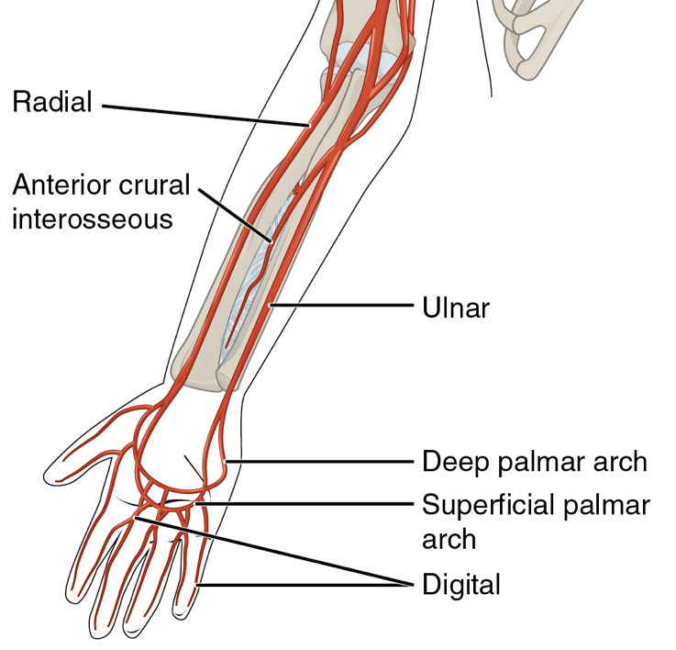
The Ulnar Artery
•The larger of the two terminal branches of the brachial artery. (Larger than the radial artery)
•Begins in the cubital fossa at the level of the neck of the radius.
•Descends through the anterior compartment of the forearm (lateral to the ulnar nerve)
•Enters the palm, in front of the flexor retinaculum, with the ulnar nerve.(doesn't enter the carpal tunnel)
•Ends by forming the superficial palmar arch, by anastomosing with superficial palmar branch of radial artery.
•The radial artery is small but superficial so we can feel its pulse, while the ulnar artery is big but deep so we can’t feel its pulse. (Team 436)

Slide 13
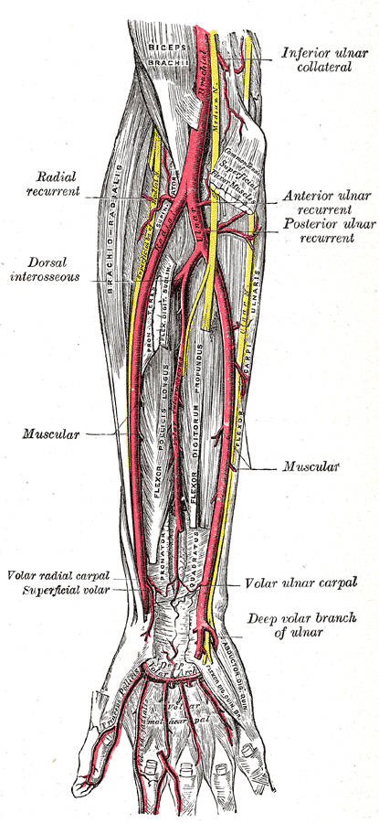
Branches of Ulnar Artery
•Muscular.
1- Recurrent branch (for anastomosis around the elbow joint). Around the medial epicondyle, to anastomose with the inferior and superior ulnar collateral arteries
2- Common Interosseous artery, which gives:
Anterior Interosseous artery
Posterior Interosseous artery
3- Branch to anastomoses around the wrist joint.
Ulnar Recurrent : branch of Ulnar Artery
ulnar collateral : branch of brachial Artery

Slide 14
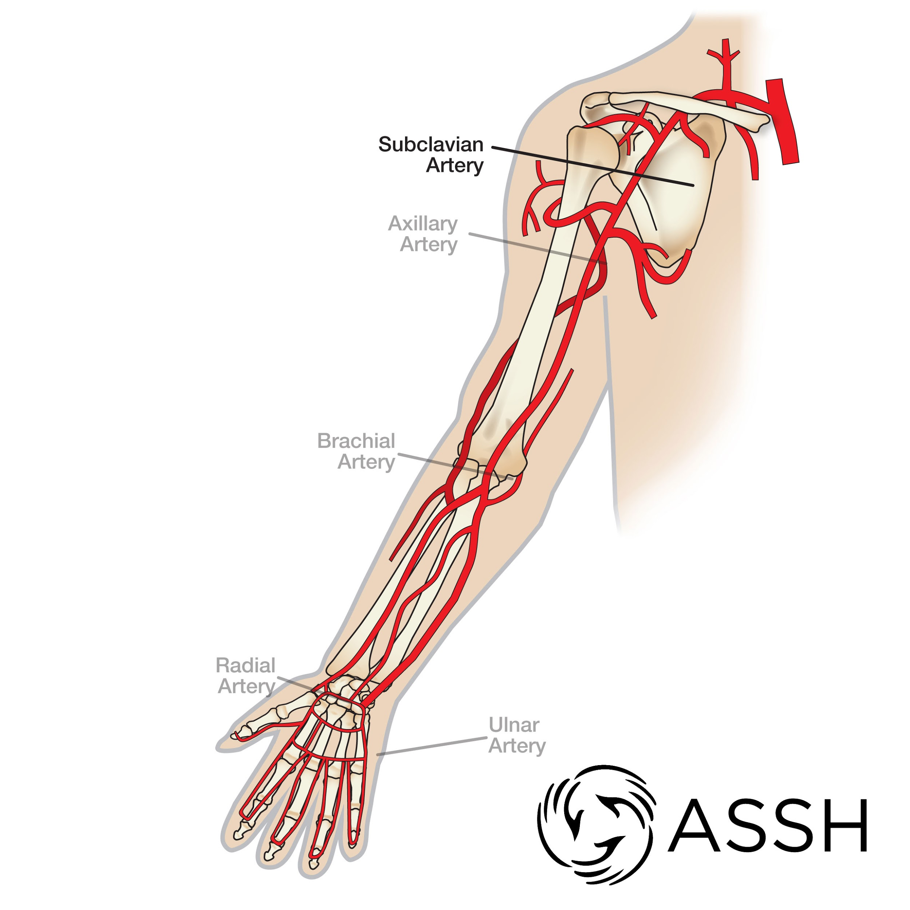
Radial Artery
•The smaller of the two terminal branches
of the brachial artery.(smaller than the ulnar artery)
•Begins in the cubital fossa at the level
(In front) of neck of radius.
•Descends downward and laterally
•Leaves the forearm by winding around
the lateral aspect of the wrist to reach
the dorsum of the hand through
anatomical snuff box.

Slide 15
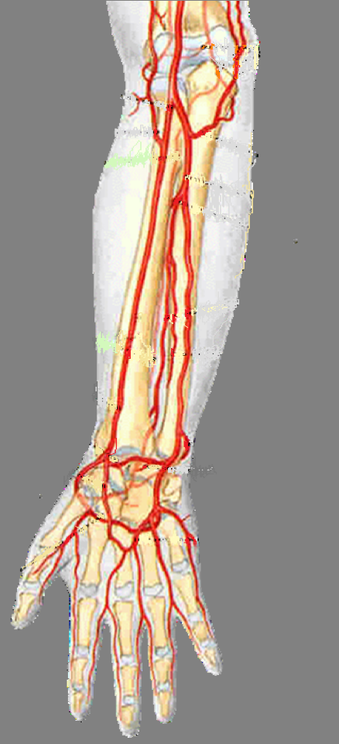
Branches of Radial Artery
• Muscular
• Recurrent branch for anastomosis around
the elbow joint. (Lateral epicondyle)
•Superficial palmar branch, joins the
ulnar artery to form the Superficial
Palmar arch. (90% ulnar , 10% radial)
Deep arch is the opposite, most of it is radial.

Slide 16
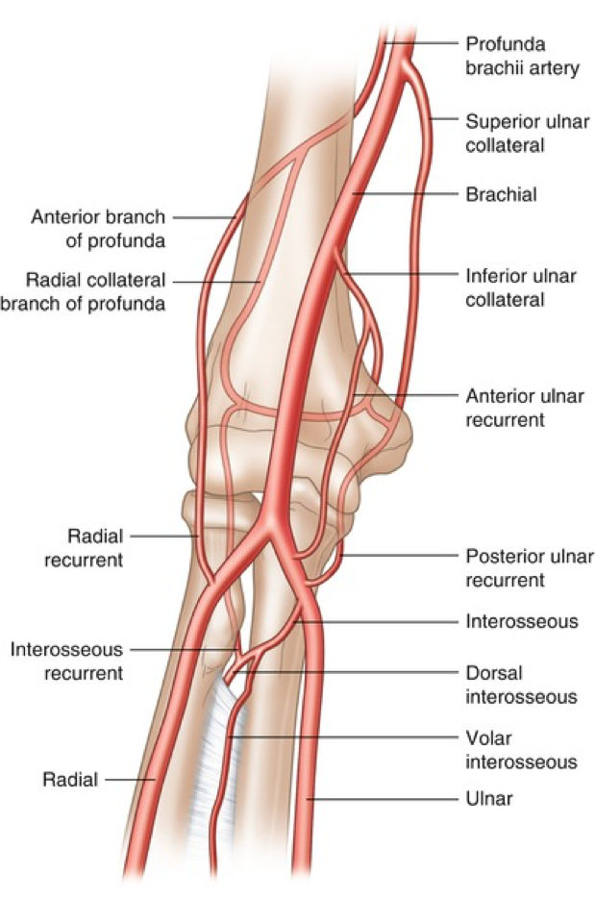
Anastomosis around elbow joint
From Girls’ lecture only
•Anastomosis occurs between branches of
•Branches from Brachial Artery: 1-Profunda Brachii artery 2-Superior ulnar collateral artery 3-Inferior ulnar collateral artery •Branches from Ulnar and Radial Arteries: 1-Radial & ulnar recurrent arteries 2-posterior Interosseous recurrent artery (from ulnar)
brachial, radial and ulnar arteries.

Slide 17
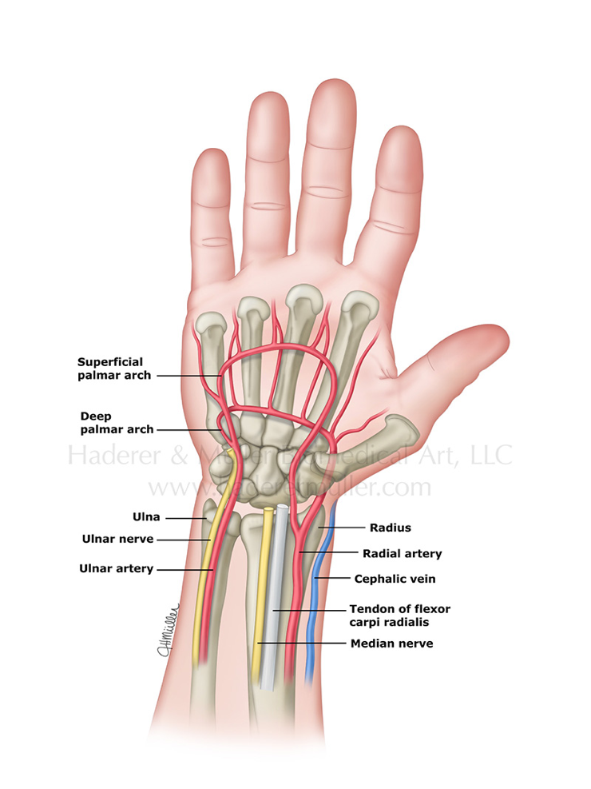
Arteries of the palm
Ulnar artery:
Enters the hand:
- anterior to the flexor retinaculum,
- on the lateral side of the ulnar nerve and pisiform
bone.
•Gives a deep branch.
•Continue as the superficial palmar arch.

Slide 18
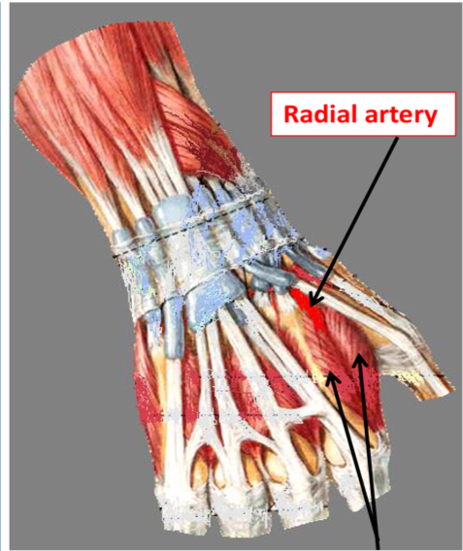
Arteries of the palm
Radial artery:
•Leaves dorsum of the hand by turning forward
between the proximal ends of the 1st and 2nd
metacarpal bones, and between two heads of
the 1st dorsal interosseous muscle.
•On entering the palm it continues as the deep palmar arch.
•It gives; arteria radialis indicis and arteria princeps pollicis.
(lateral side of the index) (to the thumb)
(This place is called the anatomical snuff box)
1st dorsal interosseous muscle
(between thumb and index)
The digits have arterial supply from the superficial palmar arch except the thumb and the lateral side of the index which are supplied by the radial artery

Slide 19
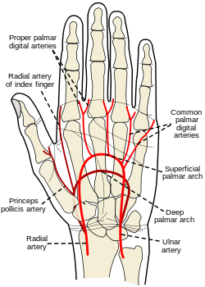
The superficial palmar arch
• Is the direct continuation of the ulnar artery, as it
curves laterally behind the palmar aponeurosis. It comes from the medial side and curves laterally
• Is completed by a branch from the radial artery.
• Lies approximately at the level of the distal border
of the extended thumb.
• Gives digital arteries from its convexity to supply
the finger
• The superficial palmar arch is more distal than the deep palmar arch (very important, had its own slide)

Slide 20
The deep palmar arch
• Is a continuation of the radial artery as it curves
medially beneath long flexor tendons, in front of
the metacarpal bones and interosseous muscles.
• Is completed on the medial side by the deep branch of
the ulnar artery
• Lies at the level of the proximal border of extended thumb
• It sends branch: -Superiorly to share in anastomosis around the wrist joints.
-Inferiorly to join branches of the superficial palmar arch.

Slide 21
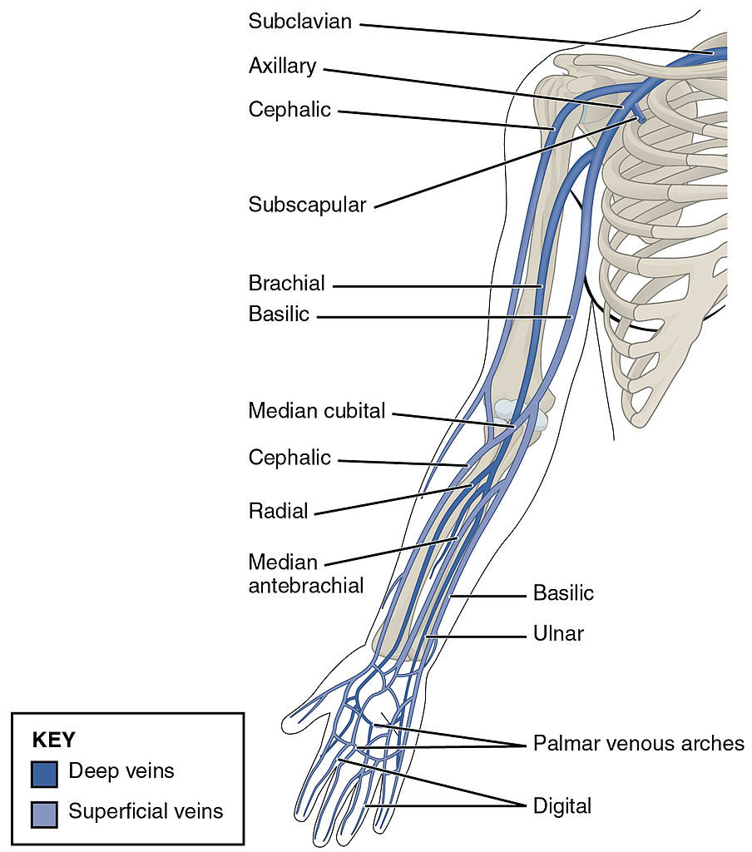
Veins of the Upper Limb
The veins of the upper limb are divided into two sets: Superficial and Deep
• The two sets anastomose frequently with each other.
• The superficial veins are placed immediately beneath the skin, in the superficial fascia.
• The deep veins (الأوردة المصاحبة ) accompany the arteries, and constitute the venæ comitantes of those vessels.

Slide 22
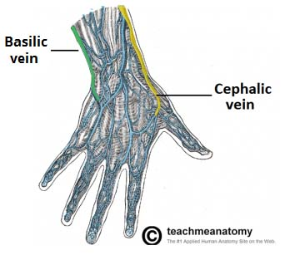
Superficial Veins of the Upper Limb
Dorsal Venous Arch (network)
The dorsal digital veins drain into dorsal metacarpal veins, which unite to form a dorsal venous arch or network.
▪ Dorsal venous network lies on the dorsum of the hand(ظاهر الكف ), in the subcutaneous tissue, proximal to the metacarpophalangeal joints
▪ Drains into the cephalic vein laterally, and basilic vein medially
Dorsal view

Slide 23
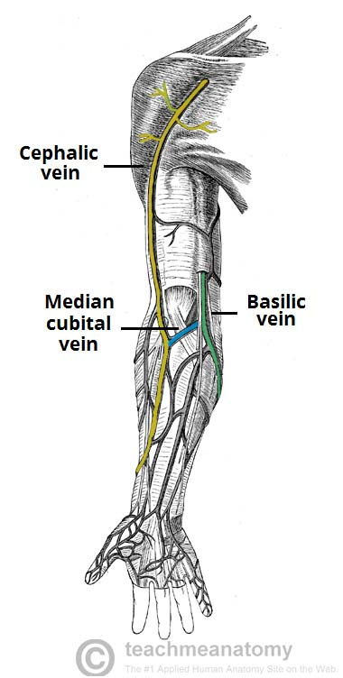
Cephalic Vein
Deltopectoral groove
Basilic Vein
Arises from the lateral end of the dorsal venous arch of hand.
Ascends on radial side of the forearm to the elbow and continues up the arm in the deltopectoral groove.
Pierces clavipectoral fascia to drain into the axillary vein.
(يخترق fascia عشان يفرغ الدم في axillary vein )
Arises from the medial side of the dorsal venous arch of hand.
Ascends on the ulnar side of forearm to the elbow ,
In the middle of the arm, it pierces the deep fascia and joins the brachial vein or axillary vein.
Basilic vein is nearer to the Body
Blood is always drained from superficial veins into deep veins
-Links cephalic vein and basilic vein in the cubital fossa.
-Is a frequent site for venipuncture(Vein of choice for IV injection)
-Carries most of cephalic blood to basilic vein
Median Cubital Vein

Slide 24
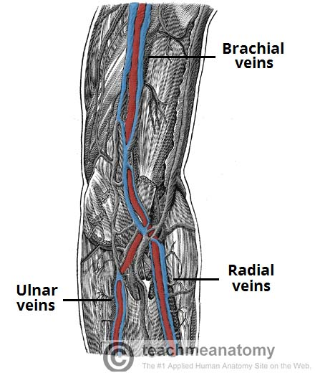
Deep Veins of the Upper Limb
Accompany the arteries of the same region and bear similar names.( مالها اسم خاص )
Venae comitantes: They are generally arranged in pairs, and are situated one on either side of the corresponding artery, and connected at intervals by short transverse branches.
The superficial and deep palmar arterial arches are each accompanied by a pair of venæ comitantes which constitute the superficial and deep palmar venous arches, and receive the veins corresponding to the branches of the arterial arches.
The deep veins of the forearm are the venæ comitantes of the radial and ulnar veins.
The brachial veins are placed one on either side of the brachial artery.
Recall what we took in foundation:

Slide 25
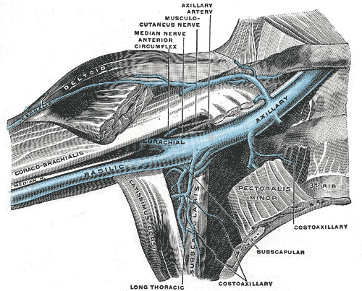
The axillary vein:
Begins at the lower border of the Teres major, as the continuation of the basilic vein.
Ends at the outer border of the first rib as the subclavian vein.
Receives the brachial veins and, close to its termination, the cephalic vein.
Opposite of axillary artery
The subclavian vein:
Is the continuation of the axillary vein.
Extends from the outer border of the first rib to the sternal end of the clavicle, where it unites with the internal jugular to form the brachiocephalic (innominate) vein.

Slide 26
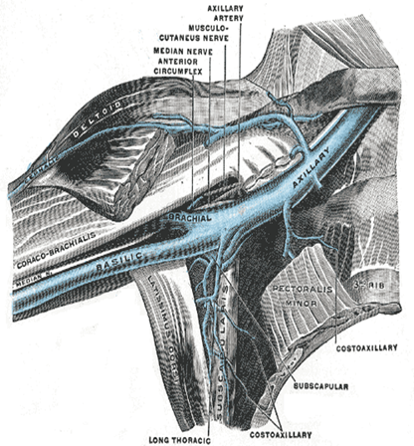
Anatomy of basilic and cephalic vein catheterization
Entire Slide from girls’ slides
The basilic vein is the vein of choice for central venous catheterization. (a flexible tube inserted through a narrow opening into a body cavity for removing fluid)
From the cubital fossa until reaching the axillary vein it: 1- increases in diameter (because it receives blood from the cephalic) 2- lies in direct line with the axillary vein.
Abduction of the arm (الوضعية المناسبة) will overcome the trouble caused by the valves in the axillary vein, and allows the catheter (أنبوب القسطرة) to move past (skip) the obstruction.
*The cephalic vein: 1- does not increase in size as it ascends (go up) in the arm 2- frequently divides into small branches (↓diameter=↓amount of blood ) 3- At it's termination it joins the axillary vein at right angle ,so it is difficult to maneuver the catheter around this angle.
*that’s why we don’t choose the cephalic.

Slide 27
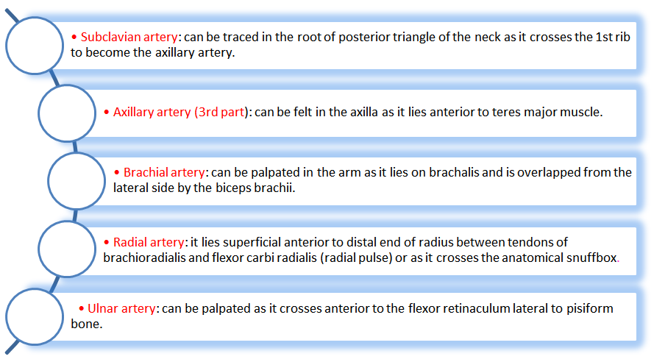
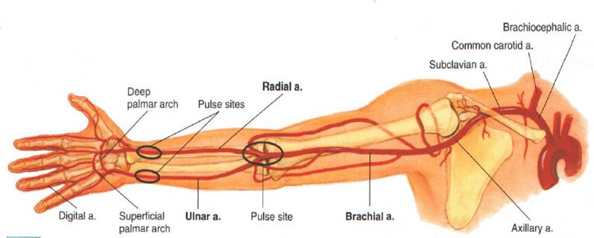
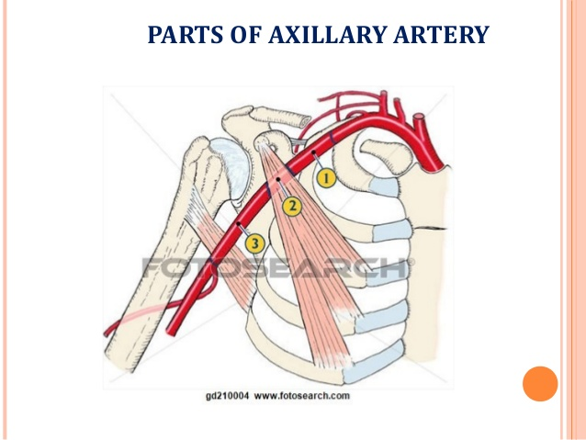
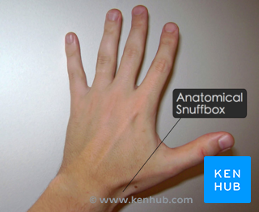
Palpation and compression of arteries
Entire Slide from girls’ slides
Arteries of the upper limb can be palpated or compressed in an emergency.

Slide 28
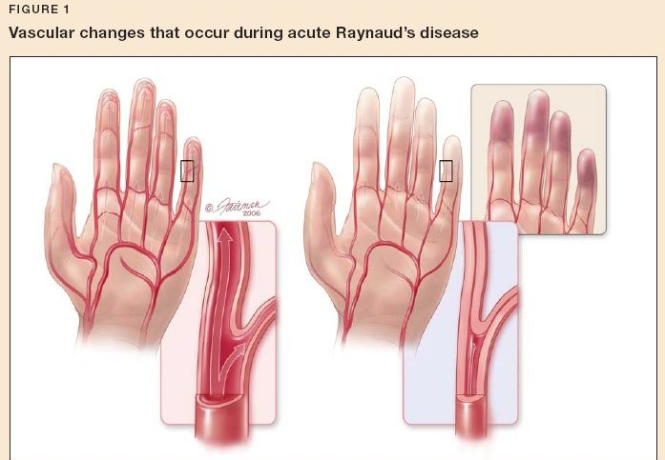
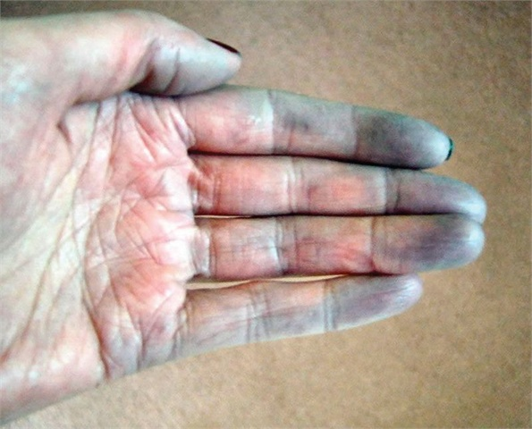
ARTERIAL INNERVATION AND RAYNAUD’S DISEASE
from girls’ slides and boys’ slides from last year
• Sympathetic innervation of the upper limb arteries is carried on by; preganglionic fibers from cell bodies from 2nd to 8th thoracic segments.
• They ascend in the sympathetic trunk to synapse in middle and inferior cervical and 1st thoracic.
• Postganglionic fibers are distributed along branches of the brachial plexus.
• Raynaud’s disease is a vasospastic diseases involves digital arteries.
• It may require cervicodorsal preganglionic (or post...) sympathectomy* to prevent necrosis of the fingers.
Overstimulation of sympathetic
↓
permanent vasoconstriction
↓
Raynaud’s disease
blue
*prevents any sympathetic supply to the arteries
always cold

Slide 29
Summary
From team 436

Slide 30
Questions
1. The left subclavian artery originates from
A- left common carotid artery B- aorta artery C-suprascapular artery D- the arch of aorta
2. The 3rd part of the axillary artery ends at
A-lower end of pectoralis maj. B-lower end of teres maj. C-lower end of pectoralis min. D- lower end of teres min.
3. Which of the following are branches of axillary artery
A-subscapular artery. B-posterior circumflex humeral artery C- anterior circumflex humeral artery D-all of the above
4. A branch of brachial artery is :
A-submuscular. B-lateral ulnar collateral C-medial radial unilateral. D- profunda brachii
5.The deep palmar arch is more proximal than:
A- superficial palmar arch B- ulnar artery. C- radial artery. D- brachial artery
6. Which is the vein of choice for injection
A-basilic B-cephalic C-median cubital D-axillary
7.Which is the vein of choice for central venous catheterization
A-basilic B-cephalic. C-median cubital. D-axillary

Slide 31
8.Dorsal venous network lies on the dorsum of the hand, in the subcutaneous tissue, proximal to the
A-deltopectoral groove. B-clavipectoral groove. C-metacarpophalangeal joints D- wrist joint
9.what is the correct for the basilic vein:
A- lies in indirect line with the axillary vein B-↓diameter. C-↓amount of blood. D-vein of choice for central venous catheterization
10.Sympathetic innervation of the upper limb arteries is carried on by; preganglionic fibers from cell bodies from:
A-1st thoracic segment B-8th thoracic segment C-1st-8th thoracic segments. D-2nd-8th thoracic segments
1-D 2-B 3-D 4-D 5-A 6-C 7-B 8-C 9-D 10-D

Slide 32
Team Members
Faisal Fahad Alsaif (Team Leader) Abdulaziz Al dukhayel ‏Fahad Alfaiz ‏Akram Alfandi ‏Saad Aloqile ‏Saleh Almoaiqel ‏Abdulaziz Alabdulkareem ‏Abdullah Almeaither ‏Yazeed Aldossari ‏Muath Alhumood
Abdulrahman Almotairi ‏
Abdulelah Aldossari ‏Abdulrahman Alduhayyim ‏Hamdan Aldossari ‏Abdullah Alqarni ‏Mohammed Alomar ‏Abdulrahman Aldawood ‏Saud Alghufaily ‏Hassan Aloraini
Khalid Almutairi ‏‏
Lamia Abdullah Alkuwaiz (Team Leader)
Rawan Mohammad Alharbi
Abeer Alabduljabbar Afnan Abdulaziz Almustafa Ahad Algrain Alanoud Almansour Albandari Alshaye AlFhadah abdullah alsaleem Arwa Alzahrani Dana Abdulaziz Alrasheed Dimah Khalid Alaraifi Ghada Alhaidari Ghada Almuhanna Ghaida Alsanad Hadeel Khalid Awartani Haifa Alessa Khulood Alwehabi Layan Hassan Alwatban Lojain Azizalrahman Lujain Tariq AlZaid
Maha Barakah Majd Khalid AlBarrak Norah Alharbi Nouf Alotaibi Noura Mohammed Alothaim Rahaf Turki Alshammari Reham Alhalabi Rinad Musaed Alghoraiby Sara Alsultan Shahad Alzahrani Wafa Alotaibi Wejdan Fahad Albadrani Wjdan AlShamry
Abdulmajeed Alwardi ‏Abdulrahman Alageel ‏Rayyan Almousa ‏Sultan Alfuhaid ‏Ali Alammari ‏Fahad Alshughaithry Fayez Ghiyath Aldarsouni ‏Mohammed Alquwayfili ‏‏Abduljabbar Al-yamani ‏Sultan Al-nasser ‏Majed Aljohani ‏Zeyad Al-khenizan ‏Mohammed Nouri ‏Abdulaziz Al-drgam ‏Fahad Aldhowaihy ‏Omar alyabis

