Slide 1
Muscles of the Forearm
Lecture 13
Please check our Editing File.
هذا العمل لا يغني عن المصدر الأساسي للمذاكرة
{وَمَنْ يَتَوَكَّلْ عَلَى اللَّهِ فَهُوَ حَسْبُهُ}

Slide 2
Objectives
List the names of the Flexors Group of Forearm (superficial & deep muscles).
Identify the common flexor origin of flexor muscles and their innervation & movements.
Identify supination & pronation and list the muscles produced these 2 movements.
List the names of the Extensor Group of Forearm (superficial & deep muscles).
Identify the common extensor origin of extensor muscles and their innervation & movements.
Text in BLUE was found only in the boys’ slides
Text in PINK was found only in the girls’ slides
Text in RED is considered important
Text in GREY is considered extra notes

Slide 3
436 Team

Slide 4
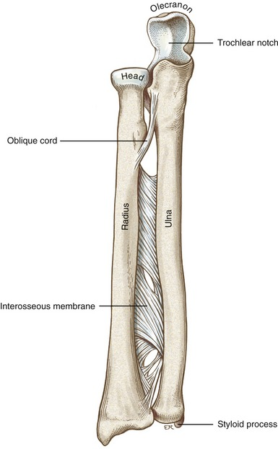
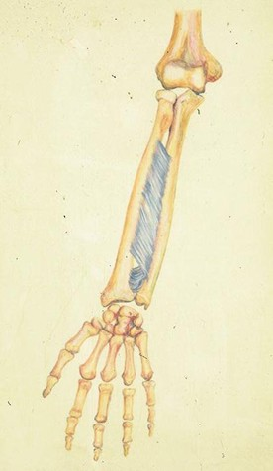
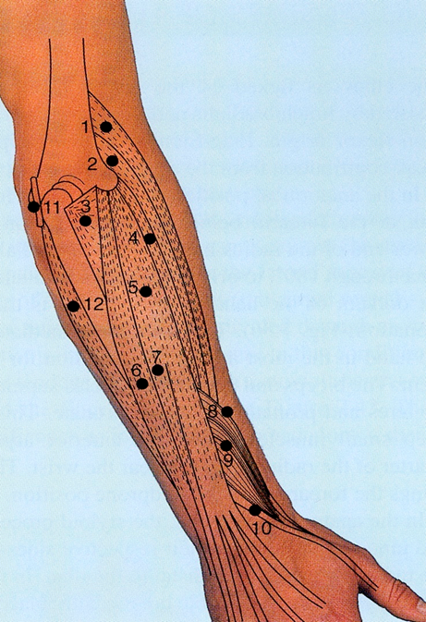
Forearm
The forearm extends from elbow to wrist.
It passes two bones radius laterally & Ulna medially.
The two bones are connected together by the interosseous membrane.
This membrane allows movement of Pronation and Supination while the two bones are connected together. (تسمح لها تسوي الحركه لكن ما تسوي الحركة نفسها)
Also it gives origin for the deep muscles.
436 Team
- The radius and ulna are connected by 3 structures: the interosseous membrane, superior radioulnar joint and inferior radioulnar joint. - An interosseous membrane is a broad and thin plane of fibrous tissue that separates many of the bones of the body.
*Supination & Pronation: Happen only at Radio-ulnar joint.
The Radius moves over ulna.

Slide 5
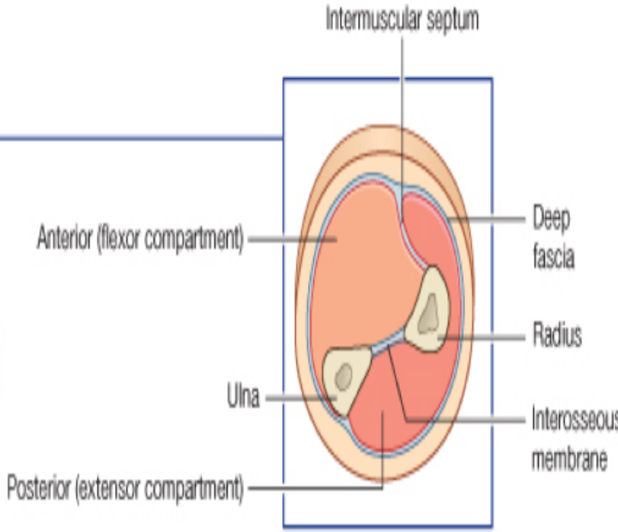
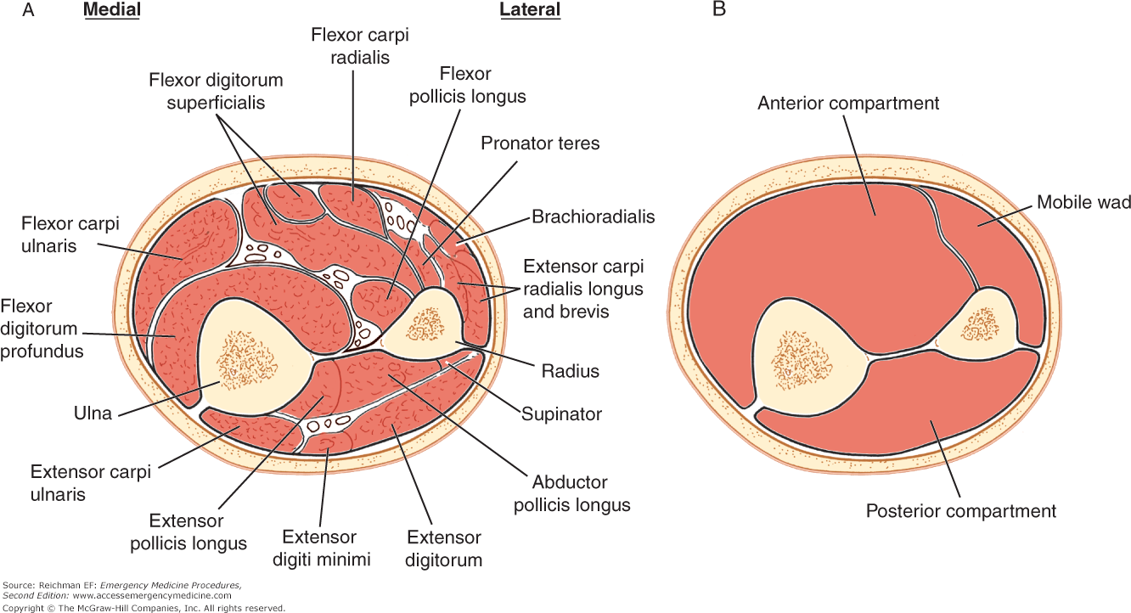
Fascial Compartment of Forearm
The forearm is enclosed in a sheath of deep fascia, which is attached to the posterior border of the ulna (it's not attached to radius).
This fascial sheath, together with the interosseous membrane and intermuscular septum, divides the forearm into 2 compartments ( anterior & posterior), each having its own muscles, nerves, and blood supply.
We can say that it has A Lateral compartment in the lateral of Posterior compartment. We also have Anterior compartment
The forearm in general has 20 muscles (8 anterior & 12 posterior)
The posterior compartment can be divided to lateral(3 muscles) and posterior (9 muscles)

Slide 6
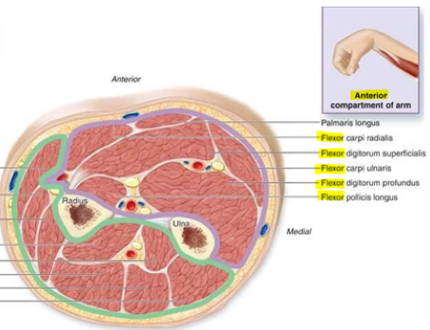
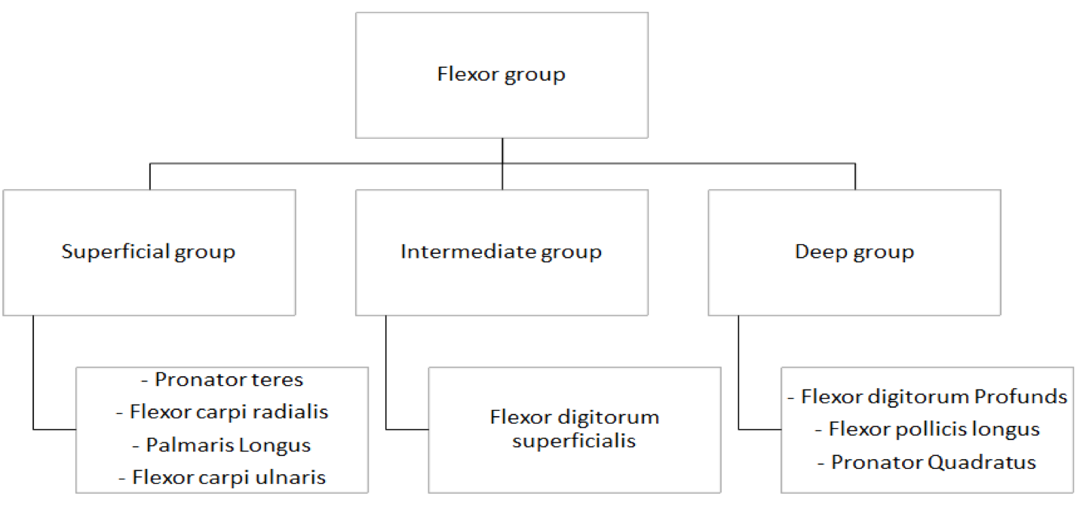
Anterior Compartment (Flexor group)
These 8 muscles:
Act on the elbow, wrist joints and the fingers.
Form fleshy masses in the proximal part and become tendinous in the distal part of the forearm.
*Teres: مبرومة
436 Team
*

Slide 7
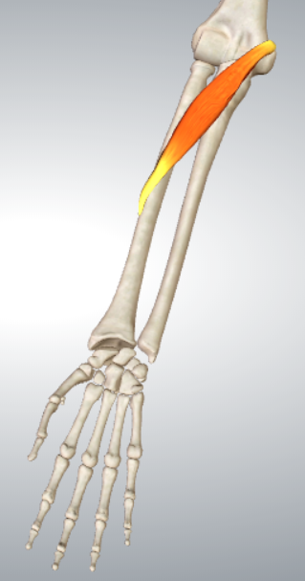
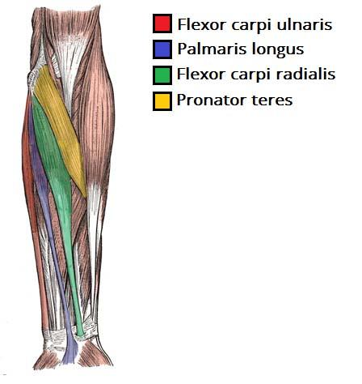
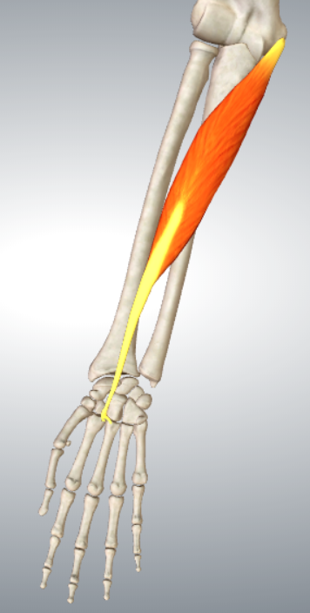
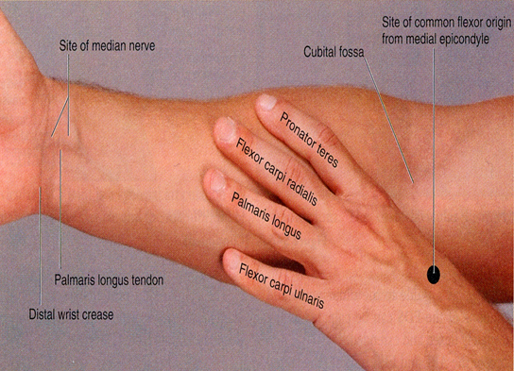
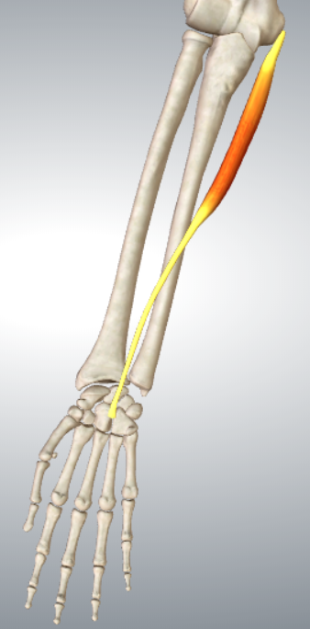
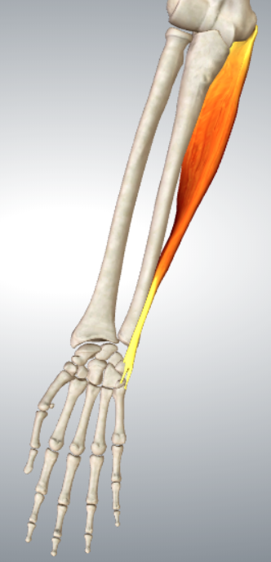
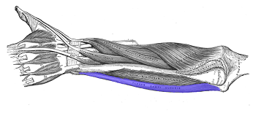
Superficial Flexors
Pronator Teres:
Insertion: Middle of lateral surface of radius.
Action: Pronation & Flexion of forearm (elbow).
Arise “More or less” from the Common Flexor origin (front of medial epicondyle).
All are supplied by median nerve except one, Flexor Carpi Ulnaris (FCU)*.
All cross the wrist joint except one, pronator teres (PT).
Does not cross the wrist
Left forearm Anterior view
Flexor Carpi Radialis:
Insertion: Base of 2nd metacarpal bone.
Action: Flexion & Abduction of the hand.
تسحب اليد جهة الradius
*FCU supplied by Ulnar nerve
436 Team
Flexor Carpi Ulnaris:
Insertion: Pisiform, hook of hamate & base of 5th metacarpal bone
Action: Flexion and Adduction of the hand (wrist).
Palmaris Longus:
Insertion: Into the Flexor retinaculum & Palmar aponeurosis.
Action: Flexes hand & tightens palmar aponeurosis.
Note:
Radialis always inserts at either 2nd or 3rd metacarpal since they are lateral.
Ulnaris always inserts at 5th metacarpal because it is medial.
تسحب اليد جهة الulna

Slide 8
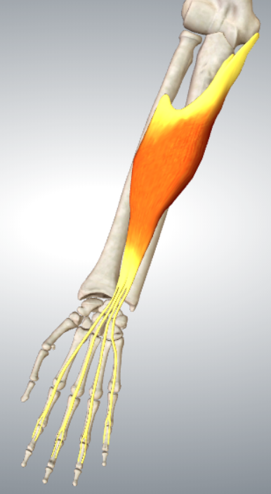
Intermediate Flexor
Flexor Digitorum Superficialis:
Origin:
Common flexor origin (front of medial epicondyle).
Coronoid process of ulna.
Anterior surface of radius.
Insertion:
Base of middle phalanges of medial 4 fingers.
Action:
Flexes middle and proximal phalanges of medial 4 fingers, and the hand (wrist).

Slide 9
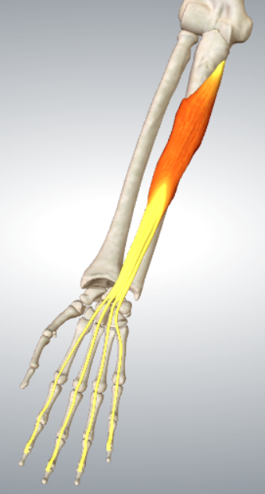
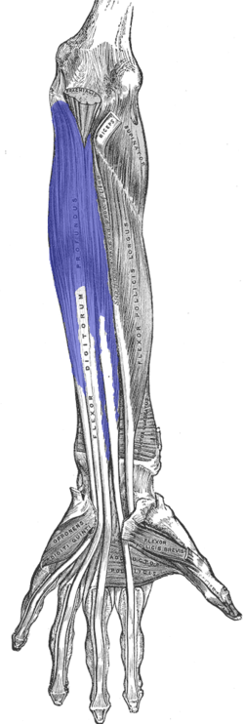
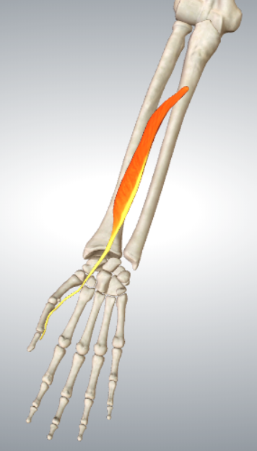
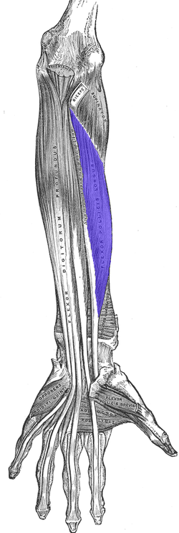
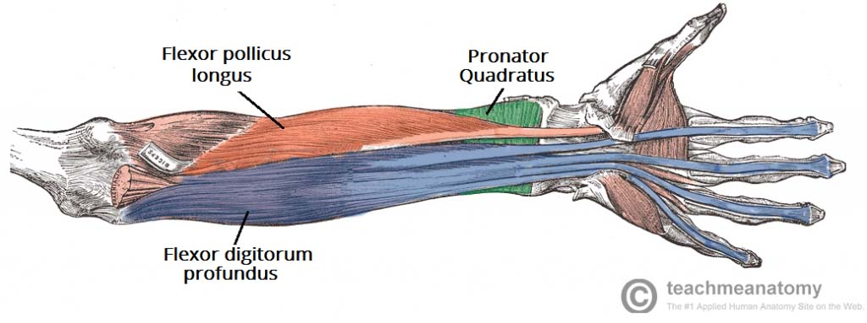
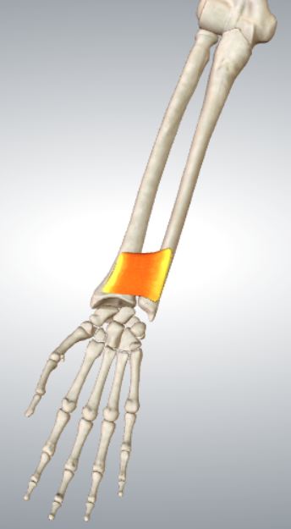
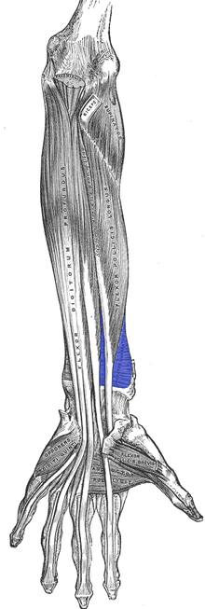
Deep Flexors
Flexor Digitorum Profundus:
Insertion: bases of distal phalanges of medial 4 digits.
Action: Flexes distal phalanges of medial 4 digits.
Deep Flexors Based on Origin*:
Front (above) of radius:
Flexor pollicis longus.
Front (above) of ulna:
Flexor Digitorum Profundus.
Front of lower 4th of ulna (above the two bones (ulna & radius)):
Pronator Quadratus**.
Flexor Pollicis Longus:
Insertion: Base of distal phalanx of thumb.
Action: Flexes (interphalangeal, metacarpophalangeal & carpometacarpal)* joints of thumb.
Pronator Quadratus:
Insertion: distal fourth of anterior surface of radius.
Action: pronates forearm (prime mover), helps to hold the 2 bones together (radius and ulna)
The medial half of the muscle is supplied by the ulnar nerve, while the lateral half is supplied by anterior interosseous nerve (a branch of median nerve).
This muscle is supplied by anterior interosseous nerve (a branch of median nerve).
*All the joints of the thumb
*They all originate from Interosseous. **مكانها مثل مكان الساعة
This muscle is supplied by anterior interosseous nerve (a branch of median nerve).
Notes:
ff

Slide 10
Nerve Supply of the Deep Flexors
This Slide was in males’ slides only
All are supplied by the anterior interosseous nerve (branch of the median nerve).
Except the medial half of the Flexor Digitorum Profundus by the Ulnar Nerve.

Slide 11
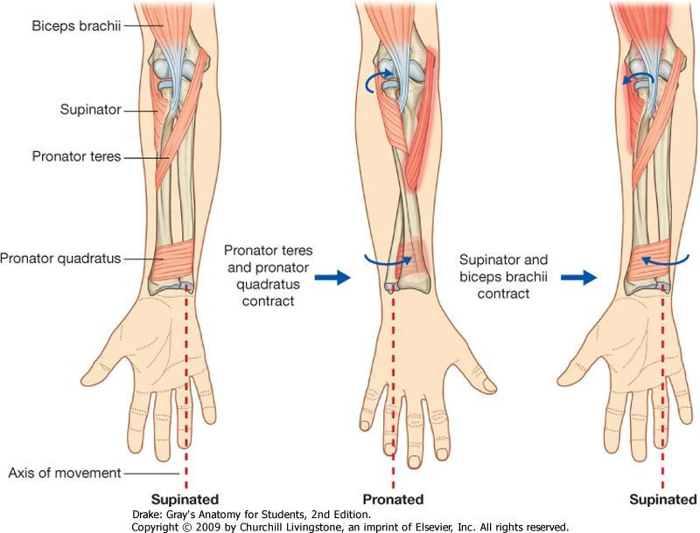
Supination and Pronation
It occurs in the Superior and Inferior Radioulnar joints (pivot uniaxial synovial joint)
Muscles produce supination***:
Biceps brachii
Supinator
Muscles produce pronation:
Pronator teres
Pronator quadratus
NB. Brachioradialis puts the forearm in mid-prone* position**.
*Put the forearm in a position between Supine and Prone (مثل ما تمد يدك عشان تسلّم)
**Brachioradialis initiates Supination and Pronation.
***When the elbow is flexed both muscles are acting
When it is extended only the supinator is active

Slide 12
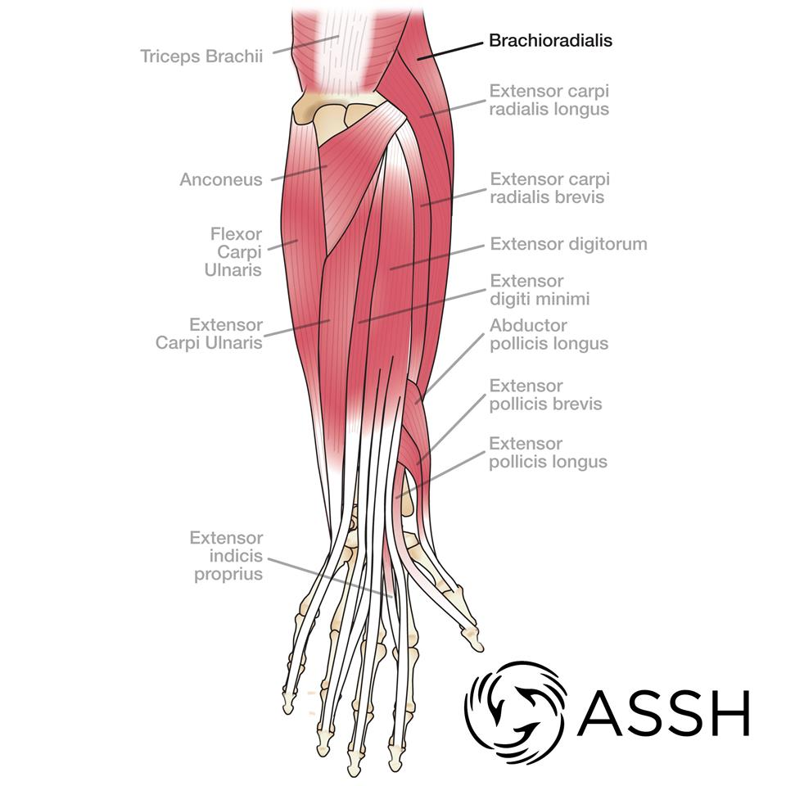
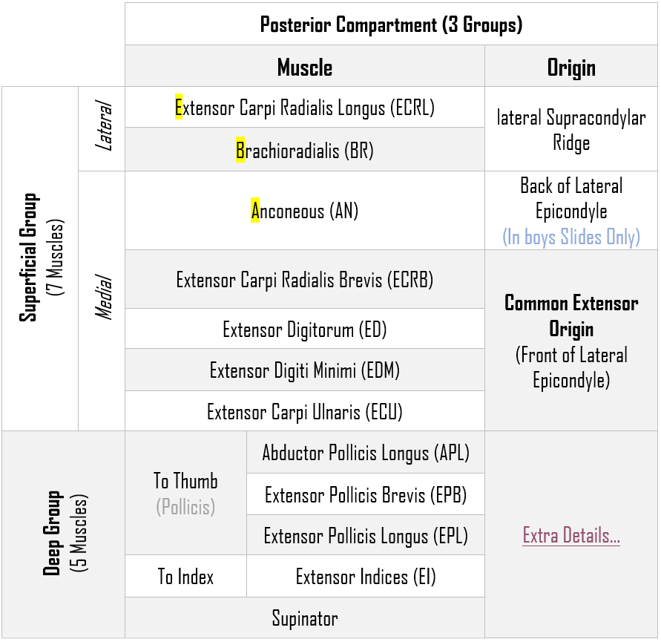
Posterior Compartment (3 Groups)

Slide 13
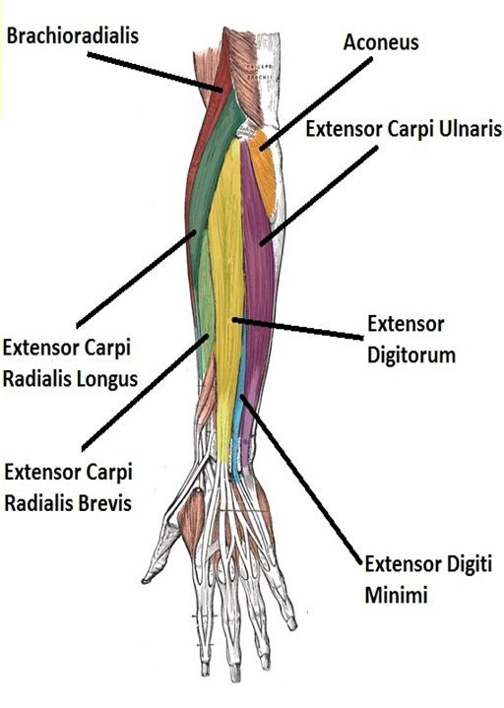
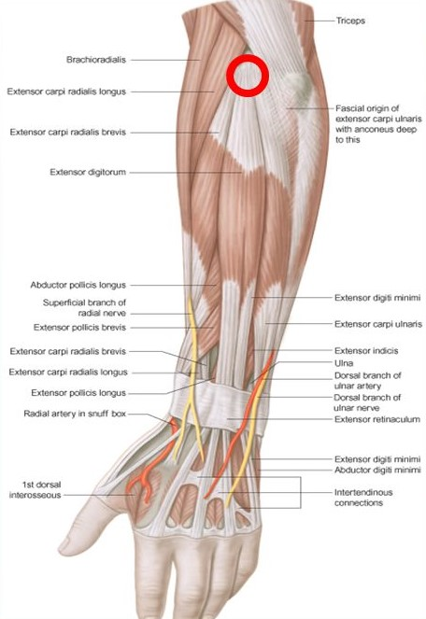
Posterior Compartment
Insertion
Superficial Extensors
Extensor carpi radialis brevis:
base of 3rd metacarpal bone.
Extensor digitorum:
Extensor expansion of the medial 4 fingers.
Extensor digiti minimi:
Extensor expansion of the little finger.
Extensor carpi ulnaris:
Base of the 5th metacarpal bone.
Anconeus:
Upper back (Superior Posterior) of shaft of Ulna
Superficial Group:
7 muscles (from lateral to medial):
Brachioradialis, (BR).
Extensor carpi radialis longus, (ECRL).
Extensor carpi radialis brevis, (ECRB).
Extensor digitorum, (و بس) (ED).
Extensor digiti minimi, (EDM).
Extensor carpi ulnaris, (ECU).
Anconeus, (An).
باسل كسر كرسي دلال و دلال كسرت أسواره
و بس :)
All cross the wrist
EXCEPT 2 (In girls slides 1)
(Brachioradialis & Anconeus).
Nerve Supply:
All supplied by deep branch of radial nerve (also called posterior interosseous nerve).
EXCEPT (ABE):
A, Anconeus.
B, Brachioradialis.
E, Extensor carpi radialis longus.
These 3 muscles are supplied by the Radial Nerve itself.
Origin:
All arises from
Common Extensor Origin (front of lateral epicondyle of the humerus).
EXCEPT 3 (In girls slides 2)
BR & ECRL: Lateral Supracondyle
(Anconeus: Back of lateral epicondyle of humerus).

Slide 14
Extensor Carpi Radialis Longus
Brachioradialis
Origin:
Lateral Supracondylar ridge of humerus.
Insertion:
Base of styloid process of radius
Action:
Flexes forearm; (elbow).
Rotates forearm to the mid-prone position.
Origin:
Lateral Supracondylar ridge of humerus.
Insertion:
Posterior surface of base of 2nd metacarpal bone
Action:
Extends and abducts hand at wrist joint.
تسحب اليد جهة الradius

Slide 15
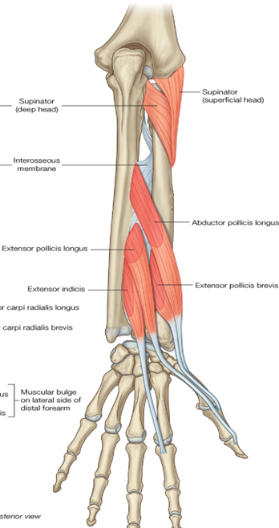
Deep Group
Deep Group:
5 muscles:
Abductor pollicis longus (APL)
Extensor pollicis brevis (EPB)
Extensor pollicis longus (EPL)
Extensor indicis (EI)
Supinator
Nerve Supply:
All back muscles of the forearm are supplied by Posterior Interosseous Nerve Except, (ABE) by Radial Nerve itself.

Slide 16
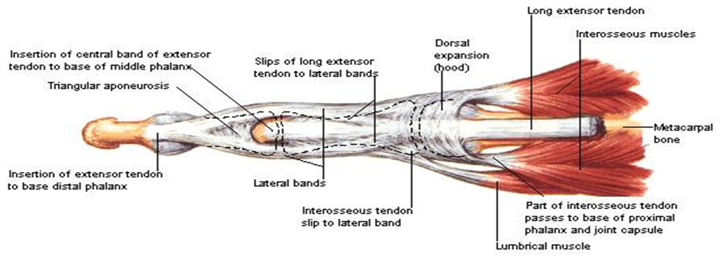
Dorsal Extensor Expansion
It is formed on the dorsum of medial 4 fingers by the union of the tendons of:
Extensor digitorum
Extensor indicis
Extensor digiti minimi
Lumbricals
Palmar & Dorsal:
Interossei
All these tendons unite to form one tendon which divides into 3 Slips:
Median one attached to:
Middle phalanges
2 Lateral attached to:
Terminal phalanges
(In index finger only)
(In little finger only)

Slide 17
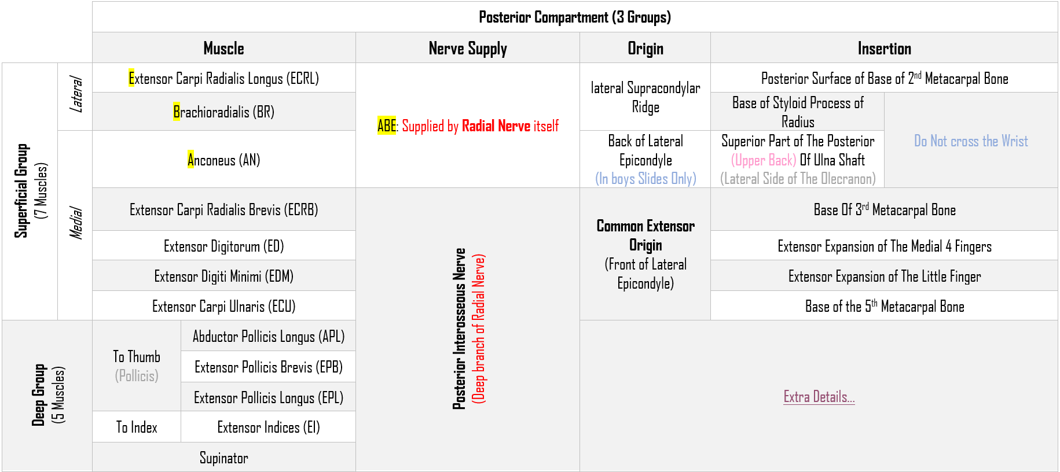
Summary of Posterior Compartment of Forearm

Slide 18
MCQ:
Flash cards test :)
1-All Superficial Flexors are supplied by median nerve except:
A- Pronator teres
B- Flexor Carpi Radialis
C- Palmaris Longus
D- Flexor Carpi Ulnaris
2- All Superficial Flexors cross the wrist joint except:
A- Pronator teres
B- Flexor Carpi Radialis
C- Palmaris Longus
D- Flexor Carpi Ulnaris
3- What is the common extensor origin?
A- Back of lateral epicondyle of humerus
B- Front of lateral epicondyle of humerus
C- Back of medial epicondyle of humerus
D- Front of medial epicondyle of humerus
4- Which one of the following is a superficial muscle of the posterior compartment of the forearm?
A- Coracobrachialis
B- Brachialis
C- Brachioradialis
D- Biceps brachii

Slide 19
5-which one of the following does not cross the wrist?
A- Extensor carpi radialis brevis
B- Brachioradialis
C- Anconeus
D- B&C
6- A man standing up and fixing a lamp in the ceiling (His hand extended), which muscle is used for the supination?
A- Supinator
B-Trapezius
C-Flexor digitorum
D-Brachioradialis
7-which of these muscles supplied by posterior interosseous nerve ?
A-supinator.
B-Extensor indicis.
C-Extensor pollicis brevis.
D-all the above.
8- A man screwing a painting on the wall, while his hand is flexed, which muscle is used for the supination?
A- Triceps brachii.
B- Biceps brachii.
C-Extensor pollicis longus
D-Lumbricals muscles

Slide 20
9- The deep muscles of the posterior compartment are:
A-3 muscles
b-2 muscles
C-5 muscles
d-6 muscles
10- The insertion of Pronator Quadratus is:
A-distal 1/4th of anterior surface of Radius
B- interosseus membrane
C-base of 2th metacarpal
D-superior intertochintar
11-Which of the following is most accurate about Posterior Interosseous Nerve?
A- it’s the deep branch of Ulnar nerve.
B-it’s innervate the posterior compartment of the shoulder.
C-it’s supply ABE.
D- it’s supply index deep muscle .
12-Action of Flexor Digitorum Profundus is?
A-Flexes distal phalanges of medial 4 digits.
B- abduction of the thumb
C-Flexes the forearm
D-opposition of thumb
1-D
2-A
3-B
4-C
5-D
6-A
7-D
8-B
9-C
10-A
11-D
12-A

Slide 21
Team Members
Faisal Fahad Alsaif (Team Leader) Abdulaziz Al dukhayel ‏Fahad Alfaiz ‏Akram Alfandi ‏Saad Aloqile ‏Saleh Almoaiqel ‏Abdulaziz Alabdulkareem ‏Abdullah Almeaither ‏Yazeed Aldossari ‏Muath Alhumood
Abdulrahman Almotairi ‏
Abdulelah Aldossari ‏Abdulrahman Alduhayyim ‏Hamdan Aldossari ‏Abdullah Alqarni ‏Mohammed Alomar ‏Abdulrahman Aldawood ‏Saud Alghufaily ‏Hassan Aloraini
Khalid Almutairi ‏‏
Lamia Abdullah Alkuwaiz (Team Leader)
Rawan Mohammad Alharbi
Abeer Alabduljabbar Afnan Abdulaziz Almustafa Ahad Algrain Alanoud Almansour Albandari Alshaye AlFhadah abdullah alsaleem Arwa Alzahrani Dana Abdulaziz Alrasheed Dimah Khalid Alaraifi Ghada Alhaidari Ghada Almuhanna Ghaida Alsanad Hadeel Khalid Awartani Haifa Alessa Khulood Alwehabi Layan Hassan Alwatban Lojain Azizalrahman Lujain Tariq AlZaid
Maha Barakah Majd Khalid AlBarrak Norah Alharbi Nouf Alotaibi Noura Mohammed Alothaim Rahaf Turki Alshammari Reham Alhalabi Rinad Musaed Alghoraiby Sara Alsultan Shahad Alzahrani Wafa Alotaibi Wejdan Fahad Albadrani Wjdan AlShamry
Abdulmajeed Alwardi ‏Abdulrahman Alageel ‏Rayyan Almousa ‏Sultan Alfuhaid ‏Ali Alammari ‏Fahad Alshughaithry Fayez Ghiyath Aldarsouni ‏Mohammed Alquwayfili ‏‏Abduljabbar Al-yamani ‏Sultan Al-nasser ‏Majed Aljohani ‏Zeyad Al-khenaizan ‏Mohammed Nouri ‏Abdulaziz Al-drgam ‏Fahad Aldhowaihy ‏Omar alyabis

