Slide 1
Radial and Ulnar Nerves
Lecture 14
Please check our Editing File.
هذا العمل لا يغني عن المصدر الأساسي للمذاكرة
{وَمَنْ يَتَوَكَّلْ عَلَى اللَّهِ فَهُوَ حَسْبُهُ}

Slide 2
Objectives
Describe the anatomy of the radial & ulnar nerves regarding: origin, course & distribution.
List the branches of the nerves.
Describe the causes and manifestations of nerve injury
Text in BLUE was found only in the boys’ slides
Text in PINK was found only in the girls’ slides
Text in RED is considered important
Text in GREY is considered extra notes

Slide 3
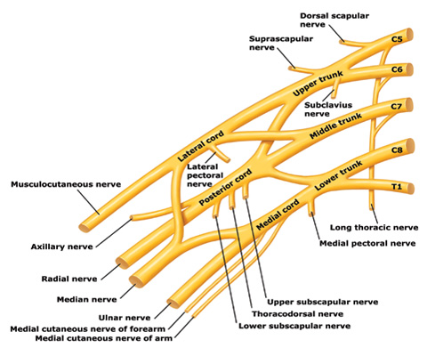
Recall

Slide 4
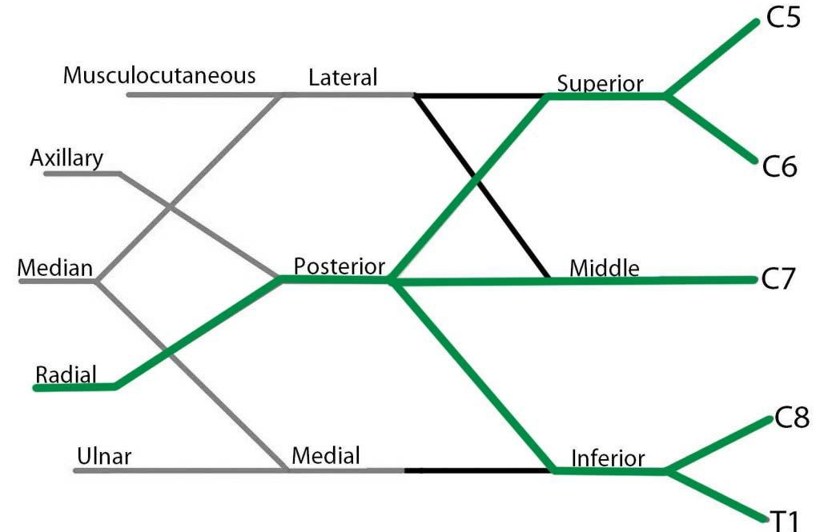
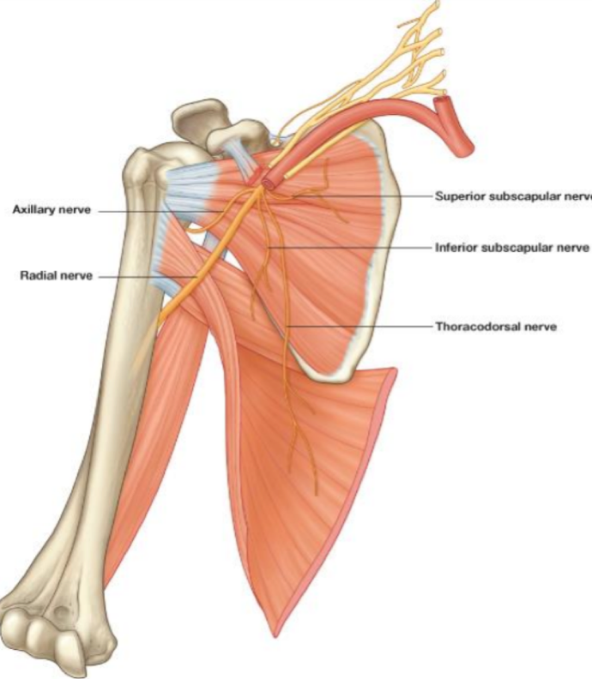
Radial Nerve
Origin: Posterior cord of the brachial plexus in the axilla (the largest branch of nerves in the upper limb)
Supplies: All muscles of the posterior compartment of the arm (triceps) & forearm (3 groups)
*No muscle supplied by the radial nerve in the hand

Slide 5
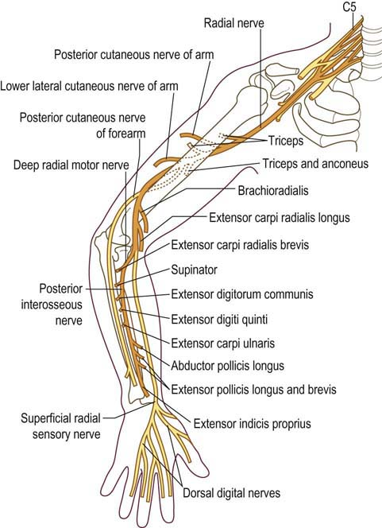
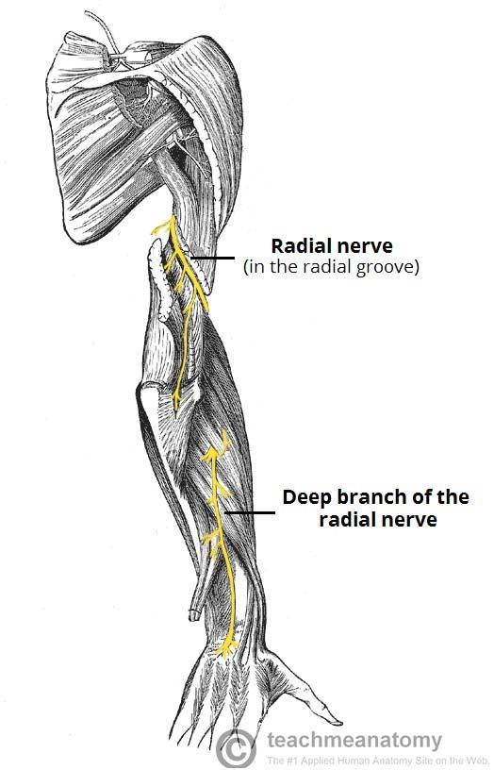
Radial Nerve, Course & Distribution
In the Arm | In the Forearm
It winds(يلف) around the back of the arm in the Spiral Groove(radial groove) on the back of the humerus between the heads of the triceps. In the spiral groove, the nerve is accompanied by the Profunda Vessels, and it lies directly in contact with the shaft of the humerus (Dangerous Position). *Team436: Any fracture of humerus specifically the spiral groove leads to injury of the radial nerve | It pierces the Lateral Intermuscular septum.(The nerve runs posterior to the humerus in the arm, يثقب the intermuscular septum so it can reach the cubital fossa) Descends in front of the Lateral Epicondyle. Passes forward into the Cubital Fossa: Divides into Superficial & Deep branches. (Here radial nerve ends.)

Slide 6
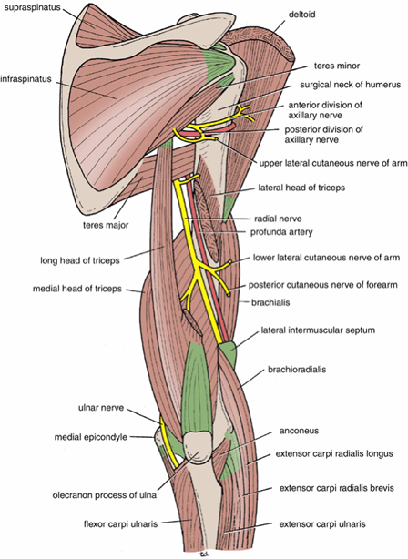
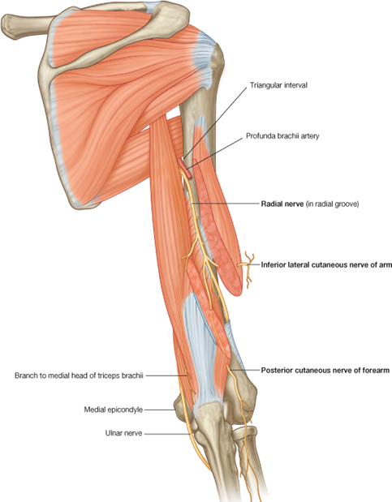
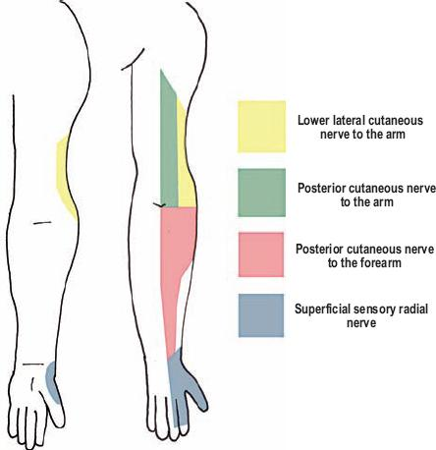
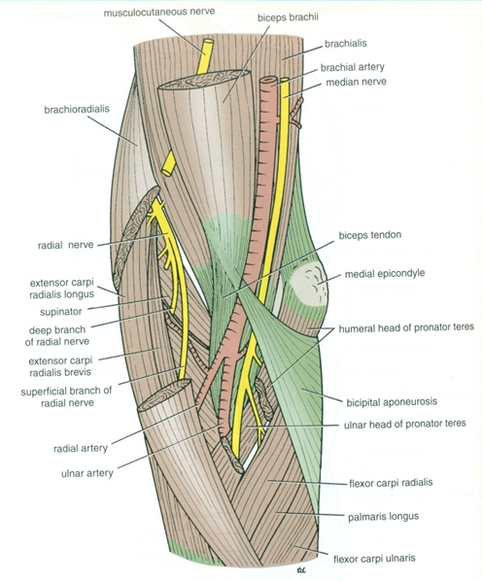
Branches
Picture
From team 436
Arising In The Axilla: | Arising In the Spiral Groove: | Arising Close to Lateral Epicondyle:
Cutaneous: Posterior cutaneous nerve of arm. | Cutaneous: 1. Lower lateral cutaneous nerve of arm. 2. Posterior cutaneous nerve of forearm. | Articular to: Elbow joint No Cutaneous Branches
Muscular to: Long & Medial Heads of Triceps | Muscular to: 1.Lateral & Medial heads of triceps. 2.Anconeus. | Muscular to : 1.Brachioradialis. 2.Extensor carpi radialis longus. 3.Brachialis.

Slide 7
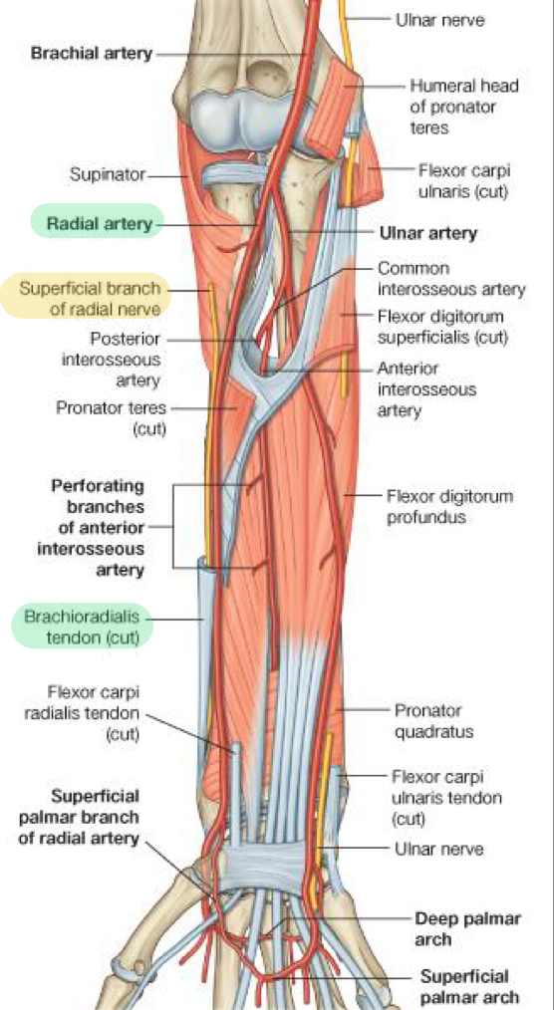
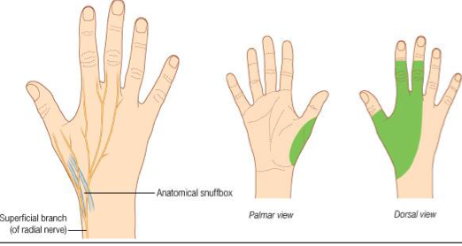
Superficial branch of the radial nerve
Sensory nerve only
Course:
1- It descends under cover (tendon) of Brachioradialis.
2-Lateral to radial artery
3-It emerges beneath the brachioradialis tendon.
“cutaneous supply”
The medial and lateral cutaneous of the arm and forearm is supplied by the medial cutaneous nerve of the arm and medial cutaneous nerve of the forearm
علشان يعدي من الـ Anatomical Snuff Box.
Termination:
It reaches the posterior surface of the wrist, where it divides into terminal branches that supply the skin:
on the lateral two thirds of the posterior surface (dorsum) of the hand
the posterior surface over the proximal phalanges of the lateral three and half fingers. (All finger except distal phalanges “nail beds”)
The area of skin supplied by the nerve on the dorsum of the hand is variable.

Slide 8
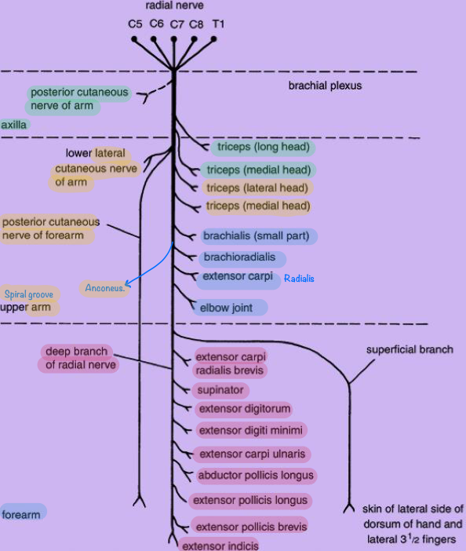
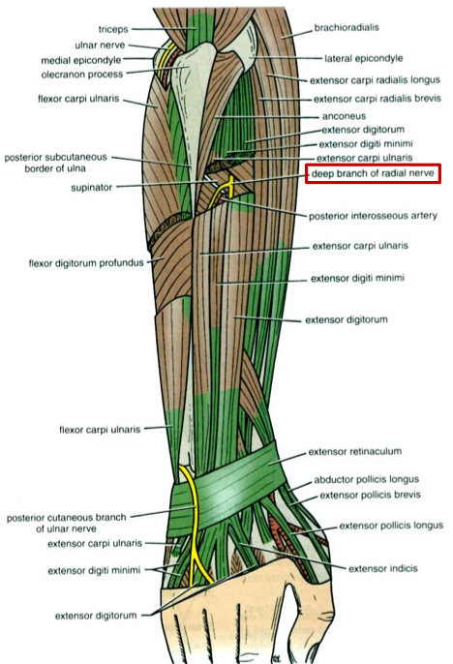
Deep branch of the radial nerve
Summary of branches of radial nerve
Deep branch of radial nerve = posterior interosseous nerve
It winds around the neck of the radius, within the supinator muscle, and enters the posterior compartment of the forearm.
It supplies: (9 muscles out of 12 in the posterior compartment)
Extensor carpi radialis brevis.
Extensor carpi ulnaris.
Supinator.
Abductor pollicis longus.
Extensor pollicis brevis.
Extensor pollicis longus.
Extensor indicis.
Extensor digitorum.
Extensor digiti minimi.
All the extensors except ABE

Slide 9
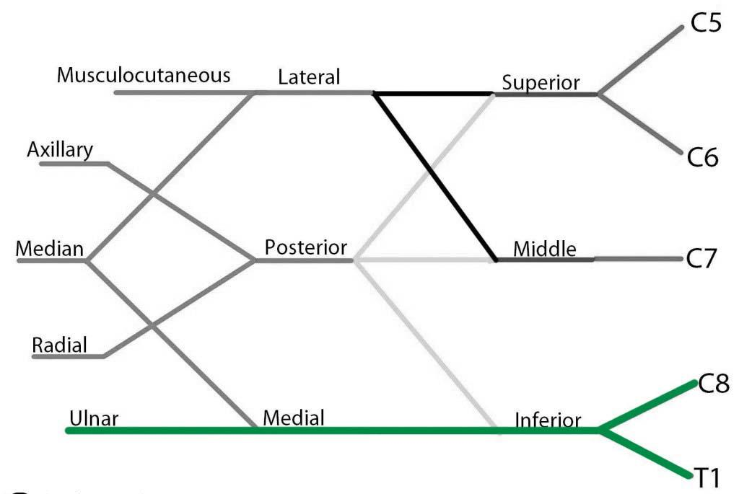
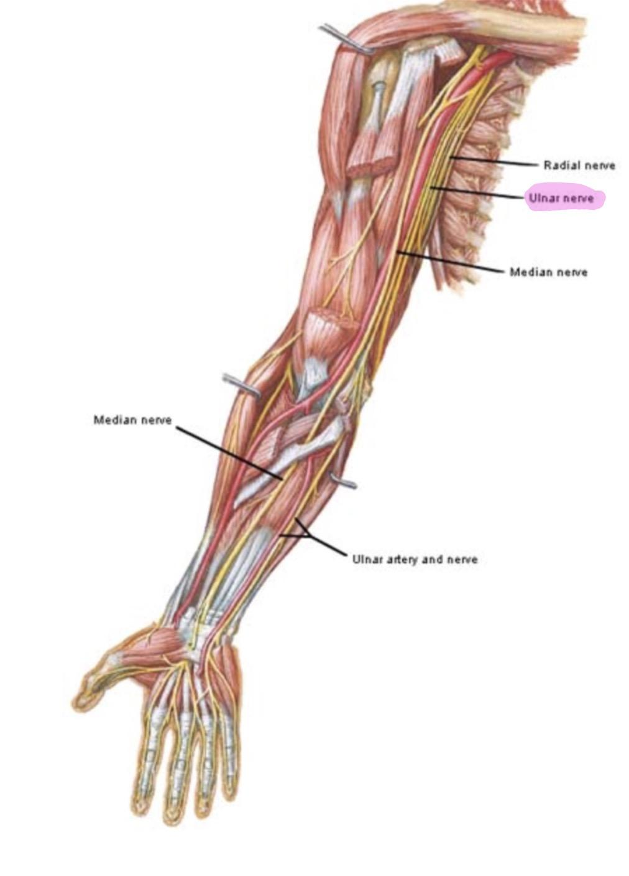
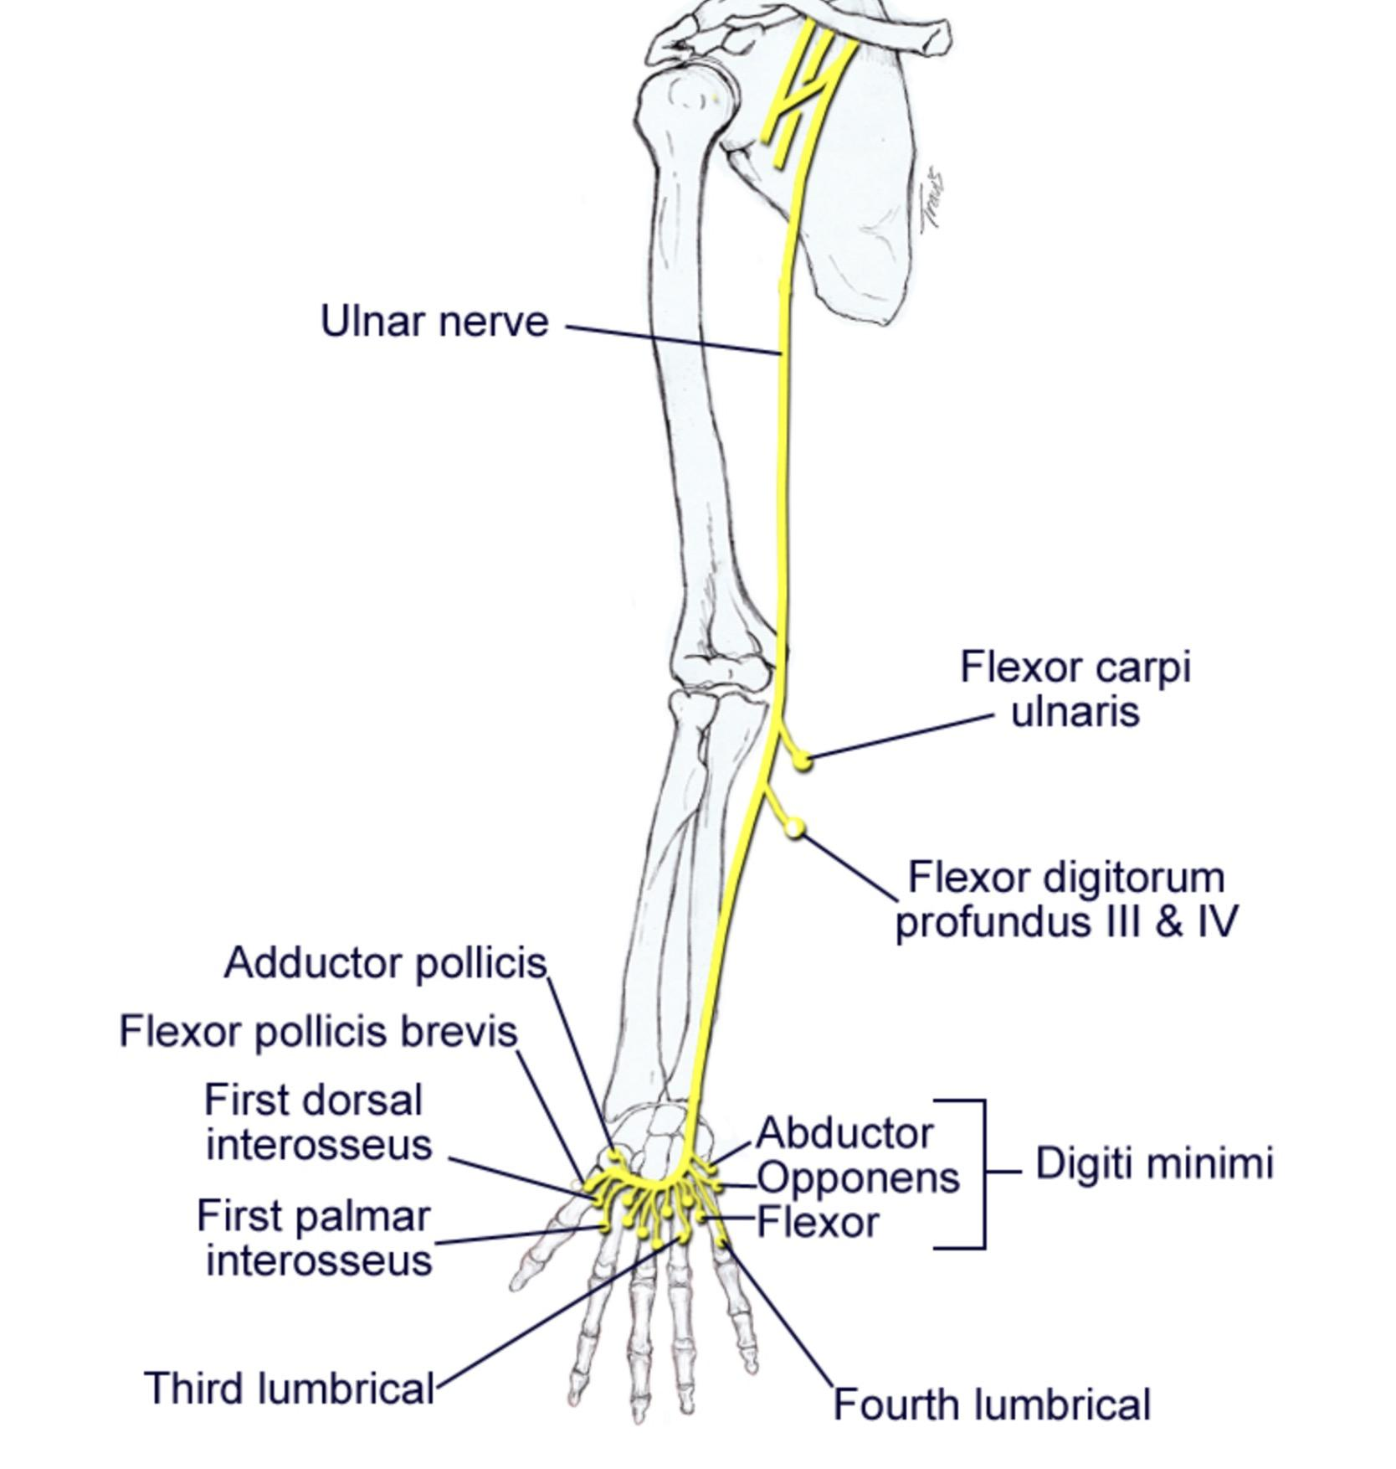
Ulnar nerve
Origin: medial cord of brachial plexus
Course: descends along the medial side of axillary artery and brachial artery .
3- Pierces the medial intermuscular septum.
4- passes behind the medial epicondyle of the humerus.

Slide 10
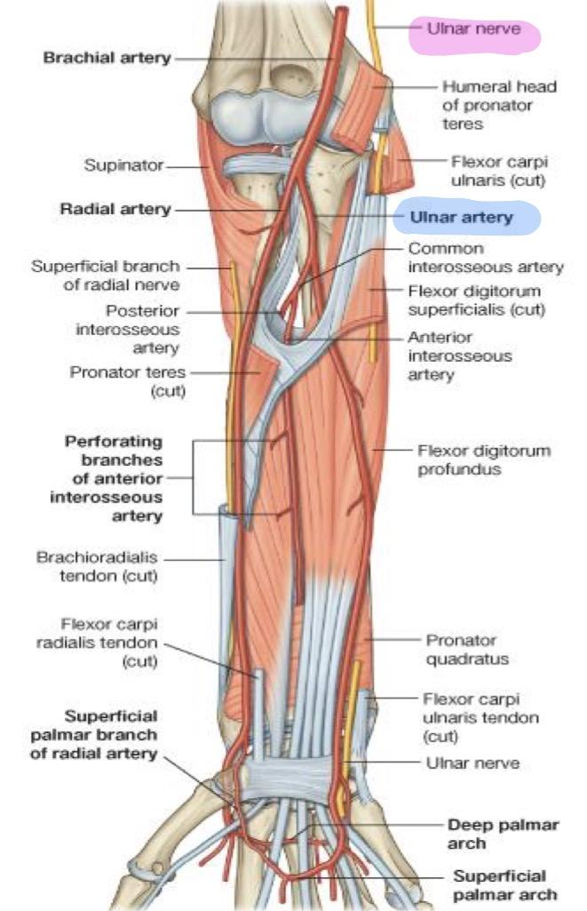
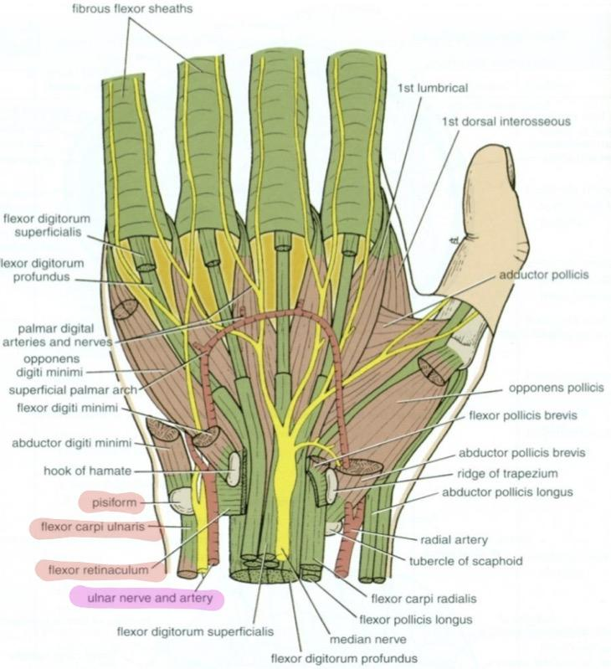
Ulnar nerve
It has no branches in the arm.
Course in the forearm:
Enters the anterior compartment through: flexor carpi ulnaris
Descends:
1- behind the flexor carpi ulnaris
2- Medial to ulnar artery
Course at the wrist:
Passes:
Anterior to flexor retinaculum*
Lateral to pisiform bone
Medial to ulnar artery
Divides into: superficial
and deep branches
*the ulnar nerve & ulnar artery does not pass through the carpal tunnel

Slide 11
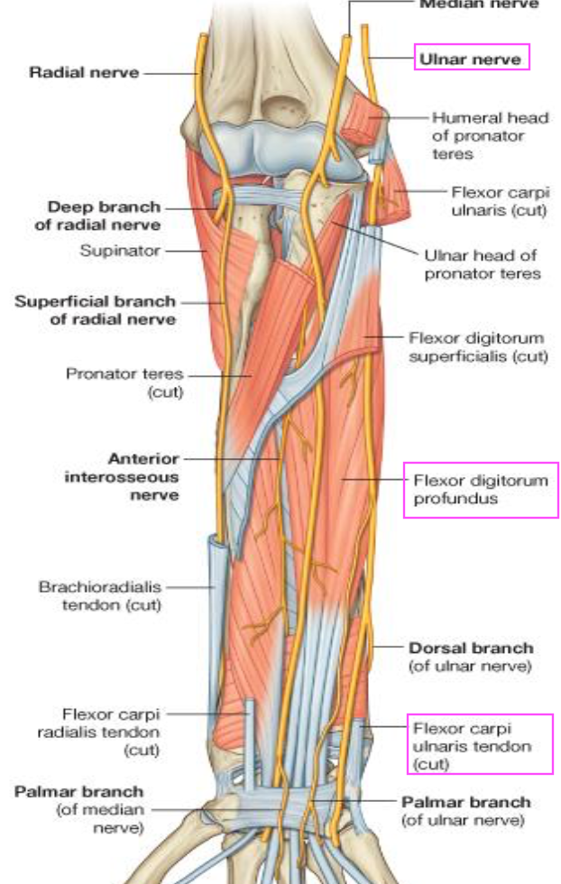
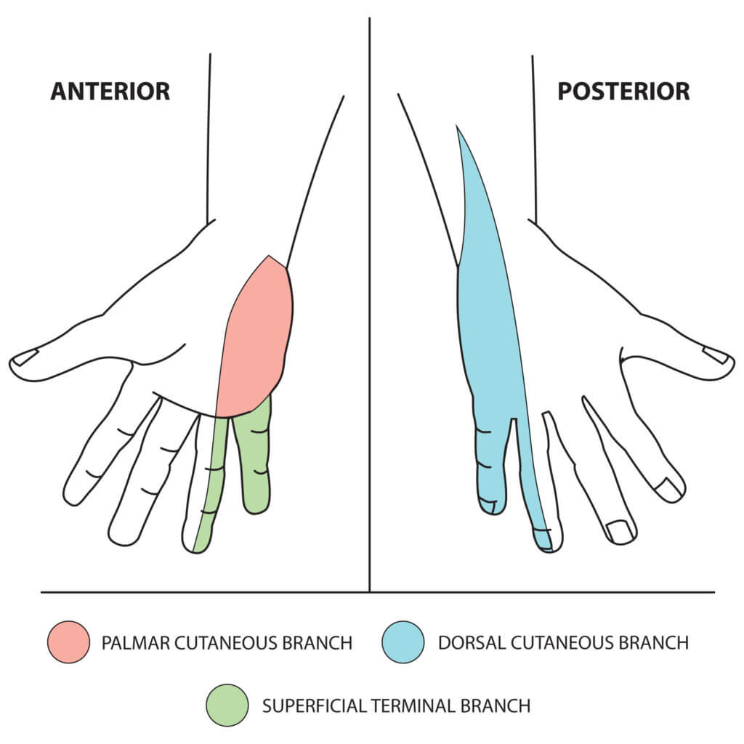
Branches of Ulnar Nerve
Flexor Carpi Ulnaris
It has no branches in the arm.
(1&½ muscles)
Muscular To:
Medial ½ of Flexor Digitorum Profundus
Elbow joint
In the Forearm
Articular To:
Supplies the skin over the back of Medial side of the hand and Medial 1½ fingers
Dorsal (posterior) cutaneous
Cutaneous:
Palmar cutaneous
Supplies the skin over the Medial part of the palm

Slide 12
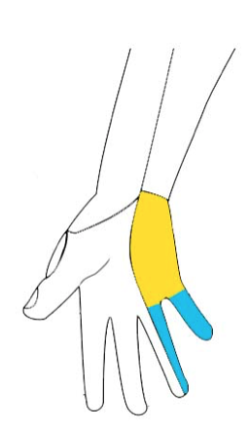
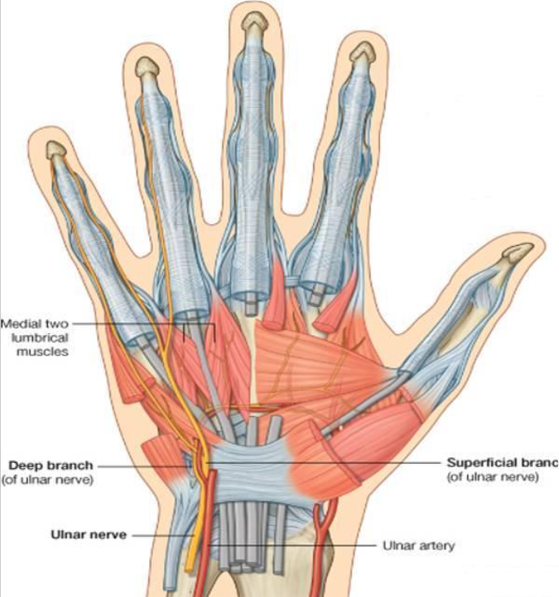
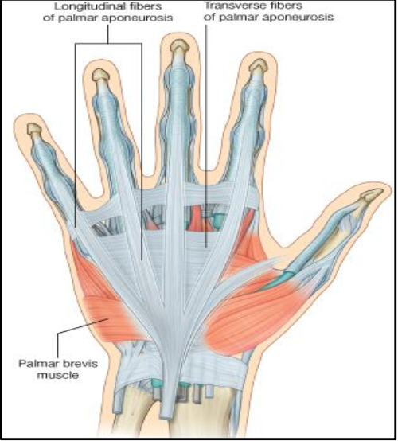
Branches of Ulnar Nerve
Branches of Deep Terminal Branch: 1- Muscular:
Hypothenar Eminence
All Interossei (Palmar & Dorsal)
3rd & 4th Lumbricals
Adductor pollicis
2- Articular:
Carpal joints.
Superficial Terminal Branch:
1- Muscular:
Palmaris Brevis
2- Cutaneous:
Skin over the Palmar aspect of the medial 1½ fingers (including nail beds).

Slide 13
Summary of Branches of Ulnar Nerve

Slide 14
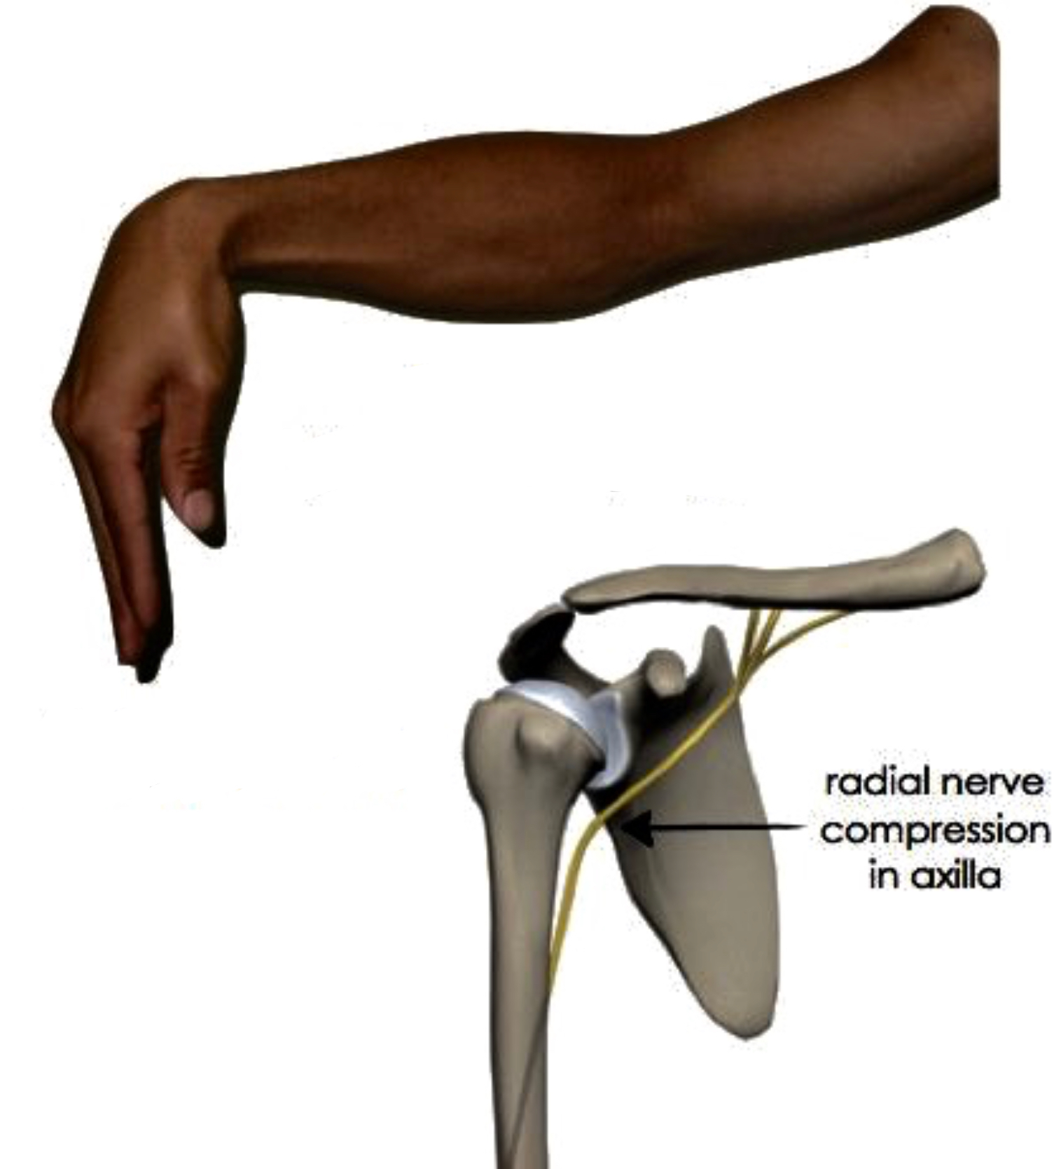
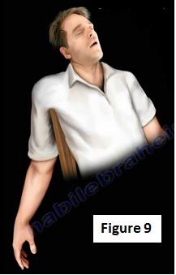
Injuries to the Radial nerve
In the axilla The nerve can be injured by:
A drunkard falling asleep with one arm over the back of a chair**.
By fractures and dislocations of the proximal end of the humerus*.
The triceps, the anconeus, and the long extensors of the wrist are paralyzed.
The patient is unable to extend the elbow & the wrist joints, and the fingers (Wrist Drop)
In the Spiral Groove:
Injury or fracture of the spiral groove of the humerus, the patient is unable to extend the wrist and the fingers (Wrist Drop).
**Saturday night paralysis
*a dislocation of the shoulder joint will cause the head of humerus to descend to the axilla (because of the presence of the rotator cuff) and press on the radial nerve.

Slide 15
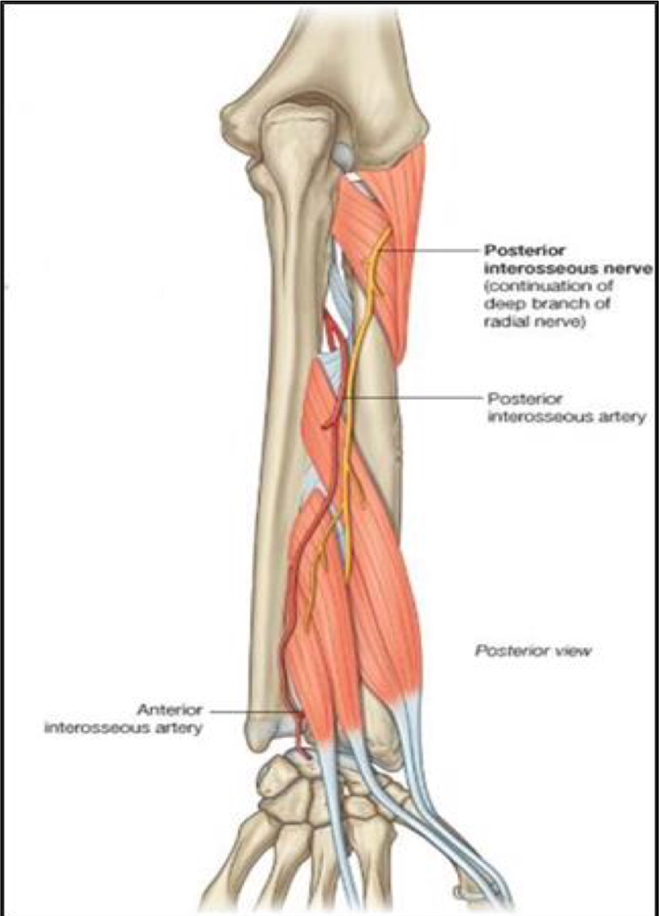
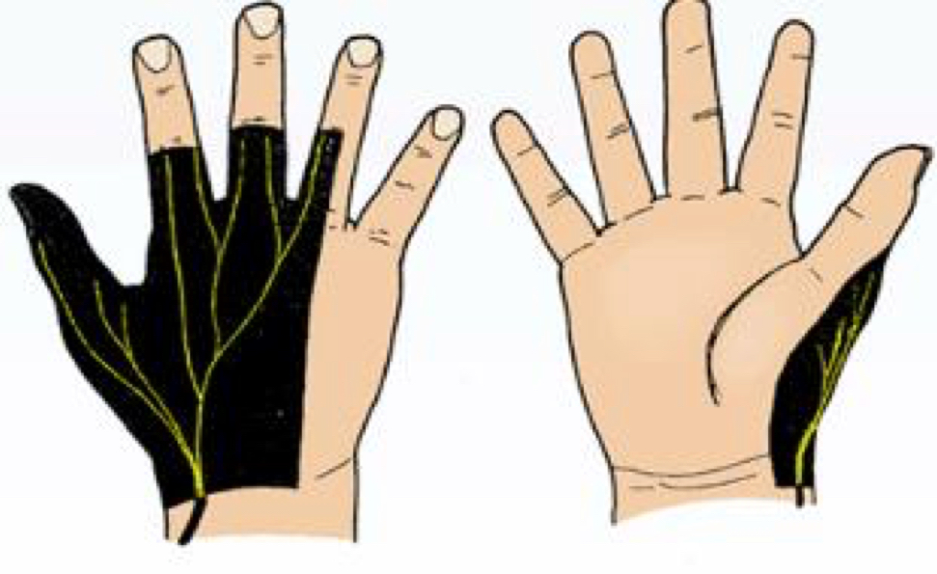
Injuries to the superficial branch of the radial nerve
Injuries to the deep branch of the radial nerve
The deep branch of the radial nerve is purely Motor (It supplies the extensor muscles in the posterior compartment of the forearm).
• It can be damaged in fractures of the proximal end of the radius or during dislocation of the radial head.
• The nerve that supply the supinator and the extensor carpi radialis longus will be undamaged.
and because the latter muscle is powerful, it will keep the wrist joint extended,
• (No wrist Drop) ABE muscles are still working • No sensory loss
Superficial radial nerve, is a Sensory nerve.
Injury like a stab wound, results in a variable small area of anesthesia over the dorsum of the hand and lateral three and half fingers up to the base of their distal phalanges.

Slide 16
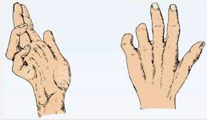
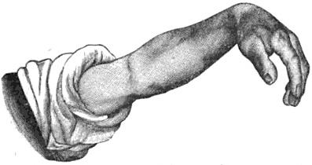
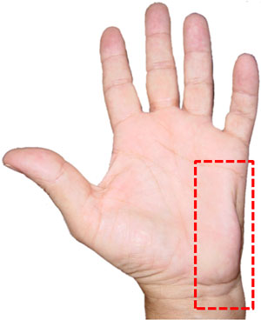
Ulnar nerve Injury
*Partial: only 2 fingers are affected (complete in case of injury to both median & ulnar nerves)
** Claw Hand: is characterized deformity of ulnar nerve injury, it causes extension of metacarpophalangeal joint and flexion of interphalangeal joints. Opposite to writing position.
Different deformities of Nerve injury
At the Elbow:
Atrophy of Ulnar side of forearm.
Flexion of the wrist with Abduction.
Partial* Claw hand.**
Wasting of Hypothenar Eminence.
Claw Hand
Ulnar Nerve
Wrist Drop
Radial Nerve
At the wrist:
Partial Claw Hand.
Wasting of Hypothenar Eminence.
Ape Hand
Median Nerve

Slide 17
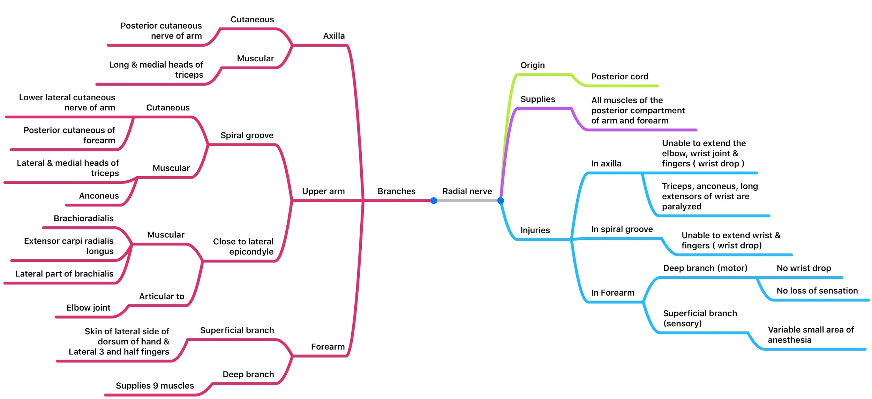
Summary

Slide 18
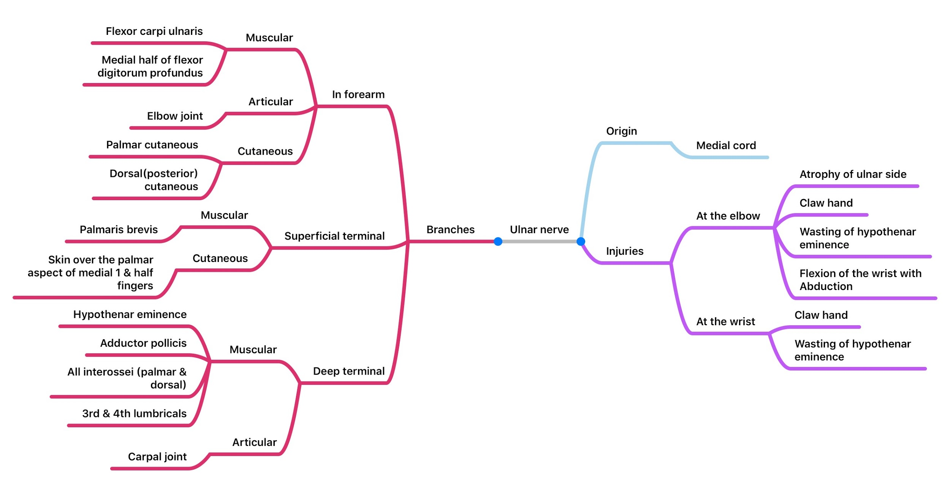
Summary

Slide 19
SAQ
Questions
The roots contributing to the radial nerve are
Posterior cord C8,T1
Posterior cord C5,6,7,8,T1
Medial cord C5,6,7,8,T1
6. Describe the characteristics of ulnar nerve injury at the wrist.
4. The neck of the humerus is directly in contact with which of the following nerves?
Axillary nerve
Radial nerve
Medial nerve
7. Name 5 muscles innervated by the deep branch of the radial nerve.
2. The radial nerve divides into deep and superficial branches where?
In the axilla
Close to the lateral condyle
At the cubital fossa
8. Which part of the humerus is directly in contact with the ulnar nerve?
5. A man with injury of the radial nerve at the spiral groove will be able to:
Extend wrist
Extend elbow
Extend fingers
3. The shaft of the humerus is directly in contact with which of the following nerves?
Radial nerve
Ulnar nerve
Musculocutaneous nerve
Answers: 1. B 2. C 3. A 4. A 5. B
6. Hypothenar eminence wasting, claw hand
7. Supinator, Extensor pollicis brevis, extensor digitorum, extensor digiti minimi, extensor carpi ulnaris
8. Medial epicondyle

Slide 20
Team Members
Faisal Fahad Alsaif (Team Leader) Abdulaziz Al dukhayel ‏Fahad Alfaiz ‏Akram Alfandi ‏Saad Aloqile ‏Saleh Almoaiqel ‏Abdulaziz Alabdulkareem ‏Abdullah Almeaither ‏Yazeed Aldossari ‏Muath Alhumood Abdulrahman Almotairi
‏
Abdulelah Aldossari ‏Abdulrahman Alduhayyim ‏Hamdan Aldossari ‏Mohammed Alomar ‏Abdulrahman Aldawood ‏Saud Alghufaily ‏Hassan Aloraini Khalid Almutairi‏‏
Lamia Abdullah Alkuwaiz (Team Leader)
Rawan Mohammad Alharbi
Abeer Alabduljabbar Afnan Abdulaziz Almustafa Ahad Algrain Alanoud Almansour Albandari Alshaye AlFhadah abdullah alsaleem Arwa Alzahrani Dana Abdulaziz Alrasheed Dimah Khalid Alaraifi Ghada Alhaidari Ghada Almuhanna Ghaida Alsanad Hadeel Khalid Awartani Haifa Alessa Khulood Alwehabi Layan Hassan Alwatban Lojain Azizalrahman Lujain Tariq AlZaid
Maha Barakah Majd Khalid AlBarrak Norah Alharbi Nouf Alotaibi Noura Mohammed Alothaim Rahaf Turki Alshammari Reham Alhalabi Rinad Musaed Alghoraiby Sara Alsultan Shahad Alzahrani Wafa Alotaibi Wejdan Fahad Albadrani Wjdan AlShamry
Abdulmajeed Alwardi ‏Abdulrahman Alageel ‏Rayyan Almousa ‏Sultan Alfuhaid ‏Ali Alammari ‏Fahad alshughaithry Fayez Ghiyath Aldarsouni ‏Mohammed Alquwayfili ‏‏Abduljabbar Al-yamani ‏Sultan Al-nasser ‏Majed Aljohani ‏Zeyad Al-khenaizan ‏Mohammed Nouri ‏Abdulaziz Al-drgam ‏Fahad Aldhowaihy ‏Omar alyabis

