Slide 1
Hand and Wrist
Lecture 15
Please check our Editing File.
هذا العمل لا يغني عن المصدر الأساسي للمذاكرة
{وَمَنْ يَتَوَكَّلْ عَلَى اللَّهِ فَهُوَ حَسْبُهُ}

Slide 2
Objectives
Describe the anatomy of the deep fascia of the wrist & hand (flexor & extensor retinacula & palmar aponeurosis).
List the structures passing superficial & deep to flexor retinaculum.
Describe the anatomy of the insertion of long flexor & extensor tendons.
Describe the anatomy of the small muscles of the hand (origin, insertion action & nerve supply)
Text in BLUE was found only in the boys’ slides
Text in PINK was found only in the girls’ slides
Text in RED is considered important
Text in GREY is considered extra notes

Slide 3
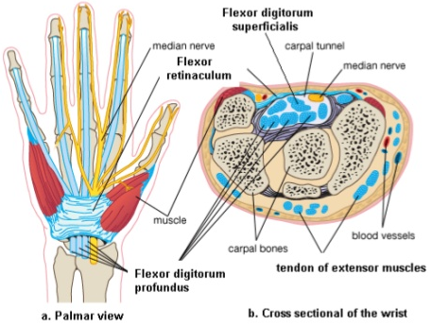
Retinacula
Retinaculum=single | Retinacula=plural Flexor & Extensor Retinaculum: Bands of Deep (thickening) Fascia at the Wrist
Function | Hold the long flexor and extensor tendons at the wrist in position.
Attachment | Medially: Both retinacula attached to Pisiform & Hook of Hamate. Laterally: - Flexor Retinaculum attached to Tubercle of Scaphoid & Trapezium. - Extensor Retinaculum attached to Distal end of Radius.

Slide 4
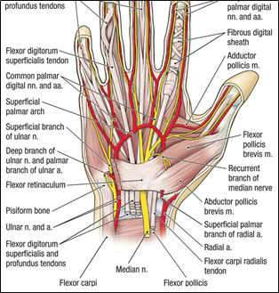
Structure superficial to flexor Retinaculum
From Medial to Lateral
1. Tendon of Flexor carpi ulnaris. 2. Ulnar nerve. 3. Ulnar artery. 4. Palmar cutaneous branch of ulnar nerve. 5. Palmaris longus tendon. 6. Palmar cutaneous branch of median nerve. Do NOT enter the carpal tunnel

Slide 5
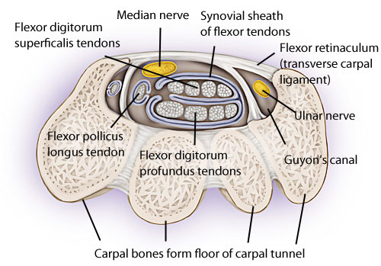
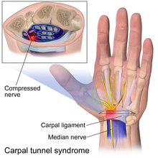
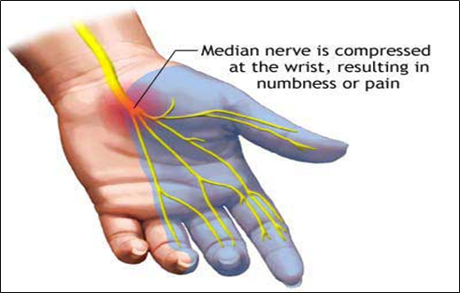
*Paresthesia refers to a burning or prickling sensation that is usually felt in the hands, arms, legs, or feet, but can also occur in other parts of the body.
Carpal Tunnel
Form | from Concave anterior surface of the Carpus covered by Flexor Retinaculum.
Content | From Medial to Lateral • Tendons of flexor digitorum superficialis & profundus • Median nerve • Flexor Pollicis Longus • Flexor carpi radialis
Carpal tunnel syndrome | Causes : Compression of the median nerve within the carpal tunnel. Manifestations: 1. Burning pain (pins and needles ) in the lateral three and half fingers. 2. No paresthesia* over the thenar eminence “Because the palmar cutaneous of median nerve does not go under the tunnel” 3. Weakness or atrophy of the thenar muscles (Ape Hand). 4. Inability to Oppose the thumb.

Slide 6
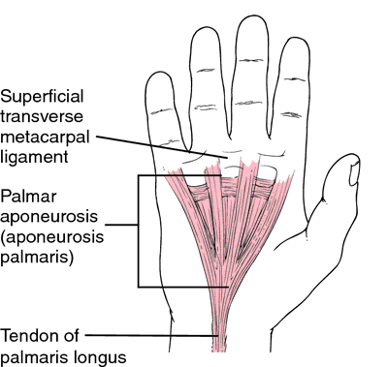
Palmar Aponeurosis
- The Thickened deep fascia of the Palm. - it is Triangular in shape , occupies the central area of the palm.
Apex | Attached to the distal border of flexor retinaculum and receives the insertion of palmaris longus tendon.
Base | Divides at the bases of the fingers into four slips that pass into the fingers
Functions | 1. Firmly attached to the overlying skin and improves the grip. 2. Protects the underlying tendons, vessels & nerves. 3. Gives origin to palmaris brevis muscle.

Slide 7
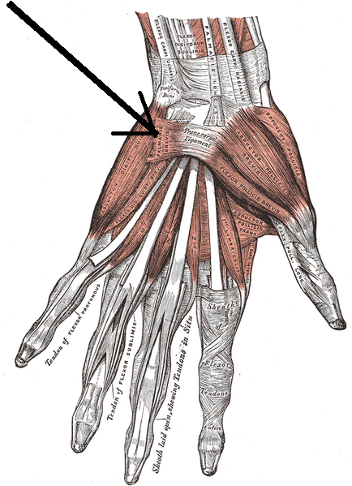
Small muscles of the hand
Palmaris Brevis
Origin | Flexor retinaculum (FR) & Palmar aponeurosis (PA)
Insertion | Skin of the palm.
Nerve supply | Ulnar nerve (superficial branch)
Action | Corrugation of skin to improve grip.

Slide 8
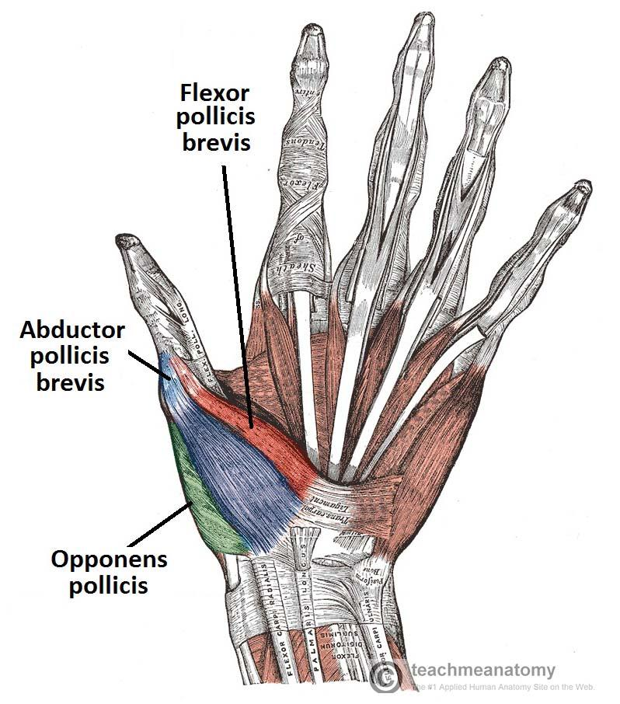
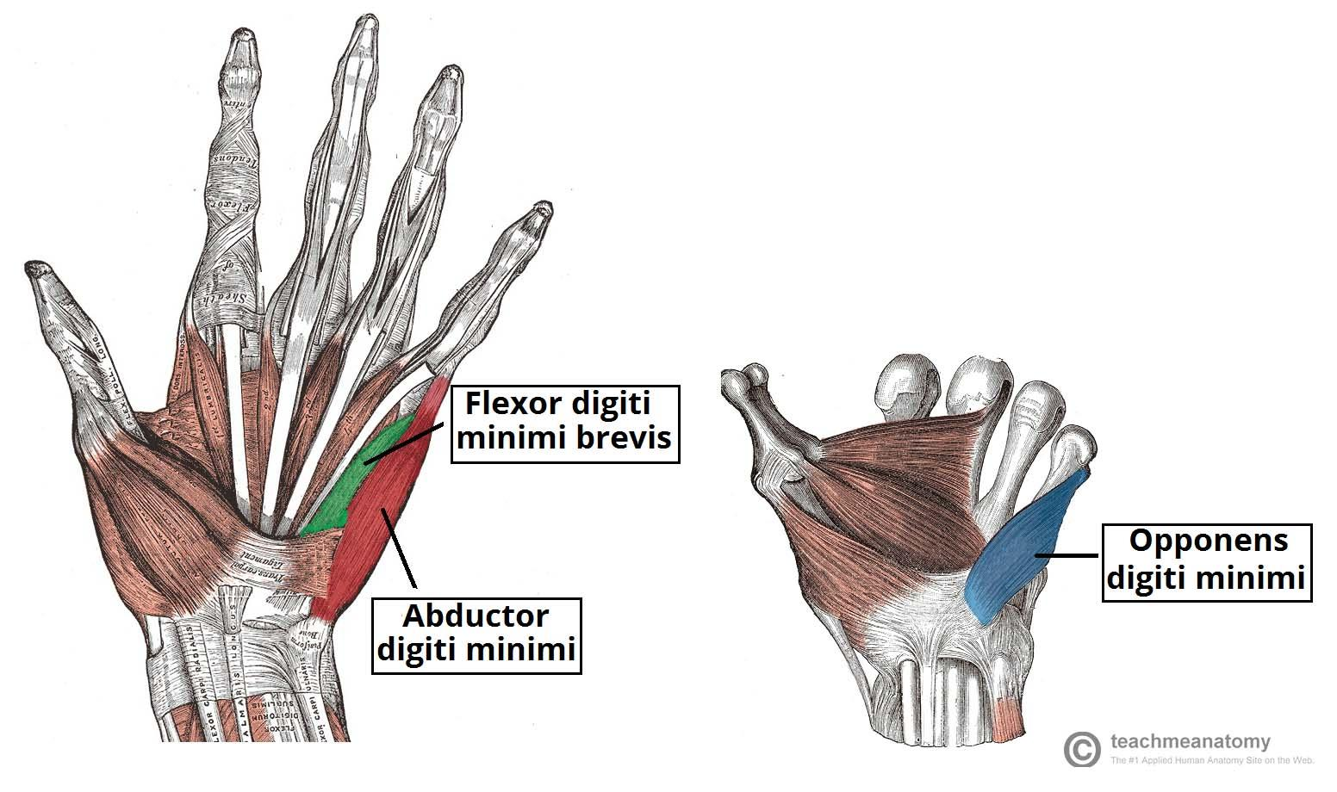
Short muscles of hand (thumb & little finger) + Movement of thumb
Team436
Can be remembered using the mnemonic, "A OF A OF A" for:
(thenar muscles) ❖ Abductor pollicis brevis
❖Opponens pollicis
❖ Flexor pollicis brevis
❖ Adductor pollicis (Hypothenar muscles) ❖ Opponens digiti minimi
❖ Flexor digiti minimi
❖ Abductor digiti minimi

Slide 9
Small muscles of the hand
Hypothenar Eminence (3 muscles)
 | Abductor Digiti minimi | Flexor Digiti Minimi | Opponens Digiti Minimi
Origin | Pisiform | Flexor retinaculum | Flexor retinaculum
Insertion | Base of proximal phalanx | Base of proximal phalanx | Palmer surface of 5th metacarpal
Nerve supply | Deep branch of ulnar nerve | Deep branch of ulnar nerve | A Deep branch of ulnar nerve
Action | Abduction of little finger | Flexion of little finger | Pulls the 5th metacarpal forward

Slide 10
Small muscles of the hand
Thenar Eminence (3 muscles)
 | Abductor Pollicis Brevis | Flexor Pollicis Brevis | Opponens Pollicis
Origin | Flexor retinaculum, Scaphoid and trapezium | Flexor retinaculum | Flexor retinaculum
Insertion | Base of proximal phalanx | Base of proximal phalanx | Lateral part of 1st metacarpal
Nerve supply | Supplied by median nerve | Supplied by median nerve | Supplied by median nerve
Action | Abduction of thumb | Flexion of thumb | Opposition of thumb

Slide 11
Small muscles of the hand
Not in the Thenar Eminence

Slide 12
Small muscles of the hand
“Writing Position”

Slide 13
Small muscles of the hand

Slide 14
Small muscles of the hand

Slide 15
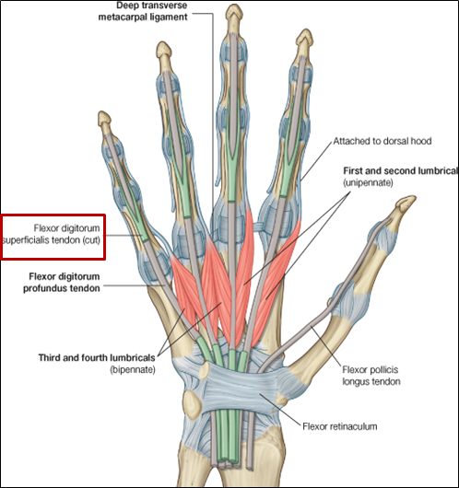
Insertion of:
Flexor dig superficialis | Each tendon: - Divides into two halves & pass around the Profundus Tendon. - The two halves Meet on the posterior aspect of Profundus tendon (partial decussation of fibers). - Reunion of the two halves. - Further Division into two slips attached to the Borders of Middle Phalanx. | Green -> superficialis |Grey -> Profundus
Flexor dig Profundus | Inserted into the Base of the Distal Phalanx.

Slide 16
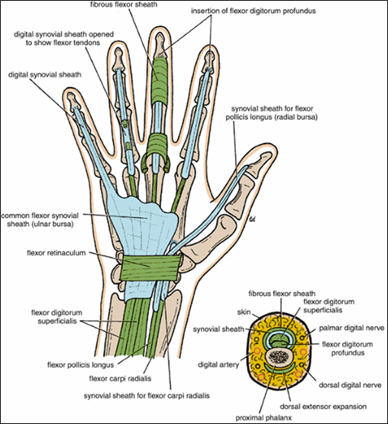
Fibrous flexor (digital) sheath
Fibrous Flexor is strong fibrous sheath which covers the anterior surface of the fingers and attached to the sides of the phalanges . Its proximal end is opened. Its distal end is closed. The sheath with the anterior surface of the phalanges and interphalangeal joints form osteofibrous blind tunnel for the long Flexor tendons of fingers.

Slide 17
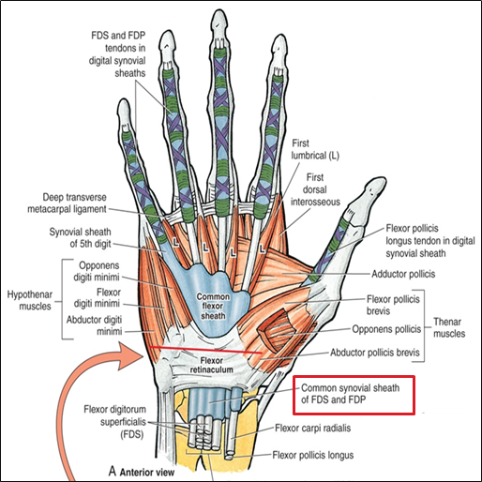
Synovial flexor sheath
A- Common synovial sheath ( Ulnar bursa ) Contains tendons of Flexor digitorum superficialis and profundus. The medial part of the sheath extends distantly ( without interruption) on the tendons of the little finger. The lateral part of the sheath stops on the middle of the palm. (doesn't cover the 3 middle fingers) The distal ends of the long Flexor tendons to - index, middle and ring - fingers acquire digital synovial sheaths. B- Flexor Pollicis Longus Tendon has its own synovial sheath ( Radial bursa)
Functions | They allow the long tendons to move smoothly with a minimum of friction beneath the Flexor retinaculum and the fibrous Flexor sheaths

Slide 18
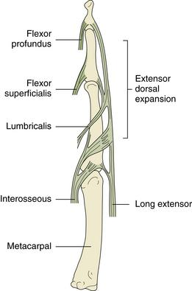
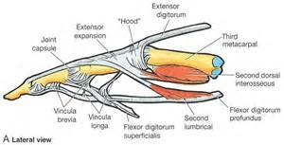
Extensor Expansion
- Formed from the expansion of the tendons of extensor digitorum at the PIJ (P = proximal - I = interphalangeal - J = joint) - The tendon splits into three parts: One Central: inserted into the base of Middle phalanx. Two laterals: inserted into the base of the Distal phalanx. - The Expansion Receives the insertions of: Corresponding Interosseous muscle (on each side). Lumbrical muscle (on the lateral side).

Slide 19
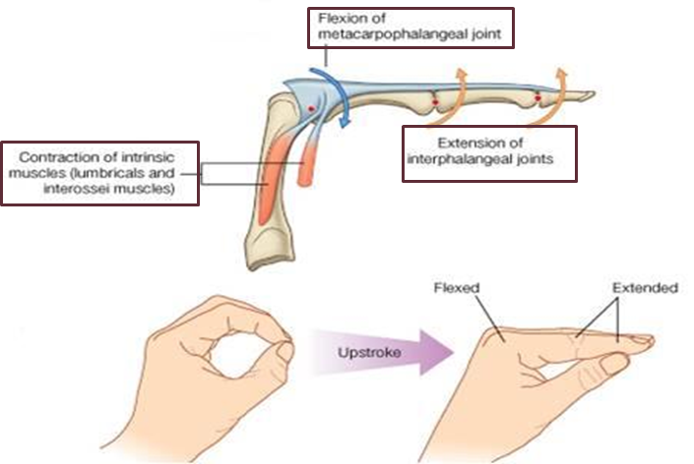
Action of Lumbricals & Interossei
Writing position

Slide 20
MCQs
SAQ
(4) Which one of the following is a symptom of Carpal Tunnel Syndrome _______ :
A- burning pain
B- weakness
C- both A and B
(5) Retinacula bands of ______ Fascia at the Wrist :
A- deep
B- superficial
C- both A and B
(1) Which one of the following is Hypothenar Eminence ______ : A- abductor digiti minimi B- opponens digiti minimi
C- both A & B
(2) Each tendon of flexor digiti superficialis divides into ______ around the profundus tendon :
A- 2
B- 3
C- 4
(3) In Fibrous Flexor (Digital) Sheath the proximal end is ______ and the distal end is ______ :
A- closed, opened
B- opened, closed
C- opened, opened
(1) List the attachment Retinacula?
(2) A boy injured his median nerve and as a result there was a wasting in the thenar muscles. List the muscles affected and the action of each one?
(3) Lost the Structure superficial to flexor Retinaculum from medial to lateral?

Slide 21
(MCQs)
1-B
2-A
3-B
4-C
5-A
Answers
SAQ:
(1) Medially:
Both retinacula attached to Pisiform & Hook of Hamate.
Laterally:
- Flexor Retinaculum attached to Tubercle of Scaphoid & Trapezium.
- Extensor Retinaculum attached to Distal end of Radius.
(2) 1) abductor pollicis brevis (abduction)
2) flexor pollicis brevis (flexion)
3) opponens pollicis (opposition)
(3) 1. Tendon of Flexor carpi ulnaris.
2. Ulnar nerve.
3. Ulnar artery.
4. Palmar cutaneous branch of ulnar nerve.
5. Palmaris longus tendon.
6. Palmar cutaneous branch of median nerve.

Slide 22
Team Members
Faisal Fahad Alsaif (Team Leader) Abdulaziz Al dukhayel ‏Fahad Alfaiz ‏Akram Alfandi ‏Saad Aloqile ‏Saleh Almoaiqel ‏Abdulaziz Alabdulkareem ‏Abdullah Almeaither ‏Yazeed Aldossari ‏Muath Alhumood Abdulrahman Almotairi
‏
Abdulelah Aldossari ‏Abdulrahman Alduhayyim ‏Hamdan Aldossari ‏Abdullah Alqarni ‏Mohammed Alomar ‏Abdulrahman Aldawood ‏Saud Alghufaily ‏Hassan Aloraini Khalid Almutairi‏‏
Lamia Abdullah Alkuwaiz (Team Leader)
Rawan Mohammad Alharbi
Abeer Alabduljabbar Afnan Abdulaziz Almustafa Ahad Algrain Alanoud Almansour Albandari Alshaye AlFhadah abdullah alsaleem Arwa Alzahrani Dana Abdulaziz Alrasheed Dimah Khalid Alaraifi Ghada Alhaidari Ghada Almuhanna Ghaida Alsanad Hadeel Khalid Awartani Haifa Alessa Khulood Alwehabi Layan Hassan Alwatban Lojain Azizalrahman Lujain Tariq AlZaid
Maha Barakah Majd Khalid AlBarrak Norah Alharbi Nouf Alotaibi Noura Mohammed Alothaim Rahaf Turki Alshammari Reham Alhalabi Rinad Musaed Alghoraiby Sara Alsultan Shahad Alzahrani Wafa Alotaibi Wejdan Fahad Albadrani Wjdan AlShamry
Abdulmajeed Alwardi ‏Abdulrahman Alageel ‏Rayyan Almousa ‏Sultan Alfuhaid ‏Ali Alammari ‏Fahad alshughaithry Fayez Ghiyath Aldarsouni ‏Mohammed Alquwayfili ‏‏Abduljabbar Al-yamani ‏Sultan Al-nasser ‏Majed Aljohani ‏Zeyad Al-khenaizan ‏Mohammed Nouri ‏Abdulaziz Al-drgam ‏Fahad Aldhowaihy ‏Omar alyabis

