Slide 1
Frontal and the Medial Compartments of Thigh
Lecture 16
Please check our Editing File.
هذا العمل لا يغني عن المصدر الأساسي للمذاكرة
{وَمَنْ يَتَوَكَّلْ عَلَى اللَّهِ فَهُوَ حَسْبُهُ}

Slide 2
Objectives
List the name of muscles of anterior compartment of thigh.
Describe the anatomy of muscles of anterior compartment of thigh regarding: origin, insertion, nerve supply and actions.
List the name of muscles of medial compartment of thigh.
Describe the anatomy of muscles of medial compartment of thigh regarding: origin, insertion, nerve supply and actions.
Describe the anatomy of femoral triangle & adductor canal regarding: site, boundaries and contents.
Text in BLUE was found only in the boys’ slides
Text in PINK was found only in the girls’ slides
Text in RED is considered important
Text in GREY is considered extra notes

Slide 3
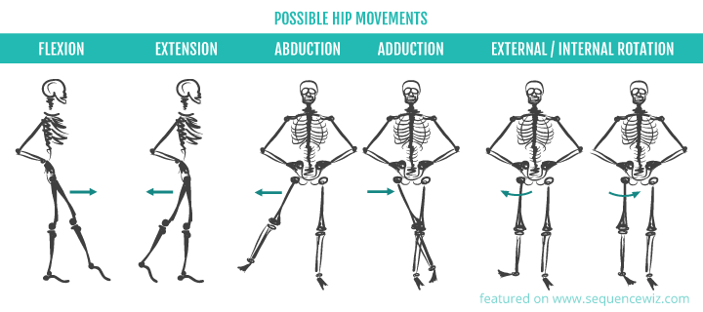
Team 436
Or lateral
Or medial

Slide 4
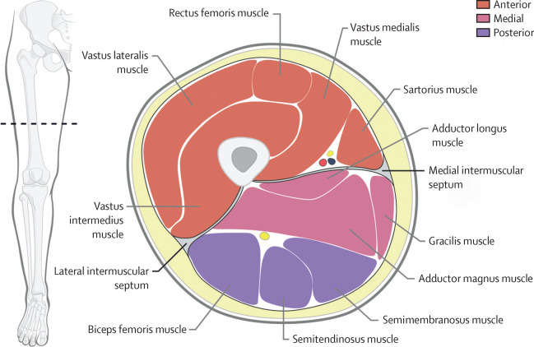
The thigh is divided into 3 compartments
by 3 intermuscular septa (extending from deep fascia into femur)
Medial Compartment:
Adductors of hip:
1- Adductor longus muscle.
2- Adductor brevis muscle.
3- Adductor magnus
(adductor part) muscle.
4- Gracilis muscle.
Nerve supply:
Obturator nerve.
,L
Anterior Compartment:
Extensors of knee:
Quadriceps femoris.
Flexors of hip:
1-Sartorius muscle.
2-Pectineus muscle.
3- psoas major muscle.
4- Iliacus muscle.
Nerve supply:
Femoral nerve.
femur
Posterior Compartment:
Flexors of knee & extensors of hip:
Hamstrings muscle.
Nerve supply:
Sciatic nerve.
Longus = Long
Brevis = Short
Magnus = Big

Slide 5
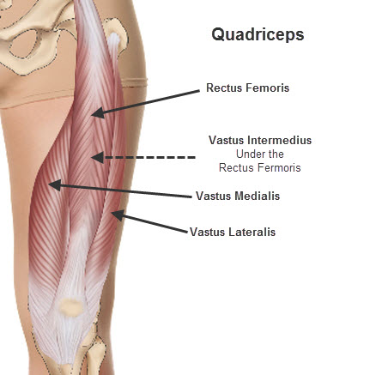
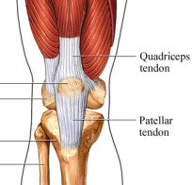
Anterior compartment
1- Quadriceps femoris (4 muscles):
 | Rectus femoris | Vastus intermedius | Vastus medialis | Vastus lateralis
origin | Anterior inferior iliac spine (Hip bone) | Front of shaft of femur | Posterior border of femur “linea aspera” | Posterior border of femur “linea aspera”
insertion | Into PATELLA (is a sesamoid bone) *final insertion (Tuberosity of tibia) *From patella into TUBEROSITY OF TIBIA through ligamentum patellae (patellar ligament)
Nerve supply | Femoral nerve
Action | Extension of knee joint

Slide 6
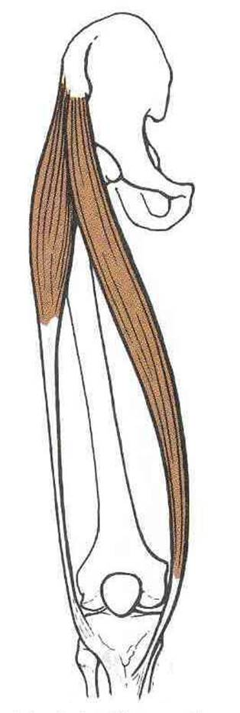
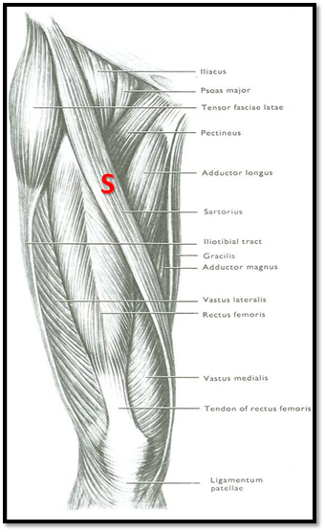
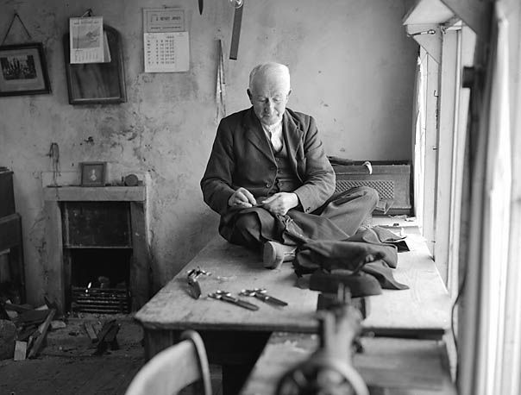
Anterior compartment
2- Sartorius
origin | Anterior superior iliac spine.
insertion | Upper part of medial surface of tibia SGS: same insertion S: sartorius G: gracilis S: semitendinosus
Nerve supply | Femoral nerve
Action | Hip joint: Flexion, Abduction and Lateral rotation. (Tailor’s position) Knee joint: Flexion. لما تتربع على الأرض

Slide 7
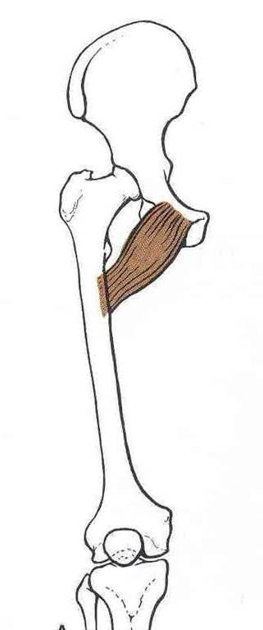
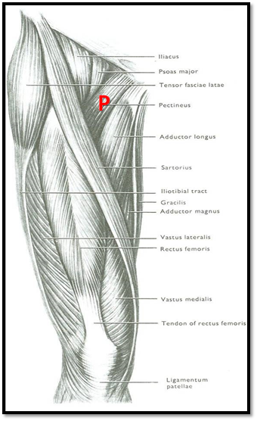
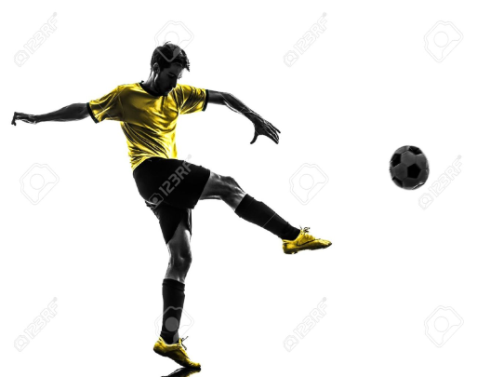
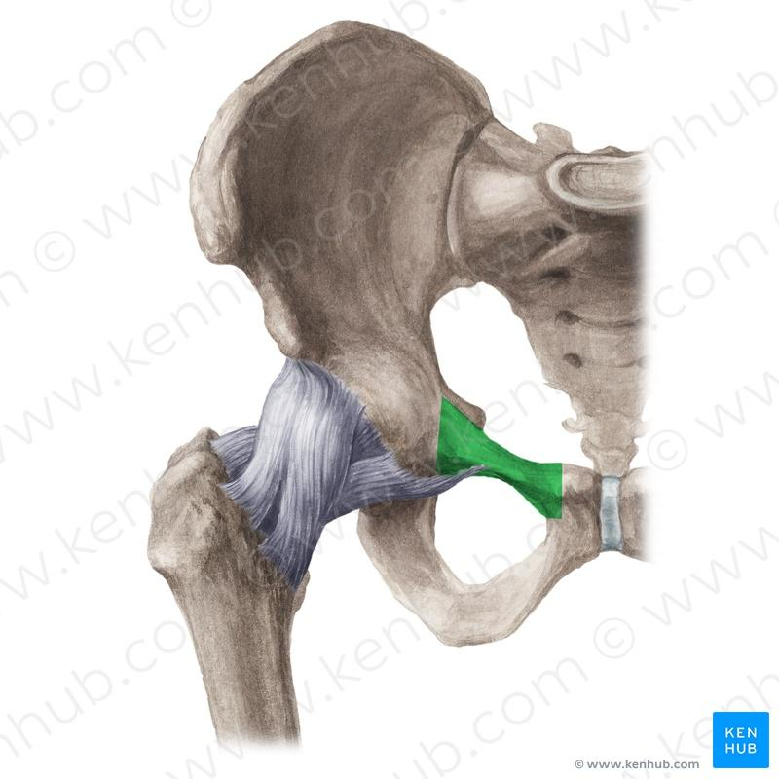
Anterior compartment
3- pectineus
origin | Superior pubic ramus
insertion | Back of femur (below lesser trochanter)
Nerve supply | Femoral nerve
Action | Flexion & adduction of Hip joint.

Slide 8
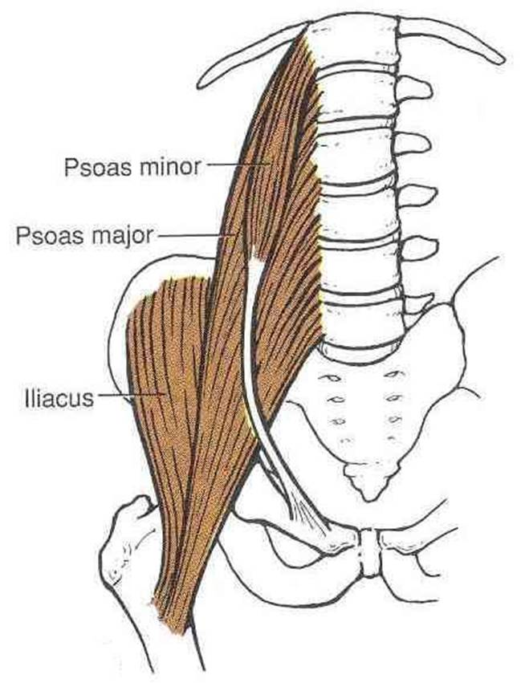
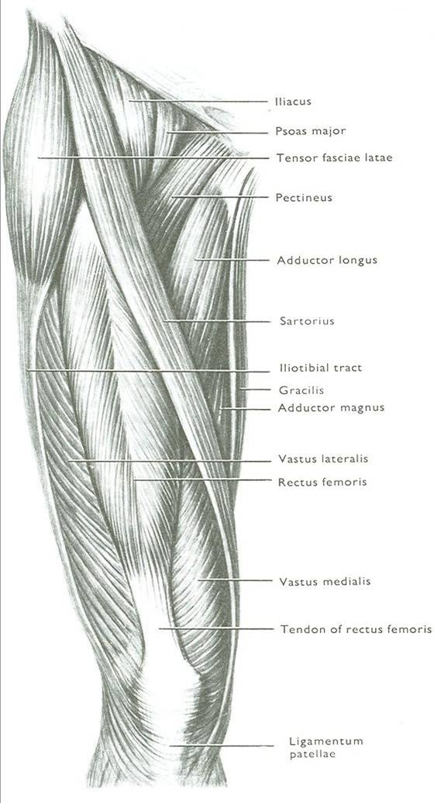
Anterior compartment
4- ILIOPSOAS: ILIACUS & PSOAS MAJOR الأورجن يختلف بس لهم نفس الانسيرشن
origin | Iliacus: ilium of hip bone Psoas: transverse process of lumbrical vertebral
insertion | Lesser trochanter of femur
Nerve supply | Femoral nerve
Action | Flexion of hip joint

Slide 9
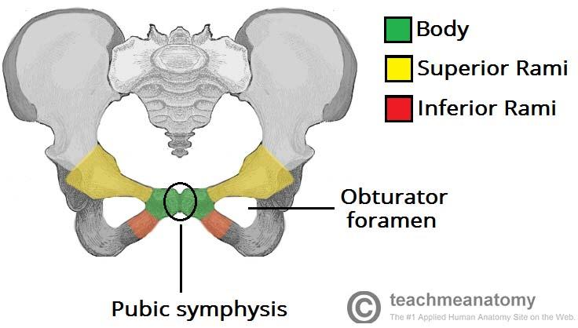
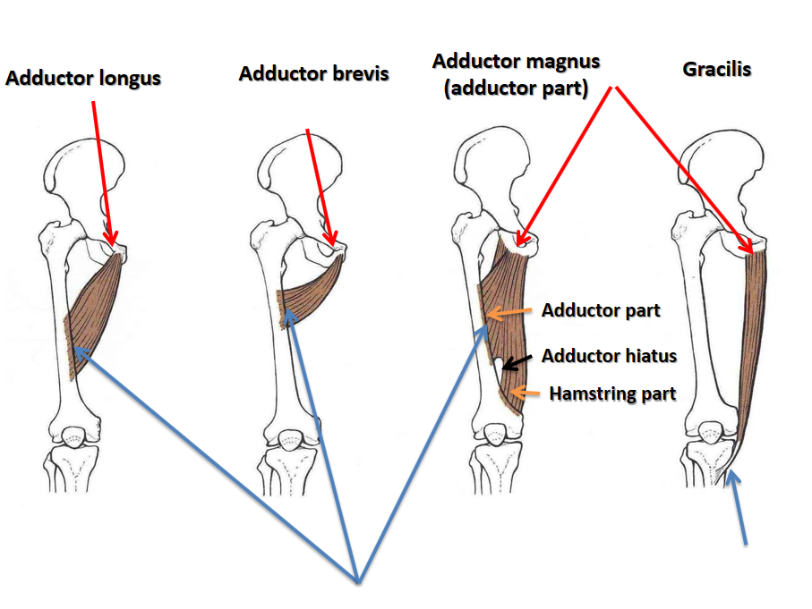
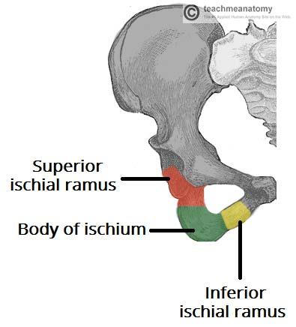
Medial compartment
 | Adductor longus | Adductor brevis | Adductor magnus (adductor part) | Gracilis
origin | Body of pubis | 1-Body of pubis 2- inferior pubic ramus | 1-Inferior pubic ramus 2- ischial ramus
insertion | Posterior border of femur ( Linea Aspera) |  |  | Upper part of medial surface of tibia *SGS* (behind sartorius)
Nerve supply | Obturator nerve
Action | Adduction of hip joint N.B.: Gracilis also flexes knee joint + adduction of thigh
(The most medial )
Extra for understanding
Origins are shown in red arrows
Insertions are shown in blue arrows
Note that Adductor magnus and Gracilis have the same origin as mentioned in the boys slides, according to Gray's Anatomy for Students
Extra notes:
-Adductor magnus is greater than longus
-Gracilis muscle is the second one from SGS which share the same insertion ((Upper part of medial
surface of tibia))

Slide 10
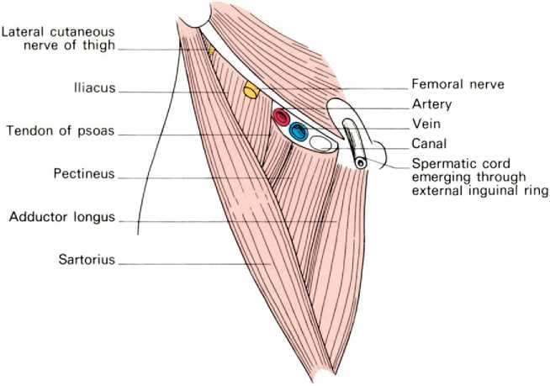
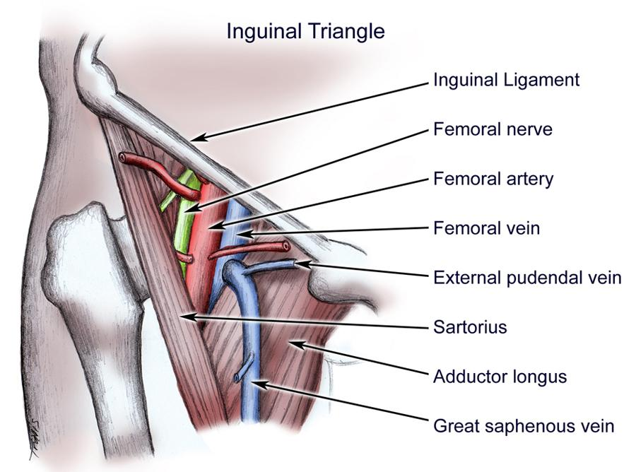
FEMORAL TRIANGLE
CONTENTS:
Femoral vein
Femoral artery
Femoral nerve “the nerve is outside femoral sheath”.
Deep inguinal lymph nodes.
Site:
Upper 1/3 of front of thigh.
BOUNDARIES:
Base: inguinal ligament.
Lateral: medial border of sartorius.
Medial: medial border of adductor longus.
ROOF:
Skin.
Fasciae*: superficial & deep.
FLOOR: From medial to lateral
Adductor longus muscle.
Pectineus muscle.
Psoas major muscle.
Iliacus muscle.
Both vein & artery are enclosed in
a fascial envelope (Femoral sheath).
*fasciae = connective tissue

Slide 11
ADDUCTOR CANAL (Subsartorial canal)
(Deep to Sartorius muscle) اسم آخر لها ، لأنها تقع
DEFINITION:
intermuscular passage of A fascial envelope for femoral artery & vein to become the popliteal vessels in the popliteal fossa at the back of knee.
Team 436: (Other def: it is an aponeurotic tunnel of femoral artery & vein) .
SITE:
In middle 1/3 of front of thigh.
EXTENT:
From apex of femoral triangle to adductor hiatus
(in adductor magnus).
BOUNDARIES:
Roof: Sartorius muscle.
Floor: Adductor longus & magnus muscles.
Located deep to
Sartorius muscle.

Slide 12
MCQs
SAQ
(1) Where is the femoral triangle located?
(2) What’s the content of the femoral triangle floor from medial to lateral?
(3) Name 3 muscles that are supplied by femoral nerve?
(1) the thigh is divided into?
A- 2 compartments
B- 3 compartments
C- 4 compartments
(2) flexor of the hip?
A- sartorius
B- adductor longus
C- adductor brevis
(3) the origin of sartorius ?
A- anterior superior iliac spine
B- anterior inferior iliac spine
C- front of the shaft of femur
(4) the insertion of adductor longus?
A- posterior border of femur (linea aspera)
B- upper part of medial surface of tibia
C- front of shaft of femur
(5) the base of femoral triangle?
A- medial border of adductor longus
B- medial border of sartorius
C- inguinal ligament

Slide 13
Answers (MCQs)
1-B
2-A
3-A
4-A
5-C
Answers (SAQ)
(1) Upper 1/3 of front of thigh.
(2) Adductor longus muscle.
Pectineus muscle.
Psoas major muscle.
Iliacus muscle
(3)
1-Sartorius muscle.
2-Pectineus muscle.
3- psoas major muscle.
4- Iliacus muscle.

Slide 14
Team Members
Faisal Fahad Alsaif (Team Leader) Abdulaziz Al dukhayel ‏Fahad Alfaiz ‏Akram Alfandi ‏Saad Aloqile ‏Saleh Almoaiqel ‏Abdulaziz Alabdulkareem ‏Abdullah Almeaither ‏Yazeed Aldossari ‏Muath Alhumood Abdulrahman Almotairi
‏
Abdulelah Aldossari ‏Abdulrahman Alduhayyim ‏Hamdan Aldossari ‏Abdullah Alqarni ‏Mohammed Alomar ‏Abdulrahman Aldawood ‏Saud Alghufaily ‏Hassan Aloraini Khalid Almutairi‏‏
Lamia Abdullah Alkuwaiz (Team Leader)
Rawan Mohammad Alharbi
Abeer Alabduljabbar Afnan Abdulaziz Almustafa Ahad Algrain Alanoud Almansour Albandari Alshaye AlFhadah abdullah alsaleem Arwa Alzahrani Dana Abdulaziz Alrasheed Dimah Khalid Alaraifi Ghada Alhaidari Ghada Almuhanna Ghaida Alsanad Hadeel Khalid Awartani Haifa Alessa Khulood Alwehabi Layan Hassan Alwatban Lojain Azizalrahman Lujain Tariq AlZaid
Maha Barakah Majd Khalid AlBarrak Norah Alharbi Nouf Alotaibi Noura Mohammed Alothaim Rahaf Turki Alshammari Reham Alhalabi Rinad Musaed Alghoraiby Sara Alsultan Shahad Alzahrani Wafa Alotaibi Wejdan Fahad Albadrani Wjdan AlShamry
Abdulmajeed Alwardi ‏Abdulrahman Alageel ‏Rayyan Almousa ‏Sultan Alfuhaid ‏Ali Alammari ‏Fahad alshughaithry Fayez Ghiyath Aldarsouni ‏Mohammed Alquwayfili ‏‏Abduljabbar Al-yamani ‏Sultan Al-nasser ‏Majed Aljohani ‏Zeyad Al-khenaizan ‏Mohammed Nouri ‏Abdulaziz Al-drgam ‏Fahad Aldhowaihy ‏Omar alyabis

