Slide 1
Gluteal region and the Back of the Thigh
Lecture 17
Please check our Editing File.
هذا العمل لا يغني عن المصدر الأساسي للمذاكرة
{وَمَنْ يَتَوَكَّلْ عَلَى اللَّهِ فَهُوَ حَسْبُهُ}

Slide 2
Objectives
Contents of gluteal region:
Groups of Glutei muscles and small muscles (Lateral Rotators).
Nerves & vessels.
Foramina and structures passing through them as: 1-Greater Sciatic Foramen. 2-Lesser Sciatic Foramen.
Back of thigh : Hamstring muscles.
Text in BLUE was found only in the boys’ slides
Text in PINK was found only in the girls’ slides
Text in RED is considered important
Text in GREY is considered extra notes

Slide 3
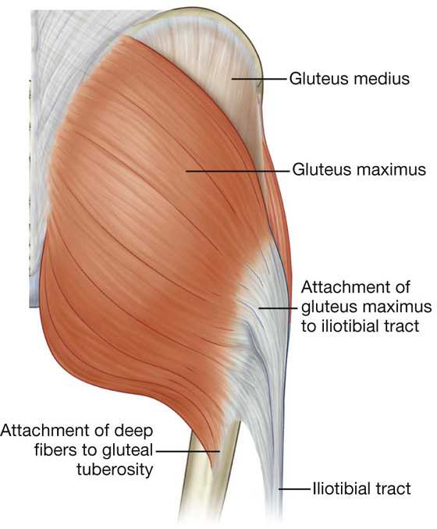
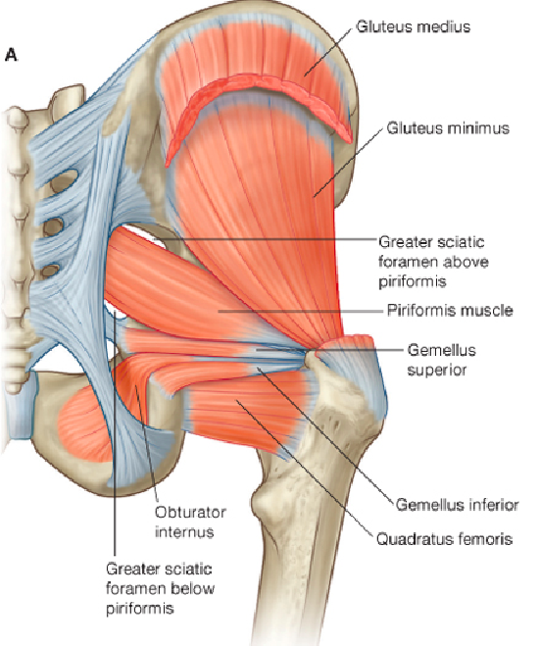
Contents of gluteal region
Muscles (8 muscles) | GLUTEI Gluteus maximus Gluteus medius Gluteus minimus GROUP OF SMALL MUSCLES (Lateral Rotators) Piriformis Obturator internus Superior gemellus Inferior gemellus Quadratus femoris

Slide 4
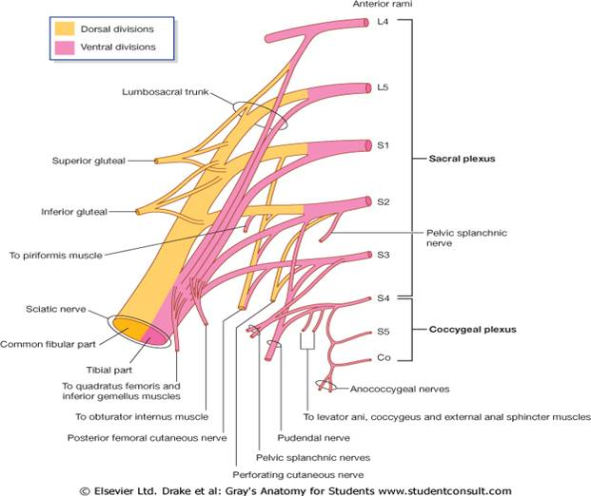
Contents of gluteal region
Nerves (7 nerves) (all from sacral plexus) | Sciatic nerve Superior gluteal nerve Inferior gluteal nerve Posterior cutaneous nerve of thigh. Nerve to obturator internus Nerve to quadratus femoris Pudendal nerve
Vessels (all from internal iliac vessels) | Superior gluteal Inferior gluteal Internal pudendal vessels

Slide 5
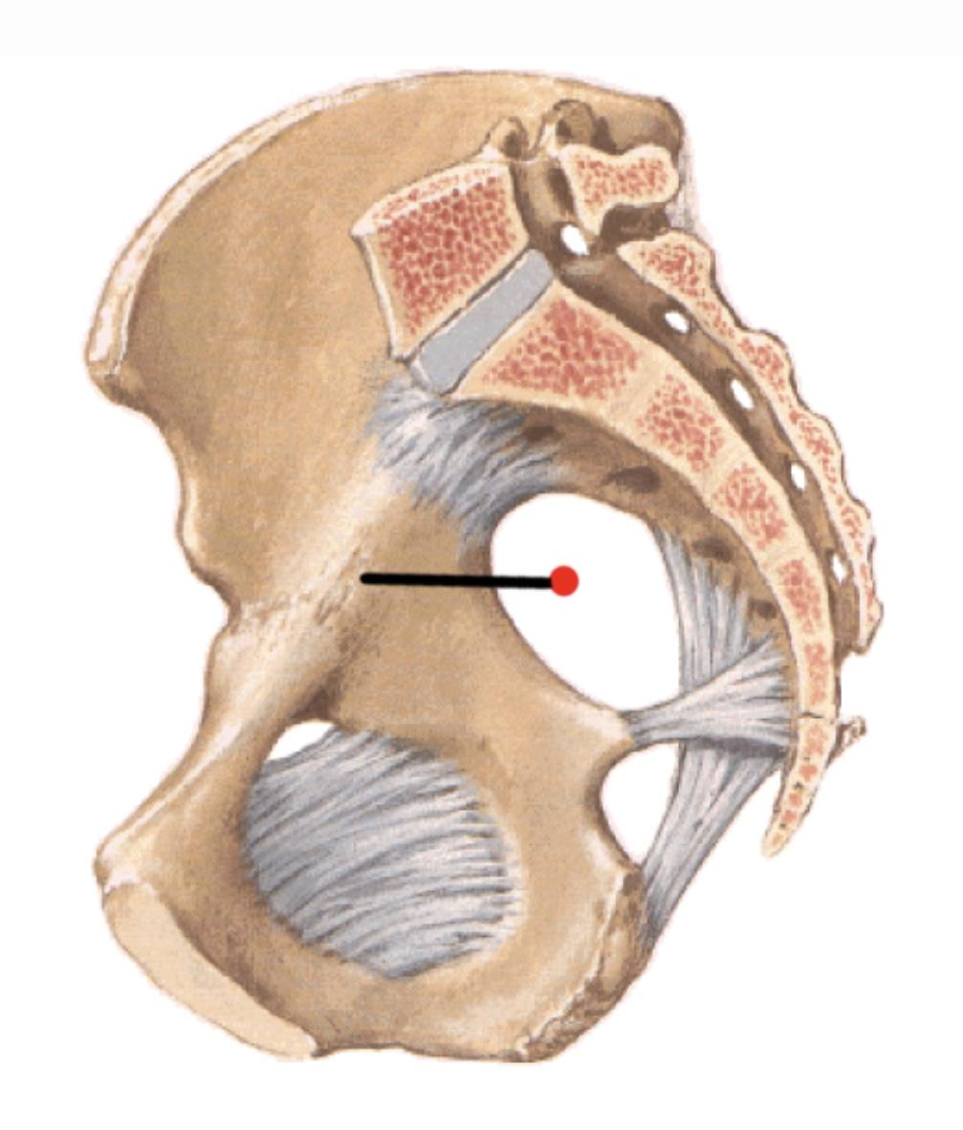
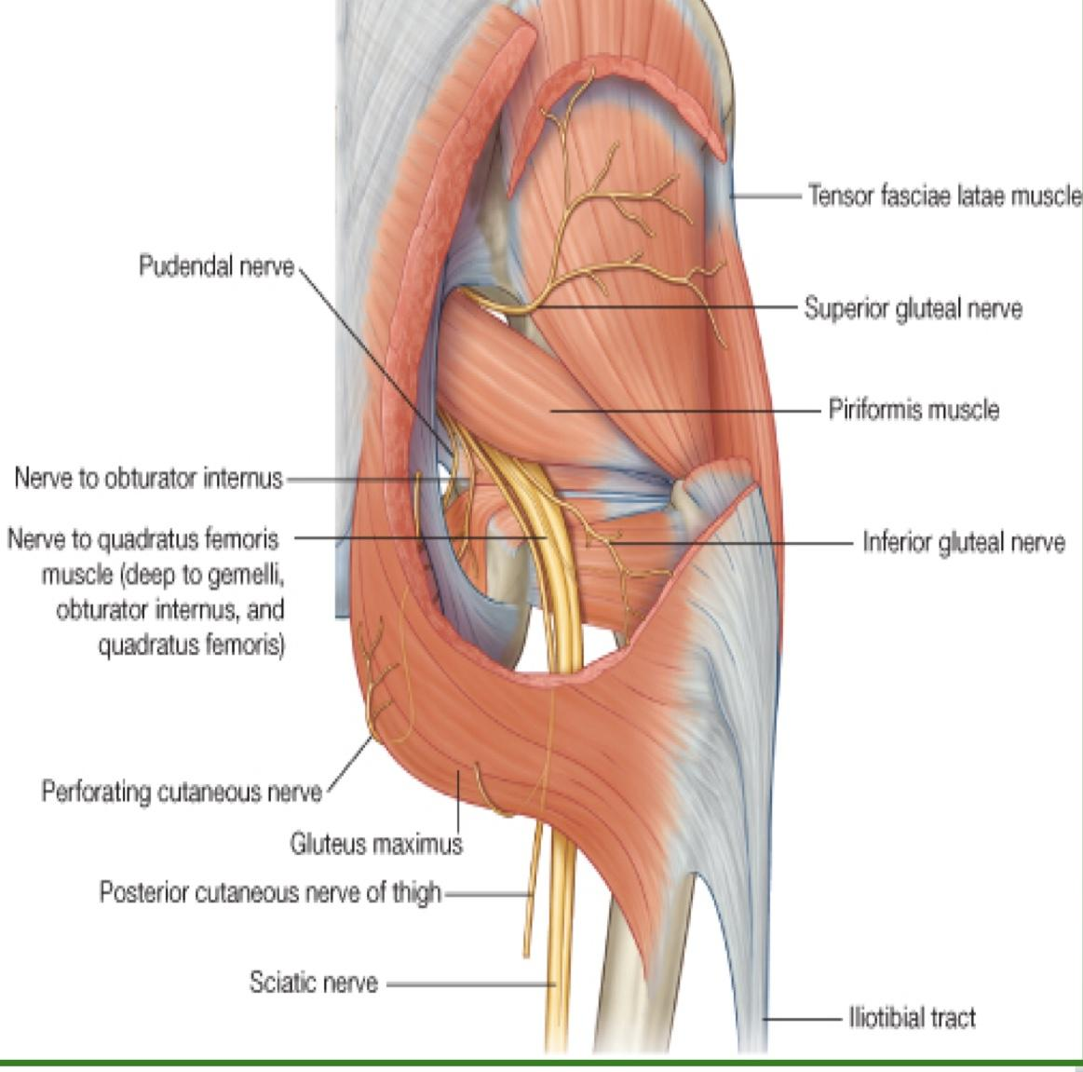
Greater sciatic foramen
 |  | Greater sciatic notch of hip bone is transformed into foramen by Sacrotuberous (between the sacrum to ischial tuberosity) & sacrospinous (between the sacrum to ischial spine) ligaments. Structures passing through Greater sciatic foramen: Piriformis muscle. Above piriformis: Superior gluteal nerves & vessels. Below piriformis: Inferior gluteal nerves & vessels. Sciatic nerve. Posterior cutaneous nerve of thigh. Nerve to quadratus femoris. Nerve to obturator internus. Pudendal nerve Internal pudendal vessels.
Greater sciatic foramen
Lesser sciatic foramen
Pass through both greater and lesser foramen.

Slide 6
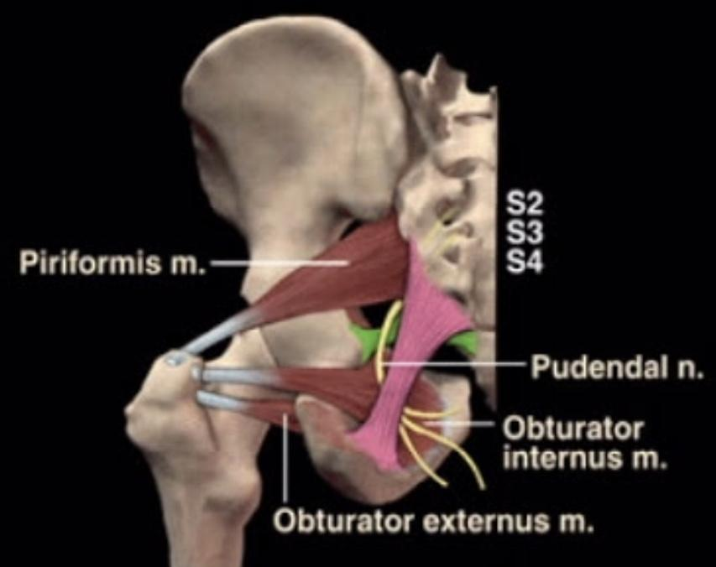
Lesser sciatic foramen
 |  | Lesser sciatic notch of hip bone is transformed into foramen by Sacrotuberous & sacrospinous ligaments. Structures passing through Lesser sciatic foramen: Tendon of obturator internus. Nerve to obturator internus. Pudendal nerve. Internal pudendal vessels.
Pass through both greater sciatic and lesser foramen:
Nerve to obturator internus.
pudendal nerve.
internal pudendal vessels.

Slide 7
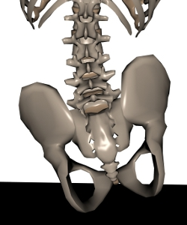
Glutei muscles
Name of the muscle | Gluteus minimus | Gluteus medius
Origin | Anterior part of the gluteal surface of ilium | Middle part of the gluteal surface of ilium
Insertion | Anterior surface of greater trochanter | Lateral surface of greater trochanter
Nerve supply | Superior gluteal nerve
Action | Abduction and medial rotation of hip joint. Normally they prevent lateral tilt of the pelvis by contraction ABDUCTORS of opposite side, on raising the other limb from ground. if the pelvis. tilts this is mean positive Trendlenburge's sign.

Slide 8
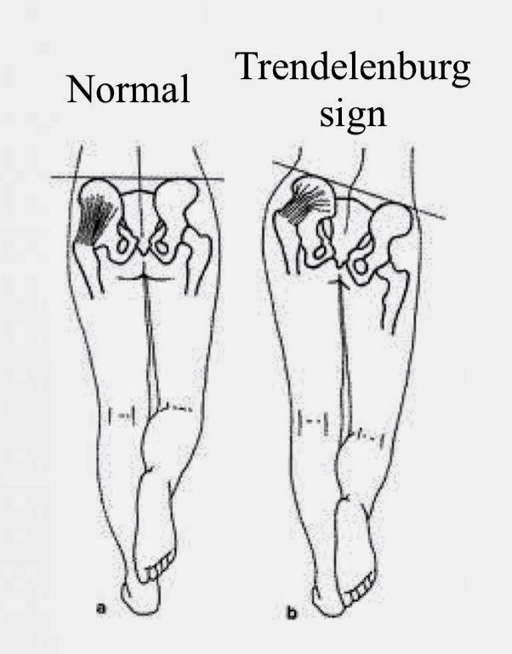
Glutei muscles
Action of gluteus minimus and medius
Right pelvic tilt as is the right picture means : paralysis of abductor of the OPPOSITE side
-the left side of the pelvis is elevated higher than the right side-
يعني الپلفس اذا مال من جهته اليسار يعني العضلة بجهة اليمين فيها مشكلة لانها ماشدت كويس والعكس
Insertions

Slide 9
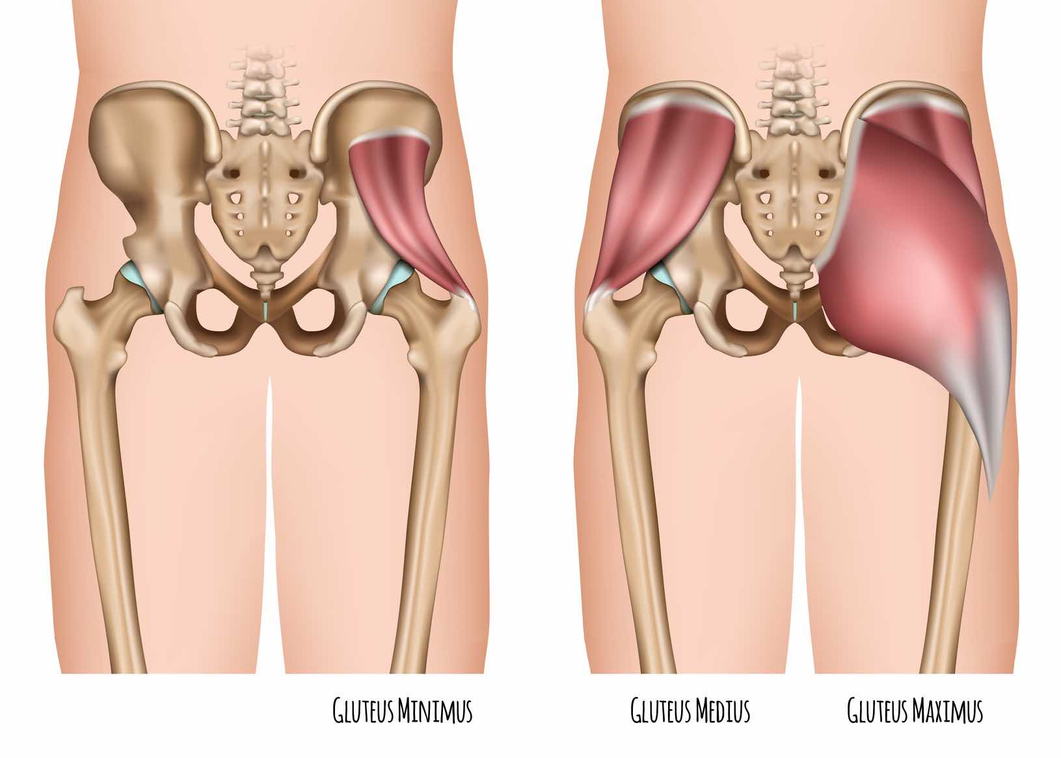
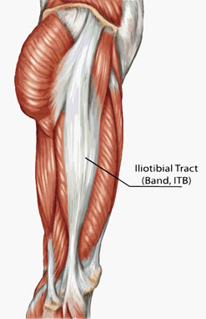
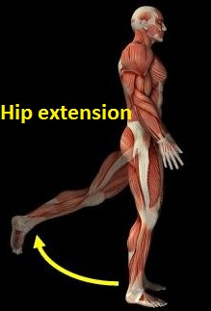
Glutei muscles
Gluteus maximus
origin | Posterior part of the gluteal surface of ilium The main origin: Back of sacrum ,coccyx and back of Sacrotuberous ligament.
insertion | 1- main insertion : iliotibial tract 2- other insertion : gluteal tuberosity of the femur
Nerve supply | Inferior gluteal nerve
Action | Extension and lateral rotation of the hip joint. Through its attachment to iliotibial tract, it stabilize the femur on tibia during standing.

Slide 10
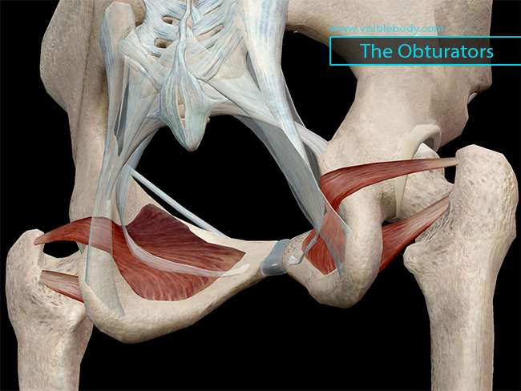
Small muscles (lateral rotators)
Obturator internus
origin | Inner surface of the side wall of the pelvis
insertion | Into the medial surface of the greater trochanter
Nerve supply | Nerve to obturator internus
Action | Lateral rotation of the hip joint & Control movement of the hip joint.

Slide 11
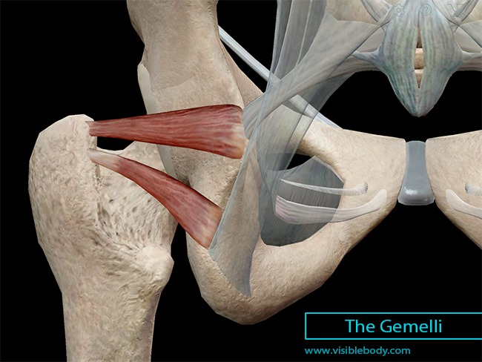
Small muscles (lateral rotators)
Superior & inferior Gemelli
 | Superior gemellus | Inferior gemellus
origin | Upper part of lesser sciatic notch | Lower border of lesser sciatic notch
insertion | Upper & lower parts into tendon of obturator internus
Nerve supply* | Nerve to obturator internus | Nerve to quadratus femoris
Action | Lateral rotation of hip joint & control movement of hip joint | Lateral rotation of hip joint & control movement of hip joint
Superior gemellus
Inferior gemellus
*كل وحده منهم يغذيها النيرڤ اللي يغذي المسل اللي تحتها

Slide 12
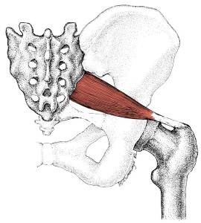
Small muscles (lateral rotators)
Piriformis
origin | Pelvic surface of middle 3 sacral vertebrae
insertion | It passes through GSF* to be inserted into the upper border of the greater trochanter
Nerve supply | Anterior rami of S1, S2
Action | Lateral rotation of hip joint & control movement of hip joint.
*Greater sciatic foramen
-almost all small muscles in the gluteal region make an insertion in greater trochanter Except, Quadratus femoris.

Slide 13
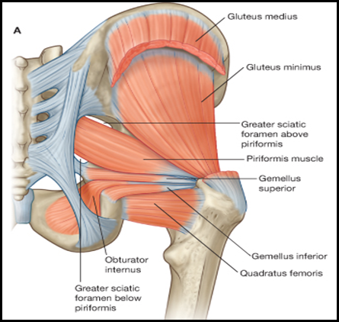
Small muscles (lateral rotators)
Quadratus femoris
origin | Lateral border of the ischial tuberosity.
insertion | Quadrate tubercle & intertrochanteric crest.
Nerve supply | Nerve to quadratus femoris
Action | Lateral rotation of the hip joint. Control movement of the hip joint.

Slide 14
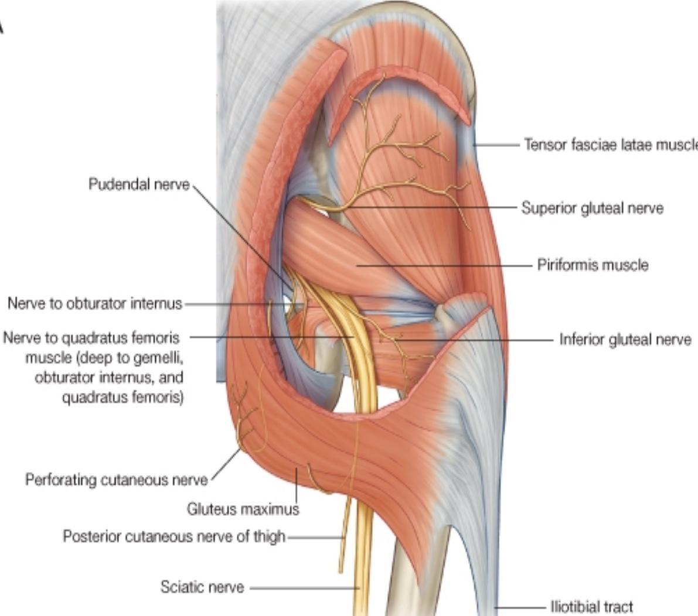
Nerves
 | Course | Branches
Superior gluteal | Passes through GSF (greater sciatic foramen), above piriformis, then between gluteus medius & minimus | Muscular to gluteus medius, minimus & tensor fasciae lata Articular to hip joint
Inferior gluteal | Passes through GSF, below piriformis, then deep to gluteus maximus. | Muscular to gluteus maximus
To quadratus femoris | Passes through GSF, below piriformis | Muscular to quadratus femoris & inferior gemellus Articular to hip joint

Slide 15
Only in girls slides
Nerves
 | Course | Branches
Posterior cutaneous | Passes through GSF, below piriformis, then descends deep to deep fascia. | Cutaneous branches to: Gluteal region Back of scrotum in males (labium majus) in females Back of thigh & upper part of back of leg.
Sciatic | Passes through GSF, below piriformis, then superficial to: Ischial spine Superior gemellus Tendon of obturator Internus Inferior gemellus Quadratus femoris Adductor magnus. | No branches in gluteal region Divides into tibial & common peroneal nerves, in the middle of back of thigh

Slide 16
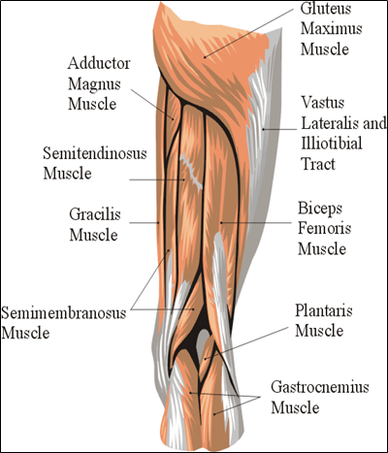
Posterior compartment of the thigh Contents
Muscles | Hamstring muscles: • Biceps femoris. • Semitendinosus. • Semimembranosus. • Ischial part of adductor magnus.
Blood supply | Branches of the profunda femoris artery
Nerve supply | Sciatic nerve

Slide 17
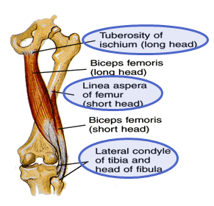
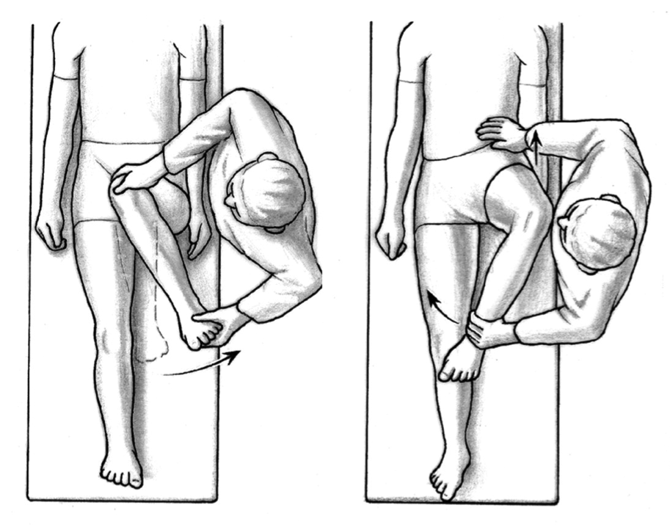
Hamstring muscles
Biceps Femoris
origin | The long head from the ischial tuberosity. The short head from the linea aspera .
insertion | Mainly into the head of the fibula
Nerve supply | The long head is supplied by the tibial part of sciatic; The short head is supplied by the common peroneal part of the sciatic.
Action | Flexion of knee. Lateral rotation of flexed leg. Long head: extends hip.
Lateral
Medial

Slide 18
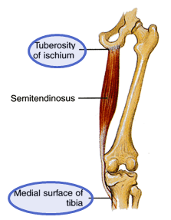
Hamstring muscles
SEMITENDINOSUS
origin | Ischial tuberosity
insertion | Upper part of the medial surface of the shaft of the tibia (SGS) *SGS (semitendinosus / gracialis / sartorius):Three muscles that have the same insertions.
Nerve supply | Tibial portion of the sciatic.
Action | Flexes and medially rotates the leg at the knee joint; Extends the thigh at the hip joint.

Slide 19
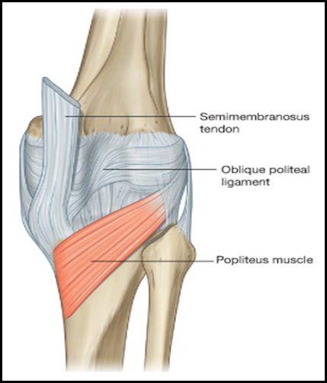
Hamstring muscles
SEMIMEMBRANOSUS
origin | Ischial tuberosity.
insertion | Posterior surface of the medial condyle of the tibia. It forms the oblique popliteal ligament, which reinforces the capsule on the back of the knee joint.
Nerve supply | Tibial portion of the sciatic nerve.
Action | Flexes and medially rotates the leg at the knee joint; Extends the thigh at the hip.

Slide 20
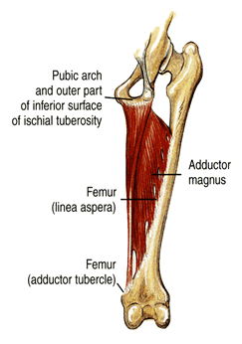
Hamstring muscles
Adductor magnus (hamstring part)
origin | Ischial ramus and ischial tuberosity
insertion | Adductor tubercle of the medial condyle of the femur
Nerve supply | The tibial portion of the sciatic
Action | Extends the thigh at the hip joint *it doesn't reach the tibia or fibula so it can't move the knee joint.
The adductor magnus has 2 parts: adductor part and hamstring part. The 2 parts have different origin, insertion, action and nerve supply. They are also in different compartments of the thigh

Slide 21
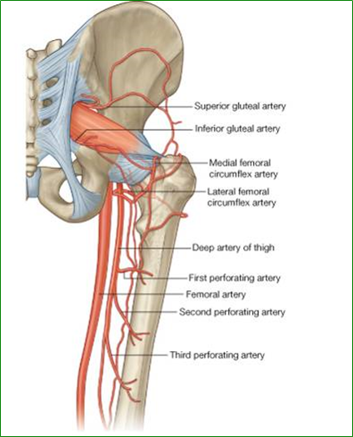
Blood supply
Only in girls slides
Blood supply
 | •The four perforating branches of the profunda femoris artery (deep artery of thigh) provide a rich blood supply to this compartment. (perforating= to pierce or to make a hole) •The profunda femoris vein drains the greater part of the blood from the compartment.
perforating branches shown in green

Slide 22
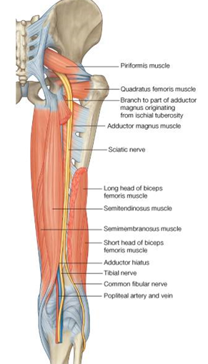
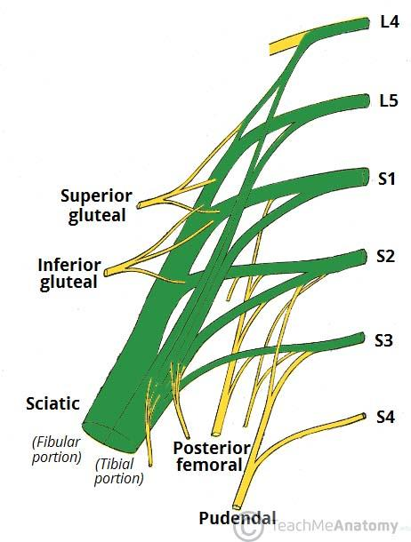
Nerve supply
Nerve supply
 | •The sciatic nerve, a branch of the sacral plexus (L4 and L5; S1, S2,and S3), leaves the gluteal region as it descends in the midline of the thigh.
sciatic nerve
It is overlapped posteriorly by
the adjacent margins of the biceps femoris and semimembranosus muscles
It lies on
the posterior aspect of the adductor magnus.
Sciatic nerve shown in green
In the lower third of the thigh
it ends by dividing into the tibial and common peroneal nerves.
note : common peroneal nerve, also known as common fibular nerve

Slide 23
MCQs
(1) How many vessels are supplying the gluteal region?
A- 2
B- 3
C- 4
(2) Which one of the following muscles abduct & medially rotates the hip in the gluteal region?
A- Gluteus medius & minimus B- Gluteus medius & maximus C- Gluteus maximus & minimus (3 )Sciatic nerve passes through GSF, ________ piriformis? A- below B- above C- beside
(4) If someone comes to ER with injury in his semitendinosus muscle, Which one of these nerves may be affected?
A- Superior gemellus B- Sciatic nerve C- Tibial portion of the sciatic nerve
(5) Gluteal region consists of glutei and group of small muscles, Which one of the following isn’t a glutei muscle?
A- Gluteus maximus B- Gluteus minimus C- Quadratus femoris

Slide 24
SAQ
A patient came to the clinic complaining from difficulty of extending his thigh at the hip joint:
(1) List the muscles responsible for this action:
(2) Name The nerve responsible of these muscles:
(3) Name the muscles that are responsible of lateral rotation of hip joint?

Slide 25
Answers (MCQs)
1-B
2-A
3-A
4-C
5-C
Answers (SAQ)
(1) Semimembranosus
Semitendinosus
Long head : biceps femoris
Adductor magnus (hamstring part)
(2)
Tibial portion of sciatic nerve
(3) Gluteus maximus
quadratus femoris
piriformis
obturator internus.
Superior & inferior gamelli

Slide 26
Team Members
Faisal Fahad Alsaif (Team Leader) Abdulaziz Al dukhayel ‏Fahad Alfaiz ‏Akram Alfandi ‏Saad Aloqile ‏Saleh Almoaiqel ‏Abdulaziz Alabdulkareem ‏Abdullah Almeaither ‏Yazeed Aldossari ‏Muath Alhumood Abdulrahman Almotairi
‏
Abdulelah Aldossari ‏Abdulrahman Alduhayyim ‏Hamdan Aldossari ‏Abdullah Alqarni ‏Mohammed Alomar ‏Abdulrahman Aldawood ‏Saud Alghufaily ‏Hassan Aloraini Khalid Almutairi‏‏
Lamia Abdullah Alkuwaiz (Team Leader)
Rawan Mohammad Alharbi
Abeer Alabduljabbar Afnan Abdulaziz Almustafa Ahad Algrain Alanoud Almansour Albandari Alshaye AlFhadah abdullah alsaleem Arwa Alzahrani Dana Abdulaziz Alrasheed Dimah Khalid Alaraifi Ghada Alhaidari Ghada Almuhanna Ghaida Alsanad Hadeel Khalid Awartani Haifa Alessa Khulood Alwehabi Layan Hassan Alwatban Lojain Azizalrahman Lujain Tariq AlZaid
Maha Barakah Majd Khalid AlBarrak Norah Alharbi Nouf Alotaibi Noura Mohammed Alothaim Rahaf Turki Alshammari Reham Alhalabi Rinad Musaed Alghoraiby Sara Alsultan Shahad Alzahrani Wafa Alotaibi Wejdan Fahad Albadrani Wjdan AlShamry
Abdulmajeed Alwardi ‏Abdulrahman Alageel ‏Rayyan Almousa ‏Sultan Alfuhaid ‏Ali Alammari ‏Fahad alshughaithry Fayez Ghiyath Aldarsouni ‏Mohammed Alquwayfili ‏‏Abduljabbar Al-yamani ‏Sultan Al-nasser ‏Majed Aljohani ‏Zeyad Al-khenaizan ‏Mohammed Nouri ‏Abdulaziz Al-drgam ‏Fahad Aldhowaihy ‏Omar alyabis

