Slide 1
Popliteal Fossa, Posterior Compartment of leg & Sole of foot
Lecture 18
Please check our Editing File.
{وَمَنْ يَتَوَكَّلْ عَلَى اللَّهِ فَهُوَ حَسْبُهُ}
هذا العمل لا يغني عن المصدر الأساسي للمذاكرة

Slide 2
Objectives
The location, boundaries & contents of the popliteal fossa
The contents of posterior fascial compartment of Leg.
The structures hold by retinacula at ankle.
Layers forming in the sole of foot & bone forming the arches of the foot.

Slide 3
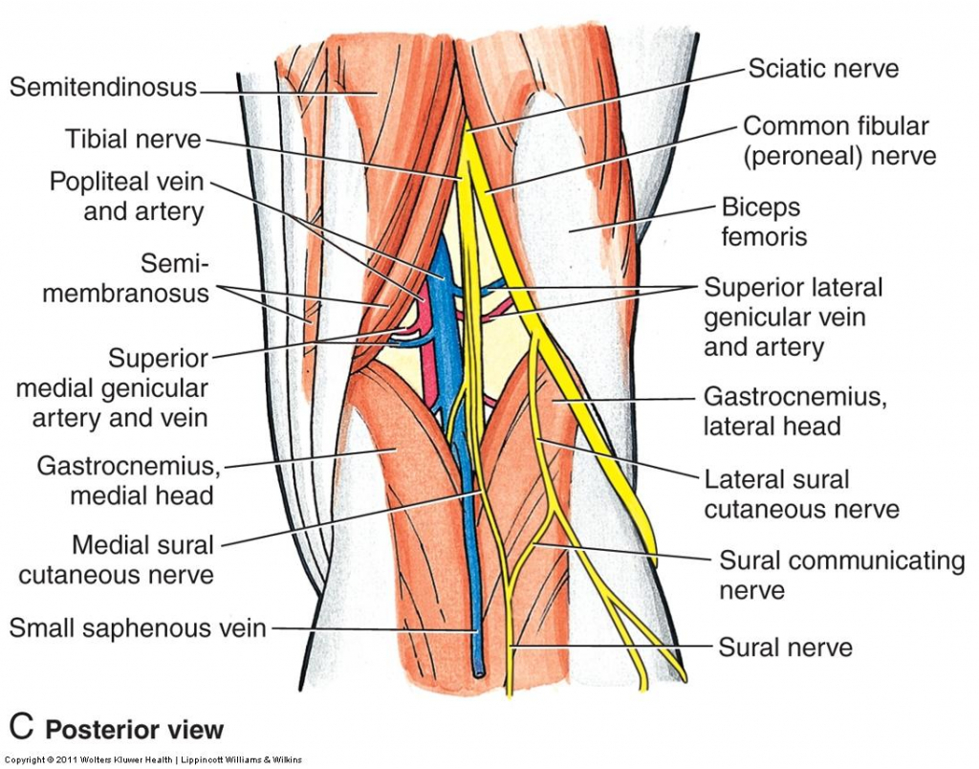
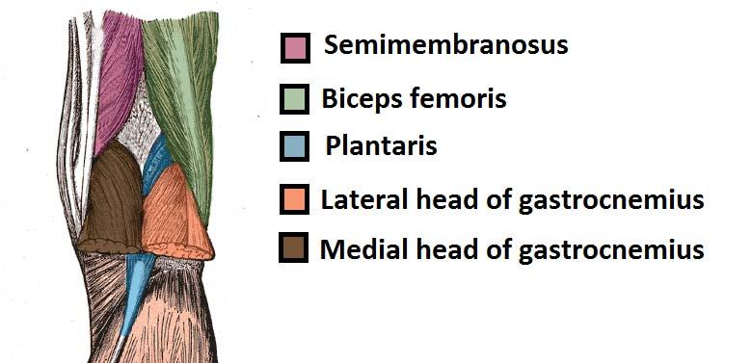
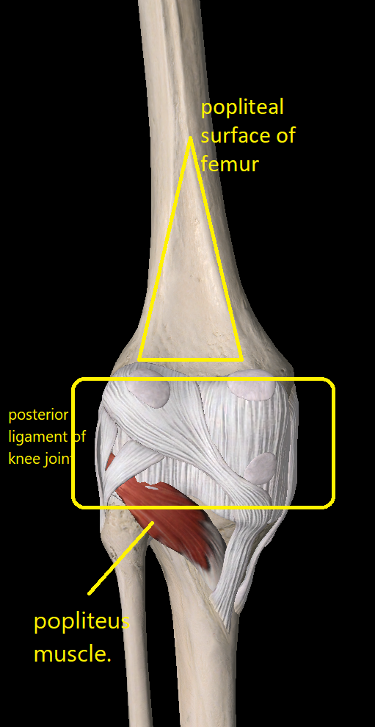
Popliteal Fossa
Definition :
Is a diamond-shaped, intermuscular space
at the back of knee .
Boundaries :
Laterally Above : biceps femoris.
Laterally Below : lateral head of
gastrocnemius & plantaris
Medially Above : semitendinosus &
semimembranosus.
Medially Below : medial head of gastrocnemius.
Roof (يقصد به اللي مغطيه (مو شرط يكون فوق: Skin, superficial fascia and deep fascia of the thigh.
Floor: popliteal surface of femur, posterior ligament of knee joint and popliteus muscle.
يوجد فراغ معين الشكل في الجزء الخلفي من الركبة ويحده أربعة عضلات :
لاترال فوق biceps femoris وتعتبر من عضلات hamstring muscles .
ميديال فوق العضلات السيمي الثنتين من hamstring .
اللي تحت فيه عضلة gastrocnemius ولها راسين واحد ميديال والثاني لاترال ويكون مع اللاترال تحت بعد plantaris

Slide 4
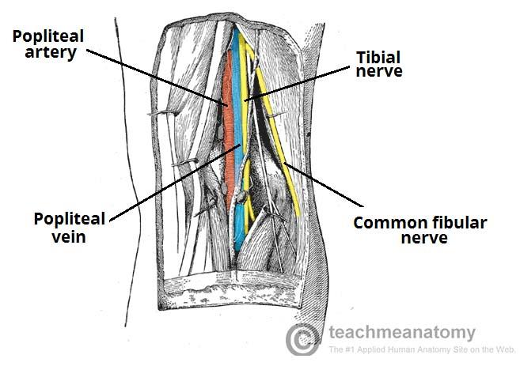
Popliteal Fossa
Contents : (From medial to lateral) 6 structures
Popliteal vessels(artery & vein) → Small saphenous vein → Tibial nerve → Common peroneal nerve → Posterior cutaneous nerve of thigh → Connective tissue & popliteal lymph nodes.
The deepest structure is popliteal artery.

Slide 5
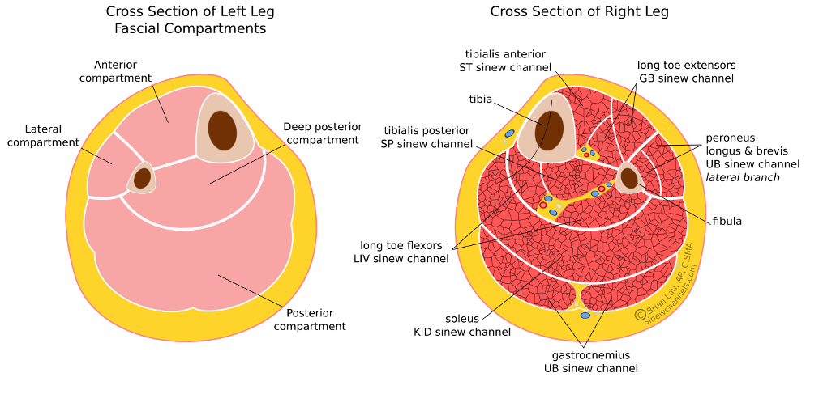
Contents of The posterior fascial compartment of the leg
The deep transverse fascia or
transverse intermuscular septum
of the leg is a septum that divides the
muscles of the posterior compartment
into superficial and deep groups.
Contents: **no veins
1.Superficial group of muscles
2.Deep group of muscles
3.Posterior tibial artery
4.Tibial nerve
بشكل عام Interosseous membrane يقسم الـ Leg الى anterior and posterior compartment و الـ posterior compartment ينقسمون الى قسمين بواسطة
transverse intermuscular septum الى deep and .
superficial .
Interosseous = بين العظام
intermuscular = بين العضلات

Slide 6
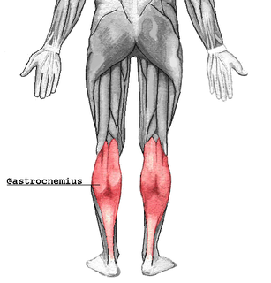
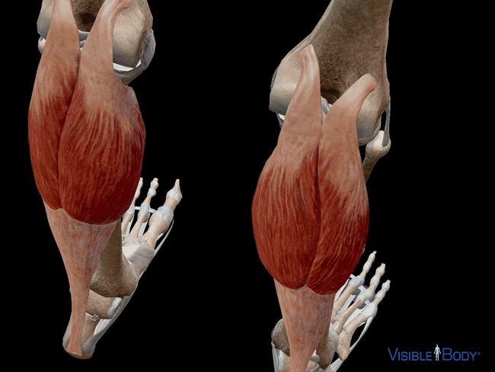
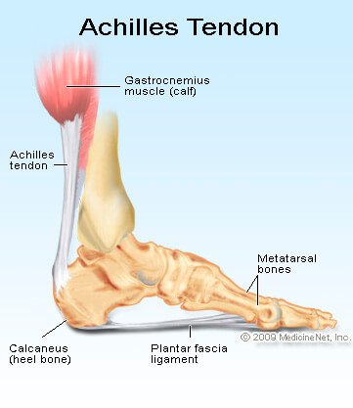
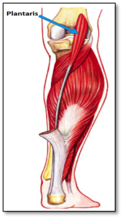
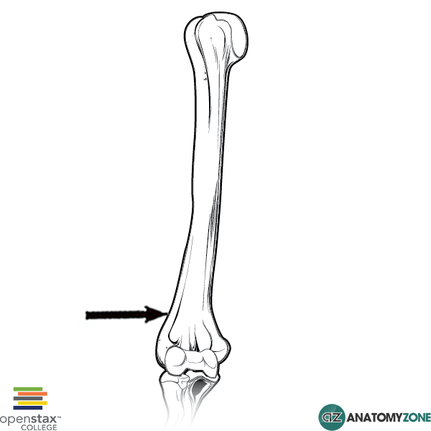
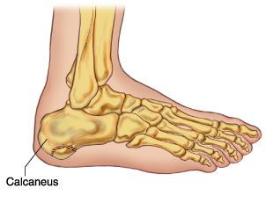
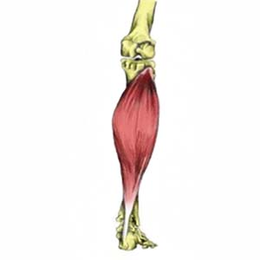
Superficial group
Muscle | Origin | Insertion | Nerve | Action
Gastrocnemius | Lateral head from lateral condyle of femur & medial head from above medial condyle | Posterior surface of calcaneum via tendo calcaneus | Tibial | Plantar flexes foot at ankle joint; flexes knee joint
Plantaris | Lateral supracondylar ridge of femur | Posterior surface of calcaneum |  | Plantar flexes foot at ankle joint; flexes knee joint
Soleus | Shafts of tibia and fibula | Posterior surface of calcaneum via tendo calcaneus |  | Together with gastrocnemius and plantaris,it is a powerful plantar flexor of ankle joint; provides main propulsive force in walking and running
lateral condyle
medial condyle

Slide 7
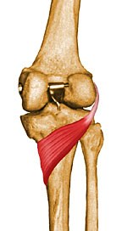
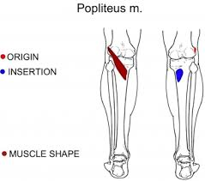
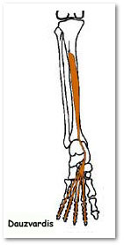
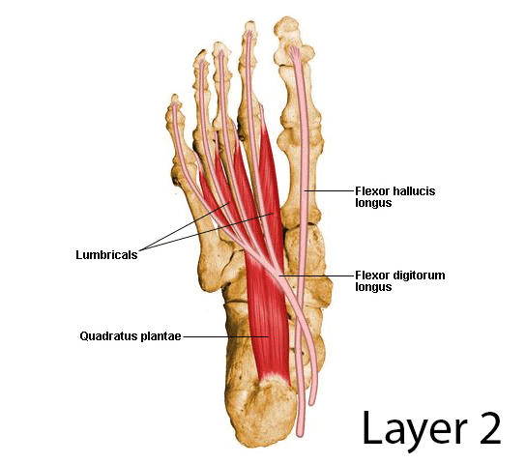
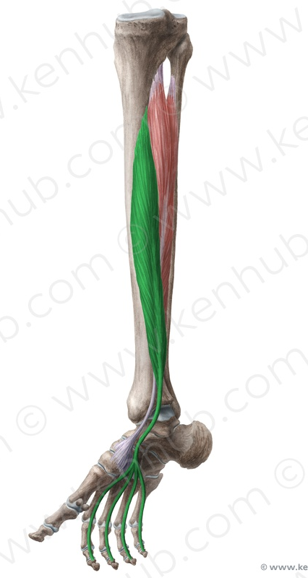
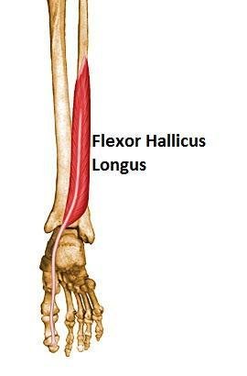
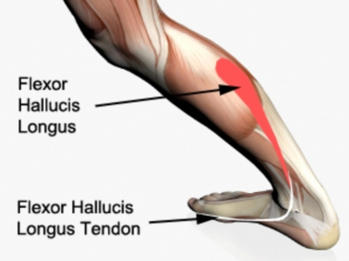
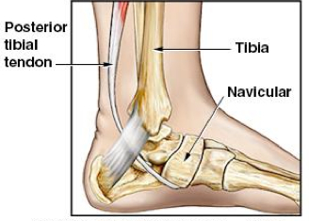
Deep group
muscle
origin
insertion
nerve
action
Popliteus | Groove on Lateral surface of lateral condyle of femur (Intracapsular) | Post surface of shaft of tibia above soleal line | Tibial | Flexes knee joint : Unlocks knee joint by lateral rotation of femur on tibia(or slight medial rotation of leg which accompanies the flexion)
Flexor digitorum longus | Posterior surface of shaft of tibia | Bases of distal phalanges of lateral 4 toes |  | Flexes distal phalanges of lateral four toes; plantar Flexes foot at ankle joint; Supports medial and lateral longitudinal arches
Flexor hallucis longus | Posterior surface of shaft of fibula | Base of distal phalanx of big toe |  | Flexes distal phalanx of big toe; plantar flexes foot at ankle joint; supports medial longitudinal arch
Tibialis posterior | Posterior surface of shafts of tibia and fibula and interosseous membrane | Tuberosity of navicular bone and other neighboring tarsal bones, except talus |  | Plantar flexes foot at ankle joint; inverts foot at subtalar and transverse tarsal joints; supports medial longitudinal arch

Slide 8
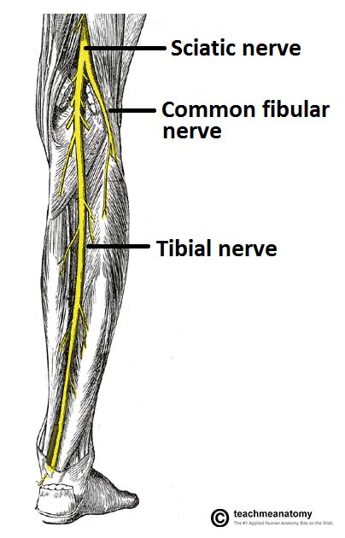
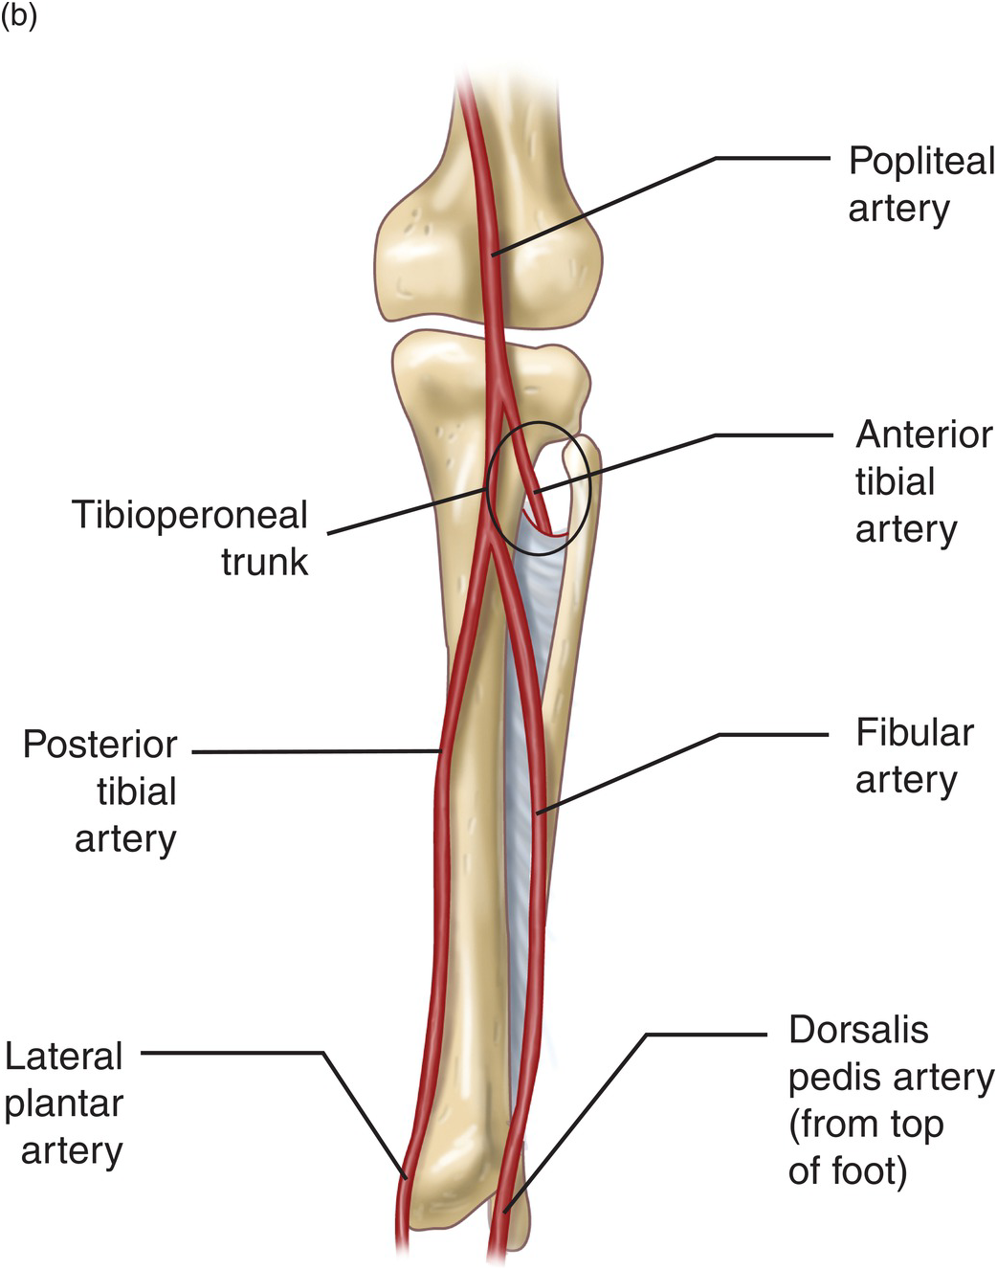
Posterior tibial artery and tibial nerve
Posterior tibial artery:
It is one of the terminal branches of the popliteal artery.
Tibial nerve
It is the larger terminal branch of the sciatic nerve in the lower 1/3 of the back of the thigh

Slide 9
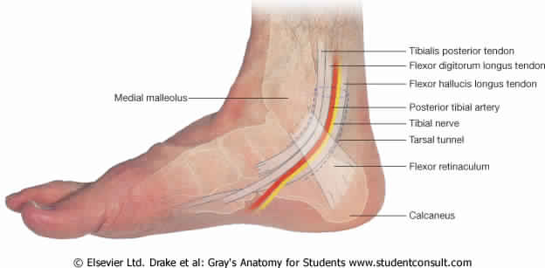
Flexor Retinaculum
Extends from back of medial malleolus to medial side of calcaneum.
Structures passing posterior to medial malleolus, deep to flexor retinaculum: Medial to lateral :
1- Tibialis posterior tendon
2- Flexor digitorum longus tendon
3- Posterior tibial artery with venae comitantes
4- Tibial nerve
5- Flexor hallucis longus tendon
(All the tendons are surrounded by a synovial sheath)
“Tom, Dick And Nervous Harry”

Slide 10
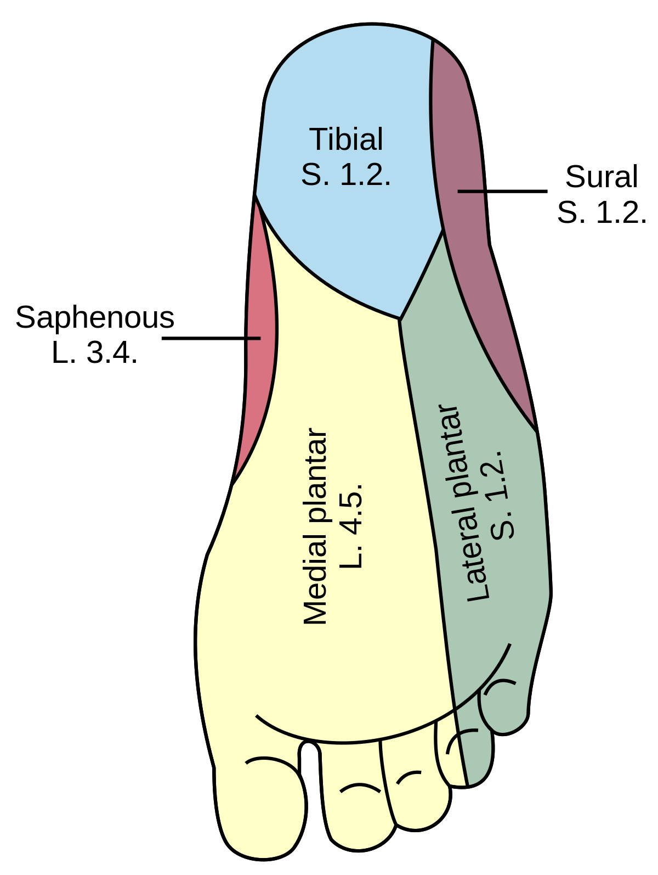
Sensory Nerve supply
Lateral plantar nerve innervate the lateral third of the sole.
The sensory nerve supply to the skin of the sole of the foot is derived from:
Tibial nerve innervates the medial side of the heel.
Medial plantar nerve innervate the medial two thirds of the sole

Slide 11
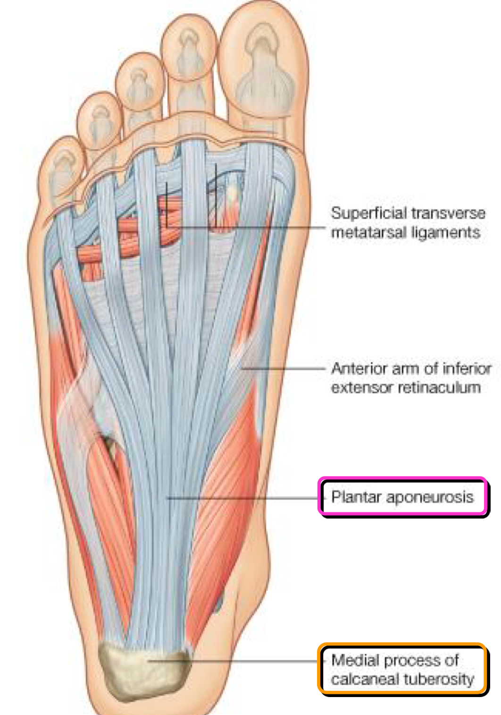
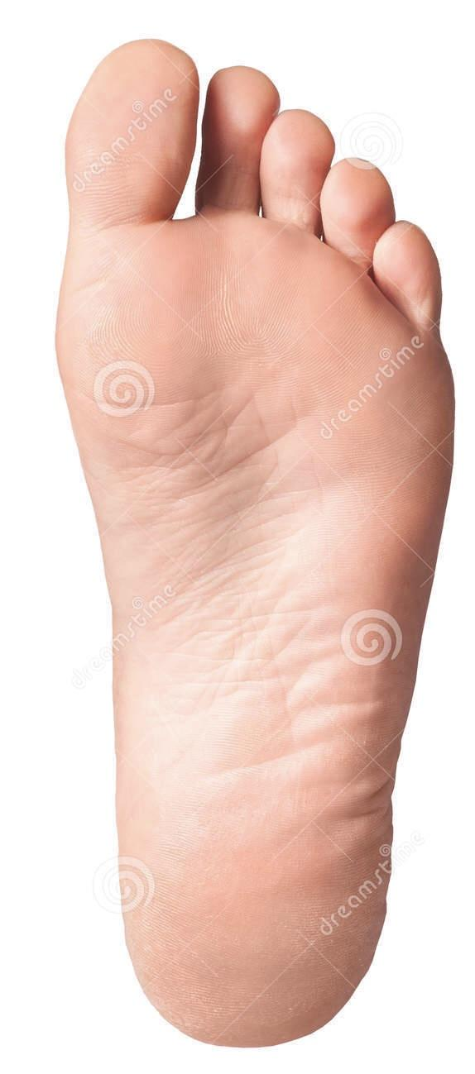
Sole of the foot
Deep fascia
The skin of the sole of the foot is thick and hairless.
The skin of the sole shows a few flexure creases at the sites of skin movement.
Sweat glands are present in large numbers.
The plantar aponeurosis is a triangular thickening of the deep fascia that protects the underlying nerves, blood vessels, and muscles.
Its apex is attached to the medial and lateral tubercles of the calcaneum.
The base of the aponeurosis divides into five slips that pass into the toes.

Slide 12
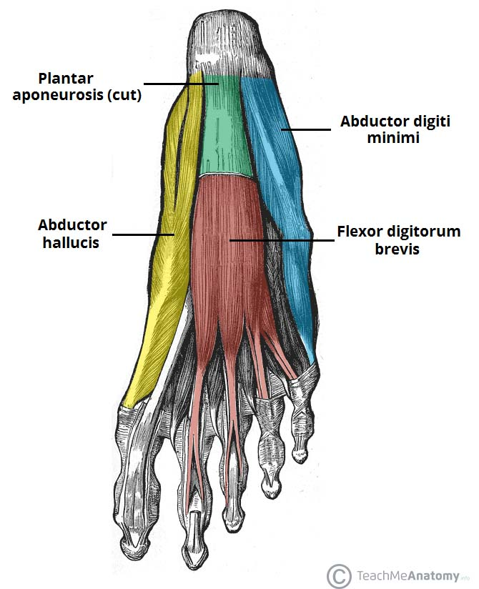
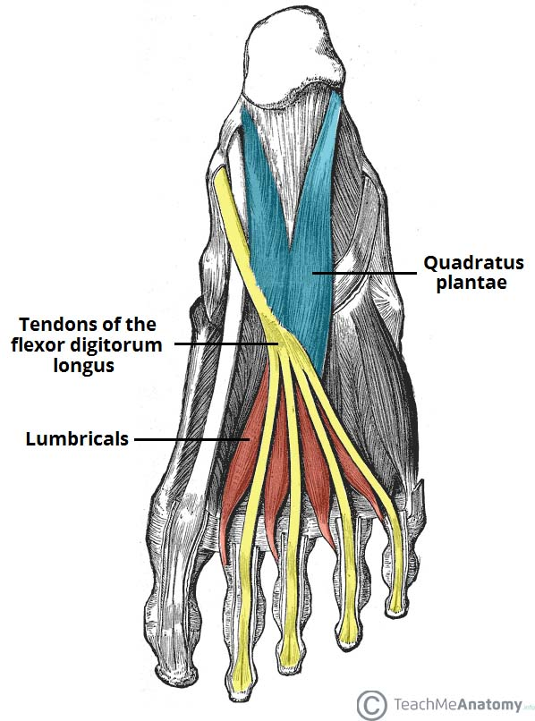
Muscles of the sole of the foot
The muscles of the sole are conveniently described in four layers from superficial to deep
1- Abductor hallucis
2- Flexor digitorum brevis
3- Abductor digiti minimi
3
(TEAM436)
*Only the TENDON not the muscle To remember: only the even layers have tendons (2,4)
First Layer
1
2
1- Quadratus plantea 2- Lumbricals (4 muscles) 3- Flexor digitorum longus tendon* 4- Flexor hallucis longus tendon*
1
Second Layer
2

Slide 13
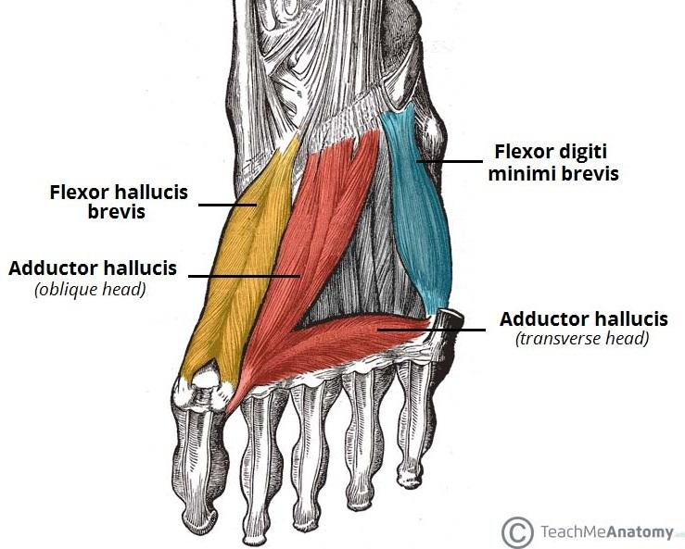
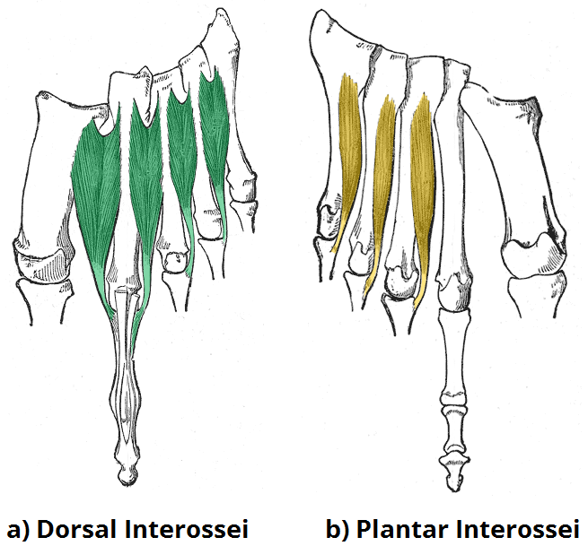
Muscles of the sole of the foot cont
1-Flexor hallucis brevis
2-Adductor hallucis
3-Flexor digiti minimi brevis
Third Layer
1-Interossei, (3 plantar + 4 dorsal).
2-Peroneus longus tendon,
3-Tibialis posterior tendon
Fourth Layer

Slide 14
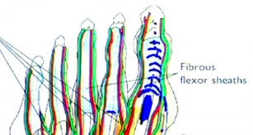
Fibrous Flexor Sheaths
the inferior surface of each toe, from the head of the metatarsal bone to the base of the distal phalanx, is provided with a strong fibrous sheath which is attached to the sides of the phalanges.
the fibrous sheath, together with the inferior surfaces of the phalanges and the interphalangeal joints, forms a blind tunnel in which lie the flexor tendons of the toe.

Slide 15
Synovial Flexor Sheaths
the tendons of the flexor hallucis longus and the flexor digitorum longus are surrounded by synovial sheaths.

Slide 16
1-extensor hallucis longus
2-extensor digitorum longus
3-extensor digitorum brevis
1-flexor digitorum brevis
2-lumbricals
3-interossei
4-flexor hallucis brevis
5-flexor hallucis longus
6-flexor digiti minimi brevis
7-flexor digitorum longus
1-abductor hallucis
2-abductor digiti minimi
3-dorsal interossei
extension
Movement of Metatarsophalangeal joints
abduction
flexion
adduction
1-adductor hallucis
2-planter interossei
muscles in bold are chiefly responsible for the movement, the other muscles assist them

Slide 17
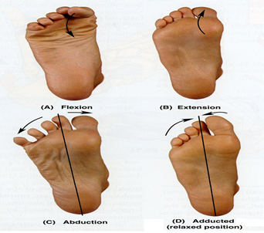
1-extensor hallucis longus
2-extensor digitorum longus
3-extensor digitorum brevis
1-flexor hallucis longus
2-flexor digitorum longus
3-flexor digitorum brevis
4-quadratus plantae
Movement of Interphalangeal joints
extension
flexion
muscles in bold are chiefly responsible for the movement, the other muscles assist them

Slide 18
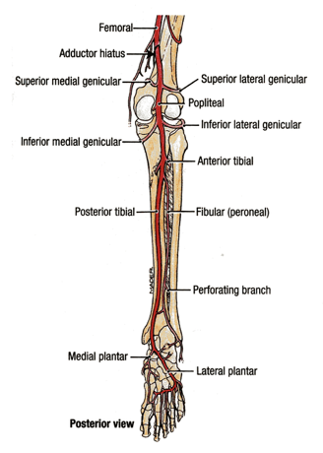
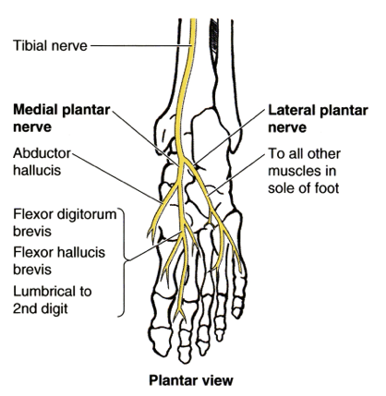
Medial and lateral plantar arteries and nerve
The medial plantar nerve is a terminal branch of the tibial nerve.
The lateral plantar nerve is a terminal branch of the tibial nerve.
The medial plantar artery is the smaller & lateral plantar artery is the larger of the terminal branches of the posterior tibial artery
(1st lumbrical )

Slide 19
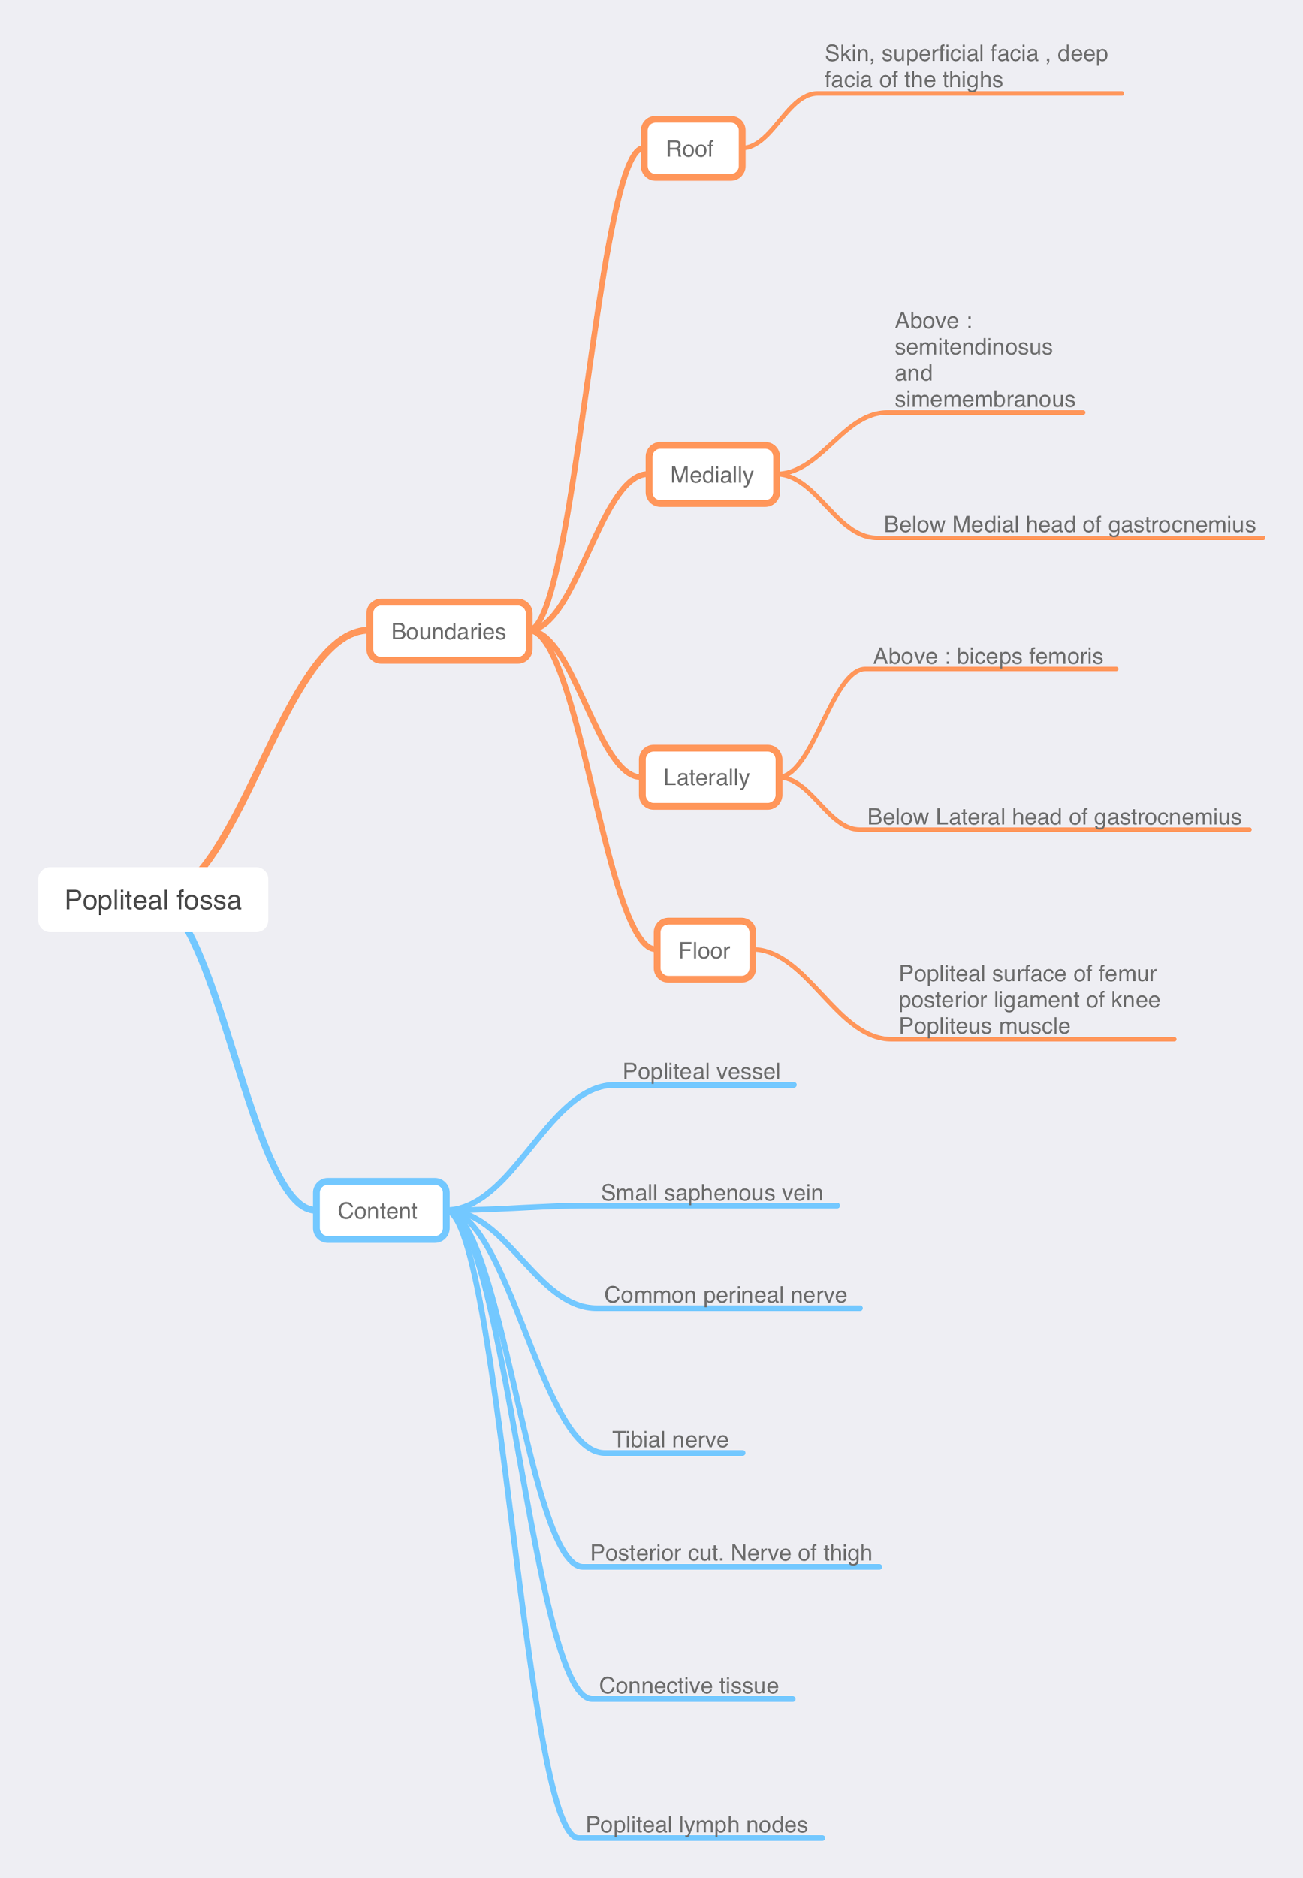
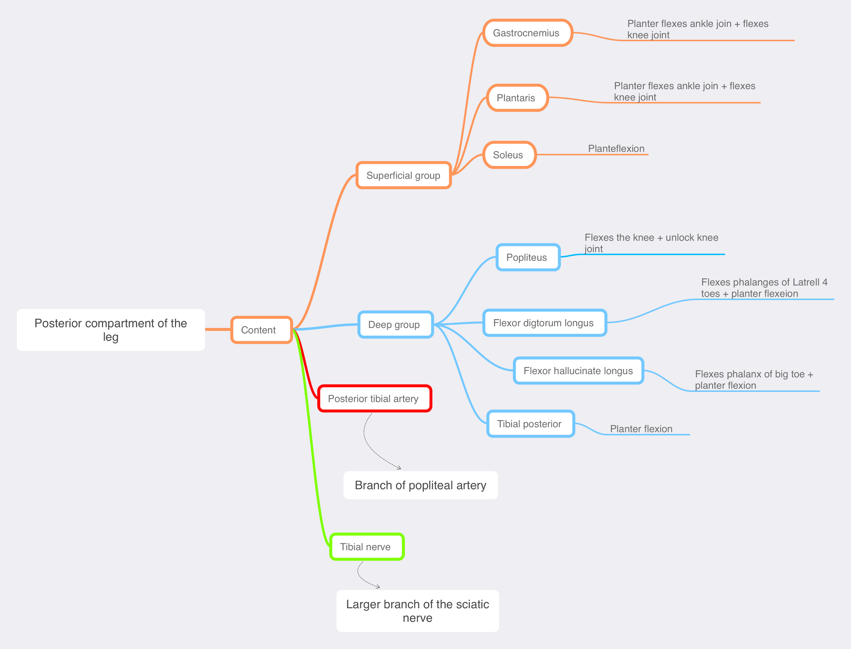
summary

Slide 20
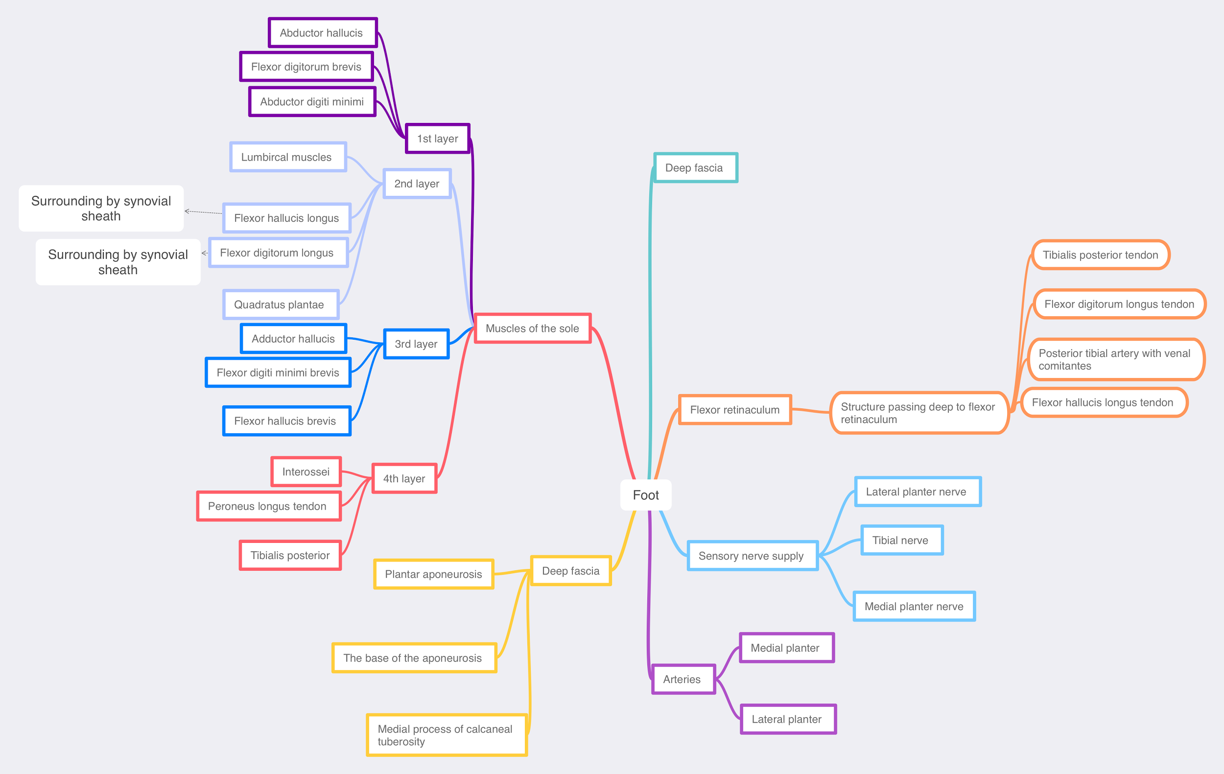

Slide 21
Team Members
Faisal Fahad Alsaif (Team Leader) Abdulaziz Al dukhayel ‏Fahad Alfaiz ‏Akram Alfandi ‏Saad Aloqile ‏Saleh Almoaiqel ‏Abdulaziz Alabdulkareem ‏Abdullah Almeaither ‏Yazeed Aldossari ‏Muath Alhumood Abdulrahman Almotairi
‏
Abdulelah Aldossari ‏Abdulrahman Alduhayyim ‏Abdullah AlOmar
Hamdan Aldossari ‏Mohammed Alomar ‏Abdulrahman Aldawood ‏Saud Alghufaily ‏Hassan Aloraini Khalid Almutairi‏‏
Rakan Alkharan
Abdullah AL-Essa
Lamia Abdullah Alkuwaiz (Team Leader)
Rawan Mohammad Alharbi
Abeer Alabduljabbar Afnan Abdulaziz Almustafa Ahad Algrain Alanoud Almansour Albandari Alshaye AlFhadah abdullah alsaleem Arwa Alzahrani Dana Abdulaziz Alrasheed Dimah Khalid Alaraifi Ghada Alhaidari Ghada Almuhanna Ghaida Alsanad Hadeel Khalid Awartani Haifa Alessa Khulood Alwehabi Layan Hassan Alwatban Lojain Azizalrahman Lujain Tariq AlZaid
Maha Barakah Majd Khalid AlBarrak Norah Alharbi Nouf Alotaibi Noura Mohammed Alothaim Rahaf Turki Alshammari Reham Alhalabi Rinad Musaed Alghoraiby Sara Alsultan Shahad Alzahrani Wafa Alotaibi Wejdan Fahad Albadrani Wjdan AlShamry
Abdulmajeed Alwardi ‏Abdulrahman Alageel ‏Rayyan Almousa ‏Sultan Alfuhaid ‏Ali Alammari ‏Fahad alshughaithry Fayez Ghiyath Aldarsouni ‏Mohammed Alquwayfili ‏‏Abduljabbar Al-yamani ‏Sultan Al-nasser ‏Majed Aljohani ‏Zeyad Al-khenaizan ‏Mohammed Nouri ‏Abdulaziz Al-drgam ‏Fahad Aldhowaihy ‏Omar alyabis

