Slide 1
Hip, Knee & Ankle joints
Lecture 19
Please check our Editing File.
هذا العمل لا يغني عن المصدر الأساسي للمذاكرة
{وَمَنْ يَتَوَكَّلْ عَلَى اللَّهِ فَهُوَ حَسْبُهُ}

Slide 2
Objectives
ملاحظة: السلايدات كثيرة بس تراها سهلة مرة :)
List the type & articular surfaces of the hip, knee and ankle joints.
Describe the capsule and ligaments of the hip, knee and ankle joints.
Describe movements of hip, knee and ankle joints and list the muscles involved in these movements.
List important bursae in relation to knee joint.
Apply Hilton’s law about nerve supply of joints.
Text in BLUE was found only in the boys’ slides
Text in PINK was found only in the girls’ slides
Text in RED is considered important
Text in GREY is considered extra notes

Slide 3
Objectives (Knee Joint)
List the type & articular surfaces of knee joint.
List the function of knee joint.
Describe the capsule of knee joint, its extra- & intra -capsular ligaments.
List important bursae in relation to knee joint.
Describe movements of knee joint.
Describe the stability of knee joint.

Slide 4
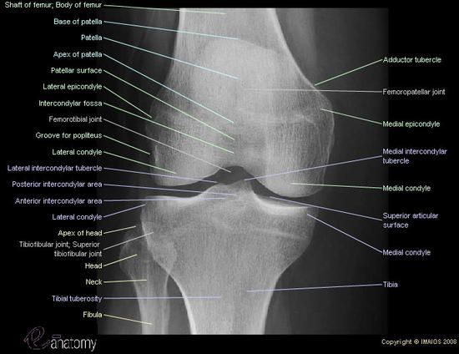
X-Ray Knee Structures (Identify)
Know the difference:
The Condyle:
Is the articular surface, and it’s smooth.
The Epicondyle:
Is a tubercle above the Condyle.

Slide 5
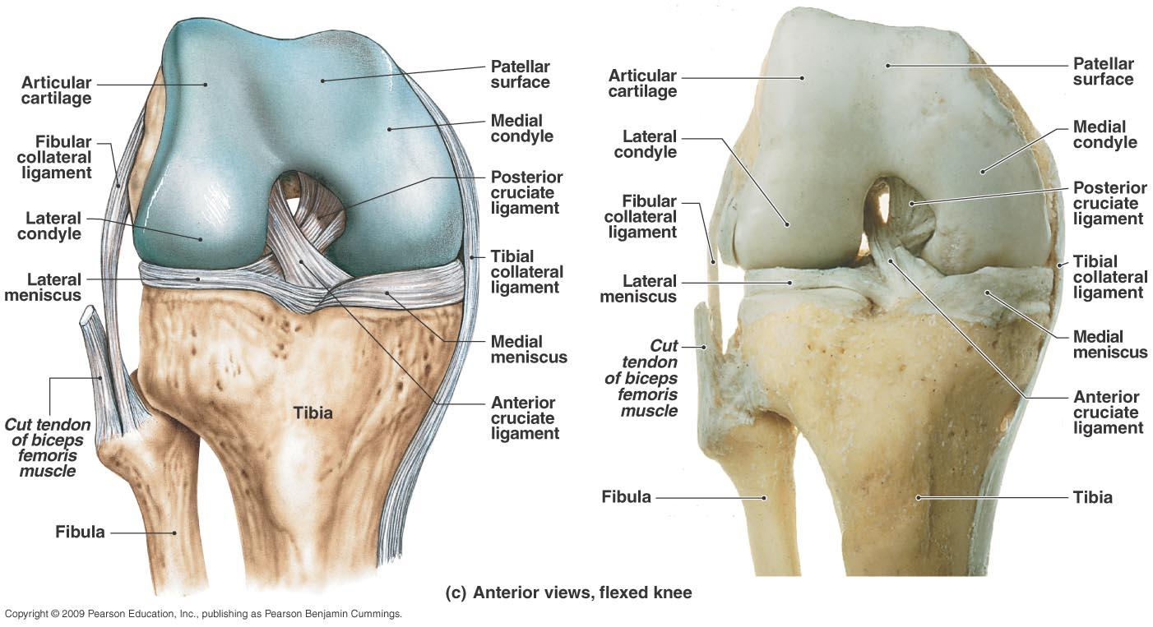
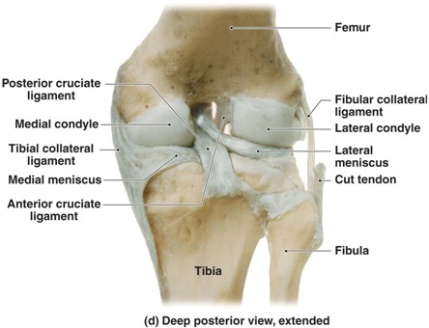
Extra: Structures of the Knee

Slide 6
Recall

Slide 7
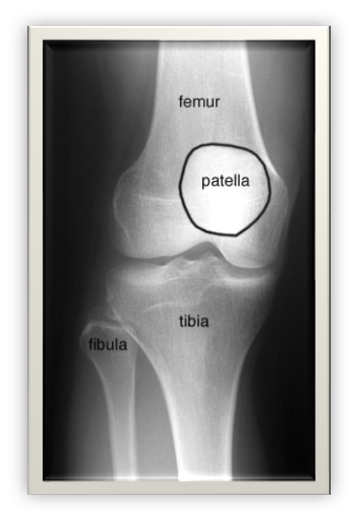
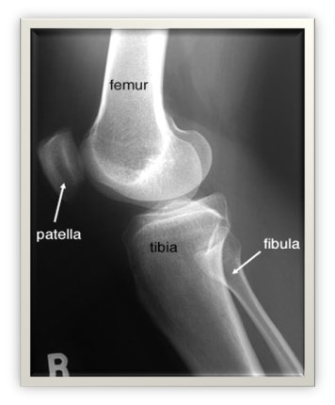
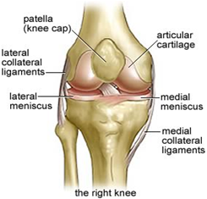
Knee Joint
Function
Types & Articular Surfaces
Knee joint is formed of:
Three bones:
(Femur, Patella & Tibia)
Three articulations*:
Two Femoro-tibial articulations:
Between the 2 femoral condyles & upper surfaces of the 2 tibial condyles.
(Type: synovial, modified hinge**).
Femoro-patellar articulation:
Between posterior surface of patella & patellar surface of femur.
(Type: synovial, plane***).
Weight bearing.
Essential for daily activities:
Standing, walking & climbing stairs.
The main joint responsible for sports:
Running, jumping, kicking etc.
This was in girls’ slides only
*First articulations does an action, the other articulation does a separate action. **A normal hinge joint can only do Flexion & Extension, but since the knee joint can also do some degree of rotation is considered as a modified hinge joint. ***gliding

Slide 8
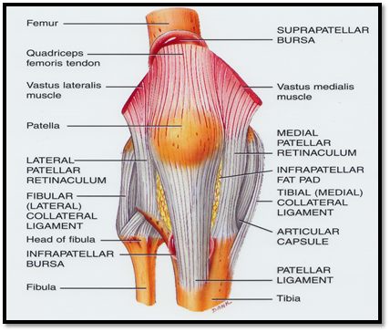
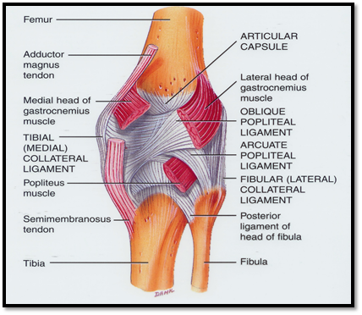
Capsule
& the 4 EXTRA-CAPSULAR LIGAMENTS
Ligamentum patellae (patellar ligament):
From patella to tibial tuberosity.
Medial (tibial) collateral ligament:
From medial epicondyle of femur to upper part of medial surface of tibia (firmly attached to medial meniscus).
Lateral (fibular) collateral ligament:
From lateral epicondyle of femur to head of fibula (separated from lateral meniscus by popliteus tendon).
Oblique popliteal* ligament:
Extension of semimembranosus tendon.
Is deficient anteriorly & is replaced by:
Quadriceps femoris tendon.
Patella.
Ligamentum patellae(Patellar ligament).
Possesses 2 openings (Posteriorly):
One for Popliteus tendon*
One for Communication with Suprapatellar bursa**.
*From the popliteus muscle.
**Opens in the joint cavity through an opening in the posterior part of the capsule.
*Careful: it has nothing to do with Popliteal muscle.

Slide 9
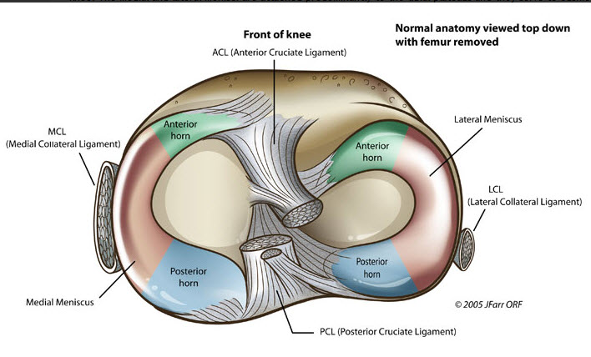
INTRA-CAPSULAR STRUCTURES (LIGAMENTS)
Menisci
ATTACHMENTS:
Each meniscus is attached by:
Anterior & Posterior horns* into upper surface of tibia.
FUNCTIONS:
Deepen articular surfaces of tibial condyles.
Serve as cushions** between tibia & femur.
They are two C-shaped plates of fibro-cartilage:
Medial Meniscus:
Large & Oval.
Its outer border is firmly attached to:
Capsule.
Medial collateral ligament.
Lateral Meniscus:
Small & Circular.
Its outer border is separated from lateral collateral ligament by popliteal tendon.
medial meniscus is less mobile & more liable to be injured***.
*The two ends of each meniscus are called: Horns.
**Cushion: وسادة, to absorb shocks
***Why? Because it’s larger and attached to medial ligament (which is more susceptible to injury).

Slide 10
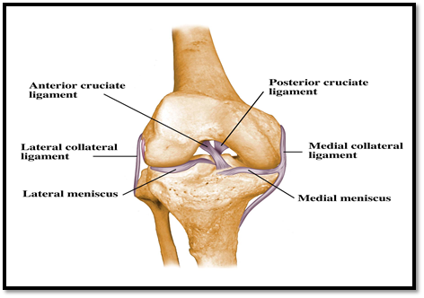
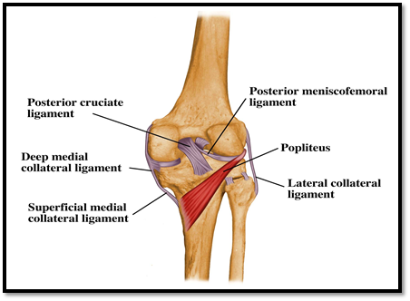
INTRA-CAPSULAR STRUCTURES (LIGAMENTS)
ANTERIOR & POSTERIOR CRUCIATE LIGAMENTS
Two in number, situated in the middle of the joint.^
They are called Cruciate because they cross each other.^
Have received the names Anterior and Posterior, from the position of their attachments to the tibia.^
FUNCTIONS:
Anterior Cruciate Ligament:
Prevents:
Posterior displacement of femur on the tibia.
The tibia from being pulled anteriorly when the knee joint is extended.^
It’s taught in Hyper extension.^
Posterior Cruciate Ligament:
Prevents:
Anterior displacement of femur on tibia.
the tibia from being pulled posteriorly when the knee joint is flexed.^
It’s taught in Hyper flexion.^
ATTACHMENTS:
Anterior Cruciate ligament:
Extends from anterior part of intercondylar area of tibia to posterior part of lateral condyle of femur.
Posterior Cruciate Ligament:
Extends from posterior part of intercondylar area of tibia to anterior part of medial condyle of femur.
Most common injuries:
ACL.
Medial Meniscus.
Tibial Collateral Ligament.
(ACL): Start Anterior then goes: Upward, Laterally, Backward. (PCL): Start Posterior then goes: Upward, Medially, Forward.
^was in girls’ slides only^

Slide 11
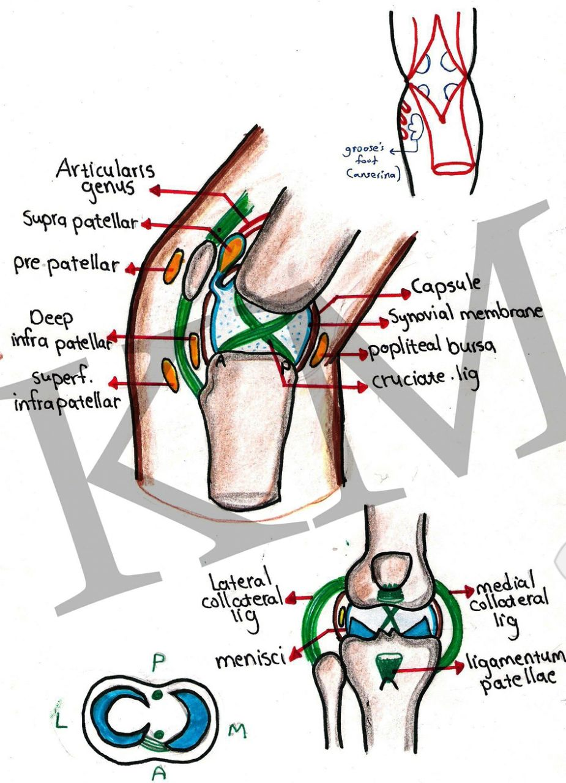
Knee joint: Bursae
Suprapatellar bursa:
Between:
Femur.
Quadriceps tendon.
Communicates with synovial (membrane) (cavity) of knee joint.
Has a clinical importance*.
Prepatellar bursa**:
Between:
Patella.
Skin.
Deep Infrapatellar bursa:
Between:
Tibia.
Ligamentum patella.
Subcutaneous infrapatellar bursa:
Between:
Tibial tuberosity.
Skin.
Popliteal bursa:
Between:
Popliteus tendon.
Capsule.
Communicates with synovial (membrane) (cavity) of knee joint.*
*If there’s an inflammation/infection it will be transferred between the joint and this bursa.
**Another name: Housemaid Bursa.
Because when housemaid sit on the floor while cleaning she presses on this bursa.

Slide 12
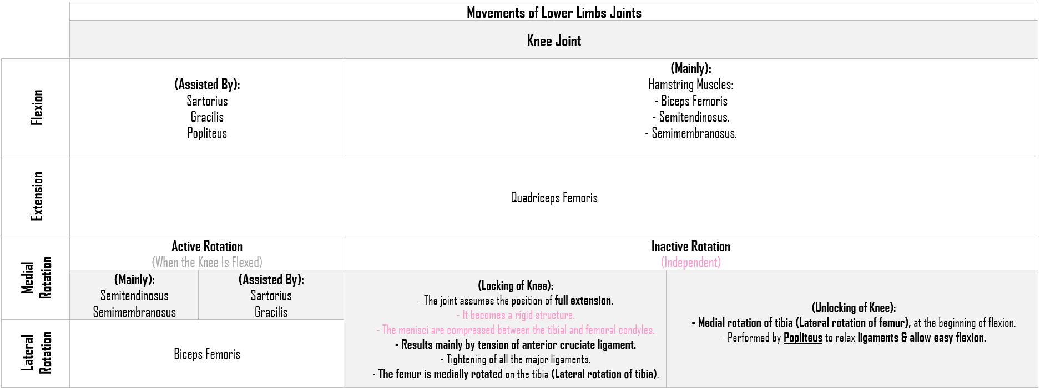
Knee joint: Movements

Slide 13
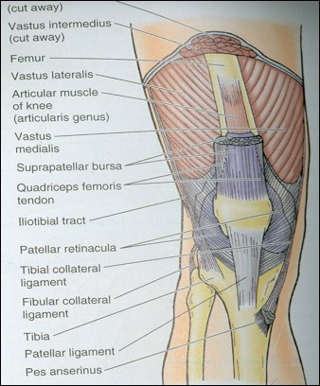
STABILITY OF THE JOINT
This Slide was in girls’ slides only
Maintained by*:
Muscles**:
Quadriceps particularly the inferior fibers of the Vasti lateralis and medialis.
Many sport injuries can be preventable through appropriate training and conditioning of the muscle.
Ligaments:
The knee joint can function well following a ligamentous strain if the quadriceps is intact.
*the shape of the Bones has no role here.
**Muscles are the most important stabilizer.

Slide 14
Objectives (Hip Joint)
List the type & articular surfaces of hip joint.
Describe the ligaments of hip joints.
Describe the capsule of hip joint.
Describe movements of hip joint.
Describe the blood supply of hip joint.
Describe the avascular necrosis & how may it occur.
Describe the stability of hip joint.
Mention the types of dislocation, and describe each one of it.

Slide 15
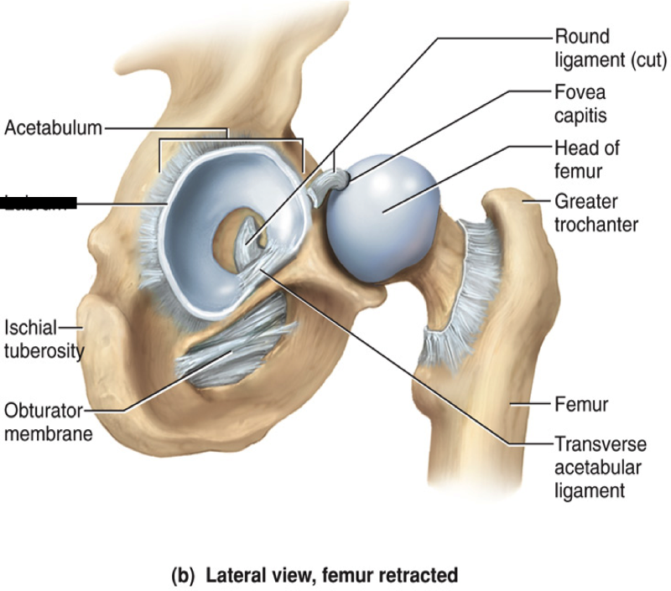
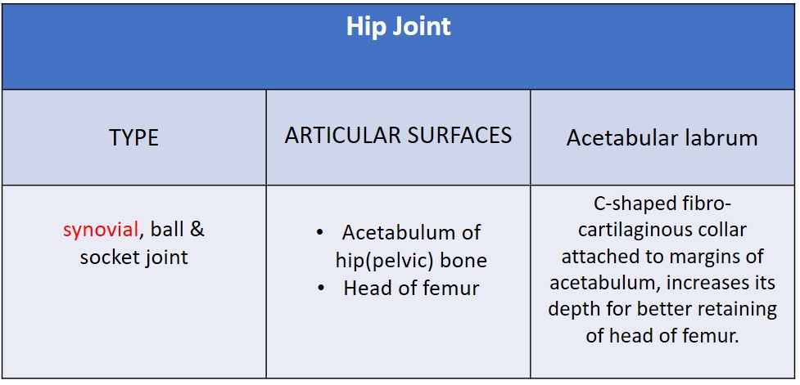
Hip Joint
(socket)
(Polyaxial)
(ball)
Converts the notch to foramen

Slide 16
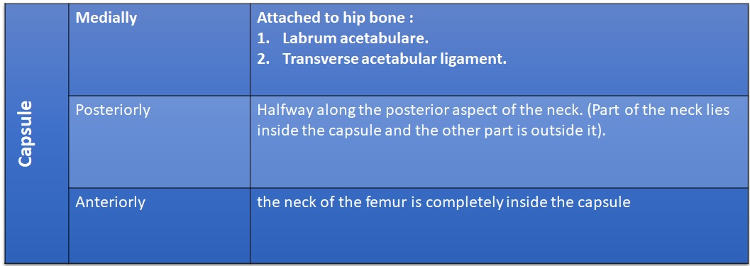
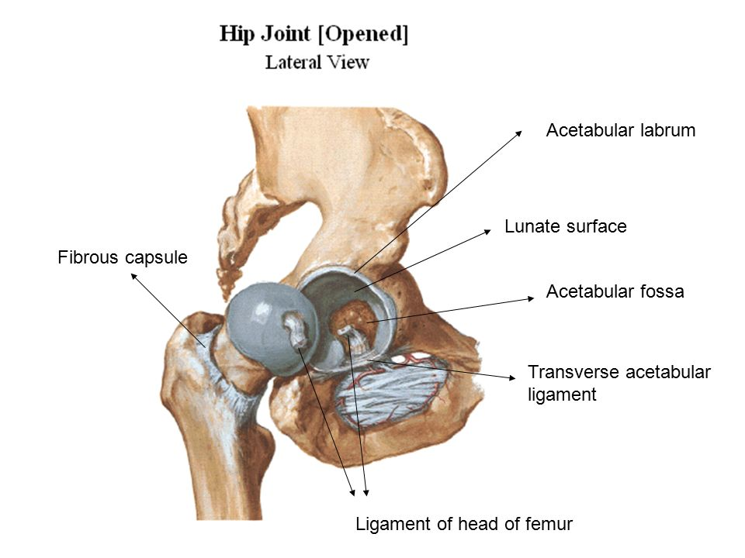
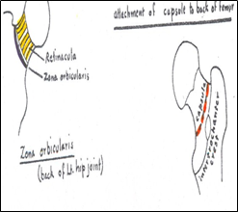
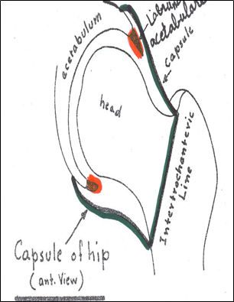
Capsule
This Slide was in girls’ slides only
Neck of Femur is:
Fully Covered Anteriorly.
Only Upper Part Covered Posteriorly.

Slide 17
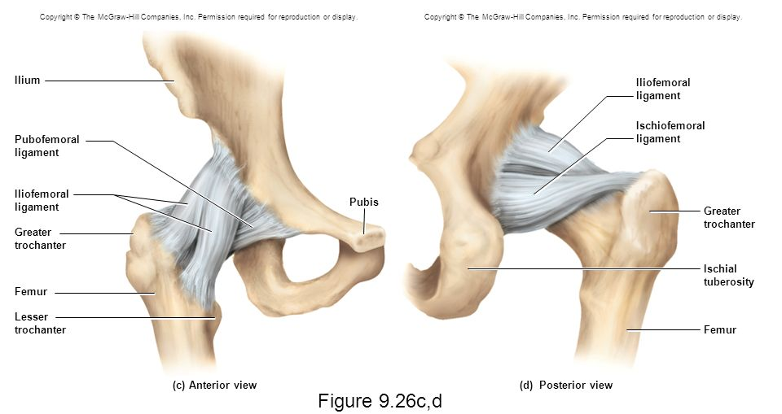
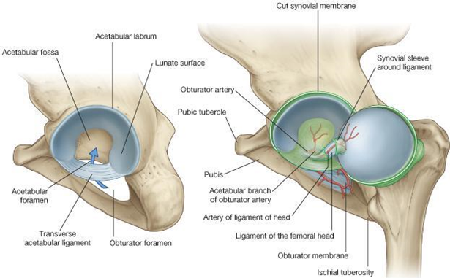
Ligaments of Hip Joint
3 EXTRACAPSULAR:
Iliofemoral ligament:
Y-shaped.
Anterior to joint.
Limits Extension.
Pubofemoral ligament:
Antero-inferior to joint.
Limits Abduction & Lateral Rotation.
Ischiofemoral ligament:
Posterior to joint.
Limits Medial Rotation.
3 INTRACAPSULAR:
Acetabular labrum:
Fibro-cartilaginous collar* attached to margins of acetabulum to increase its depth for better retaining of head of femur.
Transverse acetabular ligament:
Converts acetabular notch into foramen through which pass acetabular vessels.
Ligament of femoral head:
Carries vessels to head of femur.

Slide 18
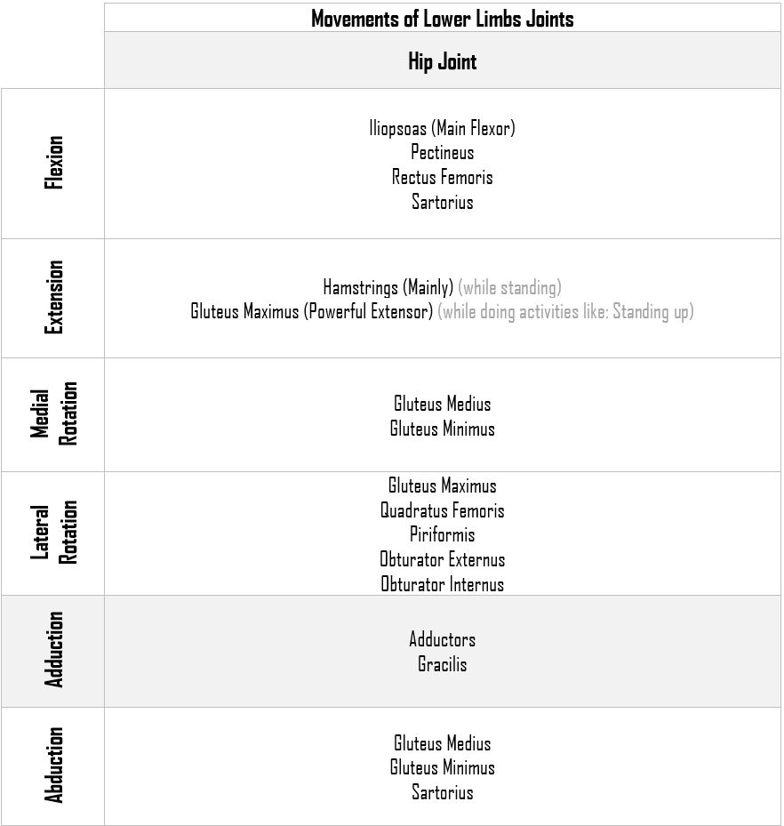
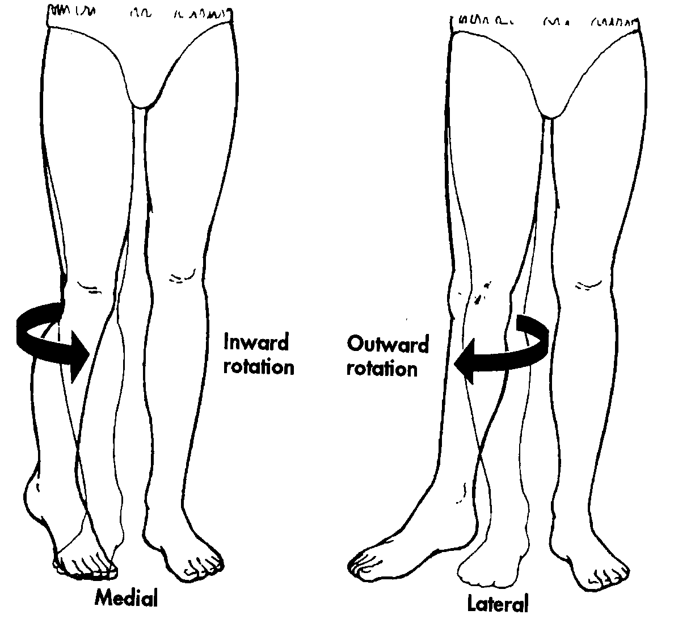
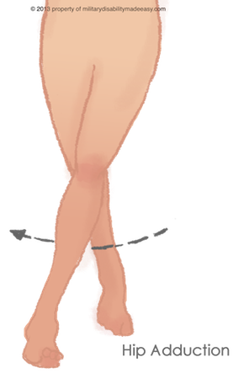
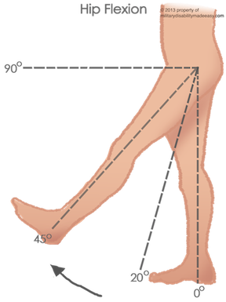
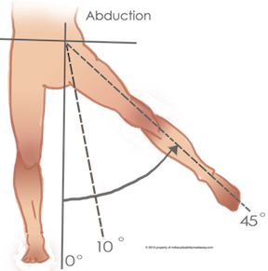
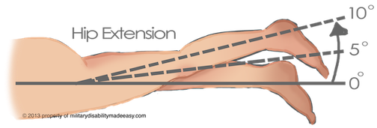
Movements of Hip Joint

Slide 19
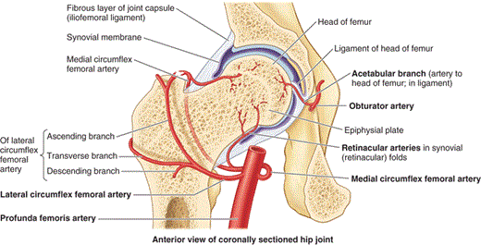
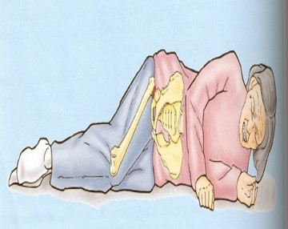
Blood Supply
This Slide was in girls’ slides only
The main arterial supply is from branches of the circumflex femoral arteries (especially the medial).
The blood passes to the joint through:
Retinacular fibers of the neck.
Ligament of the head of the femur.
Damage of the retinacular fibers as in fracture neck of the femur can results in:
Avascular* necrosis of the head of the femur. (Because there won’t be blood supply)
Fracture neck of the femur is common after age of (60) years especially in women because of Osteoporosis.
*Avascular necrosis (AVN):also called osteonecrosis or bone infarction, is death of bone tissue due to interruption of the blood supply.

Slide 20
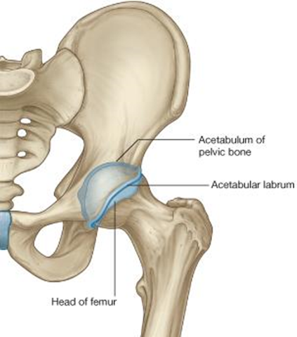
Stability of the Joint
This Slide was in girls’ slides only
The hip joint is one of the most stable joints of the body because of:
The Head of the femur* fits very accurately in the acetabulum due to the following:
The acetabulum is very deep and its depth is increased by the labrum acetabulare.
The labrum acetabulare forms a firm grip on the head of the femur.
The atmospheric pressure resists separation between the head of the femur and the acetabulum.
The three strong Extrinsic ligaments**.
The surrounding strong Muscles.
**
Iliofemoral ligament.
Pubofemoral ligament.
Ischiofemoral ligament.
*Head of Femur is the most important factor in this joint, unlike the shoulder joint, it was the muscles surrounding the joint.

Slide 21
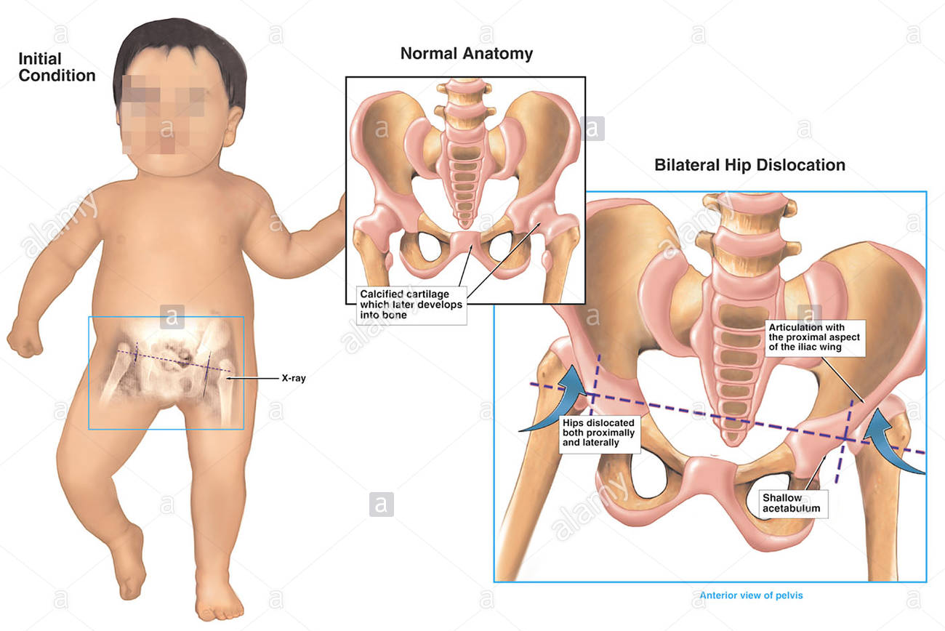
Dislocation of Hip Joint
This Slide was in girls’ slides only
CONGENITAL:
More common in girls and associated with inability to adduct the thigh.
The upper lip of the acetabulum fails to develop adequately.
The head of the femur rides up out of the acetabulum onto the gluteal surface of the ileum.
TRAUMATIC:
It is common in motor vehicle accidents when the thigh is flexed and adducted.
The dislocated head is displaced posteriorly to lie on the posterior surface of the ileum.
In posterior dislocation the sciatic nerve (عرق النَّسا) is liable to be injured.

Slide 22
Objectives (Ankle Joint)
List the type & articular surfaces of ankle joint.
Describe the ligaments of ankle joints.
Describe movements of ankle joint.

Slide 23
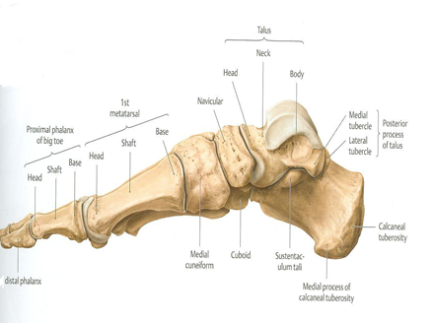
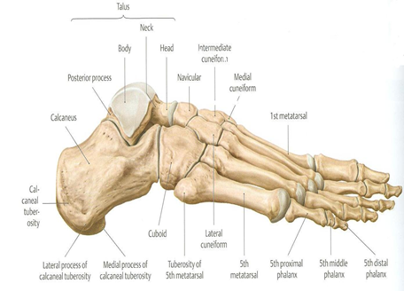
Skeleton of Foot

Slide 24
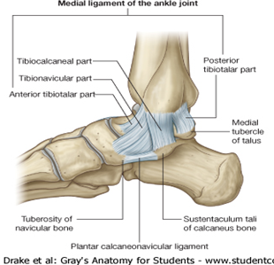
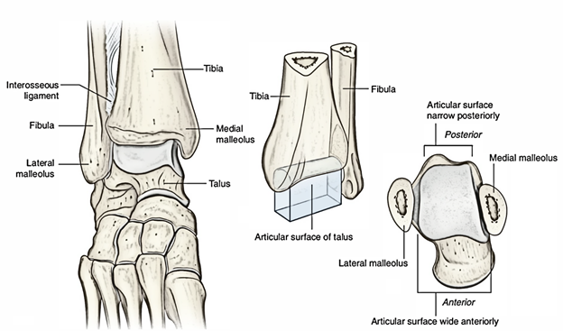
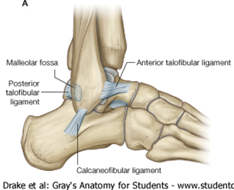
Type & Articular Surfaces
Ligaments
Type:
It is a synovial, hinge joint.
Articular Surfaces:
UPPER:
A socket formed by:
the lower end of tibia.
Medial malleolus
Lateral malleolus.
LOWER:
Body of talus.
MEDIAL (DELTOID) LIGAMENT:
A strong triangular ligament.
Apex: Attached to medial malleolus.
Base: Subdivided into 4 parts:
Anterior tibiotalar part.
Tibionavicular part.
Tibiocalcaneal part.
Posterior tibiotalar part.
LATERAL LIGAMENTS:
Composed of 3 separate ligaments:
Anterior talofibular ligament.
Calcaneofibular ligament.
Posterior talofibular ligament.

Slide 25
Movements of Ankle Joint

Slide 26
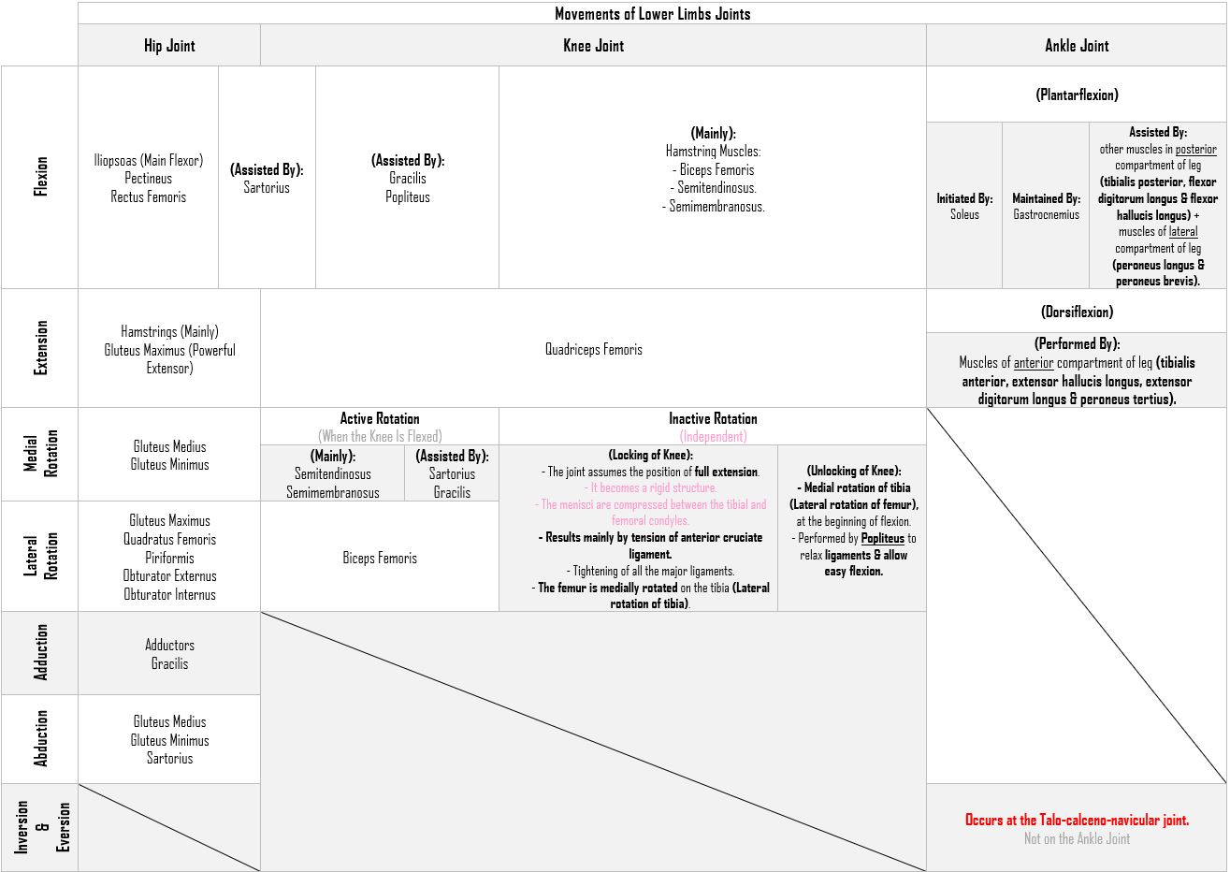
Summary of Lower Limbs Joints Movements

Slide 27
Nerve Supply of All Joints
REMEMBER HILTON’S LAW:
“The joint is supplied by branches from nerves supplying muscles acting on it”.

Slide 28
MCQ:
Flash cards test :)
1- Which muscle of the following starts the plantar flexion?
A- Peroneus longus
B- Peroneus brevis
C- soleus
D- gastrocnemius
2- which one of the following is a lateral ligament for the ankle joint:
A- Tibionavicular part
B-Anterior talofibular ligament
C- Tibiocalcaneal part
D-Posterior tibiotalar part
3-which one of the following consider is the type of the ankle joint:
A-fibrous joint
B-cartilaginous joint
C-synovial hinge joint
D-synovial ellipsoid joint
4-which one of the following consider is the type of the hip joint:
A-synovial hinge joint
B-synovial , ball and socket joint
C- synovial, modified hinge
D-synovial ellipsoid joint

Slide 29
5- Bursa between femur and quadriceps tendon:
A- Suprapatellar bursa.
B- Deep Infrapatellar bursa.
C- Prepatellar bursa.
D- Subcutaneous Infrapatellar bursa.
6-The muscle that extends the hip & flexes the knee joint is:
A- Gluteus maximus.
B- Quadriceps femoris.
C- Sartorius.
D- Semitendinosus.
7-Pubofemoral ligament is :
A- Anterior to hip joint.
B- Posterior to hip joint.
C- Anterior inferior to hip joint.
8-TRAUMATIC Dislocation of Hip Joint can happen due:
A- Common in motor vehicle accidents.
B- Falling from high altitude.
C- Osteoporosis.
D- Fails of developing.
9-what it is HILTON’S LAW
………………
10-capsule of hip joint attach Medially to
………………
Transverse acetabular ligament,▪Acetabular labrum
11- fracture neck of the femur can results
……………….
1-C
2-B
3-C
4-B
5-A
6-D
7-C
8-A
9-
10-
“The joint is supplied by branches from nerves supplying muscles acting on it”.
11-
Avascular necrosis of the head of the femur

Slide 30
Team Members
Faisal Fahad Alsaif (Team Leader) Abdulaziz Al dukhayel ‏Fahad Alfaiz ‏Akram Alfandi ‏Saad Aloqile ‏Saleh Almoaiqel ‏Abdulaziz Alabdulkareem ‏Abdullah Almeaither ‏Yazeed Aldossari ‏Muath Alhumood
Abdulrahman Almotairi ‏
Abdulelah Aldossari ‏Abdulrahman Alduhayyim ‏Hamdan Aldossari ‏Abdullah Alqarni ‏Mohammed Alomar ‏Abdulrahman Aldawood ‏Saud Alghufaily ‏Hassan Aloraini
Khalid Almutairi ‏‏
Lamia Abdullah Alkuwaiz (Team Leader)
Rawan Mohammad Alharbi
Abeer Alabduljabbar Afnan Abdulaziz Almustafa Ahad Algrain Alanoud Almansour Albandari Alshaye AlFhadah abdullah alsaleem Arwa Alzahrani Dana Abdulaziz Alrasheed Dimah Khalid Alaraifi Ghada Alhaidari Ghada Almuhanna Ghaida Alsanad Hadeel Khalid Awartani Haifa Alessa Khulood Alwehabi Layan Hassan Alwatban Lojain Azizalrahman Lujain Tariq AlZaid
Maha Barakah Majd Khalid AlBarrak Norah Alharbi Nouf Alotaibi Noura Mohammed Alothaim Rahaf Turki Alshammari Reham Alhalabi Rinad Musaed Alghoraiby Sara Alsultan Shahad Alzahrani Wafa Alotaibi Wejdan Fahad Albadrani Wjdan AlShamry
Abdulmajeed Alwardi ‏Abdulrahman Alageel ‏Rayyan Almousa ‏Sultan Alfuhaid ‏Ali Alammari ‏Fahad Alshughaithry Fayez Ghiyath Aldarsouni ‏Mohammed Alquwayfili ‏‏Abduljabbar Al-yamani ‏Sultan Al-nasser ‏Majed Aljohani ‏Zeyad Al-khenaizan ‏Mohammed Nouri ‏Abdulaziz Al-drgam ‏Fahad Aldhowaihy ‏Omar alyabis

