Slide 1
Bones of the Upper Limb
Lecture 1
Please check our Editing File.
هذا العمل لا يغني عن المصدر الأساسي للمذاكرة
{وَمَنْ يَتَوَكَّلْ عَلَى اللَّهِ فَهُوَ حَسْبُهُ}

Slide 2
Objectives
List the different bones of the Upper Limb
List the characteristic features of each bone.
Differentiate between the bones of the right and left sides.
List the articulations between the different bones.
Text in BLUE was found only in the boys’ slides
Text in PINK was found only in the girls’ slides
Text in RED is considered important
Text in GREY is considered extra notes

Slide 3
Terminology (Team 434)

Slide 4
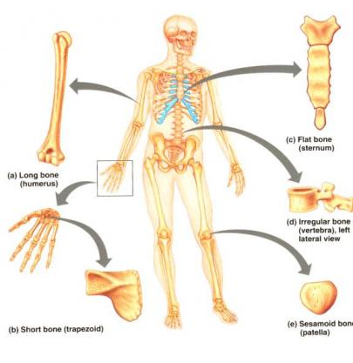
This slide was only found in boys lecture.
Bones
Bones support and protect the various organs of the body “the chest”
Produce red and white blood cell “bone marrow”
Store minerals “ مثل الكالسيوم”
Enable movement
Provides attachment for muscles
Come in a variety of shapes and sizes
There are FIVE types of bones in the Human body:
- Long bones (limbs and fingers)
- Short bones (wrist and ankles)
- Flat bones (skull and sternum)
-Irregular bones (spine and pelvis)
- Sesamoid bones (patella)

Slide 5
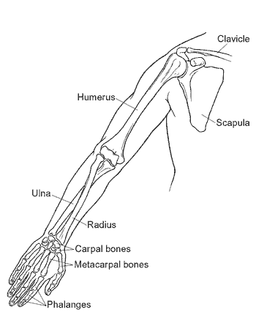
Bones of upper limb
pectoral girdle { Scapula , Clavicle }
Arm {Humerus}
Forearm {Radius , Ulna }
Wrist {Carpal bones }
Hand { Metacarpal , Phalanges }

Slide 6
Pectoral girdle
Formed of Two Bones:
Clavicle (anteriorly)
Scapula (posteriorly).
It is very light and allows the upper limb to
have exceptionally free movement.
مهمتها الأساسية تفصل بين Upper limbs و Trunk .

Slide 7
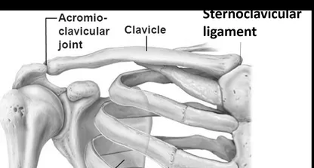
Clavicle
It serves as a rigid support from which the scapula and free upper limb are suspended & keep them away from the trunk so that the arm has maximum freedom of movement.
It is a doubly curved long bone lying horizontally across the root of the neck
It is subcutaneous “under skin” throughout its length.
with no medullary cavity.
It has the appearance of an elongated letter Capital (S) lying on one side.
If the clavicle is broken, the whole shoulder region caves in medially.
functions
Transmit forces from the upper limb to the axial skeleton
Provides attachment for muscles
It forms a boundary of the cervicoaxillary canal for protection of the neurovascular bundle of the UL.

Slide 8
Clavicle
It has Two Ends:
Body (shaft):
Surfaces:
Lateral (Acromial):
flattened.
Medial (Sternal) : enlarged & triangular.
its lateral 1/3 is concave forward.
Its medial 2/3 is convex forward.
Inferior : rough because strong
Ligaments bind it to the 1st rib
Superior: smooth as it lies just deep to the skin

Slide 9
Articulation of clavicle
Medially | With the manubrium at the Sternoclavicular joint
Laterally | With the scapula(Acromion) at the Acromioclavicular joint
Inferiorly | With the first rib at the Costoclavicular joint

Slide 10
Fractures of the Clavicle
The clavicle is commonly fractured, especially in children as forces are impacted to outstretched hand during falling.
The weakest part of clavicle is the junction of the medial and lateral thirds
After fraction, the medial fragment is elevated [ by the sternomastoid muscle] , the lateral fragment drops because of the weight of the upper limbs
The whole shoulder joint may be caves in(pulled)medially by the adductor of the arm
The sagging limb is supported by the other

Slide 11
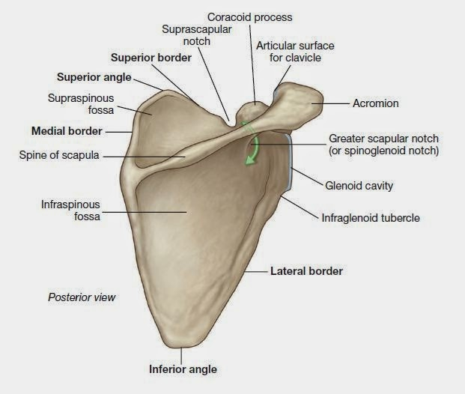
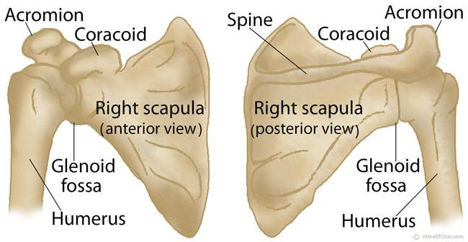
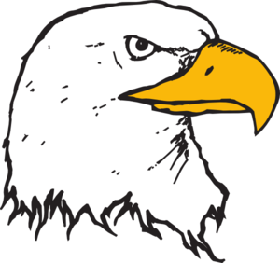
Scapula (Shoulder Blade)
It is a triangular Flat bone.
Extends between the 2nd - 7th ribs.
It has three Processes:
1-Spine: a thick projecting ridge of bone that
continues laterally as the flat expanded posteriorly.
2- Acromion : forms the subcutaneous point of the shoulder.
3- Coracoid: a beak like"منقار" process , It resembles in size, shape
& direction a bent finger pointing to the shoulder.
It has three Borders: Superior, Medial (Vertebral)
& Lateral (Axillary) it’s the thickest part of the bone, it terminates
at the lateral angle .

Slide 12
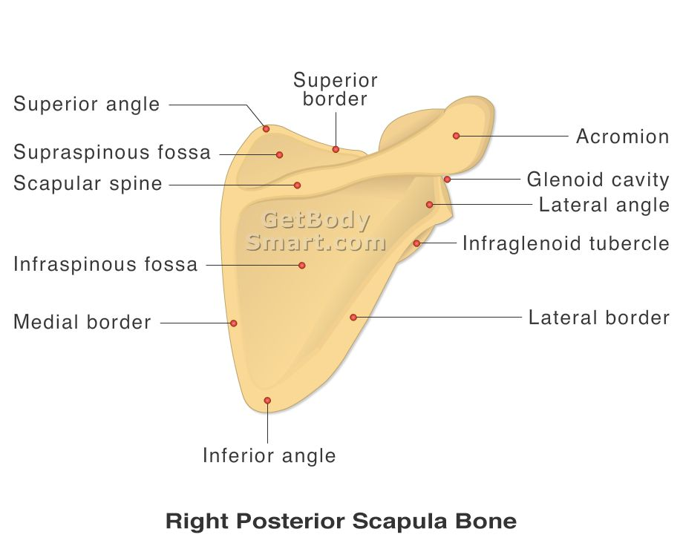
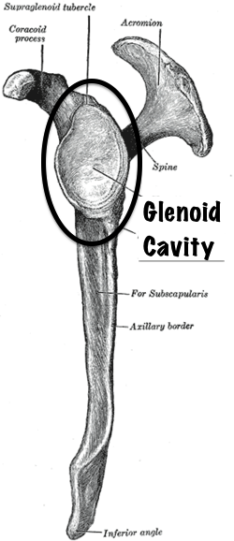
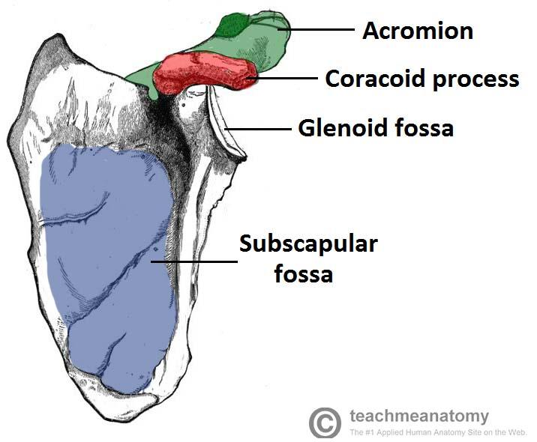
Scapula (Shoulder Blade)
Suprascapular notch
It has Three Angles : Superior, Inferior & Lateral forms the (Glenoid cavity) : a shallow concave oval fossa that receives the head of the humerus.
It has Two Surfaces:
1- Convex Posterior : divided by the spine of the scapula into :
Supraspinous Fossa: it’s small & above the spine.
Infraspinous Fossa: it’s large & below the spine.
2- Concave Anterior (Costal) : it forms the large Subscapular Fossa.
Suprascapular notch: It is a nerve passageway, medial to coracoid process.
Suprascapular nerve

Slide 13
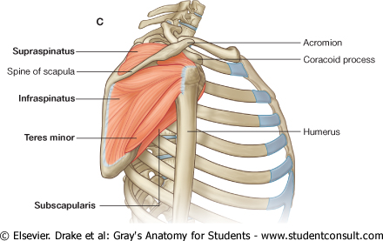
Functions of Scapula
Gives attachment to muscles.
Has a considerable degree of movement on the thoracic wall to enable the arm to move freely(give us extra movement)
The glenoid cavity forms the socket of the shoulder joint.
Because most of the scapula is well protected by muscles and by its association with the thoracic wall , most of its fractures involve the protruding subcutaneous Acromion.

Slide 14
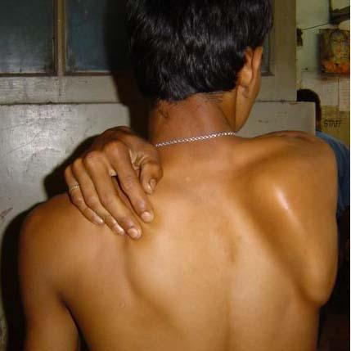
WINGED SCAPULA
only in the girls’ slides
It will protrude posteriorly.
The patient has difficulty in raising the arm above the head (difficult in rotation of the scapula).
It is due to injury of the long thoracic nerve
(as in radical mastectomy "استئصال الثدي") which causes
paralysis of serratus anterior muscle.
The medial border and inferior angle of the scapula will no longer be kept closely applied to the chest
wall.
WINGED SCAPULA

Slide 15
Humerus
Typical Long bone.
It is the largest bone of the UL (upper limb)
Proximal End: Head, Neck, Greater & Lesser Tubercles.
• Head : Smooth, it forms 1/3 of a sphere, it articulates with the glenoid cavity of the scapula
• Greater tubercle: at the lateral margin of the humerus.
• Lesser tubercle: projects anteriorly.
(The two tubercles are separated by Intertubercular Groove “bicipital groove” )
•Anatomical neck: formed by a groove separating the head from the tubercles. “between the head and greater tubercle”
•Surgical Neck: a narrow part distal to the tubercles, it is the most common fracture site of the humerus.
←surgical
Anterior posterior

Slide 16
Humerus
Shaft (Body): Has two prominent features:
1. Deltoid tuberosity:
A rough elevation laterally for the attachment of deltoid muscle.
2. Spiral (Radial) groove:
Runs obliquely down the posterior aspect of the shaft.
It lodges the important radial nerve & vessels.
Anterior posterior

Slide 17
Humerus
Distal End:
Widens as the sharp medial and lateral Supracondylar Ridges and end in the Medial (can be felt) and Lateral Epicondyles, they providing muscular attachment.
- Anteriorly:
• Trochlea: (medial) for articulation with the ulna
• Capitulum: (lateral) for articulation with the radius.
• Coronoid fossa: above the trochlea.
• Radial fossa: above the capitulum.
- Posteriorly:
• Olecranon fossa : above the trochlea.
Fossa= تجويف بسيط في العظام
Anterior posterior

Slide 18
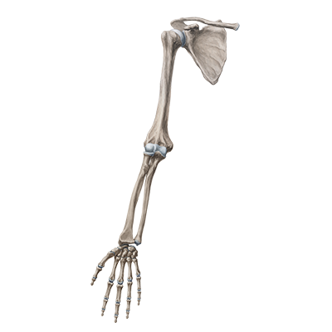
Articulations of Humerus
Proximal End:
Articulate with the Glenoid cavity in the Scapula to form
Shoulder Joint
Distal End:
Articulate with the Radius and Ulna to form
Elbow joint

Slide 19
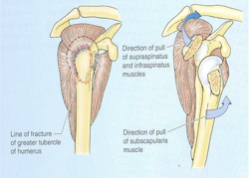
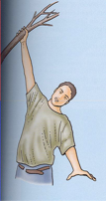
Fractures of Humerus
fractures of the Surgical Neck
fractures of the greater tubercle
fractures of The body of the humerus
Most common fractures are of the Surgical Neck especially in older people with osteoporosis “هشاشة العظام”
In younger people, fractures of the greater tubercle results from falling on the hand when the arm is abducted .
The body of the humerus can be fractured by a direct blow to the arm or by indirect injury as falling on the outstretched hand.
The fracture results from falling on the hand (transition of force through the bones of forearm of the extended limb).
ملاحظة من الدكتورة : الكسر في هذا الموقع شائع لأنه يعتبر أضعف نقطة في هذه العظمة
يحدث هذا النوع من الكسر خصوصا إذا كان الشخص يسقط من ارتفاع فيسند بيده
ملاحظة من الدكتورة : هذا المكان هو أقل واحد عرضة للكسر، يحتاج ضربة قوية عشان يحدث فيه كسر

Slide 20
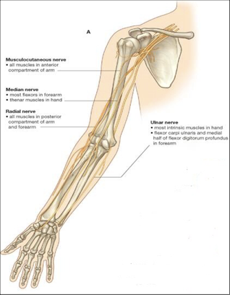
Nerves Affected in Fractures of Humerus
Distal end of humerus: Median nerve.
Surgical neck: Axillary nerve
Medial epicondyle : Ulnar nerve.
Radial groove:
Radial nerve.

Slide 21
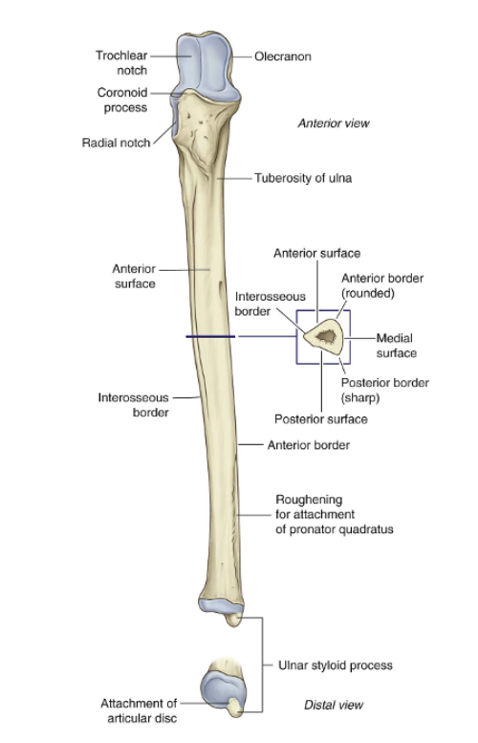
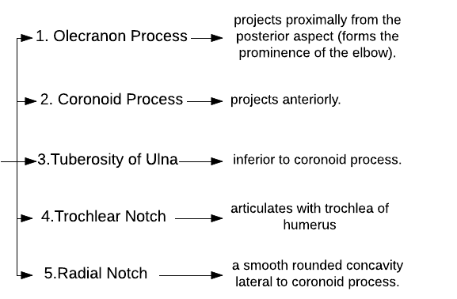
Ulna
It is the stabilizing bone of the forearm. It is the medial & longer of the two bones of the forearm.
Proximal end
The olecranon process and the coronoid process articulate with the humerus through the humerus fossa.

Slide 22
Ulna
Shaft:
Thick & cylindrical superiorly but diminishes in diameter inferiorly.
It has Three Surfaces: (Anterior,Medial & Posterior).
Sharp Lateral Interosseous border.
Distal End:
Head: Small rounded lies distally at the wrist.
styloid process: medial site.
The articulations between the ulna and humerus at the elbow joint allows primarily only flexion and extension (small amount of abduction and adduction occurs).

Slide 23
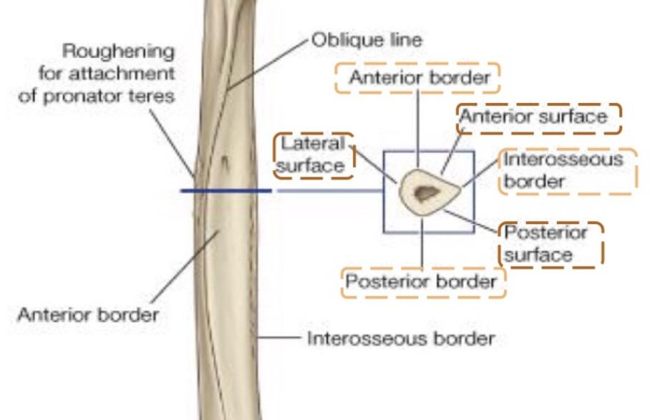
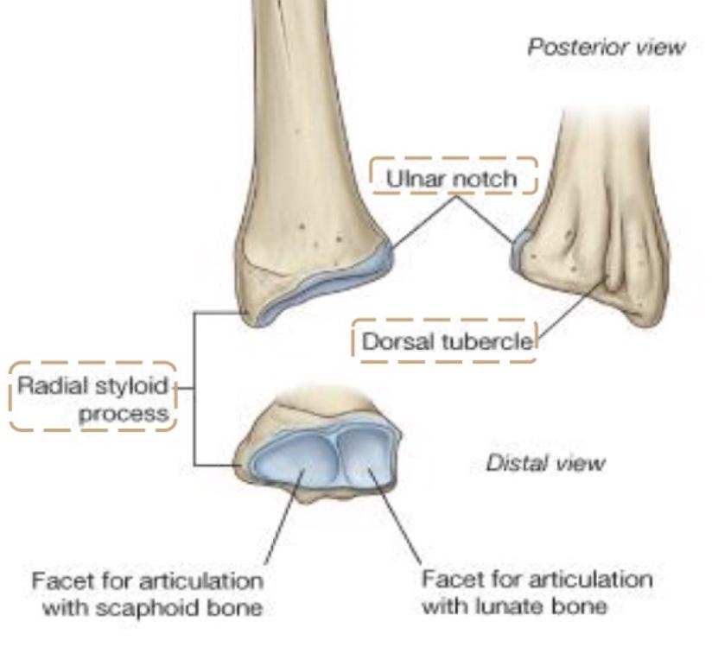
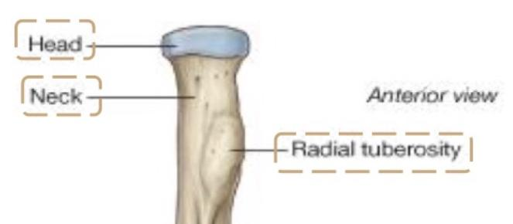
Radius
It is the shorter and the lateral of the two forearm bones.
Proximal End
Shaft
Distal (lower) End
Head: small and circular, its upper surface is concave for articulation with the Capitulum.
Neck.
Radial (Bicipital) Tuberosity: medially directed and separates the proximal end from the body.
Has a lateral convexity.
It gradually enlarges as it passes distally.
It has 3 borders: anterior border, interosseous border, posterior border
It has 3 surfaces: anterior surface, posterior surface, lateral surface
It is rectangular.
Ulnar Notch: a medial concavity to accommodate the head of the ulna.
Radial styloid process: extends from the lateral aspect.
Dorsal tubercle: projects dorsally.

Slide 24
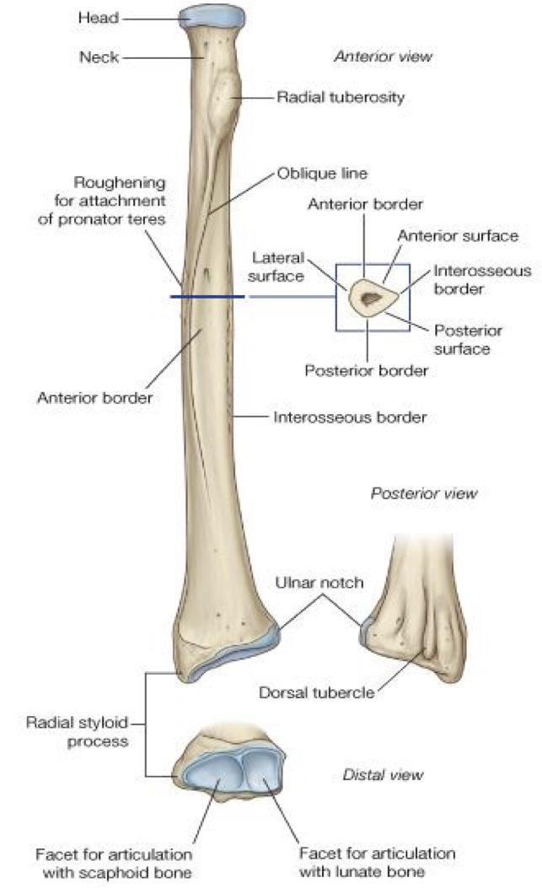
Radius
Note: Ulna and Radius both have the same surfaces and borders BUT since Radius is on the lateral side it has a lateral surface, and Ulna on the medial side has a medial surface.
Articulation with the Capitulum of the humerus
Sharp
The interosseous border is sharp because it is attached to the interosseous membrane.
Smooth
Medial
Lateral
Attaches to the head of ulna.
Forms the lateral border to the proximal row of carpal bones.
Divides the posterior surface into cavities for tendons to pass through.

Slide 25
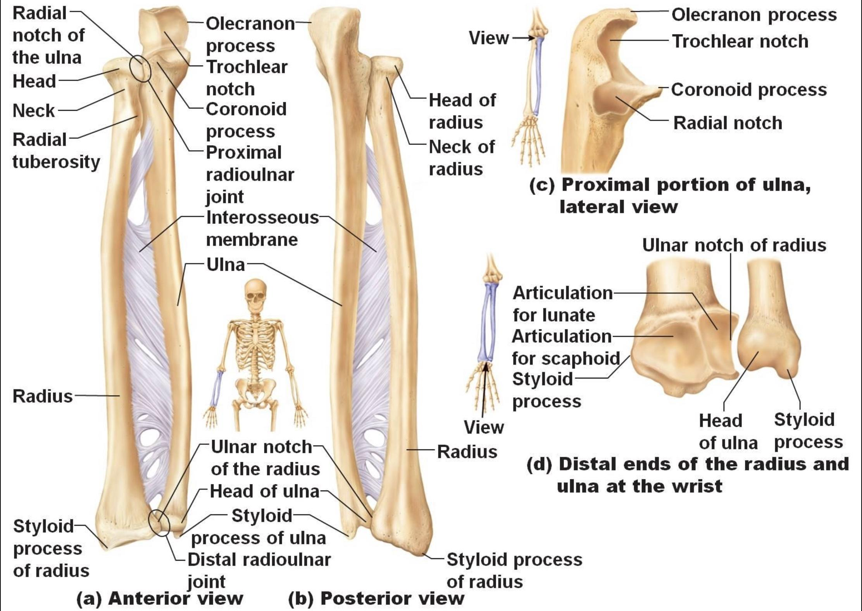
Articulations of Radius and Ulna
Distal end of Humerus with the proximal ends of Radius and Ulna form the Elbow joint
The two bones are connected by the flexible interosseous membrane
Distal Radioulnar joint: between the head of the ulna and the ulnar notch of the radius
Proximal Radioulnar joint: between the head of the radius and the radial notch of the ulna
Take a look at this picture for a better understanding.
This slide was only found in boys slides.

Slide 26
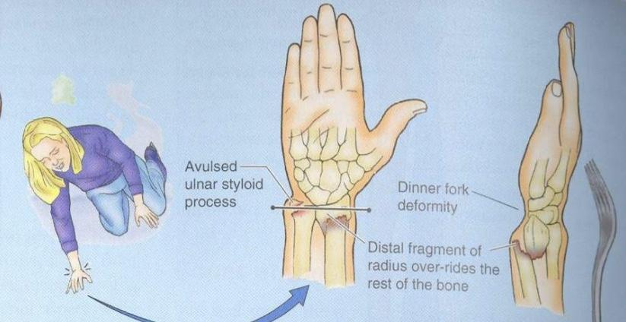
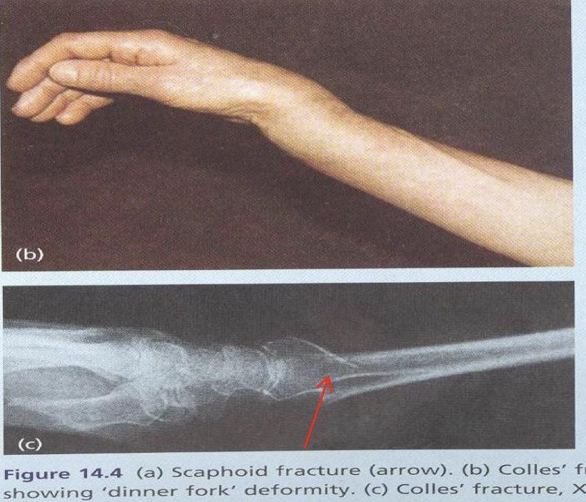
Fractures of Radius and Ulna
Because the radius & ulna are firmly bound by the interosseous membrane, a fracture of one bone is commonly associated with dislocation of the nearest joint. (If the force causing fracture in Radius is strong, it might transmit to ulna, humerus, and clavicle. This happens in seconds.)
Colle’ s Fracture (fracture of the distal end of radius) is the most common fracture of the forearm.
It is more common in women after middle age because of osteoporosis.
It causes dinner fork deformity.
It results from forced dorsiflexion of the hand as a result to ease a fall by outstretching the upper limb.
The typical history of the fracture includes slipping. Because of the rich blood supply to the distal end of the radius, bony union is usually good. (Rapid healing in young people because of the rich blood supply. On the other hand, surgical interference is needed in old people because of the poor blood supply.)

Slide 27
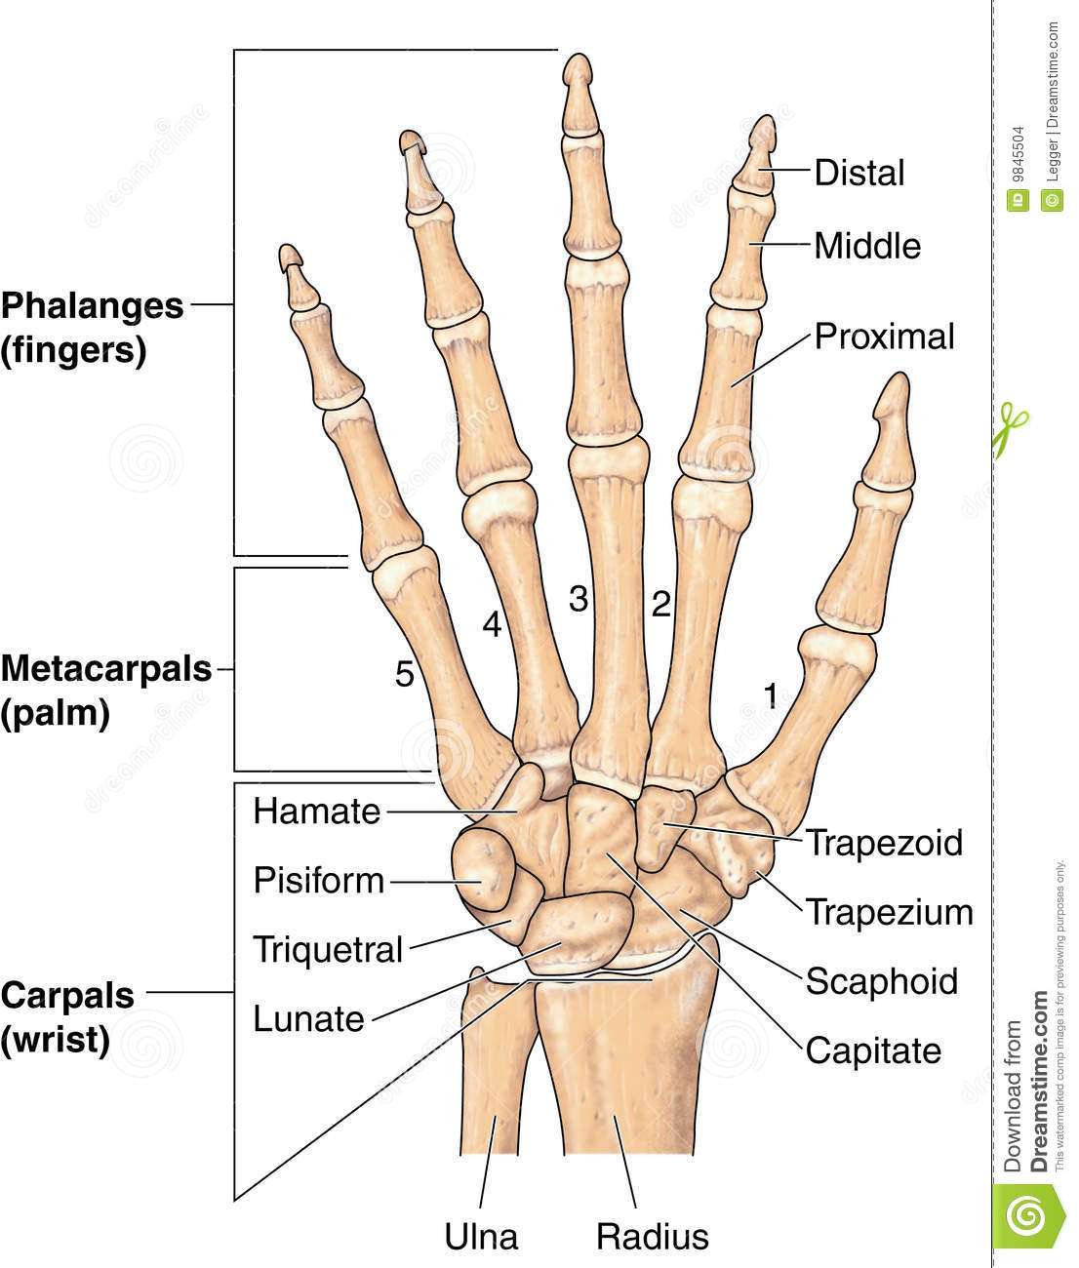
Hands
This slide was only found in boys slides.
The skeleton of the hand consists of:
Carpals for the carpus (wrist)
Hands
Metacarpals for the palm
Phalanges for the fingers

Slide 28
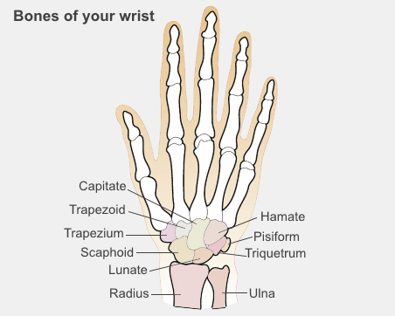
Carpal Bones (Carpus)
Composed of Eight short bones arranged in two irregular rows, Four bones in each row.
These Small bones give flexibility to the wrist.
The carpal bones are small so they won’t interfere with the movement of the wrist so that give it flexibility
The carpus presents Concavity on their Anterior surface & Convex from side to side Posteriorly.
Proximal row (from lateral to medial):
Scaphoid, Lunate, Triquetral & Pisiform bones.
Distal row (from lateral to medial):
Trapezium, Trapezoid, Capitate & Hamate.
To help you memorize:
Sally Left The Party To Take Cathy Home
She Looks Too Pretty Try To Catch Her

Slide 29
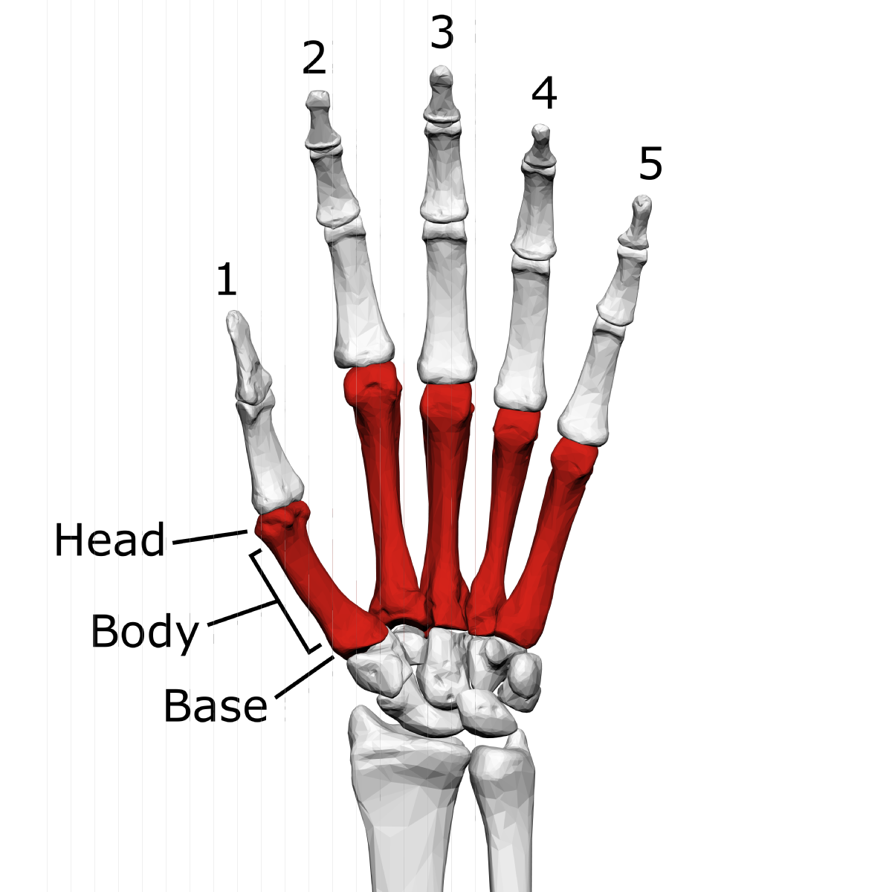
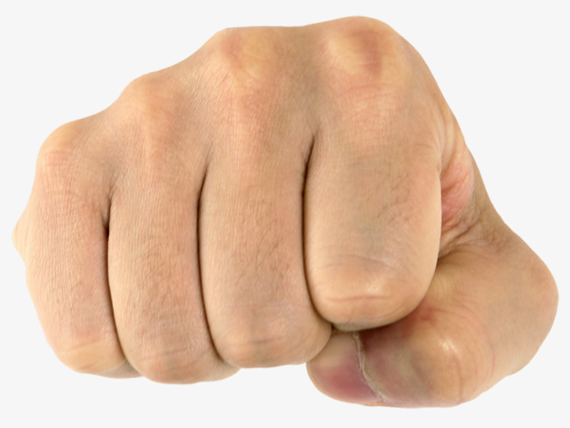
Metacarpals
Metacarpals form the skeleton of the hand.
Position: Between the carpus and the phalanges.
Features: Head (distal), Shaft (middle), Base (proximal).
Count: 5 metacarpal, numbered 1-5 from the thumb.
Shaft
N.B: The 1st metacarpal is the shortest and most mobile.
-The distal ends (Heads) articulate with the proximal
-phalanges to form the Knuckles of the fist.
-The base of the metacarpals articulates with the carpal bones.
-The third metacarpal has a styloid process on the lateral side of the base.
قبضة اليد
Knuckles

Slide 30
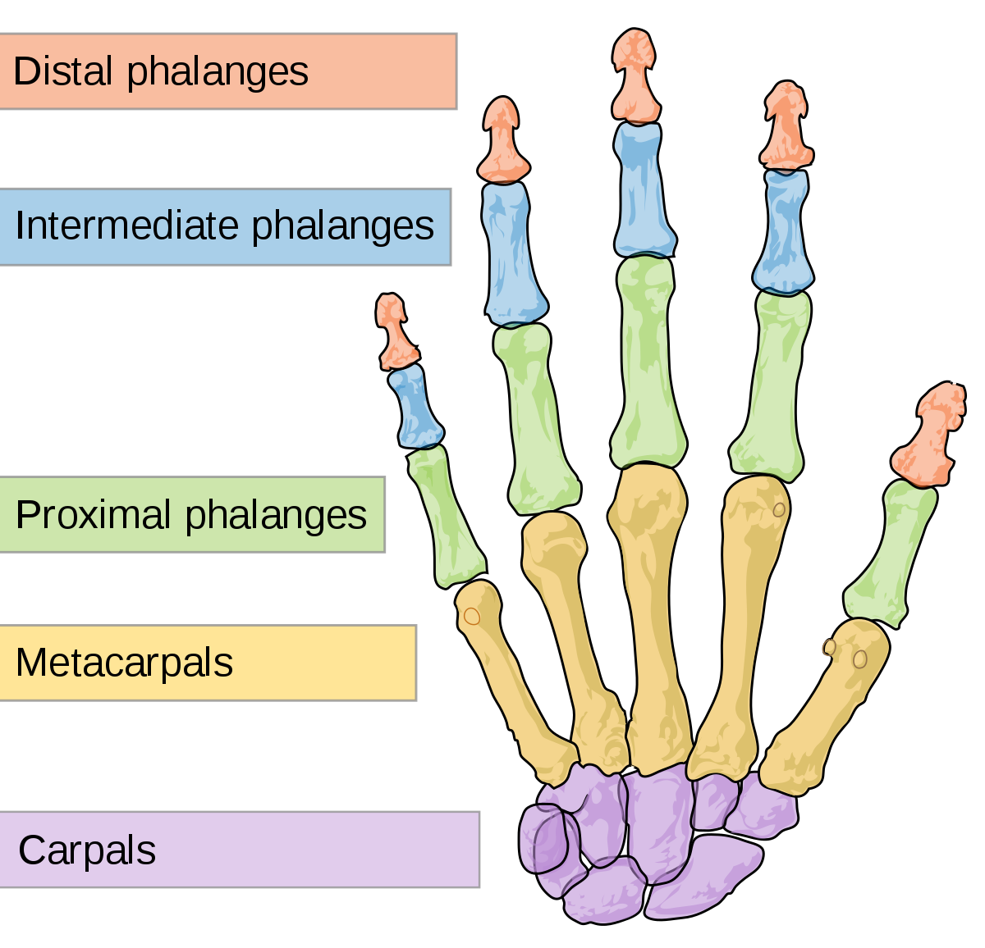
Phalanges
Short
Medium
Position: connected to the metacarpals distally.
Features: Head(Distal), Body(middle shaft), Base(proximal).
Count: Total 14. ( each finger has 3 Except the thumb has 2)
N.B:
-The proximal phalanx are the largest.
-The middle ones are medium sized.
-The distal ones are the smallest. ( flattened and expanded distally to form the nail beds )
Large

Slide 31
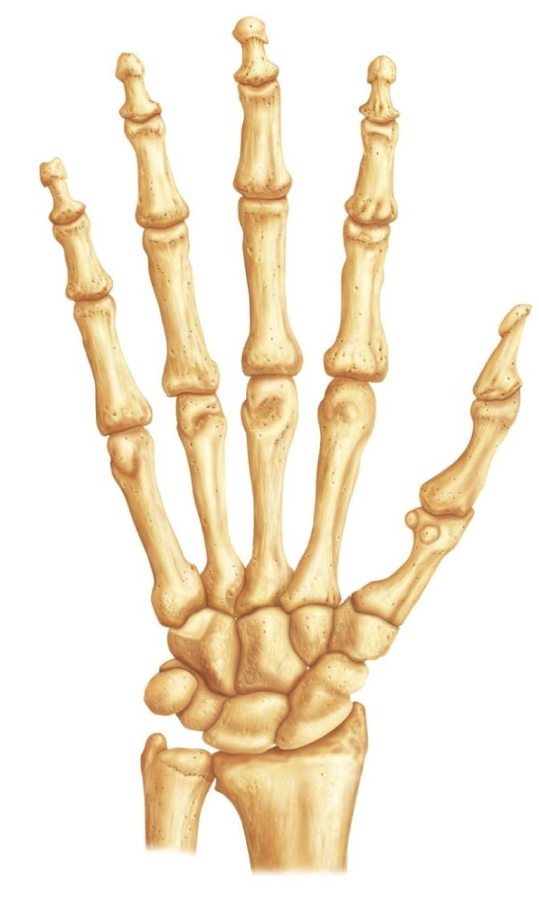
Articulations of the Hand
This slide was only found in boys lecture.
The phalanges articulate with each other.
Interphalangeal joints.
Head of metacarpals articulate with the proximal phalanges.
Metacarpophalangeal joint
Bases of the Metacarpal bones articulate with the distal row of the carpal bones .
Carpometacarpal Joint.
Distal end of the radius articulate with the Proximal row of carpal bones.
Wrist joint.

Slide 32
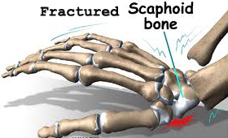
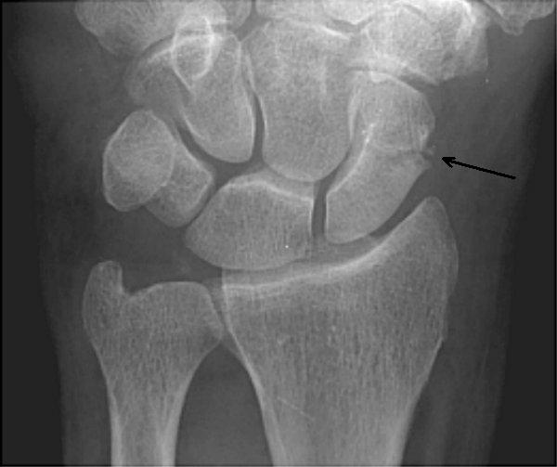
Fracture of Scaphoid
It is the most commonly fractured carpal bone and it is the most common injury of the wrist.
It is the result of a fall onto the palm when the hand is abducted.
Pain occurs along the lateral side of the wrist especially during dorsiflexion and abduction of the hand.
Union of the bone may take several months because of poor blood supply to the proximal part of the scaphoid.

Slide 33
QUESTIONS
1-clavicle has ………. rough surface which attaches with the first rib by a ligament .
A-anterior
B-posterior
C-inferior
D-superior
2-the thickest border of the scapula is ………..
A- medial
B-lateral
C-superior
3-this bone has 2 prominent features which are deltoid tuberosity and radial groove .
A-humerus B-femoris
4- ulna has a head at the proximal end (true/false)
5- a bone that get wider as it goes distally and has rectangular distal end …………
A-radius
B- femur
C- ulna
D- tibia

Slide 34
1-c
2-b
3-a
4-False
5-a
Test yourself! https://tiny.cards/decks/ce81f413-ca8e-4372-9b4f-3dedb867bc2chttps://tiny.cards/decks/ce81f413-ca8e-4372-9b4f-3dedb867bc2c

Slide 35
Team Members
Faisal Fahad Alsaif (Team Leader) Abdulaziz Al dukhayel ‏Fahad Alfaiz ‏Akram Alfandi ‏Saad Aloqile ‏Saleh Almoaiqel ‏Abdulaziz Alabdulkareem ‏Abdullah Almeaither ‏Yazeed Aldossari ‏Muath Alhumood ‏
Abdulelah Aldossari ‏Abdulrahman Alduhayyim ‏Hamdan Aldossari ‏Abdullah Alqarni ‏Mohammed Alomar ‏Abdulrahman Aldawood ‏Saud Alghufaily ‏Hassan Aloraini ‏‏
Lamia Abdullah Alkuwaiz (Team Leader)
Rawan Mohammad Alharbi
Abeer Alabduljabbar Afnan Abdulaziz Almustafa Ahad Algrain Alanoud Almansour Albandari Alshaye AlFhadah abdullah alsaleem Arwa Alzahrani Dana Abdulaziz Alrasheed Dimah Khalid Alaraifi Ghada Alhaidari Ghada Almuhanna Ghaida Alsanad Hadeel Khalid Awartani Haifa Alessa Khulood Alwehabi Layan Hassan Alwatban Lojain Azizalrahman Lujain Tariq AlZaid
Maha Barakah Majd Khalid AlBarrak Norah Alharbi Nouf Alotaibi Noura Mohammed Alothaim Rahaf Turki Alshammari Reham Alhalabi Rinad Musaed Alghoraiby Sara Alsultan Shahad Alzahrani Wafa Alotaibi Wejdan Fahad Albadrani Wjdan AlShamry
Abdulmajeed Alwardi ‏Abdulrahman Alageel ‏Rayyan Almousa ‏Sultan Alfuhaid ‏Ali Alammari ‏Fahad alshughaithry Fayez Ghiyath Aldarsouni ‏Mohammed Alquwayfili ‏‏Abduljabbar Al-yamani ‏Sultan Al-nasser ‏Majed Aljohani ‏Zeyad Al-khenaizan ‏Mohammed Nouri ‏Abdulaziz Al-drgam ‏Fahad Aldhowaihy ‏Omar alyabis

