Slide 1
Sciatic Nerve
Lecture 21
Please check our Editing File.
{وَمَنْ يَتَوَكَّلْ عَلَى اللَّهِ فَهُوَ حَسْبُهُ}
هذا العمل لا يغني عن المصدر الأساسي للمذاكرة

Slide 2
Objectives
Describe the anatomy (origin, course & distribution) of the sciatic nerve.
List the branches of the sciatic nerve.
Describe briefly the main motor and sensory manifestations in case of injury of the sciatic nerve or its main branches.
Text in BLUE was found only in the boys’ slides
Text in PINK was found only in the girls’ slides
Text in RED is considered important
Text in GREY is considered extra notes

Slide 3
Origin
Goes to Lumbar Plexus
L4,L5
From Sacral to Plexus
(L4,L5,S1,S2,S3)
Largest branch of the plexus
Largest nerve in the body
واسع
نلاحظ ان ال
sciatic nerve
ياخذ كل الروتس حقت ال
sacral plexus
ما عدا S4

Slide 4
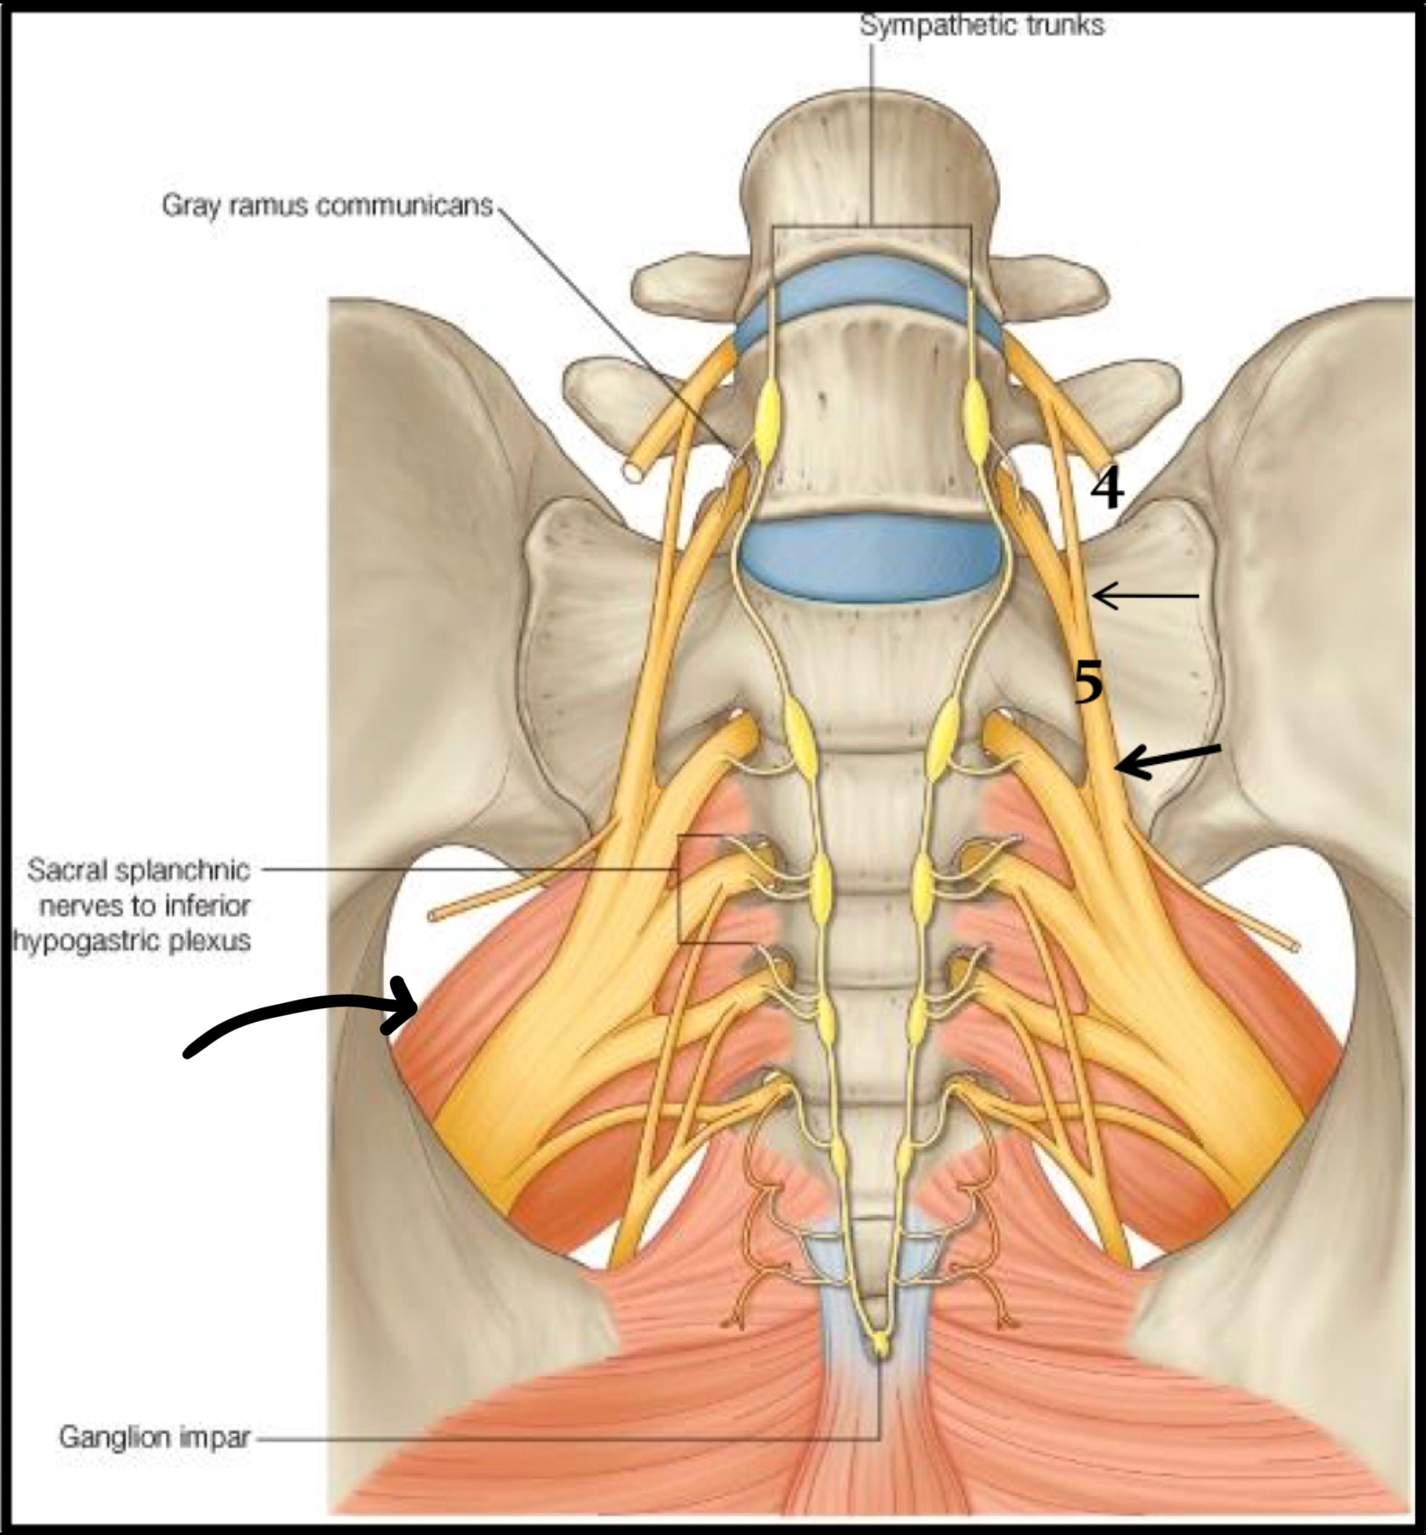
Sacral plexus
Formation:
-Ventral (anterior) rami of a part of L4 and whole L5 (Lumbosacral trunk) + S1, S2, S3 and most of S4
-Ventral (anterior) rami of (L4,5,S1,2,3,& 4)
Site:
-On the posterior wall of pelvis
- In front of piriformis muscle
Nerve in front of piriformis

Slide 5
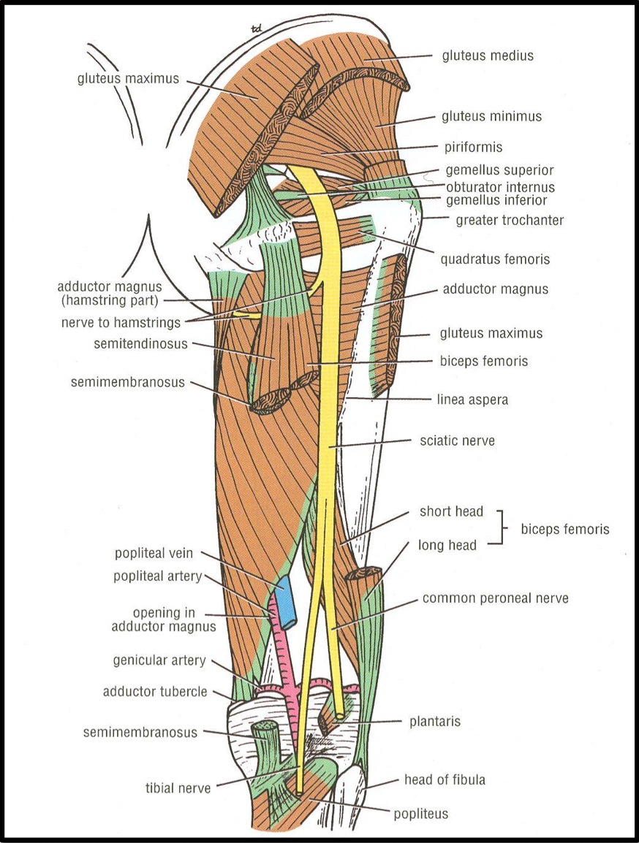
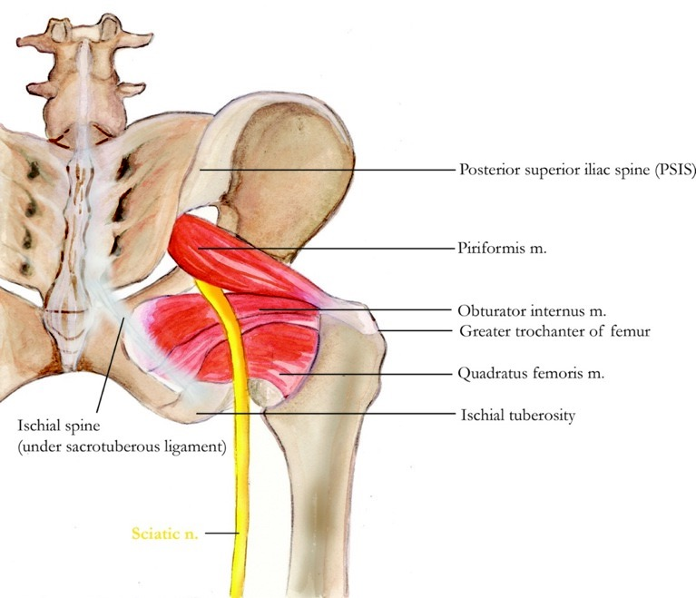
Course and distribution:
It leaves the pelvis through greater sciatic foramen, below the piriformis & passes in the gluteal region (between ischial tuberosity & greater trochanter) then to posterior compartment of thigh.
Termination:
In the middle of the back of the thigh It divides into 2 branches: - Tibial (medial popliteal) - Common Peroneal (Fibular) (lateral popliteal)

Slide 6
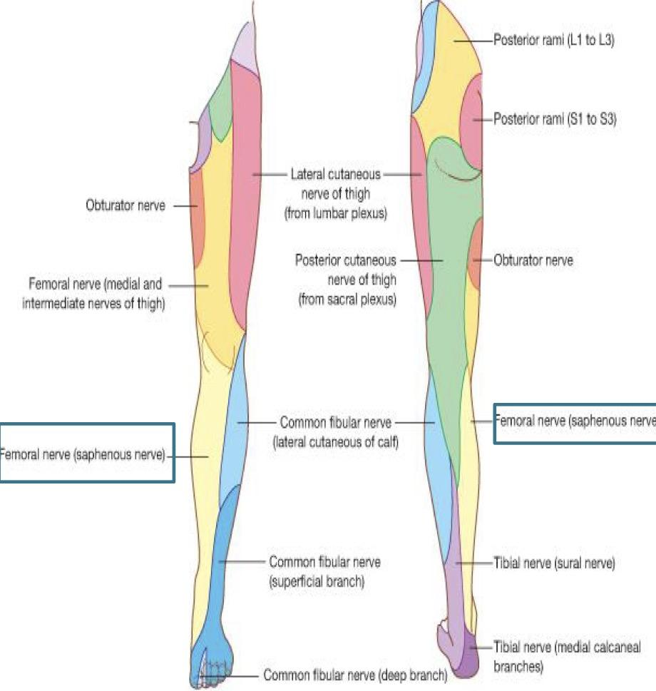
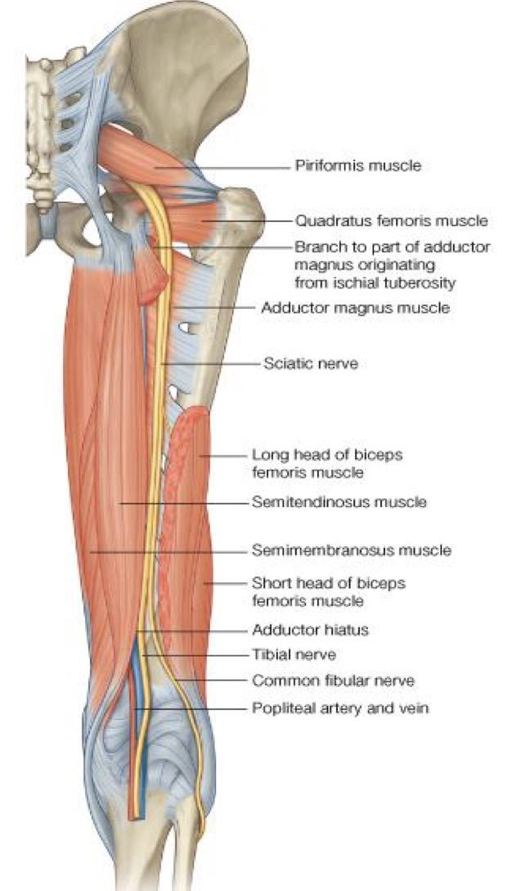
To all leg and foot EXCEPT areas supplied by the saphenous nerve (branch of femoral nerve)
Cutaneous:
Through tibial part
1- Hamstring part of Adductor Magnus
2-Long head of biceps femoris
3-Semitendinosus
4-Semimembranosus
Branches of Sciatic Nerve
Muscular:
To hamstrings (flexors of the knee and extensors of the hip)
Except: Short head of biceps femoris receives its branch from the lateral popliteal (common peroneal) nerve

Slide 7
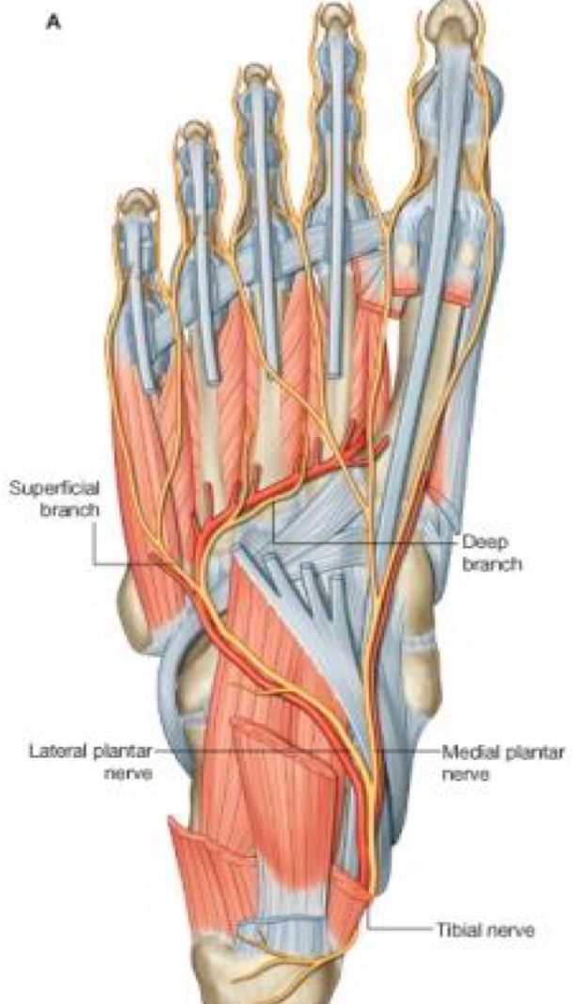
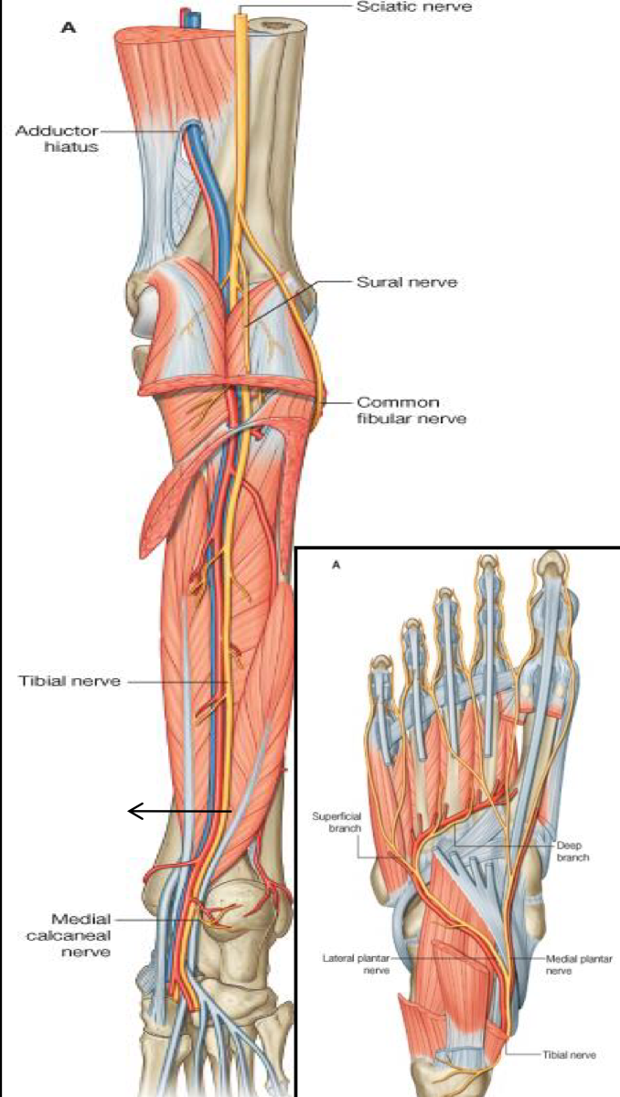
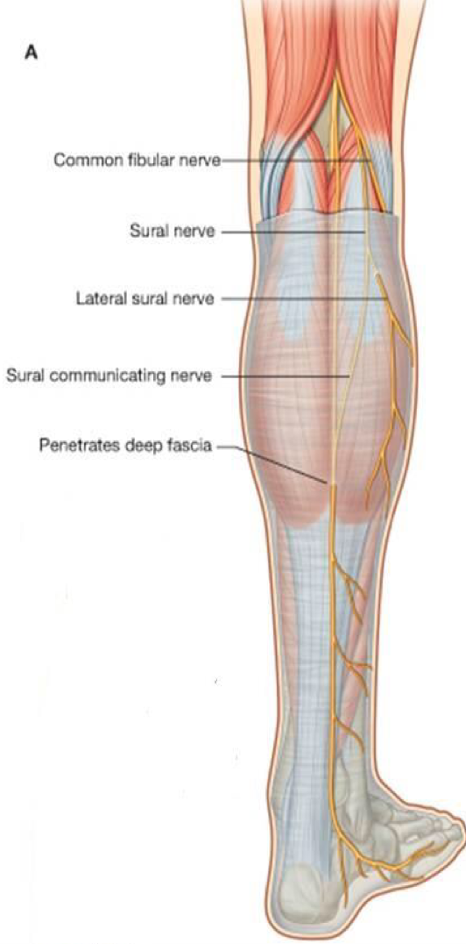
Tibial Nerve
Course:
1- Bisect the popliteal fossa. *most superficial structure
Diamond shape
2- Descends through popliteal fossa to posterior compartment of leg, accompanied with posterior tibial vessels.
If it passes this point it’s called posterior tibial nerve
3- Passes deep to flexor retinaculum (through the tarsal tunnel, behind medial malleolus) to reach the sole of foot where it divides into 2 terminal branches (Medial & Lateral planter nerves.)
With joints

Slide 8
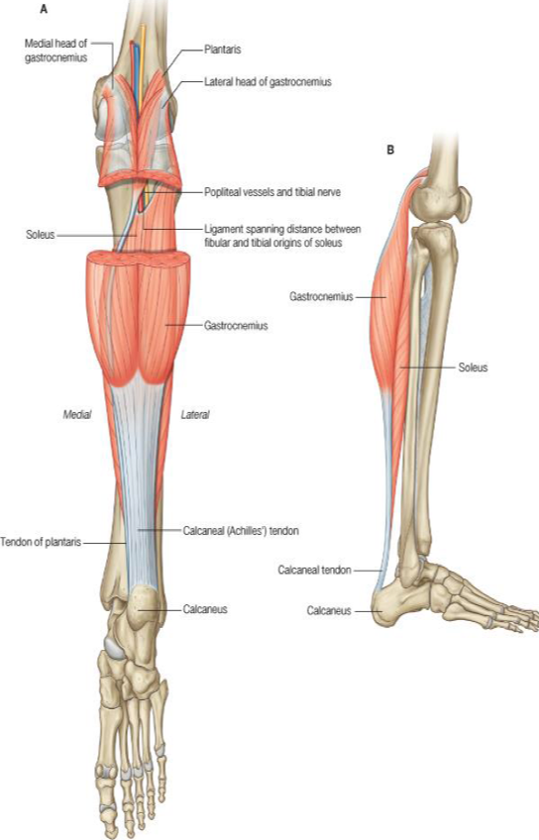
Muscular Branches
1- Muscles of posterior compartment
of leg
2- Intrinsic
muscles
of sole
3- ONE Invertor of foot (tibialis posterior).
It is a tendon
Planter flexors of ankle, Flexors of toes.

Slide 9
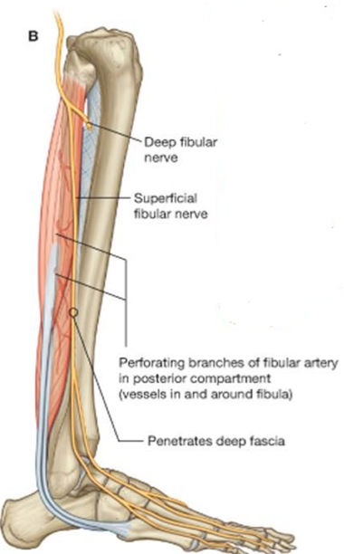
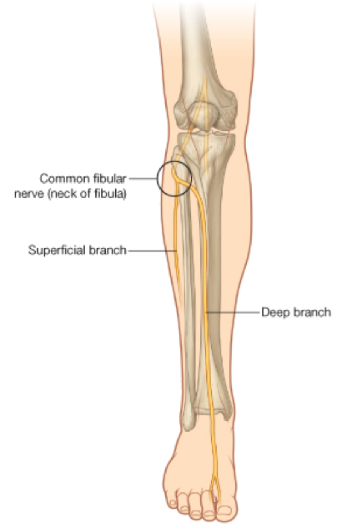
Common Peroneal (Fibular) Nerve
Course:
Leaves the lateral angle of the popliteal fossa & turns around the lateral aspect of neck of fibula, (Dangerous Position)
Then divides into :
➢ Superficial peroneal or (Musculocutaneous) :
to supply the Lateral compartment of the leg.
➢ Deep peroneal or (Anterior Tibial):
to supply the Anterior compartment of the leg.
Muscular Branches: (+ short head of biceps)
Muscles of anterior & lateral compartments of leg:
1. Dorsi flexors of ankle
2. Extensors of toes,
3. Evertors of foot.

Slide 10
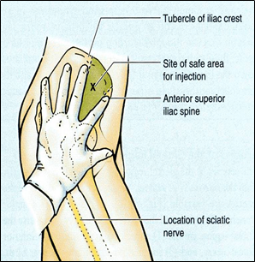
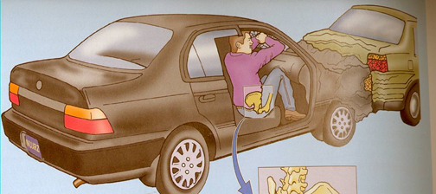
Causes of Sciatic nerve injury
The sciatic nerve is most frequently injured by:
1- Badly placed intramuscular injections in the gluteal region. To avoid this, injections should be done into the gluteus maximus or medius (into the upper outer(lateral)quadrant of the buttock).
* Most nerve lesions are incomplete, and in 90% of injuries, the common peroneal (part of the nerve) is the most affected. Because The common peroneal nerve fibers lie superficial in the sciatic nerve.
2- Posterior dislocation of the hip joint. (في حوادث السيارات)
ترجع إلى الخلف و وراها ال فتضغط عليه فيصير له
Sciatic nerve
hip
Compression and injury

Slide 11
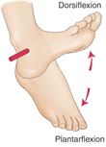
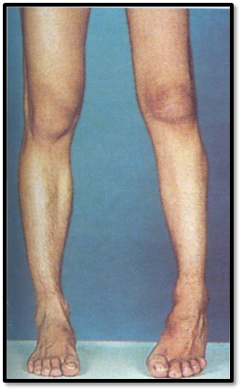
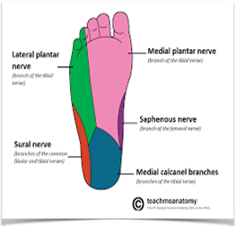
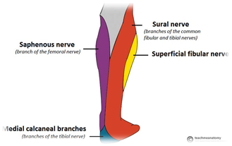
Effects of Sciatic nerve injury
Team 436 notes:
لما نمشي الحركات اللي نسويها هي
Dorsiflexion & plantarflexion
و العضلات المسؤولة عن الحركتين تغذيها تفرعات من
Sciatic nerve
فلما يصير لها إصابة ما تصير ولا حركة من الثنتين فإيش يصير بالرجل ؟ يصير بسبب الجاذبية drop للرجل
MOTOR EFFECT:
Marked wasting (Atrophy) of the muscles below the knee.
Weak flexion of the knee (sartorius & gracilis are intact).
Weak extension of hip (gluteus maximus is intact).
All the muscles below the knee are paralyzed, and the weight of the foot causes it to assume the plantar-flexed position, or Foot Drop.
Stamping gait ( high steppage gait). مثل تلزيق الطوابع يكون بسرعة
Videos from team 436: Stamping gait video Foot drop video
SENSORY EFFECT:
Sensation is lost below the knee, except for a narrow area down the medial side of the lower part of the leg (purple) and along the medial border of the foot as far as the ball of the big toe, which is supplied by the saphenous nerve (femoral nerve).
NS:
* Sartorius : Femoral nerve
*Gracilis : Obturator nerve
*gluteus maximus : Inferior gluteal nerve

Slide 12
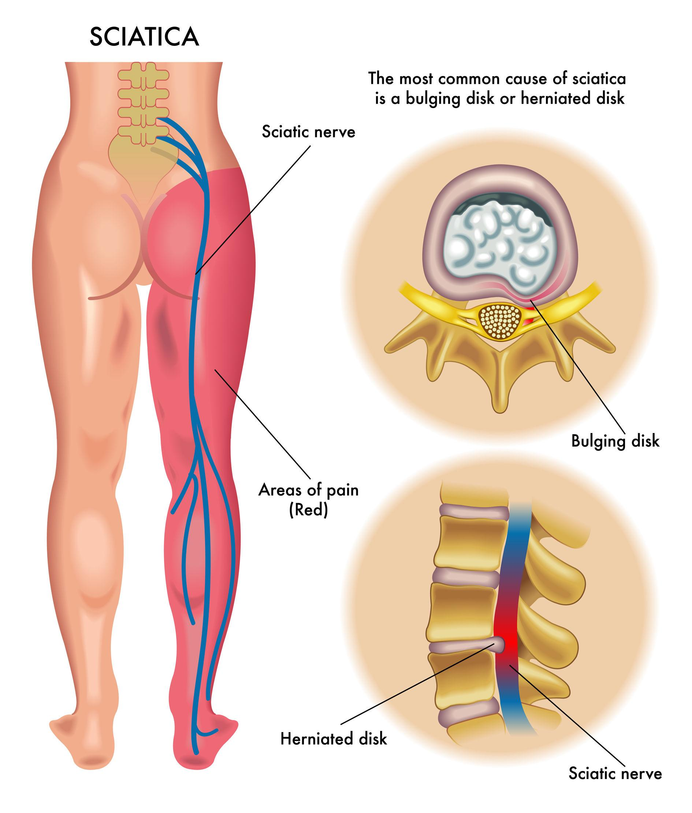
Sciatica
Sciatica describes the condition in which patients have pain along the sensory distribution of the sciatic nerve. Only pain (no muscle loss)
Thus the pain is experienced in the posterior aspect of the thigh, the posterior and lateral sides of the leg, and the lateral part of the foot
Causes of sciatica:
-Prolapse of an intervertebral disc, which pressure on one or more roots of the lower lumbar and sacral spinal nerves.
-Pressure on the sacral plexus or sciatic nerve by an intrapelvic tumor
-Inflammation of the sciatic nerve or its terminal branches

Slide 13
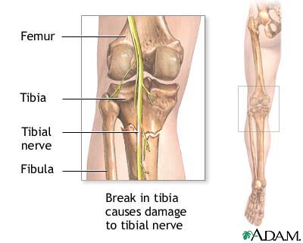
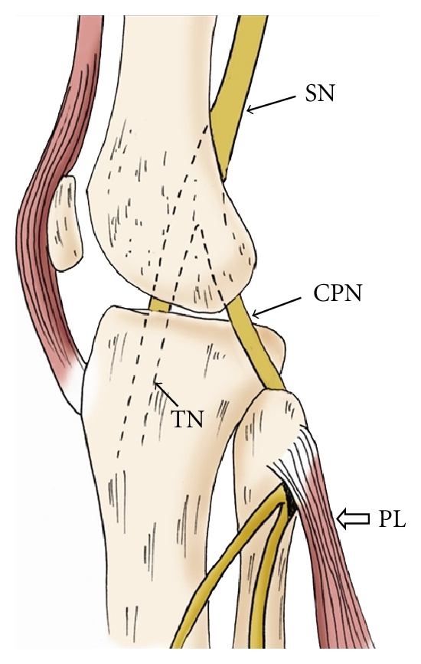
Common Peroneal Nerve Injury
Tibial Nerve Injury
The common peroneal nerve is in an exposed position as it leaves the popliteal fossa through its lateral angle .
Then it winds around neck of the fibula to enter peroneus longus muscle, (Dangerous Position).
commonly injured In Fractures of the neck of the fibula and By pressure from casts or splints.
Because of its deep and protected position, the tibial nerve is rarely injured.
Complete division results in clinical feature, (mentioned in next slide).

Slide 14
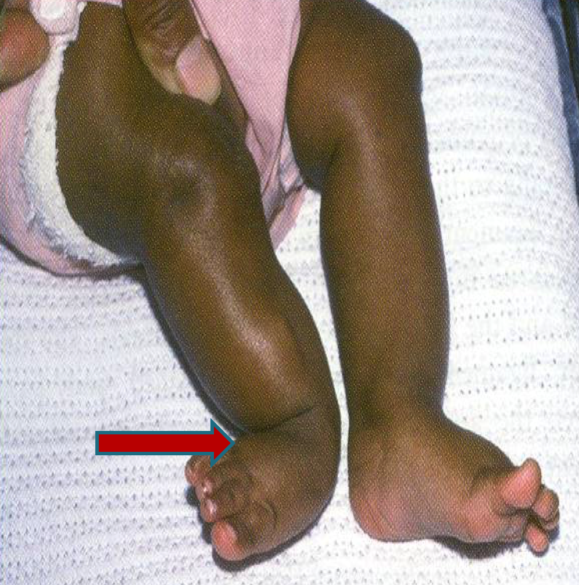
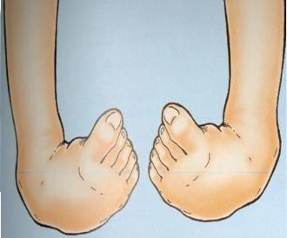
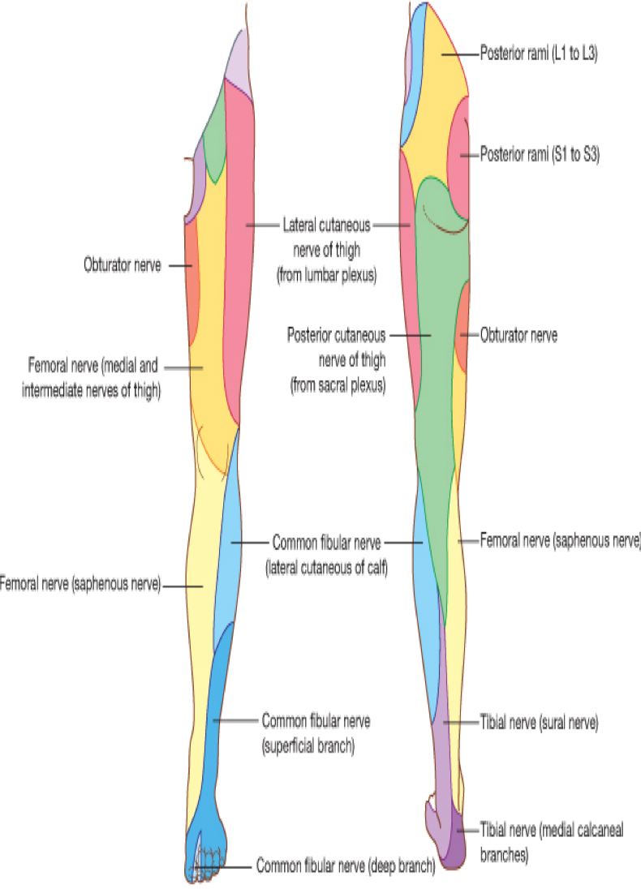
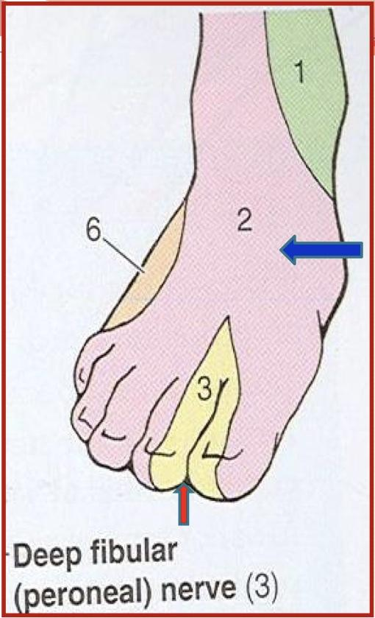
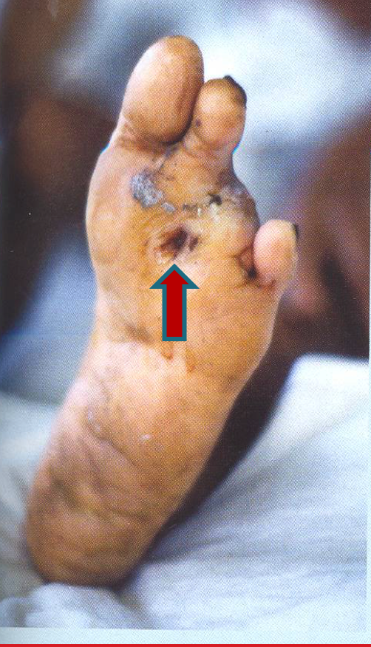
Manifestations | Common Peroneal Nerve | Tibial Nerve
Motor | The muscles of the anterior and lateral compartments of the leg are paralyzed. the opposing muscles, the plantar flexors of the ankle joint and the invertors of the subtalar joints, cause the foot to be Plantar Flexed (Foot Drop) and Inverted. An attitude referred to as Talipes Equinovarus. | All the muscles in the back of the leg, and the sole of the foot are paralyzed. The opposing muscles dorsiflex the foot at ankle joint, and evert the foot at the subtalar joint. An attitude. referred to as Talipes Calcaneovalgus.
Sensory | Sensation is lost: between the first and second toes. Dorsum of the foot and toes. Medial side of the big toe. Lateral side of the leg. | Sensation is lost: on the lateral side of the leg and foot and trophic ulcers of the sole. (also seen in case of sciatic nerve injury)
Superficial peroneal
Zoom in to see

Slide 15
EFFECT OF SCIATIC NERVE INJURY Summary
 | Paralysis | Movement affected
Motor effect | Hamstrings | Flexion of the knee & Extension of hip
 | All muscles of leg and foot | All movements of leg and foot
Sensory effect: Loss of sensation of the areas supplied by sciatic nerve (below knee).
EXCEPT area supplied by the (Saphenous nerve).

Slide 16
Summary

Slide 17
Summary

Slide 18
Questions
4. Common Peroneal Nerve turns around the:
Medial aspect of neck of fibula
Anterior aspect of neck of fibula
Lateral aspect of neck of fibula
5. Which of the following is true about the tibial nerve?
Passes superficial to flexor retinaculum to reach sole
At sole of foot it divides into 3 terminal branches
Innervates tibialis anterior
sciatic nerve leaves sacral plexus:
Through piriformis
Below piriformis
Above piriformis
Roots of sciatic nerve?
L4, L5, S1,S2
L4,S1,S2,S3
L4,S1,S2,S3,S4
Short head of biceps femoris innervated by:
saphenous nerve
Tibial nerve
lateral popliteal nerve
6. Name the most common causes of sciatic nerve injury
7. Give two causes of sciatica
8. Four motor effects of sciatic nerve injury
Answers: 1. B 2. B 3. C 4. C 5. C
6. Badly placed intramuscular injections in the gluteal region and Posterior dislocation of the hip joint
7. Prolapse of an intervertebral disc and Pressure on the sacral plexus or sciatic nerve by an intrapelvic tumor
8. Atrophy of the muscles below the knee, Foot Drop, stamping gait, weak extension of hip.

Slide 19
Team Members
Faisal Fahad Alsaif (Team Leader) Abdulaziz Al dukhayel ‏Fahad Alfaiz ‏Akram Alfandi ‏Saad Aloqile ‏Saleh Almoaiqel ‏Abdulaziz Alabdulkareem ‏Abdullah Almeaither ‏Yazeed Aldossari ‏Muath Alhumood Abdulrahman Almotairi
‏
Abdulelah Aldossari ‏Abdulrahman Alduhayyim ‏Hamdan Aldossari ‏Abdullah Alqarni ‏Mohammed Alomar ‏Abdulrahman Aldawood ‏Saud Alghufaily ‏Hassan Aloraini Khalid Almutairi‏‏
Lamia Abdullah Alkuwaiz (Team Leader)
Rawan Mohammad Alharbi
Abeer Alabduljabbar Afnan Abdulaziz Almustafa Ahad Algrain Alanoud Almansour Albandari Alshaye AlFhadah abdullah alsaleem Arwa Alzahrani Dana Abdulaziz Alrasheed Dimah Khalid Alaraifi Ghada Alhaidari Ghada Almuhanna Ghaida Alsanad Hadeel Khalid Awartani Haifa Alessa Khulood Alwehaibi Layan Hassan Alwatban Lojain Azizalrahman Lujain Tariq AlZaid
Maha Barakah Majd Khalid AlBarrak Norah Alharbi Nouf Alotaibi Noura Mohammed Alothaim Rahaf Turki Alshammari Reham Alhalabi Rinad Musaed Alghoraiby Sara Alsultan Shahad Alzahrani Wafa Alotaibi Wejdan Fahad Albadrani Wjdan AlShamry
Abdulmajeed Alwardi ‏Abdulrahman Alageel ‏Rayyan Almousa ‏Sultan Alfuhaid ‏Ali Alammari ‏Fahad alshughaithry Fayez Ghiyath Aldarsouni ‏Mohammed Alquwayfili ‏‏Abduljabbar Al-yamani ‏Sultan Al-nasser ‏Majed Aljohani ‏Zeyad Al-khenaizan ‏Mohammed Nouri ‏Abdulaziz Al-drgam ‏Fahad Aldhowaihy ‏Omar alyabis

