Slide 1
Vascular Anatomy of the Lower Limbs
Lecture 22
Please check our Editing File.

Slide 2
Objectives
List the main arteries of the lower limb.
Describe their anatomy regarding: origin, course distribution & branches.
List the main arterial anastomosis.
List the sites to feel the peripheral arterial pulse.
Describe the anatomy of the veins of the lower limb regarding: differentiation into superficial & deep, origin, course, and termination.
●Text in BLUE was found only in the boys’ slides
●Text in PINK was found only in the girls’ slides
●Text in RED is considered important
●Text in GREY is considered extra notes

Slide 3
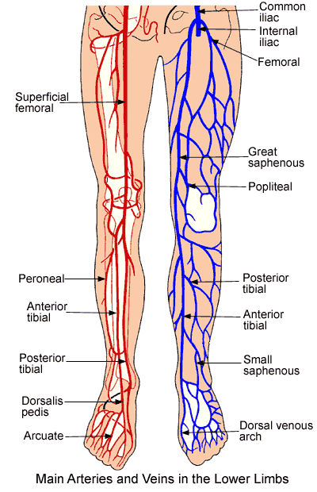
Overview
Extra*

Slide 4
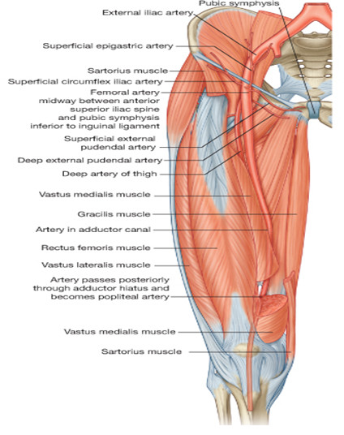
Femoral artery
It is the main arterial supply to the lower limb.
Origin
The continuation of the External iliac artery.
It enters the thigh behind the inguinal ligament; midway between the anterior superior iliac spine and the symphysis pubis.
Upper part: Skin & fascia.
Lower part: passes behind the Sartorius.
Termination
Anterior
The artery terminates by passing through the Adductor Canal (deep to sartorius). It exits the canal by passing through the Adductor Hiatus and becomes the Popliteal artery.
Posterior
Psoas (separates it from the hip joint), Pectineus, and Adductor Longus.
Relations
Medial
Femoral vein. *VAN
Lateral
Femoral nerve and its branches.

Slide 5
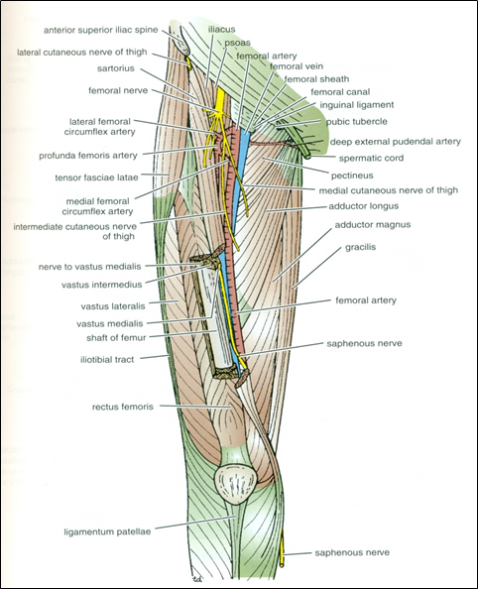
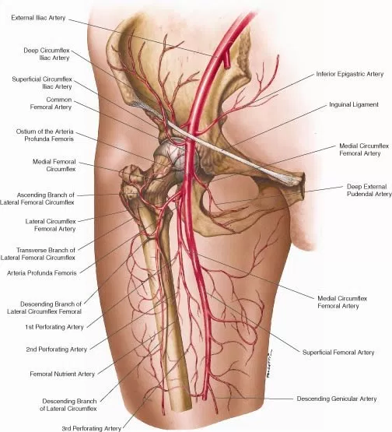
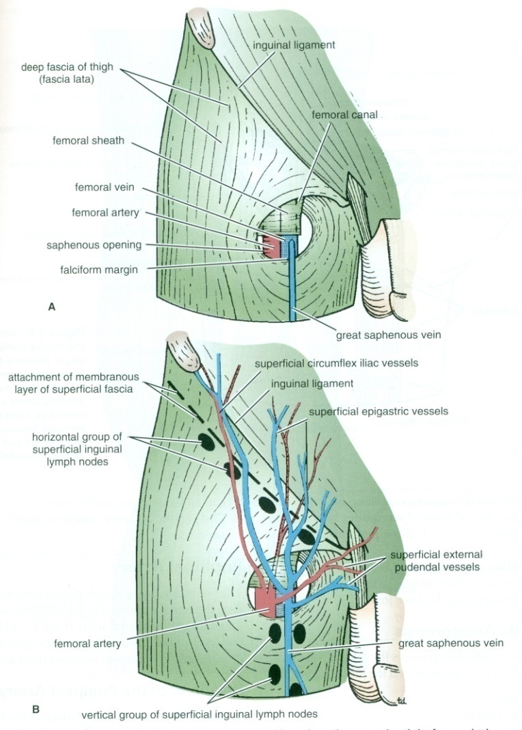
Femoral artery and femoral vein
Branches of femoral artery 3 Superficial 2 Deep.
Superficial Epigastric (supplies lower abdominal wall)
Superficial Circumflex Iliac* (supplies lower abdominal wall)
Superficial External Pudendal** (supplies external genitalia)
Deep External Pudendal (supplies external genitalia)
Profunda Femoris (supplies the medial side of the thigh)
At the inguinal ligament: The vein lies medial to the artery.
At the apex of the femoral triangle: The vein lies posterior to the artery.
At the opening in the adductor magnus: The vein lies lateral to the artery.
*The deep Circumflex iliac branch comes directly from external iliac vein
**pudendal : anything related to pudendum/الفرج

Slide 6
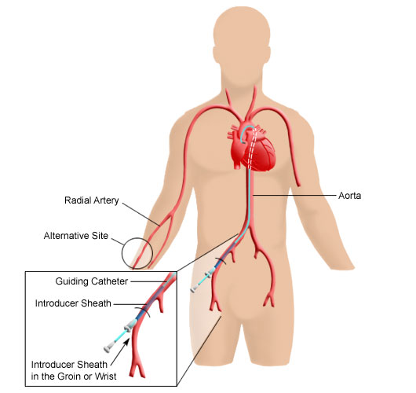
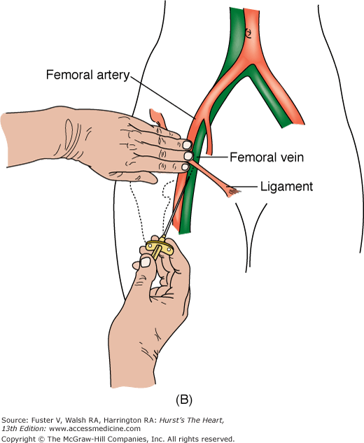
Cannulation of The Femoral Artery
The femoral artery is used for left cardiac angiography (examination of the left side of the heart) because of how superficial it is.
A long catheter is inserted percutaneously (through the skin) into the artery and passed up the external iliac artery > common iliac artery > aorta > the left ventricle.

Slide 7
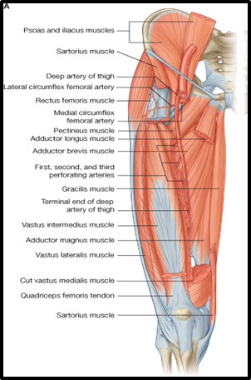
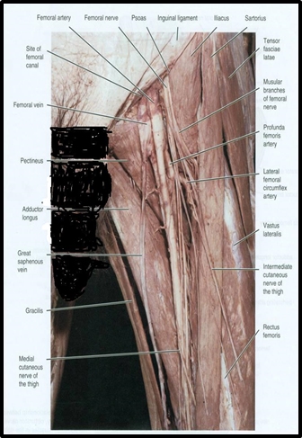
Profunda femoris
Important and large, it is the main arterial supply to the thigh.
Arises from the lateral side of the femoral artery (4 cm below the inguinal ligament).
It passes medially behind the femoral vessels.
Branches:
Medial & Lateral circumflex femoral arteries. Don't confuse them with deep and superficial circumflex arteries
Three perforating arteries.
It ends by becoming the 4th perforating artery.

Slide 8
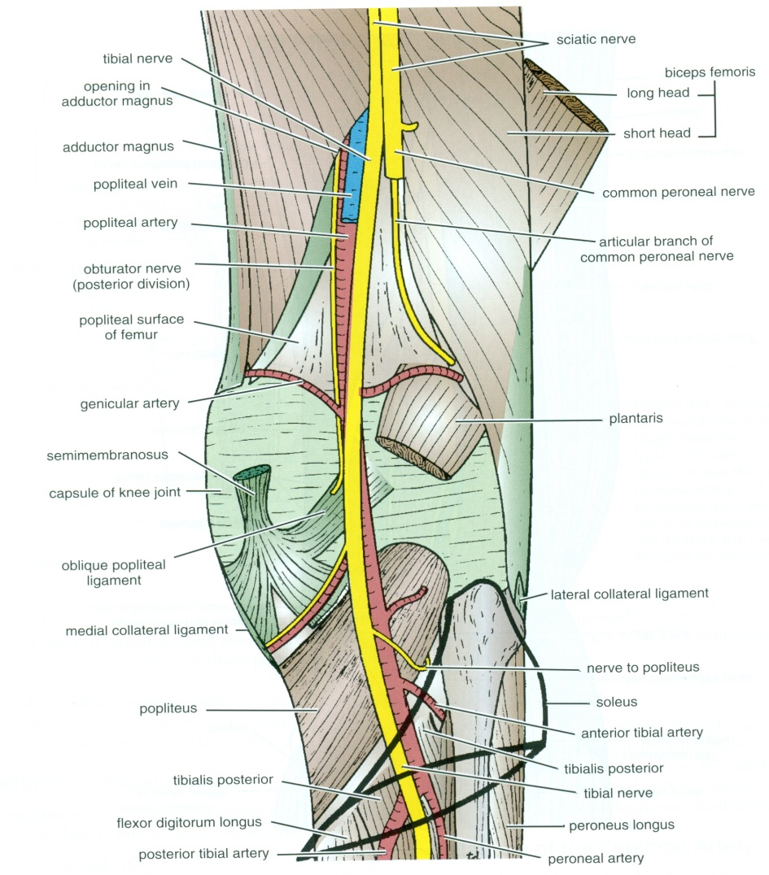
Popliteal Artery
It is the continuation of the Femoral artery.
It enters the Popliteal fossa through an opening in the Adductor magnus
(Adductor hiatus).
It is the deepest structure in the Popliteal Fossa, runs close to the capsule of the knee.
Termination
Relations
Branches
Posterior
Anterior
At the lower border of Popliteus muscle by dividing into:
Anterior and Posterior Tibial Arteries.
1-Popliteal vein
2-tibial nerve Most superficial structure
3-skin and fascia.
Popliteal surface of the femur.
knee joint.
popliteus muscle.
1-Muscular
2- Five Genicular branches to the articular capsule and ligaments of the knee joint.

Slide 9
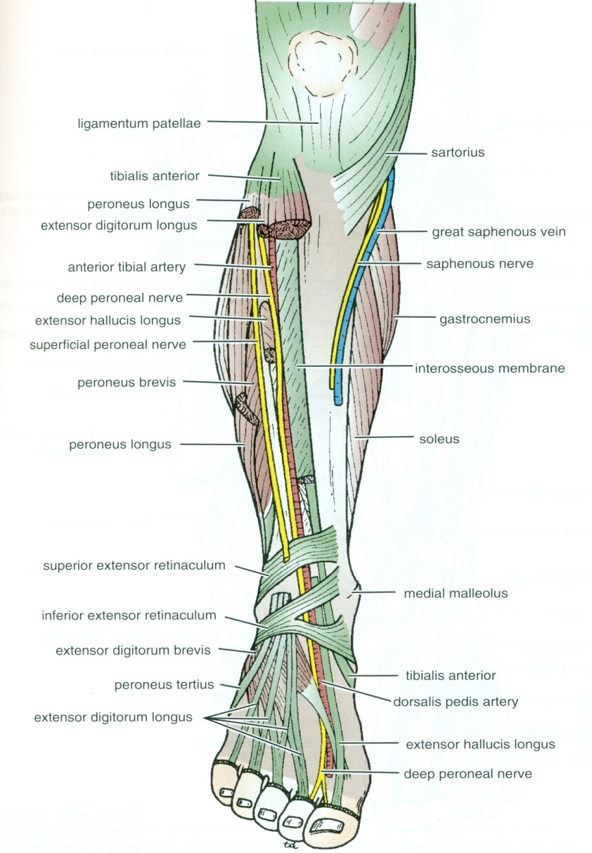
Anterior Tibial Artery
It is the smaller of the two terminal branches of the popliteal artery.
It enters the anterior compartment of the leg through an opening in the upper part of the interosseous membrane.
It descends with the Deep Peroneal nerve.
In the upper part of its course, it lies deep.
In the lower part, it lies superficial in front of the lower end of the tibia.
Branches:
Muscular & Anastomotic.
Termination:
It ends at the ankle joint midway between the malleoli where it becomes the Dorsalis Pedis artery.

Slide 10
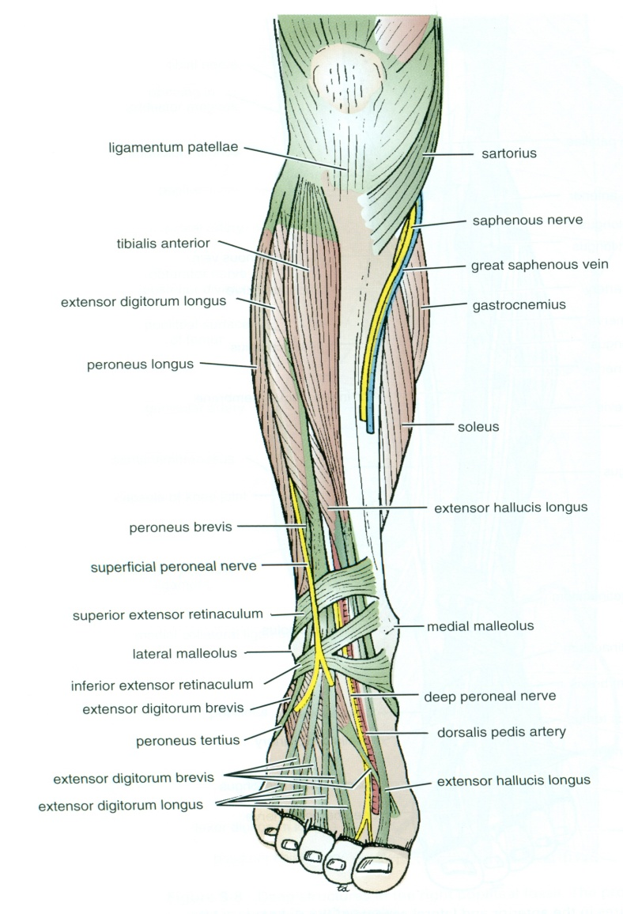
Dorsalis Pedis Artery
It is the main source of blood supply to the toes.
Begins in front of ankle joint as the direct continuation of the anterior tibial artery.
It is superficial in position.
Crossed by:
The inferior extensor retinaculum and the first tendon of extensor digitorum brevis.
Medially:
Tendon of extensor hallucis longus.
Laterally:
Deep peroneal nerve and extensor digitorum longus.
It terminates by passing between the two heads of 1st Dorsal interosseous muscle where it divides into a deep plantar artery (to the sole to join the plantar arch) and the first dorsal metatarsal artery.
It joins the lateral plantar artery to complete the plantar arch.
Branches:
Lateral tarsal artery.
Arcuate artery. (Makes the arcuate arch)
1st dorsal metatarsal artery.

Slide 11
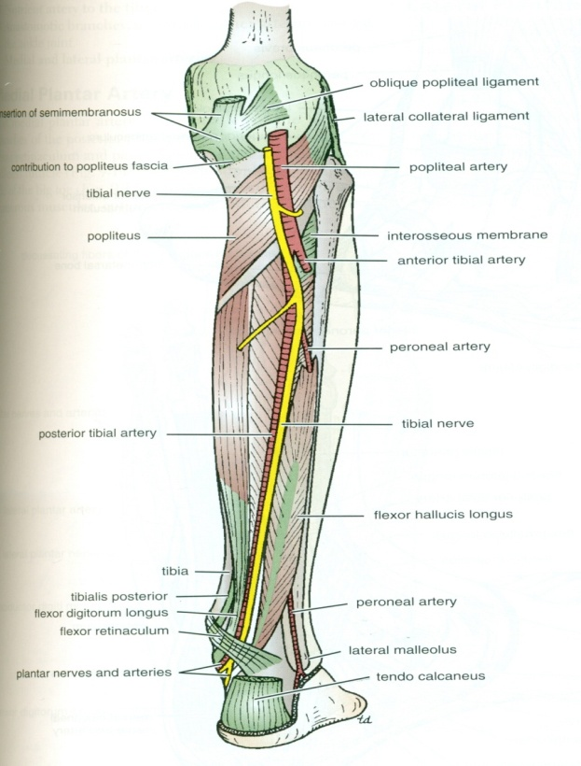
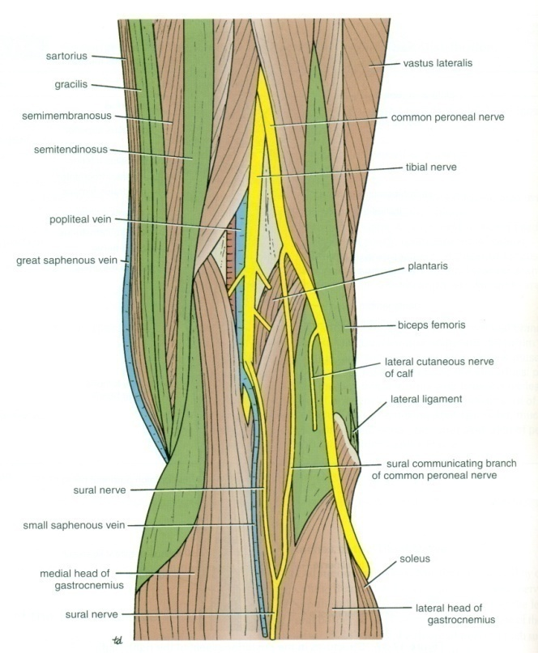
Posterior Tibial Artery (PTA)
It is the larger terminal branch of the popliteal artery and provides the main blood supply to the posterior compartment of the leg & sole of the foot.
Descends deep to soleus and gastrocnemius.
Lies on the posterior surface of tibialis posterior muscle above and on the posterior surface of tibia below.
Its lower part is covered by skin & fascia only.
Passes behind medial malleolus, deep to the flexor retinaculum.
It terminates by dividing into
Medial & Lateral plantar arteries.

Slide 12
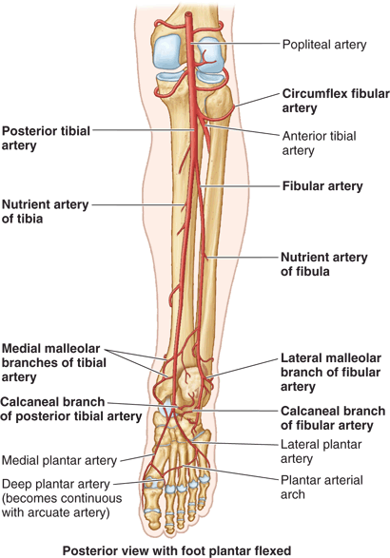
Branches Of PTA
1. Peroneal (fibular) artery:
A large artery which descends behind the fibula (the artery of the lateral and posterior compartment of the leg).
Gives:
Nutrient* artery to the fibula.
Muscular branches.
Perforating branch to lower part of front of leg.
Shares in the anastomosis around the ankle joint.
2. Nutrient artery to the tibia. (the largest nutrient artery of the body)
3. Medial & Lateral plantar arteries.
4. Anastomotic branches to anastomosis around ankle joint.
5. Calcaneal arteries: supplies the heel.
*nutrient arteries: supply the bones.

Slide 13
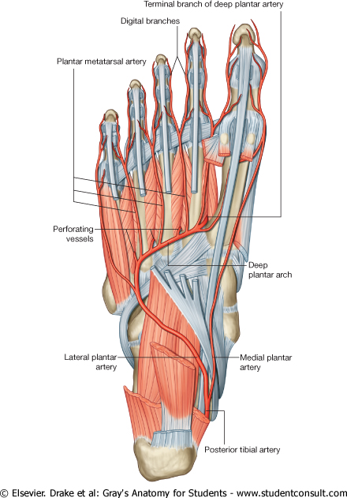
Medial plantar arteries
Lateral plantar arteries
The smaller of the two terminal branches of the posterior tibial artery.
Arises beneath the flexor retinaculum.
Gives: Muscular, articular and cutaneous branches.
Ends by supplying the medial side of the big toe.
Its superficial branch supplies the skin of the medial side of the sole.
The larger of the two terminal branches of the posterior tibial artery.
At the base of the 5th metatarsal bone, it curves medially to form the deep plantar arch which is completed by the medial plantar artery and branch of from Dorsalis pedis artery.
Joins the dorsalis pedis artery at the proximal end of the 1st intermetatarsal space.
Gives: Muscular, Articular and cutaneous branches.
The plantar arch supplies the skin, fascia, and muscles in the sole plantar digital arteries.

Slide 14
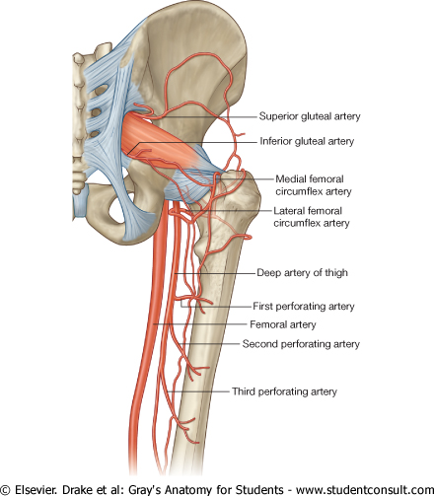
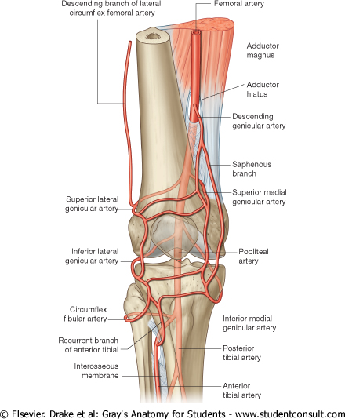
Arterial anastomosis
Trochanteric: supplies the head and neck of the femur.
Genicular: around the knee, it compensates for the narrowing of popliteal artery during prolonged flexion of the knee.
Cruciate: it supplies blood to the lower limb in case of ligation of femoral artery.
Formed by
superior and inferior gluteal .
medial and lateral circumflex femoral.
It gives a connection to the internal iliac and femoral arteries.
It is formed by the union of
medial and lateral circumflex femoral arteries.
inferior gluteal artery. (Above)
The first perforating artery.(Below)
Formed from the five genicular branches of the popliteal artery
(Very important)

Slide 15
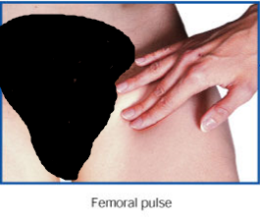
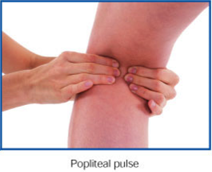
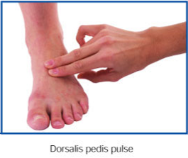
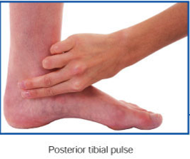
Where to feel peripheral arterial pulses.
Femoral pulse: Inferior to the inguinal ligament and midway between the anterior superior iliac spine and symphysis pubis.
Dorsalis pedis pulse:
Over the dorsum of the tarsal bones between the tendons of extensor hallucis longus and extensor digitorum.
Popliteal pulse: Deep in the popliteal fossa medial to the midline.
Posterior tibial pulse:
posteroinferior to medial malleolus in the groove between the malleolus and the heal.

Slide 16
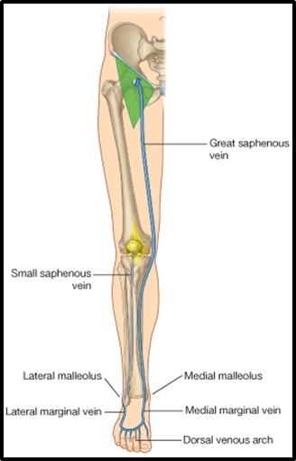
Veins of the lower limb
The veins of L.L are :
Superficial veins :
They are immediately under the skin in the subcutaneous tissue (GSV &
SSV)
Deep veins
Next slide
Small Saphenous Vein:
- Originates: from the lateral end of the dorsal venous arch.
- Ascends :
Behind (posterior) the lateral Malleolus along with the Sural nerve; along the middle of the back leg.
Termination :
1- It may join the Great saphenous vein . ( most people)
2 - joins the popliteal vein
3-or Bifurcates:
One branch joins the Great saphenous and the other joins the Popliteal vein.
Great saphenous vein :
- The longest superficial vein of the body.
- Begins from the medial end of the dorsal venous arch (as the medial marginal vein).الصمامات فيه اكثر لانه اطول
-Ascends :
1- in front of (anterior) the medial malleolus (this place existing in all people )accompanied by the (saphenous nerve ).
2- Posterior to the Medial Condyle of the femur.
3- Passes through the Saphenous Opening (in the fascia) (2.5-3.25) cm below and lateral to the pubic tubercle.
- Terminates: in femoral vein. (deep vein)
Because of its constant position in front of the medial malleolus, it is used for saphenous cutdown especially in infants, obese and shocked patients
Dorsal Venous arch (network): only in boys slides
Receives most of the blood of the foot through Digital and Communicating .
It will drain into:
Medial side by the Great saphenous vein .
Lateral side of the Small saphenous vein .

Slide 17
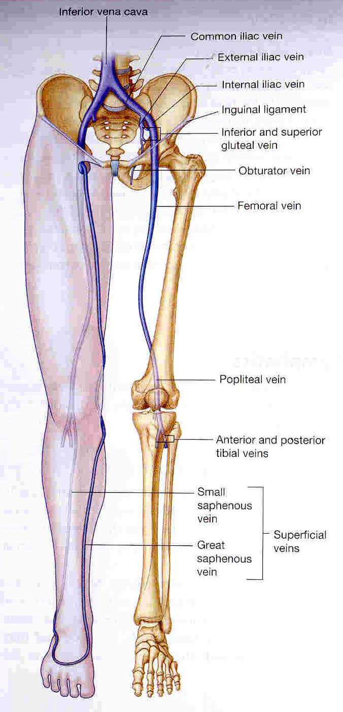
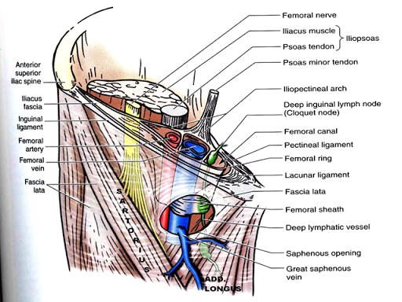
Veins of the lower limb
In boys slides only
Deep veins :
Popliteal vein : Formed by the union of venae comitantes around the anterior & posterior tibial arteries.
Lies posterior to popliteal artery.
Femoral vein : (it is a continuation of popliteal vein)
Course:
1- enters the thigh by passing through the opening in the adductor magnus .(adductor hiatus )
2- leaves the thigh in (through) the intermediate compartment of the femoral sheath.
3- Passes behind the inguinal ligament to become the External iliac vein.
Femoral sheath

Slide 18
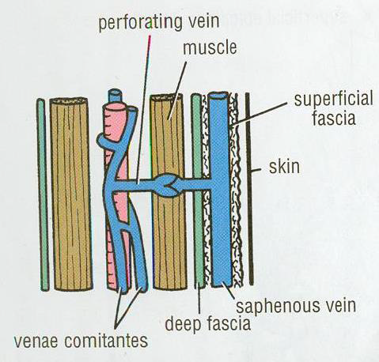
VENAE COMITANTES
PERFORATING VEINS
Accompany all the major arteries and their branches.
Usually paired.
They are contained within the vascular sheath of the artery, whose pulsations help to compress and move blood in the veins.
(the arteries help in moving the blood through the venae comitantes) لهذا السبب الواحد الذي يطيل الوقوف يغمى عليه بسبب أن الدم لا يعود للقلب
Connect the Great Saphenous vein with the deep veins along the medial side of the calf.
Penetrate the deep fascia (this is the reason of the nomination )close to their origin from the superficial veins.
They contain valves which normally allow the blood to flow from the
superficial to the deep Veins.
The perforating veins pass through the deep fascia at an oblique angle (act as a valve) so during muscular contraction, they are compressed. This also prevents blood flowing from the deep to the superficial veins.
Their valves only allow blood to flow from superficial to the deep veins.

Slide 19
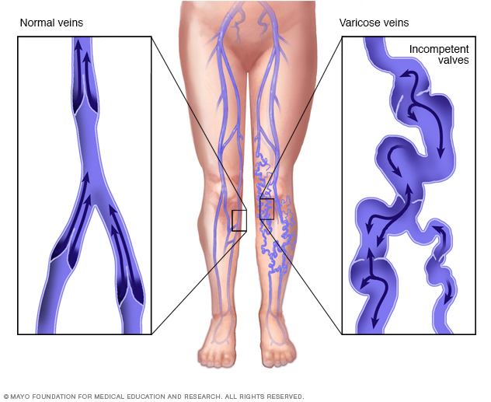
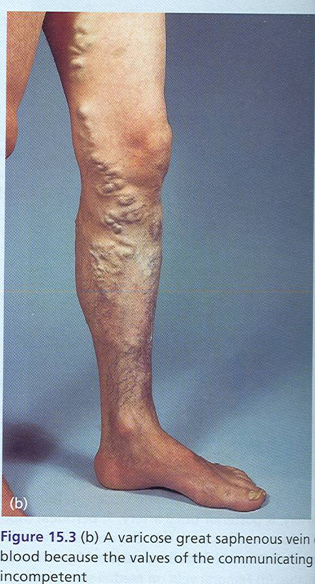
VARICOSE VEINS
VARICOSE VEINS
Definition: it is the Dilatation and Degeneration of the superficial veins that may be complicated by ulcers.
Result: This allows the passage of high pressure blood from the deep to the superficial veins.
وتتوسع الأوردة السطحية نتيجة لتجمع الدم فيها و يصير لون الدم فيها اغمق ثم تتعوج (نفس الصورة) ثم تنفجر وتسبب قرحة اسمها
Varicose ulcer.
The site: More common in the posteromedial part of the lower limb.
Cause: Results from incompetence of the valves(بسبب الحمل او ضعف طبيعي فيها او ورم ) in the perforating veins, or within the great saphenous itself.
Blood stops pumping to the deep veins and starts accumulating in the superficial veins (blood in the deep veins could also start draining to the superficial veins)

Slide 20
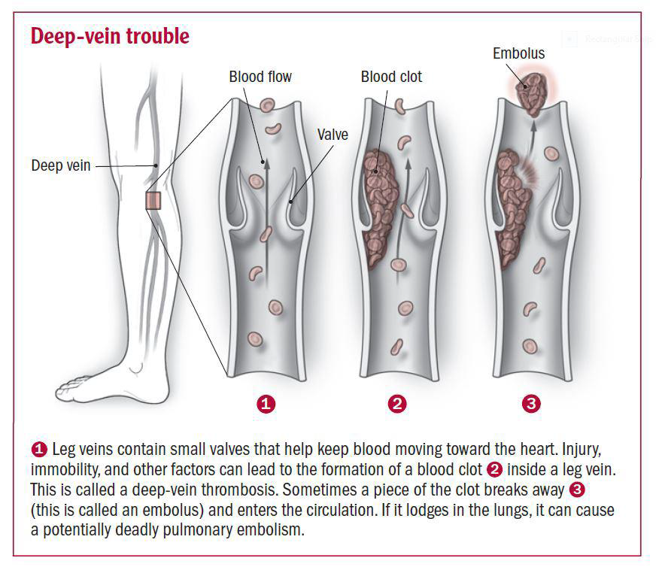
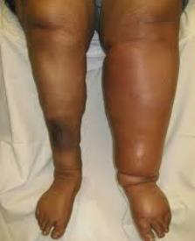
Deep Vein Thrombosis (DVT)
Girls slides only
From 436
Definition: it is when a blood clot (thrombus) forms in one
of the deep veins of the lower limb.
The veins of the lower limb are subject to venous thrombosis after a bone fracture. (أو بسبب الاستلقاء على السرير لفترة طويلة)
Venous stasis is the main cause by pressure on the veins from
the bedding during prolonged hospital stay and aggravated by muscular inactivity. عشان كذا المريض لازم يتحرك بعد الجراحة
Thrombophlebitis (inflammation of the wall of a vein with
associated thrombosis) may develop around the vein.
Pulmonary thromboembolism (blockage of a pulmonary artery in the lung) may occur when a thrombus breaks free from the lower limb vein and passes to the lungs.
مثلا بعد 7 أيام من الجراحة تصيب المريض هذه الحالة بسبب انه ما يتحرك فانتقلت الجلطة من اوردة الاطراف السفلية الى الاوردة الرئوية ثم للرئة.

Slide 21
MCQ:
Answers:
1- Where is the site of varicose veins ?
A) Posteromedial part of the lower limb
B) Anterior part of the lower limb
C) Lateral part of the lower limb
2- The popliteal vein is ……… to the popliteal artery.
A) Posterior B) Anterior C) Lateral D) Medial
3- How many deep branches does the femoral artery have?
A) 2 B) 3 C) 4 D) 5
4- Which of the following has a posterior relation with the popliteal artery?
A) Knee joint B) Tibial nerve C) Popliteal muscle
5-the superficial vein has more valves than the deep vein.
A) True B) False
6- The anterior tibial artery descends with the deep peroneal nerve.
A) True B) False
1- A
2- A
3- A
4- B
5- B
6- A

Slide 22
SAQ:
1- What are the branches of the anterior tibial artery?
2- What is the definition of varicose veins?
Answers:
1- Muscular & anastomotic
2- it is the Dilatation and Degeneration of the superficial veins that may be complicated by ulcers.

Slide 23
Team Members
Lamia Abdullah Alkuwaiz (Team Leader)
Rawan Mohammad Alharbi
Abeer Alabduljabbar
Afnan Abdulaziz Almustafa
Ahad Algrain
Alanoud Almansour
Albandari Alshaye
AlFhadah abdullah alsaleem
Arwa Alzahrani
Dana Abdulaziz Alrasheed
Dimah Khalid Alaraifi
Ghada Alhaidari
Ghada Almuhanna
Ghaida Alsanad
Hadeel Khalid Awartani
Haifa Alessa
Khulood Alwehabi
Layan Hassan Alwatban
Lojain Azizalrahman
Lujain Tariq AlZaid
Faisal Fahad Alsaif (Team Leader)
Abdulaziz Al dukhayel
‏Fahad Alfaiz
‏Akram Alfandi
‏Saad Aloqile
‏Saleh Almoaiqel
‏Abdulaziz Alabdulkareem
‏Abdullah Almeaither
‏Yazeed Aldossari
‏Muath Alhumood
Abdulrahman Almotairi
‏
Abdulelah Aldossari
‏Abdulrahman Alduhayyim
‏Hamdan Aldossari
‏Abdullah Alqarni
‏Mohammed Alomar
‏Abdulrahman Aldawood
‏Saud Alghufaily
‏Hassan Aloraini
Khalid Almutairi
‏‏
Maha Barakah
Majd Khalid AlBarrak
Norah Alharbi
Nouf Alotaibi
Noura Mohammed Alothaim
Rahaf Turki Alshammari
Reham Alhalabi
Rinad Musaed Alghoraiby
Sara Alsultan
Shahad Alzahrani
Wafa Alotaibi
Wejdan Fahad Albadrani
Wjdan AlShamry
Abdulmajeed Alwardi
‏Abdulrahman Alageel
‏Rayyan Almousa
‏Sultan Alfuhaid
‏Ali Alammari
‏Fahad Alshughaithry
Fayez Ghiyath Aldarsouni
‏Mohammed Alquwayfili
‏‏Abduljabbar Al-yamani
‏Sultan Al-nasser
‏Majed Aljohani
‏Zeyad Al-khenaizan
‏Mohammed Nouri
‏Abdulaziz Al-drgam
‏Fahad Aldhowaihy
‏Omar alyabis

