Slide 1
Anatomy of the Shoulder
Lecture 23
Please check our Editing File.
هذا العمل لا يغني عن المصدر الأساسي للمذاكرة
{وَمَنْ يَتَوَكَّلْ عَلَى اللَّهِ فَهُوَ حَسْبُهُ}

Slide 2
Objectives
List the name of muscles of the shoulder region.
Describe the anatomy of muscles of shoulder
region regarding: attachments of each of them to scapula & humerus, nerve supply and actions on shoulder joint
List the muscles forming the rotator cuff and describe the relation of each of them to the shoulder joint.
Describe the anatomy of shoulder joint regarding: type, articular surfaces, stability, relations & movements.
Text in BLUE was found only in the boys’ slides
Text in PINK was found only in the girls’ slides
Text in RED is considered important
Text in GREY is considered extra notes

Slide 3
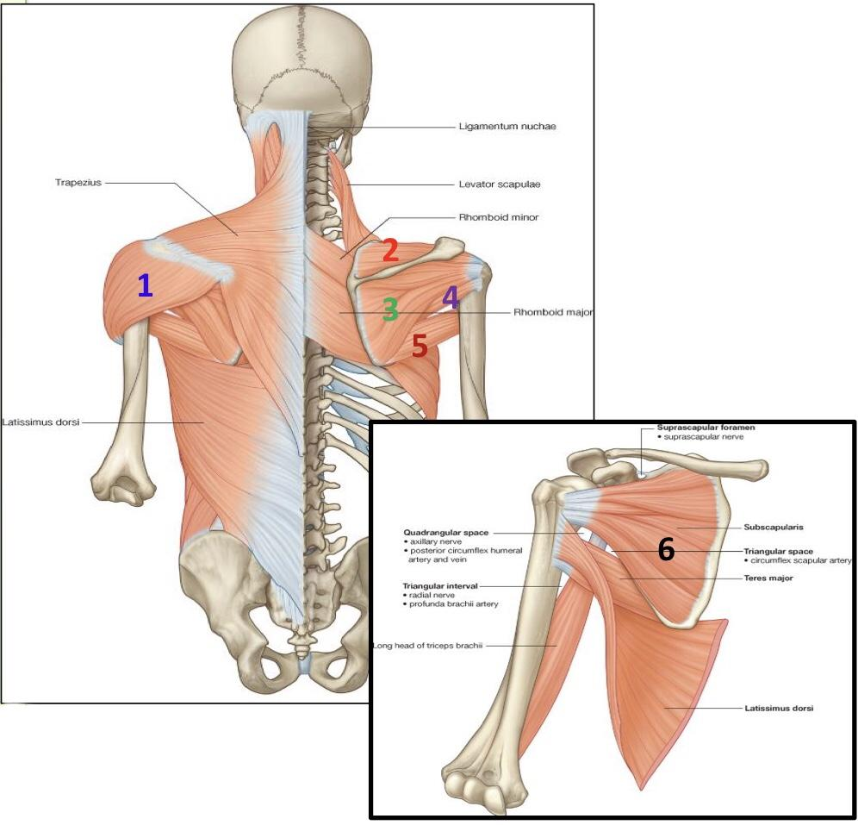
MUSCLES OF SHOULDER REGION
These are muscles connecting Scapula to Humerus.
(move humerus through shoulder joint):
Scapula يعني يطلعون من
Humerus ويدخلون في
فدايما تذكروا
Origin: scapula
Insertion: humerus
1-Deltoid
2-Supraspinatus
3-Infraspinatus
4-Teres minor
5-Teres major
6-Subscapularis

Slide 4
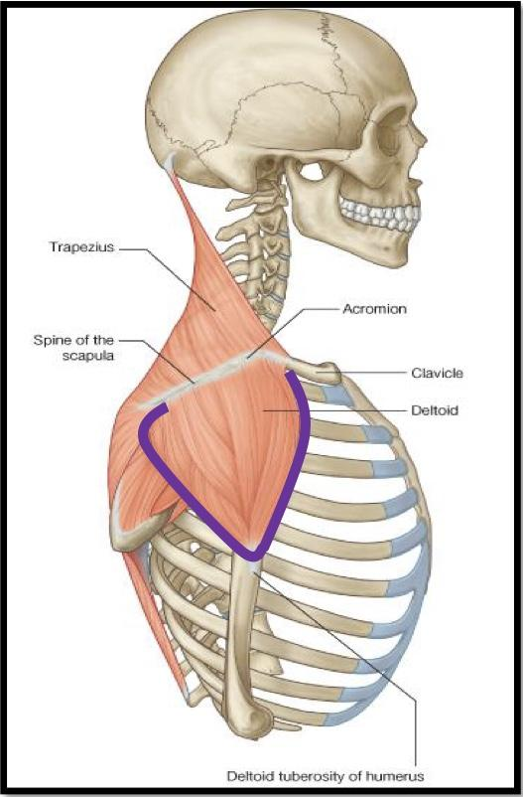
Deltoid
A triangular muscle that forms the rounded contour of the shoulder. Origin: lateral 1/3 of clavicle (Anterior Fiber)
Acromion (Middle fibers)
Spine of scapula (posterior Fibers)
(Origin of Deltoid = insertion of trapezius).
Insertion: deltoid tuberosity of humerus. Nerve supply: Axillary nerve. (C5,C6,C7,C8,T1) Actions:
1. Anterior fibers: flexion & medial rotation of humerus (arm, shoulder joint).
2. Middle fibers: abduction of humerus from 15° - 90 °.
3. Posterior fibers: extension & lateral rotation of humerus.
Adduction يعني تسوي كل شي الا

Slide 5
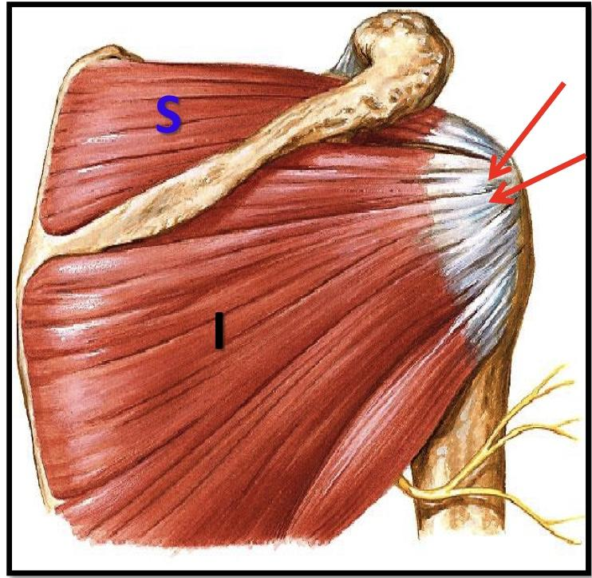
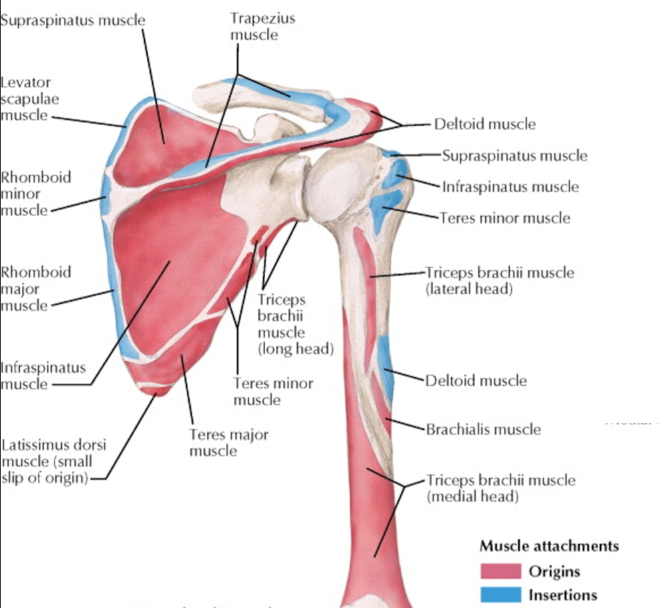
Supraspinatus & Infraspinatus
Spine
Origin: scapula
1. Supraspinatus: supraspinous fossa.
2. Infraspinatus: infraspinaous fossa. Insertion: greater tuberosity of humerus. Nerve supply: Suprascapular nerve. Action:
1. Supraspinatus: abduction of humerus from 0° - 15°. 2. Infraspinatus: lateral rotation of humerus.
(Superior Trunk)

Slide 6
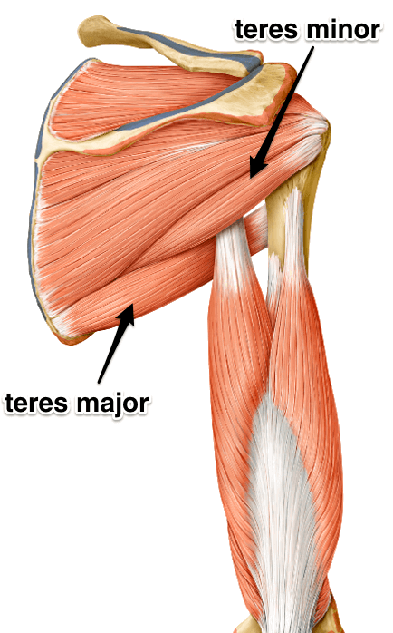
Teres minor
Origin: lateral (axillary) border of scapula
Insertion: greater tuberosity of humerus (with supra/infraspinatus)
Nerve supply: axillary nerve
Action: lateral rotation of humerus
Teres major
Origin: lateral border of scapula
Insertion: medial lip of bicipital groove of humerus (with latissimus dorsi & pectoralis major)
Nerve supply: lower subscapular nerve (Branch of posterior cord)
Actions: extension, adduction & medial rotation of humerus.
(as action of latissimus dorsi)

Slide 7
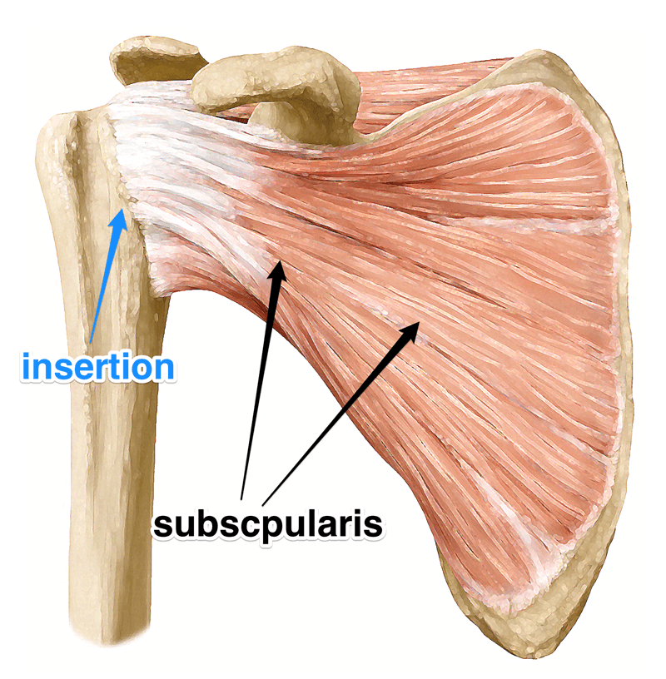
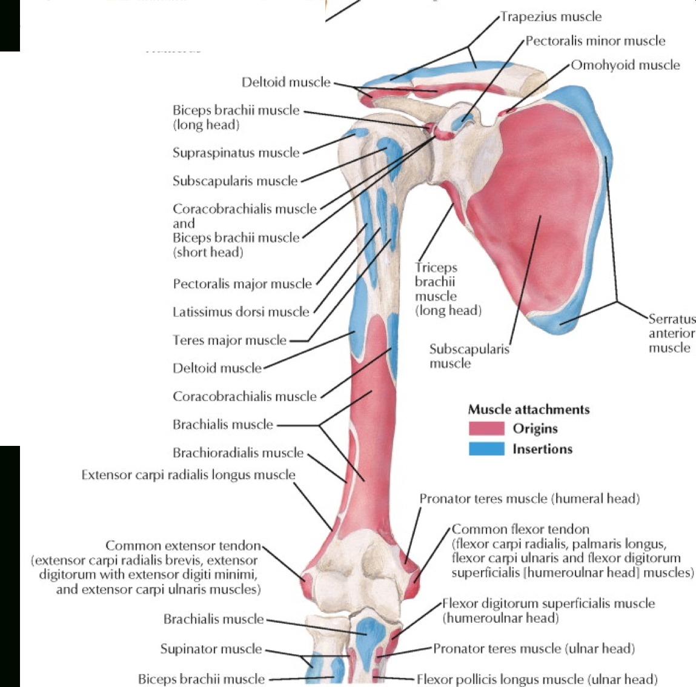
Subscapularis
Origin: subscapular fossa.
Insertion: lesser tuberosity of humerus
Nerve supply: upper & lower subscapular nerves(Branch of posterior cord)
Action: medial rotation of humerus.

Slide 8
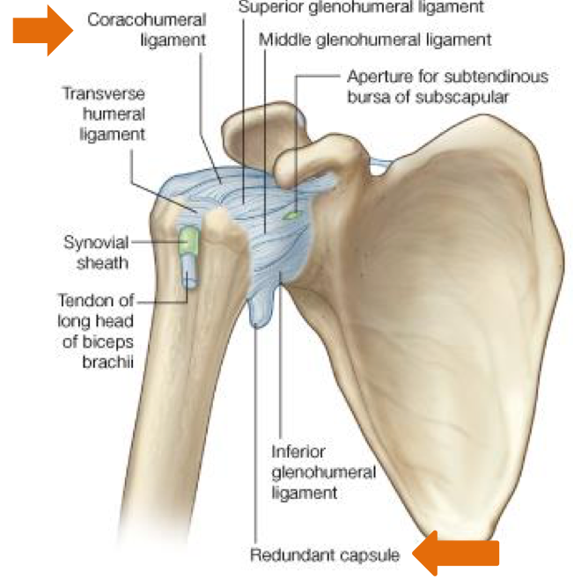
Shoulder joint
Type
Synovial,
Multiaxial or polyaxial*
(Ball & Socket)
*Only the Hip and Shoulder joints are multiaxial
Articular surfaces
Stability
(Not stable) because of :
1- Head of humerus (Ball)
2- Glenoid cavity of scapula (Socket)
The Stability the Range of movement
Head of humerus is 3 times larger than glenoid cavity.
Capsule is redundant.
Few ligamentous support: -glenoid labrum -coracohumeral.
Main support: muscles around the joint (Rotator cuff).
Wide range of movement.

Slide 9
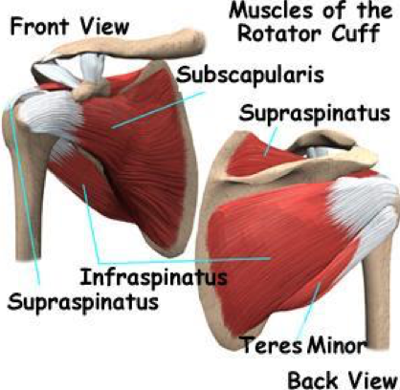
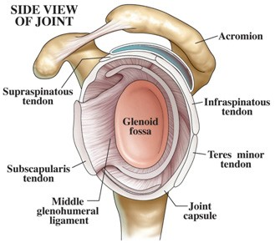
Rotator Cuff
Muscles form a tendinous cuff around the shoulder joint covering its Anterior, Posterior and Superior aspects.
The cuff is deficient Inferiorly and this is the site of potential weakness.
لهذا اغلب حالات الخلع يكون رأس ال humerus نازل لتحت جهة الaxilla
It is formed of 4 muscles (SITS) :
Supraspinatus
Infraspinatus
Teres minor
Subscapularis
The tone of these muscles help in stabilizing the shoulder joint.

Slide 10
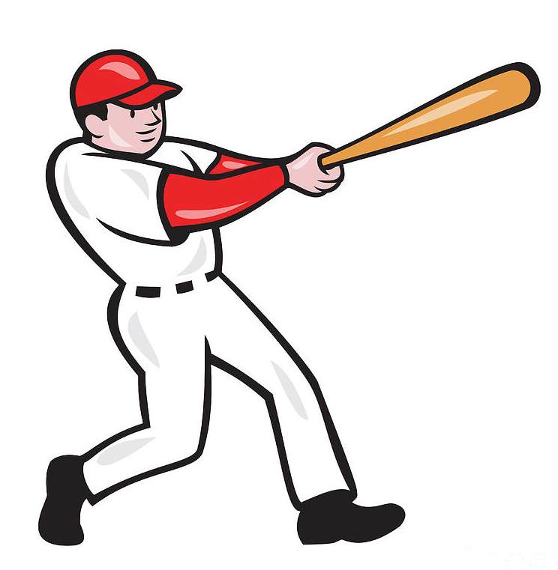
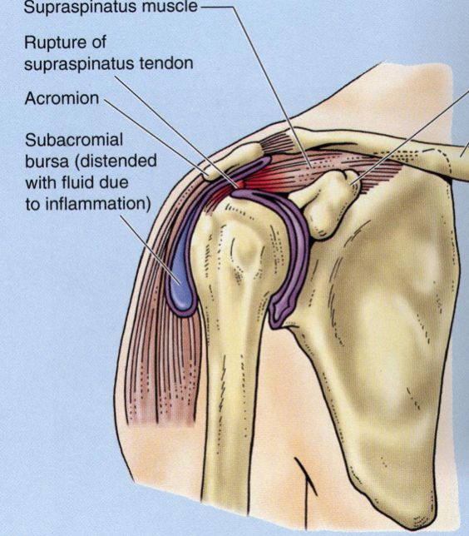
Rotator Cuff Injury
Rotator cuff can be damaged due to trauma (during playing baseball) or disease (in older individuals).
Trauma can tear or rupture one or more tendon/(s) forming the cuff. Patients with rotator injury will present with pain, shoulder instability, and limited range of motion. Have almost the same symptoms as a dislocated shoulder
Supraspinatus tendon is the most common site of rotator cuff injury.
Because It’s the weakest.

Slide 11
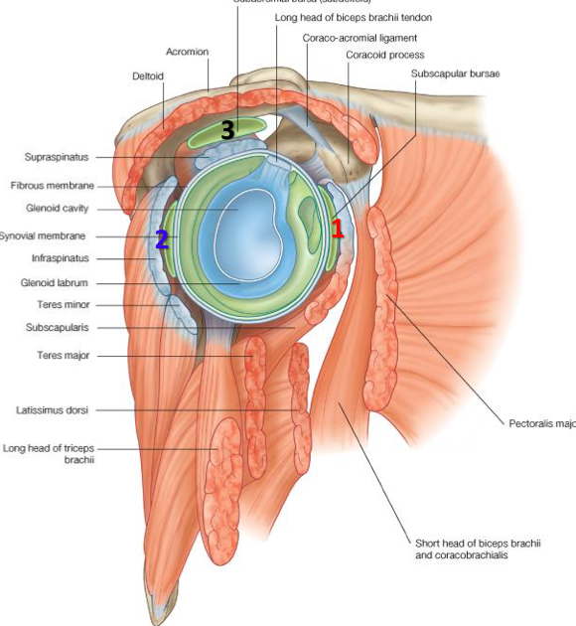
BURSAE* IN RELATION TO SHOULDER JOINT
They reduce friction between tendons, joint capsule & bone.
They are liable to be inflamed following injury of rotator cuff muscles.
1*
2*
3*
Subscapularis bursa | Infraspinatus bursa | Subacromial bursa
between subscapularis tendon & capsule. | between infraspinatus tendon & capsule. | between deltoid, supraspinatus & capsule.
*Bursae : It’s a made up of synovial membrane that produces and contains synovial fluid sac outside of the membrane of the capsule & outside the joint , it has the same function of the capsule.

Slide 12
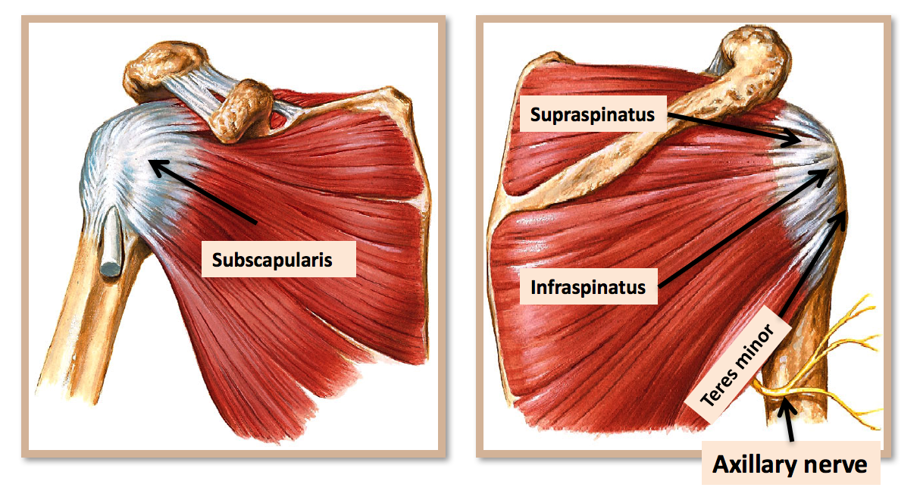
Relations of Shoulder Joint
Anterior: Subscapularis.
Posterior: infraspinatus,
And teres minor.
Superior: Supraspinatus.
Inferior: axillary nerve.

Slide 13
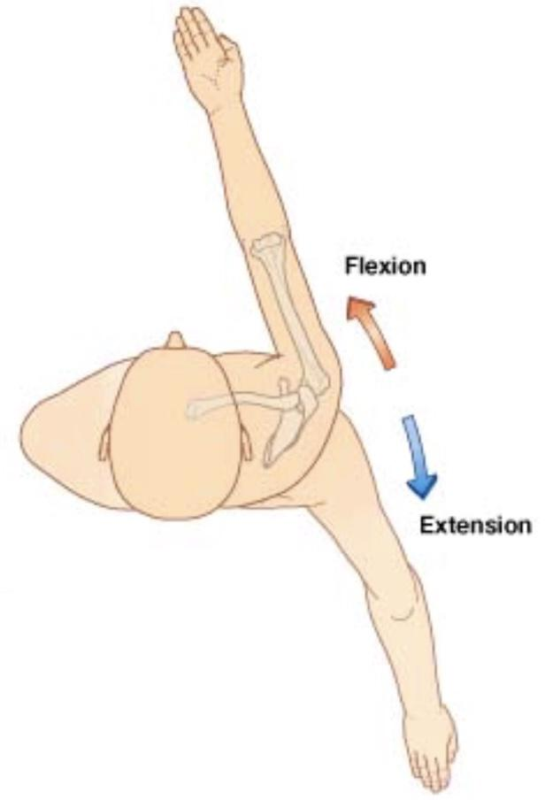
Movements of shoulder Joint
Flexion:
Anterior fibers of deltoid.
Pectoralis Major.
Coracobrachialis (Muscle of Arm).
Short head of biceps brachii (Muscle of Arm)
Extension:
Posterior fibers of deltoid.
Latissimus dorsi.
Teres Major.
Main

Slide 14
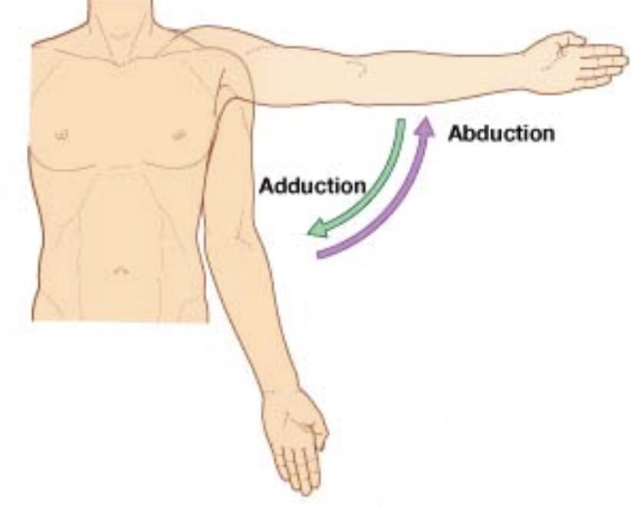
Movements of Shoulder Joint
Abduction:
From 0° - 15°: Supraspinatus.
From 15° - 90°: Middle fibers of deltoid.
Adduction:
Pectoralis major.
Latissimus Dorsi.
Teres Major.
All of them are inserted in Bicipital Groove
In case of fracture of the surgical neck of humerus, the most affected movement is Abduction

Slide 15
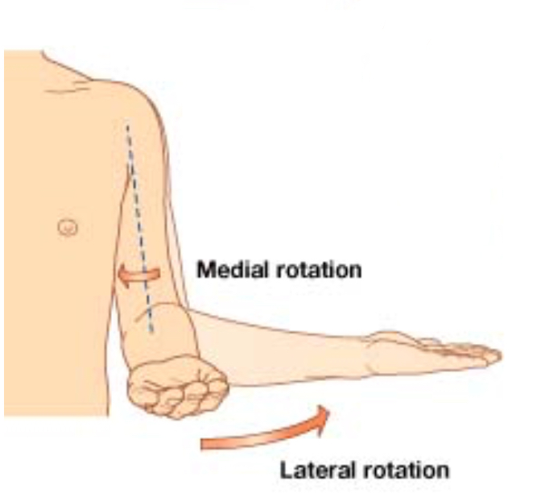
Movements of Shoulder Joint
Medial Rotation:
Pectoralis Major.
Latissimus Dorsi.
Teres Major.
Anterior Fibers of deltoid.
Subscapularis.
Lateral Rotation:
Posterior fibers of Deltoid.
Infraspinatus.
Teres minor.
First 3 are inserted in bicipital groove

Slide 16
Muscle | Deltoid | Supraspinatus & infraspinatus | Teres minor | Teres major | Subscapularis
Origin | lateral 1/3 of clavicle, acromion and spine of scapula | 1-Supraspinatus: supraspinous fossa 2-Infraspinatus: infraspinous fossa | lateral (Axillary) border of Scapula | lateral border of scapula | subscapular fossa
Insertion | deltoid tuberosity of humerus | greater tuberosity of humerus | greater tuberosity of humerus | medial lip of bicipital groove of humerus | lesser tuberosity of humerus
Nerve supply | axillary nerve | Suprascapular nerve | axillary nerve | Lower subscapular nerve | upper & lower subscapular nerves
Action | 1-Anterior fibers: flexion & medial rotation of humerus. 2-Middle fibers: abduction of humerus from 15-90°. 3-Posterior fibers: lateral rotation of humerus & extension. | 1- Supraspinatus: abduction of humerus from 0° - 15°. 2- Infraspinatus: lateral rotation of humerus. | lateral rotation of humerus | extension, adduction & medial rotation of humerus | medial rotation of humerus
S U M M A R Y

Slide 17
Summary
Muscles of shoulder region:
Origin: scapula
Insertion: humerus
Action: move humerus (SHOULDER JOINT)
Nerve supply: anterior rami of spinal nerves through brachial plexus
Rotator cuff: 4 muscles in scapular region surround and help in stabilization of shoulder joint (supraspinatus, infraspinatus, teres minor, subscapularis).
Shoulder joint:
1-Type: synovial, ball & socket
2-Articular surfaces: head of humerus & glenoid cavity of scapula
3-Stability: depends on rotator cuff
4-Relations: rotator cuff and axillary nerve
5-Movements: flexion, extension, abduction, adduction, medial & lateral rotation

Slide 18
MCQ’s
SAQ
Which of the following muscles has similar actions to latissimus dorsi ?
Teres major
Subscapularis
Teres minor
5. All of the following relate posteriorly to the shoulder joint except…
Subscapularis
Infraspinatus
Teres minor
6. Name the bursae related to to the shoulder joint.
7. What is the function of the bursae.
2. Nerve supply of subscapularis by:
Axillary nerve
Upper and lower subscapular nerve
Only lower subscapular nerve
8. Name the muscles responsible for medial rotation of the shoulder joint.
4. Which of the following rotator cuff muscles is most susceptible to injury?
Infraspinatus
Supraspinatus
Teres minor
3. Which is false about the shoulder joint?
Is not stable because humerus head is 3x larger than glenoid cavity
Relies on support from the rotator cuff
Is a hinge joint with biaxial movement
Answers: 1. A 2. B 3. C 4. B 5. A
6. Subscapularis bursa, infraspinatus bursa, subacromial bursa
7. They reduce friction between the tendons, joint capsule and bones.
8. Pectoralis Major, Latissimus Dorsi, Teres Major, Anterior fibers of deltoid, and subscapularis

Slide 19
Team Members
Faisal Fahad Alsaif (Team Leader) Abdulaziz Al dukhayel ‏Fahad Alfaiz ‏Akram Alfandi ‏Saad Aloqile ‏Saleh Almoaiqel ‏Abdulaziz Alabdulkareem ‏Abdullah Almeaither ‏Yazeed Aldossari ‏Muath Alhumood Abdulrahman Almotairi
‏
Abdulelah Aldossari ‏Abdulrahman Alduhayyim ‏Hamdan Aldossari ‏Abdullah Alqarni ‏Mohammed Alomar ‏Abdulrahman Aldawood ‏Saud Alghufaily ‏Hassan Aloraini Khalid Almutairi‏‏
Lamia Abdullah Alkuwaiz (Team Leader)
Rawan Mohammad Alharbi
Abeer Alabduljabbar Afnan Abdulaziz Almustafa Ahad Algrain Alanoud Almansour Albandari Alshaye AlFhadah abdullah alsaleem Arwa Alzahrani Dana Abdulaziz Alrasheed Dimah Khalid Alaraifi Ghada Alhaidari Ghada Almuhanna Ghaida Alsanad Hadeel Khalid Awartani Haifa Alessa Khulood Alwehabi Layan Hassan Alwatban Lojain Azizalrahman Lujain Tariq AlZaid
Maha Barakah Majd Khalid AlBarrak Norah Alharbi Nouf Alotaibi Noura Mohammed Alothaim Rahaf Turki Alshammari Reham Alhalabi Rinad Musaed Alghoraiby Sara Alsultan Shahad Alzahrani Wafa Alotaibi Wejdan Fahad Albadrani Wjdan AlShamry
Abdulmajeed Alwardi ‏Abdulrahman Alageel ‏Rayyan Almousa ‏Sultan Alfuhaid ‏Ali Alammari ‏Fahad alshughaithry Fayez Ghiyath Aldarsouni ‏Mohammed Alquwayfili ‏‏Abduljabbar Al-yamani ‏Sultan Al-nasser ‏Majed Aljohani ‏Zeyad Al-khenaizan ‏Mohammed Nouri ‏Abdulaziz Al-drgam ‏Fahad Aldhowaihy ‏Omar alyabis

