Slide 1
Bones of the Lower Limb
Lecture 2
Please check our Editing File.
هذا العمل لا يغني عن المصدر الأساسي للمذاكرة
{وَمَنْ يَتَوَكَّلْ عَلَى اللَّهِ فَهُوَ حَسْبُهُ}

Slide 2
Objectives
Classify the bones of the three regions of the lower limb (thigh, leg and foot).
Differentiate the bones of the lower limb from the bones of the upper limb.
Memorize the main features of the Bones of the thigh (femur & patella) Bones of the leg (tibia & Fibula). Bones of the foot (tarsals, metatarsals and phalanges)
Recognize the side of the bone
Text in BLUE was found only in the boys’ slides
Text in PINK was found only in the girls’ slides
Text in RED is considered important
Text in GREY is considered extra notes

Slide 3
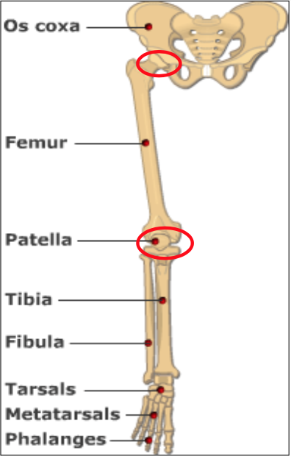
Bones of Thigh (Femur and Patella)
Femur:
Articulates above with acetabulum of hip bone to form the hip joint.
Articulates below with tibia and patella to form the knee joint. (The Fibula have no part in Knee joint)
Thigh
Knee
In thigh region 1 bone
In leg region 2 bones
In foot region 26 bones
(Long bone) Any bone has two ends and a shaft
The only short bones are: Carpals and Tarsals
(Sesamoid) a bone within the tendon of a muscle
Leg
Foot

Slide 4
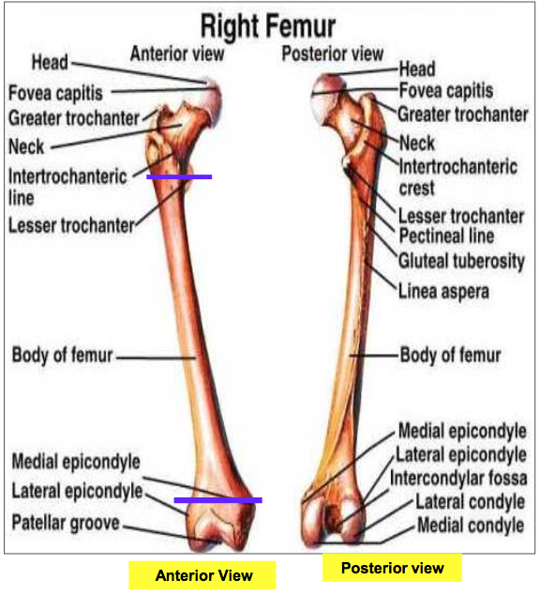
Bones of Thigh (Femur and Patella)
Femur
consists of :
Upper end
Shaft
Lower end

Slide 5
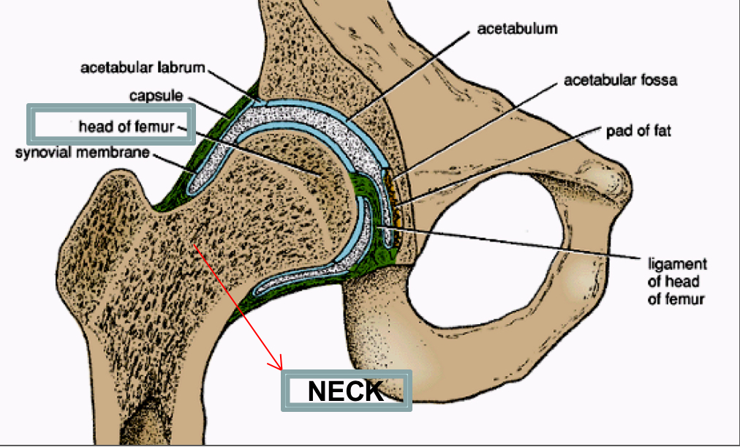
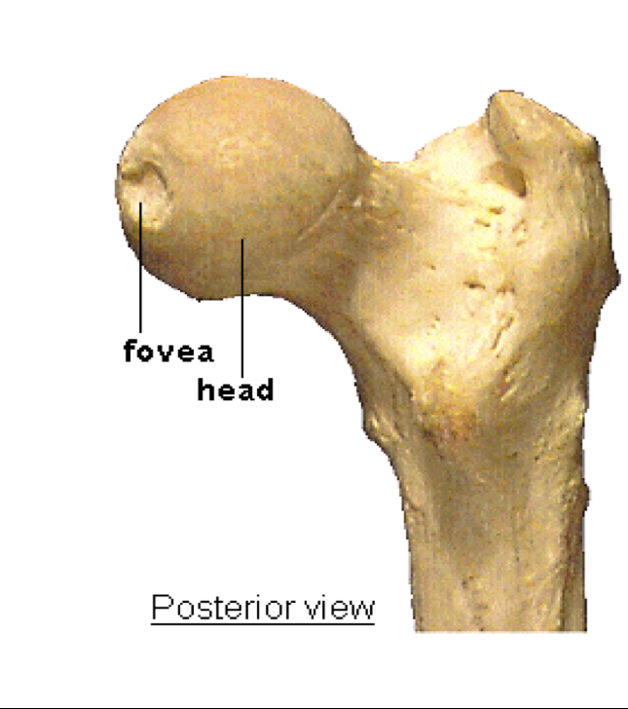
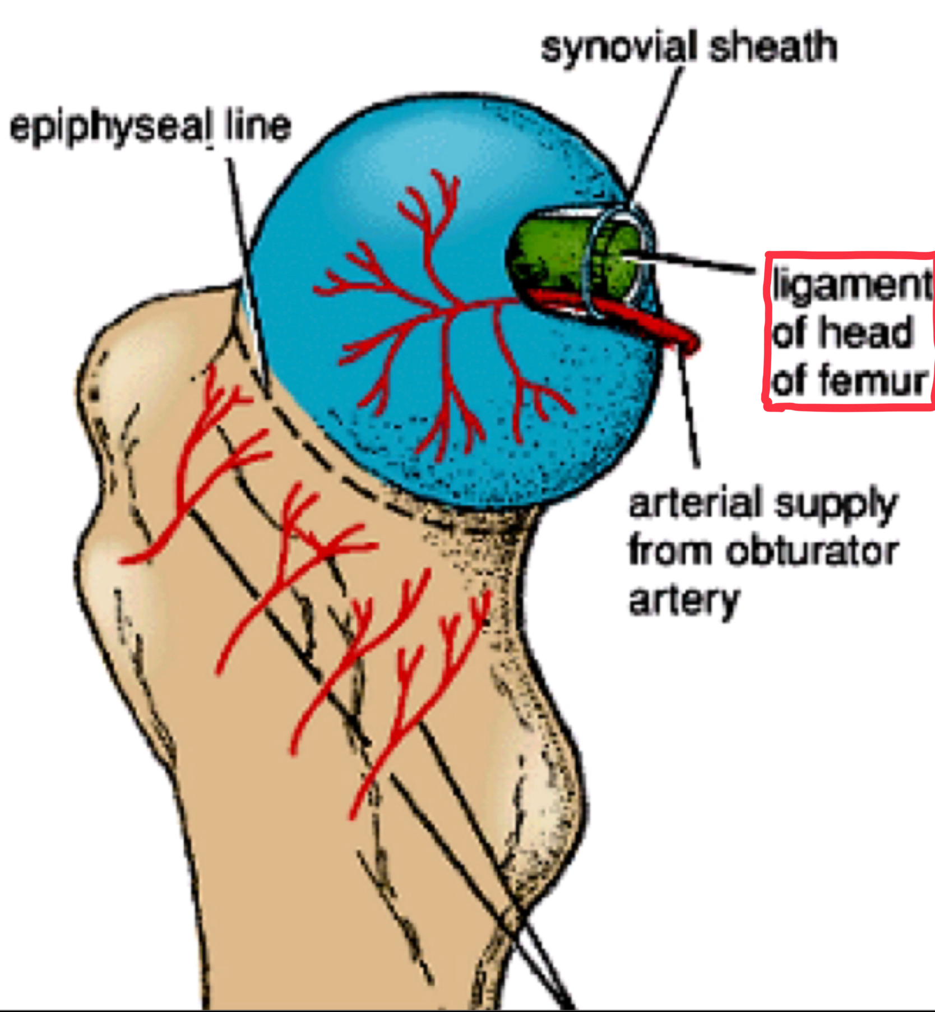
1.Head:
-It articulates with acetabulum of hip bone to form hip joint.
-Has a depression in the center (Fovea capitis) for the attachment of ligament of the head of femur.
-Obturator artery passes along this ligament to supply head of femur
2.Neck:
-It connects the head to the shaft
Upper End Of The Femur

Slide 6
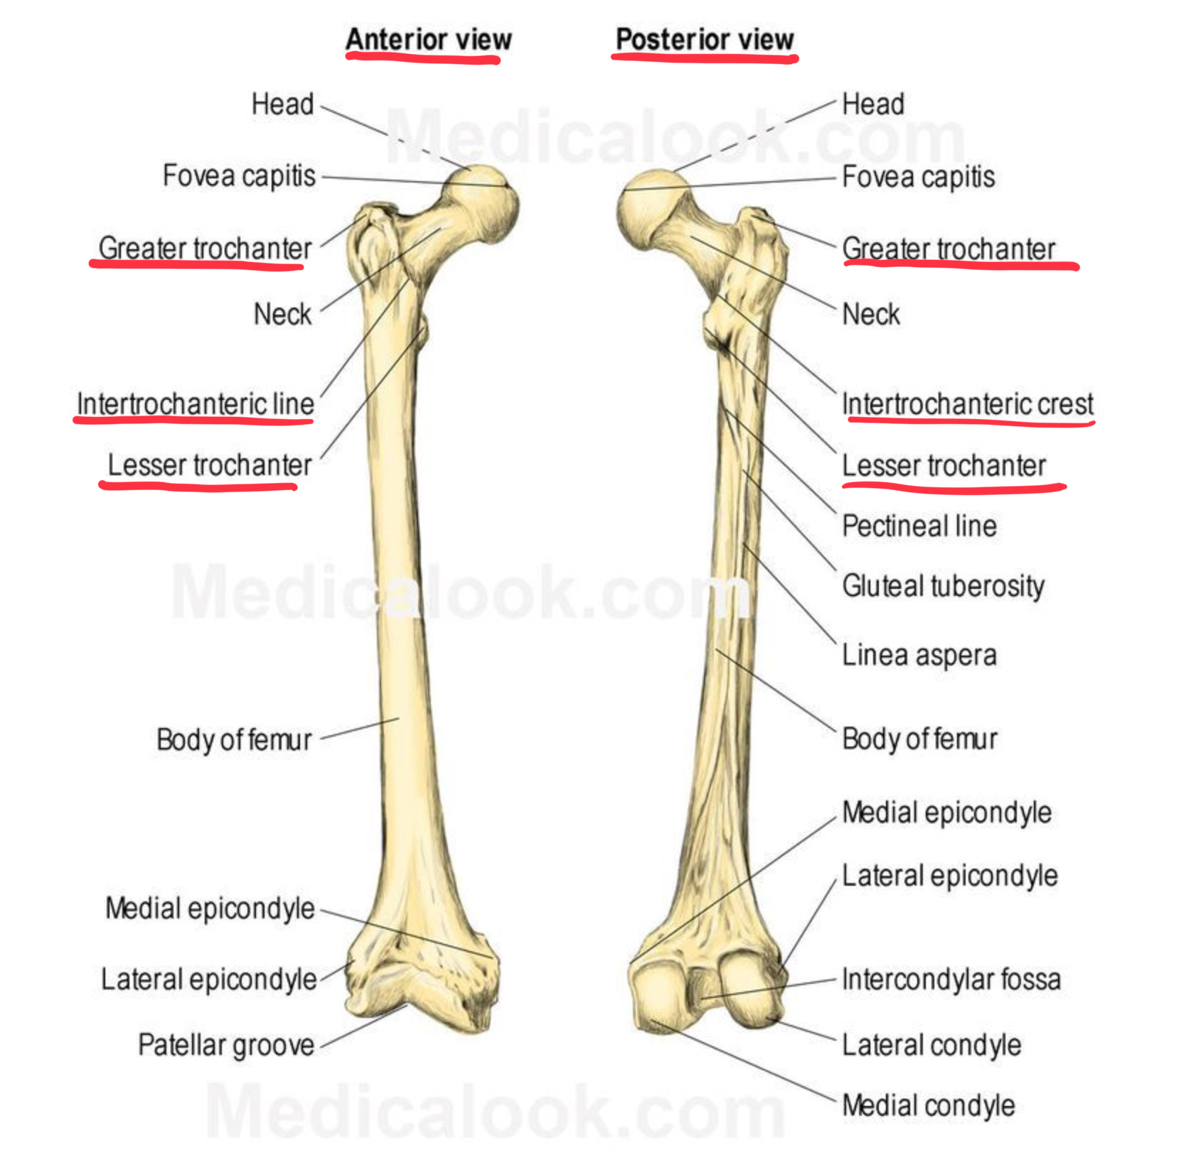
Upper End Of The Femur
Greater & lesser trochanters : 1.Anteriorly:
-The 2 trochanters are connected by the inter-trochanteric line, where the iliofemoral ligament is attached.
2.Posteriorly:
-The inter-trochanteric crest, on which is the quadrate tubercle (Quadratus femoris muscle).
Quadrate tubercle is the insertion point of the Quadratus femoris muscle

Slide 7
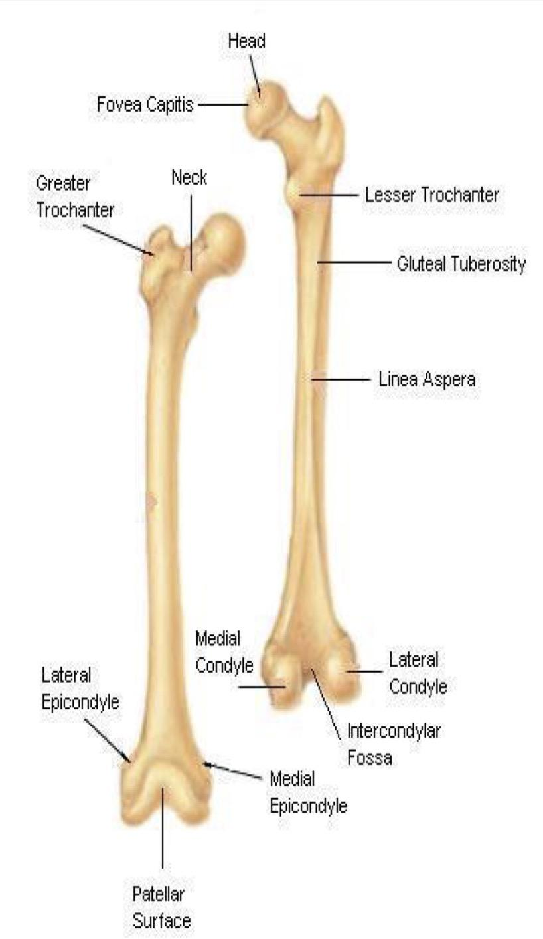
Shaft Of The Femur
It has 3 surfaces:
1- Anterior (smooth)
2- Medial
3- Lateral
It has 3 borders:
Two rounded(smooth and convex): medial and lateral
One thick posterior border or ridge called linea aspera (related to the posterior part of femur)

Slide 8
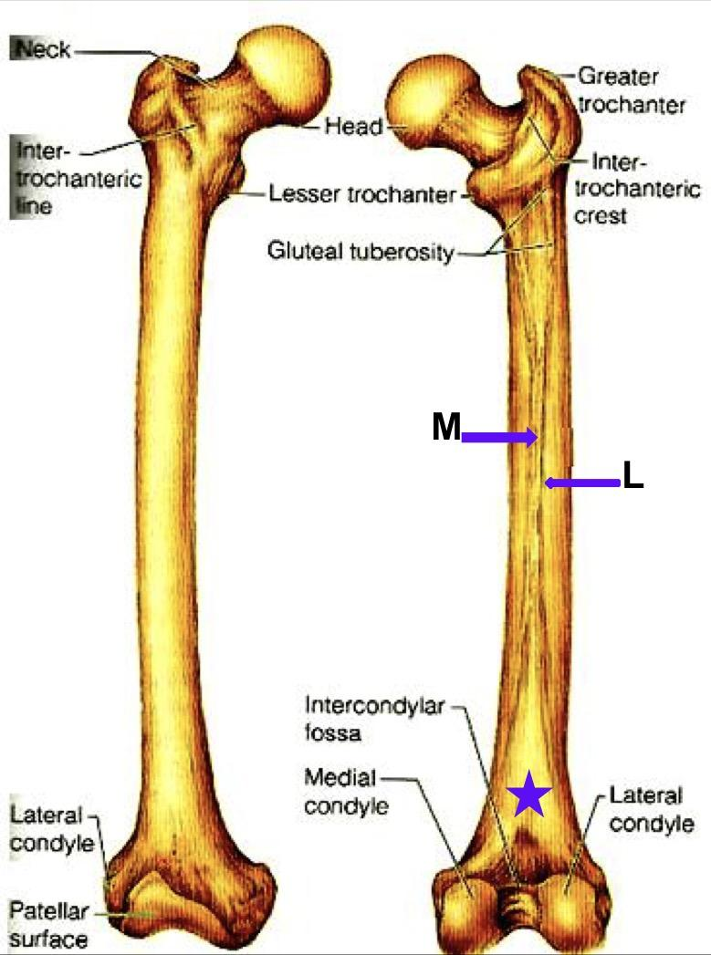
Shaft Of The Femur
1- Anteriorly: is smooth and rounded.
2- Posteriorly: has a ridge, the linea aspera.
3- Posteriorly below the greater trochanter is the gluteal tuberosity for attachment of gluteus maximus muscle(which we sit on).
4- The medial margin of the linea aspera M continues below as medial supracondylar ridge
5- The Lateral margin L continues below as the lateral supracondylar ridge
6- A triangular area, the popliteal surface lies at the lower end of shaft

Slide 9
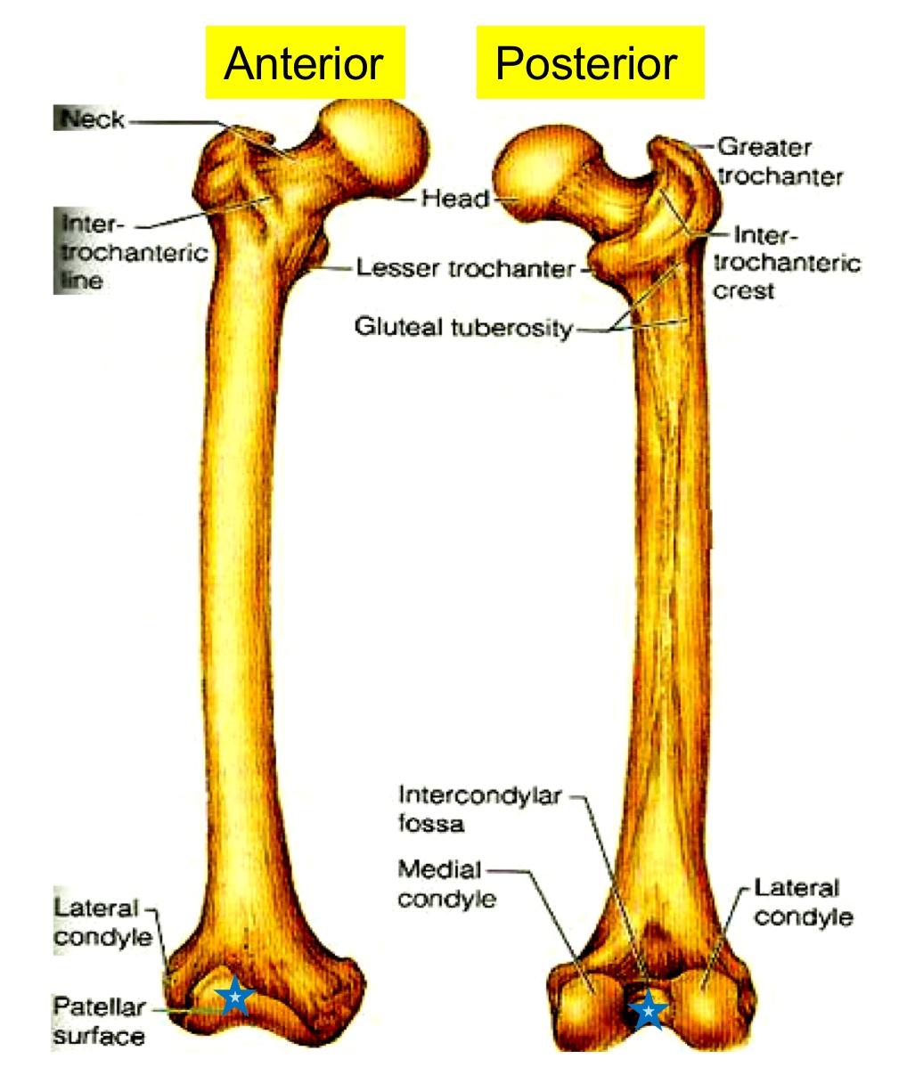
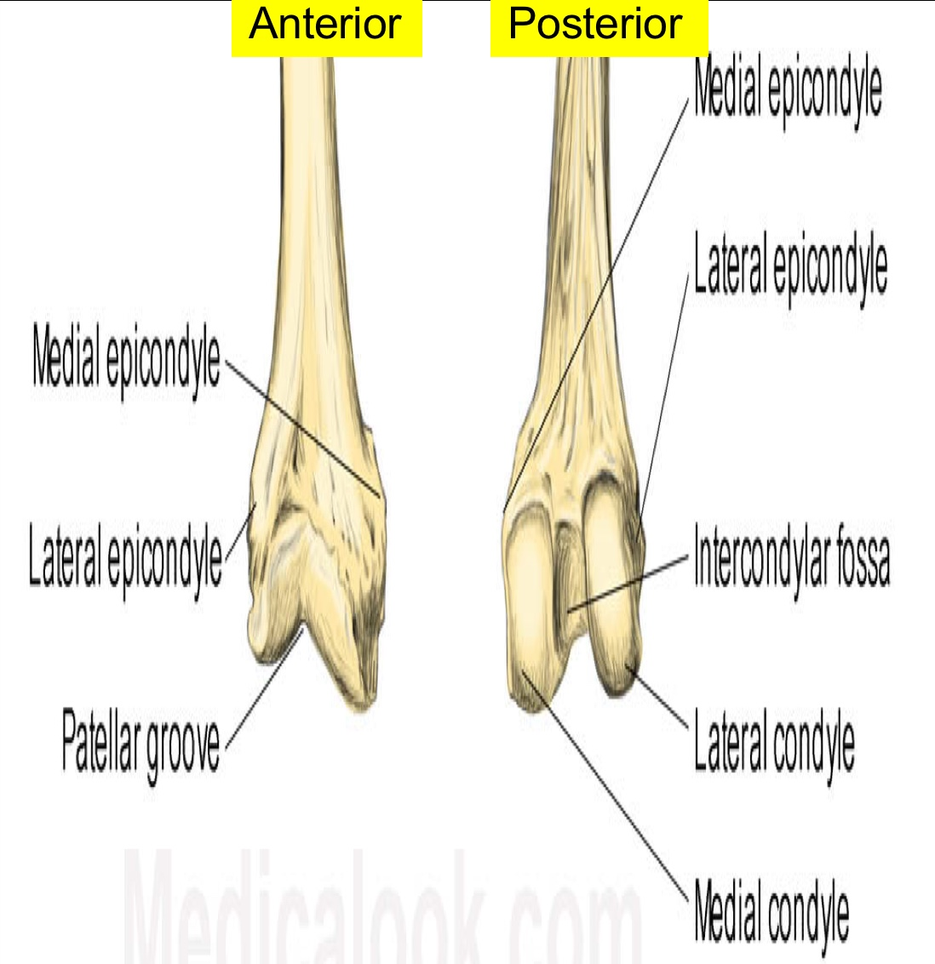
Lower end of femur
1- Has lateral and medial condyles, separated anteriorly by articular patellar surface, and posteriorly by intercondylar notch or fossa.
2- The 2 condyles take part in the knee joint.(articulate with the Tibia & Patella)
3 - Above the condyles are the medial & lateral epicondyles.بروزات على العظمه
Only in girls’ slide

Slide 10
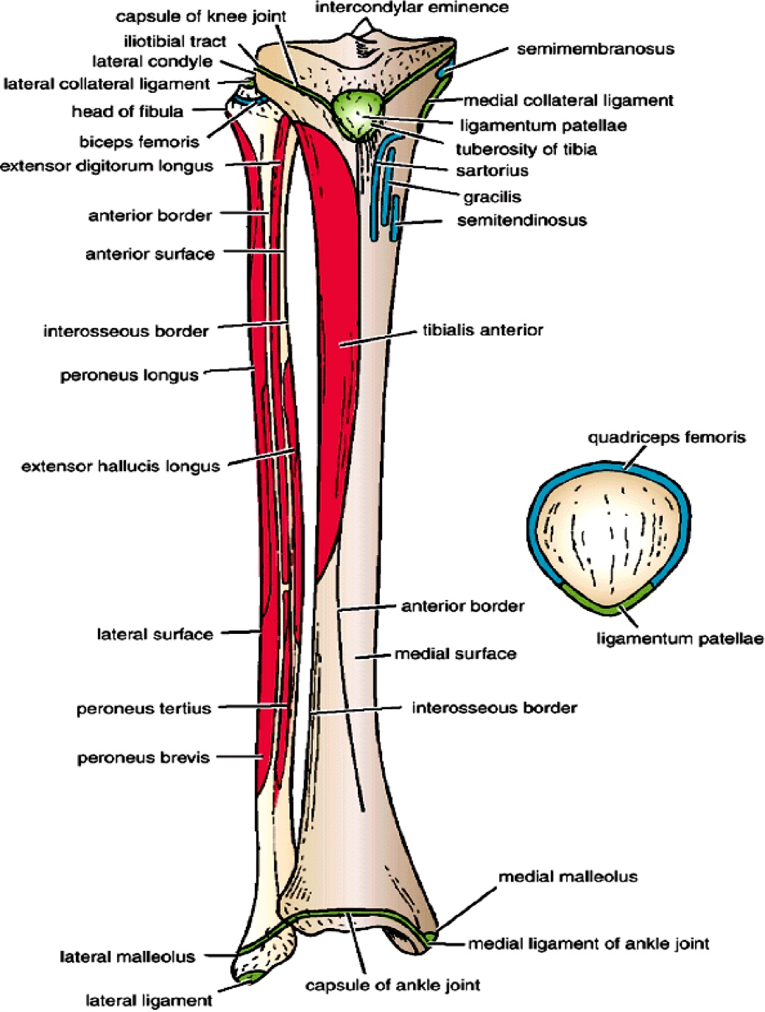
Patella
It is the largest sesamoid bone (lying inside the Quadriceps tendon in front of knee joint).
Its anterior surface is rough and subcutaneous. It is important to know the surfaces of the bones which are subcutaneous ( In the next slides)They might ask you “ which one of these is subcutaneous”
Its posterior surface articulates with the condyles of the femur to form knee joint.
Its apex lies inferiorly and is connected to tuberosity of tibia by ligamentum patellae.
Its upper, lateral, and medial margins give attachment to Quadriceps femoris muscles.
Muscle

Slide 11
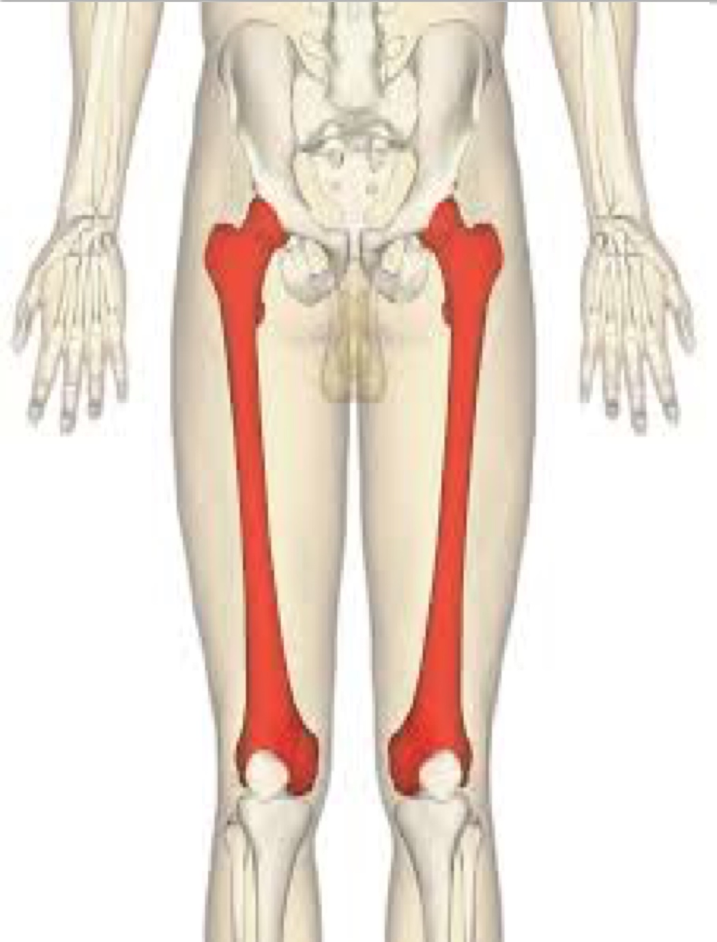
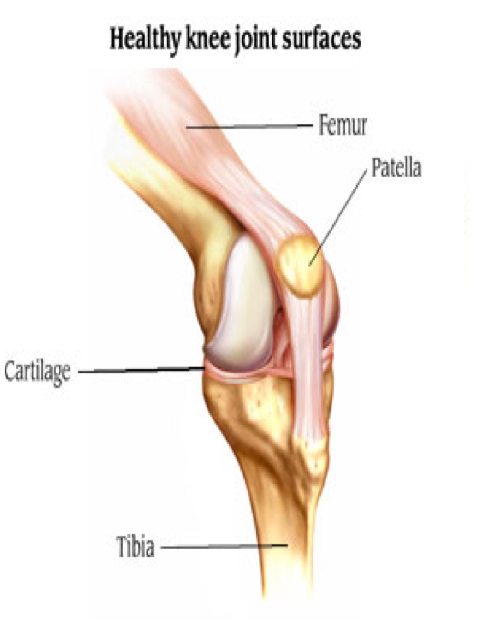
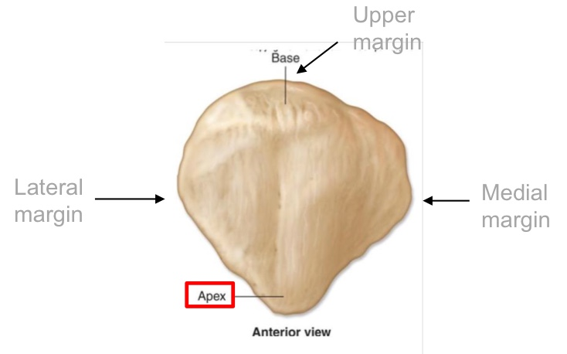
Patella and Femur
From team 436

Slide 12
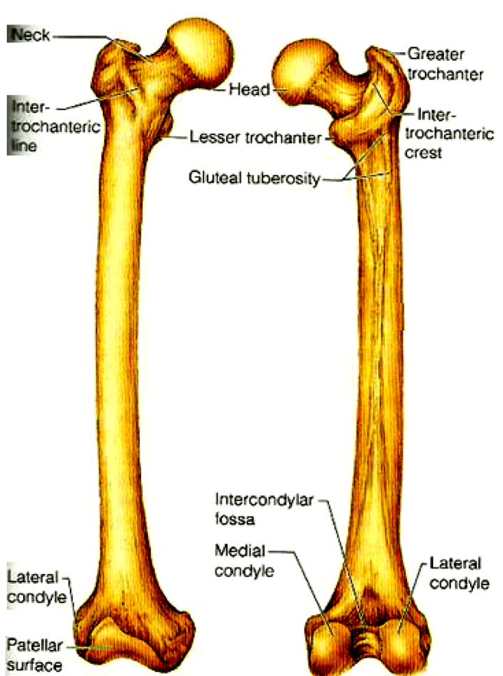
Position Of Femur (Right or Left)
Head is directed upward &Medially.
Shaft is smooth and convex anteriorly.
Shaft is rough and concave posteriorly.
Explanation:
To determine if the femur bone is in the left or right thigh:
1. Make sure that the head is facing upward and is directed medially (towards the center of the body).
2. Rotate the bone until the smooth convex side of the shaft is facing anteriorly, and the rough concave side is facing posteriorly.

Slide 13
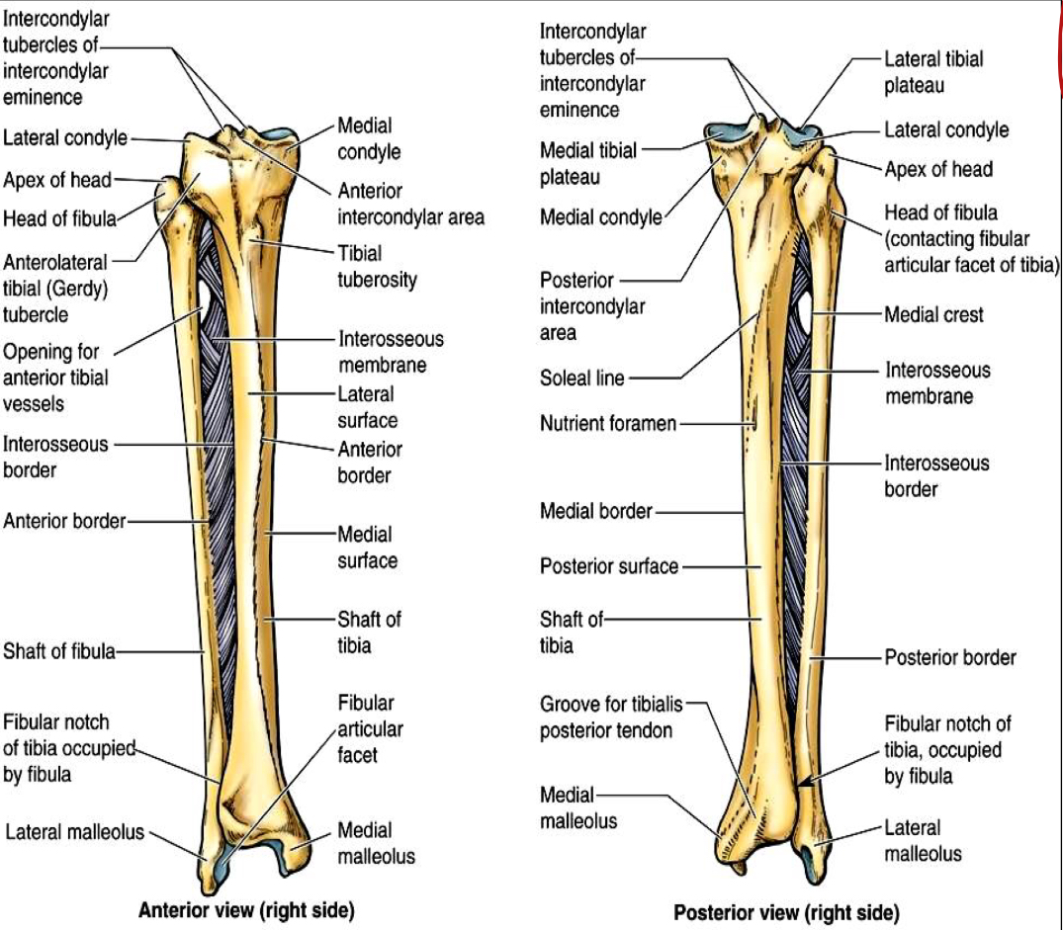
Tibia :
BONES OF LEG
(TIBIA AND FIBULA)
It is the medial bone of leg.
Each of them has:
-upper end
-shaft -lower end.
It is the lateral bone of leg.
Fibula :
لسهولة الحفظ
Lateral ( L فيها اثنين )
Fibula (L فيها)
Tibia> L ما فيها
Lateral هي Fibula فالأَوْلَى تكون-

Slide 14
TIBIA
Upper end of tibia
Contains:
A-(2)tibial condyles
B-intercondylar area:
-rough
-has intercondylar eminence
condyle | size | Articulates with | other
Medial condyle | larger | Medial condyle with femur | Has a groove on its posterior surface for semi-membranosus muscle.
Lateral condyle | smaller | Lateral condyle of femur | has facet(small oval or circular area) on its lateral side for articulation with head of fibula to form proximal tibio-fibular joint

Slide 15
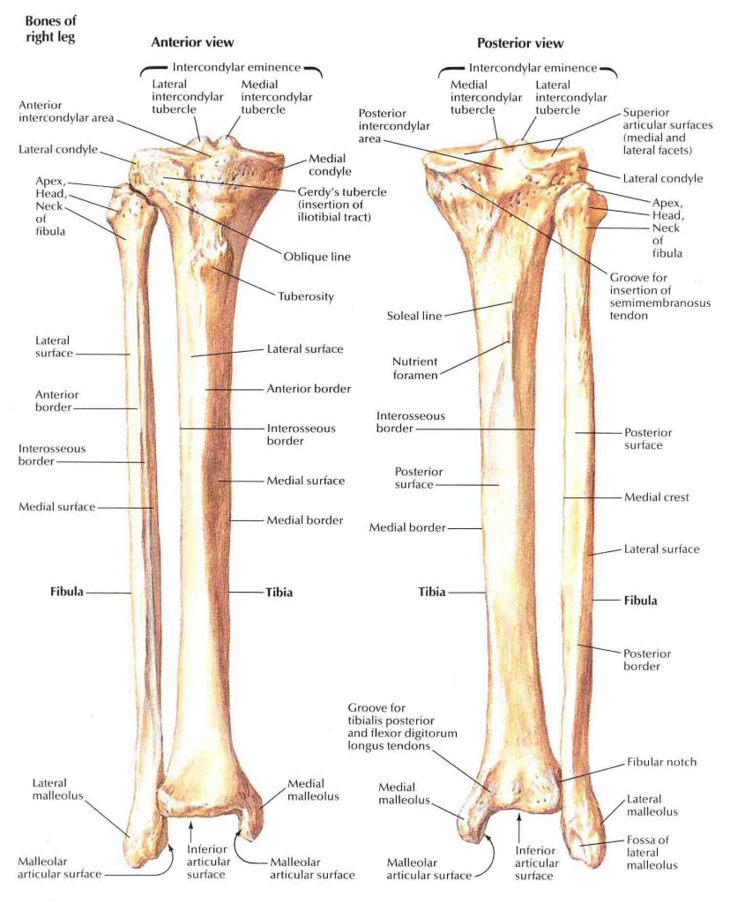
TIBIA
Shaft of tibia
A-tibial tuberosity
its upper smooth part gives attachment to ligamentum patellae
its lower rough part is subcutaneous
B-3 borders
Anterior border sharp and subcutaneous
Medial border
Lateral border or interosseous border
C-3 surfraces
Medial subcutaneous
Lateral
Posterior has oblique line, soleal line for attachment of soleus muscle

Slide 16
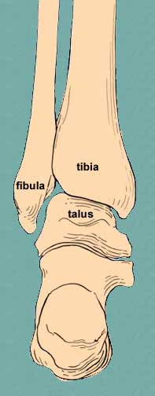
TIBIA
Lower end
articulates with talus for formation of ankle joint.
the lower end contain:
A- Medial malleolus
its medial surface is subcutaneous
itslateral surface articulate with talus
B- Fibular notch
lies on its lateral surface of lower end to form distal tibiofibular joint

Slide 17
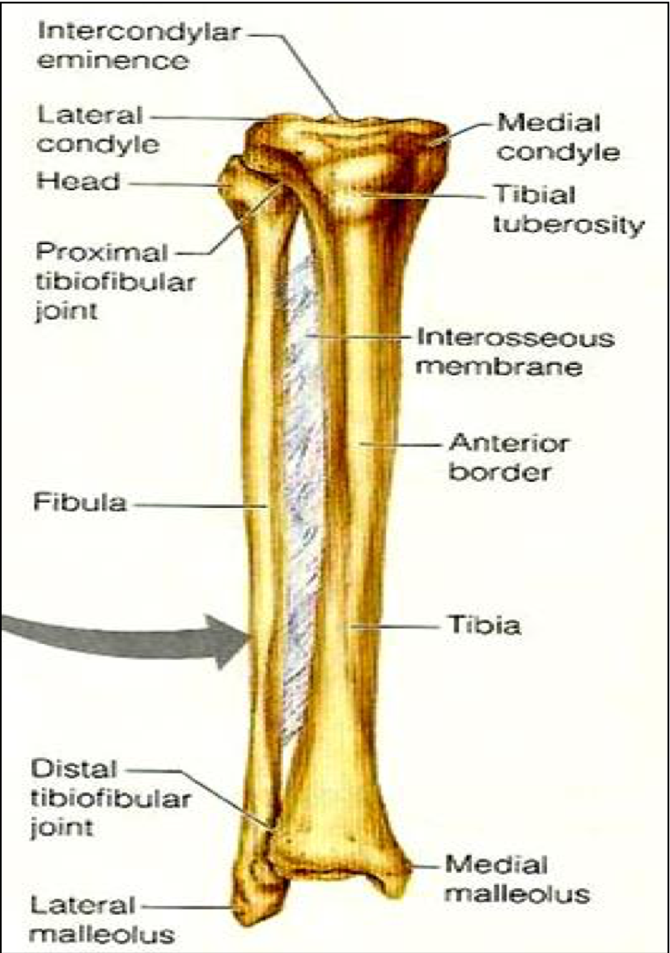
Position of Tibia
(Right or Left)
Position of Tibia (Right or Left)
Upper end is larger than lower end.
Medial malleolus is directed downward and medially.
Shaft has sharp anterior border.

Slide 18
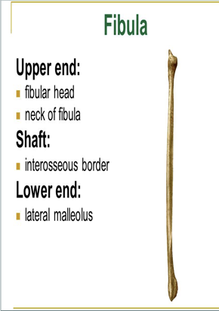
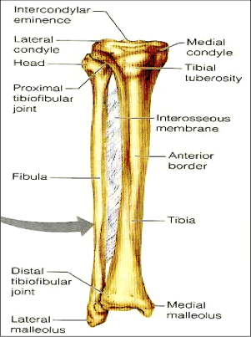
Fibula
Fibula
Upper end:
1- head: articulates with the lateral condyle of tibia (to form tibiofibular joint)
2- styloid process
3- neck
Shaft:
1- 4 borders : its medial interosseous border gives attachment to interosseous membrane.
2- 4 surfaces
1- It is the slender lateral bone of the leg.
2- It takes no part in articulation of knee joint.
3-it gives support for muscles
*interosseous membrane is a broad and thin plane of fibrous tissue that separates many of the bones of the body. In this case it separate the tibia and the fibula.
pictures above are extra , but important for better understanding

Slide 19
Fibula
Fibula
Lower end:
Forms the
Lateral malleolus: which is
subcutaneous “can be felt under the skin”.
The medial surface of the lateral malleolus is smooth for articulation with talus to form the ankle joint.
Notes “team 436” :
Both the femur and the tibia have 3 borders, but the fibula has 4 borders
For each leg there are two malleolus, a medial one coming from the tibia, and a lateral one coming from the fibula
pictures above are extra , but are important for better understanding

Slide 20
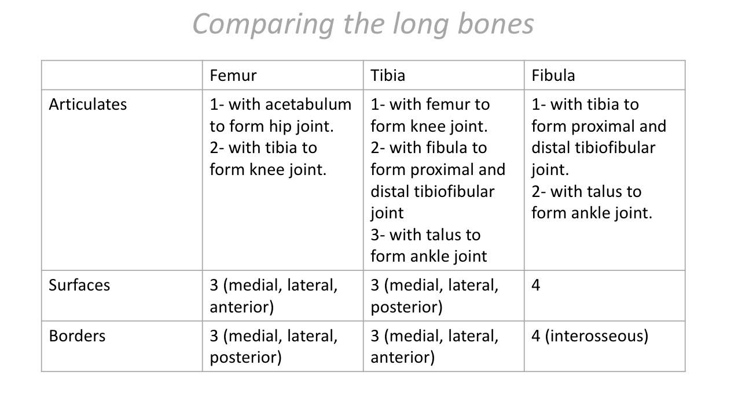
Anatomy Team
436

Slide 21
Bones of foot
7 Tarsal bones: start to ossify before birth and end ossification by 5th year in all tarsal bones. They are : 1. Calcaneus. 2. Talus . 3. Navicular. 4. Cuboid. 5. 3 cuneiform bones (Medial,Intermediate,Lateral). - Only Talus articulates with tibia & fibula at ankle joint. - Calcaneus: the largest bone of foot, forming the heel.
To help you memorize the tarsals:
The Circus Needs More Interesting Little Clowns.

Slide 22
Bones of foot
5 Metatarsal bones: (long bones) - They are numbered from medial (big toe) to lateral. - 1st metatarsal bone is large and lies medially. - Each metatarsal bone has a base (proximal). a shaft and a head (distal).
14 phalanges: (long bones) - 2 phalanges for big toe (proximal & distal) - 3 phalanges for each of the lateral 4 toes (proximal, middle & distal) - Each phalanx has base, shaft and a head.
1 2 3 4
5

Slide 23
Question
4) Talus articulates with … to form ankle joint.
Proximal end of tibia
Distal end of tibia and fibula
Proximal end of fibula
Styloid process
The head of the femur articulates with …. To form the hip joint.
Patella
Tibia
Talus
Acetabulum
7) direction of tibial malleolus ?
downward and medial
Upward and lateral
Forward and medial
2) Artery that supplies head of femur?
Radial
Obturator
Axillary
Ulnar
5) Total number of bones in the foot?
26
27
30
25
6) which of the following forms the heel?
Talus
Calcaneus
Caracoid
Cuboid
3) All of the following are surfaces on the shaft of the femur except?
Anterior
Medial
Lateral
Posterior
Answers: 1. D 2. B 3. D 4. B
5. A 6. B 7. A

Slide 24
Team Members
Faisal Fahad Alsaif (Team Leader) Abdulaziz Al dukhayel ‏Fahad Alfaiz ‏Akram Alfandi ‏Saad Aloqile ‏Saleh Almoaiqel ‏Abdulaziz Alabdulkareem ‏Abdullah Almeaither ‏Yazeed Aldossari ‏Muath Alhumood ‏
Abdulelah Aldossari ‏Abdulrahman Alduhayyim ‏Hamdan Aldossari ‏Abdullah Alqarni ‏Mohammed Alomar ‏Abdulrahman Aldawood ‏Saud Alghufaily ‏Hassan Aloraini ‏‏
Lamia Abdullah Alkuwaiz (Team Leader)
Rawan Mohammad Alharbi
Abeer Alabduljabbar Afnan Abdulaziz Almustafa Ahad Algrain Alanoud Almansour Albandari Alshaye AlFhadah abdullah alsaleem Arwa Alzahrani Dana Abdulaziz Alrasheed Dimah Khalid Alaraifi Ghada Alhaidari Ghada Almuhanna Ghaida Alsanad Hadeel Awartani Haifa Alessa Khulood Alwehaibi Layan Hassan Alwatban Lojain Azizalrahman Lujain Tariq AlZaid
Maha Barakah Majd Khalid AlBarrak Norah Alharbi Nouf Alotaibi Noura Mohammed Alothaim Rahaf Turki Alshammari Reham Alhalabi Rinad Musaed Alghoraiby Sara Alsultan Shahad Alzahrani Wafa Alotaibi Wejdan Fahad Albadrani Wjdan AlShamry
Abdulmajeed Alwardi ‏Abdulrahman Alageel ‏Rayyan Almousa ‏Sultan Alfuhaid ‏Ali Alammari ‏Fahad alshughaithry Fayez Ghiyath Aldarsouni ‏Mohammed Alquwayfili ‏‏Abduljabbar Al-yamani ‏Sultan Al-nasser ‏Majed Aljohani ‏Zeyad Al-khenaizan ‏Mohammed Nouri ‏Abdulaziz Al-drgam ‏Fahad Aldhowaihy ‏Omar alyabis

