Slide 1
Surface Anatomy of The Upper and Lower Limbs
Lecture 3
Please check our Editing File.

Slide 2
Objectives
We would like to recommend you to study this lecture at the end, after all the other 22 lectures. Good luck!
Palpate and feel the important bony prominences in upper and lower limbs.
Palpate and feel the different muscles and muscular groups and tendons.
Perform some movements to see the action of individual muscle or muscular groups in the upper and lower limbs.
Feel the pulsations of most of the arteries of the upper and lower limbs.
Locate the site of most of the superficial veins in the upper and lower limbs.
●Text in BLUE was found only in the boys’ slides
●Text in PINK was found only in the girls’ slides
●Text in RED is considered important
●Text in GREY is considered extra notes

Slide 3
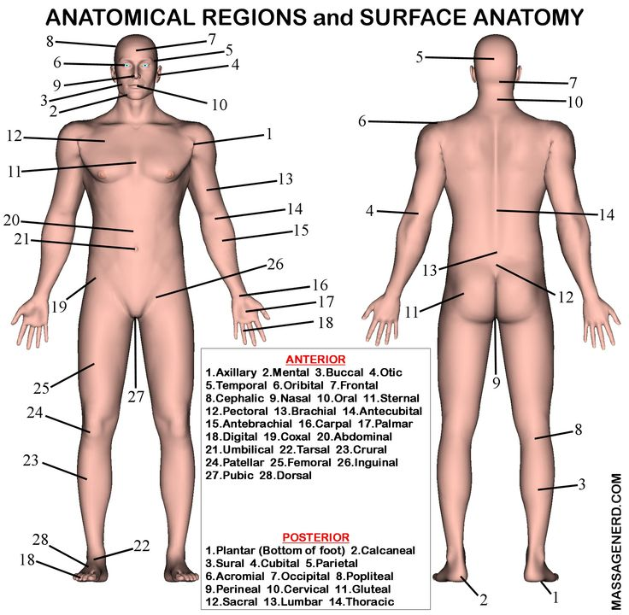
Surface anatomy
It is a branch of gross anatomy that examines shapes and markings on the surface of the body as they are related to deeper structures.
It is essential in locating and identifying anatomic structures prior to studying the internal gross anatomy.
It helps to locate the affected organ / structure / region in disease process.

Slide 4
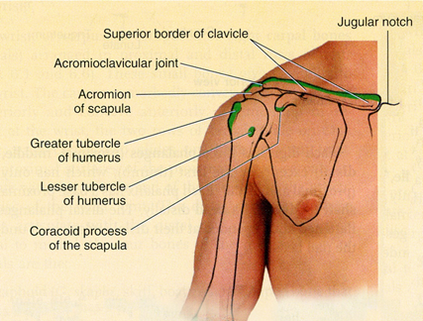
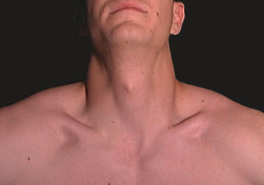
Upper limbs
•The clavicle is subcutaneous and can be palpated throughout its length.
•Its sternal end projects little above the manubrium.
•Between the 2 sternal ends of the 2 clavicle lies the jugular notch (suprasternal notch).
•The acromial end of the clavicle can be palpated medial to the lateral border of the acromion, of the scapula. particularly when the shoulder is alternately raised and depressed.
•The large vessels and nerves to the upper limb pass posterior to the convexity of the clavicle. Through the axillary canal.
(Important)
The clavicle is the only long bones that lies horizontally.
The axillary canal is walled by the clavicle anteriorly, outer border of the 1st rib medially and upper border of the scapula posteriorly.

Slide 5
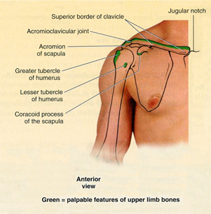
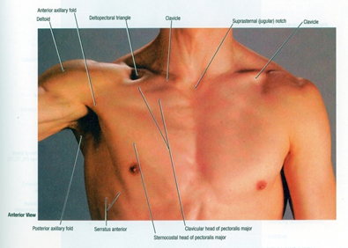
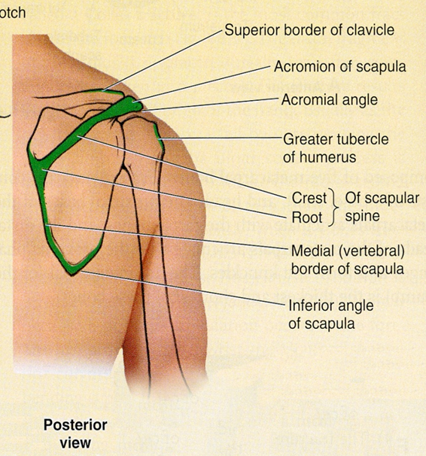
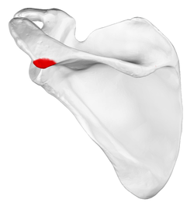
•The coracoid process of scapula can be felt deeply below the lateral one third of the clavicle in the Deltopectoral GROOVE or clavipectoral triangle.
•The clavipectoral or the (Deltopectoral) triangle is the slightly depressed area just inferior to the lateral third of clavicle.
•The clavipectoral triangle is bounded by:
–Clavicle superiorly,
–Deltoid laterally, and
–Pectoralis major medially.
The lateral and posterior borders of the acromion meet to form the acromial angle.
Inferior to the acromion, the deltoid muscle forms the rounded contour of the shoulder.
• Scapula:
Superior angle is parallel to the 2nd rib.
Spine is parallel to the 3rd rib.
Inferior angle is parallel to the 7th rib
(these are the medial borders for the scapula.)
REMEMBER: Abduction of the humerus is composed of 3 stages
0-15 > Supraspinatus
15-90 > Middle fiber of deltoid
90-180 > Trapezius and Latissimus Dorsi
Which muscles originate from the coracoid process?
Coracobrachialis and short head of biceps.

Slide 6
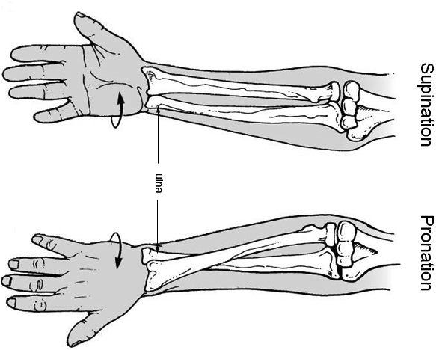
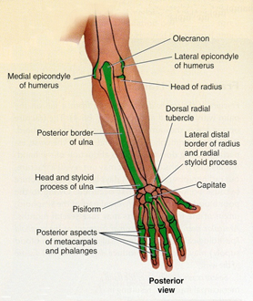
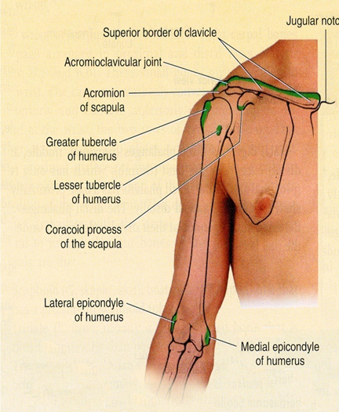
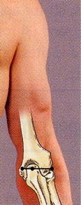
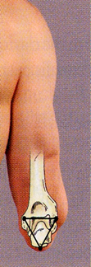
•The greater tubercle of humerus can be felt by deep palpation through the deltoid muscle, inferior to the acromion when the arm is by the side.
•In this position, the greater tubercle is the most lateral bony point of the shoulder.
•The head of ulna forms a rounded subcutaneous prominence that can be easily seen and palpated on the medial side of dorsal aspect of the wrist.
•The pointed subcutaneous ulnar styloid process may be felt slightly distal to the head when the hand is supinated.
•The olecranon and posterior border of the ulna lie subcutaneously and can be palpated easily. Behind the elbow.
•The shaft of the humerus may be felt in different areas deep to muscles surrounding it.
•The medial and lateral epicondyles of the humerus are palpated on the medial & lateral sides of the elbow.
•When the elbow joint is extended, the tip of the olecranon process, the medial and the lateral epicondyles lie in a straight line.
•When the elbow is flexed, the olecranon forms the apex of an equilateral triangle, where the epicondyles form the angles.
•Fractures of any of these structures will disturbs this arrangement.
Three muscles are attached to the greater tubercle of the humerus (SIT):
Supraspinatus
Infraspinatus
Teres minor
The subscapularis inserts into the lesser tubercle of humerus.
The medial epicondyle is more prominent than the lateral epicondyle.
Anconeus origin is the back of the lateral epicondyle.
The front of the lateral epicondyle is the common origin for the extensors.
REMEMBER: the medial epicondyle is related to the common origin for the flexors + it is related to the ulnar nerve (funny nerve).

Slide 7
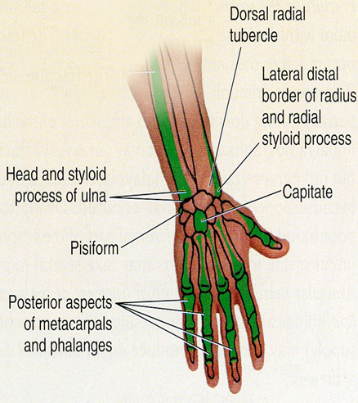
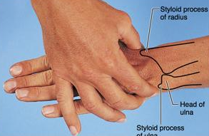
•The metacarpals, although they overlapped by the long extensor tendons of the fingers, they can be palpated on the dorsum of the hand.
•The heads of the metacarpals form the knuckles of the hand.
•Notice that the 3rd metacarpal head is the most prominent.
•The dorsal aspects of the phalanges can be easily palpated.
•The knuckles of the fingers are formed by the heads of the proximal and middle phalanges.
•The head of radius can be palpated and felt to rotate in the depression on the posterolateral aspect of the extended elbow, just distal to the lateral epicondyle of the humerus with supination and pronation.
•The radial styloid process can be palpated on the lateral side of the wrist in the anatomical snuff box.
•It is approximately 1 cm distal to that of the ulna.
You have to know the proximal and distal carpal bones medially to laterally.

Slide 8
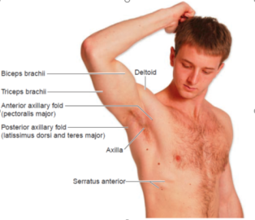
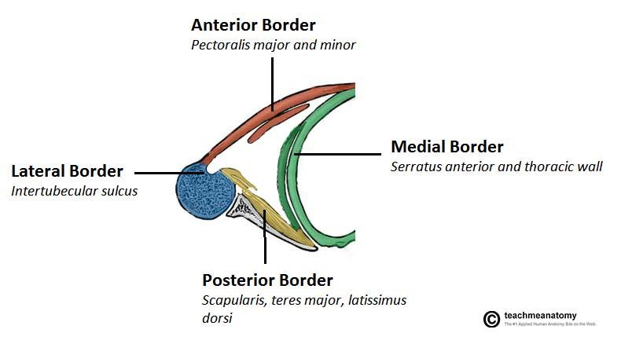
Axillary Folds
Axilla
The anterior axillary fold is formed by the lower margin of the pectoralis major, and can be palpated by the finger.
This can be made by asking the patient to press his or her hand against the ipsilateral hip.
The posterior axillary fold is formed by the tendons of latissimus dorsi and teres major muscles.
The axilla should be examined with the forearm supported and the pectoral muscles relaxed. The patient will relax their hand and you will carry and hold the arm and examine the axilla.
When the arm is by the side, the inferior part of the head of the humerus can be easily palpated through the floor of the axilla.
The pulsations of the axillary artery can be felt high up in the axilla, and around the artery are the cords of the brachial plexus.
The medial wall of the axilla is formed by the upper ribs covered by the serratus anterior.
The lateral wall is formed by the coracobrachialis and biceps brachii and the bicipital groove.

Slide 9
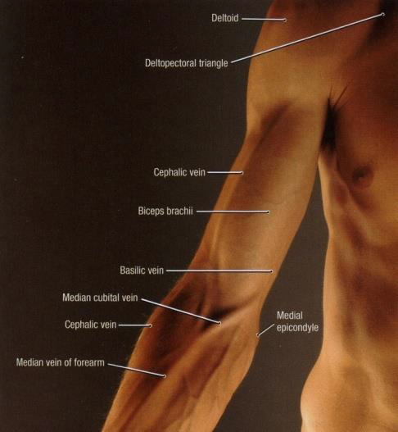
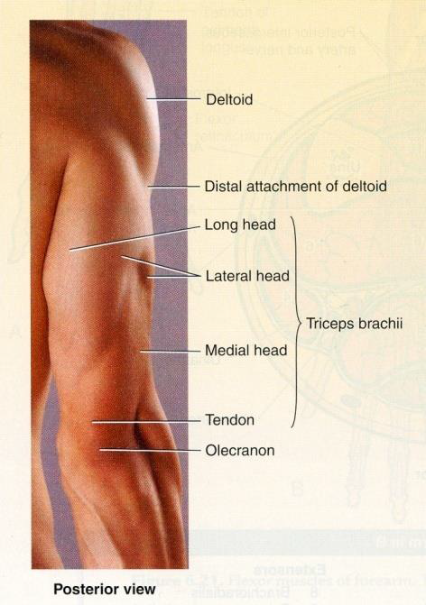
The borders of the deltoid are visible when the arm is abducted against resistance.
The distal attachment of the deltoid can be palpated on the lateral surface of the humerus (deltoid tuberosity of the humerus).
Biceps brachii and triceps brachii form bulge on the anterior and posterior surfaces of the arm.
The biceps tendon can be palpated in the cubital fossa, immediately lateral to the midline.
The triceps tendon can be palpated where it is attached to the olecranon process. Behind the elbow
There are 2 grooves: Medial and lateral grooves separate the bulges formed by the biceps and triceps.
The cephalic vein ascends superiorly in the lateral groove and
The basilic vein ascends in the medial groove.
To stop a bleed in the arm we press on the arm laterally to push the brachial artery against the humerus.

Slide 10
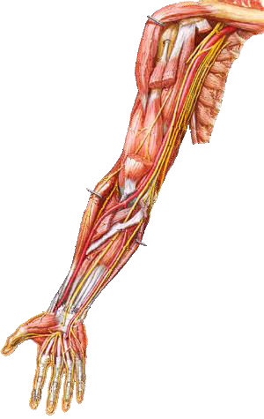
Brachial artery
From team 436
A
The brachial artery can be felt pulsating deep to the medial border of the biceps.
To stop bleeding by pressure on the artery in the upper half of the arm it is pushed laterally against the humerus (A).
In the lower half it is pushed posteriorly (B).
In the cubital fossa, it lies beneath the bicipital aponeurosis (C).
At the level of the neck of the radius, it divides into radial and ulnar arteries (D).
B
C
D

Slide 11
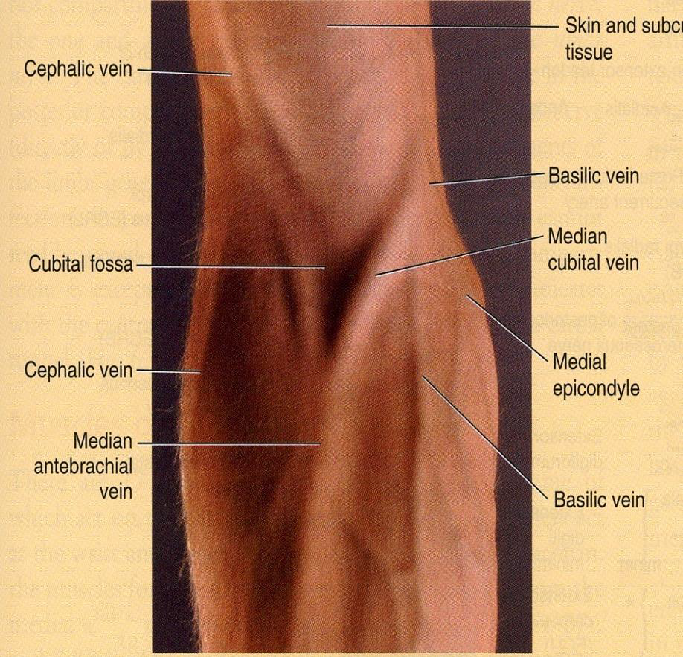
Cubital fossa
In the cubital fossa, try to locate:
1- Cephalic vein
2- Basilic vein
3- Median cubital vein are clearly visible.
The median cubital vein connects the cephalic and the basilic veins .
It crosses over the bicipital aponeurosis.
It is the vein of choice for IV line.
Why ?
The vein is separated from the artery and nerve due to the bicipital aponeurosis
It is very superficial and its position is fixed

Slide 12
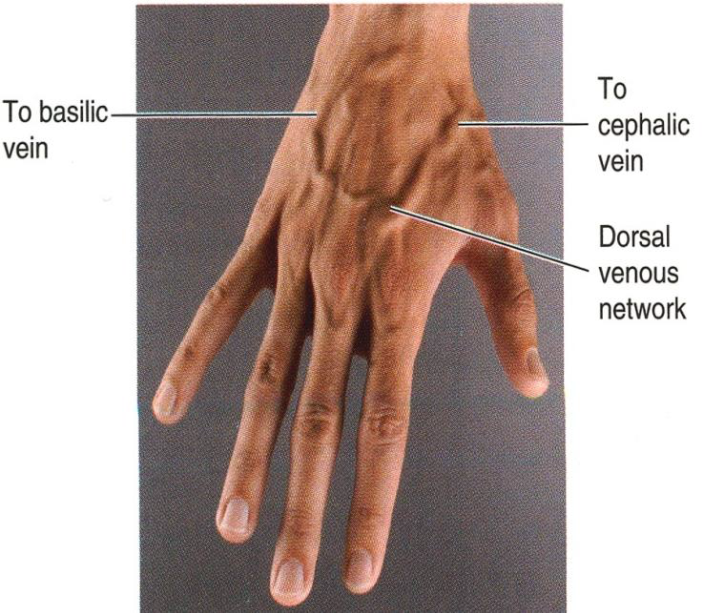
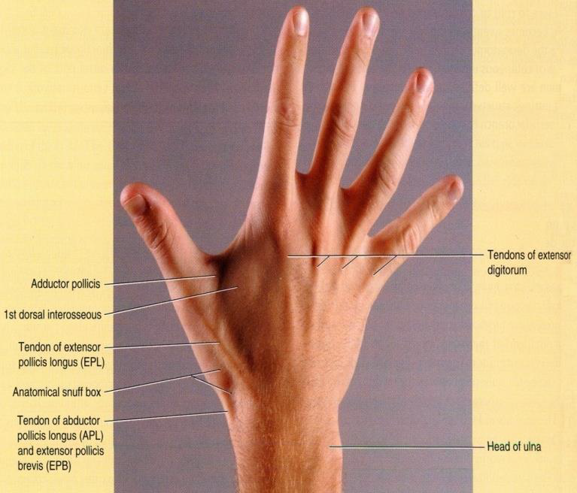
DORSUM OF THE HAND
The dorsal venous network:
The network of superficial veins can be seen on the dorsum of the hand. The network drains upward into the cephalic vein laterally, and the basilic vein medially.
The tendons of extensor digitorum, extensor indicis, and extensor digiti minimi can be seen and felt as you extends your fingers.
Each dorsum of the hand has one tendon except the index and little finger.

Slide 13
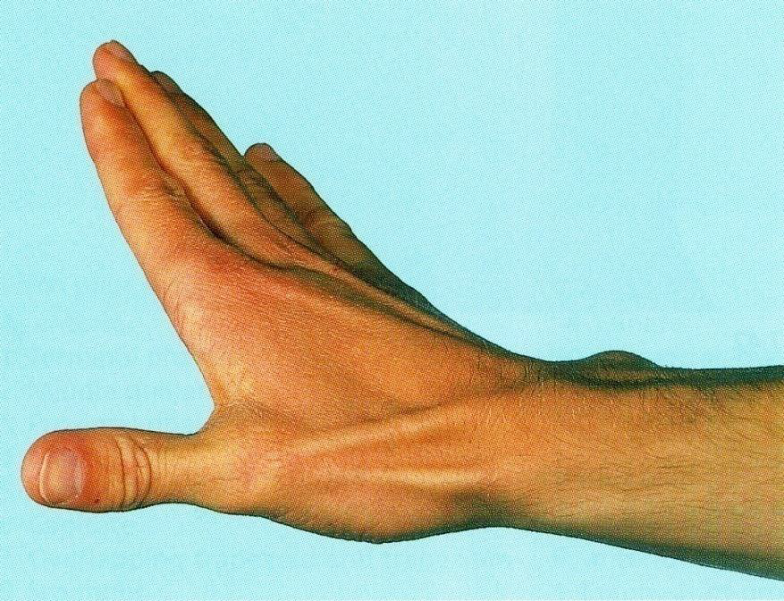
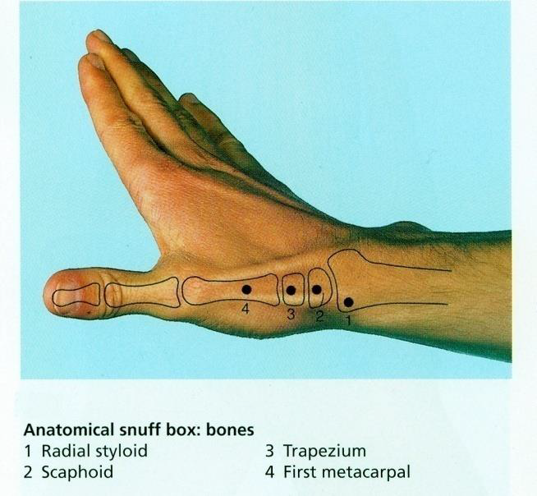
ANATOMICAL SNUFF BOX
It is a depression on the lateral aspect of the wrist joint which is accentuated when you extends your thumb.
Boundaries
•The snuff box is bounded :
•Laterally by 2 tendons:
Abductor pollicis longus
Extensor pollicis brevis
•Medially by extensor pollicis longus
V E.R Y I M P O R T A N T
•In its proximal part the radial styloid process is palpable
•The scaphoid bone is also palpable in the distal part of the anatomical snuff box.

Slide 14
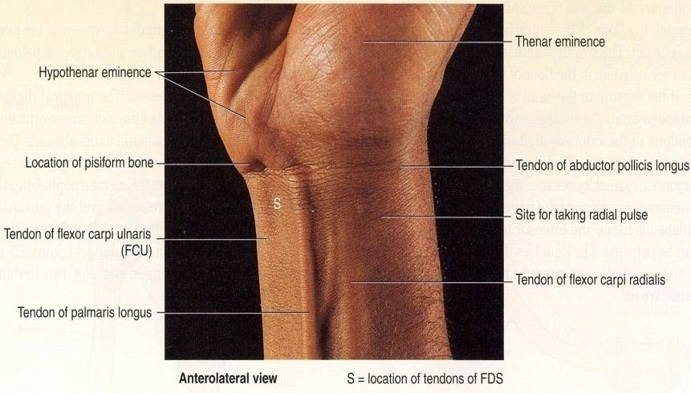
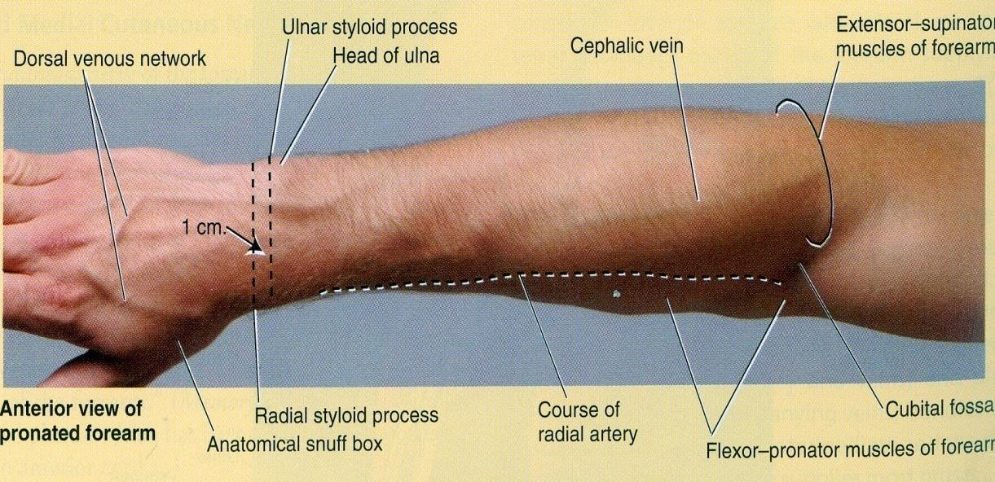
Radial artery
The Radial artery can be drawn by a line extends from the midpoint of the cubital fossa to the base of the styloid process of radius.
Radial Artery pulsation:
Universally, its pulsations can easily be felt anterior to the distal third of radius.
Here it lies just beneath the skin and fascia lateral to the tendon of flexor carpi radialis muscle.

Slide 15
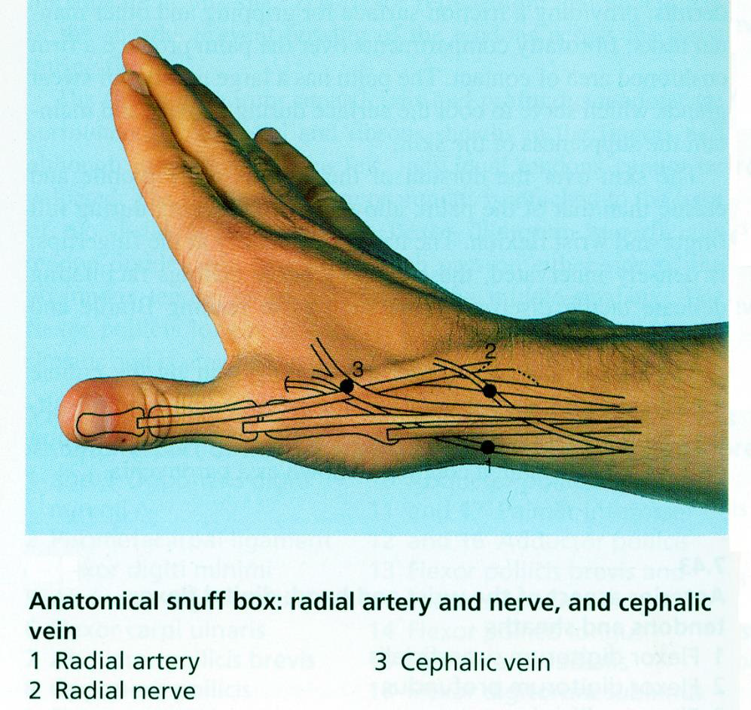
•Also, the radial artery pulsation can be felt against the floor of the snuff box*.
•More superficially, the anatomical snuff box is crossed by:
1- The cephalic vein.
2- The radial nerve.
*The reason that it is called the anatomical snuffbox is that snuff (powdered tobacco) could be put there and then inhaled.

Slide 16
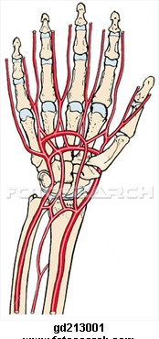
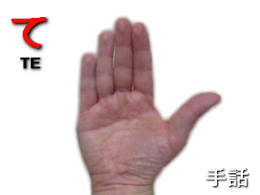
Arches of the hand
Superficial Palmar Arterial Arch:
The superficial palmar arterial arch is located in the central part of the palm and lies on a line drawn across the palm at the level of the distal border of the fully extended thumb.
Deep Palmar Arterial Arch:
The deep palmar arterial arch is also located in the central part of the palm (proximal to the superficial one), lies on a line drawn across the palm at the level of the proximal border of the fully extended thumb.
Distal border
REMEMBER:
structures that pass superficial to the flexor retinaculum:
{from medial to lateral}
Ulnar nerve>>Ulnar Artery>>Palmar cutaneous branch of ulnar nerve>>tendon of palmaris longus>>palmar cutaneous branch of medial nerve.
Proximal border

Slide 17
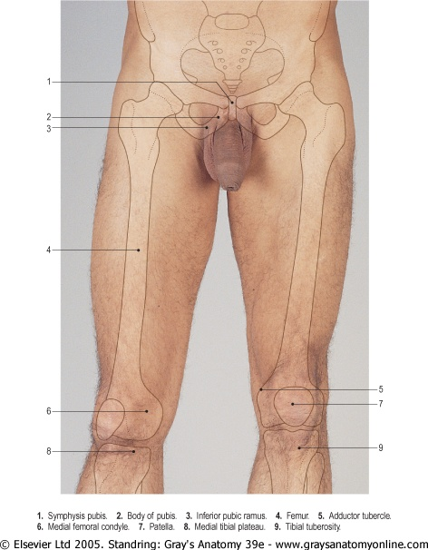
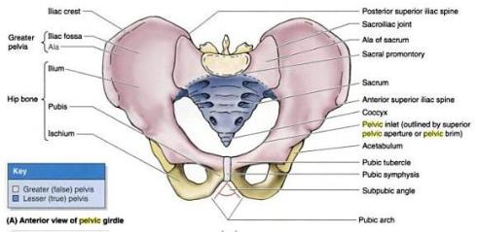
Lower Limb
All of the following structures are palpable in the inguinal region:
1-Symphysis pubis
2-Body of pubis
3-Pubic tubercle
4-ASIS (Anterior superior iliac spine)
*The pubic tubercle is a landmark for 2 types of hernias Team {436}.

Slide 18
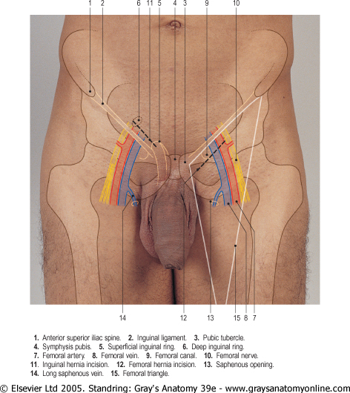
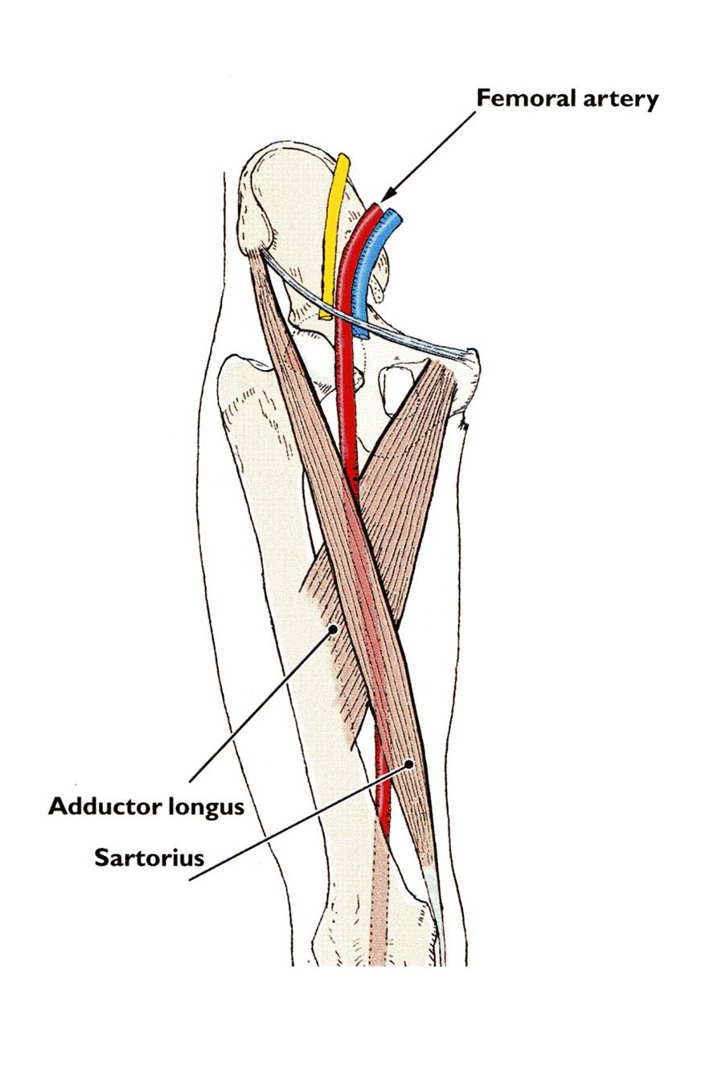
Lower Limb
The inguinal ligament extends between:
The pubic tubercle and The ASIS.
{Anterior Superior Iliac Spine}
In the mid-inguinal point you can feel the pulsations of the femoral artery.
The femoral vein lies on the medial side of the artery.
The femoral nerve lies lateral to the artery.
VAN
Pulsation of femoral artery
Midinguinal point:
It is a point on the inguinal ligament midway between the symphysis pubis and the ASIS.
The femoral artery is an important site for vascular access as a large number of arteriographic procedures are undertaken through its percutaneous puncture, (coronary angiography).

Slide 19
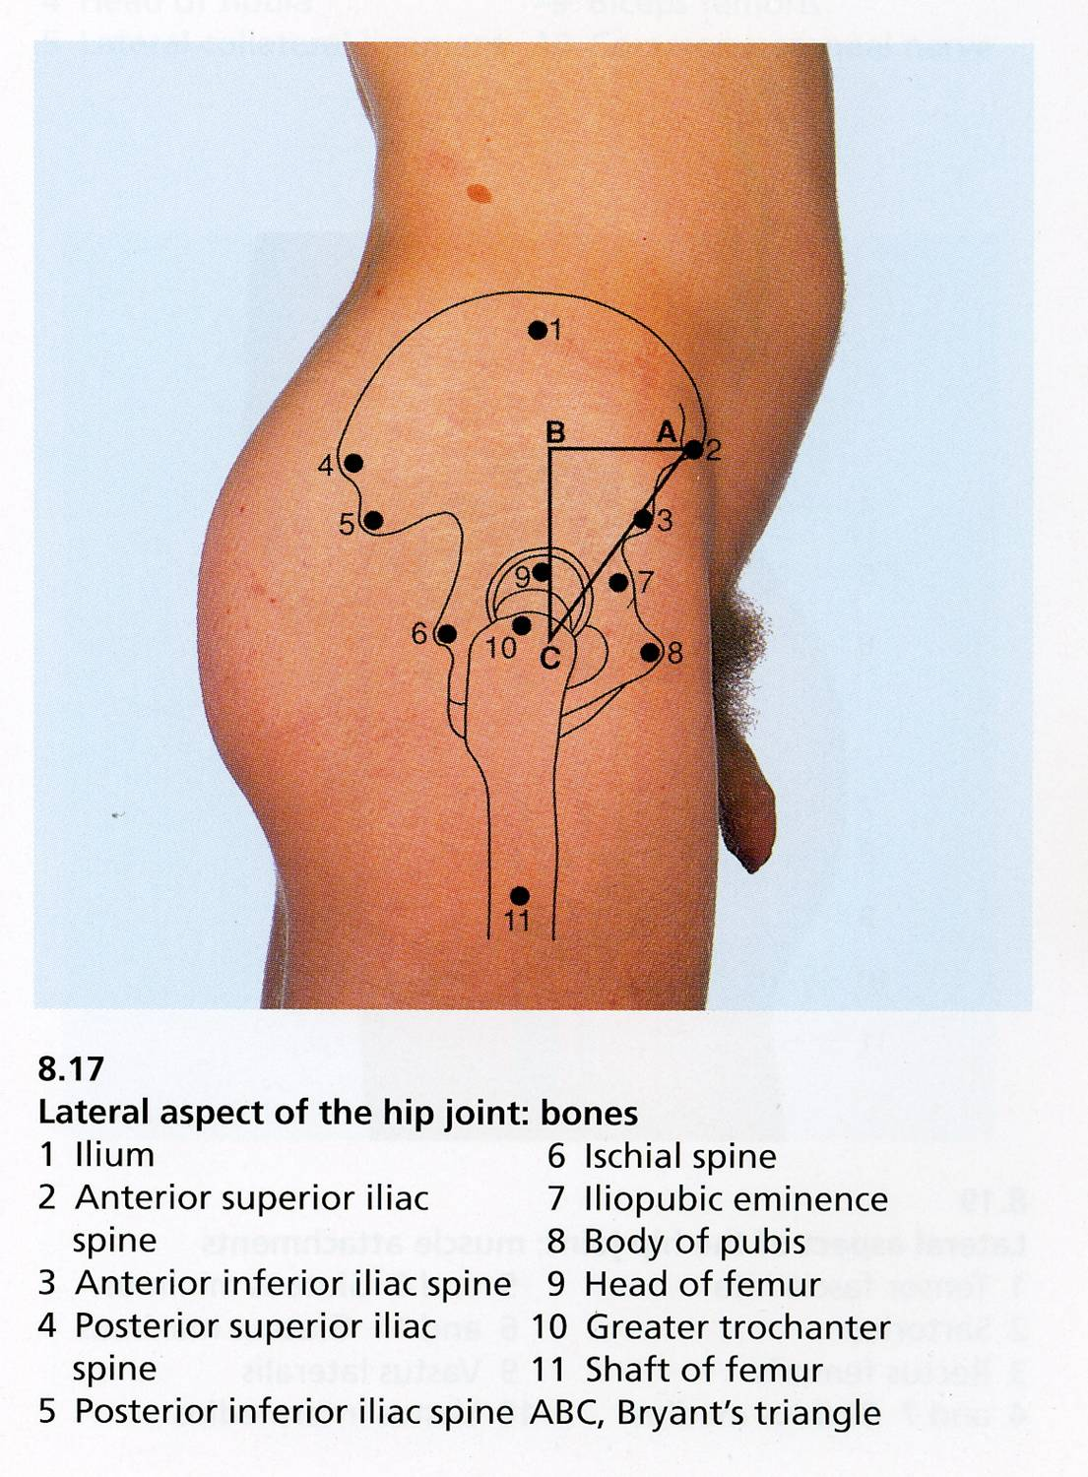
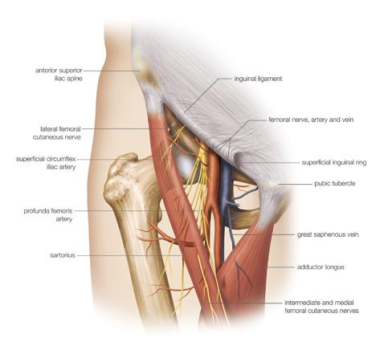
Lower Limb.cont
Femoral Triangle:
The femoral triangle can be seen as a depression below the fold of the groin in the upper part of the thigh.
In a thin, muscular subject, the boundaries of the triangle can be identified when the thigh is flexed, abducted, and laterally rotated.
The base of the triangle is formed by the inguinal ligament, the lateral border by the sartorius and the medial border by the adductor longus.
Contents of femoral triangle:
Femoral vein
Femoral artery Both vein & artery are enclosed in a fascial envelope (Femoral sheath)
Femoral nerve (outside femoral sheath) Deep inguinal lymph nodes
The iliac crest is subcutaneous and can be palpated throughout its length, from the ASIS to the PSIS.
{Posterior Superior Iliac Spine}
The greater trochanter of the femur is also subcutaneous and can be palpated on the lateral aspect of the hip joint behind and distal to the ASIS.

Slide 20
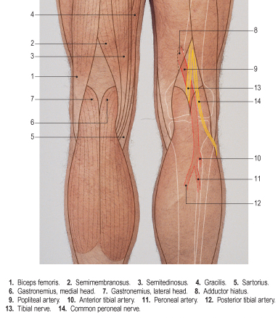
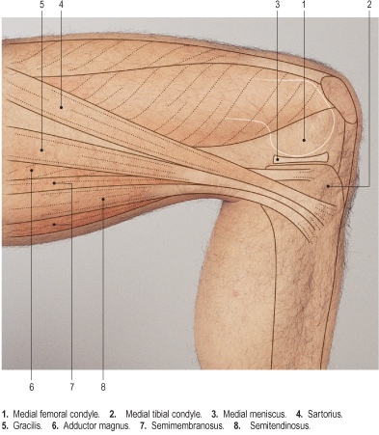
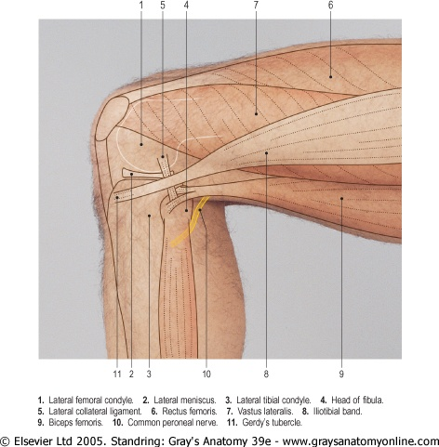
Lower limb (knee region)
In front of the knee joint the patella and the ligamentum patellae can be easily palpated. The ligamentum patellae can be traced downward as it is attached to the tibial tuberosity. The condyles of the femur and tibia can be recognized on the sides of the knee and the joint line can be identified between them.
In the back of the knee and leg try to palpate:
The boundaries of the popliteal fossa.
The pulsation of the popliteal artery which is deeply situated in the fossa.
On the lateral aspect of the knee Joint try to palpate:
Lateral femoral condyle
Lateral tibial condyle
Head of the fibula
Neck of the fibula
Tendon of biceps femoris
On the medial aspect of the knee joint try to palpate:
Medial femoral condyle
Medial tibial condyle
The 3 tendons of:
Sartorius
Gracilis
Semitendinosus

Slide 21
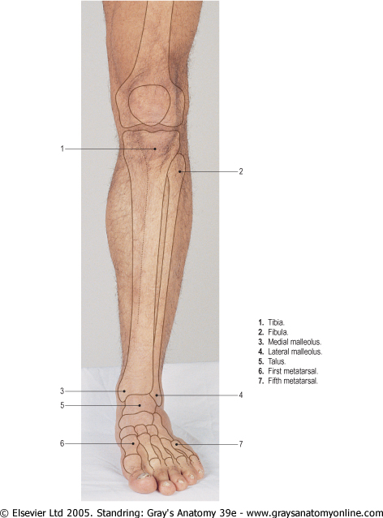
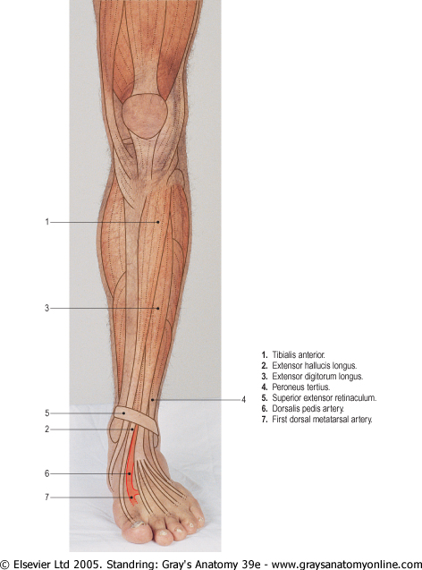
Lower limb (leg and foot)
On the anterior aspect of the leg and knee Joint and try to palpate:
The patella.
The tibial tuberosity.
The anterior border of the tibia (shin).
The medial tibial condyle.
The medial surface of the tibia.
The medial malleolus.
The lateral malleolus.
On the dorsum of the foot try to palpate:
The tuberosity of the 5th metatarsal
The tubercle of navicular.
The metatarsals.
On the dorsum of the foot try to palpate:
The long extensor tendons:
Tibialis anterior
Extensor hallucis longus.
Extensor digitorum longus.
Peroneus tertius.
Also, try to feel the pulsation of the dorsalis pedis artery. Between the tendons of extensor hallucis longus & extensor digitorum longus.

Slide 22
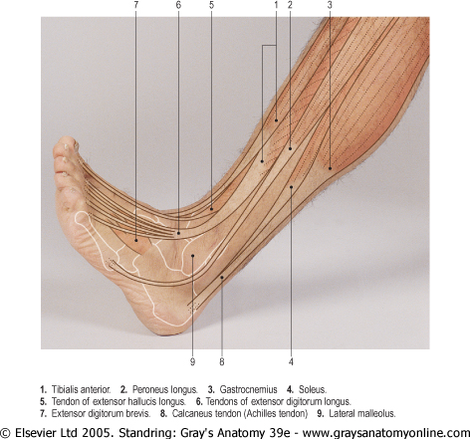
Lower limb (leg and foot)
On the lateral aspect of the leg try to palpate:
1. The tendons of peroneus longus and brevis.
2. The Achilles tendon.
3. The lateral malleolus.
On the medial aspect of the ankle try to palpate and feel:
The medial malleolus.
The tendons of tibialis posterior
The tendon of flexor digitorum longus.
The posterior tibial artery
The calcaneus.

Slide 23
MCQ:
Answers:
1- It ascends in the medial groove :
A) Cephalic vein B) Basilic vein C) Axillary vein
2- The tendon of the biceps can be palpated in?
A) The olecranon process B) Cubital fossa
C) Lateral side of the arm
3- Anterior axillary fold is formed by ?
A) Teres minor B) Teres major
C) Pectoralis major D) Pectoralis minor
4- Which of the following structures make up the knuckle of the hand? A) Head of proximal phalanges
B) Head of distal phalanges
C) Head of metacarpals
D) Base of metacarpals
5-
6-
1-b
2-b

Slide 24
SAQ:

Slide 25
Team Members
Lamia Abdullah Alkuwaiz (Team Leader)
Rawan Mohammad Alharbi
Abeer Alabduljabbar
Afnan Abdulaziz Almustafa
Ahad Algrain
Alanoud Almansour
Albandari Alshaye
AlFhadah abdullah alsaleem
Arwa Alzahrani
Dana Abdulaziz Alrasheed
Dimah Khalid Alaraifi
Ghada Alhaidari
Ghada Almuhanna
Ghaida Alsanad
Hadeel Khalid Awartani
Haifa Alessa
Khulood Alwehabi
Layan Hassan Alwatban
Lojain Azizalrahman
Lujain Tariq AlZaid
Faisal Fahad Alsaif (Team Leader)
Abdulaziz Al dukhayel
‏Fahad Alfaiz
‏Akram Alfandi
‏Saad Aloqile
‏Saleh Almoaiqel
‏Abdulaziz Alabdulkareem
‏Abdullah Almeaither
‏Yazeed Aldossari
‏Muath Alhumood
Abdulrahman Almotairi
‏
Abdulelah Aldossari
‏Abdulrahman Alduhayyim
‏Hamdan Aldossari
‏Abdullah Alqarni
‏Mohammed Alomar
‏Abdulrahman Aldawood
‏Saud Alghufaily
‏Hassan Aloraini
Khalid Almutairi
‏‏
Maha Barakah
Majd Khalid AlBarrak
Norah Alharbi
Nouf Alotaibi
Noura Mohammed Alothaim
Rahaf Turki Alshammari
Reham Alhalabi
Rinad Musaed Alghoraiby
Sara Alsultan
Shahad Alzahrani
Wafa Alotaibi
Wejdan Fahad Albadrani
Wjdan AlShamry
Abdulmajeed Alwardi
‏Abdulrahman Alageel
‏Rayyan Almousa
‏Sultan Alfuhaid
‏Ali Alammari
‏Fahad Alshughaithry
Fayez Ghiyath Aldarsouni
‏Mohammed Alquwayfili
‏‏Abduljabbar Al-yamani
‏Sultan Al-nasser
‏Majed Aljohani
‏Zeyad Al-khenaizan
‏Mohammed Nouri
‏Abdulaziz Al-drgam
‏Fahad Aldhowaihy
‏Omar alyabis

