Slide 1
Cervical Spines
Lecture 4
Please check our Editing File.
{وَمَنْ يَتَوَكَّلْ عَلَى اللَّهِ فَهُوَ حَسْبُهُ}
هذا العمل لا يغني عن المصدر الأساسي للمذاكرة

Slide 2
Objectives
Describe the 7 cervical vertebrae, (typical & atypical (Non-typical)).
Describe the joints between the cervical vertebrae.
Describe the movement which occur in the region of the cervical vertebrae.
List the structures which connect 2 adjacent vertebrae together.

Slide 3
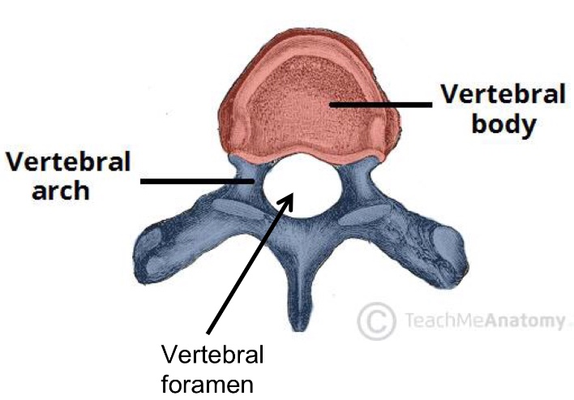
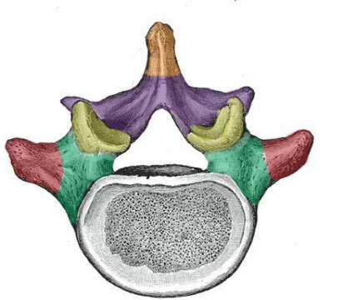
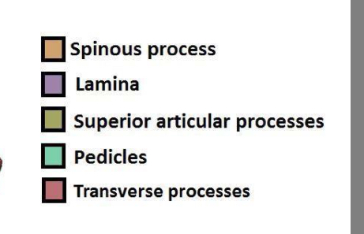
Introduction to vertebrae
Team 436:
Extra slide for understanding
There are approximately 33 vertebrae which are subdivided into 5 groups based on morphology and location: cervical, thoracic, lumbar, sacral, and coccygeal. Typical Vertebra All typical vertebrae consist of a vertebral body and a posterior vertebral arch.
Vertebral body: • weight-bearing part. The size increases as the amount of weight supported increases. Vertebral arch: • Extending from the arch are a number of processes for muscle attachment and articulation with adjacent bones.
• It consists of: 1. Two pedicles (towards the body) 2. Two lamina (towards the spine) 3. Spinous process 4. Transverse process 5. Superior and inferior articular processes. (for articulation with adjacent vertebra) The vertebral foramen is the hole in the middle of the vertebra. Collectively they form the vertebral canal through which the spinal cord passes

Slide 4
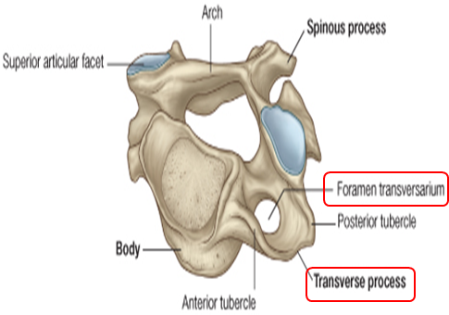
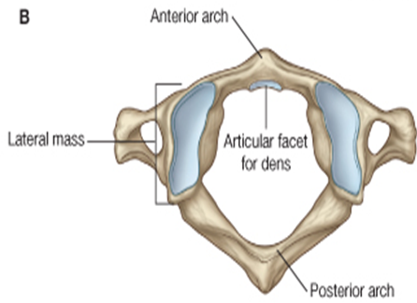
Cervical Spines
They are 7 in number.
All characterized by presence of foramen transversarium in the transverse process.
They are classified into: 1- Typical: 3rd , 4th ,5th & 6th. (Look exactly the same) 2- Atypical: 1st, 2nd and 7th.

Slide 5
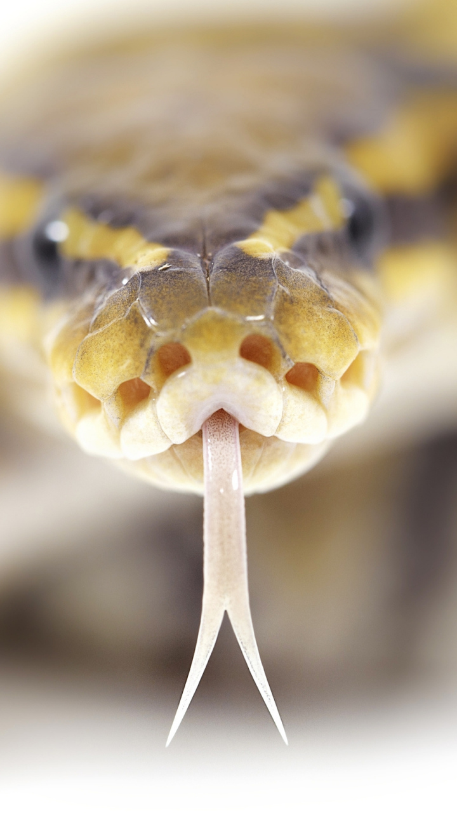
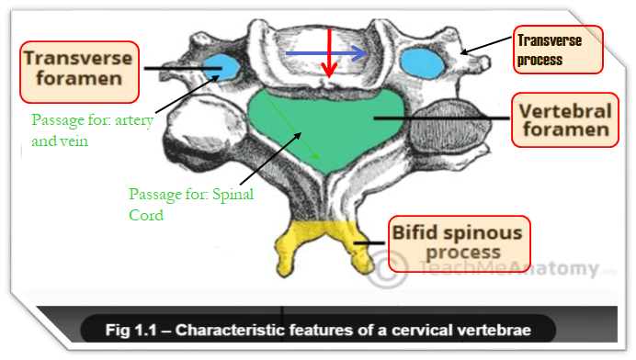
TYPICAL CERVICAL VERTEBRAE {C3,C4,C5,C6}
The body is small, longer horizontally than antero-posteriorly
Its spinous processes is short and bifid. (مشقوقة، مثل لسان الثعبان)
The transverse processes has an oval foramen transversarium, through which the vertebral vessels pass.
#Extra:
foramen transversarium is only present in cervical vertebrae.
typical cervical vertebrae has 2 types of foramen:
vertebral foramen: for cervical enlargement of spinal cord.
transverse foramen (foramen transversarium): for vertebral vessels.
there are 2 enlargements in the spinal cord:
cervical enlargement: give the brachial plexus “for UL”
Lumbosacral enlargement: give the lumbosacral plexus “for LL”
The vertebral foramen is large & triangular to accommodate the cervical enlargement of the spinal cord.

Slide 6
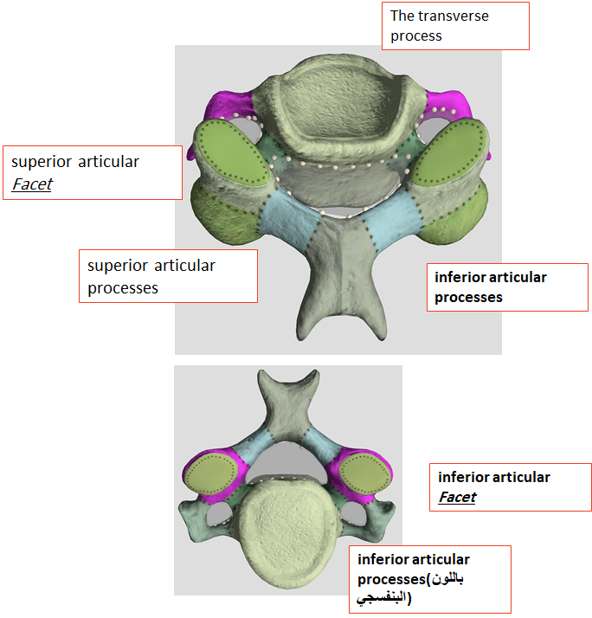
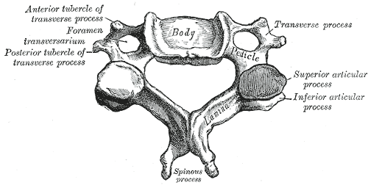
TYPICAL CERVICAL VERTEBRAE {C3,C4,C5,C6}
The superior articular processes: Have a facet that face upward & backward.
The inferior articular processes: Have a facets that, face downward and forward.
The transverse process:
Has 2 tubercles one in front and one behind the foramen transversarium.
*Facet: مثل البصمة على الصلصال

Slide 7
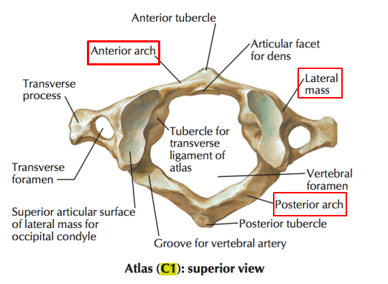
Atypical (Non typical ) cervical vertebrae
Atlas-C1
It has no body, no spine.
It has 2 lateral masses (which is found only in the atlas) connected together by small anterior arch & long posterior arch.
Each lateral mass has articular surface on its upper and lower aspects.
The upper articular surface is kidney shaped
The lower articular surface is circular shaped

Slide 8
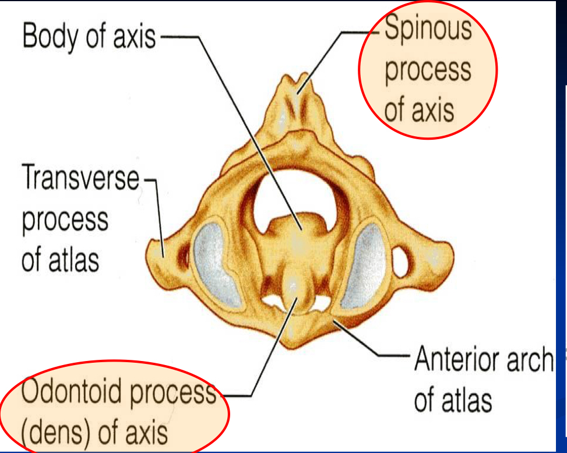
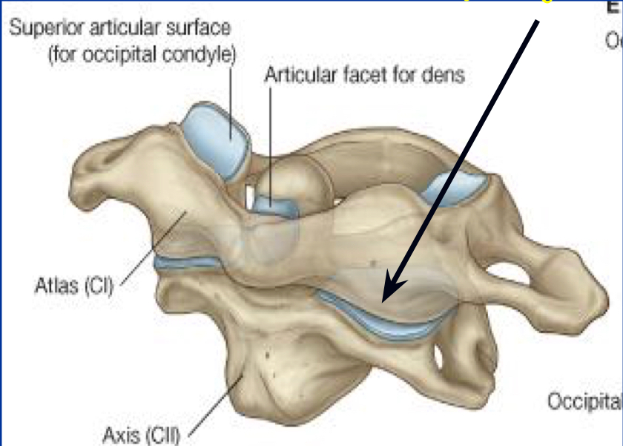
Atypical (Non typical ) cervical vertebrae
AXIS- C2
It acts as a pivot (محور) for the rotation of the atlas (and the skull) above.
It has a large upright peg-like odontoid process, or dens, which projects upward from the superior surface of the body which represents the body of the atlas that has fused with the axis.
Lateral Atlanto
-axial joints
صورة لتوضيح
Atlanto-axial joints

Slide 9
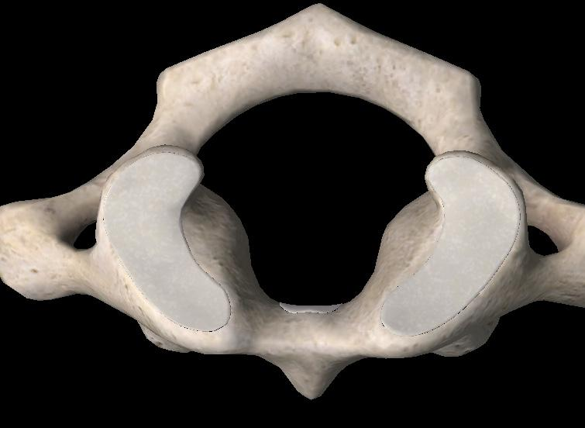
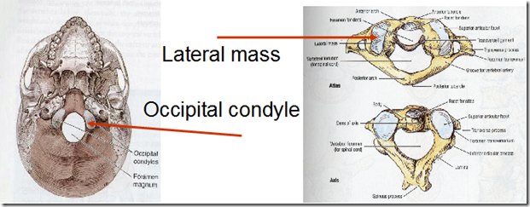
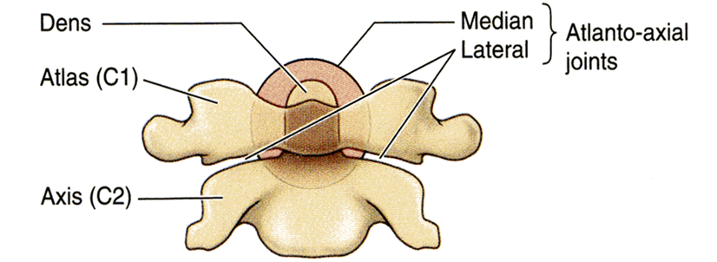
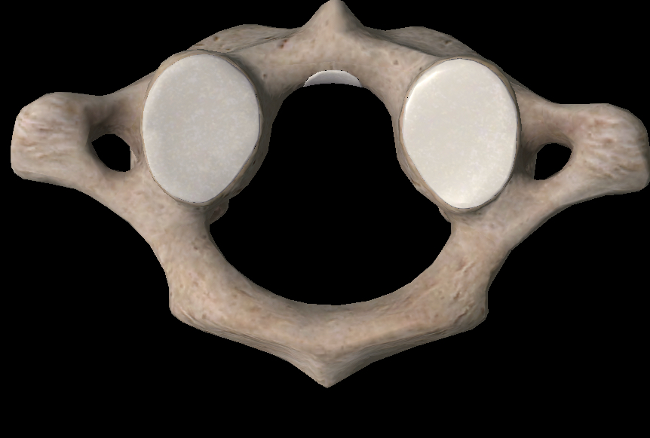
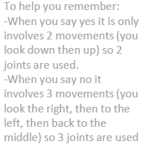
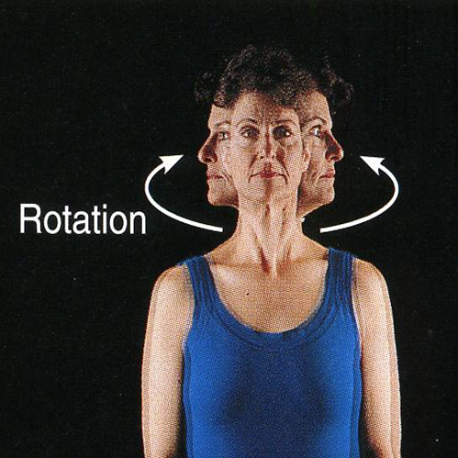
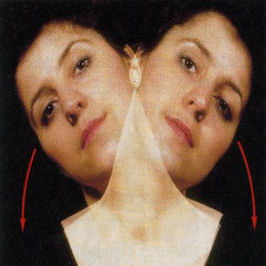
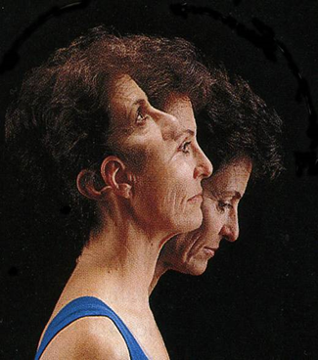
Joints of the Cervical Vertebrae: Altas-C1 Joints
 | Atlanto-Occipital joints (two) | Atlanto-Axial joints (three)
Characteristics: | The upper articular surface is kidney-shaped articulates with occipital condyles of the skull to form the joint. Synovial joints | Three Synovial Joints One Medial: between the odontoid process and the anterior small arch of atlas. Two Lateral: between the inferior facet “circular” of the lateral masses of the atlas and superior facets of the axis.
Movement: | Flexion Extention Lateral Flexion They do not rotate | Extensive rotation of the atlas and the skull. It allows you to “say no” (Lateral Rotation of the head)
Superior articular surface
Inferior articular surface
They allow you to nod your head “say Yes”
(Flexion of the Head)
Team 436

Slide 10
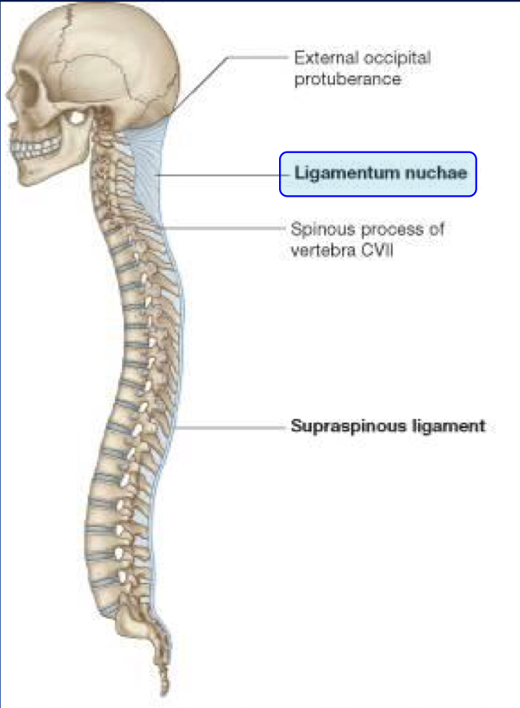
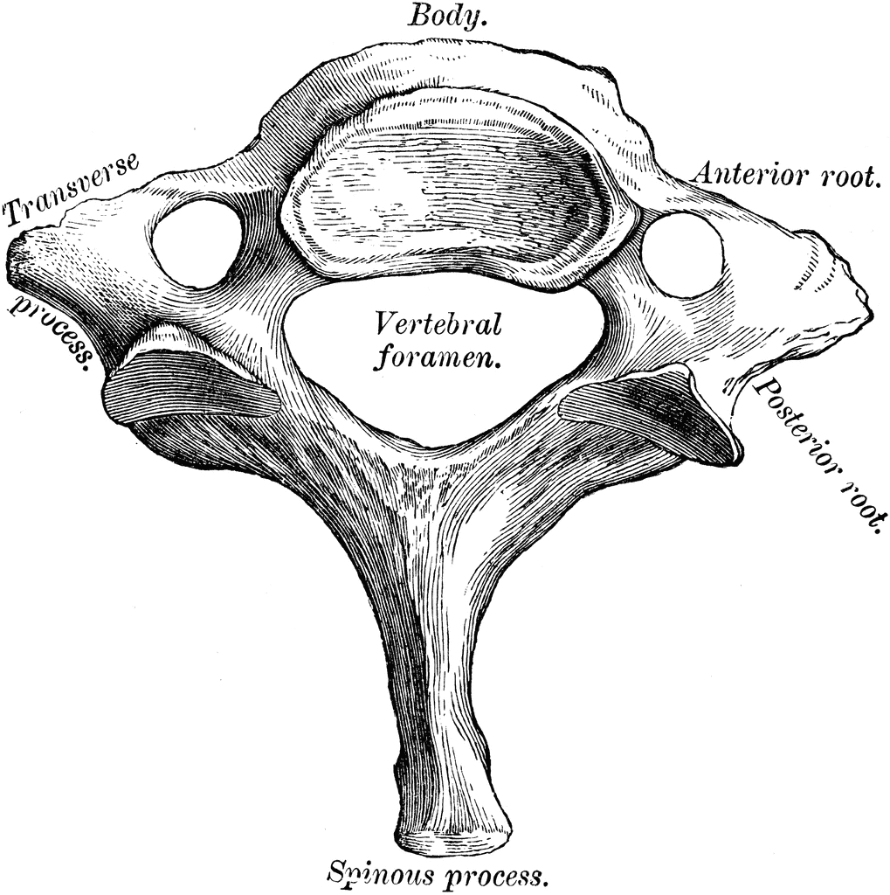
Atypical (Non typical ) cervical vertebrae
7th Cervical Vertebrae
OR Cervica/vertebra Prominens
It has the longest spinous process which is not bifid ( not separated by a ridge).
It is the first spine to be felt subcutaneously in the root of the back of the neck.
The transverse process is large while its foramen transversarium is small and may be absent, and does not transmit the vertebral artery. (only small accessory vein)

Slide 11
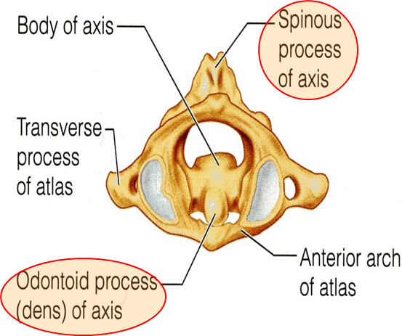
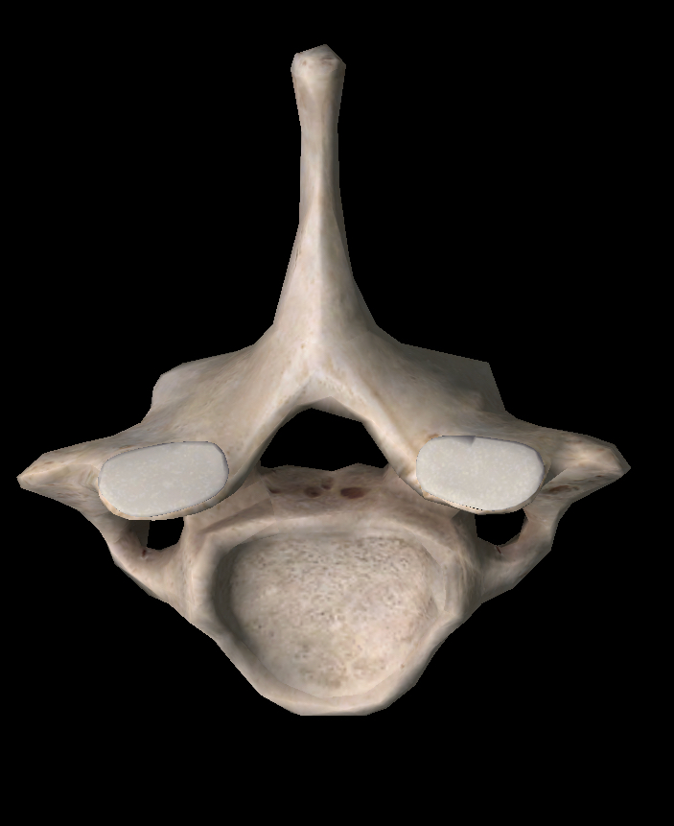
Atypical (Non typical ) cervical vertebrae
Vertebra name | Altas-C1 | AXIS- C2 | C7 (Cervica/vertebra Prominens)
Main characteristic | It has no body, no spine. It has 2 lateral masses -small anterior arch -long posterior arch. | It has a large upright peg-like odontoid process, or dens | has longest not bifid spinous process, which can be felt subcutaneously
Picture

Slide 12
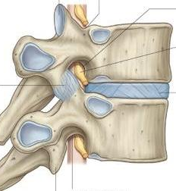
Joints Between Two Vertebral Bodies
with exception of the first two cervical vertebrae , the other cervical vertebrae (the vertebral column below the Axis “C2” ) articulate with each other by means of :
1- synovial : joints between their articular processes
2- cartilaginous : joints between their bodies
synovial joint
cartilaginous joint
تذكر كلمة الsynovial من :
syn = sin (: مثل اللي في الرياضيات
ovial = ovum

Slide 13
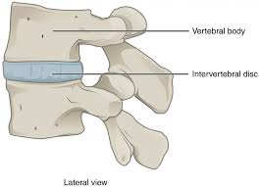
Intervertebral Disc
The upper and lower surfaces of the bodies of two adjacent vertebrae are covered by thin plates of hyaline cartilage.
between the plates of hyaline cartilage is an intervertebral disc of fibrocartilage.
the collagen fibers of the disc strongly connect the bodies of the two vertebrae.
يعني مثل الساندويتش.. ال intervertebral disc محصور بين طبقتين من الhyaline cartilage

Slide 14
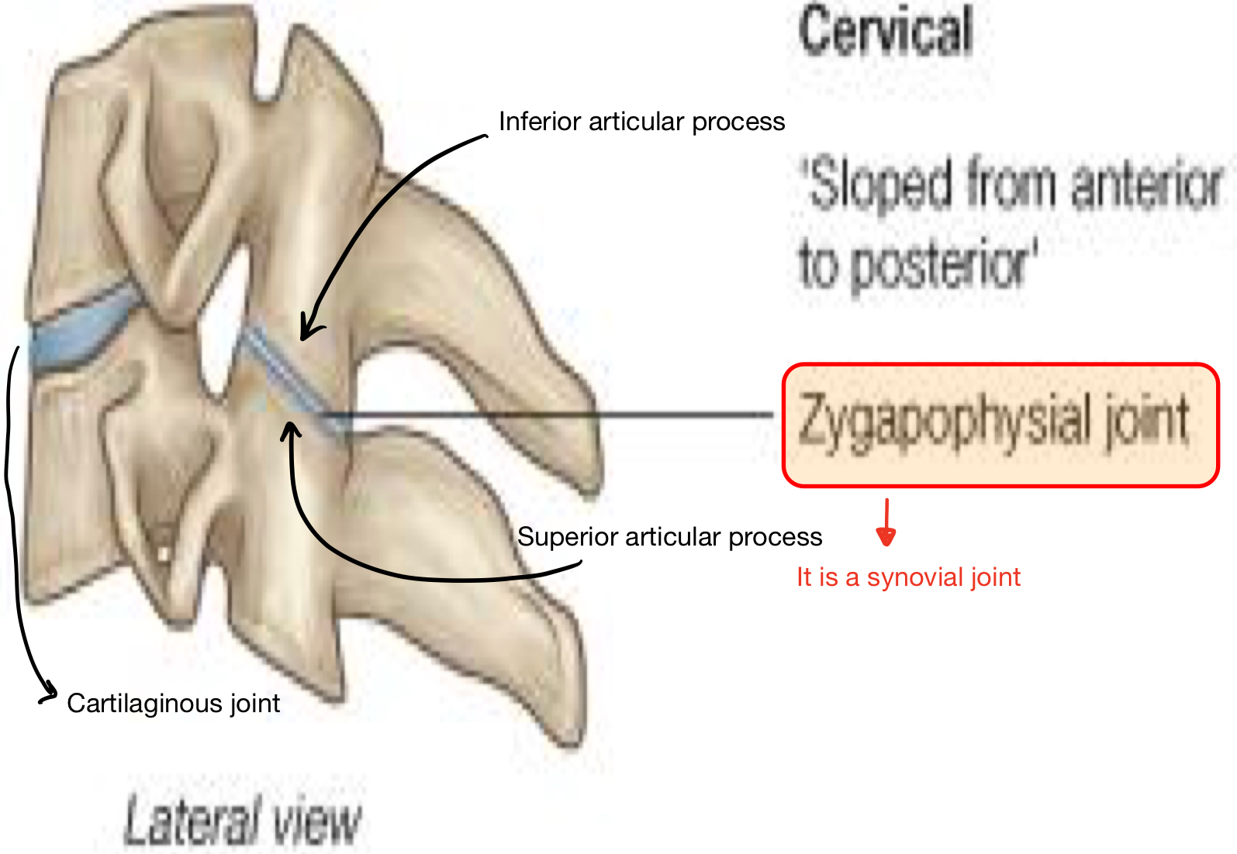
Joints between two vertebral Arches
Zygapophysial joint:
-The joints between two vertebral arches consist of synovial joints between the superior and inferior articular processes of adjacent vertebrae to connect the Arches together. -The articular facets are covered with hyaline cartilage, and the joints are surrounded by a capsule.

Slide 15
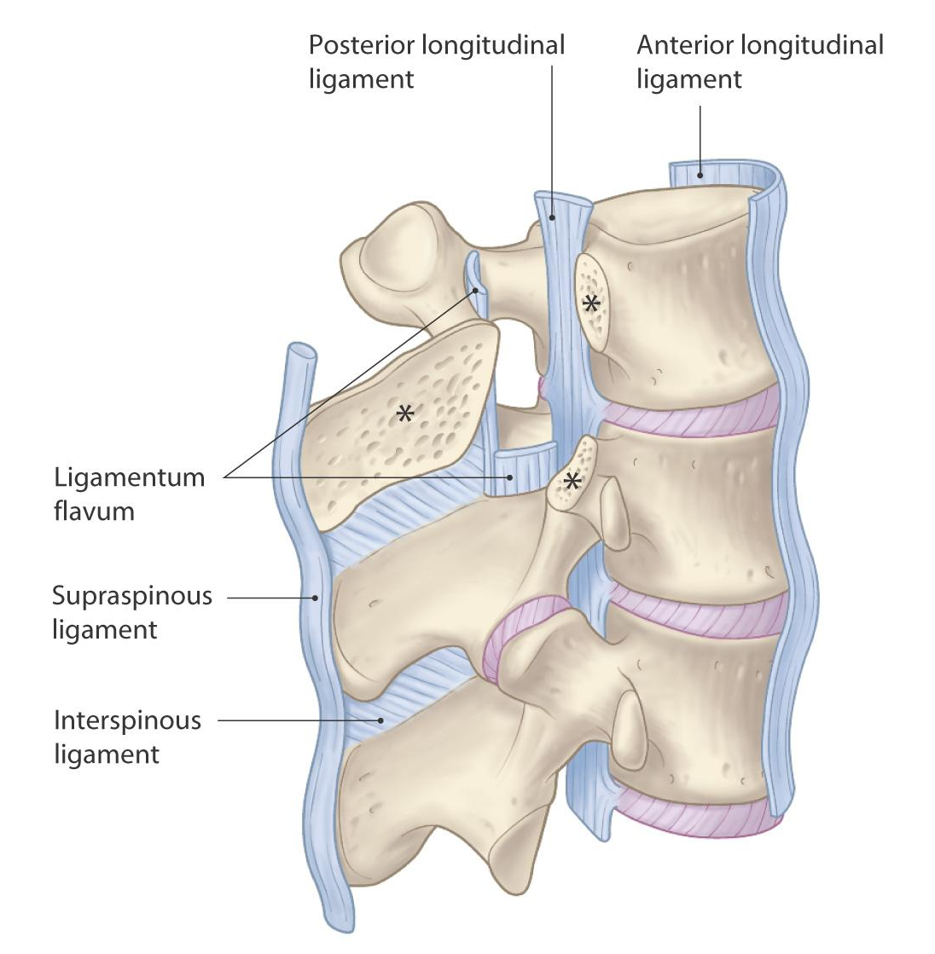
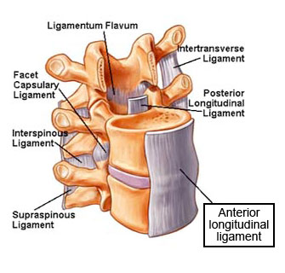
Ligaments
The anterior and posterior longitudinal ligaments run as continuous bands along the anterior and posterior surfaces of the vertebral bodies.
These ligaments hold the vertebrae firmly together but at the same time permit a small amount of movement to take place

Slide 16
Ligaments:
1-Apical Ligaments: (شكلها ومكانها في القمة)
Median ligament connects Apex of Odontoid process to foramen magnum “in the skull”
(UNDER COVER OF CRUCIATE LIGAMENT) (cruciate ligament جايه خلف او تحت ال)
2-Alar Ligament: (شكله زي الأجنحة)
These lie on each side of Apical ligament and connects Odontoid process to medial side of occipital condyles
3- Cruciate (Cruciform) ligaments: (شكله زي الصليب)
Consist of 3 parts 2 Vertical parts AND 1 Transverse “horizontal” part: (3a-b-c)
The two vertical parts is
3a-The Superior Cruciform Ligament(bind to Foramen magnum)
3b-The inferior Cruciform Ligament(bind in between the body of Axis)
The Transverse part is
3c-The Transverse Cruciform ligament
(binds odontoid process to anterior arch of atlas)
also known as: the transverse ligament of Atlas
Only in Girls lecture
Very important
check next slide for pics

Slide 17
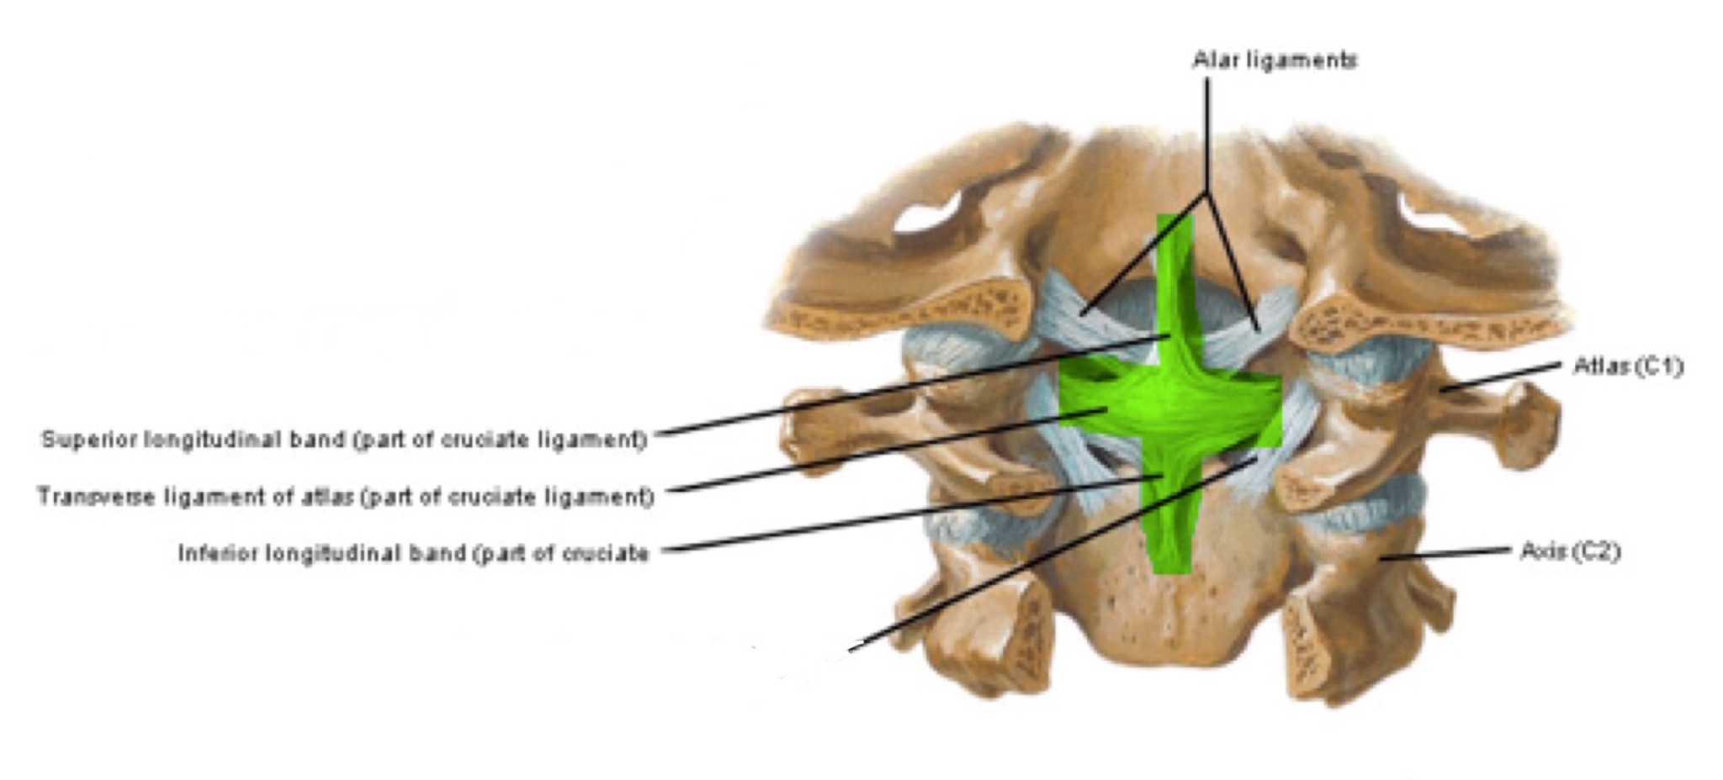
1-Apical ligament
2-Alar ligament
3a-The Superior Cruciform Ligament
3b-The inferior Cruciform Ligament
3c-The Transverse Cruciform ligament(aka the transverse ligament of Atlas)

Slide 18
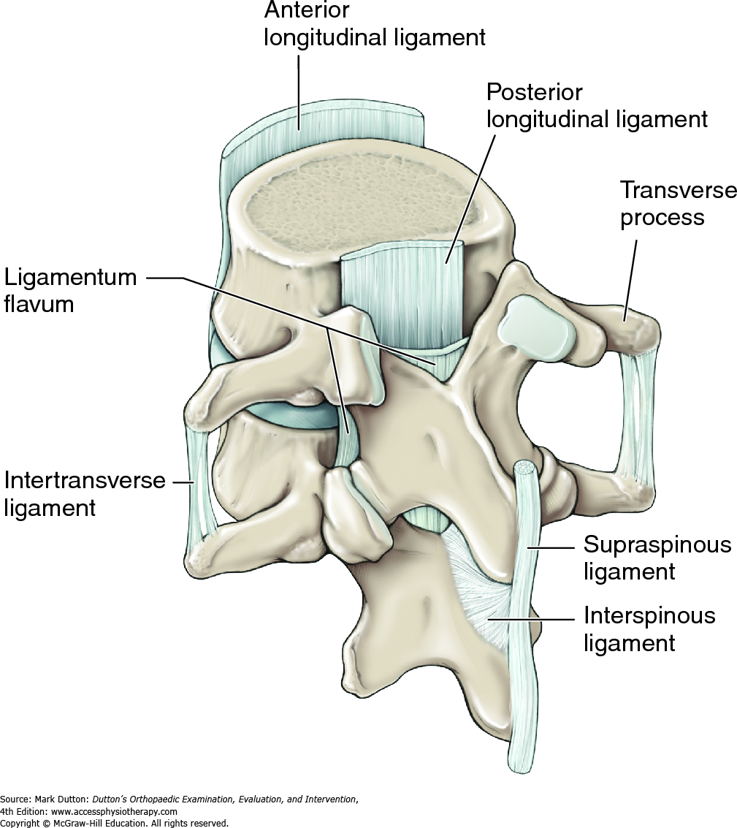
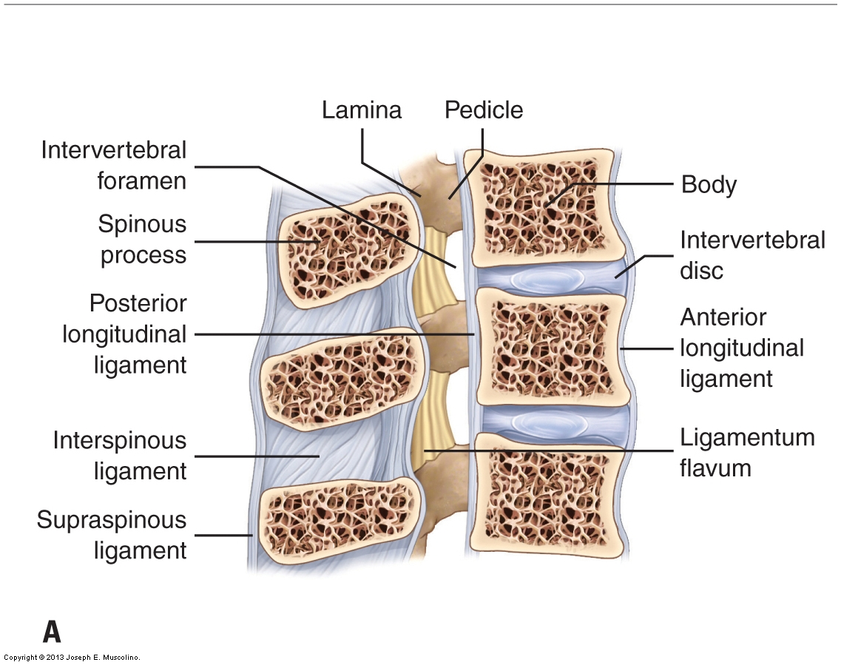
Ligaments
Supraspinous ligament: It runs between the tips of adjacent spines.
Ligaments
Interspinous ligament:
It connects adjacent spines.
Ligamentum flavum:
It connects the laminae of adjacent vertebrae.
Intertransverse ligaments: They run between adjacent transverse processes.

Slide 19
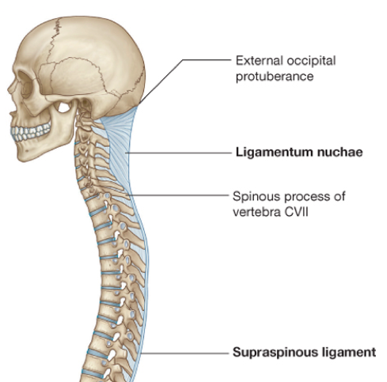
LIGAMENTUM NUCHAE
-In the cervical region, the Supraspinous and Interspinous ligaments are greatly thickened to form the strong ligamentum nuchae.
-It extends from the external occipital protuberance of the skull , to the spine of the seventh cervical vertebrae with its anterior border being strongly attached to the cervical spines in between.

Slide 20
The cervical vertebrae are 7 in number, classified into typical & atypical (non-typical) vertebrae.
All the typical vertebrae have a foramen transversarium and bifid spinous processes.
Atypical vertebrae (1,2,7) :
1st (Atlas) : has no body nor spine, has short anterior arch and long posterior arch.
2nd (Axis): has odontoid process (dens).
7th (Cervica Prominens) : has longest not bifid spinous process, which can be felt subcutaneously.
Atlanto-Occipital joints are : 2 synovial joints, the function: flexion and extension, and lateral flexion, This joint allows you to say “Yes”.
Atlanto-Axial joints are : 3 synovial joints, the function : extensive rotation, this joint allows you to say “ No”.
JOINTS BELOW THE AXIS are:
I- Synovial joints between their articular processes.
II- Cartilaginous joints between their bodies (intervertebral disc of fibrocartilage).
Ligaments of cervical spines:
Supraspinous ligament, between tips of spines.
Interspinous ligament, between adjacent spines.
Supraspinous & Interspinous ligaments are thickened to form ligamentum nuchae.
Ligamentum flavum, between laminae.
Intertransverse ligaments, between transverse processes.
Summary

Slide 21
Questions (MCQs)
1- the type of joint between two articular processes is:
A- cartilaginous B- synovial C- intervertebral disc D-none of these
2- all the cervical vertebrae articulate with each other by intervertebral discs except :
A- C1,C2 B-C2,C3 C- C3,C4 D- C4,C5
3- the LIGAMENTUM NUCHAE extends from………. to ………… ?
A- skull, CVII B- skull,CVI C- CI,CVII D- CI, CVII.
4- foramen transversarium is present on:
A- Spinous process B- Transverse process C- Pedicles D- Lamina
5- The cervical vertebral foramen is:
A- Triangular B- Oval C- flattened D- non of the above

Slide 22
Questions (SAQ)
1-What is the main features of the cervical vertebrae?
2- What type of joints are found between the atlas and the axis?
3- What is the difference between the movement of Atlanto-Occipital Joints and Atlanto-Axial Joints? Enumerate the movements of Atlanto-occipital joint?
4- Which kind of connective tissue is the Intervertebral disc is made of?
5- A 26-year-old heavyweight boxer was punched on his mandible, resulting in a slight subluxation (dislocation) of the atlanto-axial joint. The consequence of the injury was decreased range of motion at that joint. What movement would be most affected?

Slide 23
Questions (true or false)
1-There is a plate of hyaline cartilage between two intervertebral discs.
2- The articular facets are covered with hyaline cartilage, and the joints are surrounded by a capsule.
3- Movement of the Atlanto-Occipital joints include rotation.
4- The Atlanto-Occipital joint allow you to say yes.
5- The spinous process of the typical cervical vertebra is short and not bifid.

Slide 24
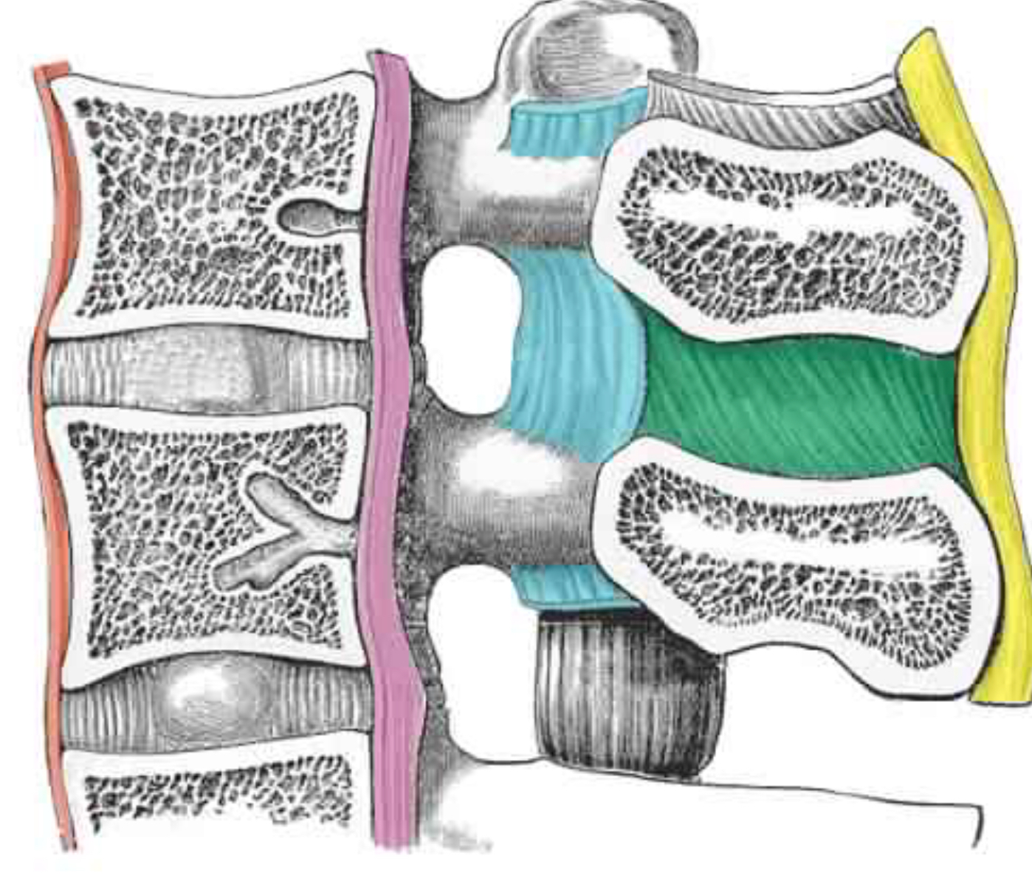
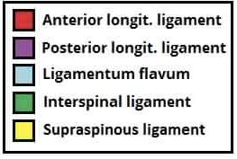
Questions (OSPE)
Q:Name the colored structures.
A:

Slide 25
Answers:
MCQ:
1-(B)
2-(A)
3-(A)
4-(B)
5-(A)
SAQ:
1-Foramen transversarium and bifid spine
2- Synovial joints
3- Atlanto-Occipital Joints : Flexion, Extension (allow you to say yes) and Lateral flexion Atlanto-Axial Joints : extensive rotation of the atlas and the skull (allows you to say no)
4- Fibrocartilage 5- Rotation, The atlantoaxial joints are synovial joints that consist of two plane joints and one pivot joint and are involved primarily in rotation of the head. Other movements do not occur at this joint.
True & False:
1-False
2-True
3-False
4-True
5- False

Slide 26
Team Members
Faisal Fahad Alsaif (Team Leader) Abdulaziz Al dukhayel ‏Fahad Alfaiz ‏Akram Alfandi ‏Saad Aloqile ‏Saleh Almoaiqel ‏Abdulaziz Alabdulkareem ‏Abdullah Almeaither ‏Yazeed Aldossari ‏Muath Alhumood Abdulrahman Almotairi
‏
Abdulelah Aldossari ‏Abdulrahman Alduhayyim ‏Hamdan Aldossari ‏Abdullah Alqarni ‏Mohammed Alomar ‏Abdulrahman Aldawood ‏Saud Alghufaily ‏Hassan Aloraini Khalid Almutairi‏‏
Lamia Abdullah Alkuwaiz (Team Leader)
Rawan Mohammad Alharbi
Abeer Alabduljabbar Afnan Abdulaziz Almustafa Ahad Algrain Alanoud Almansour Albandari Alshaye AlFhadah abdullah alsaleem Arwa Alzahrani Dana Abdulaziz Alrasheed Dimah Khalid Alaraifi Ghada Alhaidari Ghada Almuhanna Ghaida Alsanad Hadeel Khalid Awartani Haifa Alessa Khulood Alwehabi Layan Hassan Alwatban Lojain Azizalrahman Lujain Tariq AlZaid
Maha Barakah Majd Khalid AlBarrak Norah Alharbi Nouf Alotaibi Noura Mohammed Alothaim Rahaf Turki Alshammari Reham Alhalabi Rinad Musaed Alghoraiby Sara Alsultan Shahad Alzahrani Wafa Alotaibi Wejdan Fahad Albadrani Wjdan AlShamry
Abdulmajeed Alwardi ‏Abdulrahman Alageel ‏Rayyan Almousa ‏Sultan Alfuhaid ‏Ali Alammari ‏Fahad alshughaithry Fayez Ghiyath Aldarsouni ‏Mohammed Alquwayfili ‏‏Abduljabbar Al-yamani ‏Sultan Al-nasser ‏Majed Aljohani ‏Zeyad Al-khenaizan ‏Mohammed Nouri ‏Abdulaziz Al-drgam ‏Fahad Aldhowaihy ‏Omar alyabis

