Slide 1
Thoracolumbar spine
Lecture 5
Please check our Editing File.
هذا العمل لا يغني عن المصدر الأساسي للمذاكرة
{وَمَنْ يَتَوَكَّلْ عَلَى اللَّهِ فَهُوَ حَسْبُهُ}

Slide 2
Objectives
Distinguish the thoracic and lumbar vertebrae from each other and from vertebrae of the cervical region
Describe the characteristic features of a thoracic and a lumbar vertebra
Describe the joints between the vertebral bodies and the vertebral arches
List and identify the ligaments of the intervertebral joints
Compare the movements occurring in thoracic and lumbar regions
Knew the normal & abnormal Curvatures of spine
Text in BLUE was found only in the boys’ slides
Text in PINK was found only in the girls’ slides
Text in RED is considered important
Text in GREY is considered extra notes

Slide 3
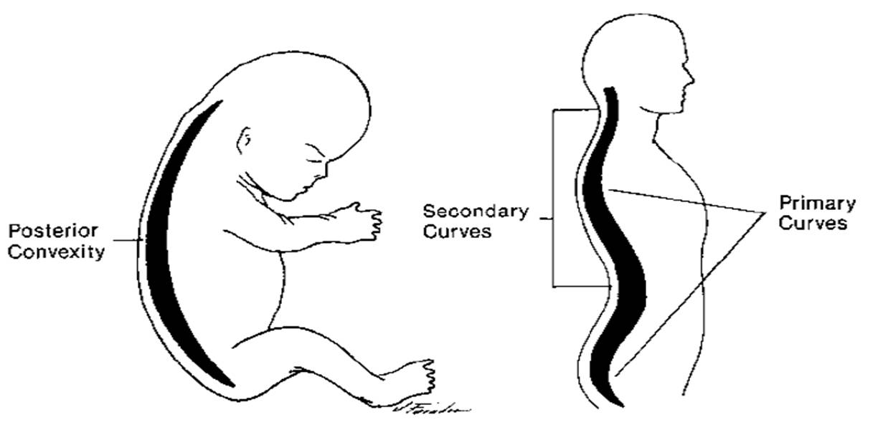
curvatures of the human's vertebral column
Normal Curvatures in Spine | Abnormal Curvatures in Spine
Primary (Thoracic & Pelvic) “present at birth” Secondary (Cervical & Lumbar) “present after birth” | Exaggerated Thoracic curvatures (Kyphosis) Exaggerated lumbar curvature (Lordosis) Lateral curvature of spine (Scoliosis)

Slide 4
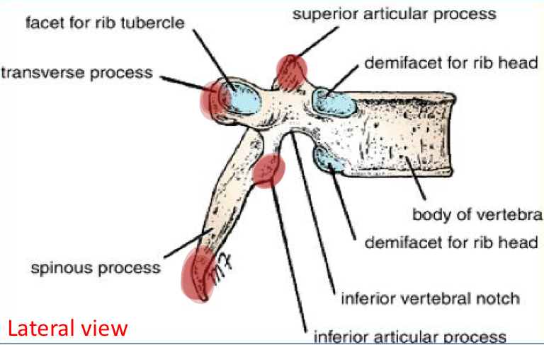
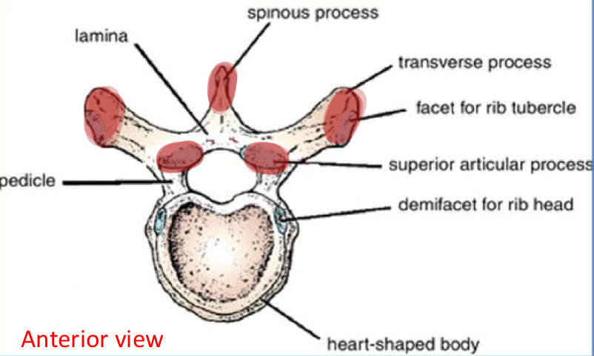
Thoracic Vertebrae
Most thoracic vertebrae are typical .
“ اغلبها وليس كلها متماثلة ، الغير متماثلة ممكن تكوّن اخر كم وحده “
- have bodies
- vertebral arches
- 7 processes “for muscular and articular connections”
The 7 processes are:
2 Transverse process
2 Superior articular process
2 inferior articular process
1 Spinous process

Slide 5
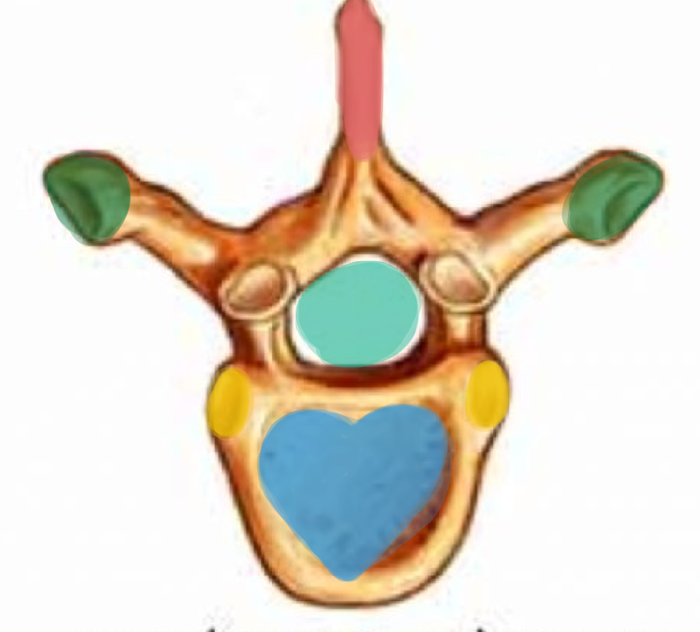
Characteristics Of Thoracic Vertebrae
The body is medium size and heart shaped
The vertebral foramen is small and circular
The spines are long and inclined downward
Costal facets are present on the sides of the bodies for articulation with the heads of the ribs
Costal facets “surface” are present on the transverse processes for articulation with the tubercles of the ribs (T11 and 12 have no facets on the transverse processes) “Because the 11 and 12 ribs are Floating“
The superior articular processes bear facets that face backward and laterally, whereas the facets on the inferior articular processes face forward and medially. The inferior articular processes of the 12th vertebra face laterally, as those of the lumbar vertebrae. - The articular “superior & inferior” Making a joint with each other

Slide 6
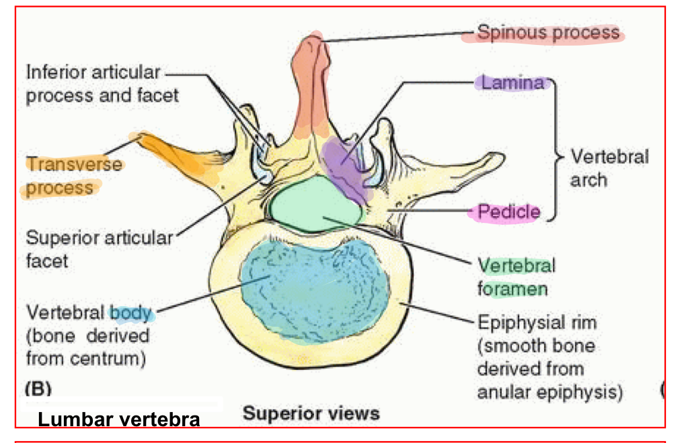
Characteristics Of Typical Lumbar Vertebrae
The body is large size and kidney shaped
The vertebral foramina are triangular
The laminae are thick “joins transverse with spinous“
The pedicles “joins body with transverse“ are strong and directed backward
The spinous process are short , flat & quadrangular
and project backward
The transverse processes are long and slender “no costal fascet“
The superior articular processes bear facets that face backward and laterally
whereas the facets on the inferior articular processes face forward and medially

Slide 7
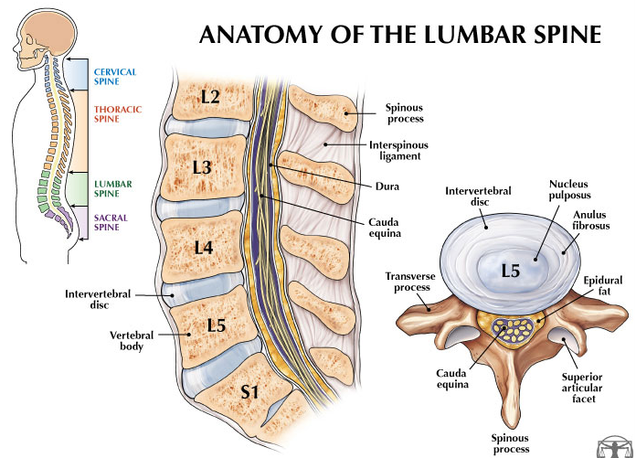
Lumbar Vertebrae (L5)
The largest movable vertebra
It has massive body and thick transverse processes
It carries the weight of the whole upper body
The body is largely responsible for the lumbosacral angle between the long axis of the lumbar vertebral column and that of the sacrum
Body weight is transmitted from L5 vertebra to the base of the sacrum, formed by the superior surface of S1 vertebra
The fifth lumbar vertebra is by far the most common site of spondylolysis “fracture” (defect in the pars interarticularis of the vertebral arch) Spondylolisthesis “displacement” (the forward displacement of a vertebra)

Slide 8
Joints
Joints
Joints between two vertebral bodies
Cartilaginous joint
The UPPER and LOWER surfaces of the BODIES of adjacent vertebrae are covered by thin plates of Hyaline Cartilage
Sandwiched between the plates of hyaline cartilage is an intervertebral disc of fibrocartilage
The COLLAGEN FIBERS of the disc strongly unite the bodies of the two vertebrae
Joints between two vertebral arches
Synovial joints
Between the SUPERIOR and INFERIOR Articular process of adjacent vertebrae

Slide 9
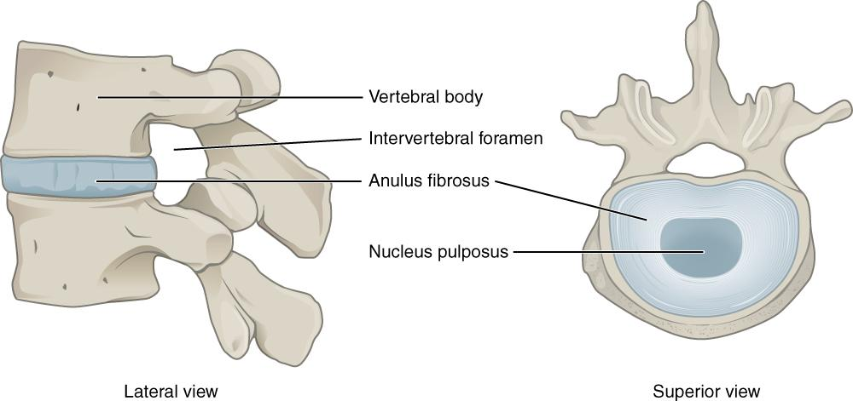
Intervertebral Discs
- The intervertebral discs are responsible for one fourth ( ¼ ) of the length of the vertebral column - They are thickest in the cervical and lumbar regions, where the movements of the vertebral column are greatest - No discs are found in the 1st & 2nd cervical vertebrae or in the sacrum or coccyx
Each disc consists of :
1) Peripheral “ribbon shipe” part “shock absorptions” : the annulus “circular” fibrosus, composed of fibrocartilage
annulus= a: no or out, nulus: like nucleus so it's not the nucleus or outside it
(fibrosus= because it’s composed of fibrocartilage)
2) Central part: the nucleus pulposus, a mass of gelatinous material, a lot of water, few collagen fibers & cartilage cells (pulposus = زي البؤبؤ في وسط العين)
From 436 team

Slide 10
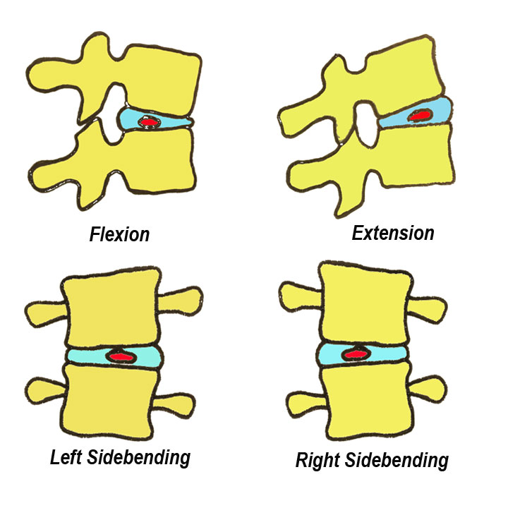
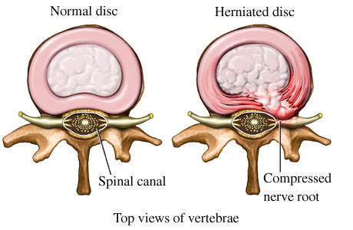
Function of the intervertebral Discs
Allow vertebra to rock forward or backward on another like flexion and extension of vertebral column
Serve as shock absorbers when the load on the vertebral column increased, as when one is jumping from a height
Sometimes, the annulus fibrosus ruptures allowing the nucleus pulposus to herniate and protrude into the vertebral canal, where it may press on spinal nerve roots, spinal nerve, or even spinal cord

Slide 11
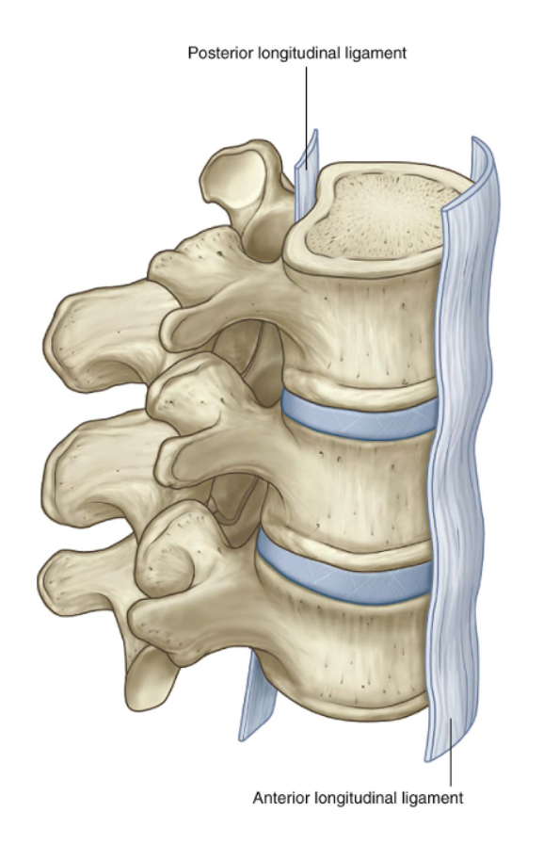
Ligaments
- The anterior and posterior longitudinal ligaments run as continuous bands down the anterior and posterior surfaces of the vertebral column from the skull to the sacrum
- The anterior longitudinal ligament is wide and is strongly attached to the front and sides of the vertebral bodies and to the intervertebral discs
- The posterior longitudinal ligament is weak and narrow and is attached to the posterior borders of the discs
- These ligaments hold the vertebrae firmly together but at the same time permit a small amount of movement to take place between them

Slide 12
Ligaments
Ligamentum flavum: connects the laminae of adjacent vertebrae
Intertransverse ligaments: run between adjacent transverse processes
Interspinous ligament: connects adjacent spines
Supraspinous ligament: runs between the tips of adjacent spines

Slide 13
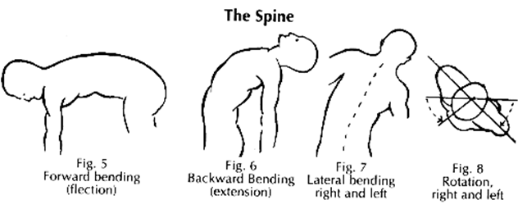
Movement Of The Thoracolumbar Spine
From 436 team
The following movements are possible on the spine:
flexion.
extension.
lateral flexion.
Rotation.
Circumduction = circular movement.
The type and range of movements possible in each region of the vertebral column largely depend on :
- The Thickness of the intervertebral discs
- The Shape and direction of the articular processes.
In the thoracic region, the ribs, the costal cartilages, and the sternum severely restrict the range of movement.
Flexion & Extension Lateral flexion
Extensive in the lumbar regions
Restricted in the thoracic regions
Rotation
Extensive in the thoracic regions
Least extensive in the lumbar regions

Slide 14
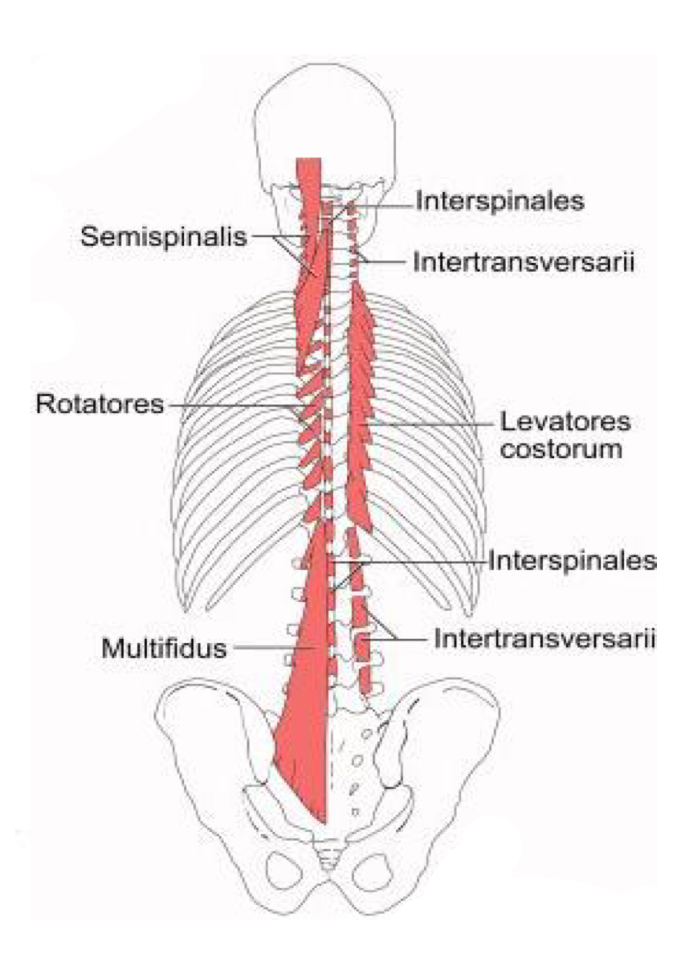
Muscles producing movements
Thoracic region
rotation | (1) semispinalis muscle (2) rotator muscle | assisted by the oblique muscles of the anterolateral abdominal wall
Lumbar region
Flexion | (1) rectus abdominis (2) psoas muscles | Extension | (1) postvertebral muscles
Rotation | (1) rotator muscles (2) oblique muscles of the anterolateral abdominal wall | Lateral | (1) postvertebral muscles (2) quadratus lumborum (3) oblique muscles of the anterolateral abdominal wall (4) psoas may also play a part in this movement

Slide 15
Summary
 | Cervical | Thoracic | Lumber
Number of vertebrae | 7 | 12 | 5
Atypical vertebrae | C1- Atlas C2- Axis C7- Cervica prominens | T1 T11 T12 | L5
Typical vertebrae | C3,C4,C5,C6 | T2,T3,T4,T5,T6,T7, T8,T9,T10 | L1,L2,L3,L4
Body | - Small - Longer horizontal - C1 doesn’t have body | - Medium - Heart shaped | - Large - Kidney shaped
Spine | All of them have spine except C1 | All of them have spine | All of them have spine
Vertebral foramen | Triangular | Circular | Triangular

Slide 16
Summary
 | Cervical | Thoracic | Lumber
Spinous process | - short - bifid | - long - inclined downward | - short - flat - quadrangular - projects backward
Transverse process | Has transverse foramen | - | Long and slender
Superior articular process | Upward & backward | Backward & laterally | Forward & medially
Inferior articular process | Downward & forward | Forward & medially | Backward & laterally

Slide 17
MCQs
(1) The inferior articular process of the 12th thoracic vertebrae faces ___________ :
A- laterally
B- medially
C- frontal
(2) Lateral curvature of the spine ……
A- lordosis
B- scoliosis
C- kyphosis
(3) The most common vertebrae for spondylitis ___________ :
A- L5
B- T5
C- S5
(4) Muscle responsible for lumbar flexion…..
A- psoas
B- rectus abdominis
C- A and B
(5) Thoracic rotation muscles are?
A- quadratus lumborum and psoas
B- rotator muscle and semispinalis muscle
C- quadratus lumborum only

Slide 18
Answers
1-A
2-B
3-A
4-C
5-B

Slide 19
Team Members
Faisal Fahad Alsaif (Team Leader) Abdulaziz Al dukhayel ‏Fahad Alfaiz ‏Akram Alfandi ‏Saad Aloqile ‏Saleh Almoaiqel ‏Abdulaziz Alabdulkareem ‏Abdullah Almeaither ‏Yazeed Aldossari ‏Muath Alhumood Abdulrahman Almotairi
‏
Abdulelah Aldossari ‏Abdulrahman Alduhayyim ‏Hamdan Aldossari ‏‏Mohammed Alomar ‏Abdulrahman Aldawood ‏Saud Alghufaily ‏Hassan Aloraini Khalid Almutairi‏‏
Lamia Abdullah Alkuwaiz (Team Leader)
Rawan Mohammad Alharbi
Abeer Alabduljabbar Afnan Abdulaziz Almustafa Ahad Algrain Alanoud Almansour Albandari Alshaye AlFhadah abdullah alsaleem Arwa Alzahrani Dana Abdulaziz Alrasheed Dimah Khalid Alaraifi Ghada Alhaidari Ghada Almuhanna Ghaida Alsanad Hadeel Khalid Awartani Haifa Alessa Khulood Alwehabi Layan Hassan Alwatban Lojain Azizalrahman Lujain Tariq AlZaid
Maha Barakah Majd Khalid AlBarrak Norah Alharbi Nouf Alotaibi Noura Mohammed Alothaim Rahaf Turki Alshammari Reham Alhalabi Rinad Musaed Alghoraiby Sara Alsultan Shahad Alzahrani Wafa Alotaibi Wejdan Fahad Albadrani Wjdan AlShamry
Abdulmajeed Alwardi ‏Abdulrahman Alageel ‏Rayyan Almousa ‏Sultan Alfuhaid ‏Ali Alammari ‏Fahad alshughaithry Fayez Ghiyath Aldarsouni ‏Mohammed Alquwayfili ‏‏Abduljabbar Al-yamani ‏Sultan Al-nasser ‏Majed Aljohani ‏Zeyad Al-khenaizan ‏Mohammed Nouri ‏Abdulaziz Al-drgam ‏Fahad Aldhowaihy ‏Omar alyabis

