Slide 1
Muscles of the Back
Lecture 6
Please check our Editing File.
هذا العمل لا يغني عن المصدر الأساسي للمذاكرة
{وَمَنْ يَتَوَكَّلْ عَلَى اللَّهِ فَهُوَ حَسْبُهُ}

Slide 2
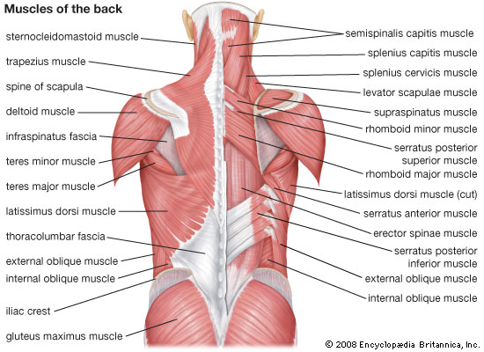
Objectives
Distinguish between the different groups of back muscles.
Compare between groups of back muscles as regard their nerve supply and action.
List the back muscles of each group.
Describe the attachments of each muscle of the superficial group, as well as, its nerve supply and action.
Describe the triangles of back and their clinical significance.
Text in BLUE was found only in the boys’ slides
Text in PINK was found only in the girls’ slides
Text in RED is considered important
Text in GREY is considered extra notes

Slide 3
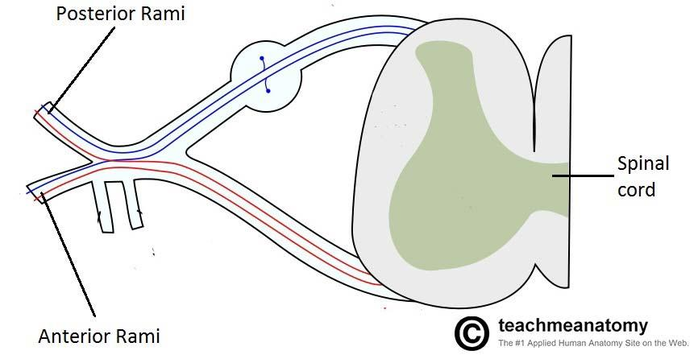
Back Muscles
They organized into 3 groups:
Intrinsic muscles
(Develop in the back)
Extrinsic muscles
(Not develop in the back)
1- Deep group :
Attached to & move vertebral column & head.
2- Intermediate group:
Attached to Ribs, may serve Respiratory Functions.
Supplied by:
3- Superficial group :
Attached to & involved movements of Upper limb.
Supplied by:

Slide 4
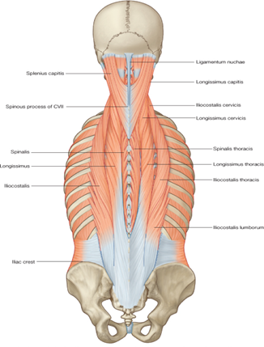
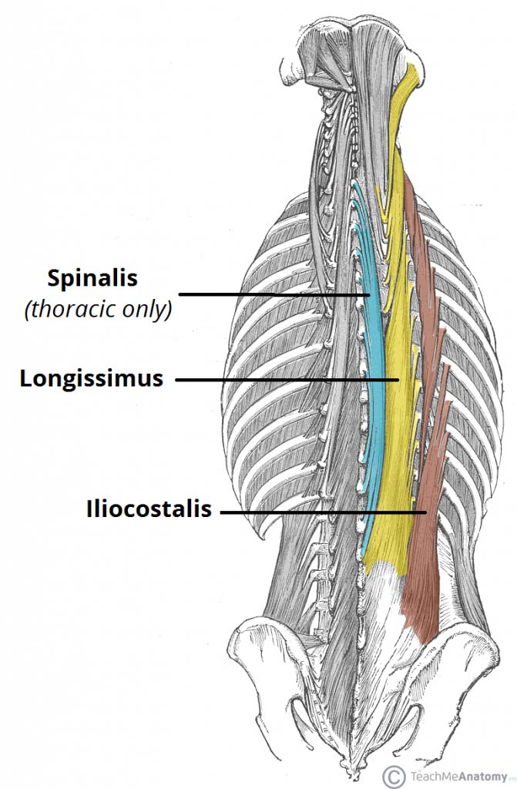
1- Deep Group of Back Muscles
*أثناء استرخاء العضلة تكون فيه كمية قليلة من ال fibers تكون في حالة انقباض هذا المقصود بال tone.
**الانقباض الجزئي المستمر والسلبي للعضلة أثناء استرخائها هو المسؤول عن المحافظة على التقوس الطبيعي للعمود الفقري.
They Extend from Sacrum to the base of the Skull
Action:
Extensors and Rotators of head and vertebral column. So, it is a set of muscles that straighten and rotate the back. (They keep our body erected)
Their Tone* is responsible for maintenance of normal curvature of vertebral column.**
The largest muscle of this group is “Erector Spinae” which is formed of 3 vertical columns (Arranged from lateral to medial as):
Iliocostalis Ilio=ilium costa=from rib.
Longissimus اسمك طويل +تنطق على وزن كريسمس :) =Long issimus
Spinalis The nearest Muscle to the spinal cord.
(Note the length and attachment of the muscle fibers).
Deep muscles group is formed of three muscle layers: Deep, Intermediate and Superficial i.e. Erector Spinae (which we are studying now).
Region:
I Love Spaghetti Muscles =) (from lateral to medial)
thoracic, cervicis and capitis parts.
lumborum, thoracics, and cervicis parts.

Slide 5
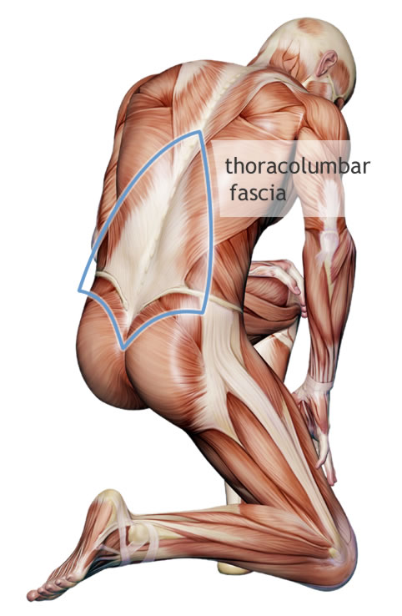
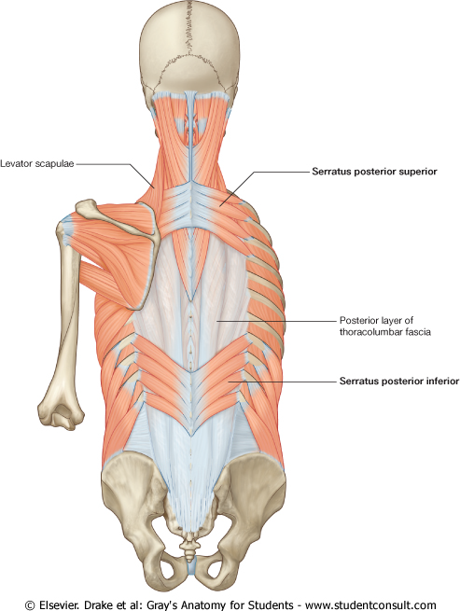
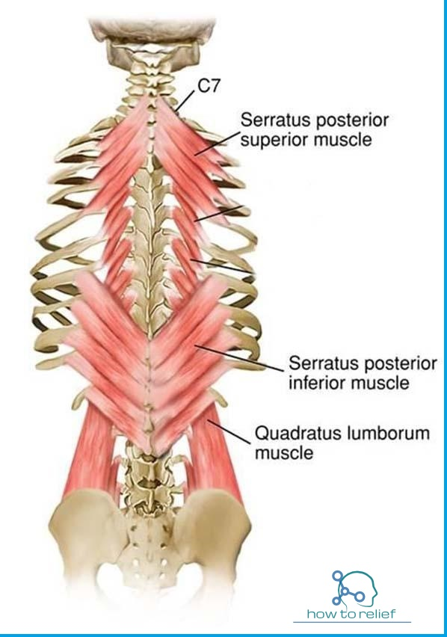
2- Intermediate Group of Back Muscles
It is separated from the deep group by Thoracolumbar Fascia.
It includes two muscles:
Serratus posterior superior (rib elevator).
contributes in deep inspiration.
Originate in: C6-T2. Insert in: 2-5th Ribs.
Serratus posterior inferior (rib depressor).
contributes in forced expiration*.
Originate in: T11-T12. Insert in: Four Lower Ribs.
Nerve supply:
Anterior rami of Thoracic spinal nerves.
Action
436 Team
*In case of asthma or excessive exercise
Fascia: is a band or sheet of connective tissue, primarily collagen, beneath the skin that attaches, stabilizes, encloses, and separates muscles and other internal organs
اسمها Serratus لأنها ماخذه شكل المنشار و ماخذة شكل المنشار لأن ال insertion في ال Ribs.

Slide 6
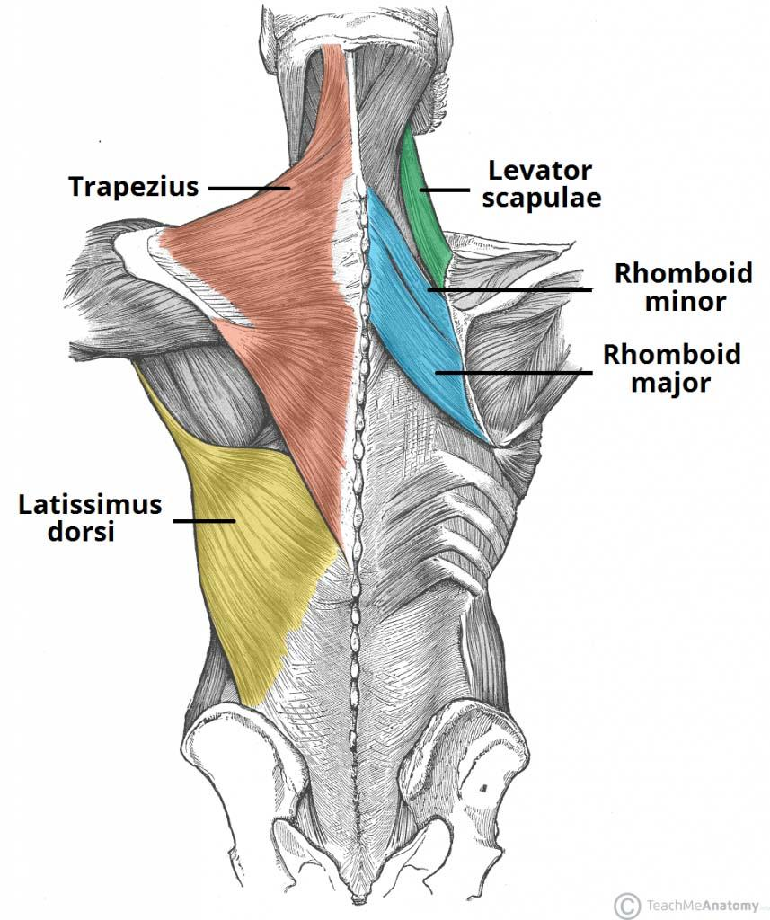
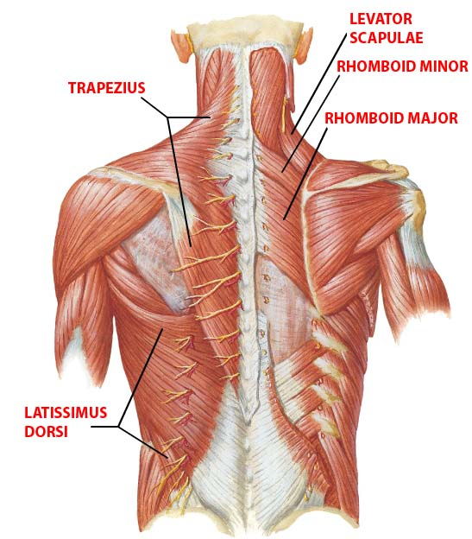
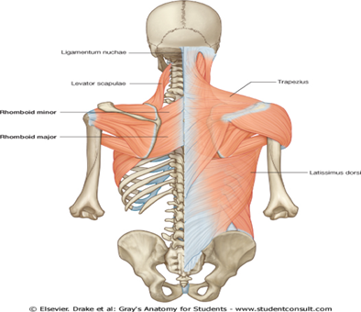
3- Superficial Group of Back Muscles
Includes TWO sets of muscles:
Muscles connecting Vertebral Column to Scapula (move scapula through shoulder girdle joints):
Trapezius
Levator scapulae
Rhomboid minor
Rhomboid major
Muscles connecting Vertebral Column to Humerus (move humerus through shoulder joint):
Latissimus dorsi
436 Team
#Levator = رافعة. #Rhomboid = معيّني الشكل

Slide 7
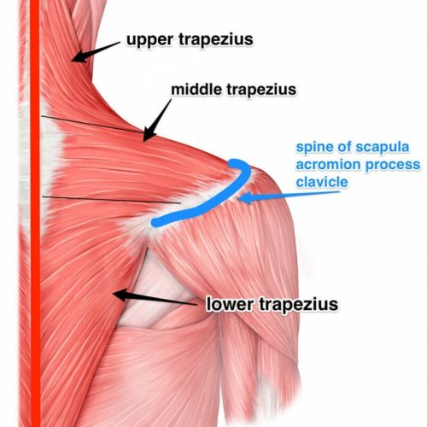
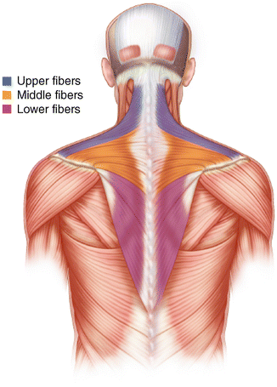
TRAPEZIUS
Origin:
Spines of Cervical & Thoracic Vertebrae (C1-T12)
Insertion:
Lateral ⅓ of Clavicle + Acromion & Spine of Scapula.
Action:
Rotation of scapula during abduction of humerus above horizontal ( >90° )
1. Upper fibers:
Elevate scapula.
2. Middle fibers:
Retract scapula.
3. Lower fibers:
Depress scapula.
Nerve supply:
Spinal part of accessory (11th cranial) nerve.
The only cranial nerve in the upper limb.
Combination of these muscles allow the rotation of Scapula.
Elevate: يرفع.
Retract: يسحب أو ينكمش.
Depress: يخفض.

Slide 8
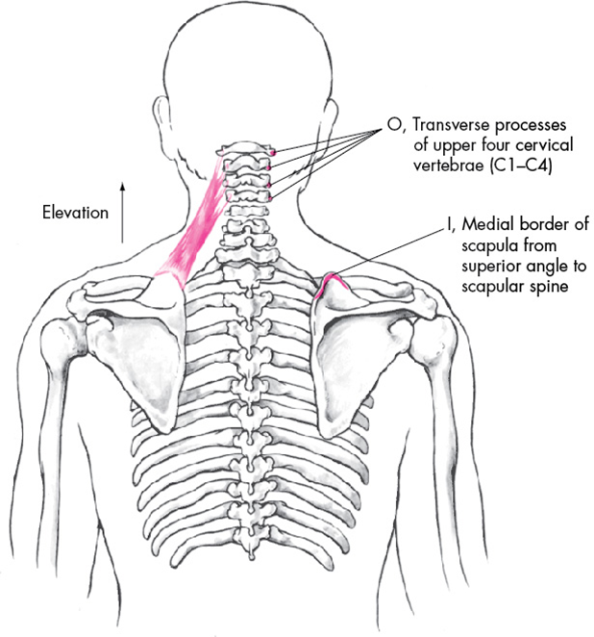
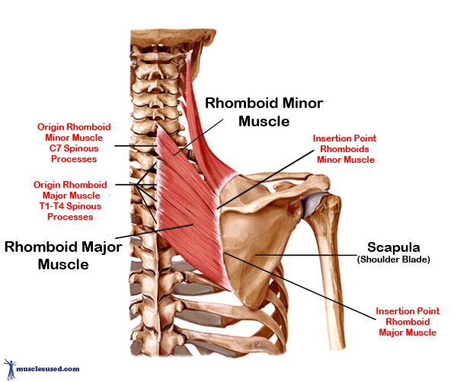
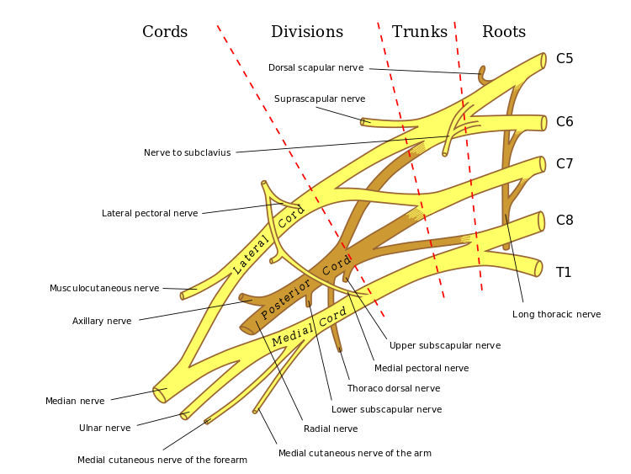
B,C,D. Levator Scapulae, Rhomboid Major & Minor
Origin:
Levator Scapulae:
Cervical transverse processes (C1-C4).
Rhomboid Major & Minor:
Thoracic spines (Major: T2-T5. Minor: C7-T1).
Insertion:
medial border of Scapula
Rhomboid Major: Below the spine.
Rhomboid Minor: Opposite to the spine.
Levator Scapulae: Above the spine.
Actions:
Levator scapulae:
Elevates scapula.
Rhomboid Major & Minor:
Retract scapula. (Have the same function as the middle fibers of Trapezius)
Nerve supply:
Dorsal scapular nerve From root of brachial plexus* (C5)
*Brachial plexus: a network of nerves formed by the anterior rami of the lower four cervical nerves and first thoracic nerve This plexus extends from the spinal cord.
And we will study it in details later.

Slide 9
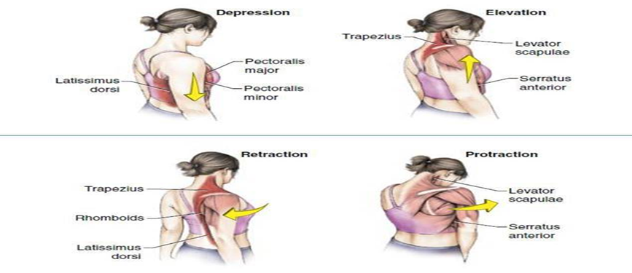
436 Team
Addition

Slide 10
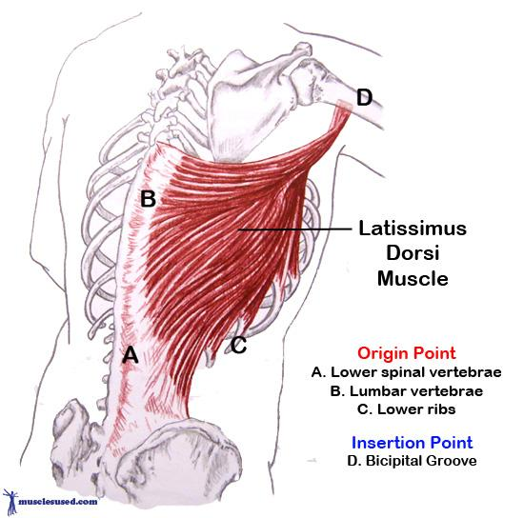
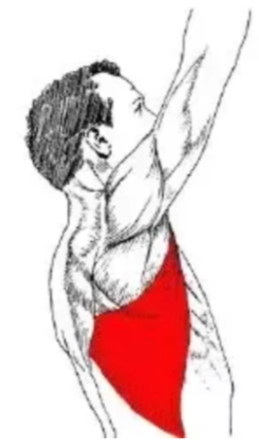
Latissimus Dorsi
Origin:
Spines of Thoracic & Lumbar vertebrae (T7 to Upper back of Sacrum, Iliac crest and four lower Ribs).
Insertion:
Bicipital (Intertubercular) groove of Humerus*.
Actions:
Extension, Adduction & Medial Rotation of Humerus (arm, shoulder joint). It is called the climbing muscle.
Nerve supply:
Thoracodorsal nerve, (C6,7,8) From posterior cord of brachial plexus
*Bicipital groove of Humerus has medial and lateral Prominences (lips) which other muscles attach to it, while this muscle attaches inside the groove between the lips (floor of bicipital groove).

Slide 11
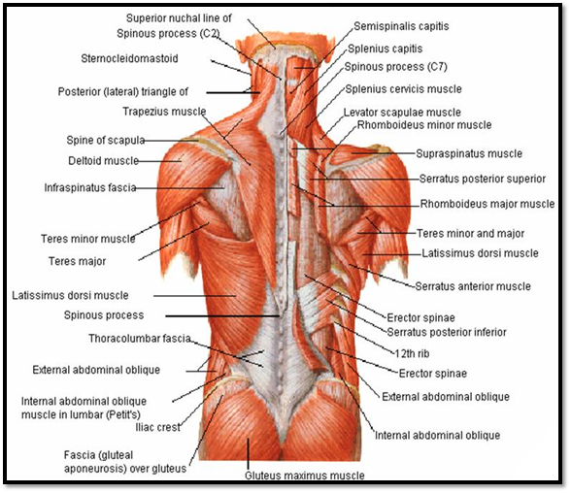
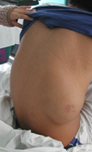
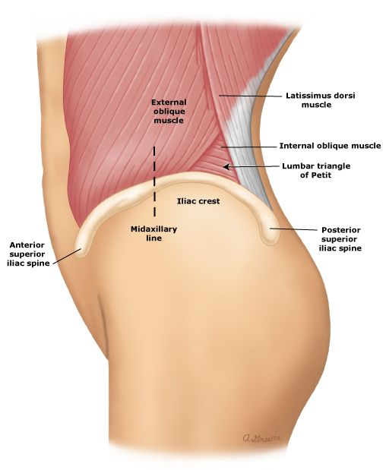
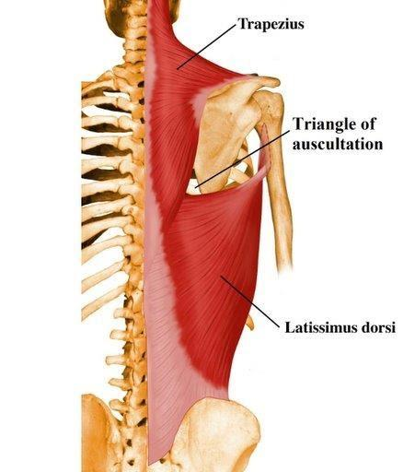
Very Important!!!
Lumbar Hernia
Muscular triangles of back
Auscultatory Triangle | Lumbar Triangle (Triangle of petit)
Boundaries: Latissimus dorsi. Trapezius. medial border of Scapula. | Boundaries: Latissimus dorsi. Posterior border of External Oblique muscle of the abdomen. Iliac crest.
Site : where breath sounds are most easily heard with a stethoscope. | Site: of an abdominal hernia*; or where pus may emerge from the abdominal wall in extra-abdominal lumbar abscess.
436 Team
#Hernia: فتق. #Auscultatory: تسمّعي

Slide 12
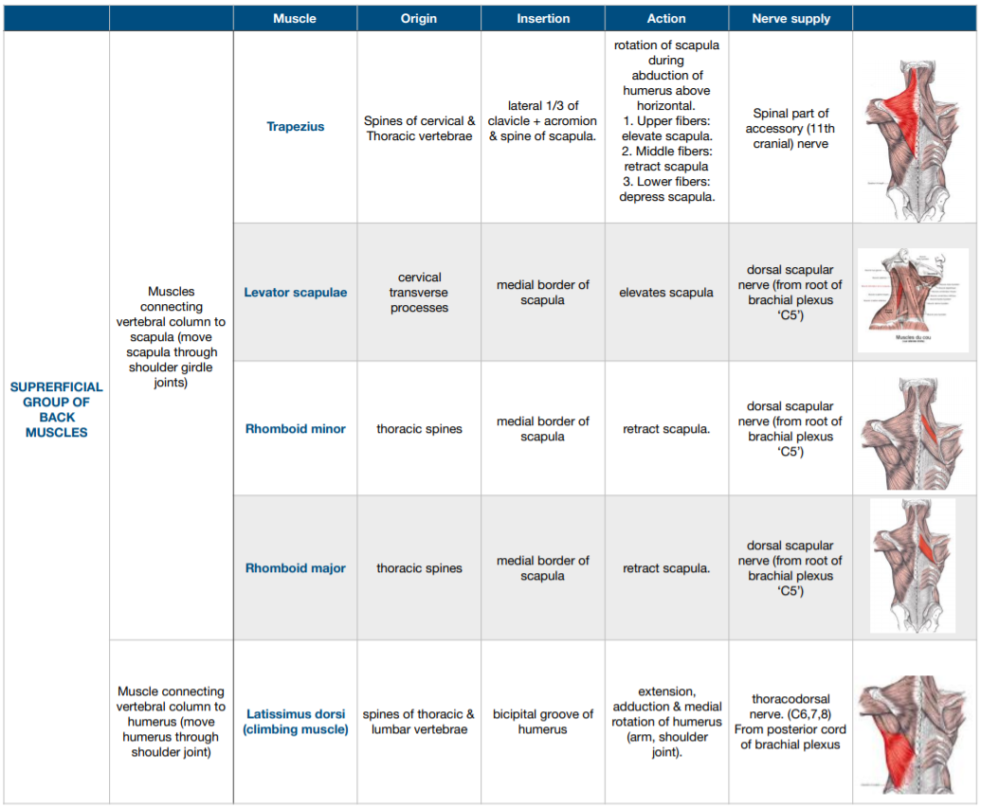
Summary of Superficial muscles

Slide 13
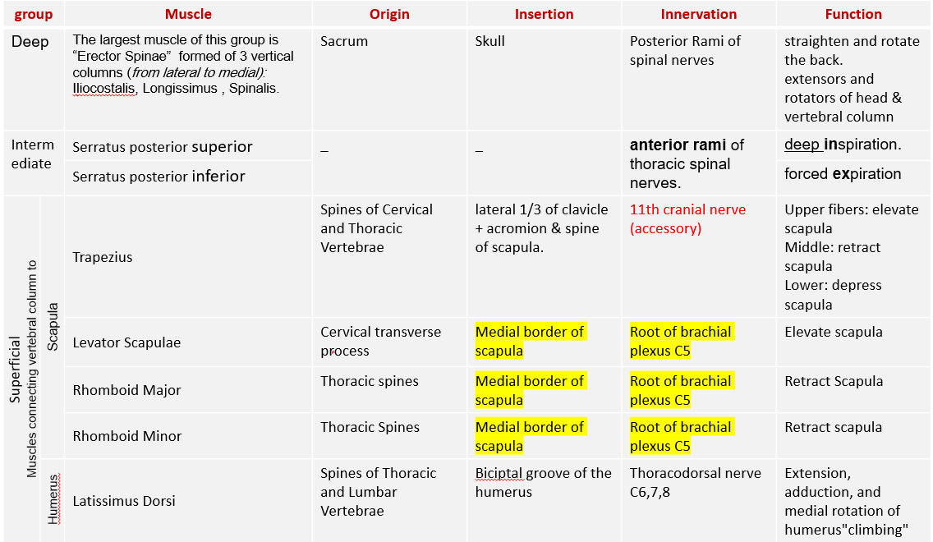
436 Team
Summary

Slide 14
MCQ:
Flash cards test :)
1- Which one of the following is the largest muscle of deep muscles of back group ?
A- Trapezius.
B- Serratus posterior superior.
C- Erector spinae.
D- Latissimus Dorsi.
2 - Which nerve supplies the intermediate group of back muscles ? A- Anterior rami of thoracic spinal nerves.
B- Posterior rami of thoracic spinal nerves.
C- Dorsal scapular nerve.
D- Thoracodorsal nerve.
3- Muscles that attached to & move vertebral column & head?
A- Deep muscles. C- Intermediate group.
B- Superficial muscles. D- Extrinsic group.
4-the Pus may merge from?
A- Auscultatory triangle. C- Petit triangle.
B- Lumbar triangle. D- C&B.
5- Which nerve supplies the trapezius muscle?
A- Dorsal scapular nerve.
B- 10th Cranial nerve.
C- 11th Cranial nerve.
D- Posterior rami of spinal cord.
6- What s the function of upper fiber of trapezius?
A-Depress scapula.
B- Elevate scapula.
C- Retract scapula.
D- Rotate scapula.

Slide 15
Team Members
Faisal Fahad Alsaif (Team Leader) Abdulaziz Al dukhayel ‏Fahad Alfaiz ‏Akram Alfandi ‏Saad Aloqile ‏Saleh Almoaiqel ‏Abdulaziz Alabdulkareem ‏Abdullah Almeaither ‏Yazeed Aldossari ‏Muath Alhumood
Abdulrahman Almotairi ‏
Abdulelah Aldossari ‏Abdulrahman Alduhayyim ‏Hamdan Aldossari ‏Abdullah Alqarni ‏Mohammed Alomar ‏Abdulrahman Aldawood ‏Saud Alghufaily ‏Hassan Aloraini
Khalid Almutairi ‏‏
Lamia Abdullah Alkuwaiz (Team Leader)
Rawan Mohammad Alharbi
Abeer Alabduljabbar Afnan Abdulaziz Almustafa Ahad Algrain Alanoud Almansour Albandari Alshaye AlFhadah abdullah alsaleem Arwa Alzahrani Dana Abdulaziz Alrasheed Dimah Khalid Alaraifi Ghada Alhaidari Ghada Almuhanna Ghaida Alsanad Hadeel Khalid Awartani Haifa Alessa Khulood Alwehabi Layan Hassan Alwatban Lojain Azizalrahman Lujain Tariq AlZaid
Maha Barakah Majd Khalid AlBarrak Norah Alharbi Nouf Alotaibi Noura Mohammed Alothaim Rahaf Turki Alshammari Reham Alhalabi Rinad Musaed Alghoraiby Sara Alsultan Shahad Alzahrani Wafa Alotaibi Wejdan Fahad Albadrani Wjdan AlShamry
Abdulmajeed Alwardi ‏Abdulrahman Alageel ‏Rayyan Almousa ‏Sultan Alfuhaid ‏Ali Alammari ‏Fahad Alshughaithry Fayez Ghiyath Aldarsouni ‏Mohammed Alquwayfili ‏‏Abduljabbar Al-yamani ‏Sultan Al-nasser ‏Majed Aljohani ‏Zeyad Al-khenaizan ‏Mohammed Nouri ‏Abdulaziz Al-drgam ‏Fahad Aldhowaihy ‏Omar alyabis

