Slide 1
Sacrum and
Pelvic
Lecture 7
Please check our Editing File.
هذا العمل لا يغني عن المصدر الأساسي للمذاكرة
{وَمَنْ يَتَوَكَّلْ عَلَى اللَّهِ فَهُوَ حَسْبُهُ}

Slide 2
Objectives
Describe the bony structures of the pelvis.
Describe in detail the hip bone, the sacrum, and the coccyx.
Describe the boundaries of the pelvic inlet and outlet.
Identify the structures forming the Pelvic Wall.
Identify the articulations of the bony pelvis.
List the major differences between the male and female pelvis.
List the different types of female pelvis.
Text in BLUE was found only in the boys’ slides
Text in PINK was found only in the girls’ slides
Text in RED is considered important
Text in GREY is considered extra notes

Slide 3
Bony Pelvis
From team 436

Slide 4
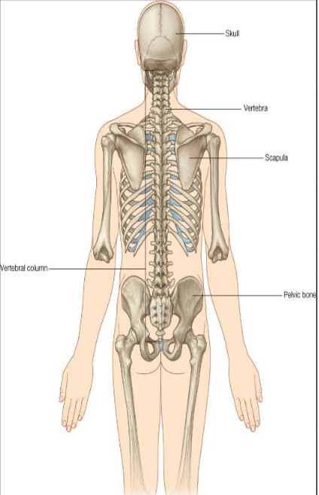
Bony Pelvis, Functions:
The skeleton of the pelvis is a basin- shaped ring of bones with holes in its walls that connect the vertebral column (Trunk) to both femora (lower extremities).
Its Primary Functions are:
Bears the weight of the upper body when sitting and standing “the most important function”.
Transfers that weight from the axial skeleton to the lower appendicular skeleton when standing and walking.
Provides attachments and withstands the forces of the powerful muscles of locomotion (movement) and posture.
Its Secondary Functions are:
Contains and Protects the pelvic and abdominopelvic viscera (inferior parts of the urinary tracts, internal reproductive organs)
Provides attachment for external reproductive organs and associated muscles and membranes.

Slide 5
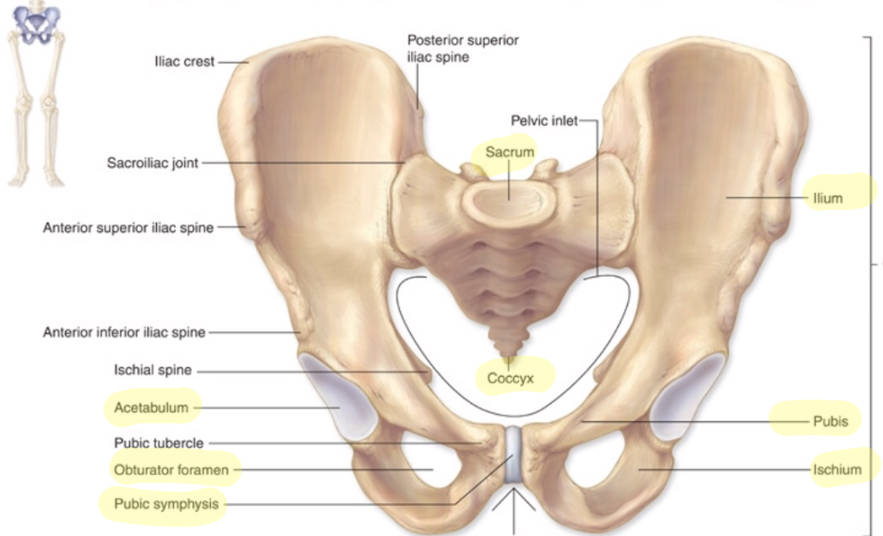
Pelvic Girdle :
Compared to the Pectoral Girdle, the pelvic girdle is Larger, heavier, and stronger.
The total weight of the upper body rests on the pelvis.
Composed of:
Two hip (coxal) bones
Hip Bone :
Each one is a large irregular bone.
Formed of three bones:
Ilium (superior)
Ischium (inferior posterior)
Pubis (inferior anterior)
They are joined at a deep socket (Acetabulum)*
During childhood, these sections are separate bones, joined by Y shaped cartilage.
During puberty, they fuse together to form a single bone.
Important to know the difference between:
Bony Pelvis : hip bones, sacrum and coccyx.
Pelvic girdle: only the two hip bones.
*Acetabulum: The socket of the hip bone, into which the head of the femur fits.

Slide 6
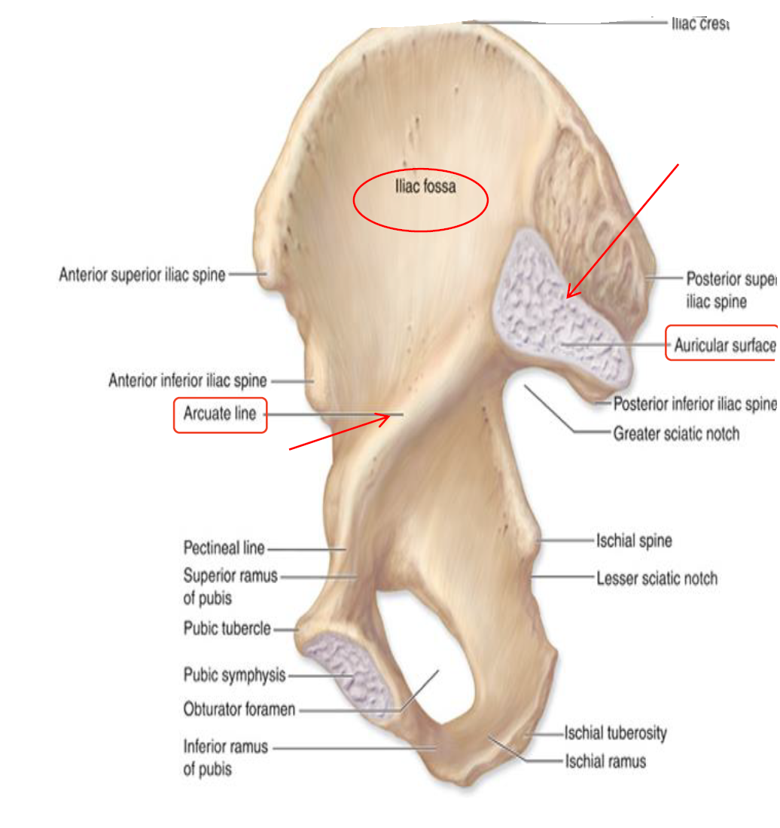
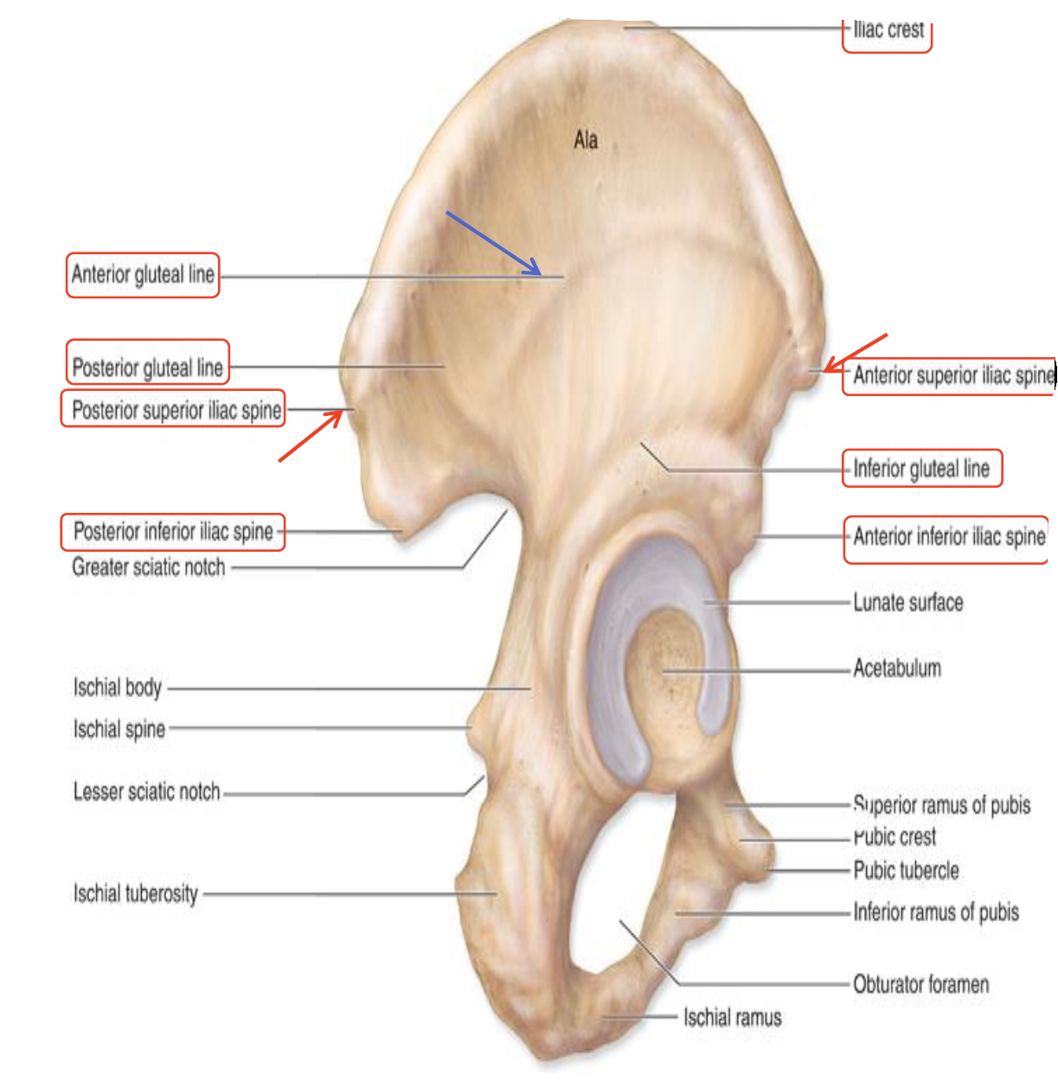
Ilium
▪ It is the Upper Flattened Part of the hip bone.
*Waist: body below the ribs and above the hips
The Inner surface has: ▪ Iliac Fossa (forms false pelvis). Smooth ▪ Auricular surface ( for articulation with the sacrum). Rough ▪ Iliopectinial (Arcuate) Line: ▪ Runs downwards & forwards. ▪ It separates between the False & the True pelvis
Iliac Crest: An important anatomical landmark below the *waist. ▪It runs between the Anterior and Posterior Superior Iliac Spines. ▪Below are the corresponding Anterior and Posterior Inferior Iliac Spines. (Total 4 spines)
▪It Possesses:
*Medial view
▪The Outer Surface: rough and has three Gluteal Lines
▪It has: two surfaces:
.
*Lateral view
Outer surface: called "Gluteal surface" because it has 3 gluteal lines, which serves as an attachment for gluteal muscles,(Maximus,medius,minimus).

Slide 7
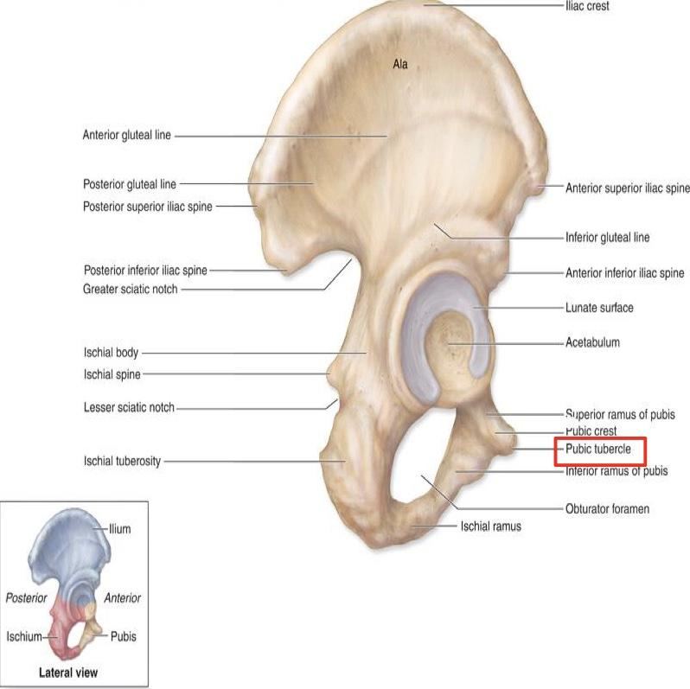
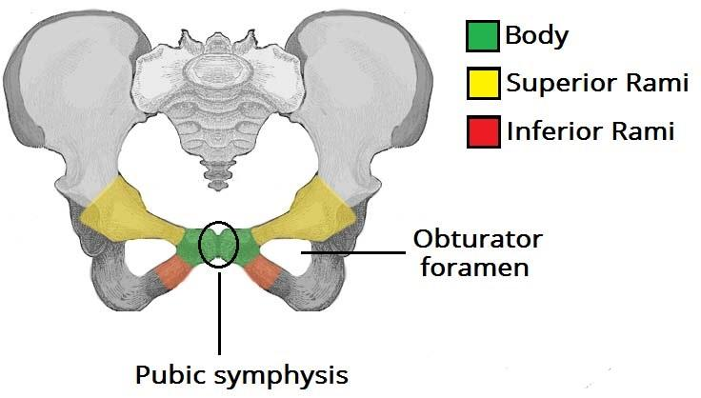
Pubis (3parts)
▪Forms the Anterior & Inferior part of the hip bone. ▪It is composed of: -Body; bears the Pubic Crest and Pubic Tubercle. -Two pubic Rami; Superior & Inferior. ▪They bound the Obturator Foramen, which is closed partially by the obturator membrane. leaving the obturator canal for passing of blood vessels & nerves into the thigh
Body
The greater and lower sciatic notches are separated by the ischial spine

Slide 8
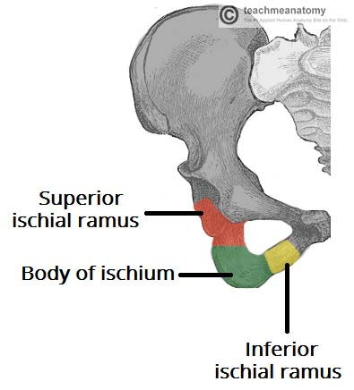
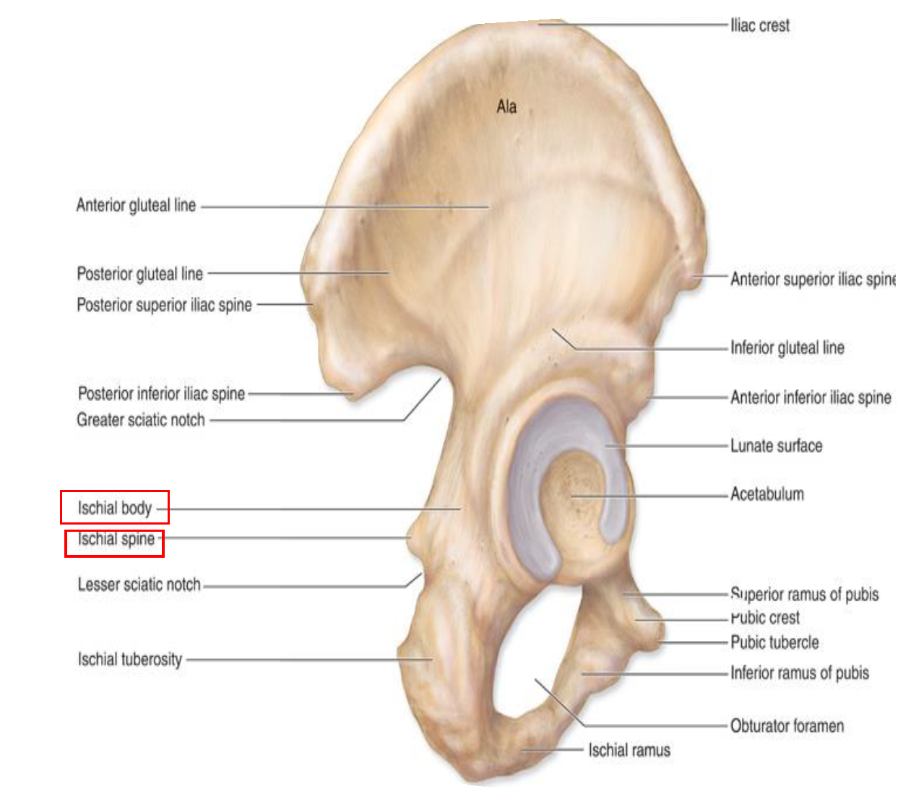
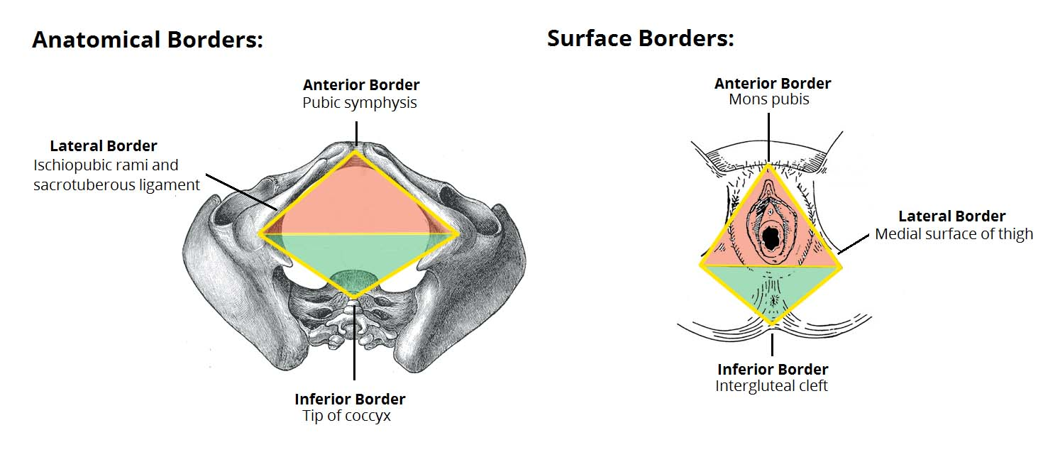
Ischium: ▪Forms the Posterior & inferior part of the hip bone ▪ Ischial Tuberosity: A roughened area that receives body weight in sitting العظمة الي نجلس عليها ▪Ischial Spine: Superior to the tuberosity, it is important landmark in pregnant women. (obstetrics) ▪Greater sciatic notch. Allow sciatic nerve & vessels to pass from the pelvis to the thigh. ▪Lesser sciatic notch. allow vessels & nerves to pass from pelvic to *perinium.
In Living patients:
• Greater Sciatic Foramen
• Lesser Sciatic Foramen
*Extra:The perinium
*The distance between two spines help us know weather the women will have a normal birth or not.

Slide 9
Articulations of hip bone
symphysis pubis:
-a secondary cartilaginous joint between the two pubic bones
Sacroiliac joints:
-strong synovial joints, between the auricular surfaces of both iliac bones and the sacrum
-transmit the weight of the body from vertebral column to the bony pelvis
Hip joints:
-The outer surface articulates at the acetabulum with the head of the femur.

Slide 10
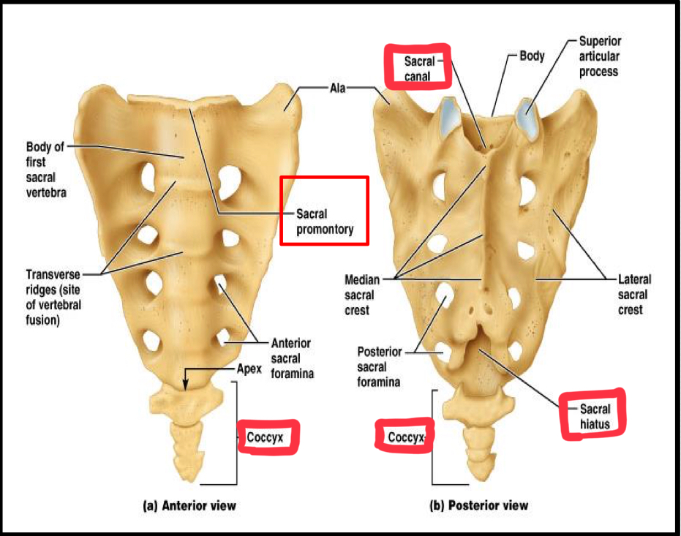
Sacrum And Coccyx:
*Sacrum:
-A single wedge shaped bone.
-Consist of Five rudimentary بدائية vertebrae fused together.
-The anterior and posterior surfaces possess on each side four Sacral Foramina.
-The fused vertebral foramina form the *Sacral Canal.
-Its lower limit is the Sacral Hiatus.
Sacral promontory:
1) The anterior and upper margin.(represent the body of the first sacral vertebrae)
2) It is tilted forward forming the lumbosacral angle.
Coccyx:
- Consists of four vertebrae fused together forming a single Triangular piece.
*Dorsal surface(Posterior): rough & ridge
Pelvic surface(anteriorly): relatively smooth
*Sacral Canal: The cauda equina, pass through the canal to send their dorsal and ventral rami through the corresponding sacral foramina.

Slide 11
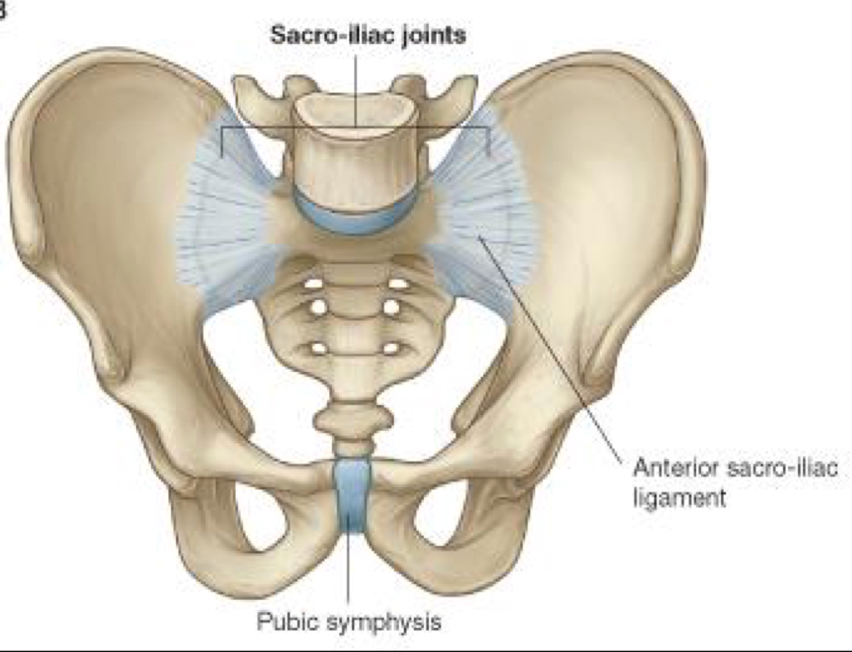
Articulation Of Sacrum
1)Lumbosacral joint:
The upper border articulates with the 5th lumbar vertebra.
2) Sacrococcygeal joint:
The inferior part articulates with the Coccyx.
3) Sacroiliac joints:
Lateral articulation with both hip bones.
These joints + pubic symphysis form the bony pelvis; by joining the sacrum and the hip bones together

Slide 12
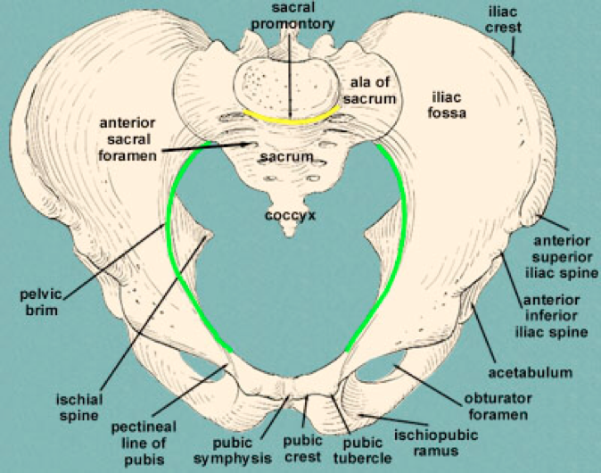
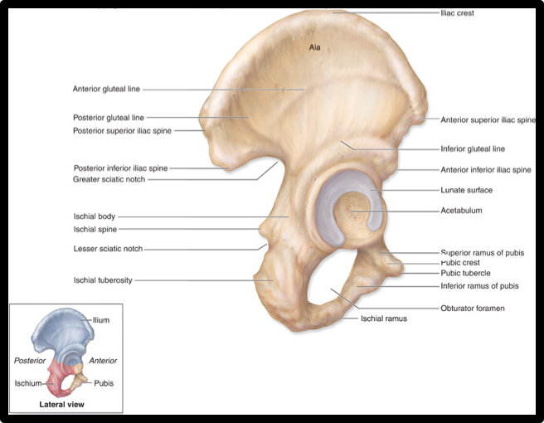
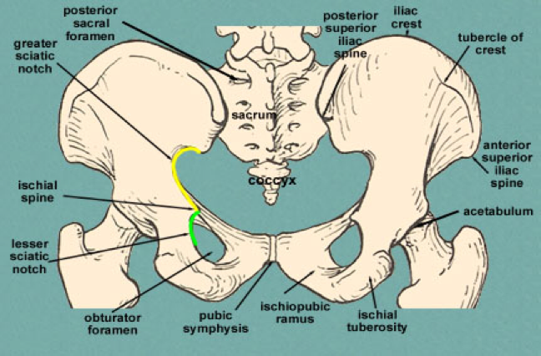
Foramina in Body pelvis
Only in girls’ slides
The holes of the basin are called foramina.
The important foramina in the bony pelvis include:
Anterior sacral foramina | Greater and lesser sciatic foramina | Obturator foramen
These are present on the anterior surface of the sacrum (which forms the posterior surface of the bony pelvis) Through these foramina pass the anterior rami of the sacral spinal nerves. | These are the major foramina of the pelvis. In the bony pelvis, they are present as greater and lesser sciatic notches but by the attachment of sacrotuberous and sacrospinous ligaments, these notches are converted to respective foramina. Through these foramina various structures enter and leave the pelvis. | Each lateral wall of the pelvis has a large hole, called the obturator foramen. In living subjects, this hole is closed by the obturator membrane except for a small opening, which represents the obturator canal. Obturator nerve passes through this small opening.

Slide 13
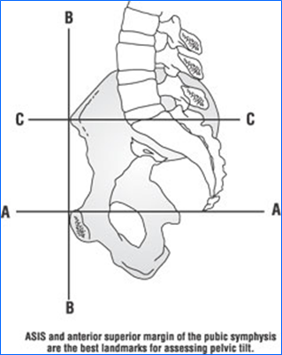
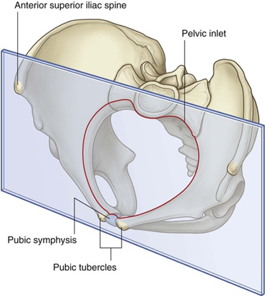
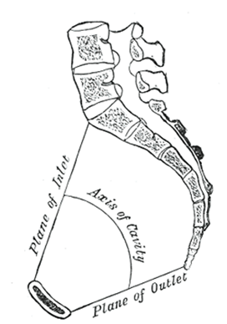
Orientation of the Pelvis
It is the Correct Position of the bony pelvis relative to the trunk (in the anatomical position):
1.The Anterior Superior iliac spine and the front of the Symphysis pubis (The pubic tubercles) are in the same vertical plane. . | 2.The coccyx and the upper margin of the pubic symphysis are in the same horizontal plane. | 3.The axis of the pelvic cavity running through the central point of the inlet and the outlet, almost parallels the curvature of the sacrum.
In this position: The anterior surface of the Sacrum is directed forward and downward while the pelvic surface of symphysis pubis faces upward and backward.

Slide 14
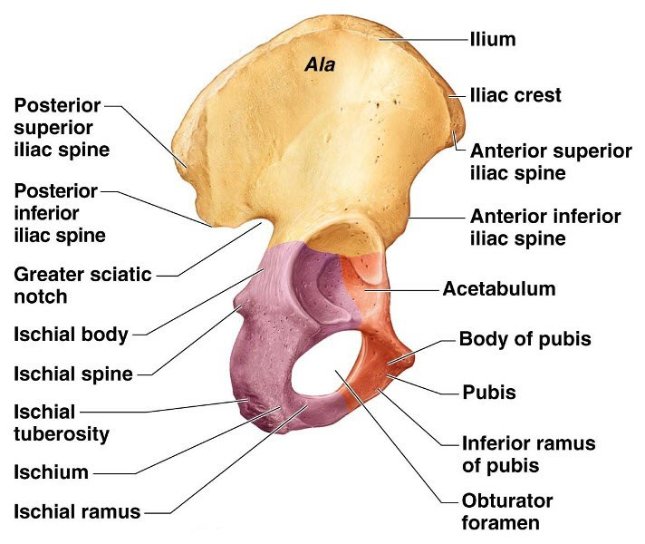
Fractures of the Bony Pelvis
Only in girl’s slides
The weakest parts of the bony pelvis are:
Pubic rami
Acetabula
Region of sacroiliac joint
Alae of the ilium
Pelvic Fractures can result from direct trauma to the pelvic bones as occurs in car accidents or by forces transmitted to these bones from the lower limbs during falls on the feet.
Pelvic fractures may cause injury to the pelvic soft tissues, blood vessels, nerves and organs.

Slide 15
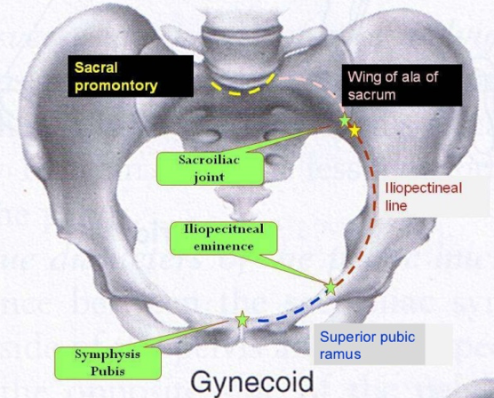
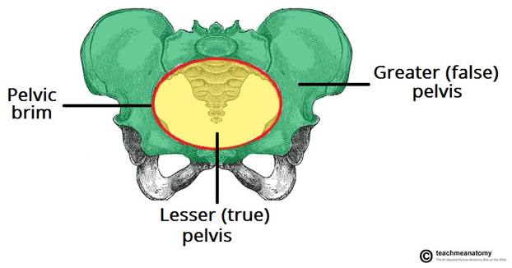
Subdivision of the bony pelvis
The bony pelvis is divided into two parts by the Pelvic Brim.
Posteriorly:
Sacral Promontory
The brim is formed
Laterally:
Iliopectineal line
Only in girl’s slides
Anteriorly : Symphysis pubis.
Above the pelvic brim lies the False Pelvis,
which is not of much clinical importance.
Below the brim is the True Pelvis
.
Below the brim is the True Pelvis

Slide 16
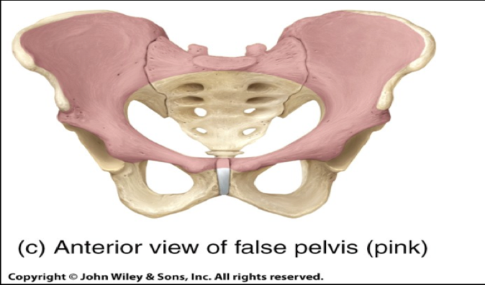
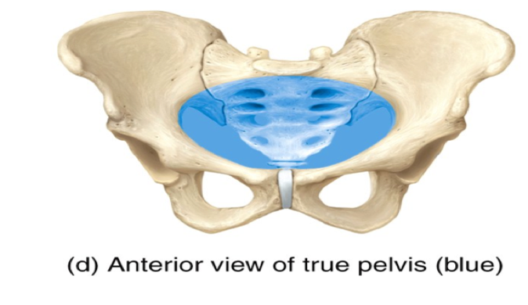
False Pelvis (Greater pelvis)
True Pelvis (lesser pelvis)
Lies superior to the pelvic brim. ▪ Enclosed by the Fossae of the iliac bones ▪ Forms the inferior region of the abdominal cavity. ▪ Houses the Inferior abdominal organs
Lies inferior to the pelvic brim. ▪Encloses the pelvic cavity. ▪Contains the pelvic organs. ▪It has : Inlet Outlet
Pelvic walls

Slide 17
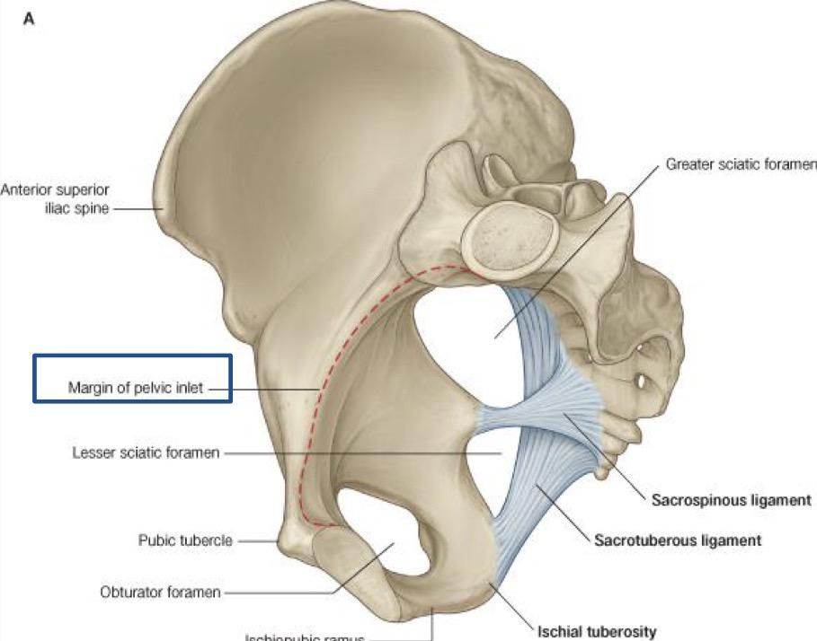
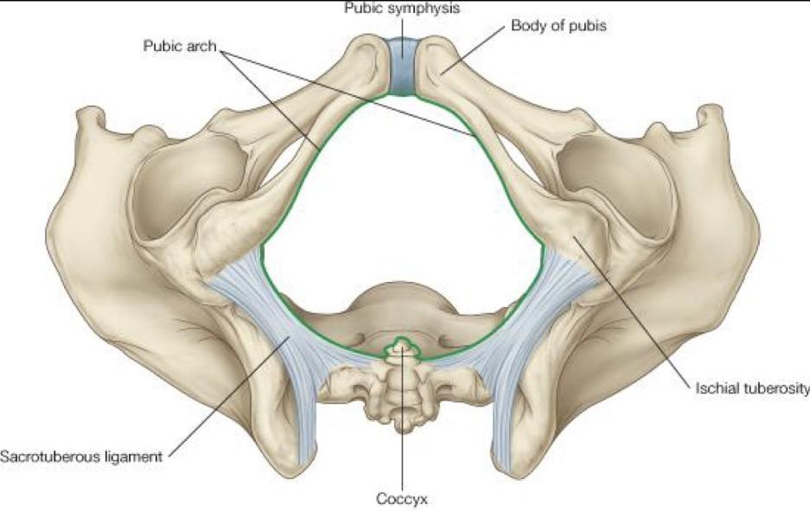
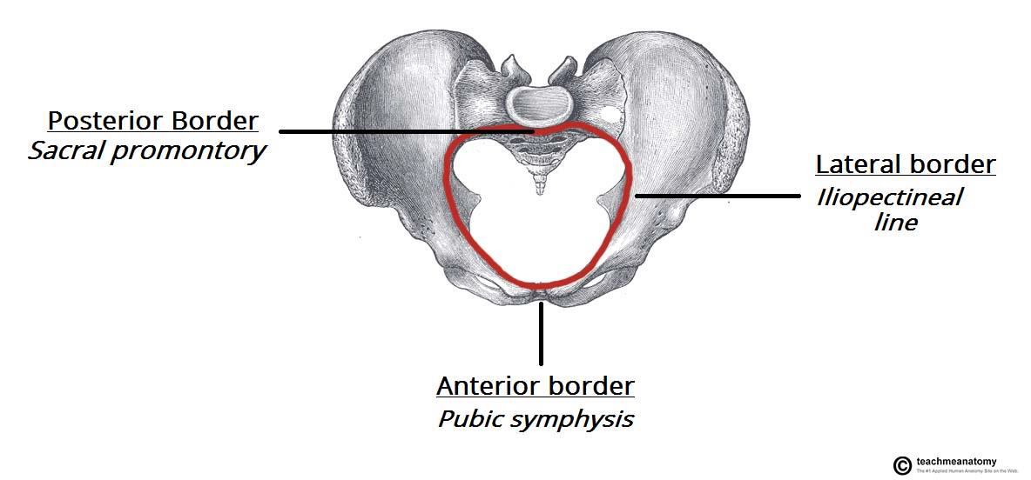
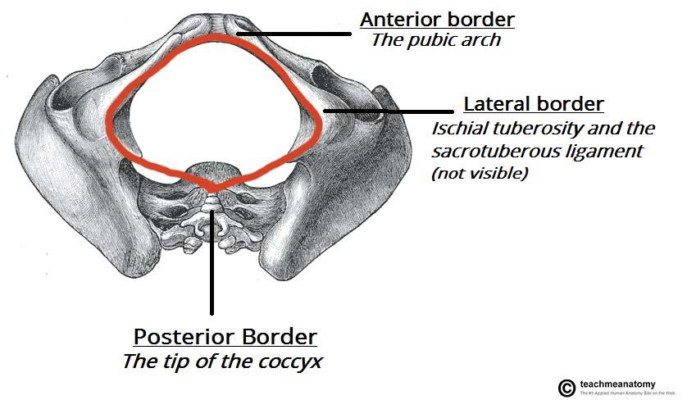
True Pelvis (pelvic inlet and outlet)
 | Pelvic Inlet (pelvic brim) | Pelvic outlet
Bounded by: | 1-Sacral promontory 2- Symphysis pubes 3- iliopectineal lines | 1- Tip of Coccyx 2- Ischial tuberosities 3- Pubic arches

Slide 18
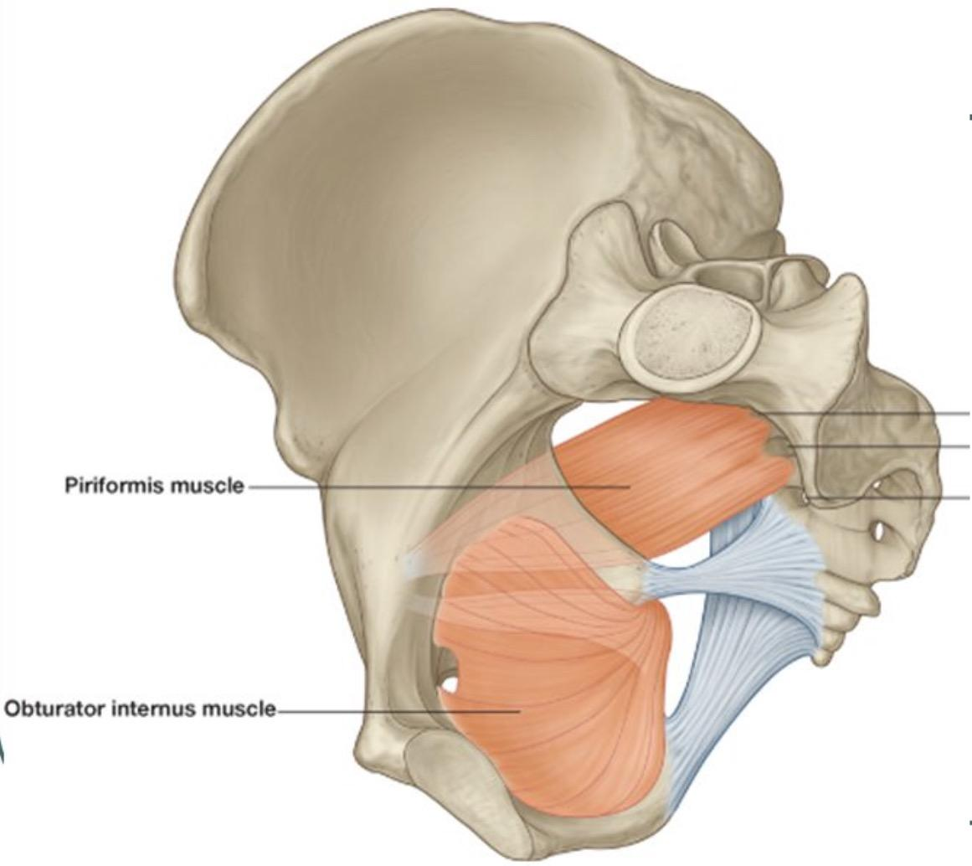
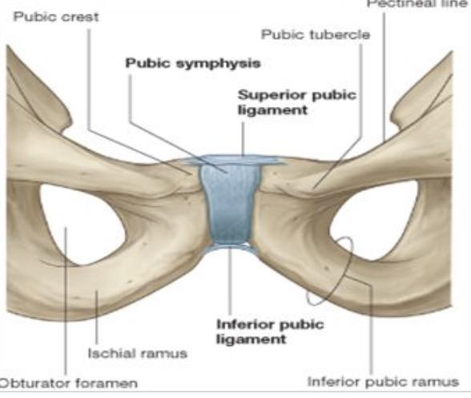
Pelvic Walls
This slide is only in males lecture
Formed by bones and ligaments
Lined with muscles, and covered with fascia
Piriformis muscle
Anterior wall | Posterior wall | Lateral wall
- Posterior surfaces of bodies of pubic bones - Pubic rami - Symphysis pubes | - Sacrum and coccyx - Piriformis muscles, and their covering of parietal pelvic fascia | - hip bone below the pelvic inlet (pelvic brim) -Obturator membrane - Sacrotuberous and sacrospinous ligaments -Obturator internus muscle and covering fascia

Slide 19
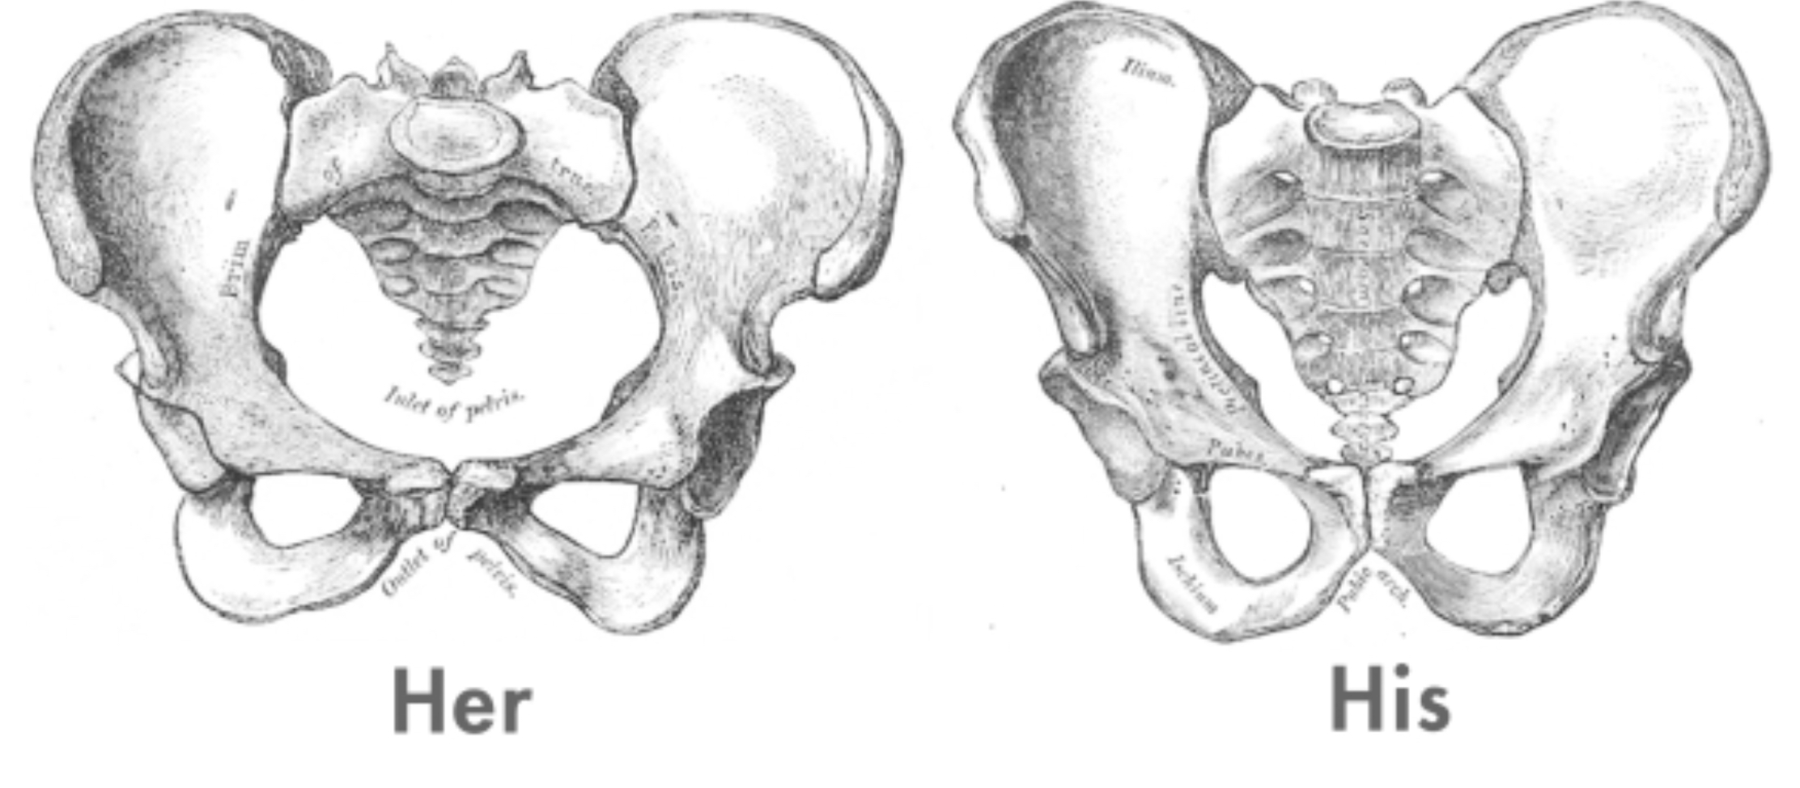
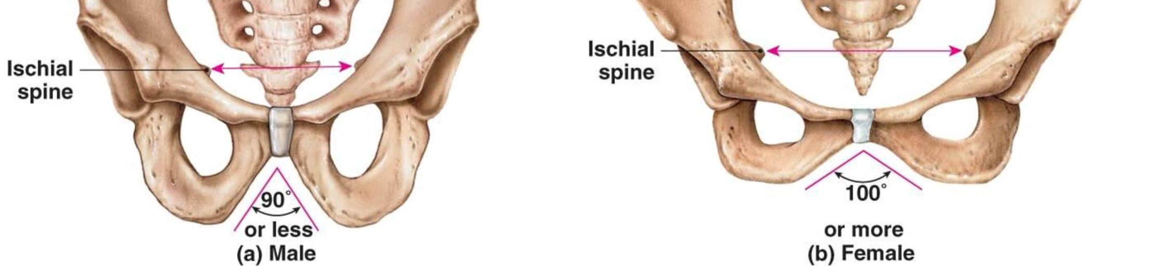
Differences between the male and female pelvis
Bony pelvis | Male | Female
General structure | Thick & heavy | Thin, Smaller & lighter
False (major) pelvis | Deep | Shallow
True (lesser) pelvis | Narrow & Deep | Wide & Shallow
Pelvic inlet | Heart shaped | Oval or Rounded
Pelvic outlet | Small | Larger
Pubic arch | Narrow | Wide
subpubic angle | Acute angle | obtuse angle
Obturator foramen | Round | Oval
Acetabulum | Large | Small
Auricular surface. | Sacrum articulates with 3 vertebrae, is fixed | Sacrum articulates with 2 vertebrae
Ischial tuberosities | Turned in | Everted
Ischial spines |  | Shorter and farther apart
Pelvic cavity | Less, small | Wide “for normal birth”
Mostly the iliac fossa
The deeper it is the smaller the cavity
Because of the everted tuberosity
The other 3 vertebrae are only bound by ligaments, during pregnancy, the ligaments relax and the sacrum moves backwards
Wide= roomer
Doctor’s notes
Male’s slides only
Females slides only

Slide 20
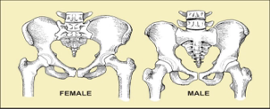
Differences between the male and female sacrum
Male | Difference | Female
Longer | Length | Shorter
Narrower | Breadth | Wider
More curved | Curvature | Less curved

Slide 21
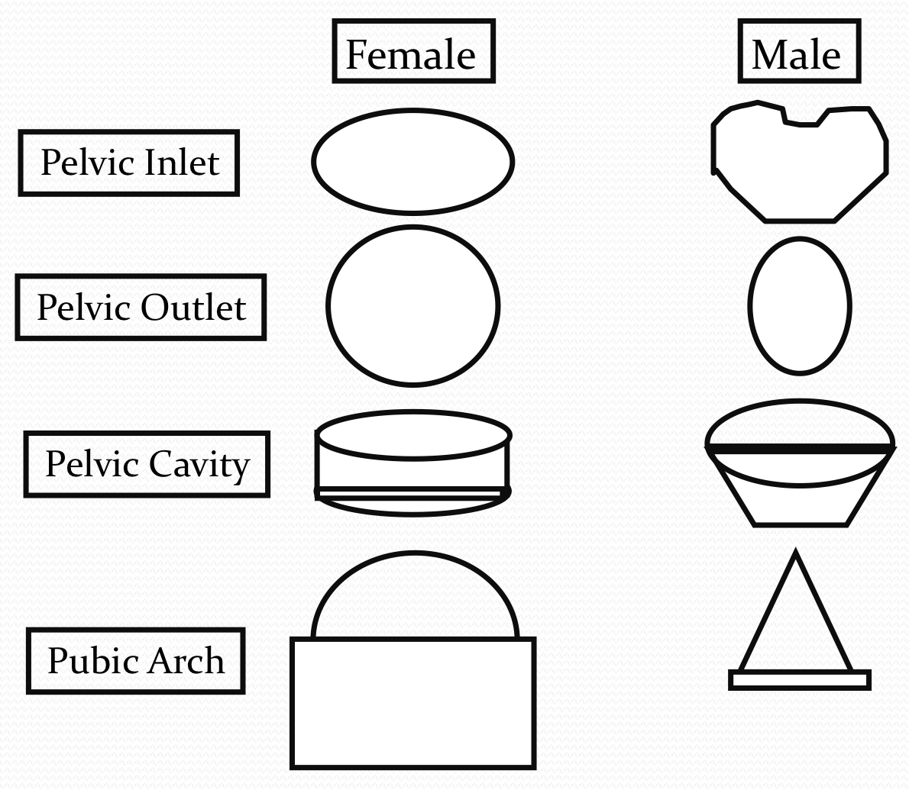
Forensic Medicine and Bony Pelvis
For identification of human skeletal remains, the bony pelvis is of prime focus of attention because sexual differences are clearly visible.
Even parts of the pelvis are useful in making a diagnosis of sex.

Slide 22
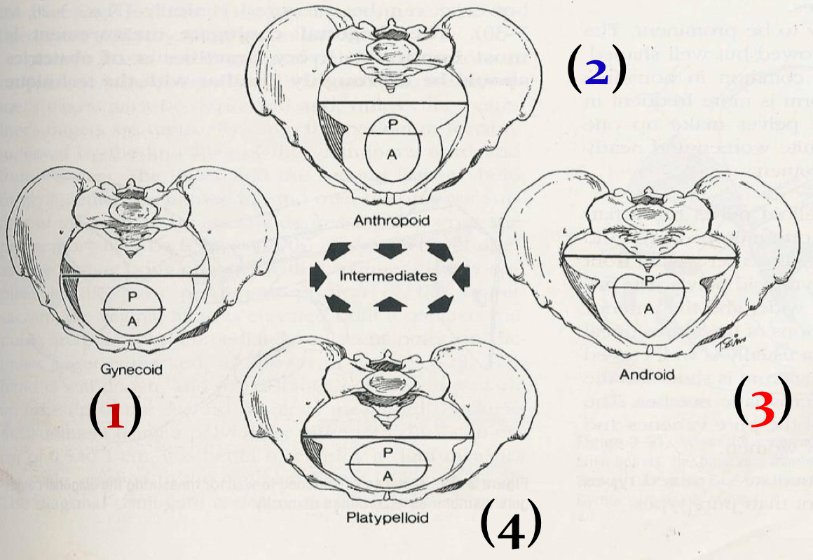
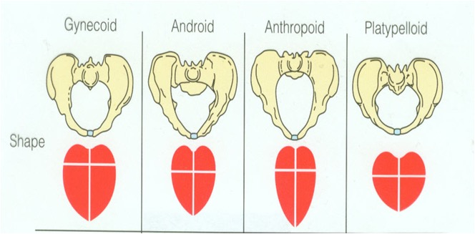
Types of Obstetrical Female Pelvis
(1)Gynaecoid: the typical female type.
(2)Anthropoid: long, narrow, and oval shaped.(Between Male & Female pelvic)
(3)Android: funnel shaped with contracted outlet. (It causes hazards to normal vaginal delivery) (close to male pelvic)
(4)Platypelloid: wide, flattened at the brim, with forward promontory. (Transverse is wider than usual)

Slide 23
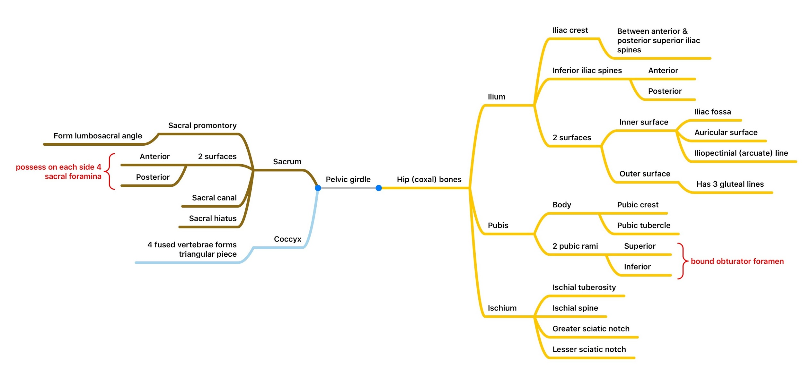
summary:
(Cartilaginous joint)
(synovial joint)

Slide 24
summary:
Foramina in Bony Pelvis:
foramina | Location | importance
(4)Sacral foramina | (2)On anterior surface of the sacrum (2)On posterior surface of the sacrum | Passes through them the anterior & posterior rami of the sacral spinal nerves
Greater and lesser sciatic foramina | Above and below the Ischial Spine *Which separates between them | allow sciatic nerve & vessels to pass from pelvis to thigh (Greater) & perinium (Lesser)
Obturator foramen | the large hole on each lateral wall of the pelvis | Obturator nerve passes through it

Slide 25
Questions
Which of the following is a secondary function of the Pelvic girdle?
Bears weight of upper body while sitting
Provides attachments & endures the forces of the muscles of locomotion and posture.
Provides attachment for external reproductive organs
4) How many types of articulations does the hip bone have?
1
2
3
7) The bony pelvis of the male is:
Thick & Heavy
Thin, Smaller & lighter
Same as female
5) the lumbosacral joint is articulation between:
Sacrum and L3 vertebra
Upper border of Sacrum and L5 vertebra
Sacrum and coccyx
8) which type of female pelvis is likely to cause hazards during normal vagina delivery?
Gynaecoid
Android
Platypelloid
2) The Iliac crest of Ilium:
Runs between the Anterior and Posterior Superior Iliac Spines.
Runs between the lateral and medial superior iliac spines
Runs between the anterior and posterior inferior iliac spines
6) The weakest part of the pelvis is:
Acetabula
Pubic bone
Ischium
3) pubis bone bounds the:
Iliac fossa
Obturator foramen
acetabulum
Answers: 1. C 2. A 3. B 4. C 5. B 6. A 7. A 8. B

Slide 26
Team Members
Faisal Fahad Alsaif (Team Leader) Abdulaziz Al dukhayel ‏Fahad Alfaiz ‏Akram Alfandi ‏Saad Aloqile ‏Saleh Almoaiqel ‏Abdulaziz Alabdulkareem ‏Abdullah Almeaither ‏Yazeed Aldossari ‏Muath Alhumood Abdulrahman Almotairi
‏
Abdulelah Aldossari ‏Abdulrahman Alduhayyim ‏Hamdan Aldossari ‏Mohammed Alomar ‏Abdulrahman Aldawood ‏Saud Alghufaily ‏Hassan Aloraini Khalid Almutairi‏‏
Lamia Abdullah Alkuwaiz (Team Leader)
Rawan Mohammad Alharbi
Abeer Alabduljabbar Afnan Abdulaziz Almustafa Ahad Algrain Alanoud Almansour Albandari Alshaye AlFhadah abdullah alsaleem Arwa Alzahrani Dana Abdulaziz Alrasheed Dimah Khalid Alaraifi Ghada Alhaidari Ghada Almuhanna Ghaida Alsanad Hadeel Khalid Awartani Haifa Alessa Khulood Alwehabi Layan Hassan Alwatban Lojain Azizalrahman Lujain Tariq AlZaid
Maha Barakah Majd Khalid AlBarrak Norah Alharbi Nouf Alotaibi Noura Mohammed Alothaim Rahaf Turki Alshammari Reham Alhalabi Rinad Musaed Alghoraiby Sara Alsultan Shahad Alzahrani Wafa Alotaibi Wejdan Fahad Albadrani Wjdan AlShamry
Abdulmajeed Alwardi ‏Abdulrahman Alageel ‏Rayyan Almousa ‏Sultan Alfuhaid ‏Ali Alammari ‏Fahad alshughaithry Fayez Ghiyath Aldarsouni ‏Mohammed Alquwayfili ‏‏Abduljabbar Al-yamani ‏Sultan Al-nasser ‏Majed Aljohani ‏Zeyad Al-khenaizan ‏Mohammed Nouri ‏Abdulaziz Al-drgam ‏Fahad Aldhowaihy ‏Omar alyabis

