Slide 1
Pectoral region and Axilla
Lecture 8
Please check our Editing File.
هذا العمل لا يغني عن المصدر الأساسي للمذاكرة
{وَمَنْ يَتَوَكَّلْ عَلَى اللَّهِ فَهُوَ حَسْبُهُ}

Slide 2
Objectives
Identify and describe the muscles of the pectoral region: - Pectoralis major - Pectoralis minor - Subclavius - Serratus anterior
Describe and demonstrate the boundaries and contents of the axilla.
Describe the formation of the brachial plexus and its branches.
Text in BLUE was found only in the boys’ slides
Text in PINK was found only in the girls’ slides
Text in RED is considered important
Text in GREY is considered extra notes

Slide 3
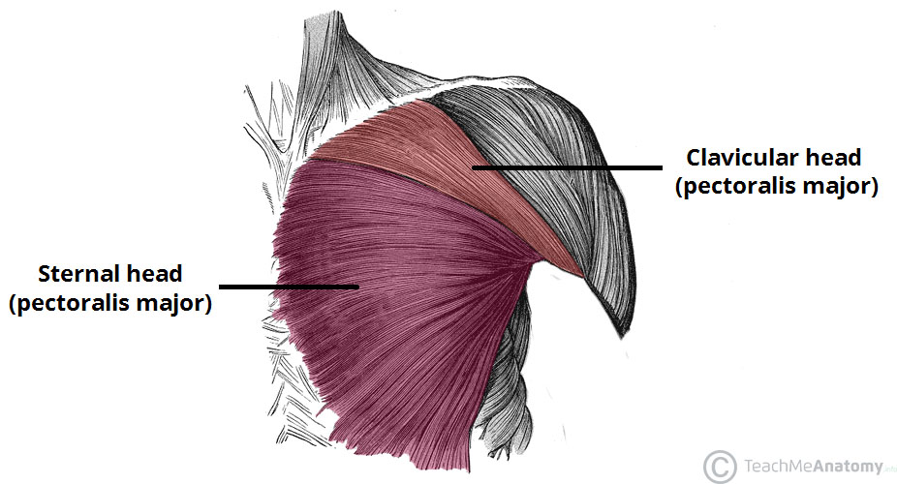
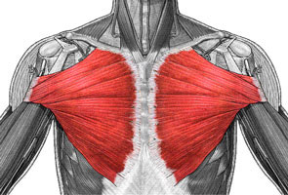
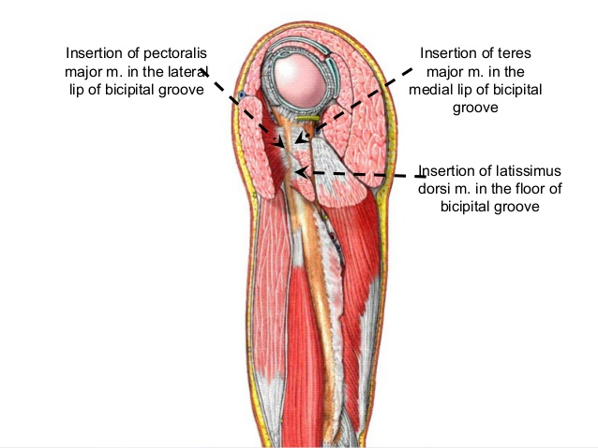
Muscles of the pectoral region
Pectoralis Major
origin | (1) Clavicular head: Medial ½ of the front of the clavicle. (2) Sternocostal head: Sternum - Upper 6 costal cartilages* - Aponeurosis** of the external oblique muscle.
insertion | Lateral lip of bicipital groove (Humerus).
Nerve supply | Medial & lateral pectoral nerves.
Action | (1) Adduction of the arm. (2) medial rotation of the arm. (3) flexion shoulder (helps by clavicular head). (4) Also it helps in climbing.
Extra picture
*Costal cartilage (hyaline cartilage that connects the ribs to the sternum) .
**Aponeurosis: a sheet of fibrous tissue which takes the place of a tendon in sheet-like muscles having a wide area of attachment.
Recall what we took in foundation: Muscles are attached to bones / ligaments / cartilage by
1) tendons 2) aponeurosis 3) raphe. **Team436

Slide 4
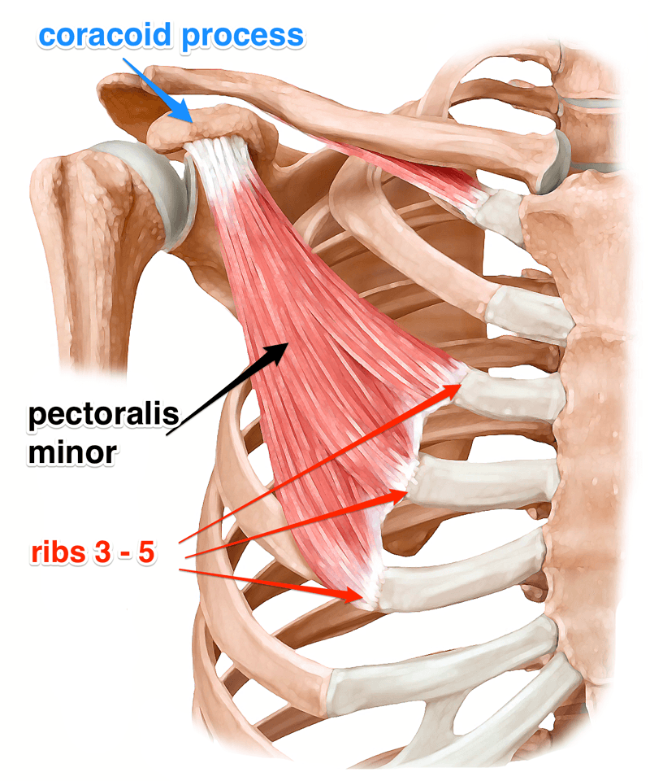
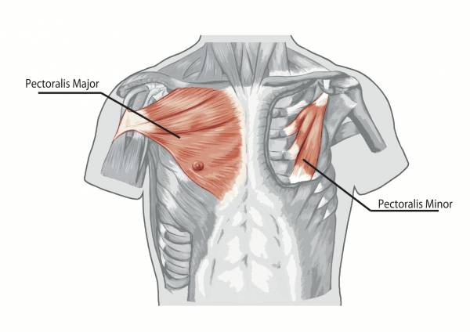
Muscles of the pectoral region
Pectoralis Minor It locate deep to Pectoralis Major
origin | 3rd ,4th, & 5th ribs close to their costal cartilages.(on the bone itself)
insertion | Coracoid process (scapula).
Nerve supply | Medial pectoral nerve.
Action | (1)Depression of the shoulder."Pectoralis Major it helps but the main is Pectoralis Minor" (2) Draw the ribs upward and outwards during deep inspiration.
Extra picture
"لما تأخذ نفس عميق "شهيق
ترتفع لفوق وتبرز لبرا"ribs الـ

Slide 5
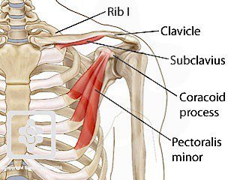
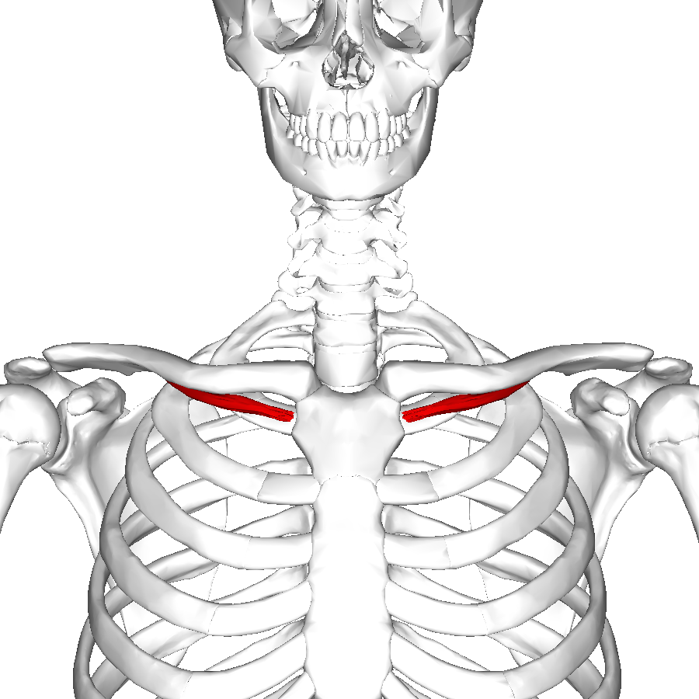
Muscles of the pectoral region
Subclavius
origin | 1st rib and its costal cartilage (1st costochondral junction).
insertion | Subclavian groove in the middle 1/3 of the inferior surface of clavicle.
Nerve supply | Nerve to subclavius from upper trunk of brachial plexus.
Action | Fixes"يثبت" the clavicle during movement of shoulder joint.

Slide 6
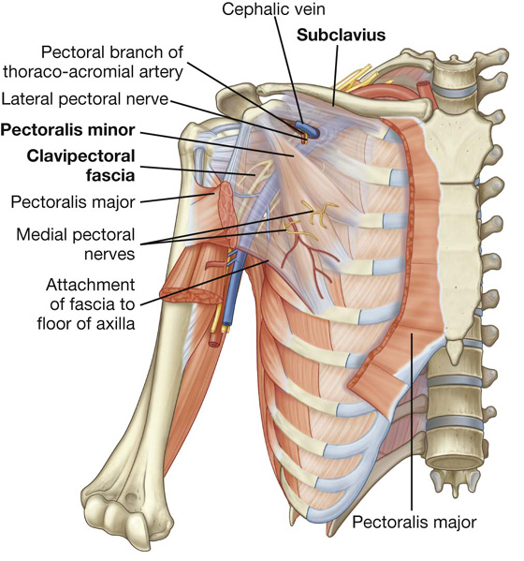
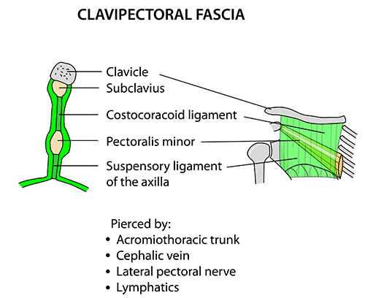
pectoral region
Clavipectoral Fascia
هي الأخضر اللي دار ما دار
fascia = dense fibrous connective tissue
For better understand watch it!
Definition:
It is a thickened membrane of deep fascia between the subclavius above and pectoralis minor below.
It’s pierced by "يمر من خلاله" : “CALL”
1- C :Cephalic vein.
2- A :Thoraco-Acromial artery.
3- L : Lateral pectoral nerve.
4- L : Few Lymph vessels.

Slide 7
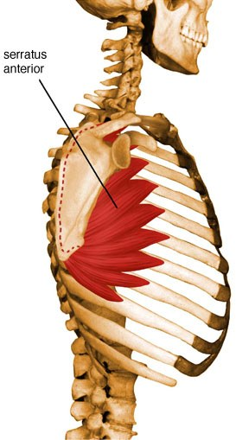
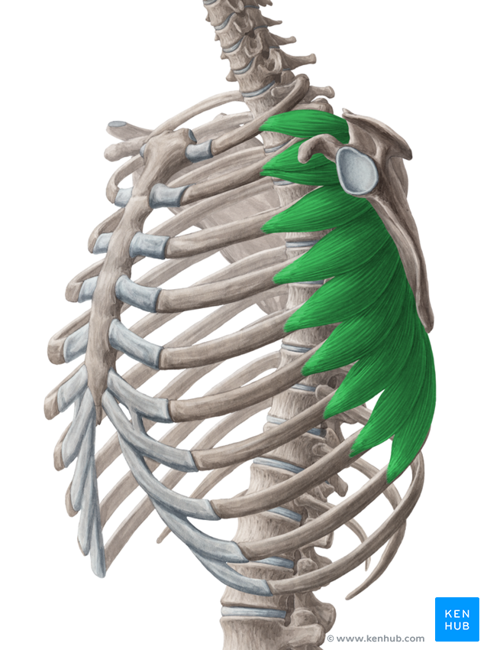
Muscles of the pectoral region
Serratus anterior
origin | Upper eight ribs.
insertion | anterior aspect of the medial border and inferior angle of scapula.
Nerve supply | Long thoracic nerve (from roots of brachial plexus,C5,6,7) “ nerve of Serratus anterior”
Action | (1) Draws the scapula forward in boxing, (protrusion or protraction*)"boxer's muscle" (2) Rotates scapula outwards in raising the arm above 90 degree (Abduction above 90) with trapezius muscle.
*Team 436:
Don’t confuse protraction and retraction.
Retraction: (when you wake up and are yawning).
Protraction: (when you extend your arm like when
punching someone or boxing hence the name boxer's muscle).
for better understand of Serratus anterior action (2:18 to 2:48)

Slide 8
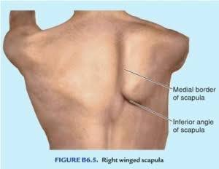
Applied Anatomy
Winging of scapula
Lesion “suffered damage” of long thoracic nerve (C5,6,7) causes : backward projection of medial border of scapula. This deformity is (Paralysis of Serratus anterior muscle)

Slide 9
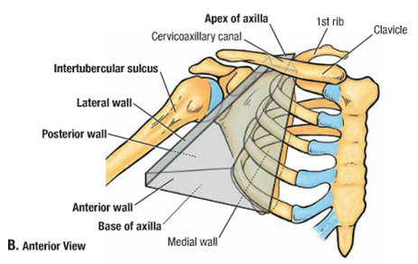
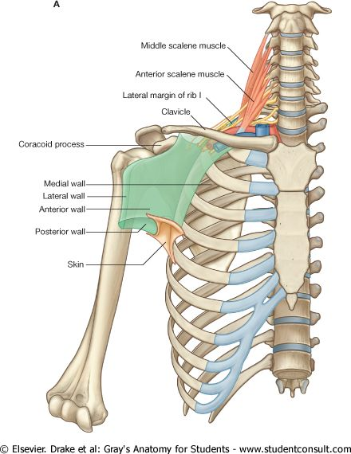
Axilla
• A 4 sided pyramidal-shaped space between the upper part of the arm and the side of the chest. • It’s the space through which major neurovascular structures pass between neck & thorax and upper limbs. The Axilla has: Apex Base Four Walls: Anterior wall Posterior wall Medial wall Lateral wall
Extra picture
for understanding

Slide 10
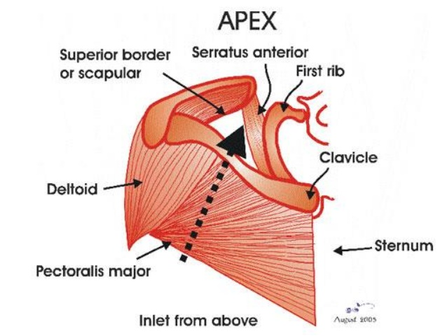
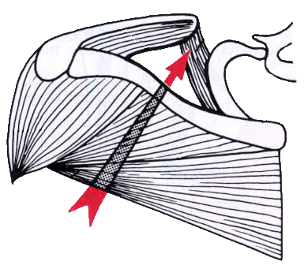
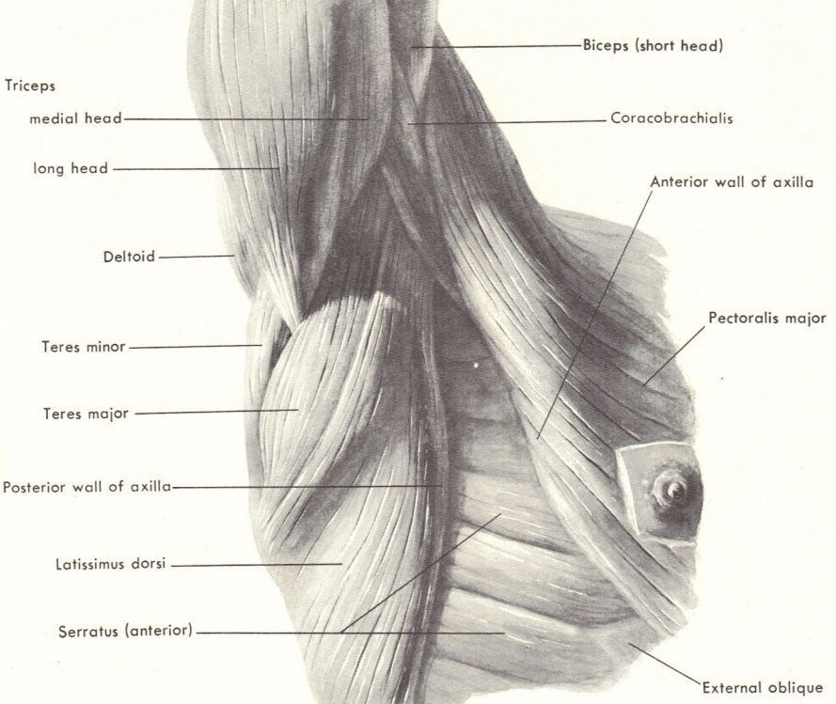
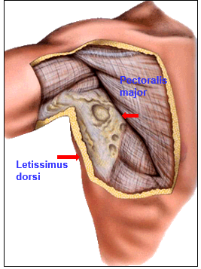
Axilla
APEX | • Is directed upwards & medially to the root of the neck. • It is called Cervicoaxillary canal (which neurovascular structures pass through) . • It is bounded, by 3 bones: - Clavicle anteriorly. - Upper border of the scapula posteriorly. - Outer border of the first rib medially.
BASE | • Formed by skin stretching between the anterior and posterior walls. The base is bounded by: • In front by the anterior axillary fold (formed by the lower border of Pectoralis major). • Behind by the posterior axillary fold (formed by tendons of latissimus dorsi and teres major). • Medially by upper 4 to 5 ribs & the chest wall. -Laterally by part of the shaft of humerus and it’s muscles.

Slide 11
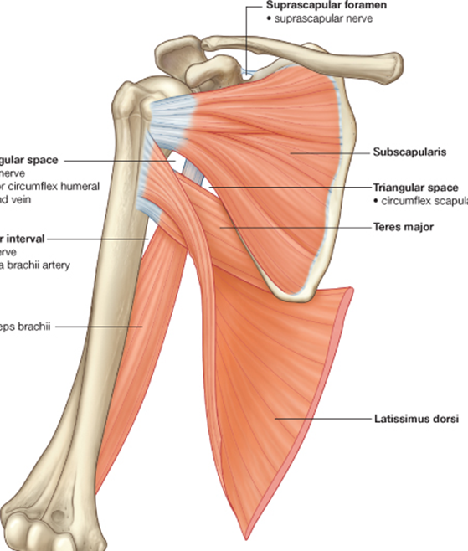
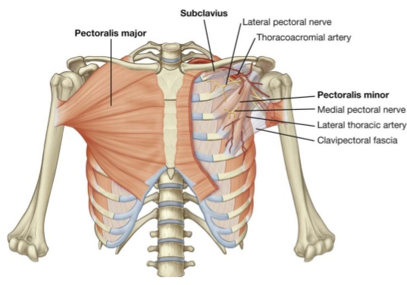
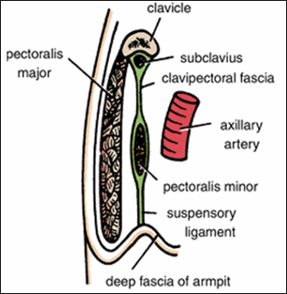
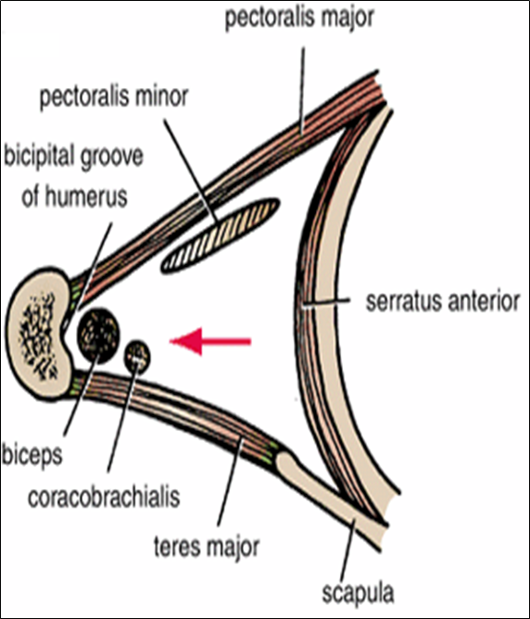
Axilla
Anterior wall | Is formed by : 1- Pectoralis major (it forms the anterior fold) 2- Pectoralis minor 3- Subclavius 4- Clavipectoral fascia
Posterior wall | Is formed by: 1- Subscapularis 2- Latissimus dorsi 3- Teres major muscles (Latissimus dorsi and Teres major muscles form the posterior fold)
Medial wall | It is WIDE and formed by: 1- Serratus anterior 2- Upper 4-5 ribs & Intercostal muscles
Lateral wall | It is NARROW and formed by: 1- Coracobrachialis 2- Biceps brachii 3- Bicipital (intertubercular) groove of the humerus
Anterior wall
Posterior wall
Upper
4-5 ribs
Anterior wall
Medial & lateral wall
Notes:
•Is formed by:
•Subscapularis.
•Latissimus dorsi.
•Teres major muscles.

Slide 12
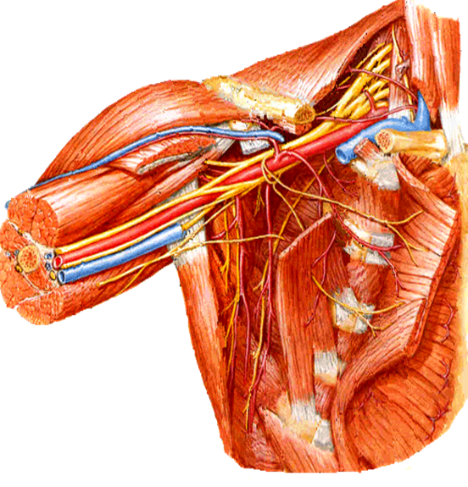
Axilla
Contents of axilla
• Cords and braches of the brachial plexus. • Axillary artery and its branches. • Axillary vein and its tributaries. • Axillary lymph nodes. • Axillary fat. • Loose connective tissue.
brachial plexus
Axillary artery
Axillary vein

Slide 13
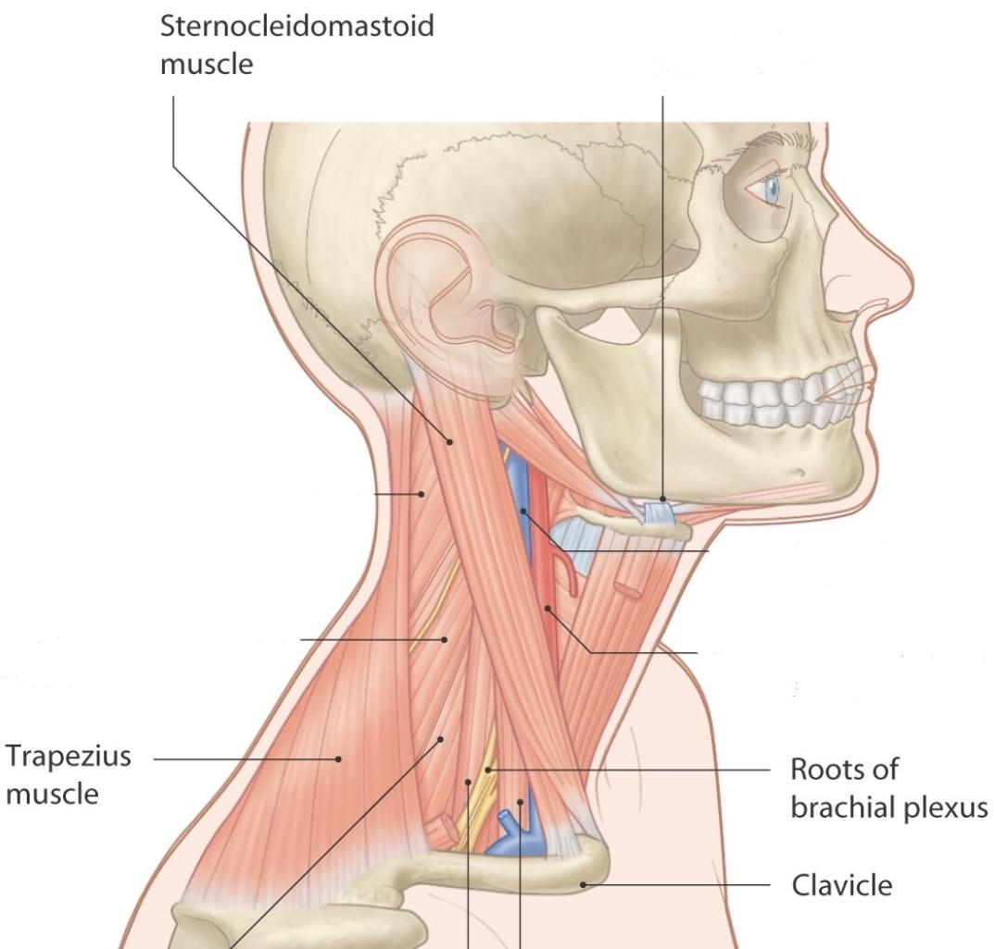
Brachial Plexus
Watch this video for a better understanding of Brachial Plexus.
The posterior triangle consists of: 1) clavicle 2) sternocleidomastoid muscle 3) trapezius
Definition: Brachial plexus is a network of nerves that is formed at the root of the neck to enter the upper limb.
Location: it is present in the posterior triangle of the neck and axilla.
Formation: it is formed by the union of the anterior Rami of the C5th, 6th, 7th, 8th (cervical spinal nerves) and the 1st thoracic spinal nerve.
Extra picture

Slide 14
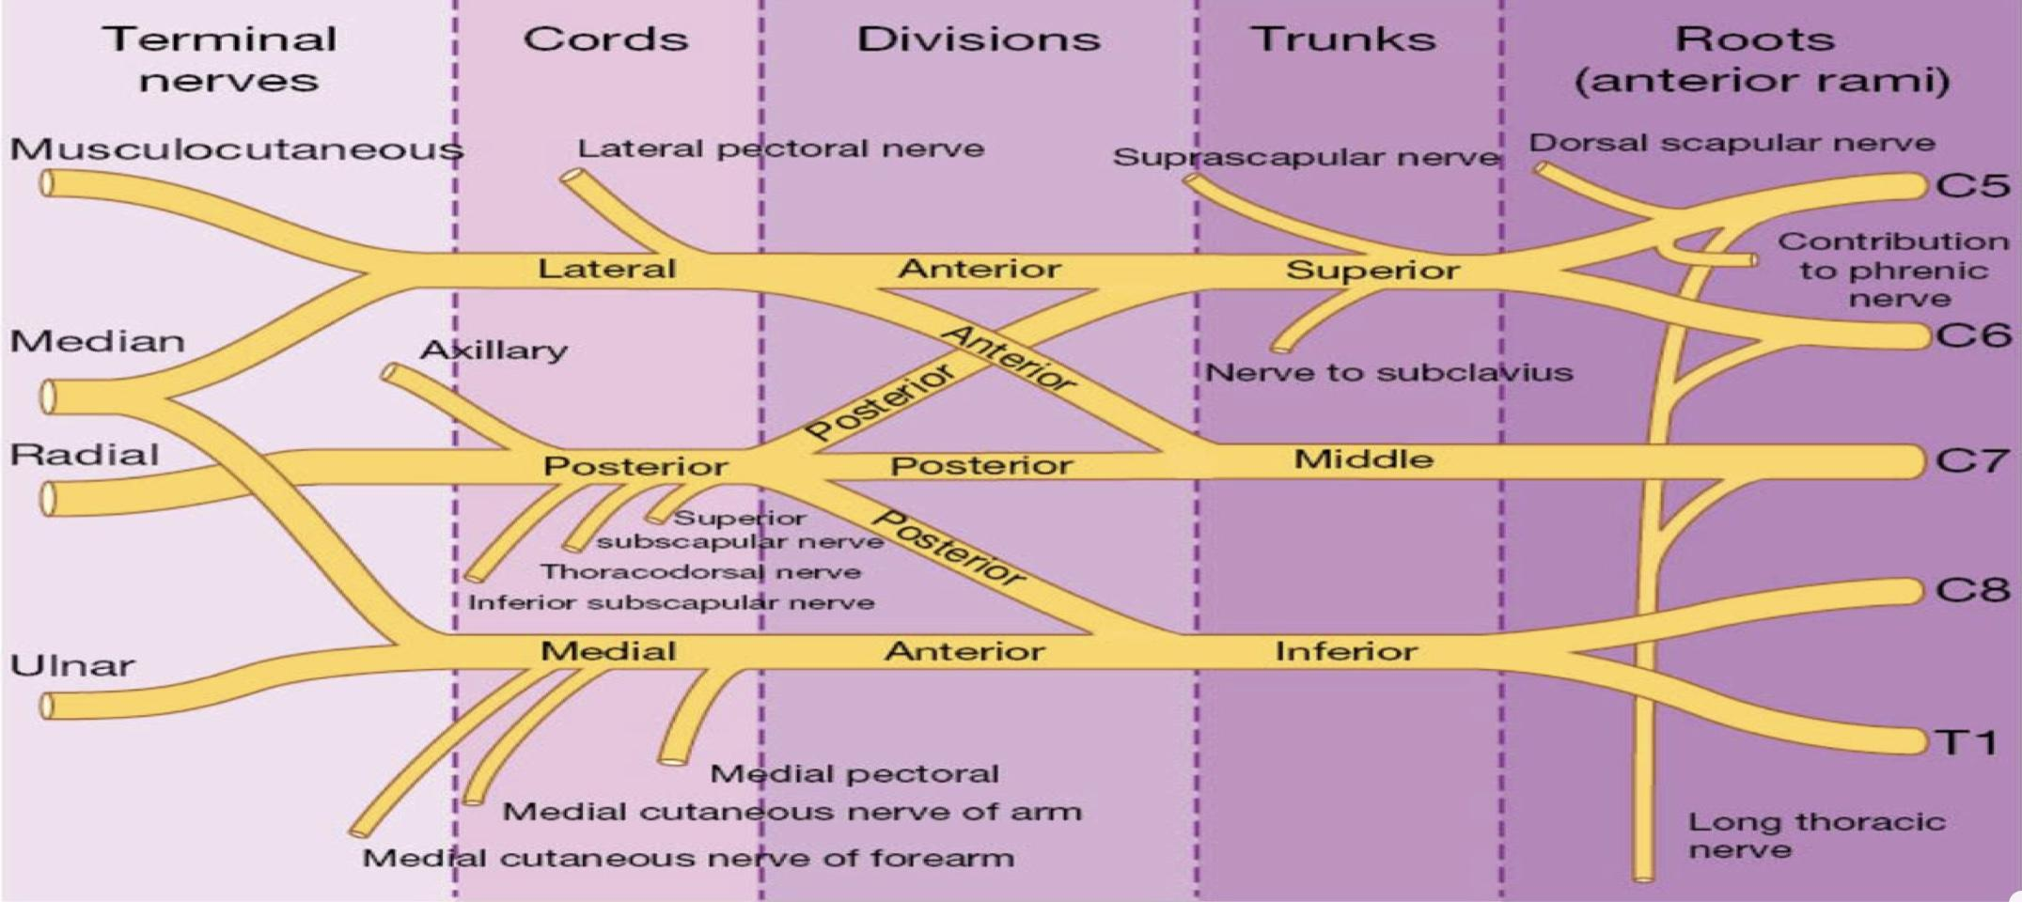
Brachial Plexus
The plexus can be divided into 5 stages:
Really Tired? … Drink Coffee
Roots from C5 and C6 unite to form upper trunk.
Roots of c7 continuous as the middle trunk.
Roots from C8 and T1 unite to form lower trunk.
Branches: in the axilla.
Cords: in the axilla.
Divisions: behind the clavicle (in cervicoaxillary canal)
Trunks: in the posterior triangle.
Roots: in the posterior triangle.
The first 2 stages lie in posterior triangle.
The last 2 stages lie in the axilla.

Slide 15
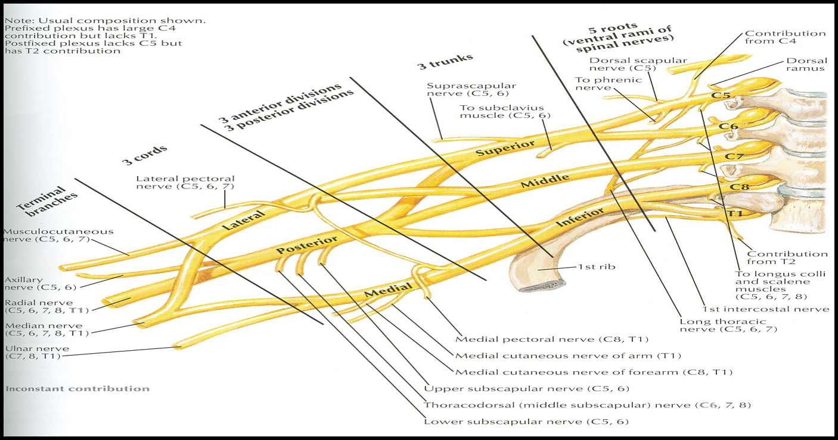
Brachial Plexus
*Each Trunk have Posterior and Anterior divisions.
The anterior divisions of the upper and middle trunks unite to form the Lateral cord.
The anterior division of the lower trunk continues as the Medial cord.
All the posterior divisions of three trunks join to form the Posterior cord.

Slide 16
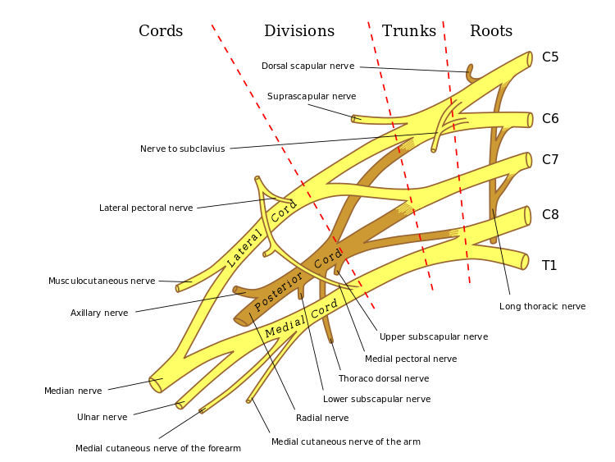
Roots | Upper trunk
Dorsal scapular nerve (C5) | Suprascapular nerve (C5,C6)
Long thoracic nerve (C5,C6,C7) | Nerve to subclavius (C5,C6)
Lateral cord-3 “Lucy Loves Me” | Medial cord-5 “Most Men Use Morphine” | Posterior cord-5 “STAR”
Lateral pectoral nerve. | Medial pectoral nerve. | Upper & lower Subscapular nerves.
Median nerve (Lateral root). | Median nerve (medial root). | Thoracodorsal (N. to latissimus dorsi).
Musculocutaneous nerve. | Ulnar Nerve | Axillary nerve
 | Medial cutaneous nerve of arm & forearm. | Radial nerve

Slide 17
Summary for Muscles of the pectoral region
Team 436

Slide 18
MCQs
(1) Insertion of pectoralis major (muscle of pectoral region) is ___________ : A- coracoid process (scapula) B- lateral lip of bicipital groove (humerus) C- subclavian groove of clavicle
(2) Clavipectoral Fascia is a thickened membrane of deep fascia between ___________ :
A- subclavius and pectoralis minor
B- subclavius and pectoralis major
C- subclavius and Serratus anterior
(3) Apex of axilla is is bounded by ___________ :
A- 4 bones
B- 2 bones
C- 3 bones
(4) Which one of these sentences about the axillary walls is/are correct :
A- the medial wall is wide, the lateral wall is narrow
B- the anterior wall is narrow, the posterior wall is wide
C- both A and B
(5) In brachial plexus the roots of C8 & T1 unite to form ___________ :
A- Upper trunk
B- Middle trunk
C- Lower trunk

Slide 19
Answers
1-B
2-A
3-C
4-A
5-C

Slide 20
Team Members
Faisal Fahad Alsaif (Team Leader) Abdulaziz Al dukhayel ‏Fahad Alfaiz ‏Akram Alfandi ‏Saad Aloqile ‏Saleh Almoaiqel ‏Abdulaziz Alabdulkareem ‏Abdullah Almeaither ‏Yazeed Aldossari ‏Muath Alhumood Abdulrahman Almotairi
‏
Abdulelah Aldossari ‏Abdulrahman Alduhayyim ‏Hamdan Aldossari ‏Mohammed Alomar ‏Abdulrahman Aldawood ‏Saud Alghufaily ‏Hassan Aloraini Khalid Almutairi‏‏
Lamia Abdullah Alkuwaiz (Team Leader)
Rawan Mohammad Alharbi
Abeer Alabduljabbar Afnan Abdulaziz Almustafa Ahad Algrain Alanoud Almansour Albandari Alshaye AlFhadah abdullah alsaleem Arwa Alzahrani Dana Abdulaziz Alrasheed Dimah Khalid Alaraifi Ghada Alhaidari Ghada Almuhanna Ghaida Alsanad Hadeel Khalid Awartani Haifa Alessa Khulood Alwehabi Layan Hassan Alwatban Lojain Azizalrahman Lujain Tariq AlZaid
Maha Barakah Majd Khalid AlBarrak Norah Alharbi Nouf Alotaibi Noura Mohammed Alothaim Rahaf Turki Alshammari Reham Alhalabi Rinad Musaed Alghoraiby Sara Alsultan Shahad Alzahrani Wafa Alotaibi Wejdan Fahad Albadrani Wjdan AlShamry
Abdulmajeed Alwardi ‏Abdulrahman Alageel ‏Rayyan Almousa ‏Sultan Alfuhaid ‏Ali Alammari ‏Fahad alshughaithry Fayez Ghiyath Aldarsouni ‏Mohammed Alquwayfili ‏‏Abduljabbar Al-yamani ‏Sultan Al-nasser ‏Majed Aljohani ‏Zeyad Al-khenaizan ‏Mohammed Nouri ‏Abdulaziz Al-drgam ‏Fahad Aldhowaihy ‏Omar alyabis

