Slide 1
Axillary & Median Nerves
Lecture 9
Please check our Editing File.
هذا العمل لا يغني عن المصدر الأساسي للمذاكرة
{وَمَنْ يَتَوَكَّلْ عَلَى اللَّهِ فَهُوَ حَسْبُهُ}

Slide 2
Objectives
Describe the origin, course, relations, branches and distribution of the axillary and median nerves
Describe the common causes and effects of injury to the axillary and median nerves
Text in BLUE was found only in the boys’ slides
Text in PINK was found only in the girls’ slides
Text in RED is considered important
Text in GREY is considered extra notes

Slide 3
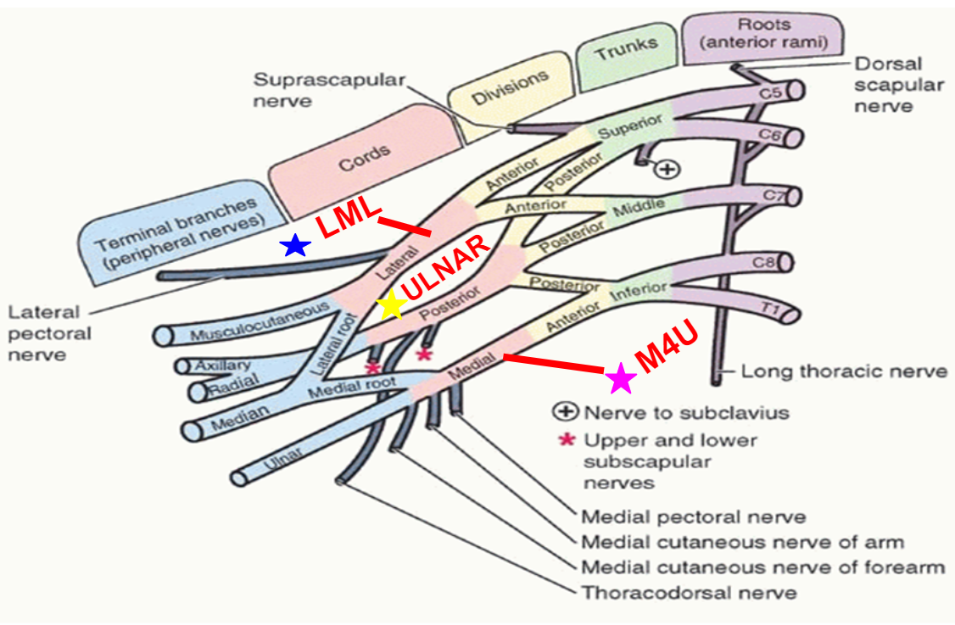
Brachial Plexus
From Lateral Cord (LML) | From Posterior Cord (ULNAR) | From Medial Cord (M4U)
Cords have C5, C6, C7 roots | ULNAR is just a mnemonic^ | All cords have C8 +T1 roots*
Lateral Pectoral Nerve | Upper Subscapular Nerve | Medial Pectoral Nerve
Musculocutaneous Nerve | Lower Subscapular Nerve | Medial root of median Nerve
Lateral root of Median Nerve | Nerve to Latissimus Dorsi (Thoracodorsal nerve) | Medial Cutaneous nerve arm
 | Axillary Nerve | Medial cutaneous nerve forearm
 | Radial Nerve | Ulnar Nerve
*:Except Ulnar nerve which is also supplied by C7

Slide 4
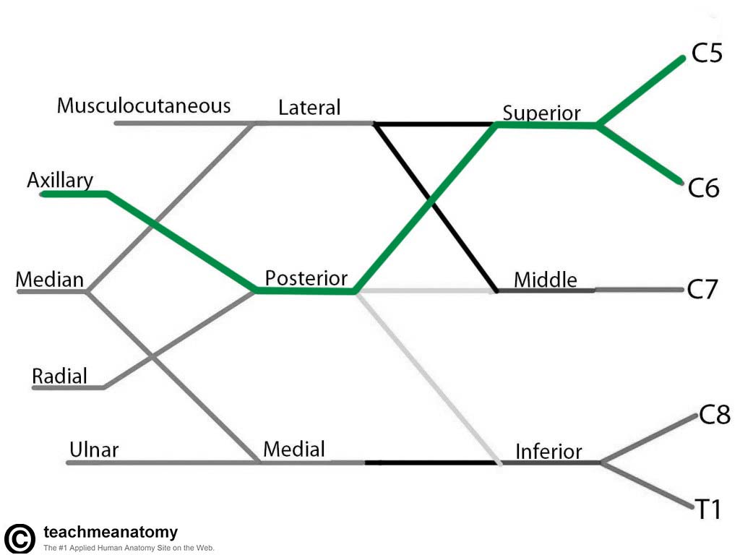
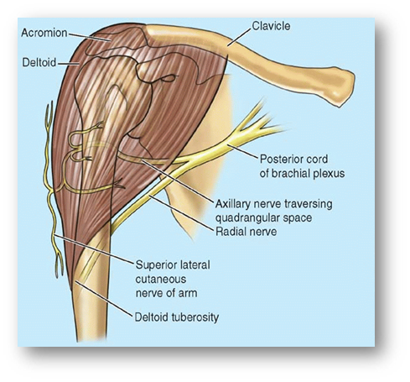
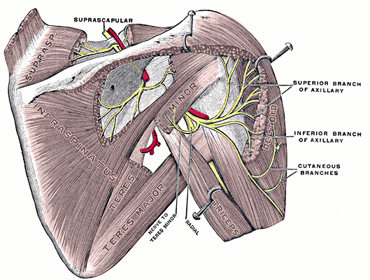
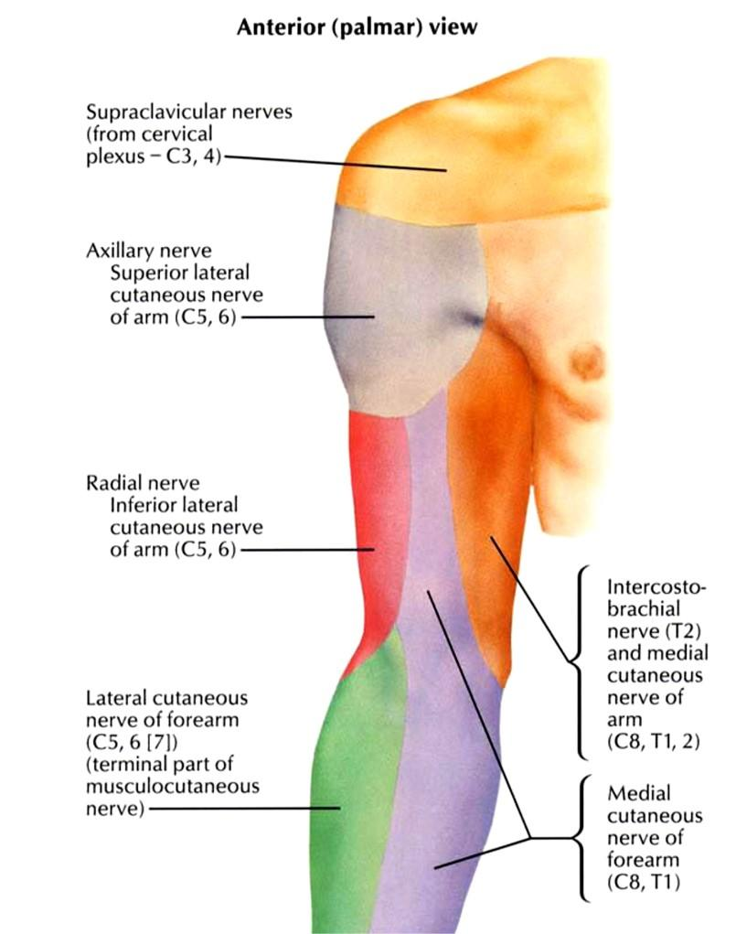
Axillary Nerve
•Origin: (C5 & C6).
•Posterior cord of brachial plexus
That means this nerve will be affected by any injury to C5 and C6 roots
•Course:
•It passes inferiorly and laterally along the posterior wall of the axilla to exit the axilla
• Then, it passes posteriorly around the surgical neck of the humerus.
•It is accompanied by the posterior circumflex humeral artery.
•Branches:
• Motor to the deltoid and teres minor muscles.
•Sensory: superior lateral cutaneous nerve of arm that loops around the posterior margin of the deltoid muscle to innervate skin in that region.

Slide 5
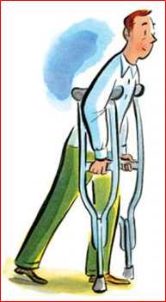
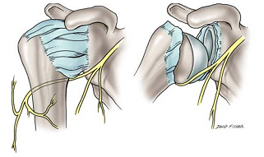
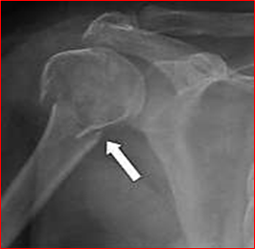
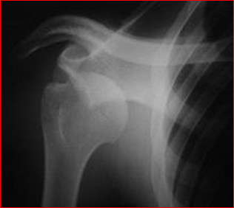
Axillary Nerve Lesion
•The Axillary Nerve is usually injured due to:
Descend to the lower part of axilla which injures the axillary nerve
The acromion and the coracoid process and the ligament , prevent the shoulder from dislocating upward and that is why it is most likely to dislocate the shoulder downward.
1.Fracture of surgical neck of the humerus.
2.Downward dislocation of the shoulder joint
3.Compression from the incorrect use of crutches.
The head of humerus leaves its place
Most common part to be fractured in the humerus.
Compression on axilla

Slide 6
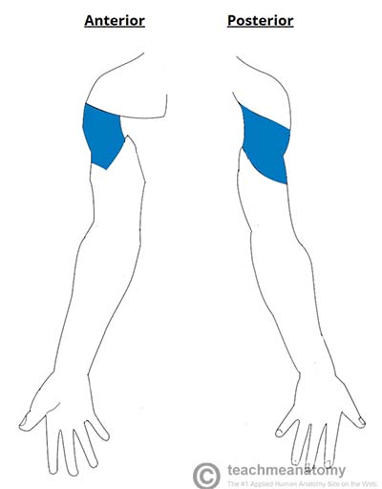
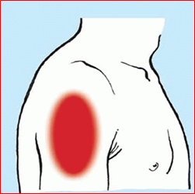
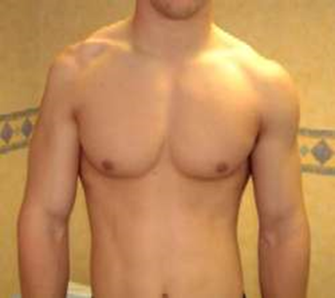
Axillary Nerve Lesion
Atrophy loss of rounded center
Abduction (15-90 degrees) (30-90 degrees) it is the only muscle with this action so it will be impaired after the injury
deltoid
Affected muscles
Lateral rotation - there are other muscles with the same action so the action won't be affected
•Motor:
•Paralysis of the deltoid and teres minor muscles.
•Impaired abduction of the shoulder (30-90˚).
•The paralyzed deltoid wastes rapidly.
•As the deltoid atrophies, the rounded contour of the shoulder is flattened compared to the uninjured side.
Teres minor
•Sensory: Loss of sensation over the lateral side of the proximal part of the arm.

Slide 7
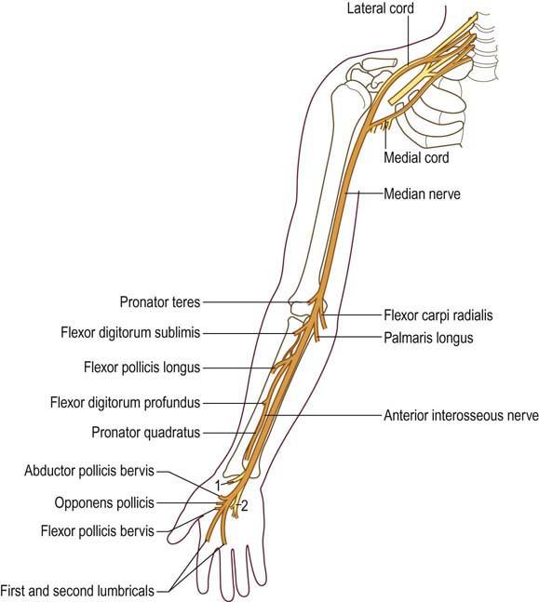
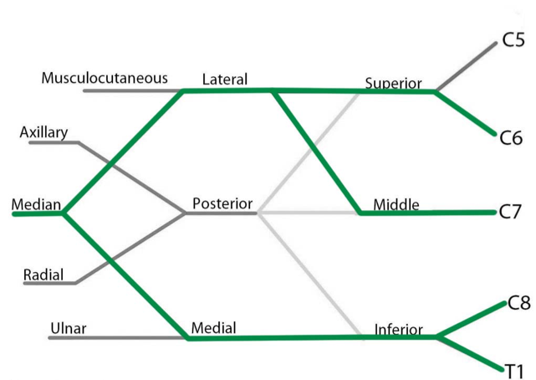
Median Nerve
•Nerve roots(Origin): (C 5, 6, 7, 8, and T1). (All roots of Brachial Plexus) - Sometimes (C6 to T1)
•The median nerve is formed anterior to the third part of the axillary artery by the union of lateral and medial roots.
•(1) The lateral root (C5,6 & 7): arises from the lateral cord of the brachial plexus.
•(2) The medial root (C8 &T1): arises from the medial cord of the brachial plexus.
Lateral Root
Medial Root

Slide 8
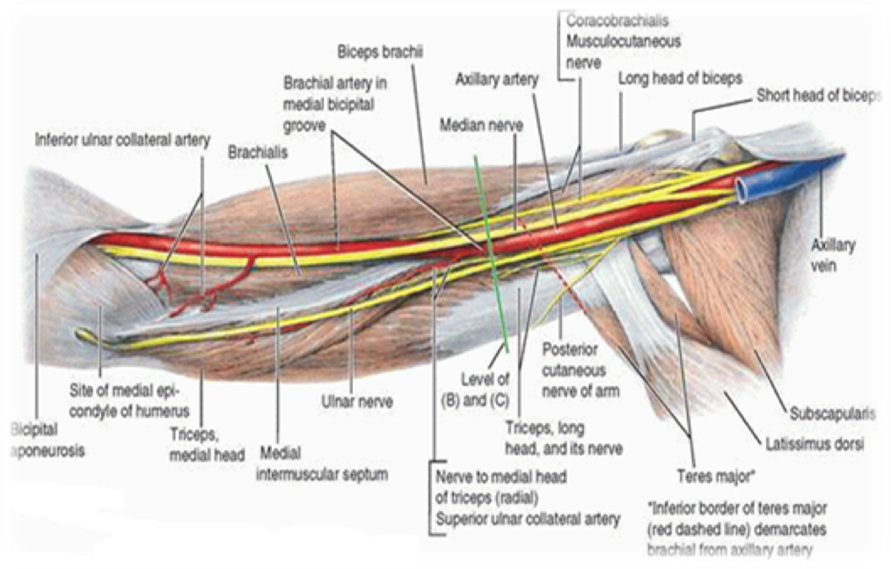
Median Nerve in the Arm
•It enters the arm from the axilla at the inferior margin of the teres major muscle.
•It passes vertically along the medial side of the arm in the anterior compartment and is related to the brachial artery throughout its course:
In upper ½ of the arm, it lies lateral to the brachial artery;
In the middle of the arm, it crosses the artery and descends on its medial side, then descends anterior to the elbow joint.
•The median nerve has no major branches in the arm, but has a branch to one of the muscles of the forearm, the pronator teres muscle, this branch may originate from the nerve immediately proximal to the elbow joint

Slide 9
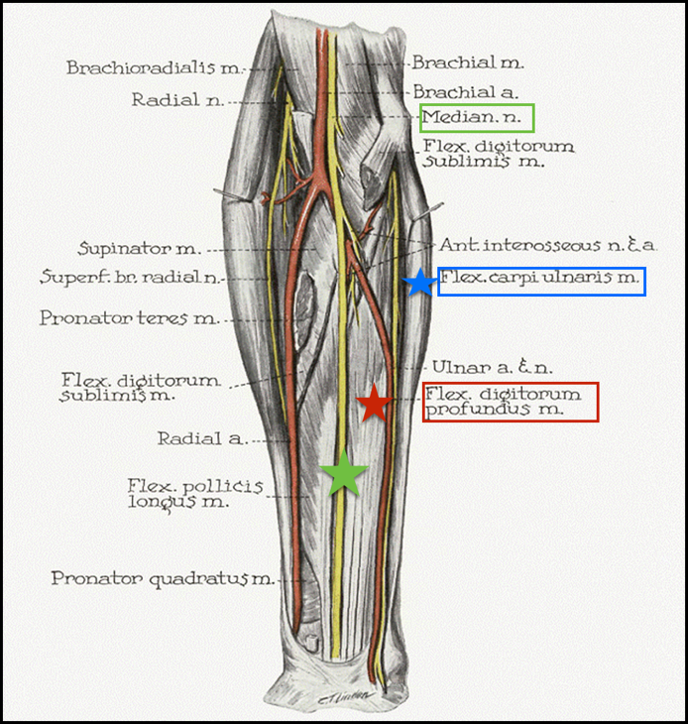
Median Nerve in the Forearm
Median nerve passes into the forearm anterior (in front of) elbow joint, between the 2 heads of the pronator teres.
•Its branches innervate most of the muscles in the anterior compartment (Flexor muscles) of the forearm, (6.5 out of 8)
•Except: (1 and half muscles)
(1)the flexor carpi ulnaris.
(2)medial half of the flexor digitorum profundus. which are supplied by the ulnar nerve.

Slide 10
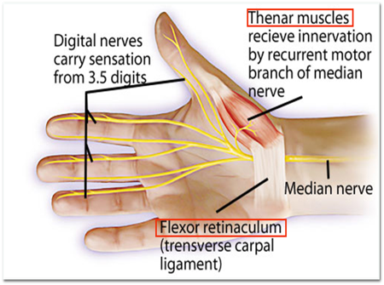
Median Nerve in the hand
The median nerve continues into the hand by passing
Deep to the flexor retinaculum.
It innervates:(5 muscles in the hand)
•The 3 thenar muscles:
Muscles associated with the
thumb.
•Lateral 2 lumbricals:
Muscles associated with movement of the index and middle fingers.
• Skin over the palmar surface of the lateral three and one-half fingers.
( thumb , index , middle , ½ ring fingers)
• The lateral 2/3rd of the palm and middle of the wrist.
• Dorsal surface in the terminal phalanges (nails) of the lateral three and half digit.

Slide 11
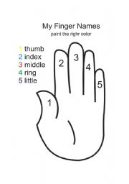
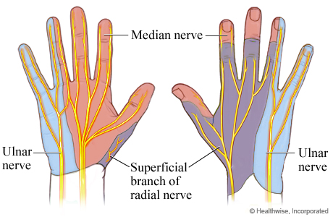
Name of the fingers
Median nerve supply to the hand

Slide 12
Median Nerve Lesion
Injury of the median nerve at different levels causes different syndromes.
In the arm and forearm the median nerve is usually not injured by trauma because of its relatively deep position.
Median nerve can be damaged in 3 areas:
• In the elbow region.
• At the wrist above the flexor retinaculum.
Flexor retinaculum:is a fibrous band on the palmar side of the hand near the wrist. It arches over the carpal bones of the hands, covering them and forming the carpal tunnel.
• In the carpal tunnel
(deep to the flexor retinaculum)
The most serious disability of median nerve injuries is:
• Loss of opposition of the thumb.
The delicate pincer-like action is not possible. All the muscles that perform the opposition movement are innervated by the median nerve, any lesion to the nerve will cause total loss of the movement.
• Loss of sensation from:
Lateral 3 ½ fingers
Lateral ⅔ of the palm

Slide 13
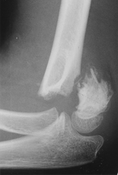
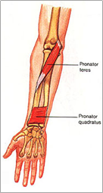
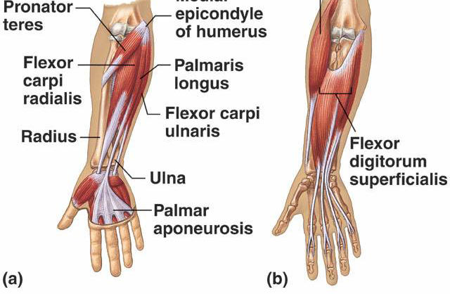
Median Nerve Lesion in the Elbow Region
Due to supracondylar fracture of humerus.
Affected Muscles:
Pronator muscles of the forearm.
All long flexors of the wrist and fingers except flexor carpi ulnaris and medial 1/2 of flexor digitorum profundus.
The muscles that aren’t affected are fed by the ulnar nerve

Slide 14
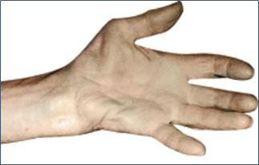
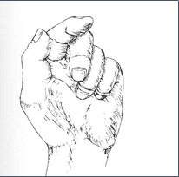
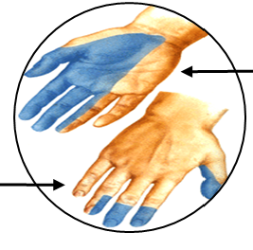
Motor:
Loss of pronation.(Hand is kept in supine position)
Weak flexion, and ulnar deviation*.
Loss of flexion of the interphalangeal joints of the index and middle fingers.
Weak flexion of ring and little finger.
Loss of flexion of terminal phalanx of thumb and loss of opposition, Thumb is adducted and laterally rotated.
Wasting of thenar eminence**.
Hand is flattened, “apelike” and unable to flex the three most radial digits when asked to make a fist.
*in normal wrist flexion
carpi radialis carpi ulnaris
(radial deviation) (ulnar deviation)
flexion
no deviation
يعني محصلتهم صفر وكل واحدة تلغي الثانية
In abnormal: one of them work only
**
Sensory:
Loss of sensation from:
Lateral 2/3rd of the palm (radial side).
Palmar aspect of the lateral 3½ fingers.
Distal part of the dorsal surface of the lateral 3½ fingers.
Trophic Changes:
Dry and scaly skin.
Easily cracking nails.
Atrophy of the pulp of the fingers.
The fleshy mass on the palmar aspect of the extremity of the finger.

Slide 15
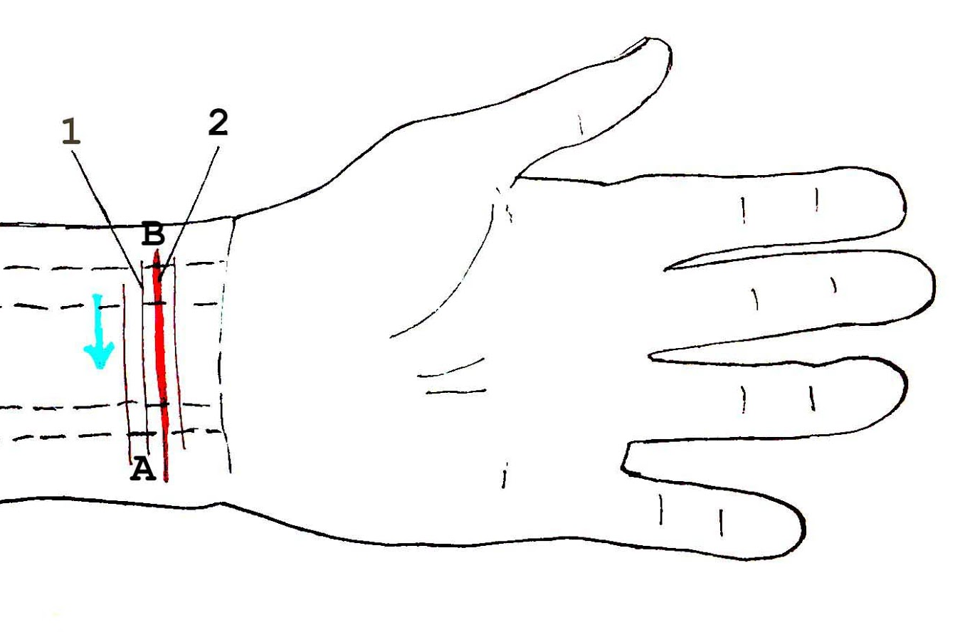
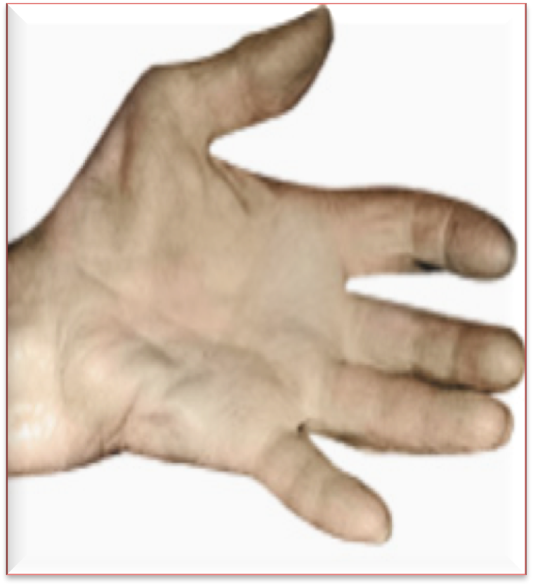
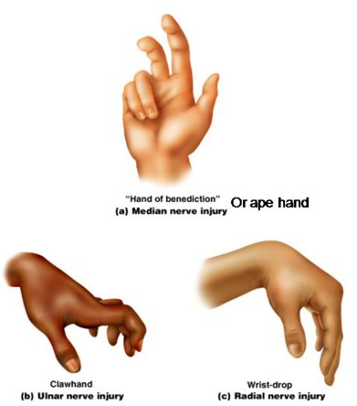
Median Nerve Lesion at the Wrist
Often injured by penetrating wounds caused by stabs or glass penetrating the forearm.
Median nerve is nourishing the 3 lateral fingers. So when it is affected it will:
Paralyze Thenar muscles (thumb muscles), the thenar muscles eventually atrophy and become flattened
Opposition & abduction of thumb are lost. Thumb and lateral two fingers (index & middle) are arrested in adduction and hyperextension position: Apelike hand
It will also result in sensory and trophic changes which are the same as in elbow region injuries, except pronation isn’t affected.

Slide 16
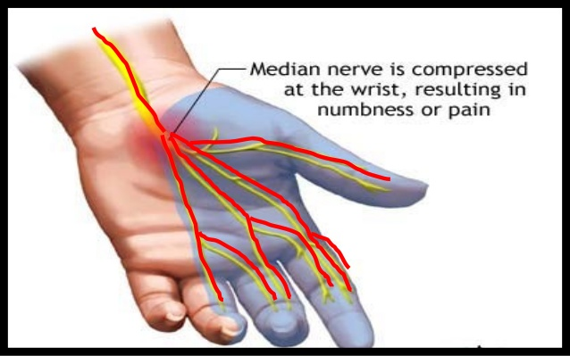
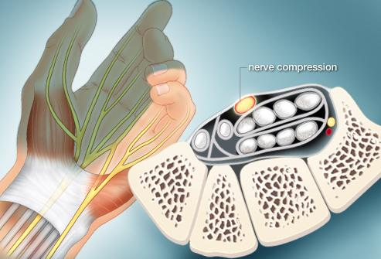
Carpal Tunnel Syndrome (Thick retinaculum)
Compression of the median nerve beneath the flexor retinaculum at the wrist caused by the thickening of the flexor retinaculum. It is by far the most common neurological problem.
Effects:
Motor: Weak motor function of thumb, index & middle finger.
Sensory: Burning pain or ‘pins and needles’ (شكشكه ودبابيس) along the lateral 3½ fingers.
No sensory changes over the palm as the palmar cutaneous branch is given before the median nerve enters the carpal tunnel. (Retinaculumلانه يمر من فوق ال)
(مقطع يساعد على الفهم)

Slide 17
Summary:
We strongly recommend using Complete Anatomy or similar apps to gain a visualization of the topic
Axillary Nerve
Origin:Posterior cord.
Spinal segments:C5, & C6
Function:
Motor:Deltoid, teres minor.
Sensory:Skin over/upper lateral part of arm.
Median Nerve
Origin: Medial and lateral cords.
Spinal segments: (C5, C6, C7, C8 & T1).
Function:
Motor: All muscles in the anterior compartment of the forearm (except FCU & medial ½ of FDP) and three thenar muscles of the thumb and two lateral lumbrical muscles.
Sensory:Skin over the palmar surface of the lateral 3½ digits and over the lateral 2/3rd of the palm of the hand.

Slide 20
Questions
1. What is the origin of the axillary nerve?
A. C5 & C6 B. C5, C6 & C7 C. C8+T1 D. C5-T1
2. Which action will be impaired after axillary nerve lesion?
A. Adduction B. Abduction C. Medial Rot. D. Lateral Rot.
3. The median nerve enters the arm at the inferior margin of:
A. Subscapularis B. Teres Major C. Teres Minor D. Deltoid
4. In the upper half of the arm the median nerve lies ___to the brachial artery:
A. Anterior B.Posterior C. Medial D. Lateral
5. The median nerve enters the forearm between the heads of:
A. Flexor Carpi Ulnaris B. Flexor Digitorum Profundus C. Pronator Teres D. Pronator Quadratus
6. If the median nerve is damaged which of the following will be affected but not fully:
A. Flexor Carpi Ulnaris B. Flexor Digitorum Profundus C. Pronator Teres D. Pronator Quadratus
7. Lesion of median nerve at the elbow occurs due to:
A. Carpal tunnel syndrome B. Thickening of flexor retinaculum C. Supracondylar fracture (humerus) D. Trauma to elbow joint
8. Axillary nerve lesion will lead to loss of sensory in:
A. Lateral ⅔ of palm B. Anterior aspect of forearm C. Lateral superior aspect of arm D. Anterior aspect of arm
9. Median nerve lesion will lead to:
A. Ape hand B. Claw hand
C. Wrist drop D. Tarsal Tunnel Syndrome
10.Which of the following is a symptom in carpal tunnel syndrome?
A.scaly skin B. Burning pain in lateral 3&½ fingers C.Atrophy of the pulp of the fingers. D. A&C
1-A 2-B 3-B 4-D 5-C 6-B 7-C 8-C 9-A 10-B

Slide 21
Team Members
Faisal Fahad Alsaif (Team Leader) Abdulaziz Al dukhayel ‏Fahad Alfaiz ‏Akram Alfandi ‏Saad Aloqile ‏Saleh Almoaiqel ‏Abdulaziz Alabdulkareem ‏Abdullah Almeaither ‏Yazeed Aldossari ‏Muath Alhumood
Abdulrahman Almotairi ‏
Abdulelah Aldossari ‏Abdulrahman Alduhayyim ‏Hamdan Aldossari ‏Abdullah Alqarni ‏Mohammed Alomar ‏Abdulrahman Aldawood ‏Saud Alghufaily ‏Hassan Aloraini
Khalid Almutairi ‏‏
Lamia Abdullah Alkuwaiz (Team Leader)
Rawan Mohammad Alharbi
Abeer Alabduljabbar Afnan Abdulaziz Almustafa Ahad Algrain Alanoud Almansour Albandari Alshaye AlFhadah abdullah alsaleem Arwa Alzahrani Dana Abdulaziz Alrasheed Dimah Khalid Alaraifi Ghada Alhaidari Ghada Almuhanna Ghaida Alsanad Hadeel Khalid Awartani Haifa Alessa Khulood Alwehabi Layan Hassan Alwatban Lojain Azizalrahman Lujain Tariq AlZaid
Maha Barakah Majd Khalid AlBarrak Norah Alharbi Nouf Alotaibi Noura Mohammed Alothaim Rahaf Turki Alshammari Reham Alhalabi Rinad Musaed Alghoraiby Sara Alsultan Shahad Alzahrani Wafa Alotaibi Wejdan Fahad Albadrani Wjdan AlShamry
Abdulmajeed Alwardi ‏Abdulrahman Alageel ‏Rayyan Almousa ‏Sultan Alfuhaid ‏Ali Alammari ‏Fahad Alshughaithry Fayez Ghiyath Aldarsouni ‏Mohammed Alquwayfili ‏‏Abduljabbar Al-yamani ‏Sultan Al-nasser ‏Majed Aljohani ‏Zeyad Al-khenizan ‏Mohammed Nouri ‏Abdulaziz Al-drgam ‏Fahad Aldhowaihy ‏Omar alyabis

