Slide 1
Frontal Lateral Compartments of the leg and dorsum foot
Lecture 20
Please check our Editing File.
هذا العمل لا يغني عن المصدر الأساسي للمذاكرة
{وَمَنْ يَتَوَكَّلْ عَلَى اللَّهِ فَهُوَ حَسْبُهُ}

Slide 2
Objectives:
At the end of the lecture, student should be able to: Identify the deep fascia of leg Identify the fascial compartments of the leg Describe the anatomy of the anterior & lateral compartments List the contents of each compartment (muscles, vessels & nerves) Describe the anatomy and contents of the dorsum of the foot
Text in BLUE was found only in the boys’ slides
Text in PINK was found only in the girls’ slides
Text in RED is considered important
Text in GREY is considered extra notes

Slide 3
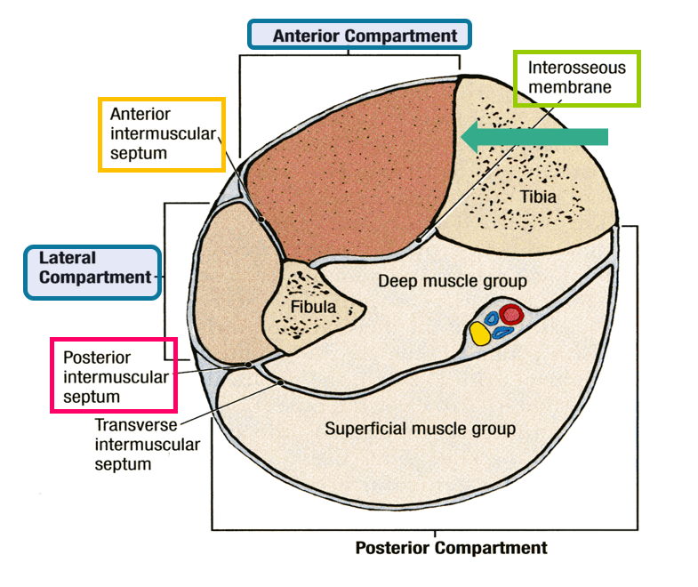
Fascia of the leg
•The deep fascia surrounds the leg and is attached to Anterior & Medial borders of Tibia.
•Two Intermuscular Septa:
Pass from the deep aspect of this fascia to be attached to :
Anterior border of fibula (Anterior intermuscular septum)
Posterior border of fibula (Posterior intermuscular septum)
•Interosseous membrane:
A thin & strong membrane, that binds the interosseous borders of tibia & fibula. It binds the two bones and provides attachment for muscles.

Slide 4
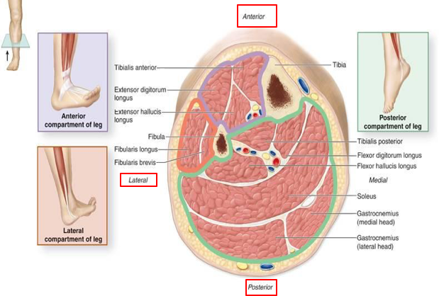
Fascial Compartments of Leg
Dorsi flexion
The interosseous membrane and the two intermuscular septa divide the leg into
3 Compartments:
1. Anterior 2. Lateral (peroneal) 3. Posterior
Each one has its own Muscles (with specific action), Blood vessels and Nerves.
Eversion
Plantar flexion

Slide 5
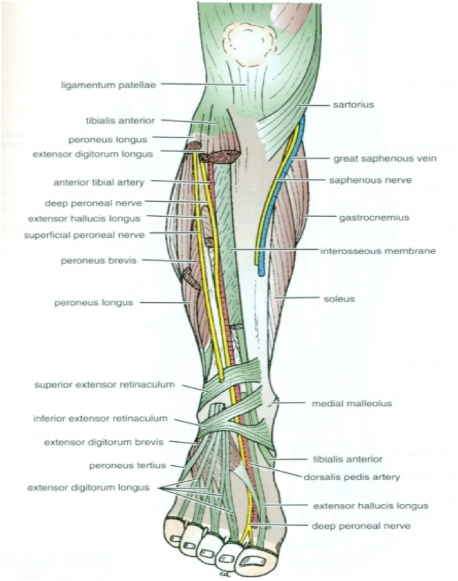
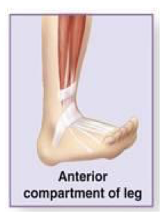
Anterior Compartment:
Muscles :
Extensor Hallucis Longus, Extensor Digitorum Longus, Peroneus Tertius, Tibialis Anterior
•All muscles take origin from the fibula EXCEPT Tibialis Anterior.
Nerve supply:
•Deep Peroneal.
Blood Supply:
•Anterior tibial.
Action: Dorsiflexion (extension) of the ankle joint & Extension of the toes & Inversion (tibialis anterior & extensor hallucis longus only).

Slide 6
Anterior comp. of leg | Origin | Insertion | Action | BLOOD & NERVE SUPPLY
TIBIALIS ANTERIOR | Lateral surface of shaft of tibia & interosseous membrane | Medial cuneiform & Base of first metatarsal bone | Extends foot/dorsiflexion Inverts foot at subtalar & transverse tarsal joints & Holds up medial longitudinal arch of foot | ANTERIOR TIBIAL & DEEP PERONEAL
EXTENSOR DIGITORUM LONGUS | Anterior surface of shaft of fibula | Extensor expansion of lateral four toes | Extends toes Extends foot/dorsiflexion
PERONEUS TERTIUS peroneus=fibularis | Anterior surface of shaft of fibula | Base of 5th metatarsal bone | Extends foot/dorsiflexion Everts foot at subtalar & transverse tarsal joints (The only evertor in the anterior compartment)
EXTENSOR HALLUCIS LONGUS hallucis=big toe | Anterior surface of shaft of fibula | Base of distal phalanx of great toe | Extends big toe Extends foot/dorsiflexion Inverts foot at subtalar & transverse tarsal joints

Slide 7
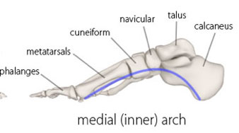
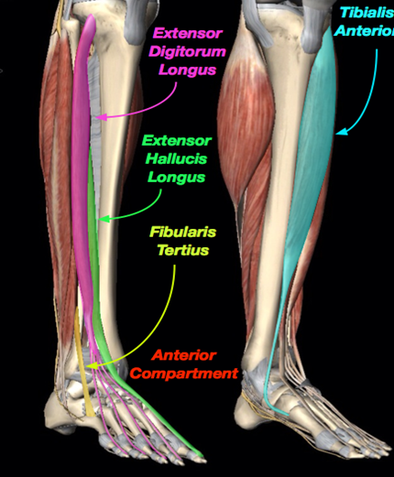
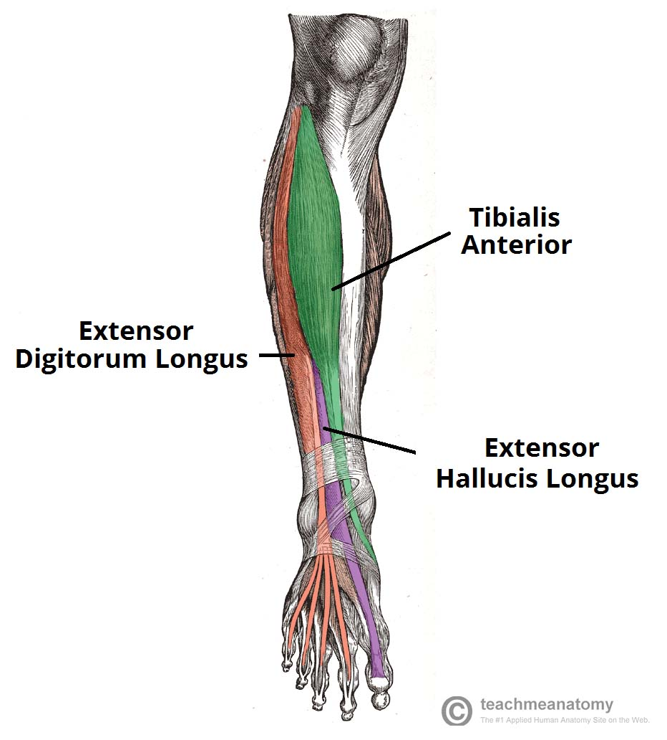
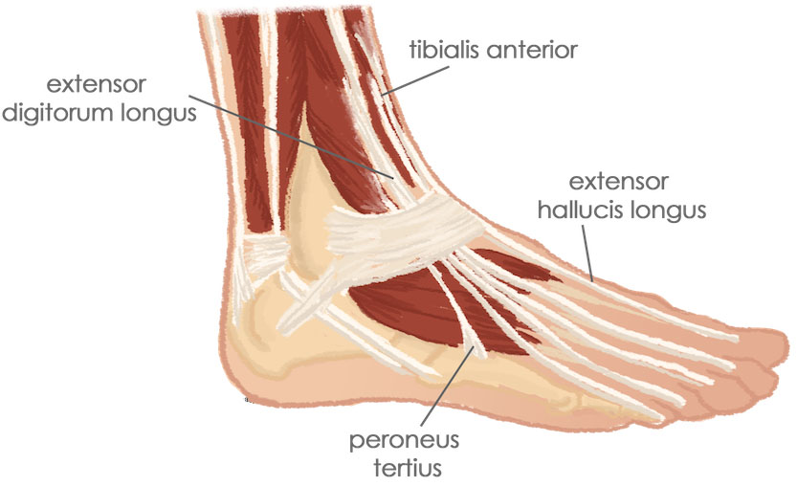
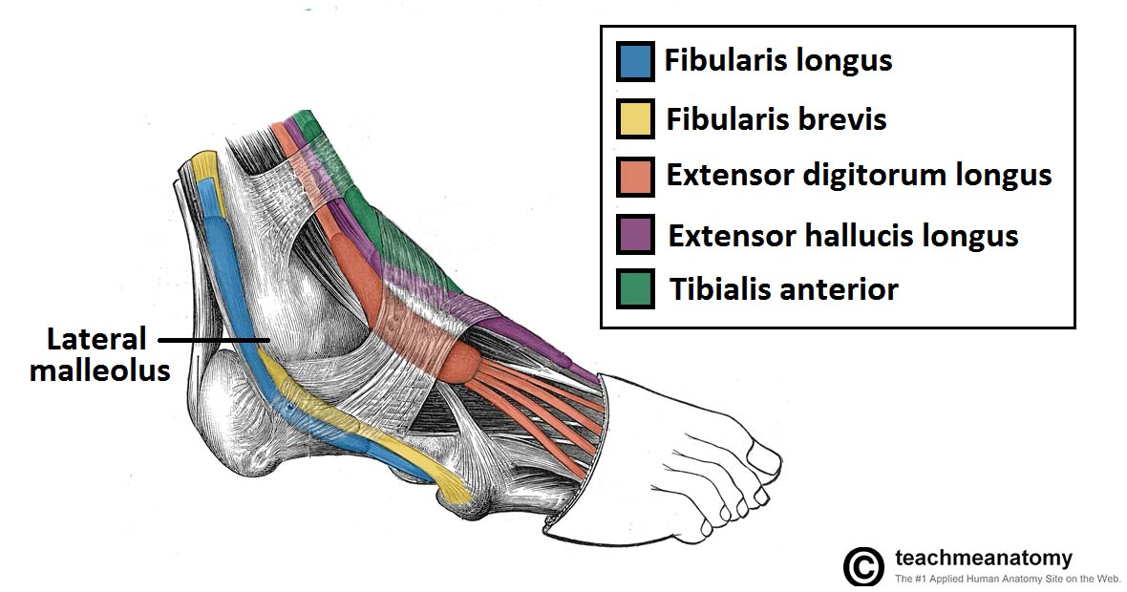
Anterior Compartment:
Visuals to help understanding:
Tibialis anterior attachment to inferior surface of cuneiform and metatarsal

Slide 8
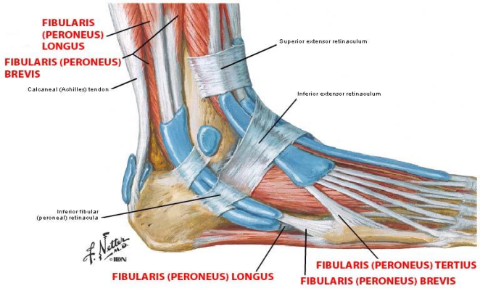
Extensor Retinacula
•A thickening of deep fascia that keeps the
long tendons around the ankle joint in position.
Superior extensor retinaculum:
•Attached to anterior borders of tibia and fibula above ankle.
(above lateral and medial malleolus)
Inferior extensor retinaculum:
•Y-shaped band located inferior to ankle.
(its base is attached to the calcaneum)

Slide 9
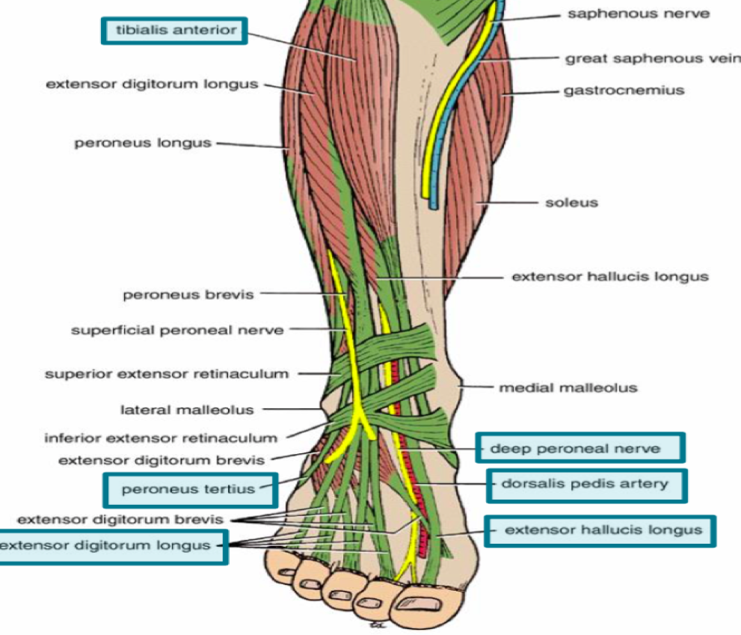
Structures passing deep to extensor retinacula
From medial to lateral :
1-Tom: Tibialis Anterior
2-Has: Extensor hallucis longus tendon
3-Very: Anterior tibial vessels
4-Nice: Deep peroneal nerve
5-Dog: Extensor digitorum longus tendon
6-Pigeon: Peroneus tertius tendon
&
These structures pass both superior & inferior retinacula

Slide 10
Lateral Compartment of the Leg:
*Peroneus brevis only supports lateral longitudinal arch while Peroneus longus supports it + transverse arch
Muscles | Origin | Insertion | Action | Blood & Nerve Supply
Peroneus Longus | Lateral surface of shaft of fibula | Base of first metatarsal + medial cuneiform* (same as Tibialis Anterior) | Plantar flexes foot at ankle joint; Everts foot at subtalar and transverse tarsal joints; Supports Lateral longitudinal & transverse* arches | Peroneal Artery & Superficial Peroneal Nerve
Peroneus Brevis |  | Base of fifth metatarsal (same as Peroneus Tertius)

Slide 11
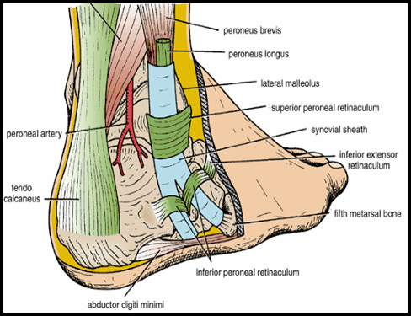
Peroneal Retinacula
One single sheath
Superior peroneal retinaculum
Connects the lateral malleolus to calcaneum & holds the tendons of peroneus longus & brevis
Inferior peroneal retinaculum
Synovial Sheaths of Peroneal Longus & Brevis:
Above the superior peroneal retinaculum tendons of peronei are surrounded by
a single common tubular synovial sheath.
Below the superior peroneal retinaculum, they have separate sheaths.
Each tendon has its own

Slide 12
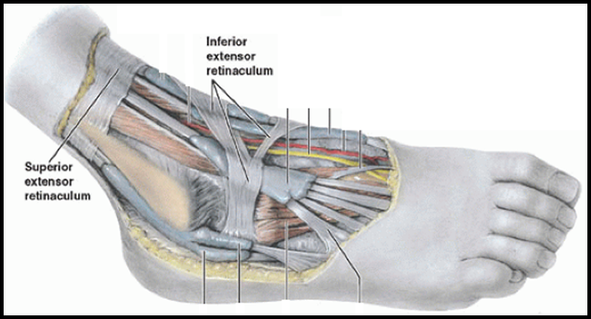
Deep Fascia of Dorsum of Foot
It is very thin, but just distal to the ankle joint, it is thickened to form the Inferior extensor retinaculum

Slide 13
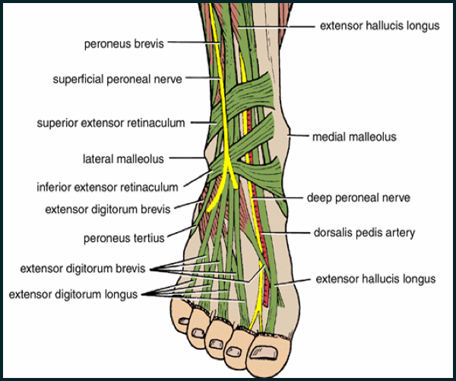
Dorsum of Foot
MUSCLE | BLood VESSEL | NERVE
Extensor Digitorum Brevis | Dorsalis Pedis | DEEP & Superficial Peroneal
Continuation of anterior tibial artery
Fibular = peroneal

Slide 14
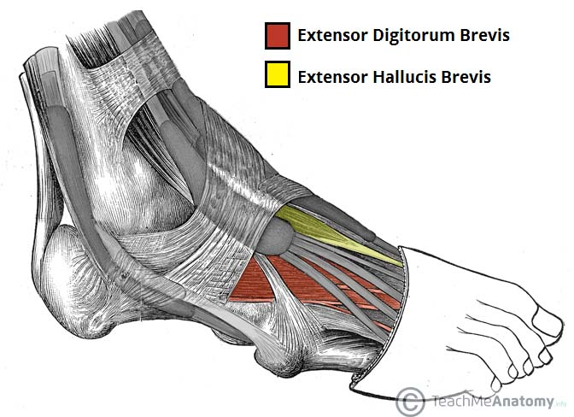
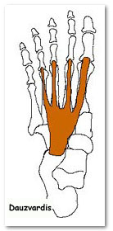
Extensor Digitorum Brevis
Muscle | Blood & Nerve Supply | Origin | Insertion | Action
Extensor Digitorum Brevis | Dorsalis pedis & Deep & superficial Peroneal | Anterior part of upper surface of the Calcaneum & from the Inferior extensor retinaculum | four tendons into the proximal phalanx of big toe (ex hall brevis) and second, third, and fourth toes | Extend toes
insertion
origin

Slide 15
Insertion of Long Extensor Tendons (Extensor Expansion)
The tendons of Extensor digitorum longus pass to the lateral four toes.
Each tendon to the 2nd , 3rd & 4th toes is joined on its lateral side by a tendon of Extensor digitorum brevis.
The extensor digitorum tendons form:
a Fascial Expansion (Extensor Expansion) on the dorsum of each toe.
The expansion divides into (3) parts:
1-Central part: inserted into the Base of Middle phalange
2-Two Lateral parts: inserted into the Base of Distal phalange
The Extensor Expansion receives insertion of :
Interossei & Lumbrical muscles.(from the sole)
Only longus
Notes:
To be edited

Slide 16
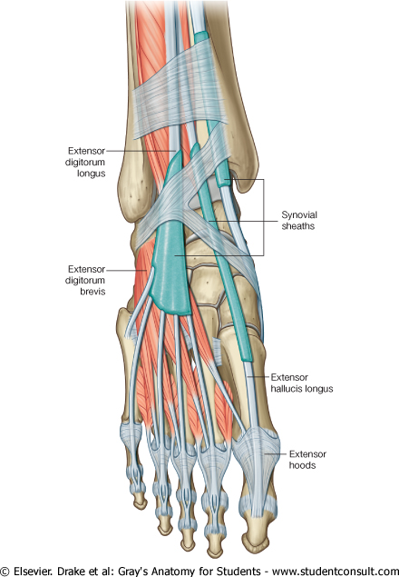
Synovial Sheaths of Extensor Tendons on the Dorsum of Foot
They surround tendons of anterior compartment muscles
1-Tibialis anterior
2-Extensor hallucis longus
(Both have their own synovial sheath)
3-Extensor digitorum longus & peroneus tertius : have a common sheath, it extends to the level of Base of 5th Metatarsal bone.(and the insertion of peroneus tertius)
Notes:
Look next slide , choose what you like most.

Slide 17
Synovial Sheaths of Extensor Tendons on the Dorsum of Foot
1-Tibialis anterior
2-Extensor hallucis longus
3-Extensor digitorum longus & peroneus tertius :
have a common sheath, it extends to the level of Base of 5th Metatarsal bone.(and the insertion of peroneus tertius)
Notes:
Choose which one you want.

Slide 19
Questions
1. Which of the following isn’t a muscle of the anterior compartment of the leg?
A- Extensor Digitorum Longus B- Extensor Hallucis Longus C- Peroneus Tertius D- Peroneus Longus
2. All of the following are attached to the fibula except?
A- Tibialis Anterior B- Extensor Digitorum Longus C- Extensor Hallucis Longus D- Peroneus Brevis
3. The insertion of the peroneus tertius is into:
A- Extensor Expansion B- Base of Distal Phalanx of big toe C- 5th Metatarsal D- 1st Metatarsal & Medial Cuneiform
4. Which of the following is medial to the vessels in the extensor retinaculum?
A- Deep Peroneal Nerve B-Extensor Hallucis Longus Tendon C-Extensor Digitorum Longus Tendon D-Peroneus Tertius Tendon
5. The nerve supplying lateral compartment of the leg is:
A- Anterior Tibial B- Deep Peroneal C- Superficial Peroneal D- Lateral Fibular
6. Which nerve supplies the anterior compartment of the leg ?
A- Anterior Tibial B-Deep Peroneal
C-Superficial Peroneal D-Lateral Fibular
7. Insertion of Extensor digitorum longus Tendons:
A- the lateral four toes B- talus
C- 5th metatarsal D- 1st metatarsal
8. Blood supply for Extensor Digitorum Brevis:
A- anterior tibial artery B-dorsalis pedis C- peroneal artery D- femoral artery
9. Which is the origin of the peroneus longus?
A-Lateral surface of shaft of fibula B- anterior surface of tibia C- medial surface of fibula D-medial surface of tibia
10. How many Intermuscular Septa pass from deep fascia to attach to fibula?
A- 1 B- 2 C-3 D-4
1-D 2-A 3-C 4-B 5-C 6-B 7-A 8-B 9-A 10-B

Slide 20
Team Members
Faisal Fahad Alsaif (Team Leader) Abdulaziz Al dukhayel ‏Fahad Alfaiz ‏Akram Alfandi ‏Saad Aloqile ‏Saleh Almoaiqel ‏Abdulaziz Alabdulkareem ‏Abdullah Almeaither ‏Yazeed Aldossari ‏Muath Alhumood
Abdulrahman Almotairi ‏
Abdulelah Aldossari ‏Abdulrahman Alduhayyim ‏Hamdan Aldossari ‏Abdullah Alqarni ‏Mohammed Alomar ‏Abdulrahman Aldawood ‏Saud Alghufaily ‏Hassan Aloraini
Khalid Almutairi ‏‏
Lamia Abdullah Alkuwaiz (Team Leader)
Rawan Mohammad Alharbi
Abeer Alabduljabbar Afnan Abdulaziz Almustafa Ahad Algrain Alanoud Almansour Albandari Alshaye AlFhadah abdullah alsaleem Arwa Alzahrani Dana Abdulaziz Alrasheed Dimah Khalid Alaraifi Ghada Alhaidari Ghada Almuhanna Ghaida Alsanad Hadeel Khalid Awartani Haifa Alessa Khulood Alwehabi Layan Hassan Alwatban Lojain Azizalrahman Lujain Tariq AlZaid
Maha Barakah Majd Khalid AlBarrak Norah Alharbi Nouf Alotaibi Noura Mohammed Alothaim Rahaf Turki Alshammari Reham Alhalabi Rinad Musaed Alghoraiby Sara Alsultan Shahad Alzahrani Wafa Alotaibi Wejdan Fahad Albadrani Wjdan AlShamry
Abdulmajeed Alwardi ‏Abdulrahman Alageel ‏Rayyan Almousa ‏Sultan Alfuhaid ‏Ali Alammari ‏Fahad Alshughaithry Fayez Ghiyath Aldarsouni ‏Mohammed Alquwayfili ‏‏Abduljabbar Al-yamani ‏Sultan Al-nasser ‏Majed Aljohani ‏Zeyad Al-khenizan ‏Mohammed Nouri ‏Abdulaziz Al-drgam ‏Fahad Aldhowaihy ‏Omar alyabis

