Slide 1


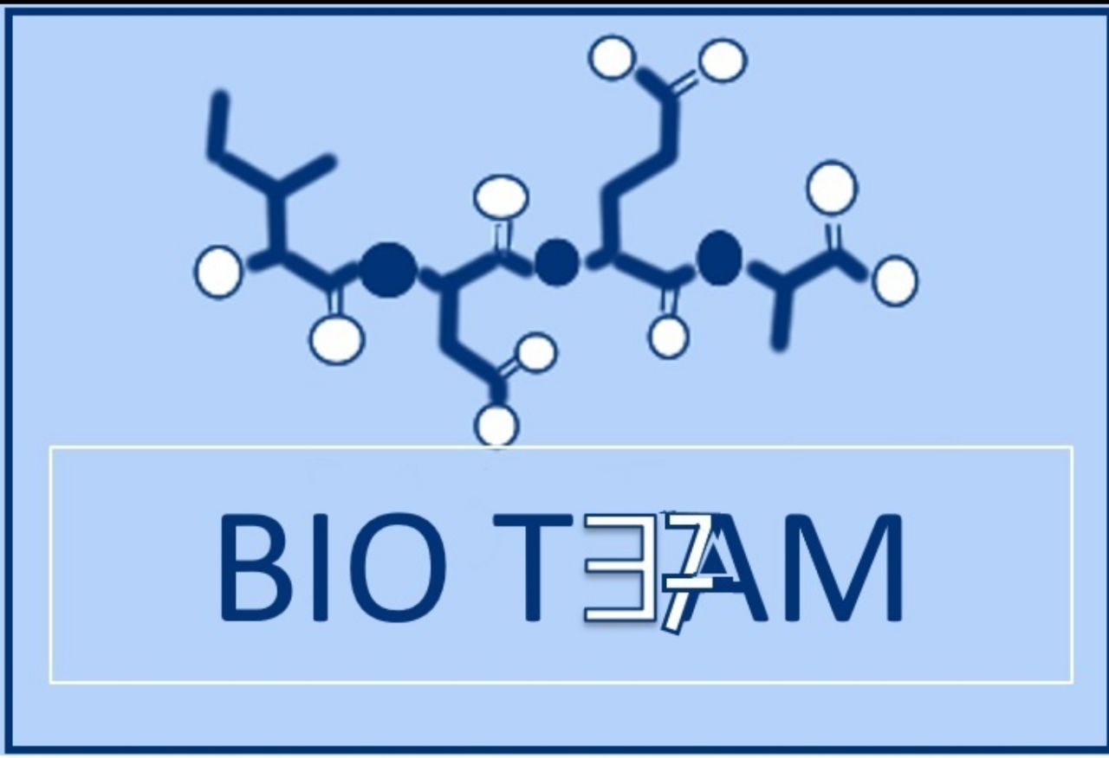

بِسْم الله الرحمن الرحيم
Creatine metabolism
and
collagen diseases
Color index:
Doctors slides
Notes and explanations
Extra information
Highlights
Musculoskeletal block

Slide 2
Objectives:
#By the end of this lecture the First Year students will be able to:
- Study the importance of creatine in muscle as a storage form of energy
- Understand the biosynthesis of creatine
- Study the process of creatine degradation and formation of creatinine as an end product
- Understand the clinical importance of creatinine as a sensitive indicator of kidney function
- Study the structure, function, types, and biosynthesis of collagen
- Understand different diseases associated with collagen

Slide 3
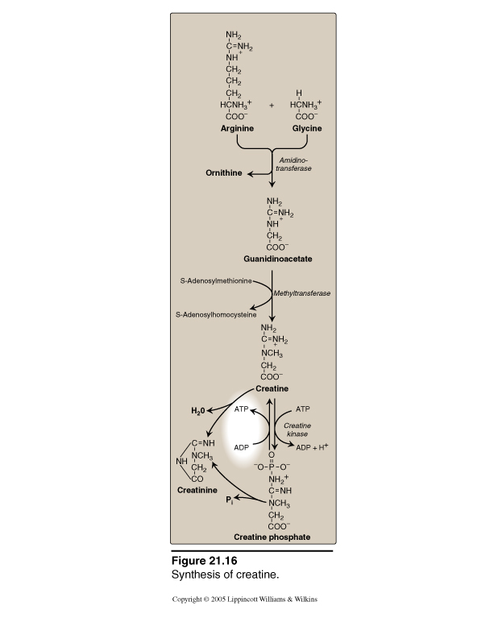
1 amino acid is produced:
ornithine
3 amino acids are required:
glycine | arginine | methionine
DOCTOR’S NOTE :
Process occur kidney--------→ blood --------liver
Kidneys
Creatine
Metabolism :
Required 3 amino acids
1- Glycine
2- Arginine
3- Methionine (as s-Adenosylmethionine)
Creatine biosynthesis
Liver
Sites of biosynthesis
steps of biosynthesis
Creatine
SAH
(It gives a methyl group)
End product
Methyltransferase
SAM
Energy source
Guanidinoacetate
Step 1: Kidneys
Step 2: Liver
Glycine
+
Arginine
هنا بكل اختصار يتحدون الحمضين جلايسين و الارجينين
بوجود انزيم يسمى Amidinotransferase
ويعطيني ناتجين :
١- Ornithine : يتم الاستخلاص منه بواسطة kidney
٢- Guanidinoacetate : يروح للكبد ، وهو اللي نبيه عشان يعطيني الكيراتين ولكن بشرط وهو إضافة مجموعة ميثايل بواسطة انزيم Methyltransferase ليعطي الكيراتين.
Ornithine
Amidinotransferase

Slide 4
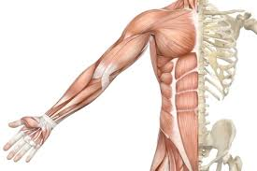
Distribution of
body creatine :
Creatine
ATP
ATP
It is formed in the liver, then Transported from liver to other tissues
Creatine Kinase
98% present in skeletal and heart muscles
ADP
ADP + H⁺
In skeletal muscle it is converted to high-energy source creatine phosphate (phosphocreatine)
Creatine phosphate
Creatine phosphate:
A high-energy phosphate compound
Acts as a storage form of energy in the muscle ( main storage form for intense and immediate muscular contraction )
Provides small but, ready source of energy during first few seconds of intense muscular contraction * it is stored in the muscle, and when intense muscle contraction is needed, such as running as fast as you can, lifting weights. In this cases creatine phosphate gives you the energy immediately ( as the stored ATP is only enough for 3 seconds ).
The amount of creatine phosphate in the body is proportional to the muscle mass * directly proportional, when the mass increases it needs more energy, so it will be stored in higher amounts.
Why dose the body make creatine phosphate?
Because muscle fibres can’t store a lot of ATP
So it stores creatine phosphate so if the body need quick energy creatine phosphate will give it phosphate group to ADP to form ATP.

Slide 5
Creatine degradation :
Kidney disease → excretion problems → less creatinine in urine → more creatinine in blood
يقومان بصناعة creatinineبنسب ثابثة تساوي 1-2 % من مجموعهما
it doesn’t require enzyme of energy
Serum creatinine increases with the impairment of kidney function
Creatinine is excreted in the urine
Creatine and creatine phosphate spontaneously form creatinine as an end product
Serum creatinine is a sensitive indicator of kidney disease (kidney function test)
Its level depends on the
muscle mass also.
Spontaneously: it doesn’t require enzyme or energy
Creatine
H₂O
Creatinine
ATP
ATP
Creatine Kinase
ADP
ADP + H⁺
Pi
Plasma
Creatine phosphate
Urine
Glomerular
filtration

Slide 6
Urinary Creatinine
A typical male excretes about 15 mmol creatinine/day.
Decrease in muscle mass (e.g. in muscular dystrophy, paralysis) leads to decreased level of urinary creatinine.
The amount of creatinine in urine is used as an indicator for the proper collection of 24 hours urine sample.

Slide 7
Creatine kinase (ck)
CK is responsible for generation of energy in contractile muscular tissues.
CK levels change in cardiac and skeletal muscle disorders.
Creatine
ATP
ATP
Creatine Kinase
من خلال التحويل بين Creatine و Creatine phosphate والعكس
ADP
ADP + H⁺
Creatine phosphate
Remmeber:
Creatine kinase = in the muscle
Amidinotransferase = in the kidney
Methyle transferase= in the liver

Slide 8
Collagen: Overview
Collagen structure
Most abundant protein in the human body.
Collagens are highly stable molecules with half-lives as long as several years.
A fibrous protein that serves structural functions.
It is part of connective tissues, bone, teeth, cartilage, tendons, skin, blood vessels.
Collagen α-chain (~1,000 amino acids long) is rich in proline and glycine.
The glycine residues are part of a repeating sequence: –Gly–X–Y–
X = Frequently proline
Y = Often hydroxyproline
(–Gly–Pro–Hyp)₃₃₃
(Y can be also hydroxylysine)
It has a long and rigid structure

Slide 9
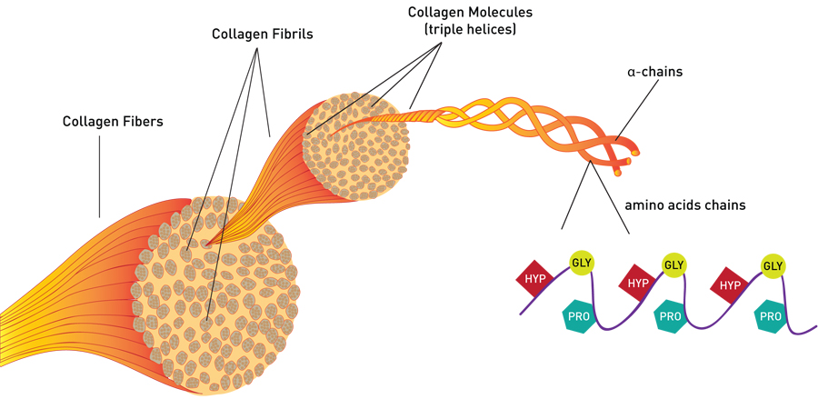
Collagen structure
Collagen consists of three α-chains wound around one another in a rope-like triple helix. “because of the proline, the α-helix is not stabilized, so it becomes a collagen triple helix”
The three polypeptide chains are held together by hydrogen bonds.
Two examples of protein secondary structure: collagen helix and α-helix.

Slide 10
Collagen structure
Rich in proline and glycine amino acids.
Proline prevents collagen chains to form α-helix because:
  Proline has no back bone amino group (it is a ring structure with secondary amino group); therefore hydrogen bonding within the helix is not possible.
The secondary structure α-helix is different from collagen helix; in collagen helix the hydrogen bonds are between the chains (intrachain); while in α-helix the hydrogen bonds are within chains (interchain).
α-helix
Collagen helix

Slide 11
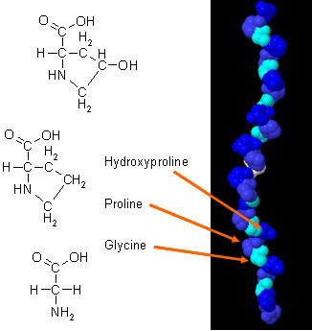
Non-standard amino acids in Collagen
Proline and lysine are converted to hydroxyproline and hydroxylysine; by hydroxylase enzymes during post-translational modifications.
Why is hydroxyproline important?
To stabilize the triple-helical structure.
The enzyme requires vitamin C for its function.
If vitamin C is decreased, the amount of the enzyme (hydroxylase) will be deficient and as a result (proline & lysine) won't be hydroxylated and the resulting collagen will be defected ( doesn't have proper strength).

Slide 12
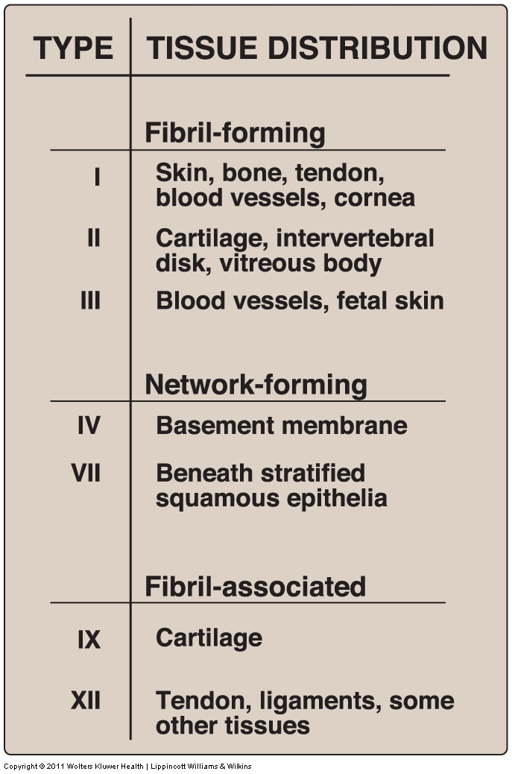
Types of collagen
Types of collagen depend on their functions.
Variations in the amino acid sequence of α-chains result in different properties.
Examples:
Type I: (α1)₂ (α2)₁ (Two α-1-chain + α−2- chain)
Type II: (α1)₃ (Three α-1-chain)
Types of collagen can be categorized into 3 groups:
Fibril-forming (Type 1, 2 and 3)
Network-forming (Type 4 and 7)
Fibril-associated (Type 9 and 12)
You have to know the types

Slide 13
biosynthesis of collagen
Collagen is synthesized in fibroblasts, osteoblasts, chondroblasts, Pre-pro → Pro → Mature collagen.
Polypeptide precursors (Pre-pro) are enzymatically modified to form triple helix which is secreted from Golgi vacuoles into the extracellular matrix as procollagen.
Procollagen is cleaved by N- and C- procollagen peptidases to release triple helical tropocollagen molecules.
Glycosylation of some hydroxylysine residues with glucose or galactose.
Tropocollagen molecules spontaneously associate to form collagen fibrils. This produces mature collagen
The modifications are:
1-hydroxylation of proline and lysine residues
2- glycosylation of some hydroxylysine residues with glucose or galactose

Slide 14
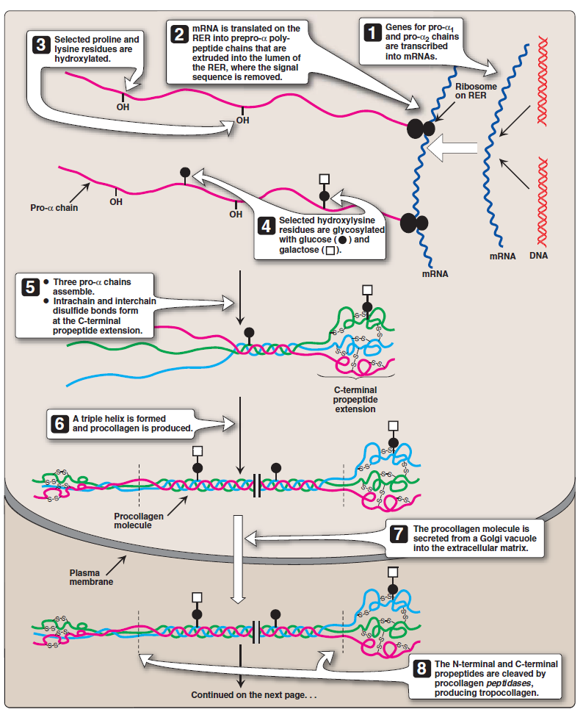
Biosynthesis of Collagen
1- gene of pro-α chains are transcribed into mRNA.
2- This mRNA translated on the RER into prepro-α- polypeptide chains that are extruded (forced out) into RER lumen, where the signal sequence is removed.
3-proline and lysine residues are hydroxylated by hydroxylase to form hydroxyproline and hydroxylysine in the presence of vitamin C.
4- hydroxylysine are glycosylated(add carbohydrate to it) with glucose (⚫) and galactose (◻️).
5- three pro-α assemble and interchain & intrachain disulfide bonds are formed at the C-terminal propeptide extension.
6- A triple helix is formed and procollagen is produced.

Slide 15
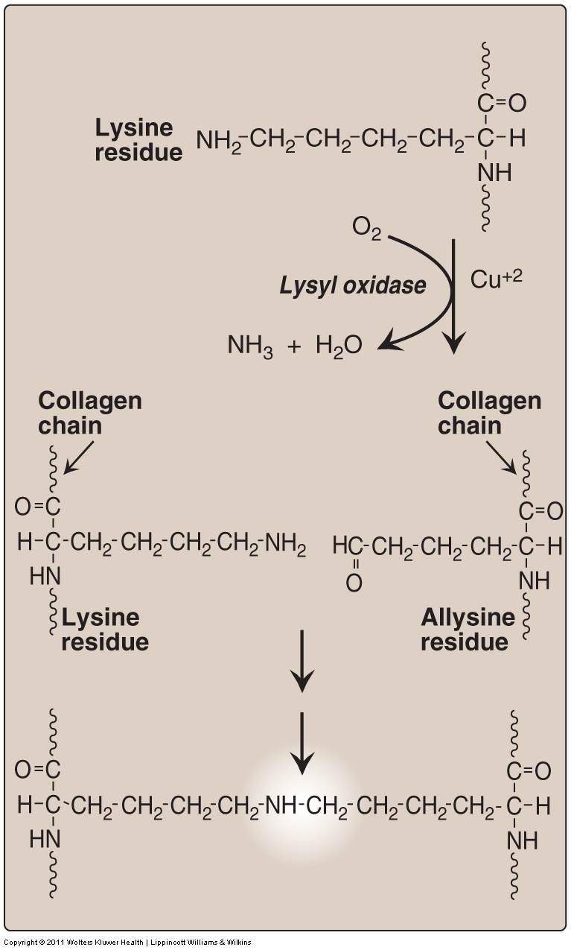
Cross-linking of collagen fibrils
Steps:
Lysyl oxidase oxidatively deaminates some of the lysine and hydroxylysine residues in collagen.
The reactive aldehydes – allysine and hydroxyallysine condense with lysine or hydroxylysine residues in neighboring collagen molecules to form covalent cross-links → this produces mature collagen fibers.

Slide 16
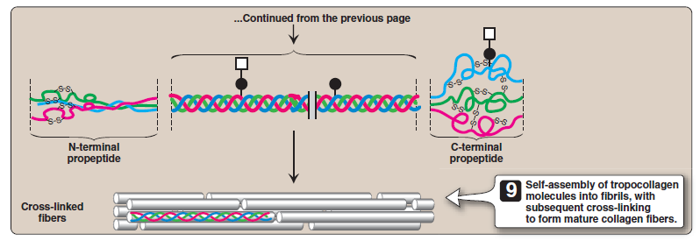
Biosynthesis of Collagen
7- the procollagen molecule is secreted through the Golgi apparatus to the extracellular matrix in Golgi vacuole.
8- The N- & C-terminal propeptides of the procollagen molecule are cleaved by procollagen peptidases, producing tropocollagen.
9- Tropocollagen molecules spontaneously associate to form collagen fibrils, then they cross-link to form mature collagen . (explained in next slide)
9- only cleaved tropocollagen molecules is used to form mature collagen fibers by assembly of tropocollagen into fibrils with subsequent cross linking.
N.B. Step 8 & 9 occur in the matrix.

Slide 17
Crosslinking of Collagen Fibrils
1- Lysyl oxidase oxidatively deaminates some of the lysine and hydroxylysine residues in collagen. (by adding oxygen and removing NH3 and H2O ).
2- The reactive aldehydes – allysine and hydroxyallysine condense with lysine or hydroxylysine residues in neighboring collagen molecules to form covalent cross-links.
3-this produces mature collagen fibres.
mature collagen fibres

Slide 18
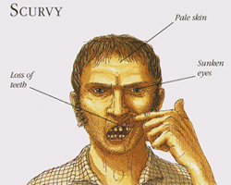
Collagen diseases
we have two types of collagen diseases:
1-Acquired disease:
The deficiency in vitamin C will cause Scurvy disease .
2-Geneticlly inherited diseases:
Ehlers-Danlos syndromes (EDS) فرط المرونة
Osteogenesis imperfecta (OI)
(also called sailors disease) :
This disease is due malnutrition and it mainly affects (gums and teeth).
Symptoms :
Bleeding gums , the gums become spongy , painful and inflamed , Detaching of the teeth from gums , Skin problems ,Enzyme affected : hydroxylase .

Slide 19
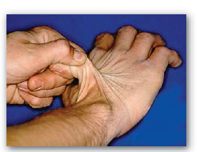
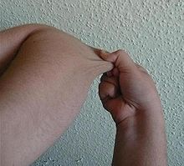
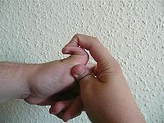
Collagen diseases
Ehlers-Danlos syndrome
Duo to :
deficiency of lysyl hydroxylase or
N-procollagen peptidase
Mutations in the amino acid sequence of collagen I , III , V
(1,3,5)
(The gene is present but mutated)
Characterized by :
Hyper-extensibility (the skin can become stretched ) of skin and joints.

Slide 20
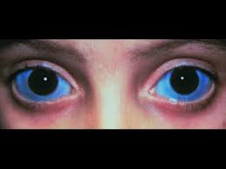
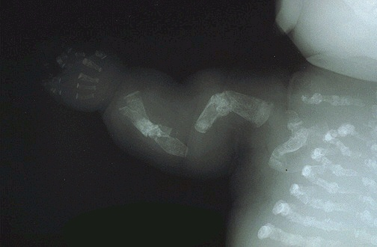
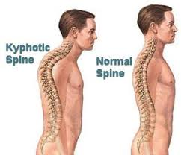
Collagen diseases
-Osteogenesis imperfecta (brittle bone disease):
Bones fracture easily with minor or no trauma
Mutations replace glycine with amino acids having bulky side chains preventing the formation of triple helical conformation.
It has three types :
Type I
Type I (most common) characterized by mild bone fragility, hearing loss and blue sclerae
بالعادة يكون سميك بس بسبب مشكلة الكولاجين يصير انحف ف يتغير لونها
Type II (most severe) and lethal in the perinatal period (fractures in utero) ممكن يجيه الكسر في بطن امه
Type III (severe form)Fractures at birth, short stature, spinal curvature
Leading to a humped back (kyphotic)
appearance and blue sclerae

Slide 21
MCQ
1- where Guanidinoacetate synthesized ?
A- liver b- kidney c- muscle d- blood
2- how many amino acid required for glycine?
A- one b- two c- three d-five
3- Collage consists of
A- one α-chains b- two α-chains and one beta c- three α-chains d- one α-chains and one beta
4 -creatine is a sensitive indicator of kidney disease
a- true b-false
5-collagen structure rich in glycine and arginine
A- true b- false
6- Collage consists of
A- one α-chains b- two α-chains and one beta c- three α-chains d- one α-chains and one beta
answers :
1-b
2-c
3-c
4-b
5-b
6-c

Slide 22
BOYS TEAM:
عبدالملك الشرهان
تركي آل بنهار
احمد ابراهيم العريفي
سعيد آل سرار
عبدالرحمن التركي
سلطان بن عبيد
صالح المعيقل
صالح الوكيل
عدنان المقبل
محمد صالح القسومي
نواف عبدالعزيز
Team leaders:
محمد حسن حكيم
رهام الحلبي
Contact us:
teambiochem437@gmail.com
For editing file:
https://docs.google.com/presentation/d/16yNcm2Y08Cr0Am83lDRfH5NB4F1ng3tdHiB3O1AqMc8
GIRLS TEAM:
الهنوف الجلعود
رهف الشنيببر
شهد الجبرين
لينا الرحمة
منيرة المسعد
ليلى الصّباغ
العنود المنصور
أرجوانة العقيل
ريناد الغريبي
مجد البراك
رزان الزهراني
ليان المانع
مشاعل القحطاني
ريما الديحان

