Slide 2
OBJECTIVES
At the end of the lecture, students should be able to:
- List the different parts of mesoderm and the different divisions of somites.
- Differentiate bones according to their embryological origin and mode of ossification.
- Describe the ossification of long bones.
- Describe the main steps for development of limbs.
- Differentiate muscles according to their embryological origin.

Slide 3
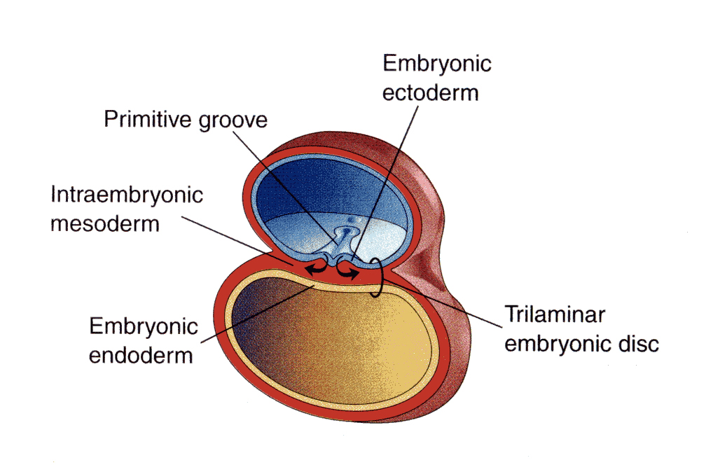
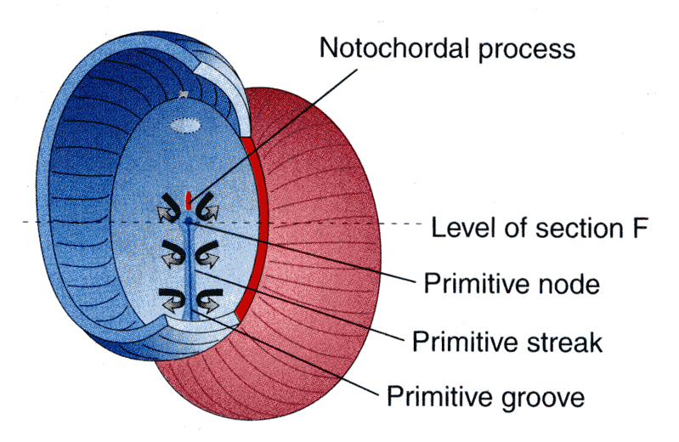
Lecture Overview
Embryo is composed three layers :-
Embryonic ectoderm
Intraembryonic mesoderm ^what gives musculoskeletal system
Embryonic ectoderm : skin الي يكون الـ
Amniotic cavity*
Embryo
Trilaminar embryonic disk will divide structure into :
1- Amniotic Cavity *dorsally
2-Yolk sac *ventrally
Yolk sac**
Embryo
For more understanding ☺:-
*Embryo will fold and as a result , amniotic cavity will form what is called fetal membrane
**most of it will dissolve after folding and a part of it will form the gut

Slide 4
Mesoderm divided into :
Paraxial Mesoderm
Intermediate medsoderm
Lateral mesoderm
Notochord:
stimulates neural tube formation (where CNS will be formed )
Lateral mesoderm contains intraembryonic coelem into :
Somatic Mesoderm : it is enclosed by ectoderm , وهي الي تكون العظم
Splanchic Mesoderm
Somatic mesoderm
Splanchnic mesoderm

Slide 5
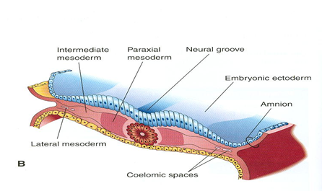
INTRAEMBRYONIC MESODERM
Proliferates between Ectoderm & Endoderm EXCEPT in the central axis of embryo where NOTOCHORD is found.
Differentiated into 3 parts
Paraxial
mesoderm
Intermediate
mesoderm
Lateral
mesoderm
-On each side of notochord.
-Divides into units (somites).
divided by intraembryonic coelom into
Somatic Mesoderm between ectoderm & coelom
Splanchic Mesoderm between endoderm & coelom

Slide 6
Paraxial mesoderm
Formed of units “SOMITE ”
Epaxial division : Muscles of back
(Extensors of vertebral column and neck)
Myotome
Myoblasts :migrate into limb:
Limb muscles
(to form the flexors and extensors muscles of the limbs)
both upper and lower limb
Sclerotome
forms the axial skeleton :-
1-Vertebral column
2-Ribs & sternum
except skull
SOMITE
Hypaxial division :Muscles of body wall
(abdominal wall , pelvic, thoracic, etc..)
Dermatome : FORM SKIN
**Dermatome : area of skin supplied by cutaneous branches of single cranial or spinal وهي تعطينا nerve ,, dermal layers
بس الـ skin نفسه يتكون من **ectoderm

Slide 7
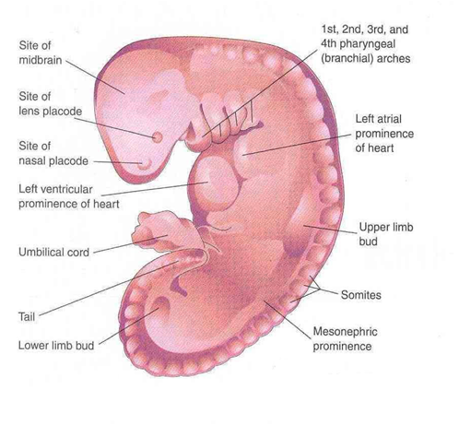
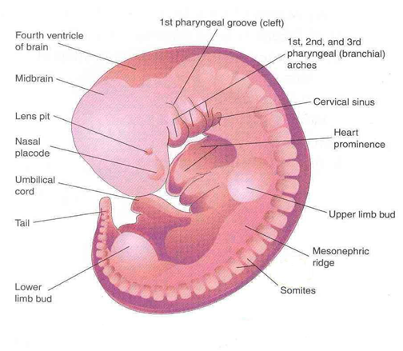
DEVELOPMENT OF LIMBS - 1
- The limbs bud appears as an elevation on the ventrolateral body wall resulting from proliferation of mesenchyme of the somatic layer of lateral mesoderm.
- Each limb bud is surrounded by an area of ectoderm.
- Upper limb buds appear at day 26 opposite the lower cervical segments.
- Lower limb buds appear at day 28 opposite the lumbar & sacral segments.
28 DAYS
32 DAYS

Slide 8
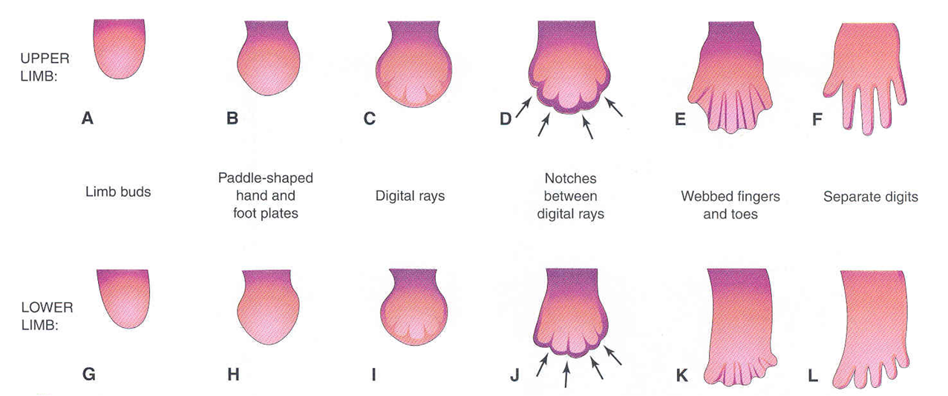
DEVELOPMENT OF LIMBS - 2
A&G
Apical ectodermal ridge: appears at the apex of limb bud and stimulates proliferation of mesenchyme and elongation of limb bud.
B&H
Distal ends of buds flatten into paddle-like hand & foot plates. (زي المجداف )
C&I
appear as mesenchymal condensations that outline the patterns of digits
Some people born with bud limb , there is no proliferation of mesenchyme , because this apical ectodermal ridge does not work or exist , so there is no stimulation which results in no elongation
D&J
Mesenchyme between rays disappears to form notches.
E&K
Digits form inside rays, elongate & appear webbed.
F&L
Mesenchyme between digits disappear to separate them.
Distal part of limb will form and THEN elongate to proximal part ^^next slide

Slide 9
Mesenchyme from somatic layer of lateral mesoderm
Induces growth of mesenchyme & its transformation into cartilage
*Cartilage ossifies by: Endochondral ossification
*Myoblasts migrate from myotomes to form: Muscles of limbs
NOTE : Elongation of limbs occurs after mesenchyme appears and separates the digits

Slide 10
في البداية تكون الأطراف غضروف ، ثم قبل الولادة تجي مرحلة primary ossific center فيولد الطفل و الـ diaphysis عظم والـ epiphysis غضروف
ومن بعد الولادة تبدأ مرحلة secondary ossific center وهو المسؤول عن الإطالة فيستمر النمو حتى يصير ossification للغضروف بين الـ diaphysis و الـ epiphysis وكذا يصير العظم كله متحد ومكتمل النمو
OSSIFICATION OF LONG BONES
Appearance of
primary ossific
centers: ossification
of diaphysis
Appearance of
secondary ossific
centers: ossification
of epiphysis
Ossification of
epiphseal plate:
Complete union of
epiphysis & diaphysis
Bone in
cartilaginous state
Epiphysis
Epiphyseal
plate of
cartilage
Diaphysis
Diaphysis
Epiphysis
BIRTH
PUBERTY
Bone increases in length by proliferation
of epiphyseal plate IN THIS RANGE
Growth of
bone stops
*Bone age is a good index of general maturation.
*Bone age is determined by:
Appearance of ossific centers in diaphysis & epiphysis (specific for each bone & sex).
Disappearance of epiphyseal plate (specific for each bone & sex).

Slide 11
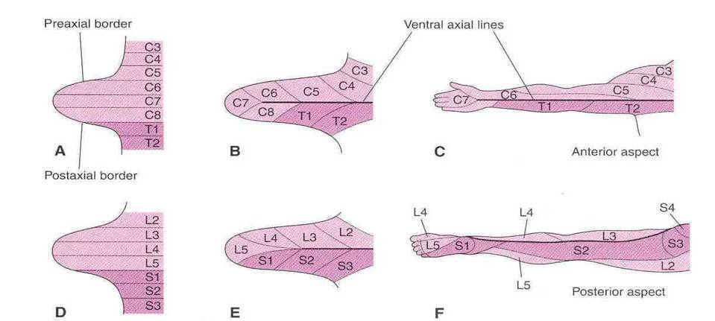
DEVELOPMENT OF LIMBS - 3
- Originally, limb buds were at right angle of the trunk with:
1- Cranial (preaxial) & caudal (postaxial) borders: radius and tibia are preaxial bones.
2- Ventral & dorsal surfaces: flexor muscles are ventral and extensors are dorsal.
- During 7th week, adduction of limb buds occurs with 90° rotation:
1- In upper limb, rotation occurs laterally: radius is lateral & flexor muscles are anterior.
2- In lower limb, rotation occurs medially: tibia is medial & flexor muscles are posterior.
بسبب اتجاه الروتيشن صارت الـ radius هي الـ lateral والـ ulna الـ medial
بسبب اتجاه الروتيشن صارت الـ tibia هي الـ medialوالـ fibula الـ lateral

Slide 12
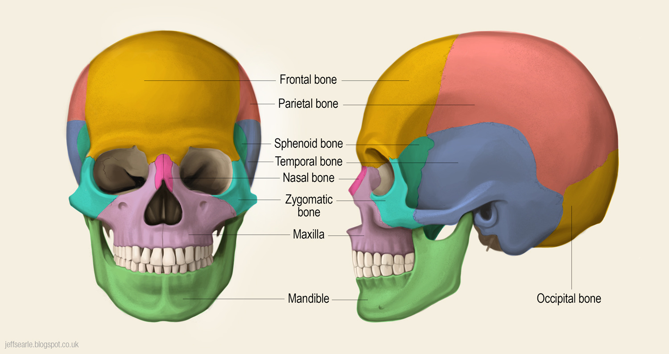
DEVELOPMENT OF CRANIUM (SKULL)
- The skull develops from mesoderm around the developing brain.
- The skull consists of:
1- Neuro-cranium: protective case for brain
2- Viscero-cranium: skeleton of face
- Bones of skull ossify either by:
Endochondral ossification : mesenchymal cells cartilage bone
Intramembranous ossification : mesenchymal celss bone (directly)
- Bones of skull that ossify by
intramembranous ossification:
Frontal
Parietal
Zygomatic
Squamous temporal
Mandible ^ except condyles ^
Maxilla

Slide 13
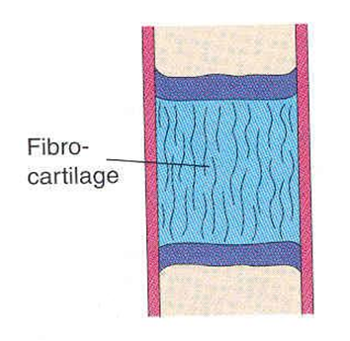
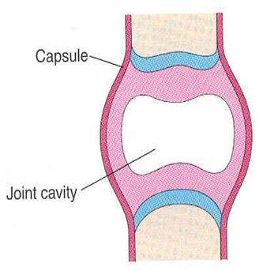
JOINTS
JUST READ IT ! 😉
They develop from mesoderm between bones:
In fibrous joints: mesoderm differentiates into dense fibrous connective tissue.
In cartilaginous joints: mesoderm differentiates into cartilage.
In synovial joints: a synovial cavity is formed inside mesoderm; mesoderm differentiates into synovial membrane, capsule & ligaments.

Slide 14
Summary
LIMBS | MUSCLES | BONE
- Mesenchyme from somatic layer of lateral mesoderm proliferates to form limb buds. - Apical ectodermal ridge stimulates proliferation & elongation of buds then cartilage formation. - All bones of limbs ossify by endochondral ossification EXCEPT: clavicle. - Muscles of limbs develop from myotomes. - Rotation of limbs occur in opposite direction. - Development of upper limb precedes that of lower limb. | - All muscles develop from MESODERM EXCEPT: Muscles of iris (eyeball) ECTODERM Myoepithelial cells of mammary & sweat glands, ECTODERM - All skeletal muscles develop from myotomes of paraxial mesoderm EXCEPT: some head & neck muscles from mesoderm of pharyngeal arches ـــــــــــــــــــــــــــــــــــــــــــــــــــــــــــــــــــــــــــــــــــــــــــــــــــــــ - Cardiac & smooth muscles develop from lateral mesoderm: Cardiac muscles from: splanchnic part of lateral mesoderm Smooth muscles: *In the wall of viscera from: splanchnic part of lateral mesoderm * In the wall of blood & lymphatic vessels from: somatic part of lateral mesoderm | - All bones develop from MESODERM. AXIAL SKELETON: 1. Vertebrae, ribs & sternum: from sclerotomes of somites (paraxial mesoderm) 2. Skull: from mesoderm surrounding the brain. APPENDICULAR SKELETON: from somatic part of lateral mesoderm - All bones ossify by endochondral ossification EXCEPT : Frontal Parietal Zygomatic Squamous temporal Mandible Maxilla And Clavicle

Slide 15
Quiz and some Helpful Videos
1- which of the following does the skull come from :
a-lateral mesoderm b- intermediate mesoderm c- mesoderm d- paraxial mesoderm
2-all the following ossifies by intramembranous ossification except :
a-Frontal bone b Parietal bone c-Zygomatic bone d-occipital bone
3-muscles of abdominal wall comes from :
a- ectoderm b- lateral mesoderm c paraxial mesoderm d- intermediate mesoderm
4-Primary ossific centers appears :
a-Before birth b-after birth c- during puberty d-after puberty
5-all the following ossifies by endochondral ossification except :
A-clavicle b- humerus c femur d-tibia
All Germ Layers: https://www.youtube.com/watch?v=QPvhl66QCqo
Overview of embryogenesis :
https://www.youtube.com/watch?v=G2HvEGUYwAU
Answers
1-c ,2-d,3-c,4-a,5a

Slide 16
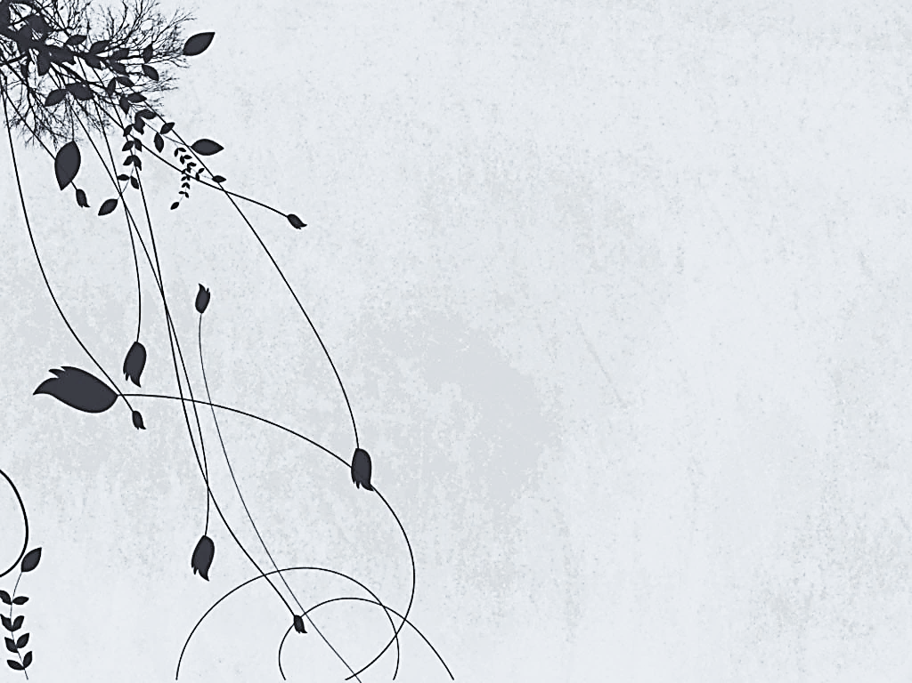
Wish You All The Best 😉
Tean Leaders :
Alaa abdulrahman alsowigh
Mohammed Thamer Alzahrani
Lecture Member :
Omar saad
Contact Us On
Embryology437@gmail.com
@embryolgy437

