Slide 3
REMEMBER from last block (connective tissue lecture)
Components of connective tissue
Cells difference types
Matrix
Rigid (rubbery, firm) “Cartilage”
Fluid (liquid) “Blood”
Soft “C.T Proper”
Fibers Collagenous, elastic & reticular
Hard (solid) “Bone”
the intercellular substance, in which
cells and fibers are embedded.

Slide 4
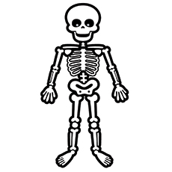
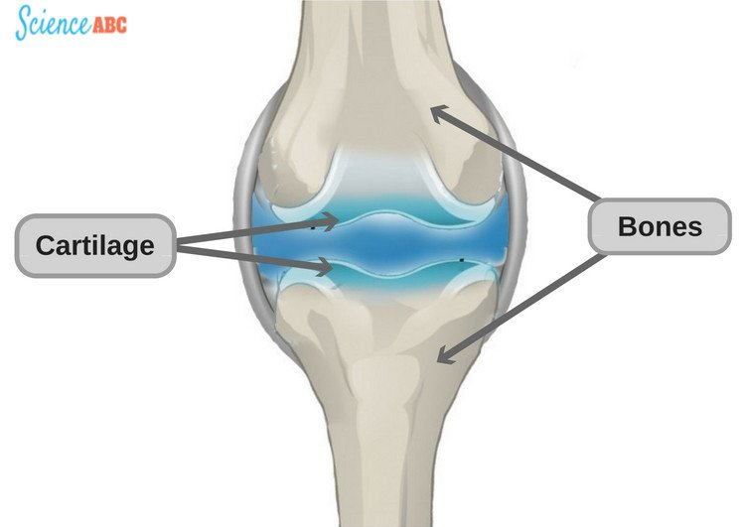
CARTILAGE “Chondro- = relating to cartilage” | BONE “Osteo- = relating to bone”
Its specialized type of connective tissue with a rigid matrix (لا يكسر بسهولة) Its usually nonvascular (avascular = lack of blood vessels) Its poor nerve supply All cartilage contain collagen fiber type II Types: 1) Hyaline cartilage (main type) 2) Elastic cartilage 3) Fibrocartilage | Its specialized type of connective tissue with a hard matrix Types: 1) Compact bone 2) Spongy bone Components: 1) Bone cells: Osteogenic cells Osteoblasts Osteocytes Osteoclasts 2) Bone Matrix (calcified osteoid tissue): hard because it is calcified (Calcium salts) It contains collagen fibers type I It forms bone lamellae and trabeculae 3) Periosteum 4) Endosteum Functions: 1) body support 2) protection of vital organs as brain & bone marrow 3) calcium store
REMEMBER!
Cartilage contain collagen fiber type II ,Bone contain collagen fiber type I

Slide 5
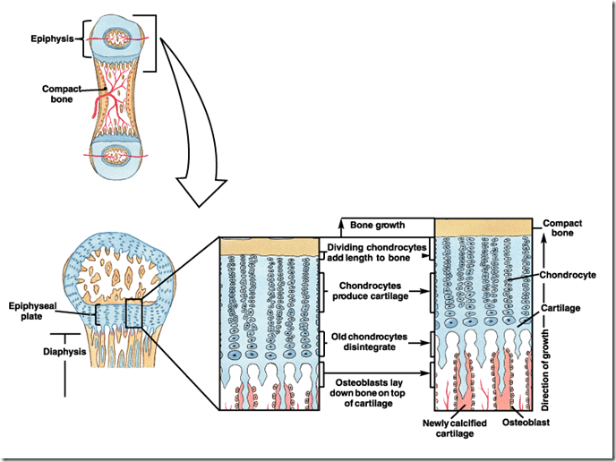
Growth of cartilage & bone
 | CARTILAGE | BONE
Appositional growth (increase in WIDTH) | produced by the activity of Chondroblasts in the inner chondrogenic layer | produced by the activity of osteoblasts
Interstitial growth (increase in LENGTH) | produced by division and activity of mature chondrocytes | produced by the activity of epiphyseal plate of cartilage
pictures for explanation | Chondroblasts chondrocytes

Slide 6
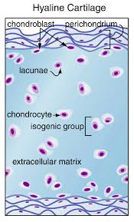
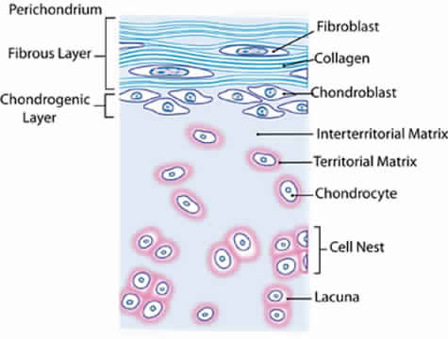
Hyaline cartilage
PERICHONDRIUM | CELLS (CHONDROCYTES) | MATRIX
Peri=outer Vascular connective tissue membrane formed of 2 layers: 1) Outer fibrous layer: dense fibrous connective tissue 2) Inner chondrogenic layer: contains chondroblasts no lacunae ,They secrete cartilage matrix and give rise to chondrocytes | Cytec=cells Found in spaces called lacunae Young chondrocytes: small & present singly in their lacunae Mature chondrocytes: large & found singly or in groups of 2, 4 or 6 cells in their lacunae (cell nests) | Homogeneous and basophilic Contains collagen fiber type II
Sites of hyaline cartilage :
Foetal skeleton
Costal cartilages
Articular surfaces of bones
Nose, trachea & bronchi

Slide 7
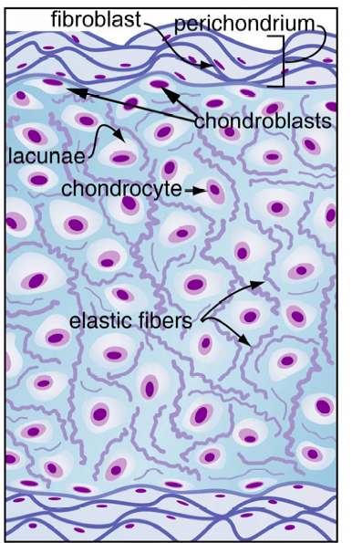
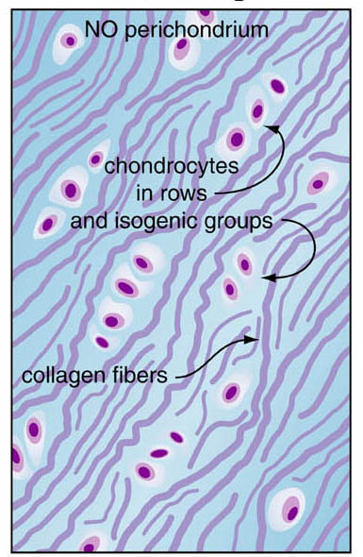
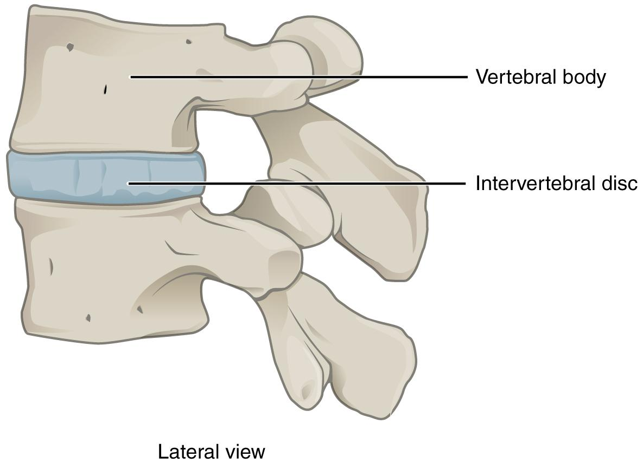
Elastic cartilage
Fibrocartilage
Similar to hyaline cartilage + elastic fibres in the matrix | No perichondrium Rows of chondrocytes in lacunae separated by parallel bundles of collagen fibres (type I) (only cartilage contain 2 types of collagen fiber I & II)
Sites: External ear Epiglottis (لسان المزمار) | Sites: Intervertebral disc

Slide 8
Bone cells
Bone cells | OSTEOGENIC | OSTEOBLASTS | OSTEOCYTES | OSTEOCLASTS
Characters | In periosteum & endosteum | In periosteum & endosteum | Branched cells, Present singly in lacunae, their branches run in the canaliculi | Large multinucleated cells on bony surfaces, in howship’s lacunae, they have striated or ruffled bored ,Cytoplasm is rich in lysosomes
Origin | - | Osteogenic cells | Osteoblasts | Blood monocytes
Fate | Give rise to osteoblasts | Change to osteocytes | - | -
Function | - | They secrete the bone matrix & deposit calcium salts in it | They maintain the bone matrix | - Bone resorption - calcium resorption by secret acid - remodeling bones and make canaliculi

Slide 9
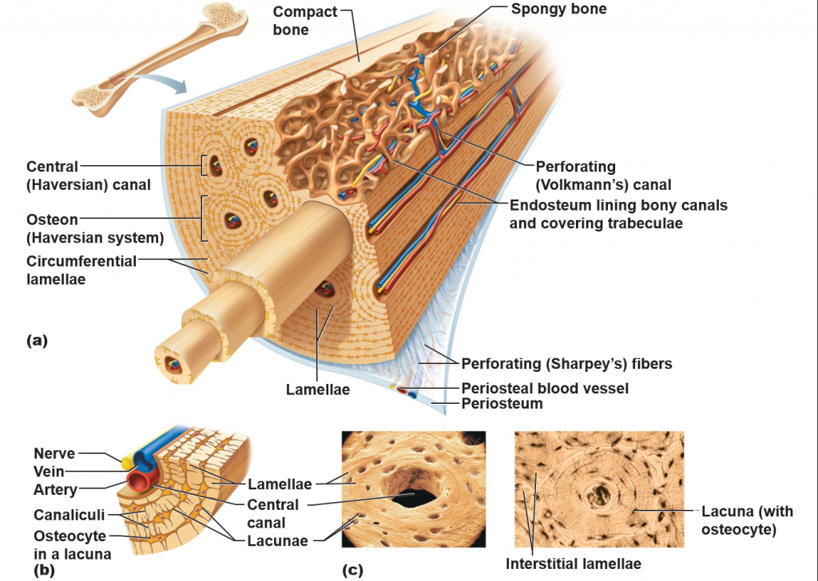
Compact bone = (Cortical bone)
It is found in the diaphysis of long bones
Consists of:
Periosteum (casing):
1) Outer fibrous layer
2) Inner osteogenic layer
Endosteum (cavity)
Bone cells
Bone lamellae:
1) Haversian Systems (Osteons):
Longitudinal cylinders
Each is formed of concentric bone lamellae & Haversian canal, running in the centre (have blood vessels and nerve supply)
Volkmann’s canals: connect the Haversian canals together ,they run obliquely or transversely
2) External Circumferential Lamellae
3) Internal Circumferential Lamellae
4) Interstitial Lamellae: between osteons

Slide 10
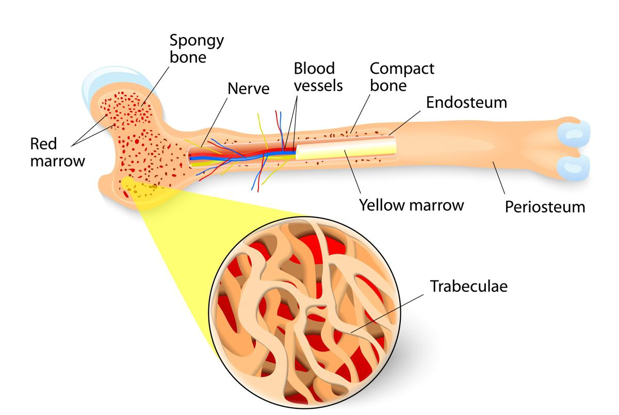
Spongy bone = (Cancellous bone ) = (Trabecular bone)
It is found in flat bones & epiphysis of long bones
Consists of:
Periosteum
Endosteum
Bone cells
Irregular bone trabeculae (are formed of irregular bone lamellae separated by osteocytes inside lacunae)
Many irregular red bone marrow spaces
No Haversian Systems (No Osteons)

